Slide 1

Section I
Electrical Properties of Matter

Slide 2
Student Online Teaching Advice Notice
The materials and content presented within this session are intended solely for use in a context of teaching and learning at Trinity.
Any session recorded for subsequent review is made available solely for the purpose of enhancing student learning.
Students should not edit or modify the recording in any way, nor disseminate it for use outside of a context of teaching and learning at Trinity.
Please be mindful of your physical environment and conscious of what may be captured by the device camera and microphone during videoconferencing calls.
Recorded materials will be handled in compliance with Trinity’s statutory duties under the Universities Act, 1997 and in accordance with the University’s policies and procedures.
Further information on data protection and best practice when using videoconferencing software is available at https://www.tcd.ie/info_compliance/data-protection/.
© Trinity College Dublin 2020

Slide 3
Core Topics
(i) Basic Atomic Theory
(ii) Conductors
(iii) Insulators (Dielectrics)
(iv) Semiconductors

Slide 4
Atomic Theory:
All matter is made up of tiny particles called atoms. These atoms are, in turn, made up of protons, neutrons, and electrons. Protons and electrons are oppositely charged and attracted to each other (this physical force of attraction is supplemental to and much greater than the gravitational force that exists between them).

Slide 5
Atomic Theory:
Protons (p⁺) are positively charged. Electrons(e⁻) are negatively charged. The magnitude of their charges is equal. Neutrons are uncharged. Most atoms exist in an uncharged or (charge) neutral state. Hence, there are equal numbers of protons and electrons in a neutral (uncharged) atom.

Slide 6
Atomic Theory:
The neutrons and protons exist tightly bound together in the nucleus. The electrons ‘revolve’ around the nucleus at various distances.
The mass of an e⁻ is 9.11x10⁻²⁸g and that of a p⁺ or neutron is 1.672x10⁻²⁴g. Hence the mass of a p⁺ or neutron is roughly 2000 times that of an e⁻ !!!
Protons, neutrons and electrons can be considered to roughly spherical in shape (Bohr model). The radii of all is approx 2x10⁻¹⁵m.

Slide 7
Atomic Theory:
For the Hydrogen (H) atom (which has one p⁺ and one e⁻), the orbit followed by the e⁻ about the nucleus is roughly
5x10⁻¹¹m. From these dimensions, this setup is equivalent to a marble revolving around another marble a quarter of a mile away !!!

Slide 8
Atomic Theory:
The number of protons an atom has in its neucleus is known as the atomic number of the atom. It is this number that distinguishes one type of atom (or element) from another. For example, Hydrogen (H) atoms have one proton in the nucleus (atomic number is 1) whereas Helium (He) has two (atomic number 2). Hydrogen and Helium are therefore said to be different elements.
Elements are arranged on the periodic table in the order of increasing atomic number. Elements are simply materials made up of a single type of atom (e.g. Hydrogen (H), Helium (He), Copper (Cu)). There are 110 elements known to man.

Slide 9
Atomic Theory:
The electrons in an atom revolve in concentric shells about the nucleus. Each shell can contain 2n² electrons – where n is the shell number. So the first shell (closest to the neucleus, n=1) can contain a maximum of two electrons. The second shell can contain a maximum of eight electrons, the third eighteen and so on.

Slide 10
Atomic Theory:
Since the nucleus is positively charged, an attractive force exists between it and the electrons revolving about it. As the distance between the nucleus and shells increases, the binding forces between the nucleus and the electrons diminishes as we move towards the outermost shell.
Due to these weaker binding forces, it is easier (and sometimes quite easy) to remove an electron from the outermost shell.

Slide 11
Atomic Theory:
Molecules are combinations of atoms that are chemically bound together. This ‘chemical binding’ is the result of atoms ‘sharing’ electrons in their outermost shells.
For example, the water (H2O) molecule consists of two atoms of Hydrogen chemically bound with one atom of Oxygen (O).
The carbon dioxide (CO2) molecule consists of one atom of Carbon chemically bound with two atoms of Oxygen.

Slide 12
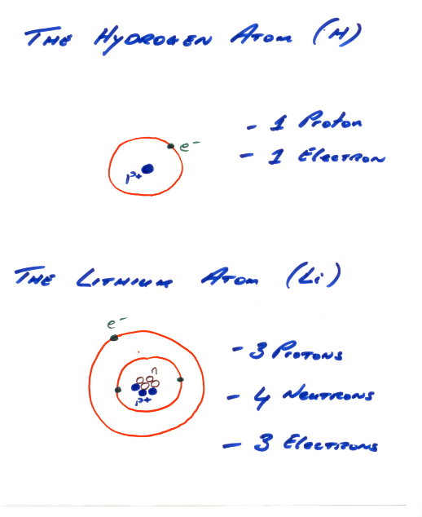
Atomic Theory:

Slide 13
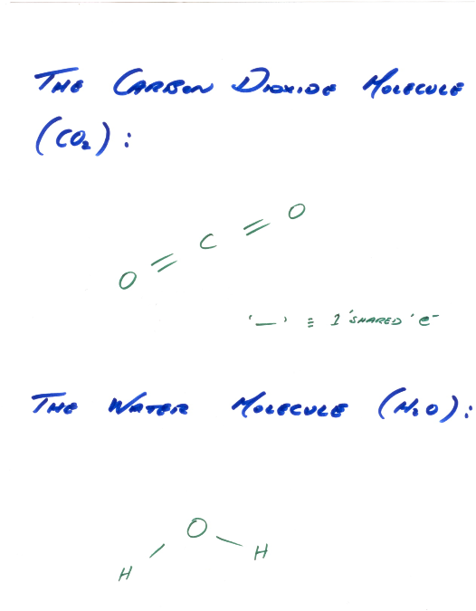
Atomic Theory:

Slide 14
Conductors:
A conductor is a material which, on application of an emf, facilitates current (i.e. charge transfer) well.
The reason for this is simple: Conductors are composed of atoms or molecules where a relatively large number of electrons, for whatever reason, are loosely bound in their atomic or molecular structure.
This means that on application of an emf, these electrons will move in the direction of relatively positive charge (i.e. the anode) while the relatively negative charge region (i.e. the cathode) will replenish the supply of electrons. Hence current!

Slide 15
Conductors:
Example:
Consider Silver (Ag), a good conductor.100g of Ag contains 6.02g x 10²³ atoms. The density of Ag is 10.5g/cm³.
Therefore 1cm³ of Ag contains:
Statistically speaking, each atom of Ag has 1 electron available for conduction at room temperature. So 1cm³ of Ag has approx. 6x10²² electrons available for conduction.

Slide 16
Insulators (Dielectrics):
A dielectric is a material which, on application of an emf, facilitates electric current poorly.
The reason for this is again simple: Insulators are composed of atoms or molecules which have their electrons tightly bound to the nucleus/nuclei which means that on application of an emf few electrons will move i.e. low current.

Slide 17
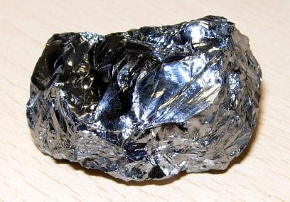
Semiconductors:
A semiconductor is a material which, on application of an emf, facilitates a ‘moderate’ current flow.
Semiconductors are a class of materials which fall between conductors and dielectrics. Examples include Silicon (Si) and Germanium (Ge).

Slide 18
Semiconductors:
As opposed to conductors, where approx. 1 electron per atom is available for conduction, in semiconductors, this figure is typically of the order of 1 electron in every 10⁸ atoms.

Slide 19
Semiconductors:
Example:
Consider Silicon (Si), a common semiconductor.
28.1g of Silicon contains 6.02x10²³ atoms. The density of Silicon is 2.33g/cm³. So 1cm³ of Silicon contains 5x10²² atoms.
Therefore there are approximately 5x10¹² e⁻/cm³ available for conduction in Silicon at room temperature

