Slide 1
Unix Basics

Slide 2


Slide 3
Unix
Unix is an operating system (OS)
  Manages machine resources
    Hides details of machine hardware
    Allows multiple programs to share resources
  Developed by Ken Thompson and Denis Ritchie at Bell Labs (AT&T) in 1970s
  Originally ran on Digital Equipment PDP minicomputers
In 1973 Unix was rewritten in C
  So Unix was portable to different machines
  And it came with a C compiler

Slide 4
Unix
Unix is the most influential OS in history
  Influenced the design of all subsequent OS
  Most modern OS are “Unix-like” operating systems
    MacOS is based on Berkeley Unix
    iPhone IoS is based on Berkeley Unix
    Linux was original based on MINIX, a clone of Unix
    Android is based on Linux
Even Microsoft provides increasing support for Unix
  Windows Subsystem for Linux
  Allows Linux to be installed on top of Windows
  Can run many Linux applications

Slide 5
Unix User Interface
The genius of the Unix user interface
  It is simple, so it’s easy to learn
  It changes relatively slowly
    Once you know it, you don’t need to relearn everything every 3-4 years
  Unix is close to universal
    The same user interface on your desktop machine, the servers in data centres, your phone, the computers inside your car, central heating system, TV
  The user interface is lightweight
    It’s based on text, so it can run where processing, memory, data bandwidth is very limited

Slide 6
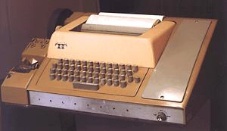
Teletype (TTY) Terminal

Slide 7
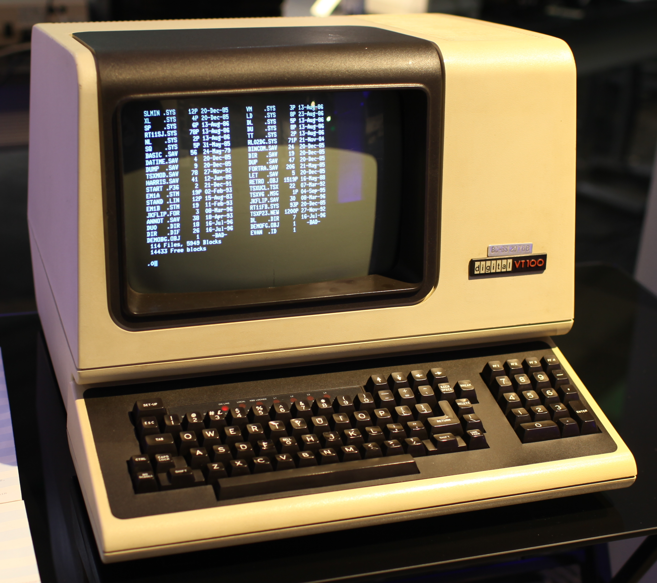
Video Terminal VT100 (1978)

Slide 8
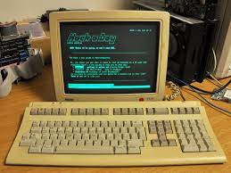
VT320 Terminal (1987)

Slide 9
Unix User Interface
Basic Unix user interface is text only
  There are also windowing systems for Unix
  But the text-only system has a lot of advantages
Unix is designed to have multiple users
  Originally lots of “terminals” attached to one Unix computer
  As a student I used a VAX minicomputer with 32MB RAM and dozens of attached VT320 terminals
  Linux assumes that it will run many programs simultaneously

Slide 10
Unix User Interface
You don’t need to sit at a Unix machine to use it
  Original design was many terminals
  Now many network connections to Linux servers
  It’s easy to log into Unix machines all over the world
    If you have an account
  You don’t need a very fast network connection
    As long as you use the text-only user interface
Log into remote machine with ssh
  Secure “shell”
  Lots of programs support ssh standard
  Extensive instructions on class Blackboard

Slide 11
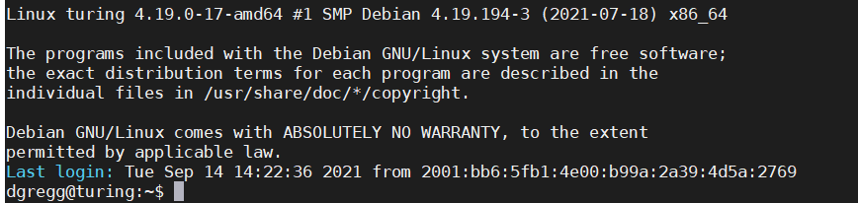
Unix Shell
The “shell” is a command-line interpreter
  You type commands
  The shell is a program that interprets your commands
    And runs programs to execute your commands
When you log into a Unix machine you are in the shell

Slide 12
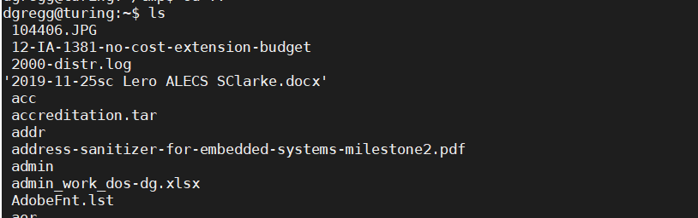
Unix Shell
You can get a listing of files in the current directory
  Use ‘ls’ command

Slide 13
Unix Shell
You can change the current directory
  Use ‘cd’ command
  Note in Linux the command prompt changes when you change directory
  Before changing, I was in my home directory ‘~’
  After changing, I’m in directory ‘~/tmp’, which is the tmp directory which is located inside my home directory

