Slide 1
DEBUGGING

Slide 2
Debugguing
The ability to debug code is an incredibly important skill
There are two main cases
  Debugging your own code you are developing
  Debugging existing code
Probably a majority of software development involves modifying existing code
  Adding new functionality
  Fixing bugs
Debugging your own code you are developing is also important

Slide 3
Debugguing code you are developing
When developing code, try to debug as you develop
  Think about your solution before you start typing
  Maybe draw some pictures
  Start with an empty main function
  Write a small amount of code and test it straightaway
  Try to always have a piece of code that works and can be tested
Make small changes to your code
  Write a small function
    Or even just add a few lines of code to a function
  The compile your new code and test again
  If your code worked before you changed it, and it doesn’t work now, then the change you made is probably the reason
  Small incremental changes help you to localize the problem to a small section of code

Slide 4
Debugguing code you are developing
Don’t be afraid to make very small changes
  I sometimes change just one or two lines of code and the recompile and re-test the code
  You always want to be able to get back to the previous working version
  Sometimes it helps to save the previous version to another filename
    Or source control tools like git can help
  Over time your confidence will grow to make bigger changes
Sometimes a bug appears that is not caused by the most recent change
  This is a more difficult type of bug
  The challenge is to localize the bug
  Find the small section of code that is causing the problem
  Localizing bugs can be difficult

Slide 5
Debugging tools
I use three main types of debugging tools
  fprintf(stderr, ….);
  Debuggers
  Sanitizers and similar tools

Slide 6
(1) printf as a debugging tool
fprintf
  By far the most important debugging tool is printf
  Always put debugging output to stderr
  fprintf(stderr, “Value of x is %d\n”, x);
  Stdout is “buffered” meaning that things written to stdout will appear on screen eventually, but not necessarily now
  Stderr does not have this problem
Everyone should learn to debug using printf
  You can get lots of information out of the program with printf
  You can get it in any format that you want
  You can compare debugging information from different runs of the program
  You can debug without a debugger
  There will be many times that you will have no debugger
    Especially when debugging in an unknown language

Slide 7
(2) printf as a debugging tool
Often more useful to dump information to screen
  Easy to scan large amount of data
  Only output relevant data
  Debugging code can be left in program
    Use #ifdef’s and #defines to comment it out
    Or just plain if statements, if you trust the compiler
    Debugging sessions are transient
Difficult bugs to find are ones where the program works for most of the input data, but some small part causes problems
Bug may depend on combination of conditions
Looking at a screen-full of data can allow you to reason backward

Slide 8
(2) Debuggers: gdb
Debuggers are programs which allow you to execute your program in a controlled manner, so you can look inside your program to find a bug.
gdb is a reasonably sophisticated text-based debugger. It can let you:
  Start your program, specifying anything that might affect its behavior.
  Make your program stop on specified conditions.
  Examine what has happened, when your program has stopped.
  Change things in your program, so you can experiment with correcting the effects of one bug and go on to learn about another.
SYNOPSIS
    gdb [prog] [core|procID]

Slide 9
(2) Debuggers: gdb
Debuggers are programs which allow you to execute your program in a controlled manner, so you can look inside your program to find a bug.
gdb is a reasonably sophisticated text-based debugger. It can let you:
  Start your program, specifying anything that might affect its behavior.
  Make your program stop on specified conditions.
  Examine what has happened, when your program has stopped.
  Change things in your program, so you can experiment with correcting the effects of one bug and go on to learn about another.
SYNOPSIS
    gdb [prog] [core|procID]

Slide 10
(2) Debuggers: gdb
GDB is invoked with the command gdb.
Once started,it reads commands from the terminal until you tell it to exit with the GDB command quit.
  The most usual way to start GDB is to run it and provide the name of the program you want to debug:
  gdb ./myprogram
  You can also pass command line arguments when you run gdb:
    gdb --args ./calc 3 + 2 X 5

Slide 11
(2) Compiling with the –g Option
To use gdb, compile your program with the –g option:
  gcc –o sample -g my_math.c sample.c
This option tells the compiler to retain information about variable names, data types, etc., so the debugger can provide more useful information.

Slide 12
(2) Common Commands for gdb
Here are some of the most frequently needed GDB commands:
  b(reak) [file:]function Set a breakpoint at function (in file).
  r(un) [arglist] Start program (with arglist, if specified).
  bt or where Backtrace: display the program stack; especially
  useful to find where your program crashed or
  dumped core.
  print expr Display the value of an expression.
  c Continue running your program (after stopping, e.g. at a breakpoint).
  n(ext) Execute next program line (after
  stopping); step over any function calls in
  the line.
  s(tep) Execute next program line (after
  stopping); step into any function calls in the line.
  help [name] Show information about GDB command name,
  or general information about using GDB.
  q(uit) Exit from GDB.
  l(ist) print the source code

Slide 13
(2) How useful are debuggers?
Debuggers can be great for seeing how small programs execute
Great for certain types of problems
  Identifying the line on which the program crashes
  Seeing state of procedure stack at crash
Less useful for non-crashing programs
Disadvantages of debuggers
  Too many low-level details
    Try debugging linked lists
  Clicking over statements is tedious
  Deal poorly with large amounts of data
  Difficult to find intermittent bugs
Debuggers are an important tool, but not the only, or even most important one for debugging programs

Slide 14
(3) Sanitizers
To use the address sanitizer:
  clang –o myprog myprog.c –g –fsanitize=address
  gcc –o myprog myprog.c –g –fsanitize=address
Some other compiler flags are sometimes needed with address sanitizer
  Turning off all compiler optimization can give more meaningful results
  gcc –o myprog myprog.c –g –fsanitize=address –O0
On some machines an extra flag is needed to link with the sanitizer versions of libraries
gcc –o myprog myprog.c –g –fsanitize=address –O0 –static-libasan

Slide 15
(3) Sanitizers
If your program accesses an invalid piece of memory you will get an error and the program will terminate
The address sanitizer is not perfect and it does not guarantee to find all invalid memory accesses
  E.g. When you ask for, say, 60 bytes from malloc, you often get 64 bytes instead
  Accessing these extra 4 bytes is wrong, but address sanitizer will probably not detect it as an error
  But in general it is pretty good at finding invalid memory accesses

Slide 16
(3) Sanitizers
Sanitizers are testing testing tools that are built into compilers such as clang and gcc
  The compiler inserts checks into your compiled code
  As your program runs, the checks are executed
The most important sanitizer in gcc and clang is the Address Sanitizer
  Compiler inserts code to check every load and store in your program
  Checks whether the address you access is a validly allocated piece of memory
    Global or local variable
    Or allocated memory that has not been freed

Slide 17
Programming defensively
One of the best ways to avoid debugging to detect bugs early
Some really good programmers can write hundreds of lines of code and then debug the code until it works
It makes sense for the learner programmer to program much more defensively
Write code in small increments
Always try to have an earlier version of your code that you can roll back to
Make small changes
If you can’t make the change work, you can always go back to the earlier version

Slide 18
Programming defensively
A good procedure while learning to program is
  (1) Start with a working program
    Even an empty program with a just a main function that returns zero
  (2) Test that your working program is behaving as you expect
  (3) Make a small change to the program
  (4) Test your program again
  (5) If your program stopped working, it is probably because of the change you just made
Localizing your errors is key to debugging
If you have 1000 (or a million) lines of code, it really helps to be able to localize the error to the newest 10 or 20 lines of code

Slide 19
Programming defensively
One of the best ways to avoid debugging to detect bugs early
Some really good programmers can write hundreds of lines of code and then debug the code until it works
It makes sense for the learner programmer to program much more defensively
Examine the most recent changes
  You should write your program incrementally
  If a bug appears, it should be because of a recent change
  Finding older bugs is very difficult
  You should never write a big bunch of code and then try to debug it into workingness.
  Need to test your program continuously as you develop it.

Slide 20
Some debugging tips
Read “The practice of programming” by Kernighan and Pike
Look for familiar patterns
  int n;
  scanf(“%d”, n);
  if ( x = y )
  double d = 3.14159265357;
  int i = 1;
  printf(“%d %f”, d, i);
  You will make these and similar mistakes time and time again

Slide 21
Some debugging tips
Backward Reasoning
Debugging is the process of reasoning backwards from the undesired behaviour (bad output, spectacular crash, running forever) to the cause of the behaviour
Debugging is backward reasoning
Like solving murder mysteries
  We have a dead body. How were they killed?
Bugs show us a gap between how we think the program behaves and how it actually behaves
Once we have identified the reason for the problem, fixing it is usually relatively easy
  But sometimes bugs reveal fundamental flaws in our whole design

Slide 22
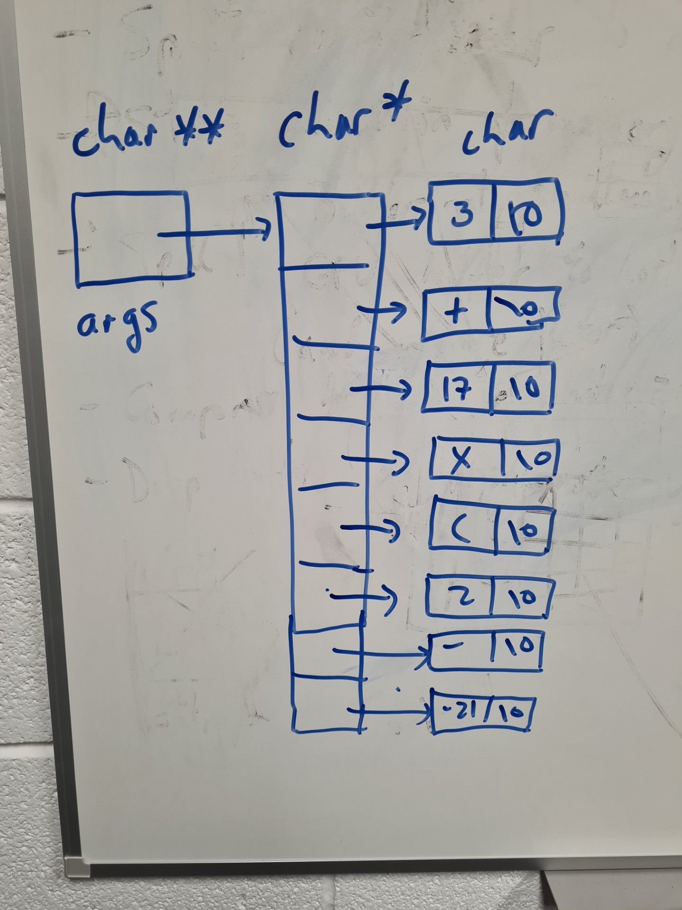
Some debugging tips
Draw a picture of your data structures
Drawing a picture tells you what you expect the data structure to look like, and how it should be used
Makes finding bugs in pointer code much easier
We can also “manually” execute the code on the data structure by drawing the changes created by each line of code
A lot of pointer bugs become clear when you draw a picture

Slide 23
Some debugging tips
Examine the most recent changes
  You should write your program incrementally
  If a bug appears, it should be because of a recent change
  Finding older bugs is very difficult
  You should never write a big bunch of code and then try to debug it into workingness.
  Need to test your program continuously as you develop it.
Aside:
  Extreme programming (XP) is a technique for smallish groups developing software
  One aspect of XP is developing test cases in parallel with the code, and extending the code incrementally to pass more and new test cases
  Continuous retesting as part of the process
    Basically just (un)common sense

Slide 24
Some debugging tips
Debug it now, not later
  Tempting to press ahead if bug seems unimportant
  But old bugs are the hardest to find
  May never find bug until after software is delivered
Mars Pathfinder
  Spacecraft’s computers reset every day
  Bug tracked down to something seen in testing
  Engineers had been too busy working on something else
  Fixing bugs over a radio link to Mars is more difficult
Also very important for embedded software
  Usually recalling large numbers of consumer devices because of software bugs is not practical

Slide 25
Some debugging tips
Don’t make the same mistake twice
  After you fix a bug, ask whether you made the same mistake elsewhere
  We often write similar code for multiple different things
  E.g. making sure that there is an extra space in strings for the ‘\0’ character
    Make sure you fix the bug in all the code using strings

Slide 26

Some debugging tips
Get a stack trace
  Debuggers will output the sequence of calls the led to the current function executing
  Stack traces are useful debugging information when a program crashes spectacularly
Read and think before typing
  Debugging is fundamentally about understanding the difference between what you think you asked the computer to do and what you actually asked it to do
  Get a cup of coffee
Explain your code to someone else
  Often end up explaining bug to yourself
  Consider using cardboard cut out

Slide 27
Difficult Bugs
Make the bug reproducible
  Most difficult bugs to fix are those that are difficult to repeat
    Big reason why concurrent programming is so difficult
  Find input and parameter settings that cause the bug to appear every time
  Will need to reproduce bug again and again
  If bug cannot be made reproducible, that is also information
Divide and conquer
  Reduce the size of the input required to trigger bug
  Make test case as small as possible
  Use binary search
    Throw away half the input
    See which half of the input causes the bug
    Repeat

Slide 28
Difficult Bugs
Check round numbers
  Round numbers in programs rarely appear randomly
  Eg program dropping characters apparently at random
    Discovered actually one character every 1023 bytes
    1023 is suspiciously close to 1024 a very round number
    Check program for appearances of constant 1023 or 1024
    Found 1024 byte buffer
    Last character being overwritten by ‘\0’ character
  This bug would be almost impossible to find with a debugger
  Always be suspicious of round numbers

Slide 29
Difficult Bugs
Display output
  Write key information to the screen
  Use %p for pointers
  Watch out for pointer values that don’t look like addresses
    Small values
    Odd numbers for non-char pointer
    Addresses usually fall within a few ranges
  Write out when program reaches key places
  Use indentation to make output easier to read
  Make sure all debugging information goes to stderr
    stdout is buffered
  Consider writing a log file
    or just redirect stderr to a file
    myprogram 2> logfile

Slide 30
Difficult Bugs
Write self-checking code
  If you believe something is true, test that it is true
  Use C’s assert feature
    #include <assert.h>
    assert(p != NULL);
  Consider writing your own functions to test more complicated conditions
  Don’t throw away all debugging code after the bug is fixed
  assert can be turned off without removing code
    pass –DNDEBUG to compiler
    but consider leaving assertions or other debugging code even in production versions

Slide 31
Difficult Bugs
Draw a picture
  Especially useful for debugging linked data structures
  Can dump pointer values to the screen
  Histograms can show statistical anomalies in data
    Crude ones with ASCII art
Look at profiling information
  Profiles of a program can show you the actual behaviour rather than what you think the program is doing
  Looking at profiles often results in bugs being found
Use tools
  Use grep, diff, etc to look through large volumes of debugging output.

