Slide 1
Unix Background

Slide 2
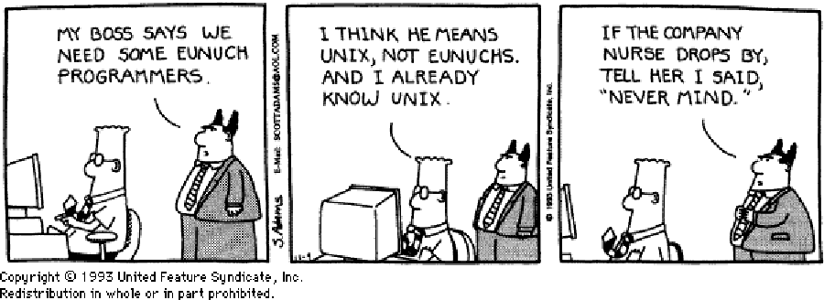
Introducing Unix

Slide 3
Brief Unix History
In 1969, Ken Thompson at AT&T Bell Labs began developing Unix.
  First done in assembly language.
  Ran on DEC PDP-7 with 8K words of memory.
In 1974, Unix was rewritten in C.
  By writing C compilers, Unix can be ported to other computers.
BSD UNIX
  BSD: Berkeley Software Distribution
  UCB put the Internet Protocols (IP) into UNIX

Slide 4
The Unix Philosophy
Unix was not meant to be a user-friendly operating system
  Instead, meant to be “user-helpful” and very powerful
The Unix operating system protects users from other users but not necessarily from themselves
It provides the necessary tools then gets out of your way

Slide 5
The Unix Philosophy
The Unix User
  Wants to use the computer to do things
  Doesn't want the computer to do things for them
    They are willing to learn to make it work
    They don't need their hands held
The Unix Approach
  Give the users the tools they need
  They'll get the job done without having to be shown how

Slide 6
The Unix Philosophy
The Unix Tools
  Keep each tool simple
  Have each tool do one thing, and do that
  one thing really well
  Keep tools terse and not too talkative
  More complex tasks can be accomplished by
  combining tools together in scripts or pipelines
  Originally, input and output to workstations were
  slow and tedious, and this approach made things
  faster and more efficient.

Slide 7
Structure of a Unix System
User
Utilities and User
Software
Shell
Kernel
Hardware

Slide 8
Parts of a Unix Operating System
Kernel
  Manages the processes and resources
  Controls and hides the hardware
Shell
  An interface between users and the kernel
  A command line interpreter (CLI)
Utilities are standard tools/applications
  They are used so often that they become a part of Unix
  “elm” and “pine” are Unix utilities, for example

Slide 9
A Word on Linux
In 1991, Linus Torvalds wrote the Linux kernel
  Wanted a version of UNIX that he could run on the old computer he owned…
Numerous programmers have worked on it
  It’s a popular Unix-like operating system now
    Started with hobbyists and at universities
    Growing popularity in corporations and elsewhere
  Occupies a large percentage of PC server market
Achieved its goal of POSIX compliance

Slide 10
A Word on Linux
Now available for many architectures
  x86, PowerPC, SPARC, SGI Indy, HP PA-RISC, DEC Alpha, IA64 …
Growing software base
  Office suites, desktops, server software, games, ...
Has become the predominant Unix in the microcomputer world
  Much more popular than Free/Open/NetBSD, Solaris x86, ...
Still a "free" operating system
  Mostly under GNU General Public License (GPL or "Copyleft")
  Many companies create and sell distributions (Redhat, SUSE,
  and many others)
  Check it out at: http://www.linux.org

