Slide 1
Section II
Electrical Fundamentals

Slide 2
Student Online Teaching Advice Notice
The materials and content presented within this session are intended solely for use in a context of teaching and learning at Trinity.
Any session recorded for subsequent review is made available solely for the purpose of enhancing student learning.
Students should not edit or modify the recording in any way, nor disseminate it for use outside of a context of teaching and learning at Trinity.
Please be mindful of your physical environment and conscious of what may be captured by the device camera and microphone during videoconferencing calls.
Recorded materials will be handled in compliance with Trinity’s statutory duties under the Universities Act, 1997 and in accordance with the University’s policies and procedures.
Further information on data protection and best practice when using videoconferencing software is available at https://www.tcd.ie/info_compliance/data-protection/.
© Trinity College Dublin 2020

Slide 3
Core Topics
(i) Coulomb’s Law
(ii) Electrical Potential (Voltage)
(iii) Electrical Current
(iv) AC Vs DC
(v) Electrical Power
(vi) RMS Voltages and Currents

Slide 4
Coulomb’s Law:
Recall from atomic theory that protons are said to be positively charged and electrons are said to be negatively charged.
A force of attraction exists between unlike charges and a force of repulsion exists between like charges. This force is given by Coulomb’s Law.

Slide 5
Coulomb’s Law:
The force between any two point charges is proportional to the product of the charges and inversely proportional to the square of the distance between them.

Slide 6
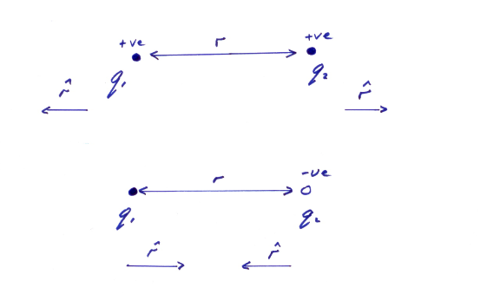
Coulomb’s Law:

Slide 7
Coulomb’s Law:
Example:
Calculate the magnitude of the force in air between two point charges of 4nC each if the distance between them is 5mm.
Note: If multiple charges exist, the force on any one charge equals the vector sum of the forces exerted on it by the other charges.

Slide 8
Electrical Potential (Voltage):
When wind blows from one point to another we say there is a pressure difference between these two points.
Likewise, when water flows from one point to another, we say there is a pressure difference or a difference in height as the case may be.
All of the above result phenomena result from a difference in the potential energy of that quantity between the two points.

Slide 9
Electrical Potential (Voltage):
Potential Energy (or Stored Energy) is the energy of a body due to its state or position.
e.g. a rock at the edge of a cliff, a wound up clock, etc.
When charge flows from one point to another we say there is an electrical potential (energy) difference between these two points.

Slide 10
Electrical Potential (Voltage):
The (Electrical) Potential Difference (p.d.) between two points is the work done in bringing a unit positive charge from one point to another.
Potential difference is a scalar quantity. Its unit (dimension) is the volt.

Slide 11
Electrical Potential (Voltage):
One Volt is the potential difference between two points if the work done in bringing a charge of one Coulomb from one point to the other is one Joule.
The Electromotive Force (E.M.F.) in any closed loop is the work done in bringing unit positive charge around that loop.
In practical terms the EMF is the ‘driving’ or supply voltage.

Slide 12
Electrical Current:
When charge (or charged particles) move (flow) from one point to another, we have electrical current.
Electrical Current is the rate of charge flow with respect to time.
Electrical Current is a scalar quantity. Its unit is the Ampere.
One Ampere is one Coulomb per second.

Slide 13
Electrical Power:
Electrical Power is defined as the rate of energy expenditure.
The units of power are Joules/sec (J/s) or the Watt (W).

Slide 14
A.C. Vs D.C:
AC and DC refer to alternating current and direct current respectively.
With DC, current flows with a constant amplitude from the anode to the cathode. The voltage between the anode and the cathode is constant. Batteries give DC.
With AC the current alternates i.e. moves backwards and forward in a periodic fashion. The applied voltage alternates positive/negative to achieve this. The mains is AC.

Slide 15
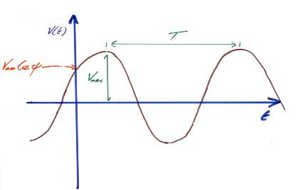
A.C. Vs DC:
An alternating voltage or current would look like this on an oscilliscope:
Let’s say the peak voltage is 5V and the frequency is 50Hz. We assume the phase shift is zero unless otherwise specified. Then:

Slide 16
Electrical Power:
Recall:
Then:
Hence:

Slide 17
Electrical Power:
The instantaneous dc power equals the average dc power.

Slide 18
Electrical Power:
Let be the average ac power over an interval.
Since then:

Slide 19
RMS Voltages and Currents:
By definition, the root mean square (rms) value of a periodic (with period T) time variant function y(t) is:
Hence:
and

Slide 20
RMS Voltages and Currents:
There is an important relationship between the peak values of sinusoidal currents and voltages and their rms values. To see this consider:

Slide 21
RMS Voltages and Currents:
Hence:
And:

Slide 22
RMS Voltages and Currents:
AC currents and voltages are often expressed in terms of their rms values. Take for example the mains voltage which is 230V. It is implicit that this is an rms value since we know the mains is not dc. The frequency of the mains is 50Hz. Hence the mathematical expression for the mains voltage is:
So the peak voltage for the mains is about 325V.

Slide 23
RMS Voltages and Currents:
Example:
A 120V dc source delivers 3.6W to a load. Determine the peak value of the applied current and voltage of an ac source delivering the same power to the load.

