Slide 1
Section IV
The Resistor

Slide 2
Core Topics
(i) The Resistor
(ii) Ohm’s Law
(iii) Series and Parallel Resistors
(iv) Basic Resistive Circuits
(v) The Potential Divider
(vi) AC Sources
(vii) Resistor Colour Coding
(viii) Kirchoff’s Laws

Slide 3
The Resistor:
The resistor is a two-terminal element which impedes the flow of electrical current (through it) converting some of the electrical energy into another form (usually heat and light).
The degree to which it impedes current flow is given numerically by its Resistance Value – measured in ‘Ohms’
Every material possesses this property (resistance) to some extent. When we refer to devices known as ‘resistors’, we are referring to what are known as ‘Ohmic Materials’ – where there is a linear relationship between the applied voltage and the current.

Slide 4
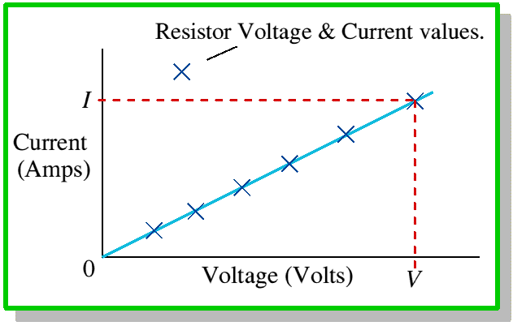
Ohm’s Law:
The relationship between the terminal voltage of a resistor and the current flowing through it is given by Ohm’s Law:

Slide 5
Ohm’s Law:
Electrical symbols for the resistor are:

Slide 6
Ohm’s Law:
Applied Voltage
Resistor
Current
i(t)

Slide 7
Ohm’s Law:
Since
Then from Ohm’s Law:

Slide 8
Ohm’s Law:
Example:
Consider a heater which is connected to a fixed electrical power supply – e.g. mains. Such heaters are common in many household items such as heaters, toasters, hairdryers, etc. The power of this heater (i.e. the rate at which heat is produced) is:
It is obvious from this equation that a smaller resistance will give a greater heating effect.

Slide 9
Ohm’s Law:
However, if R →0 then
=> burnout of circuit which is undesirable so R must be kept above a certain minimum.

Slide 10
Series and Parallel Resistors:
Resistors Connected in Series:
V₁(t)
R₁
i(t)
R₂
V₂(t)
R₃
V₃(t)

Slide 11
Series and Parallel Resistors:
By Ohm’s Law:
V₁(t) = R₁ i(t)
V₂(t) = R₂ i(t)
V₃(t) = R₃ i(t)
But: V(t) = V₁(t) + V₂(t) + V₃(t)
Hence: V(t) = i(t) (R₁ + R₂ + R₃)

Slide 12
Series and Parallel Resistors:
Hence for ‘n’ resistors in series:
And

Slide 13
Series and Parallel Resistors:
Resistors connected in parallel:
i(t)
V₁
R₁
R₂
R₃
V₂
V₃
i1(t)
i2(t)
i3(t)

Slide 14
Series and Parallel Resistors:
Then: i(t) = i₁(t) + i₂(t) + i₃(t)
And
v₁(t) = R₁ i(t)
v₂(t) = R₂ i(t)
v₃(t) = R₃ i(t)

Slide 15
Series and Parallel Resistors:
Then: i(t) = i₁(t) + i₂(t) + i₃(t)
v₁(t) = R₁ i₁(t)
v₂(t) = R₂ i₂(t)
v₃(t) = R₃ i₃(t)
But v(t) = v₁(t) = v₂(t) = v₃(t)
=> i₁(t) =
etc.

Slide 16
Series and Parallel Resistors:
=> i(t) = + +
=> = + +
=> = + +
Hence for ‘n’ resistors in parallel:

Slide 17
Basic Resistive Circuits:
Consider the following circuit:
Find the total current drawn from the source.
R₁
R₂
10Ω
5Ω
V = 5V
R₄
R₃
2Ω
1Ω

Slide 18
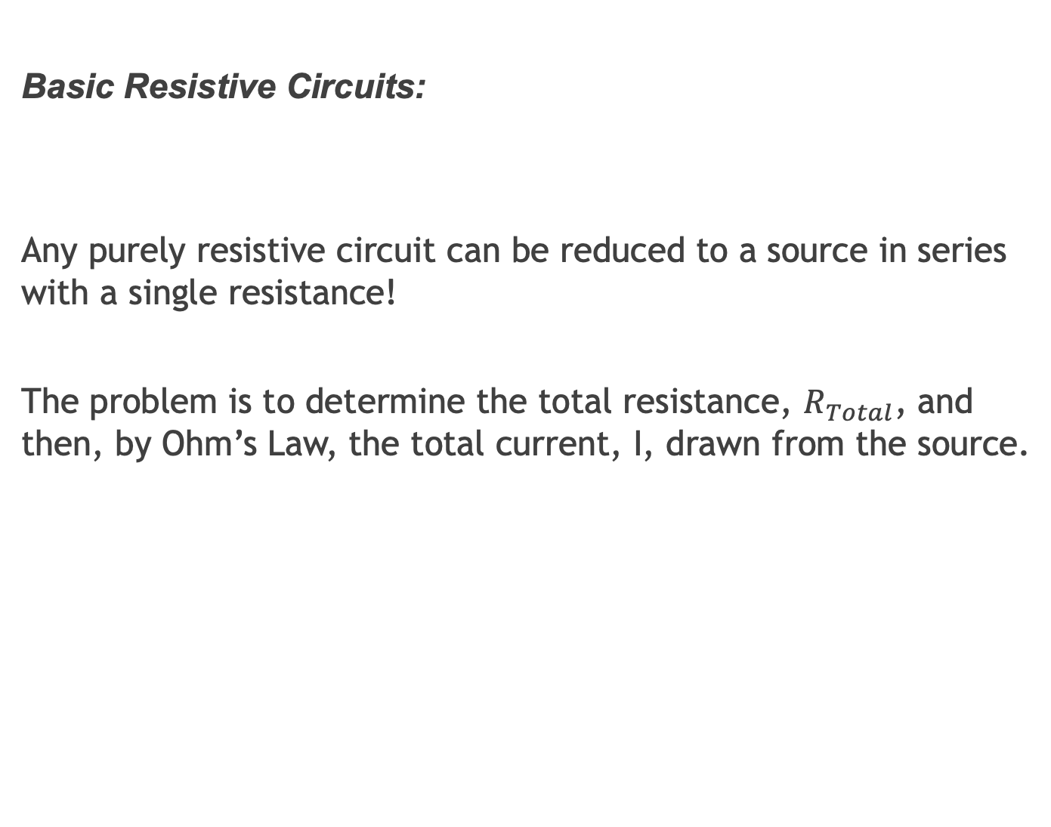
Basic Resistive Circuits:
Any purely resistive circuit can be reduced to a source in series with a single resistance!
The problem is to determine the total resistance, $R_{Total}$, and then, by Ohm’s Law, the total current, I, drawn from the source.

Slide 19
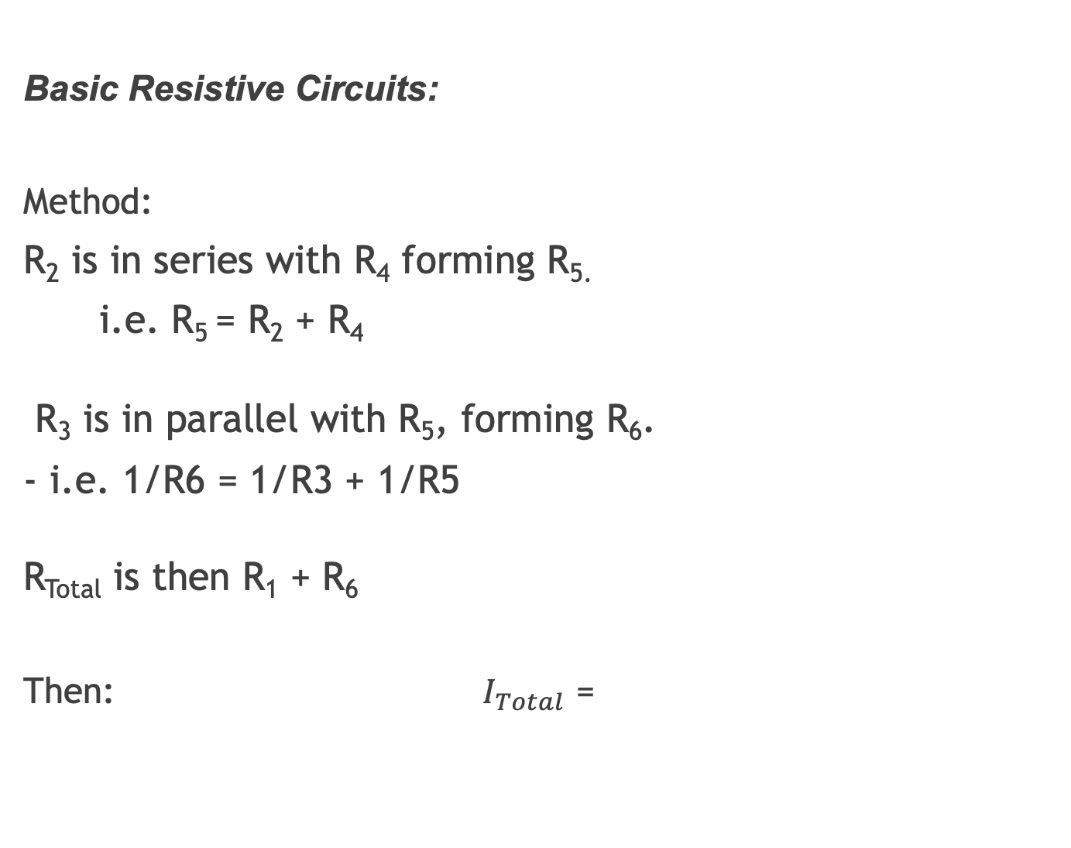
Basic Resistive Circuits:
Method:
R₂ is in series with R₄ forming R_{5.}
i.e. R₅ = R₂ + R₄
R₃ is in parallel with R₅, forming R₆.
- i.e. 1/R6 = 1/R3 + 1/R5
R_{Total} is then R₁ + R₆
Then: $I_{Total}$ =

Slide 20

Basic Resistive Circuits:
Calculations:
R₅ = R₂+ R₄ = 5 + 1 = 6Ω
R₆ = R₃ || R₅ = (1/6 + 1/2)⁻¹ = 1.5Ω
R_{Total} = R₁ + R₆ = 10 + 1.5 = 11.5Ω
Hence:
$I_{Total}=$= 0.43 A

Slide 21
The Potential Divider:
An important application of resistors is the Potential Divider. It is used to obtain a lower p.d. from a higher one:
R₁
V(t)
R₂
V2(t)

Slide 22
The Potential Divider:
Clearly: v(t) = i(t) (R₁ + R₂)
But: v₂(t) = R₂ i(t)
Hence:

Slide 23
The Potential Divider:
Find the potential difference between points ‘a’ and ‘b’ in the following circuit:
I
a
10Ω
V = 5V
5Ω
Vab
1Ω
2Ω
b

Slide 24
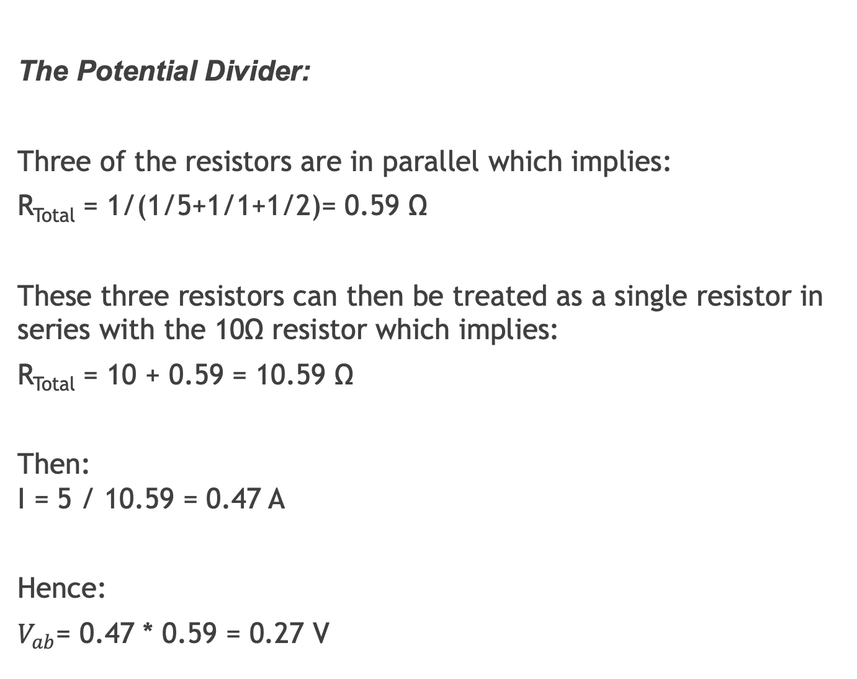
The Potential Divider:
Three of the resistors are in parallel which implies:
R_{Total} = 1/(1/5+1/1+1/2)= 0.59 Ω
These three resistors can then be treated as a single resistor in series with the 10Ω resistor which implies:
R_{Total} = 10 + 0.59 = 10.59 Ω
Then: I = 5 / 10.59 = 0.47 A
Hence:
$V_{ab}$= 0.47 * 0.59 = 0.27 V

Slide 25
The Potential Divider:
Using the Potential Divider Rule:

Slide 26
AC Sources:
Let’s say the source was sinusoidal – that is the p.d. between its terminals varies in a sinusoidal fashion.
Then the supply voltage is ac and is described by the general equation:
Vmax is the peak voltage
ω is the frequency in radians per second (= 2πf = 2π/T).
Ψ is the phase shift.

Slide 27
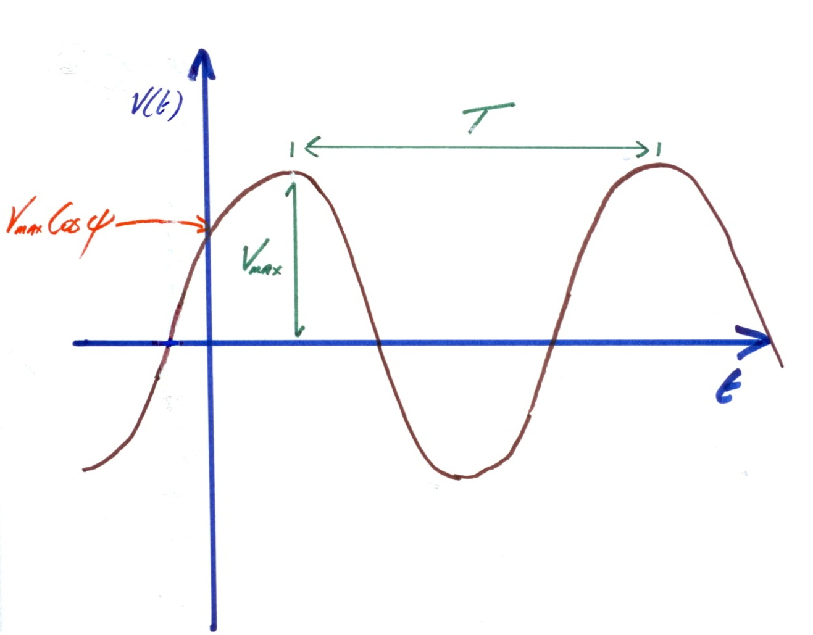
AC Sources:
Diagram:

Slide 28
AC Sources:
Let’s say the peak voltage is 5V and the frequency is 50Hz. We assume the phase shift is zero unless otherwise specified.
Then:
By repeating the above example with this supply we get:
Reading Work: ‘Sinusoidal Alternating Waveforms’ - Introductory Circuit Analysis – Boylestad

Slide 29
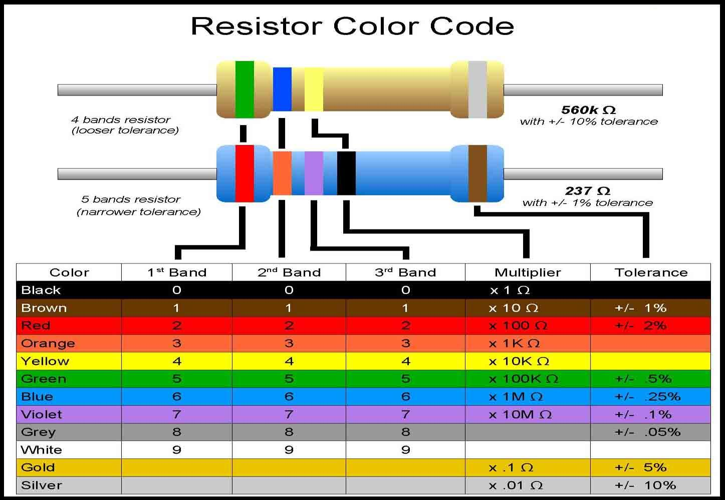
Resistor Colour Codes:
Resistors do not have their numerical Ohmic value printed on them. Rather a colour code is used where each colour band corresponds to a numerical value. The colour code is given here:

