Slide 1
Section IX
Semiconductors and Semiconductor Devices

Slide 2
Core Topics
(i) Semiconductors
(ii) Semiconductor Doping
(iii) Semiconductor Diodes
(iv) The Transistor
(v) Using Transistors to Build Logic Gates
(vi) Using Transistors to Build Amplifiers

Slide 3
Semiconductors:
A semiconductor is a material which, on application of an emf, facilitates a ‘moderate’ current flow.
Semiconductors are a class of materials which fall between conductors and dielectrics. Examples include Silicon (Si) and Germanium (Ge).
As opposed to conductors, where approx. 1 electron per atom is available for conduction, in semiconductors, this figure is typically of the order of 1 electron in every 10⁸ atoms.

Slide 4
Semiconductors:
Consider Silicon (Si), a common semiconductor.
28.1g of Silicon contains 6.02x10²³ atoms. The density of Silicon is 2.33g/cm³.
So 1cm³ of Silicon contains 5x10²² atoms.
Therefore there are approximately 5x10¹² e⁻/cm³ available for conduction in Silicon at room temperature.

Slide 5
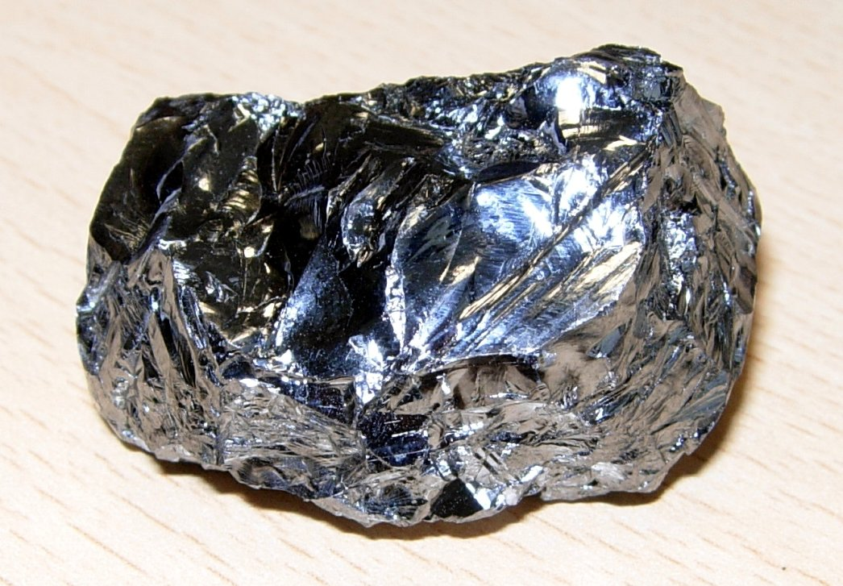
Semiconductors:
Silicon is a metalloid. Over 90% of the Earth's crust is composed of silicate (compounds of silicon) minerals, making silicon the second most abundant element in the Earth's crust (about 28% by mass) after oxygen.

Slide 6
Semiconductors:
When an emf is applied across a semiconductor, the ‘free’ electrons move towards the anode. The ‘space’ left behind, referred to as a ‘hole’, is filled by another electron coming from a neighbouring atom (on its way to the anode).
This ‘hole’ has a small positive charge (because an electron has vacated the outer orbit).
The electron in turn moves further towards the anode and a hole appears in its place until it, in turn, is replenished by another electron coming from the cathode. i.e. the process of charge flow, a.k.a. current, can be viewed as electrons flowing from the cathode to the anode or ‘holes’ moving from the anode to the cathode.

Slide 7
Semiconductors:
This latter concept is used in semiconductor physics to succinctly explain electrical current phenomena in semiconductor devices.
In a pure or ‘intrinsic’ semiconductor, there are the same number of holes as free electrons.

Slide 8
Semiconductor Doping:
A process known as ‘Semiconductor Doping’ is the addition of an ‘impurity’ element to an intrinsic semiconductor and is used to enhance the conductivity of the semiconductor itself.
A semiconductor that has been doped is referred to as an ‘extrinsic’ semiconductor.

Slide 9
Semiconductor Doping:
Consider the silicon atom (Si). It has 14 electrons. It looks like this:
i.e. there are four electrons in its valence orbit.
Si
Nucleus
e
electrons

Slide 10
Semiconductor Doping:
All atoms have a propensity to seek either the full compliment of electrons in their outer-most shell (2n²) or, failing this, eight electrons in the outer-most shell for n>=2.
Hence, the reason for chemical bonding where atoms share electrons in their outer-most shells.

Slide 11
Semiconductor Doping:
Pure silicon achieves the latter in the following manner:
Here the centre atom achieves eight electrons in its valence orbit by sharing its electrons with each of the four Silicon atoms that surround it.
Si
Valence Orbits

Slide 12
Semiconductor Doping:
These atoms in turn establish the same relationship with other neighbouring Silicon atoms. It is this regular arrangement that gives Silicon its crystalline structure.

Slide 13
Semiconductor Doping:
These have an enhanced number of free electrons and so have a better conductivity than intrinsic Silicon.
This is achieved by adding pentavalent atoms (i.e. atoms with five electrons in the outer shell) in a process known as ‘doping’.

Slide 14
Semiconductor Doping:
The resulting structure is then:
N-Type Silicon:
Si
Pentavalent Atom
Extra ‘Free Electron’

Slide 15
Semiconductor Doping:
As we can see the structure is similar to that of pure Silicon but with an electron in the valence orbit ‘left over’. This partially ‘excluded’ electron is a strong candidate for conduction and so an increased presence of such electrons enhances the conductivity of the resulting material.
Examples of Pentavalent Atoms include Arsenic, Atimony and Phosphorus.
In these materials (n-type semiconductors), there is a greater number of free electrons than there are holes. Hence, we say that the ‘majority carriers’ are electrons.

Slide 16
Semiconductor Doping:
Another way of enhancing the conductivity of an intrinsic semiconductor is to add a trivalent element.
The resulting structure is this:
P-Type Silicon
Si
Hole
Trivalent Atom

Slide 17
Semiconductor Doping:
A semiconductor doped with a trivalent impurity element (i.e. an element with three electrons in its valence orbit) is known as a p-type semiconductor. (‘p’ for positive)
The number of ‘holes’ in a p-type semiconductor exceeds the number of free electrons. Hence we say that the ‘majority carriers’ are holes.
Examples of Trivalent Atoms Include Aluminium, Boron and Gallium.

Slide 18
Semiconductor Diodes:
It is possible to produce the following crystal:
p-type n-type
+
+
-
-
-
-
+
+
-
+
+
+
-
-
-
+
+
+
-
-
+
-
-
-
+
+
-
-
-
+
+
-
-
-
Depletion Layer or Depletion Region

Slide 19
Semiconductor Diodes:
The crystal is composed half of p-type and half of n-type semiconductor material.
The ‘depletion layer’ at the junction of the p-type and n-type materials is a region devoid of free electrons and holes.
It comes about because free electrons from the n-type material diffuse across the boundary and occupy holes on the other side (and vice versa).

Slide 20
Semiconductor Diodes:
Because the depletion layer has now ‘depleted’ of charge carriers it becomes a poor conductor of current.
If, however, we apply a variable voltage source as in the following circuit, we notice the following current profile as we increase the emf from zero.

Slide 21
Semiconductor Diodes:
In this scenario (i.e. the positive terminal of the supply is connected to the p-type material and the negative terminal is connected to the n-type material) the diode is said to be ‘forward biased’
V_{diode}
+
+
-
-
-
-
+
+
-
+
+
+
-
-
-
+
+
+
-
-
+
-
-
-
+
+
-
-
-
+
+
-
-
-
I_{diode}
+
-

Slide 22
Semiconductor Diodes:
Forward Bias:
From V ~=0.7V (for a typical Si diode), we see an ‘exponential’ rise in the current.
I_{diode}
typ. 200mA
~ 0.7V (Si)
V_{diode}

Slide 23
Semiconductor Diodes:
Hence, for this diode, at V~=0.7V the potential difference (p.d.) between the terminals of the diode is enough to force carriers across the depletion layer – the depletion layer breaks down in the process at which point the crystal is now a reasonably good conductor and current flows freely!

Slide 24
Semiconductor Diodes:
Were one to reverse the polarity of the supply i.e. place the diode in ‘reverse bias’, the depletion region would expand and very little current would flow.
Were one to increase the applied voltage in the reverse ‘direction’ even further, the diode itself would break down. i.e. electrons will simply be forced across the crystal regardless of the fact that it is now entirely a depletion region.

Slide 25
Semiconductor Diodes:
The Full Transfer Characteristic of the Diode (Forward and Reverse Bias):
Reverse Bias
I
Forward Bias
Cut-in Voltage or ‘Knee’ Voltage (approx 0.7V for Si), 0.5V for g)
Reverse Breakdown Voltage (Typically -25V)
V_{diode}
Reverse Leakage
Current

Slide 26
Semiconductor Diodes:
The Full Transfer Characteristic of an Ideal Diode (Forward and Reverse Bias):
Reverse Bias
I
Forward Bias
Perfect Conductor
Perfect Insulator
V_{diode}

Slide 27
Semiconductor Diodes:
The forward characteristic is well approximated by the equation:
Essentially, the seminconductor diode is a ‘current valve’, allowing current to flow in one direction but not the other.
The electrical symbol of the semiconductor diode is:
P-Type
N-Type

Slide 28
Semiconductor Diodes:
If you take the ratio of the diode voltage to the diode current, you get the ‘Static Resistance’ of the diode (unlike ‘resistors’ diodes do not exhibit a linear relationship between voltage and current)

Slide 29
Semiconductor Diodes:
In Forward Bias (typical diode IN914):
Note how the resistance decreases as the applied voltage increases.

Slide 30
Semiconductor Diodes:
With the diode in Reverse Bias we get:
In both cases, very large resistances.

Slide 31

Semiconductor Diodes:
Zener Diodes are designed to operate in the breakdown region
Symbol:
A ‘normal’ diode is not designed to operate in the breakdown region. Operation at this point can cause overheating and damage the diode. However if the pn junction is heavily doped the reverse breakdown voltage can be reduced to a point where overheating/damage does not occur (say -5V Vs -25V). Operation at these voltage levels is useful in for example in protecting circuits from voltage surges or in voltage regulators.

Slide 32

Semiconductor Diodes:
Light Emitting Diodes (LEDs) are diodes that emit light on application of an emf.
Symbol:
On application of a potential difference in forward bias electrons combine with holes at the pn junction. In so doing they drop from a higher energy level to a lower one emitting radiation in the process. The frequency of this radiation is determined by the type of semiconductor used. For some semiconductor materials the radiation emitted is visible (i.e. light).

Slide 33
Semiconductor Diodes:
Here are some examples:
Typical LED Characteristics
Semiconductor Material | Wavelength | Colour | VF @ 20mA
GaAs | 850-940nm | Infra-Red | 1.2v
GaAsP | 630-660nm | Red | 1.8v
GaAsP | 605-620nm | Amber | 2.0v
GaAsP:N | 585-595nm | Yellow | 2.2v
AlGaP | 550-570nm | Green | 3.5v
SiC | 430-505nm | Blue | 3.6v
GaInN | 450nm | White | 4.0v

Slide 34

Semiconductor Diodes:
Photodiodes are diodes that conduct current on the application of light.
Symbol:
The principle of operation of these diodes is the same as that of LEDs but in reverse. When light impinges on the diode it imparts energy or energy is absorbed by the diode. This results in electrons gaining energy and leaving the valence orbits and resulting in the creation of free electron – hole pairs i.e. charge carriers.

Slide 35
Semiconductor Diodes:
If a very small voltage is applied these charge carriers move to the anode and cathode respectively.
There are thus two currents flowing in the photo diode: the Dark Current which is the current flowing in the absence of light due to the small voltage supply and the photocurrent due to the impact of incident light. The dark current must be minimised to maximise the sensitivity of the device.

Slide 36
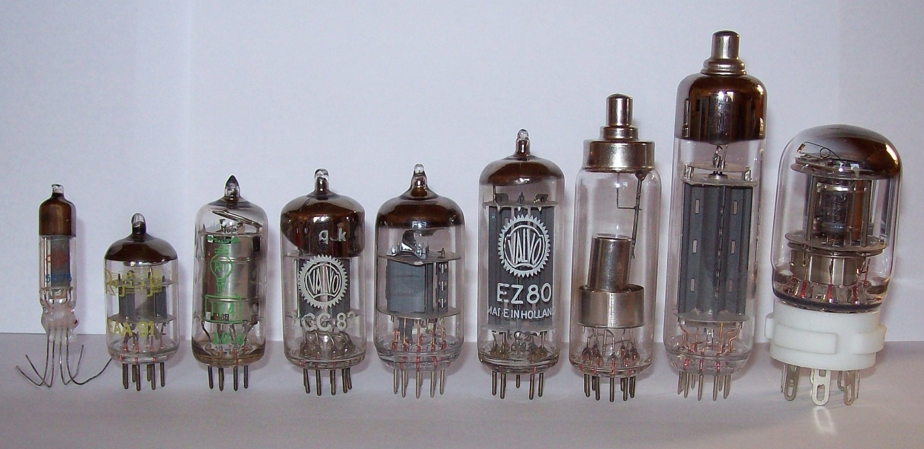
The Transistor:
Before 1950 electronic equipment used vacuum tubes, otherwise called valves, which acted as transistors. They usually consumed a few Watts of power each and as a result created a lot of heat. They were also quite bulky as you can see below:

Slide 37
The Transistor:
They generally worked by having an incandecent connection (a heated cathode that emits light and electrons) along with a separate anode separated by a grid. Electrons flowed from the incandecent connection to the isolated anode. The grid was connected to a supply voltage which modulated the current flow between the incandescent connection and the isolated anode. In this way signal amplification was possible. In 1951 William Shockley invented the first transistors based on semiconductors for which he received the Nobel Prize. The advantages of these types of transistors are that they can be made much smaller than a vacum tube and that they consume much less power. The transistor’s impact on electronics has been enormous. Almost all electronic equipment produced today uses semiconductor technology. Before 1951 a computer filled an entire room and cost millions of euro. Today a much better computer sits on a desk with a few billion transistors in its CPU and costs roughly a thousand euro.

Slide 38
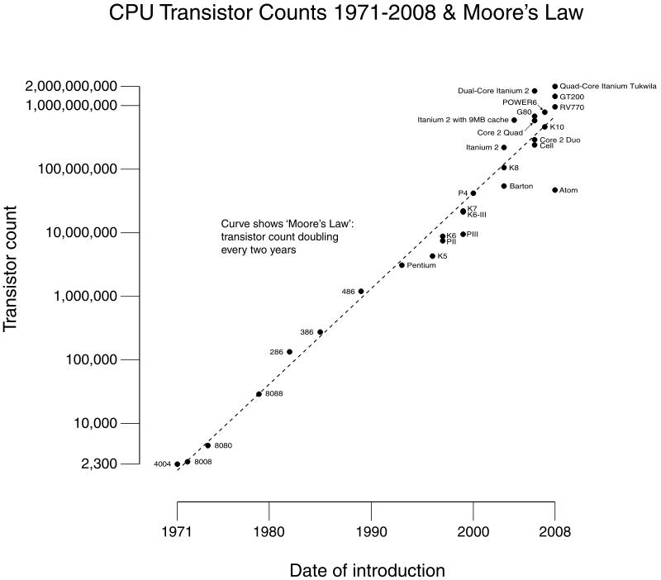
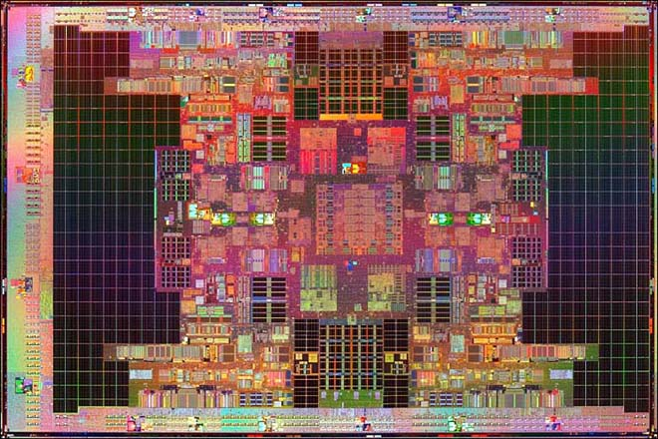
The Transistor:

Slide 39
The Transistor:
In this course we examine the most widely used transistor, the Enhancement Metal Oxide Field Effect Transistor – the Enhancement MOSFET (E-MOSFET). The advantage of these types of transistors over others is that faster switching speeds are possible which translates into, for example, faster computer processors. Furthermore the E-MOSFET is relatively easy to manufacture and can be used also as a resistor or a capacitor. It does not however achieve the same gain as, for example, the Bipolar Junction Transistor.

Slide 40
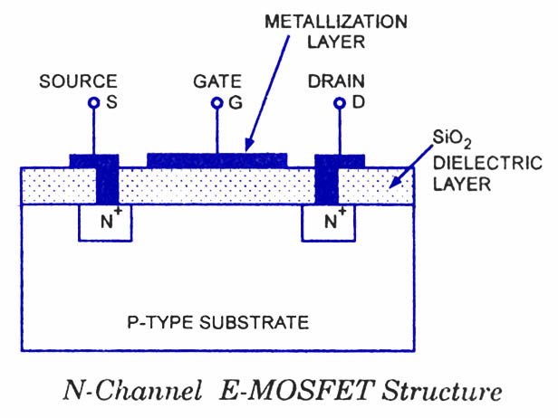
The Transistor:
The structure of an n-channel E-MOSFET is as follows:

Slide 41
The Transistor:
Between the gate and the substrate there is a layer of silicon dioxide which is a very good insulator. Silicon dioxide is also called silica (glass). It is most commonly found in nature as quartz and is the primary component of sea sand. With a supply voltage connected between the drain and the source (ground) and a zero voltage between the gate and the source no current will flow because of the depletion regions that will exist between the n+ and p-type materials.

Slide 42
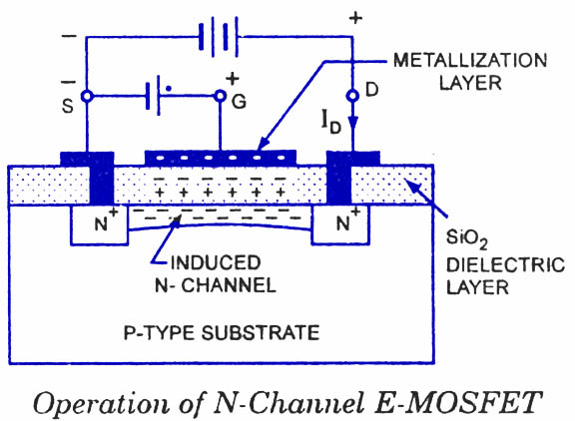
The Transistor:
As the gate-source voltage is increased electrons are drawn from the source to the gate region forming an n-channel between the drain and the source and current starts to flow from the drain to the source. This n-channel is called an inversion layer.

Slide 43
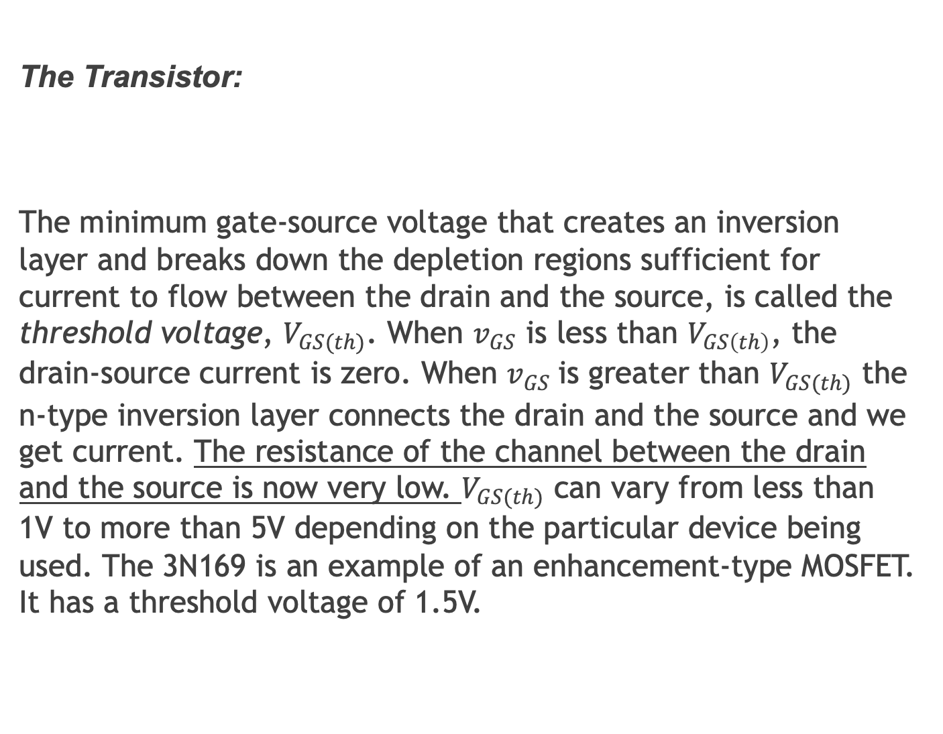
The Transistor:
The minimum gate-source voltage that creates an inversion layer and breaks down the depletion regions sufficient for current to flow between the drain and the source, is called the threshold voltage, $V_{GS(th)}$. When $v_{GS}$ is less than $V_{GS\left(th\right)}$, the drain-source current is zero. When $v_{GS}$is greater than $V_{GS(th)}$ the n-type inversion layer connects the drain and the source and we get current. The resistance of the channel between the drain and the source is now very low. $V_{GS(th)}$ can vary from less than 1V to more than 5V depending on the particular device being used. The 3N169 is an example of an enhancement-type MOSFET. It has a threshold voltage of 1.5V.

Slide 44
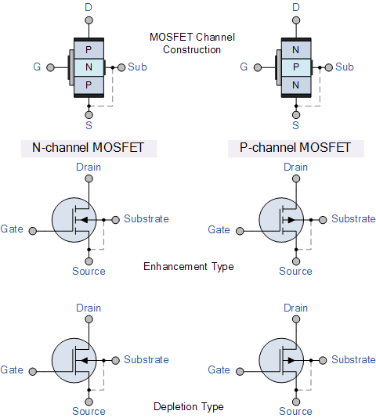
The Transistor:
The symbols for enhancement-type MOSFETs are as follows:

Slide 45

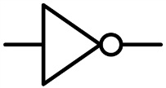
Using Transistors to build Logic Gates:
As you can see, from the diagrams below, transistors can be used to build logic gates. The principle of operation is fairly simple. Let’s start with the inverter or NOT-gate.
A X

Slide 46
Using Transistors to build Logic Gates:
If the input is HIGH (i.e. a high voltage) then the transistor is switched ON (current flows from the drain to the source). If the resistor at the drain is chosen to be much greater than the ‘ON’ resistance of the transistor then the output will be LOW (i.e. a low voltage) – recall the Potential Divider!
If the input is LOW then the transistor is OFF. There is no drain current and the output voltage is equal to the supply voltage i.e. HIGH. It is left to the student to figure out how the other logic gates work.

Slide 47
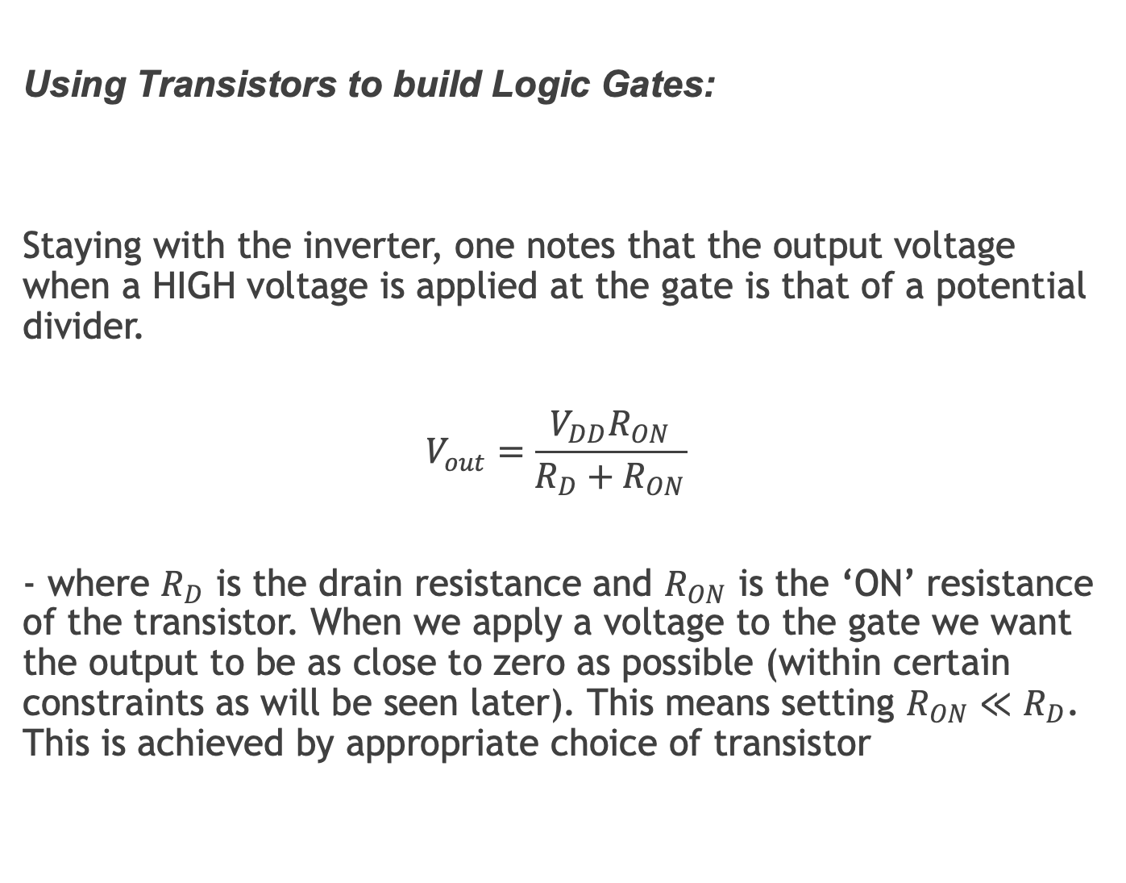
Using Transistors to build Logic Gates:
Staying with the inverter, one notes that the output voltage when a HIGH voltage is applied at the gate is that of a potential divider.
$$V_{out}=\frac{V_{DD}R_{ON}}{R_{D}+R_{ON}}$$
- where $R_{D}$ is the drain resistance and $R_{ON}$ is the ‘ON’ resistance of the transistor. When we apply a voltage to the gate we want the output to be as close to zero as possible (within certain constraints as will be seen later). This means setting $R_{ON}≪R_{D}$. This is achieved by appropriate choice of transistor

Slide 48

Using Transistors to build Logic Gates:

Slide 49
Using Transistors to build Logic Gates:
You will note here with the NAND gate that two equivalent circuits are given.
A transistor has a resistance albeit not being an Ohmic device. Since a transistor occupies about 20 times less space on an IC as a resistor it is common to use transistors as ‘resistors’.

Slide 50
Using Transistors to build Logic Gates:

Slide 51
Using Transistors to build Amplifiers:
It is somewhat more complicated to use a transistor(s) to build amplifiers. Amplifiers are common in electronic systems but probably their most important function in relation to Computer Science is in telecommunications where a received wireless signal is amplified.
This amplification is necessary to separate out the desired signal from all others and to make it large enough to process (and, for example, to convert to audible sound on phones etc.).

Slide 52
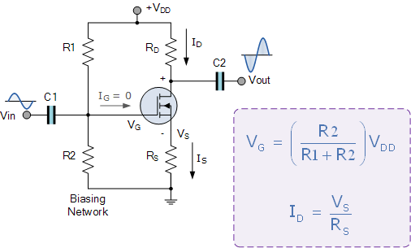
Using Transistors to build Amplifiers:
Amplifier with Voltage Divider bias:

Slide 53
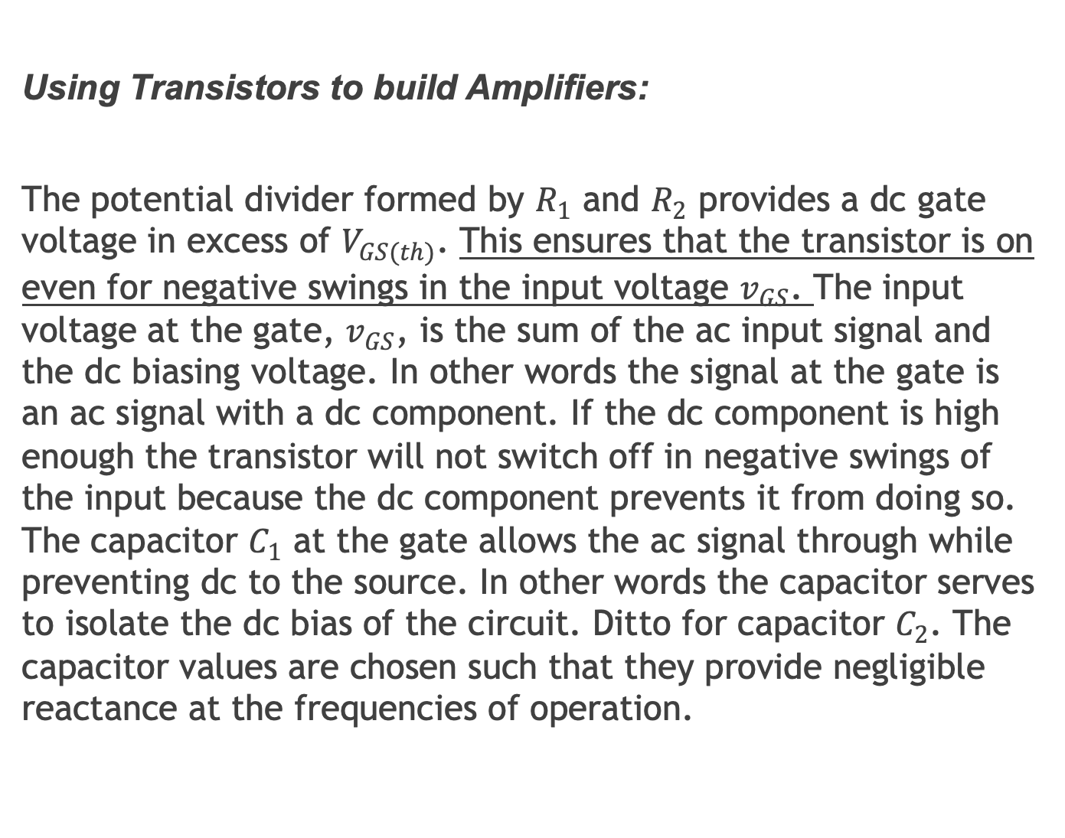
Using Transistors to build Amplifiers:
The potential divider formed by $R_{1}$ and $R_{2}$ provides a dc gate voltage in excess of $V_{GS(th)}$. This ensures that the transistor is on even for negative swings in the input voltage $v_{GS}$. The input voltage at the gate, $v_{GS}$, is the sum of the ac input signal and the dc biasing voltage. In other words the signal at the gate is an ac signal with a dc component. If the dc component is high enough the transistor will not switch off in negative swings of the input because the dc component prevents it from doing so. The capacitor $C_{1}$ at the gate allows the ac signal through while preventing dc to the source. In other words the capacitor serves to isolate the dc bias of the circuit. Ditto for capacitor $C_{2}$. The capacitor values are chosen such that they provide negligible reactance at the frequencies of operation.

Slide 54
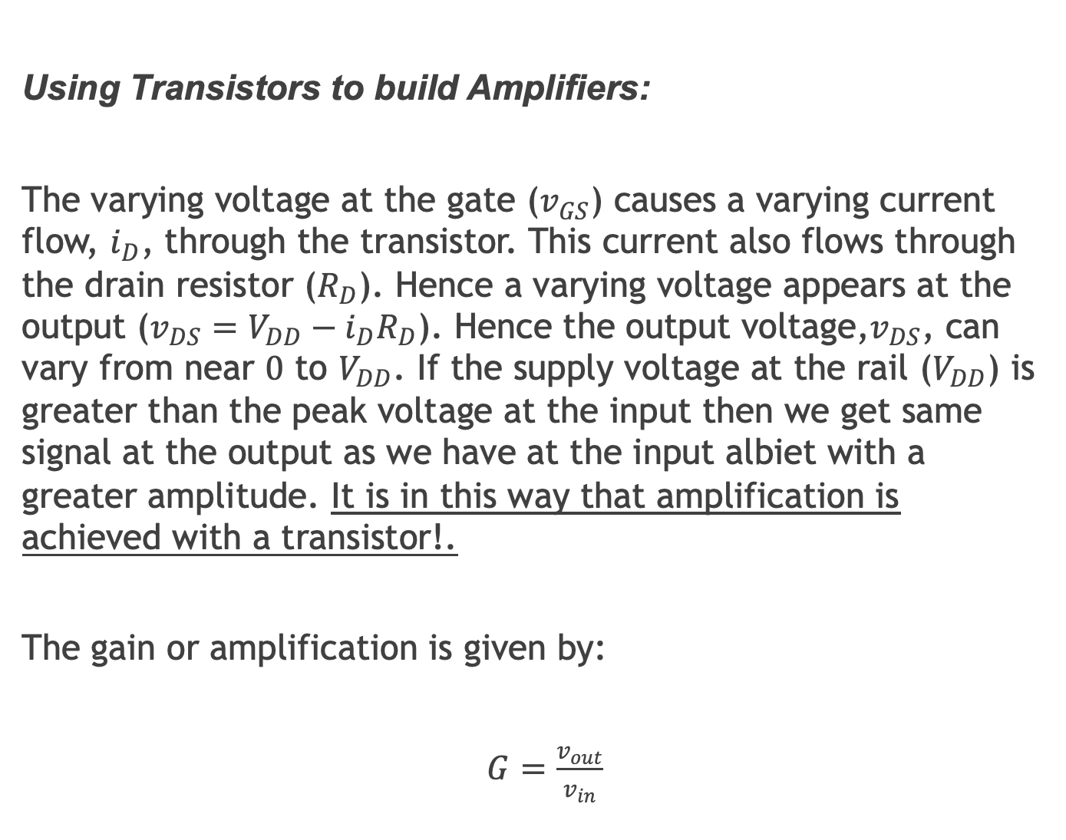
Using Transistors to build Amplifiers:
The varying voltage at the gate ($v_{GS}$) causes a varying current flow, $i_{D}$, through the transistor. This current also flows through the drain resistor ($R_{D}$). Hence a varying voltage appears at the output ($v_{DS}=V_{DD}−i_{D}R_{D}$). Hence the output voltage,$v_{DS}$, can vary from near $0$ to $V_{DD}$. If the supply voltage at the rail ($V_{DD}$) is greater than the peak voltage at the input then we get same signal at the output as we have at the input albiet with a greater amplitude. It is in this way that amplification is achieved with a transistor!.
The gain or amplification is given by:
$G=\frac{v_{out}}{v_{in}}$

Slide 55
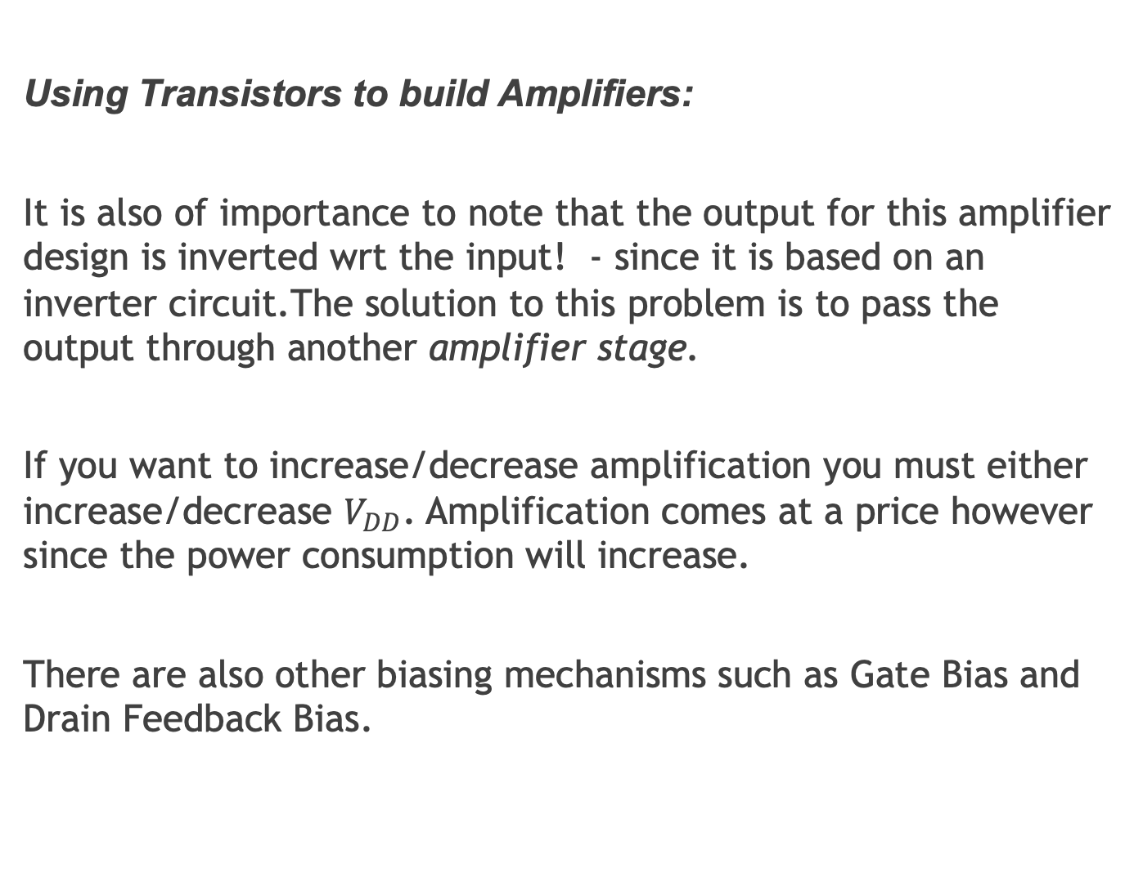
Using Transistors to build Amplifiers:
It is also of importance to note that the output for this amplifier design is inverted wrt the input! - since it is based on an inverter circuit.The solution to this problem is to pass the output through another amplifier stage.
If you want to increase/decrease amplification you must either increase/decrease $V_{DD}$. Amplification comes at a price however since the power consumption will increase.
There are also other biasing mechanisms such as Gate Bias and Drain Feedback Bias.

