Slide 1




Annyhaha
2018 @Ucalgary

Slide 2
Annyhaha
2018 @Ucalgary

Slide 3
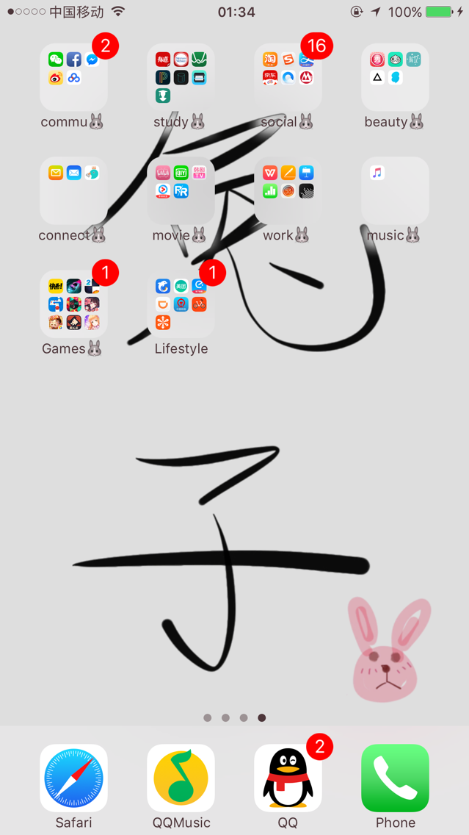


Annyhaha
2018 @Ucalgary

Slide 4


