Slide 1
Wave Simulator
Yu Duo Zhang

Slide 2
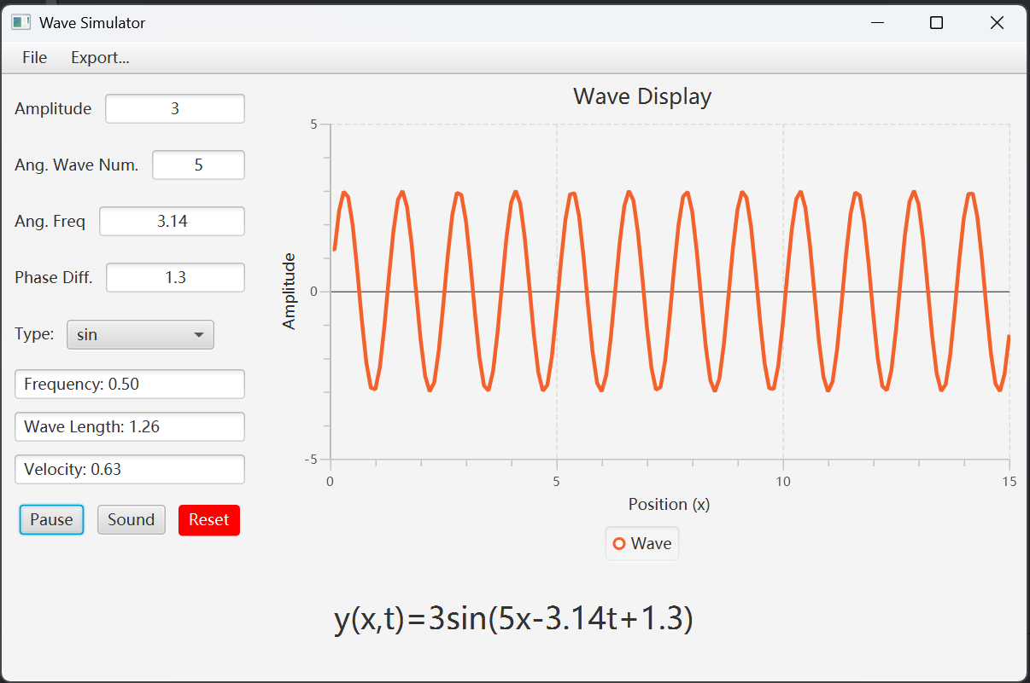
Application Demo
- Parameter modifying
- Information Display
- Traveling wave animation
- Sound generation
- Saving/Loading & Image
- Reset

Slide 3
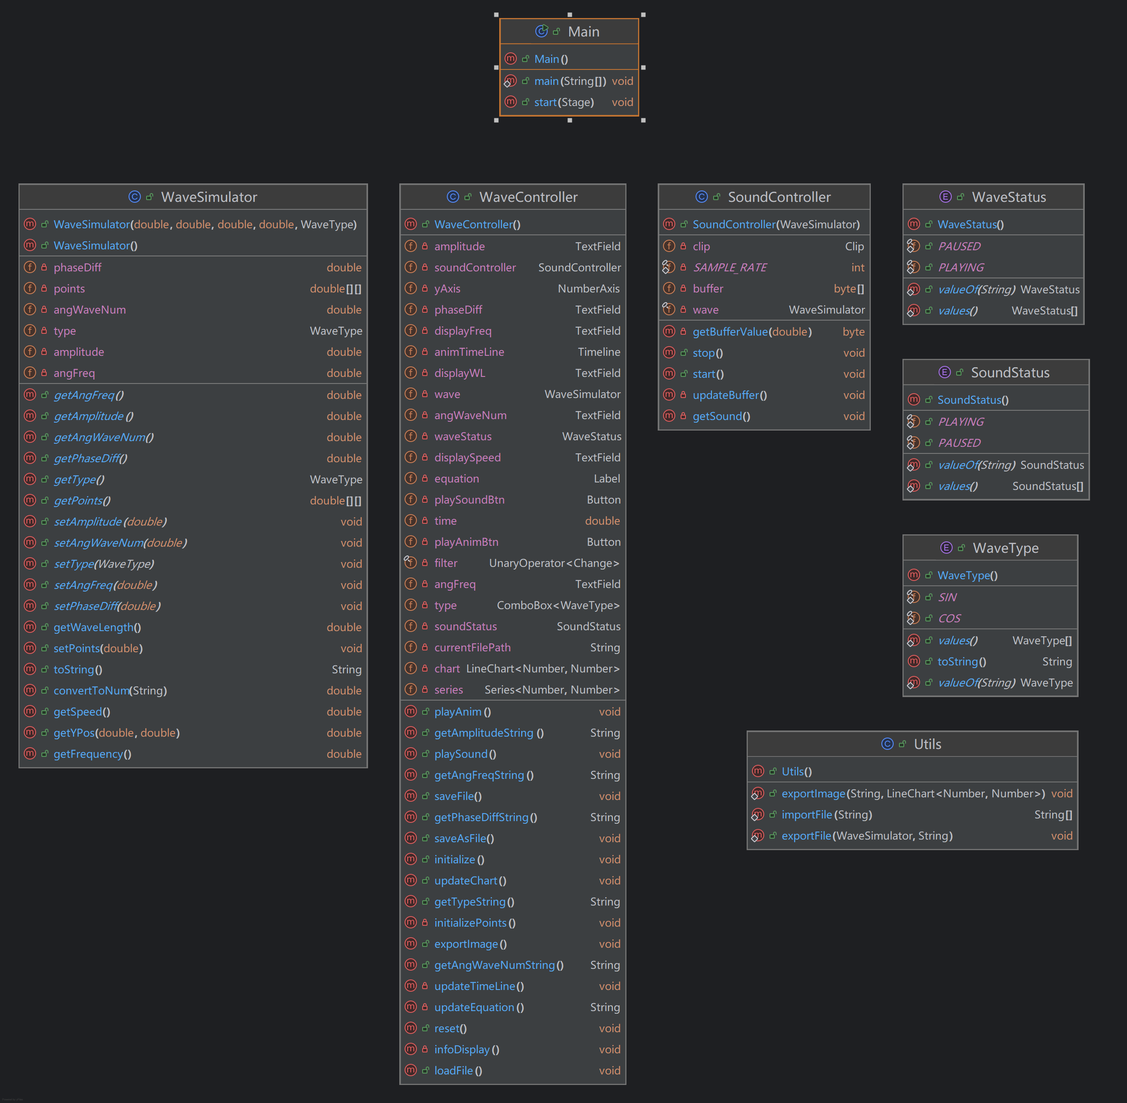
Project Structure in UML Diagram

Slide 4
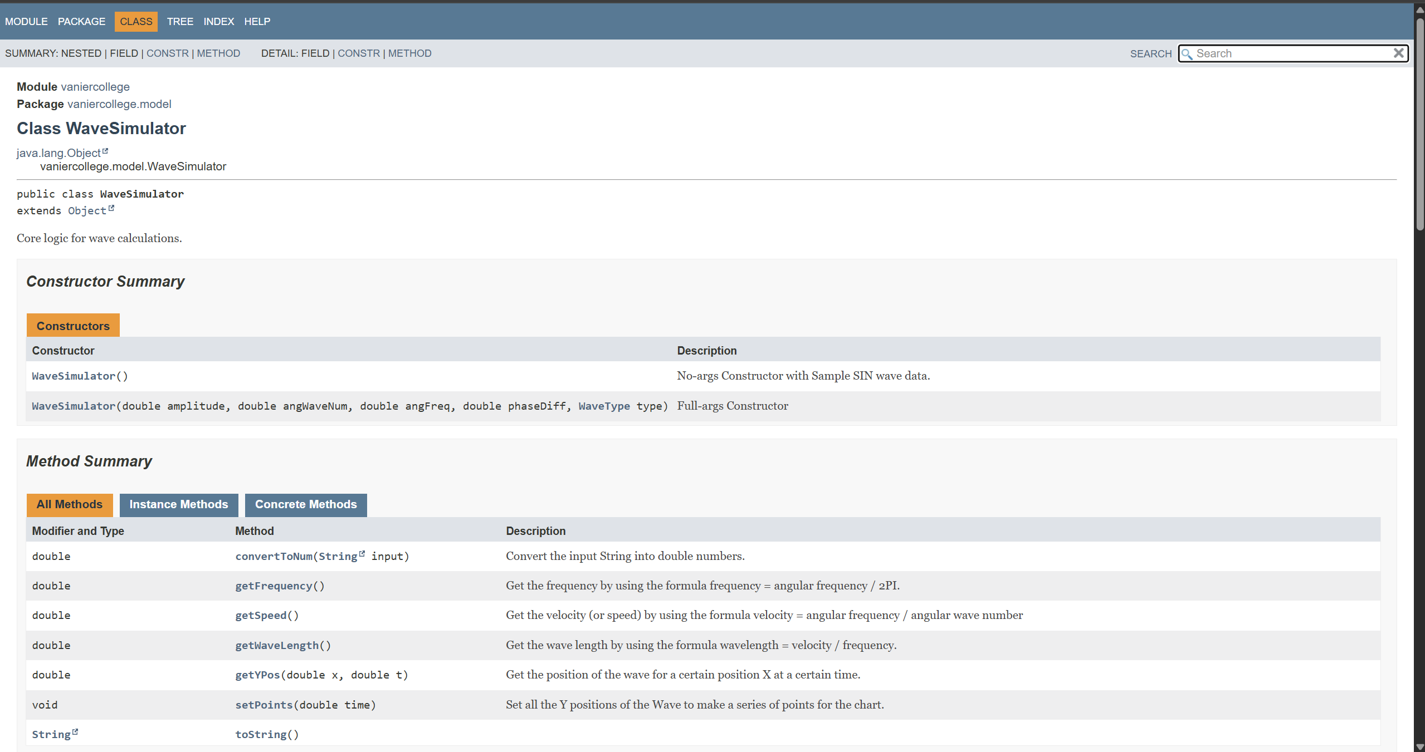
Javadoc

