Slide 1

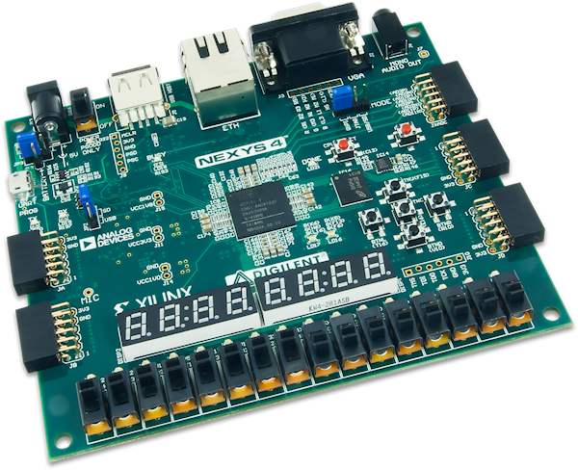
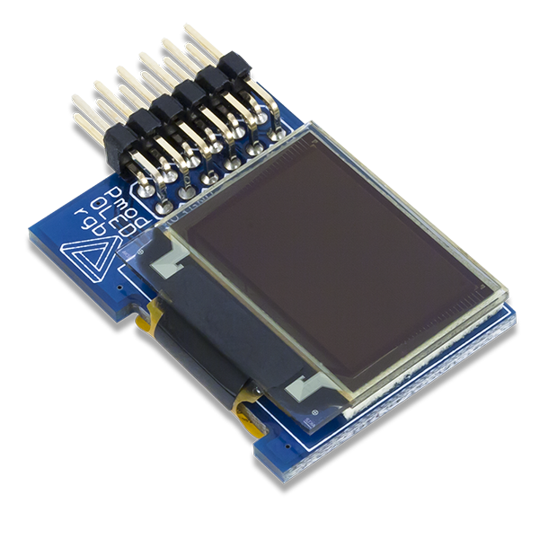
MARINO Xavier & DURAND Clovis | PR214

Slide 2
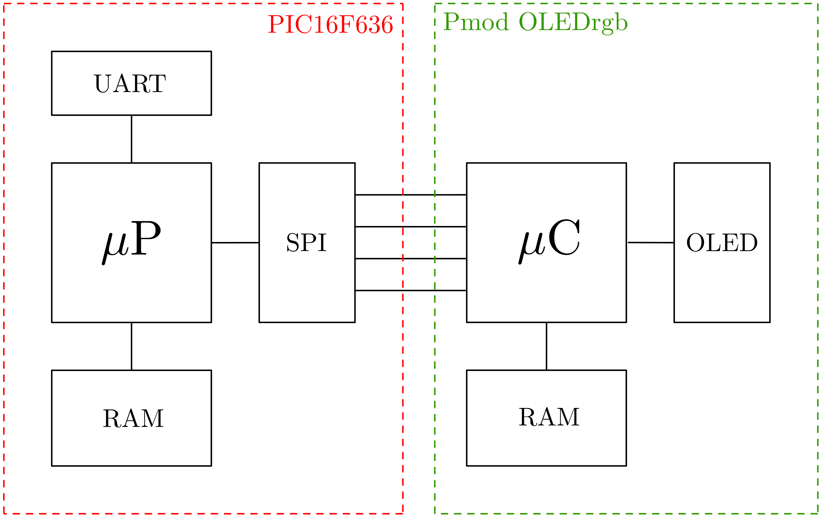
PR214 | Soutenance | E2
 | 2

Slide 3
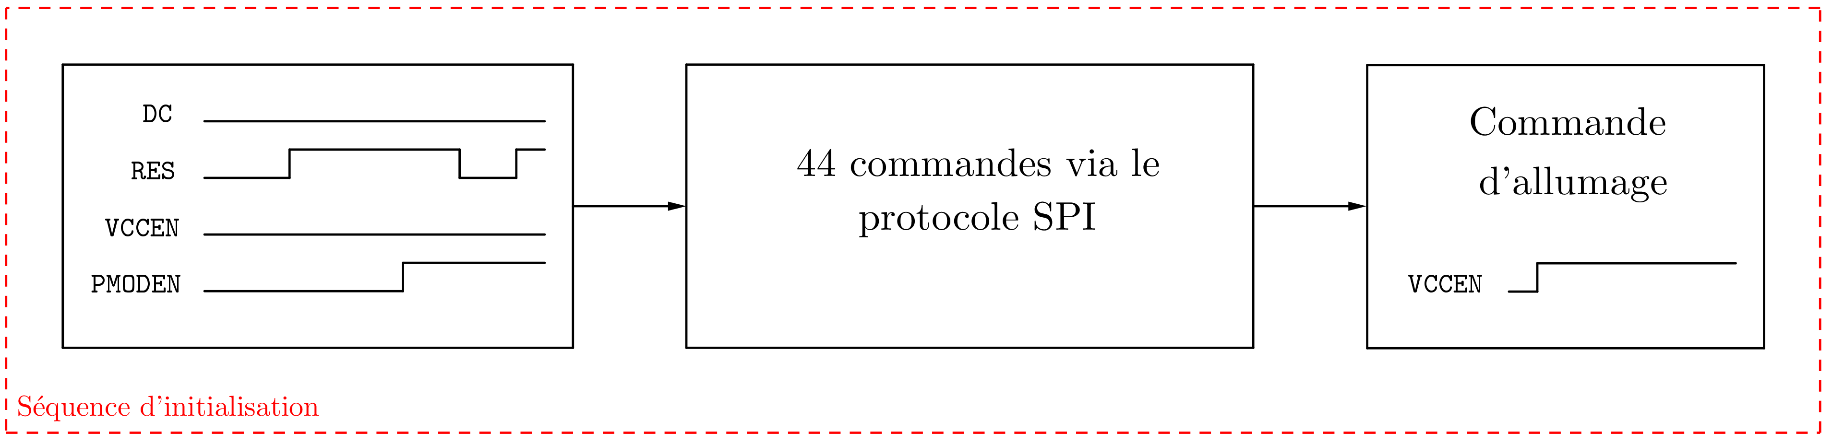
PR214 | Soutenance | E2
 | 3

Slide 4
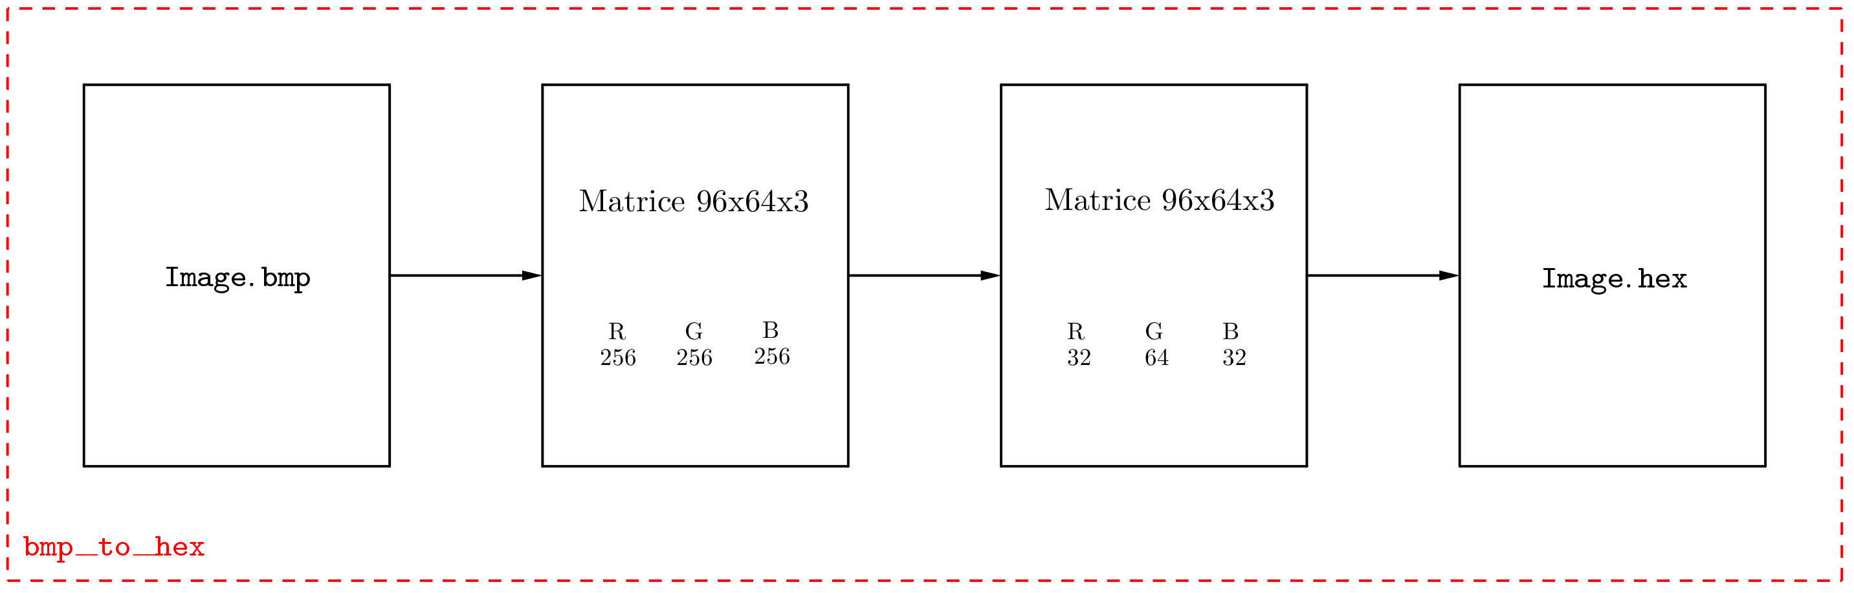
PR214 | Soutenance | E2
 | 4

Slide 5
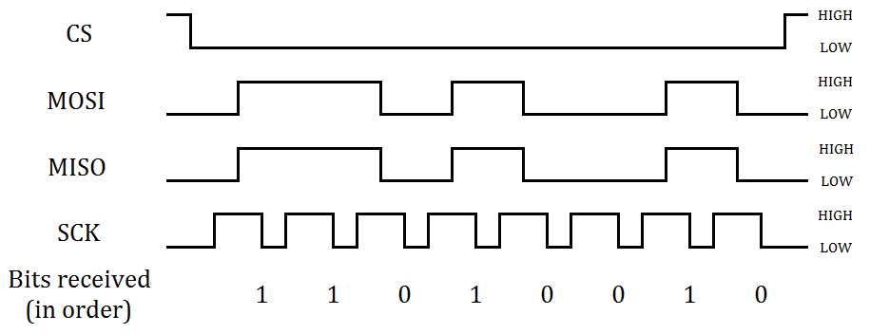
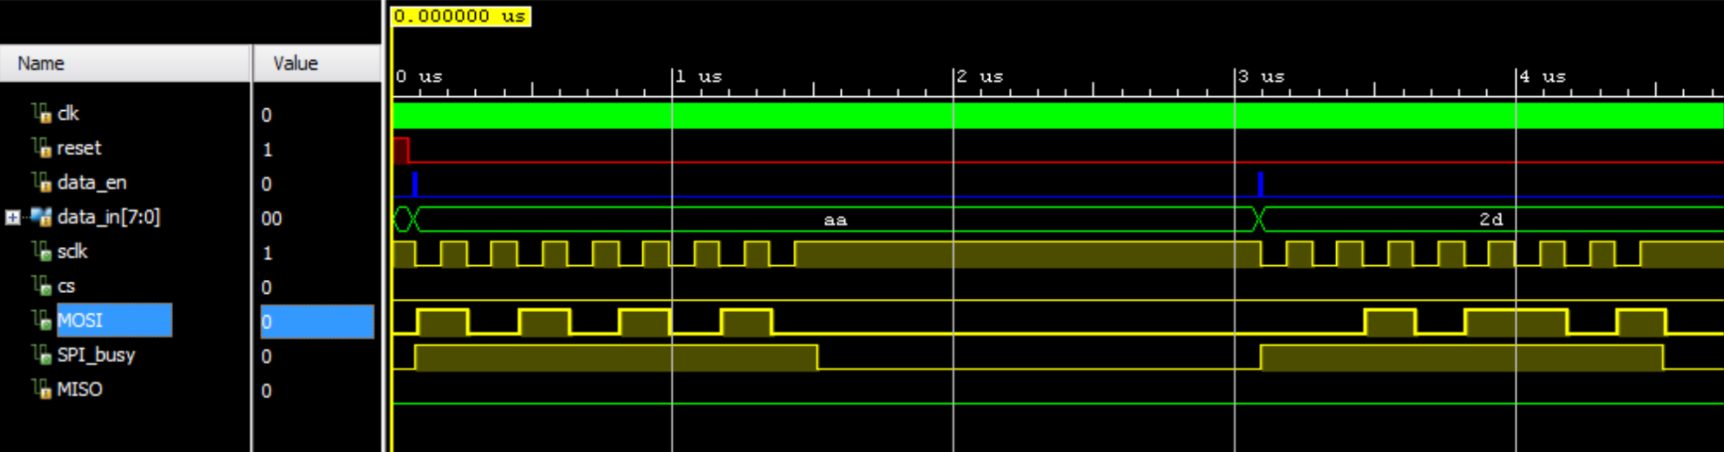
PR214 | Soutenance | E2
 | 5

Slide 6
PR214 | Soutenance | E2
 | 6

