Slide 1
uses Airflow to make healthcare work.
George Leslie-Waksman – Data Platform Engineering
January 11, 2017
Notes:
Title

Slide 2
is a health insurance company. We cover elderly and disabled individuals. Our focus is on preventative care.
Notes:
About Clover

Slide 3
is an Artisanal Data company, not a Big Data company.
Notes:
Bureaucratic Data != Big Data

Slide 4
has engineers has data scientists has actuaries has insurance ops people all contributing to our pipeline
Notes:
I took a quick look at the contributors to our pipeline repo and…

Slide 5




Everybody loves stack icons…
#!/bin/sh
Notes:
Before Airflow, and I’m sure we’re not alone here, things were held together with a mix of bubble gum, bailing wire, and shell scripts

Slide 6



Especially with pinwheels!
Notes:
Exit shell scripts, enter Airflow, and a few more cloud providers while we’re at it.

Slide 7
Pipelines are hard, let’s go declarative
The vast majority of non-engineer interactions with Airflow are through:
Declarative definitions
SQL + Dependencies
Airflow UI
Pipeline development flow
Custom code (high technical difficulty)
Iterate (moderate technical difficulty)
If not <understand problem>: goto 2
Abstract problem to declarative specification (high technical difficulty)
Make a new specification (low technical difficulty)
If not <solved healthcare>: goto 5
Managing pipeline complexity is the really hard part
Notes:
How is it that we have that breadth of contributors?
Well, not everybody writes pipelines from scratch.

Slide 8
Specification → Parse Tasks
def _single_spec_tasks(dag, spec, upstream, pg_schema_task):
classify_task = _classify_task(dag, spec)
classify_task.set_upstream(upstream)
classify_catalog_task = _catalog_task(
dag, CLASSIFIED_BUCKET, spec.name)
classify_catalog_task.set_upstream(classify_task)
parse_task = _parse_task(dag, spec)
parse_task.set_upstream(classify_task)
pg_load_task = _pg_load_task(dag, spec)
pg_load_task.set_upstream([pg_schema_task, parse_task])
parse_catalog_task = _catalog_task(
dag, PARSED_BUCKET, spec.name)
parse_catalog_task.set_upstream(parse_task)
finished_task = operators.DummyOperator(
task_id='finished_{}'.format(spec.name),
dag=dag)
finished_task.set_upstream([
classify_catalog_task, parse_catalog_task,
pg_load_task])
return finished_task
classify:
source_folders: ['SFTP2', 'SFTP_TMGUSER']
classifier:
regex:
source: '^EFTO\.RH5141\.HCCMODD.*\.D(?P<date>\d{6})\.T(?P<time>\d{6})\d.*$'
target: 'hccmodd_d\g<date>_t\g<time>.cbl'
parse:
filename_strptime_format: 'hccmodd_d%y%m%d_t%H%M%S.cbl'
parser:
copybook:
record_type: {start: 0, end: 1}
records:
- id: '1'
name: header
columns:
- record_type: {start: 0, end: 1, type: string}
- contract: {start: 1, end: 6, type: string}
- run_date: {start: 6, end: 14, type: date, format: '%Y%m%d'}
- payment_date: {start: 14, end: 20, type: date, format: '%Y%m'}
- id: '3'
name: trailer
columns:
- record_type: {start: 0, end: 1, type: string}
- contract: {start: 1, end: 6, type: string}
- record_count: {start: 6, end: 15, type: integer}
- id: 'A'
name: detail_record_a
columns:
- record_type: {start: 0, end: 1, type: string}
- health_insurance_claim_account_number: {start: 1, end: 13, type: string}
- beneficiary_last_name: {start: 13, end: 25, type: string}
- beneficiary_first_name: {start: 25, end: 32, type: string}
- beneficiary_initial: {start: 32, end: 33, type: string}
- date_of_birth: {start: 33, end: 41, type: date, format: '%Y%m%d'}
- sex: {start: 41, end: 42, type: enum, format: {'0': Unknown, '1': Male, '2': Female}}
- social_security_number: {start: 42, end: 51, type: string}
- age_group_female_00_34: {start: 51, end: 52, type: boolean, format: {true_values: ['1'], false_values: ['0']}}
- age_group_female_35_44: {start: 52, end: 53, type: boolean, format: {true_values: ['1'], false_values: ['0']}}
- age_group_female_45_54: {start: 53, end: 54, type: boolean, format: {true_values: ['1'], false_values: ['0']}}
- age_group_female_55_59: {start: 54, end: 55, type: boolean, format: {true_values: ['1'], false_values: ['0']}}
- age_group_female_60_64: {start: 55, end: 56, type: boolean, format: {true_values: ['1'], false_values: ['0']}}
- age_group_female_65_69: {start: 56, end: 57, type: boolean, format: {true_values: ['1'], false_values: ['0']}}
- age_group_female_70_74: {start: 57, end: 58, type: boolean, format: {true_values: ['1'], false_values: ['0']}}
- age_group_female_75_79: {start: 58, end: 59, type: boolean, format: {true_values: ['1'], false_values: ['0']}}
- age_group_female_80_84: {start: 59, end: 60, type: boolean, format: {true_values: ['1'], false_values: ['0']}}
- age_group_female_85_89: {start: 60, end: 61, type: boolean, format: {true_values: ['1'], false_values: ['0']}}
- age_group_female_90_94: {start: 61, end: 62, type: boolean, format: {true_values: ['1'], false_values: ['0']}}
- age_group_female_95_gt: {start: 62, end: 63, type: boolean, format: {true_values: ['1'], false_values: ['0']}}
- age_group_male_00_34: {start: 63, end: 64, type: boolean, format: {true_values: ['1'], false_values: ['0']}}
- age_group_male_35_44: {start: 64, end: 65, type: boolean, format: {true_values: ['1'], false_values: ['0']}}
- age_group_male_45_54: {start: 65, end: 66, type: boolean, format: {true_values: ['1'], false_values: ['0']}}
- age_group_male_55_59: {start: 66, end: 67, type: boolean, format: {true_values: ['1'], false_values: ['0']}}
- age_group_male_60_64: {start: 67, end: 68, type: boolean, format: {true_values: ['1'], false_values: ['0']}}
- age_group_male_65_69: {start: 68, end: 69, type: boolean, format: {true_values: ['1'], false_values: ['0']}}
- age_group_male_70_74: {start: 69, end: 70, type: boolean, format: {true_values: ['1'], false_values: ['0']}}
- age_group_male_75_79: {start: 70, end: 71, type: boolean, format: {true_values: ['1'], false_values: ['0']}}
- age_group_male_80_84: {start: 71, end: 72, type: boolean, format: {true_values: ['1'], false_values: ['0']}}
- age_group_male_85_89: {start: 72, end: 73, type: boolean, format: {true_values: ['1'], false_values: ['0']}}
- age_group_male_90_94: {start: 73, end: 74, type: boolean, format: {true_values: ['1'], false_values: ['0']}}
- age_group_male_95_gt: {start: 74, end: 75, type: boolean, format: {true_values: ['1'], false_values: ['0']}}
Notes:
Most people write declarative parser specifications.

Slide 9
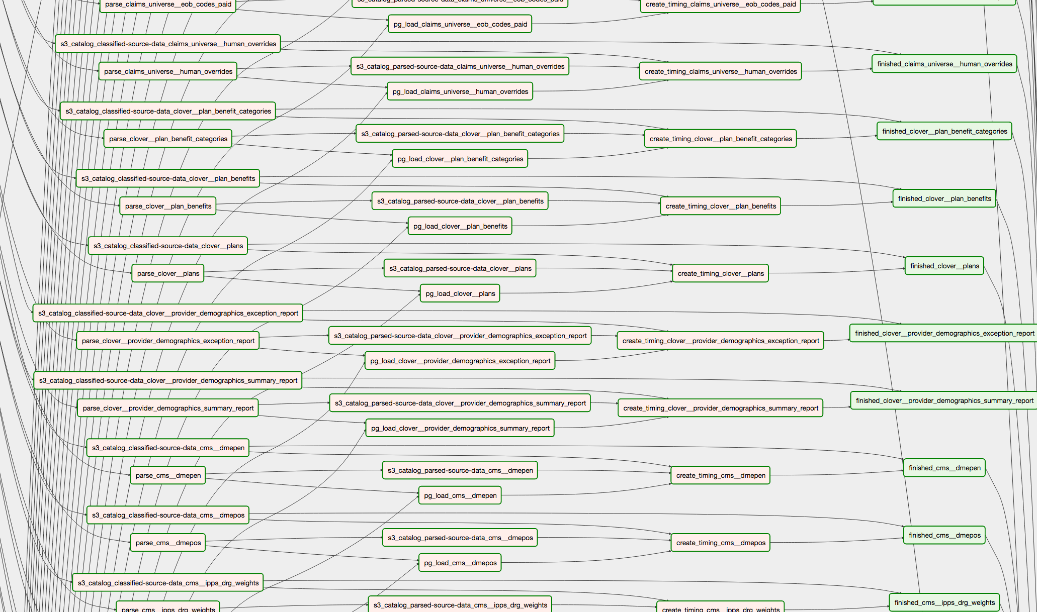

Parse all the things!
Notes:
Right now we parse > 200 distinct file types in about a dozen different file formats and counting (including copybook, EDI, csv, excel, etc.)
Our rate of file type and file format growth has increased substantially since introducing specifications.
And this is just parsers; we do similar things for file writers, data transport,

Slide 10
Not just parsing…
for campaign_spec in SPECIFICATIONS:
campaign = campaign_object.Campaign(campaign_spec)
campaign_eligibility_task = python_operator.PythonOperator(
task_id='campaign_eligibility_' + campaign_spec.name,
python_callable=process_campaigns.process,
op_kwargs={...},
pool=APP_DB_TASK_POOL,
dag=DAG)
campaign_eligibility_task.set_upstream(NOTIFIER_TASK)
sheet_reader_task = python_operator.PythonOperator(
task_id='sheet_reader_' + campaign_spec.name,
python_callable=reconcile_states.mark_spreadsheet_states,
op_kwargs={...},
pool=APP_DB_TASK_POOL,
dag=DAG)
sheet_reader_task.set_upstream(campaign_eligibility_task)
sheet_writer_task = python_operator.PythonOperator(
task_id='sheet_writer_' + campaign_spec.name,
python_callable=sheet_writer.process_campaign,
op_kwargs={...},
pool=APP_DB_TASK_POOL,
dag=DAG)
sheet_writer_task.set_upstream(sheet_reader_task)
sheet_writer_task.set_downstream(DAG_FINISHED_TASK)
name: [REDACTED] Screening
uuid: [REDACTED]
splits:
- name: Holdout
description: Members that should not show up in the list
allocation: 2
control: true
- name: Active
description: Members that we're trying to call
allocation: 8
spreadsheet:
id: [REDACTED]
write_to: Member Info
read_from: State
timeline:
start: [REDACTED]
ops_end: [REDACTED]
data_end: [REDACTED]
queries:
eligibility:
file: eligibility.sql
success:
file: success.sql
reference:
file: reference.sql
Notes:
We also manage member outreach campaigns via similar yaml specifications

Slide 11
From simple pieces…
def sql_task_builder(dag, task_spec, conn_id=None):
conn_id = task_spec.get('db_id', conn_id)
if not conn_id:
raise ValueError('valid connection ID is required for SQL tasks')
if task_spec.get('timeout_seconds'):
task_timeout = datetime.timedelta(
seconds=task_spec.get('timeout_seconds'))
else:
task_timeout = datetime.timedelta(hours=6)
return af_op.InstrumentedPostgresOperator(
task_id=path_to_task_id(task_spec['task_id']),
postgres_conn_id=conn_id,
sql=task_spec['file_to_run'],
execution_timeout=task_timeout,
dag=dag)
depends_on:
- trg_analytics/call_logs/fact_call_logs_all.sql
- stg_analytics/hospital_events/stg_rehab_admissions.sql
- stg_analytics/home_visits/stg_awv_home_visits.sql
- stg_analytics/home_visits/stg_clover_home_visits.sql
- stg_analytics/medical_claims/medical_claims_office_visits.sql
- stg_analytics/hospital_events/stg_hospital_sessions.sql
- stg_analytics/clover/clover_staff.sql
- stg_analytics/home_visits/stg_qraps_visits.sql
file_to_run: trg_analytics/events/fact_contact_events.sql
task_id: trg_analytics/events/fact_contact_events.sql
task_type: sql
def setup_tasks_dependencies(dag, task_specs):
for spec in task_specs:
task = dag.get_task(path_to_task_id(spec['task_id']))
upstream_task_ids = spec.get('depends_on', [])
for upstream_task_id in upstream_task_ids:
dag.get_task(path_to_task_id(upstream_task_id)).set_downstream(task)
Notes:
Some people write rules for executing transforms.

Slide 12
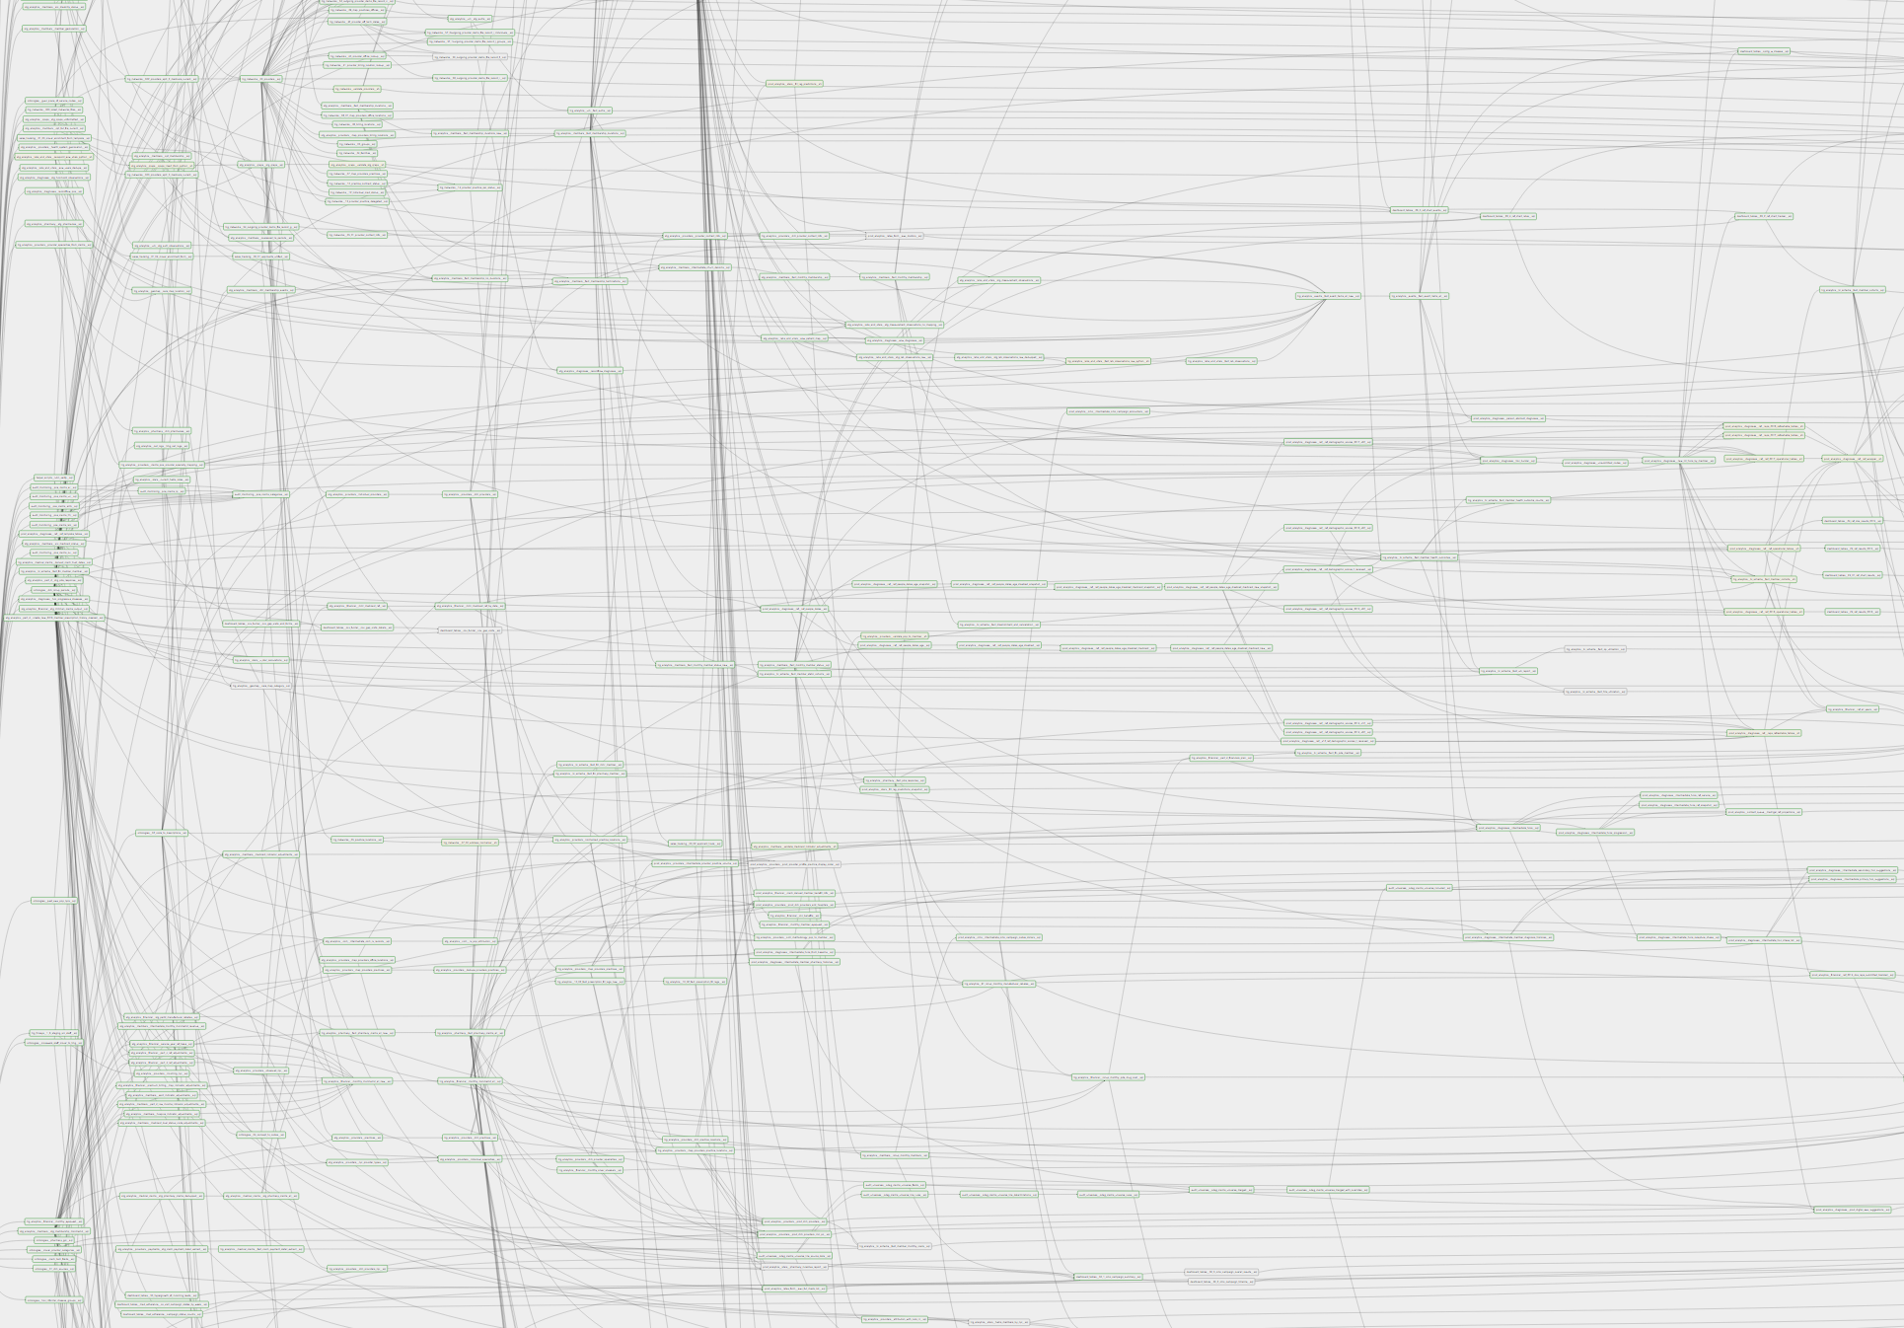

…we build complex systems
Notes:
What does the ATL look like?
Analytics + ETL + portmanteau = ATL

Slide 13
Logical Code Diagram
Integrity Tests
Airflow
Library Code
Task Generators
Integration tests
Unit Tests
YAML specifications
SQL Transforms
Notes:
Testing and manual development independent of airflow

Slide 14
And now, more bullet points…
YAML is very human-readable and DSLs are easy to teach
Copy + Paste + Edit + Push + wait for CI is a quickly adopted workflow
Declarative structures can be used for multiple purposes
We have unit tests and integration test structures in parallel to Airflow
Schema validation is like free unit tests
PyKwalify is powerful and easy to use
PyYAML’s native Python implementation is very slow
yaml.CSafeLoader is pretty quick
More contributors ⇒ stricter testing requirements
More contributors ⇒ faster iteration
Notes:
No, really, yaml.SafeLoader is REALLY slow
Common specifications mean that we can develop a common understanding of what a “unit” is for testing in a given context.

Slide 15
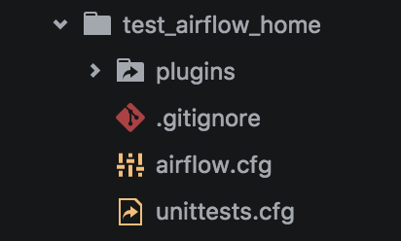
On the topic of testing…
conftest.py
pytest is a magical library that can make your test environment look like a production airflow environment
TEST_AIRFLOW_HOME = os.path.join(
os.path.dirname(__file__),
'tests', 'test_airflow_home')
TEST_ENV_VARS = {
'AIRFLOW_HOME': TEST_AIRFLOW_HOME,
'AIRFLOW_CONN_S3_DEFAULT': 'n/a',
}
def pytest_configure(config):
"""Configure and init envvars for airflow."""
config.old_env = {}
for key, value in TEST_ENV_VARS.items():
config.old_env[key] = os.getenv(key)
os.environ[key] = value
def pytest_unconfigure(config):
"""Restore envvars to old values."""
for key, value in config.old_env.items():
if value is None:
del os.environ[key]
else:
os.environ[key] = value
Notes:
Micro airflow env for integrity testing

Slide 16
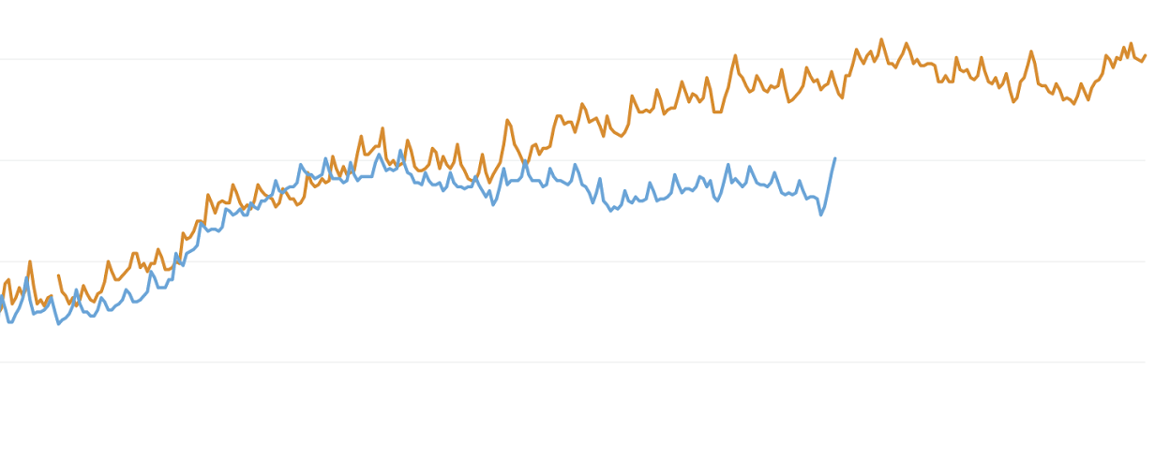
And now, a punchline.

Slide 17
Thanks
Clover Engineering and Data Science
The Airflow community
pytest
YAML
PyKwalify
SQLAlchemy
testing.postgresql
Notes:
Thanks

