Slide 1

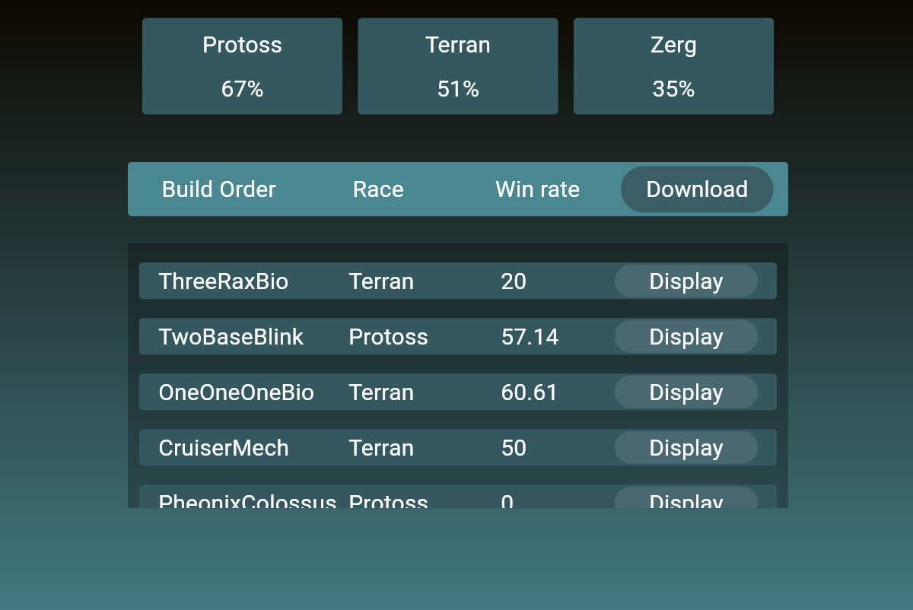
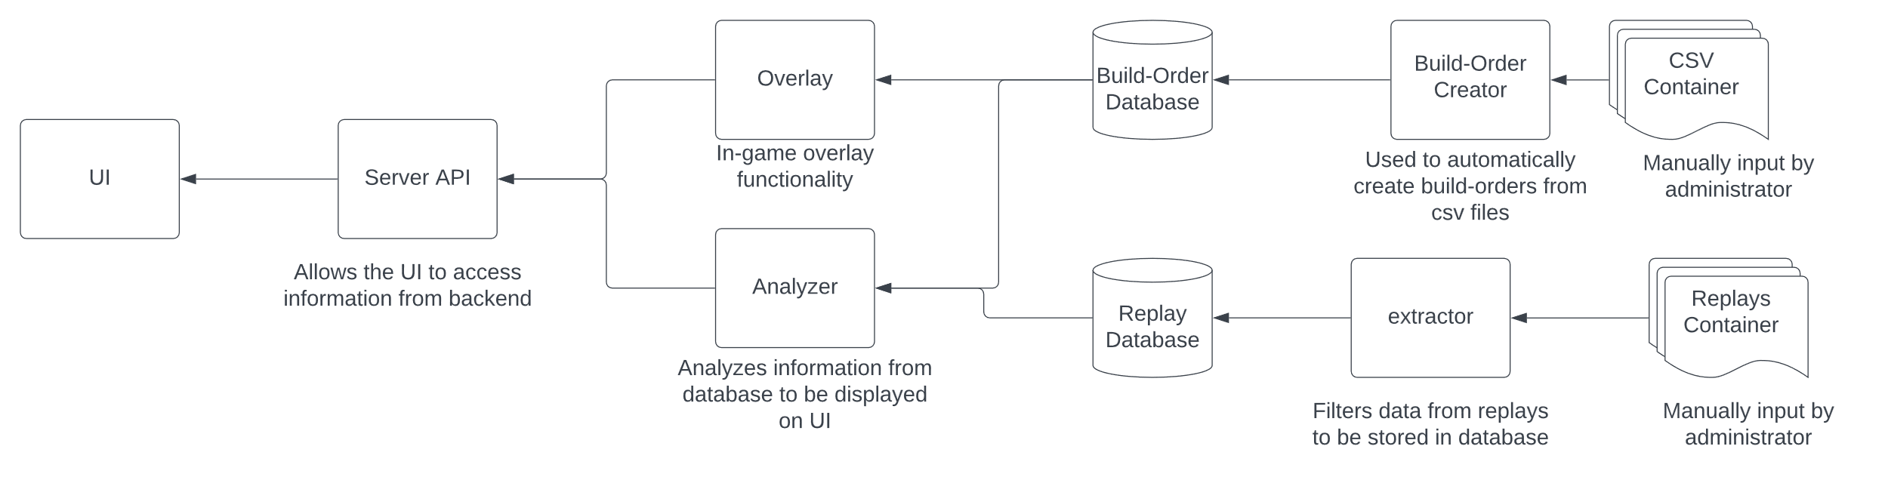
Seamless Parking Solution for UVU
Cody Strange, Jayden Albrecht, Hoyoung Kim
Computer Science Department, Utah Valley University
Faculty Advisor: Dr. Sayeed Sajal
Introduction
High Cohesion
Next Iterations
The competitive esports landscape demands advanced analytics, yet RTS classics like StarCraft II (SC2) lack robust tools found in other games. Our project introduces a dedicated platform for current and upcoming RTS titles. Offering detailed build order displays, replay analysis, and features designed to sharpen player knowledge and in-game prowess.
Our code is structured around the principle of high cohesion, ensuring that all elements within a module are closely related and serve a singular purpose. This principle organizes everything from methods to directories according to their specific functionality. When code doesn't align functionally, we either reassign it to a more appropriate section or create a new, function-specific module.
Login/Account System: User-specific data and analytics will be securely stored and accessible, paving the way for tracking progress over time.
Post-Game Battle Reports: Upon completion of a match, players will receive comprehensive reports detailing key performance metrics and tactical insights.
Matchup-Specific Win Rates: We will implement an advanced analysis feature to calculate win rates filtered by specific matchups, giving players strategic data to refine their tactics against particular opponents.
Features
Win rate analysis; Analyze replays and calculate win rates based on factors such as race and build orders. This lets users know most prominent and successful strategies.
Build order overlay; Select and overlay build orders directly onto user’s live game, easing the challenge of memorizing sequences and enabling seamless multitasking.
Loosely Coupled
Our architecture embraces loose coupling, allowing individual modules to operate independently. Alterations in one module remain contained, safeguarding the integrity of others. This modular approach extends down to individual methods, guaranteeing that changes are localized and do not propagate unnecessary dependencies.
App Design
Saini, M. (2019, December 3). Parking space detection using deep learning. Medium. Retrieved March 28, 2022, from https://medium.com/the-research-nest/parking-space-detection-using-deep-learning-9fc99a63875e
SOLID Principles
Data Flow Diagram
Shows the different modules that makes up our application and how data flows from one module to another
Our RTSanalytics project is built on the SOLID principles: Single Responsibility, Open-Closed, Liskov Substitution, Interface Segregation, and Dependency Inversion, ensuring our code is robust and scalable.
Liskov Substitution and Dependency Inversion are central to our project. By following LSP, our components are easily swappable, simplifying updates and maintenance. DIP lets RTSanalytics smoothly transition to support new RTS titles, pushing past initial design limits to stay competitive.
Our application is available as both a web-based platform and a downloadable executable. Users can visit our website to install the desktop version, which offers additional functionalities, including an overlay feature for displaying build orders in-game.

