Slide 1
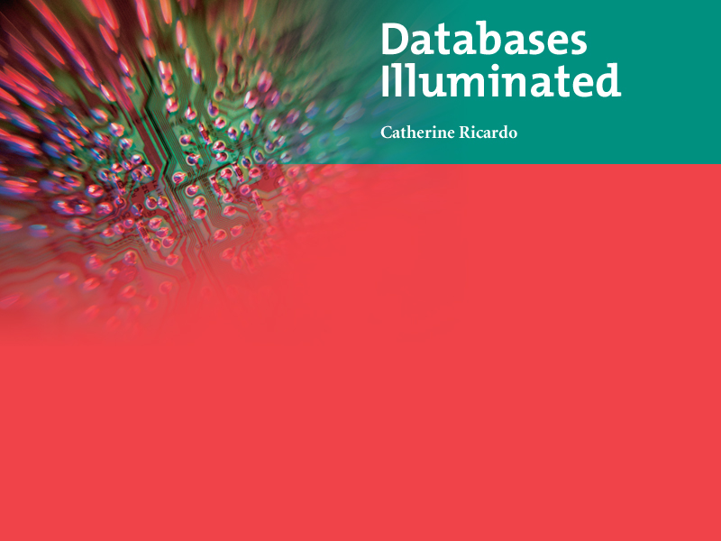
Databases Illuminated
Chapter One
Introductory Database Concepts

Slide 2
Basic Definitions
Database: A collection of related data.
Database: A collection of interrelated files with minimum redundancy.
Data: Known facts that can be recorded and have an implicit meaning.
Mini-world: Some part of the real world about which data is stored in a database. For example, student grades and transcripts at a university.

Slide 3
Uses of Databases
Used in large and small organizations. Examples
  Consumer websites—ordering products
  Customer service websites – e.g. utility, health insurance, telephone service providers
  Mortgage companies
  Online banking
  Credit card companies
  Supermarkets and retail stores, including inventory control systems
  Airline reservations
  Medical records and billing
  Employment records
  School records
  Bibliographic databases
  Library Records
  Police department
  DMV
  Stock market
  And more

Slide 4
A Sample Database
Simple University database
Need to keep information about
  Students
  Classes
  Professors
  Enrollment-links students to their classes
Example uses Microsoft Access (Relational)
Data represented as tables
Each row of Student table represents one student
Each row of Class table represents one class
Each row of Enroll represents relationship between one student and one class
See Figure 1.1

Slide 5
Query Tool
Microsoft Access has a simple tool for forming and executing queries
Query: Find the names of all students enrolled in ART103A
Need to use Enroll table and Student table, since Enroll does not have names
See Figure 1.1
Figure 1.2 shows query result

Slide 6
Reporting Tool
Microsoft Access has a report generator
Example: Print a report showing each class number, the ID and name of the faculty member teaching the class, and the IDs and names of all the students in that class
Figure 1.3 shows the report

Slide 7
The Integrated Database Environment Includes
Database
  Large repository of data
  Shared resource, used by many departments and applications
  Contains several different record types
  “knows” about relationships in data
  Managed by database administrator - DBA
DBMS, Database Management System
  Controls access to database
  Has facilities to
    Set up database structure
    Load the data
    Retrieve requested data and format it for users
    Hide sensitive data
    Accept and perform updates
    Handle concurrency
    Perform backup and recovery … and many other functions…
Users
Applications

Slide 8
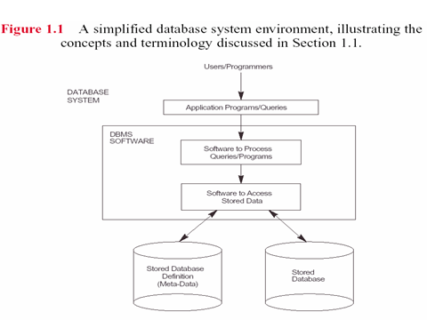

Slide 9
Example of Integrated Database Environment
  University database
  DBMS - may be Access, Oracle, DB2,…
  Users may be individuals on workstations (interactive users) or application programs
  Both users and applications go through DBMS
  Applications produce standard output, such as reports
See Figure 1.4

Slide 10
People in Integrated Database Environment
End users
  Casual users use query language
  Naïve users use programs
  Secondary users use database output
Applications programmers – write programs for other users
Database administrator (DBA) – designs, creates, maintains the database
See Figure 1.5

Slide 11
Advantages of Integrated Databases
Compared with file systems, database can provide
  Sharing of data
  Control of redundancy
  Data consistency
  Improved data standards
  Better data security
  Improved data integrity
  Balancing of conflicting requirements
  Faster development of new applications
  Better data accessibility
  Economy of scale, sharing facility justifies better equipment
  More control of concurrency
  Better backup and recovery procedures

Slide 12
Disadvantages of Databases
Compared with file systems, databases have some disadvantages
  High cost of DBMS
  Higher hardware costs
  Higher programming costs
  High conversion costs
  Slower processing of some applications
  Increased vulnerability, security and delay risk
  More difficult recovery

Slide 13
Brief History of Information Systems -1
Early human records-clay tablets, hieroglyphics, cave paintings, paper records of family histories, treaties, inventories, and so on
Hollerith used punched cards in 1890 US census
Punched paper tape introduced in 1940s
Magnetic tape introduced about 1950-used in UNIVAC I
Cards, paper tape, magnetic tape are sequential access devices
Used in sequential processing applications such as payroll, shown in Figure 1.6
Batch processing uses master file and transaction file as input; produces new master file as output

Slide 14
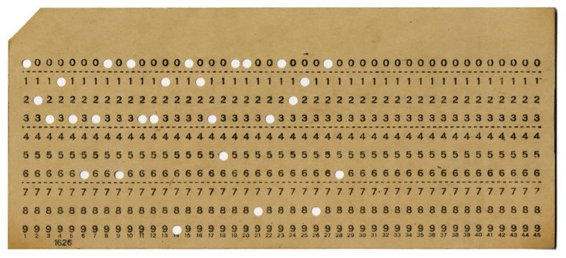
Punched Card

Slide 15
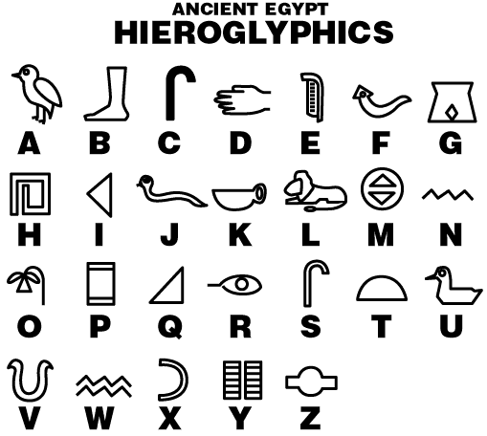
Example of hieroglyphics

Slide 16
Brief History of Information Systems - 2
Magnetic disk introduced in 1950s - direct access device
Programming languages COBOL and PL/1 developed in 1960s
Early database models developed
Hierarchical model
  IBM IMS developed for Apollo moon landing project
  IMS product released in 1968
  Most popular pre-relational DBMS
  SABRE airline reservation system used IMS
Network model
  GE IDS (Integrated Data Store) one of the oldest DBMS, developed by Charles Bachman in early 1960s
  CODASYL DBTG proposed standards published in 1971
  ANSI rejected proposal
  New standards published in 1973, 1978, 1981 and 1984
  Provided standard terminology, notion of layered database architecture

Slide 17
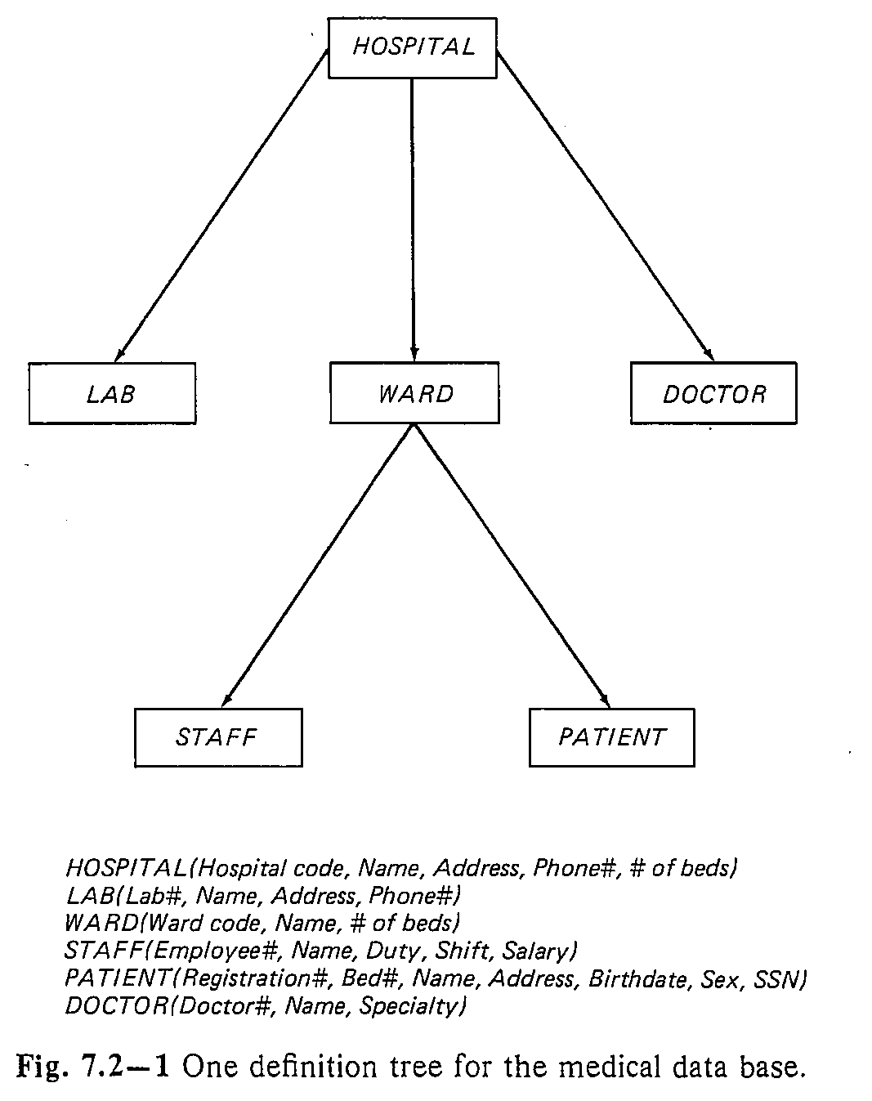
Hierarchical Model

Slide 18
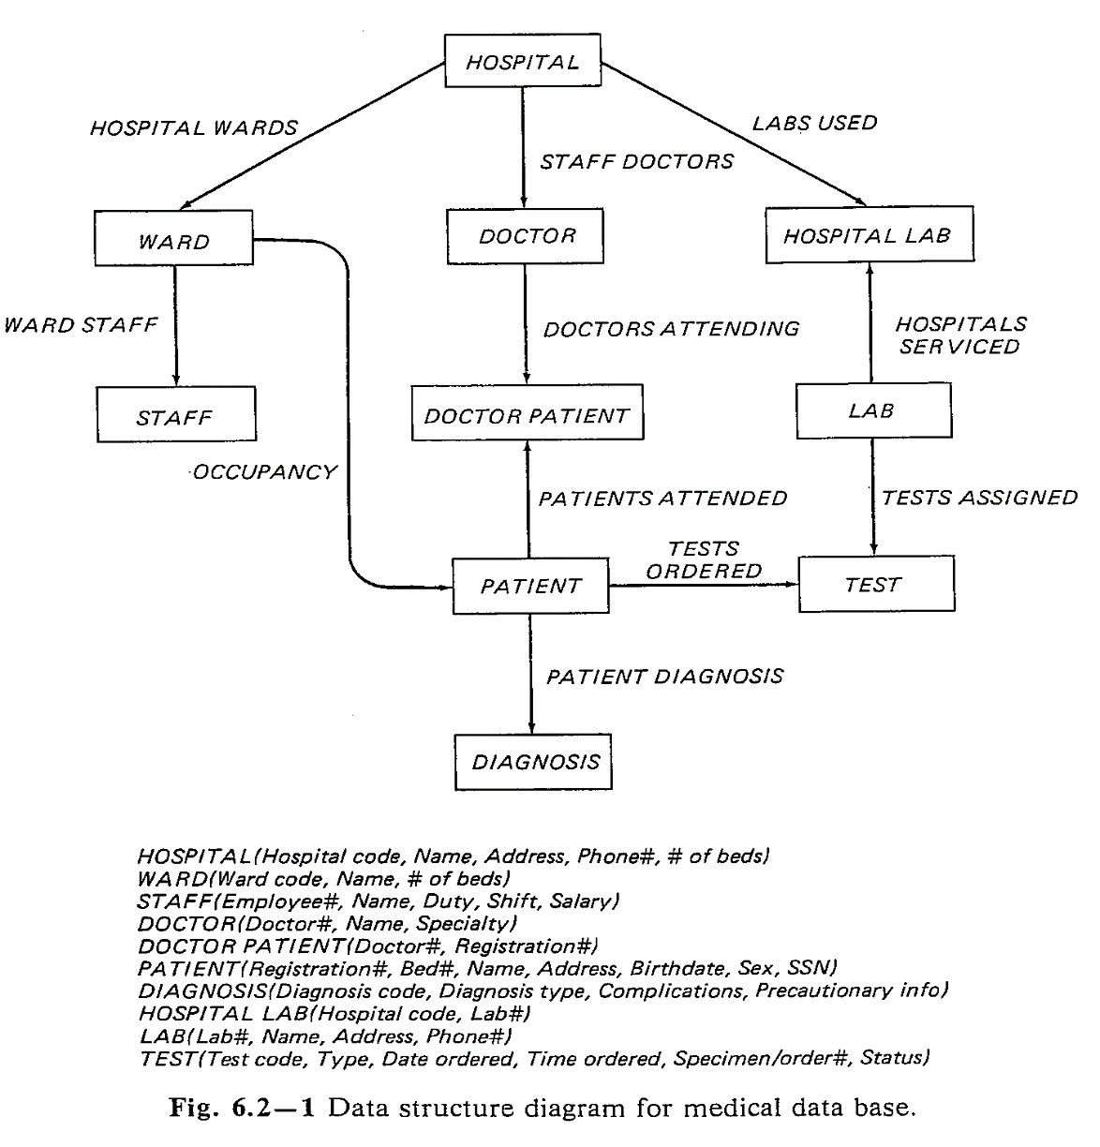
Network Model

Slide 19
Brief History of Information Systems-3
Relational model
  Proposed by E.F. Codd in 1970 paper, "A Relational Model of Data for Large Shared Data Banks"
  Strong theoretical foundation
  System R, late 1970s
    IBM’s prototype relational system
    Introduced SQL, Structured Query Language, now Standard Query Language
  Peterlee Relational Test Vehicle at IBM UK Scientific Laboratory
  INGRES at University of California, Berkeley
  ORACLE used some System R results
  Early microcomputer relational DBMSs :dBase, R:Base, Foxpro, Paradox R:BASE (or RBASE) was the first relational database program for the PC. Created by Wayne Erickson in 1982, the original R:Base was called MicroRIM. ...
  Microsoft Access most popular microcomputer-based DBMS
  Oracle, DB2, Informix, Sybase, and Microsoft’s SQL Server most popular enterprise DBMSs

Slide 20
Brief History of Information Systems-4
Entity Relationship model
  P.P. Chen, 1976
  It is a semantic model – tries to capture meaning of data
Object-oriented model
  Can handle complex data
  Introduced in 1990s
Object-relational model: object-oriented capabilities added to relational databases
Data warehouses developed in 1990s
  Take data from many sources
  May store historical data
  Used for data mining, finding trends in data
Internet provides access to vast network of databases
  E-commerce
  Wireless computing
  Thin clients such as PDAs

Slide 21


Slide 22
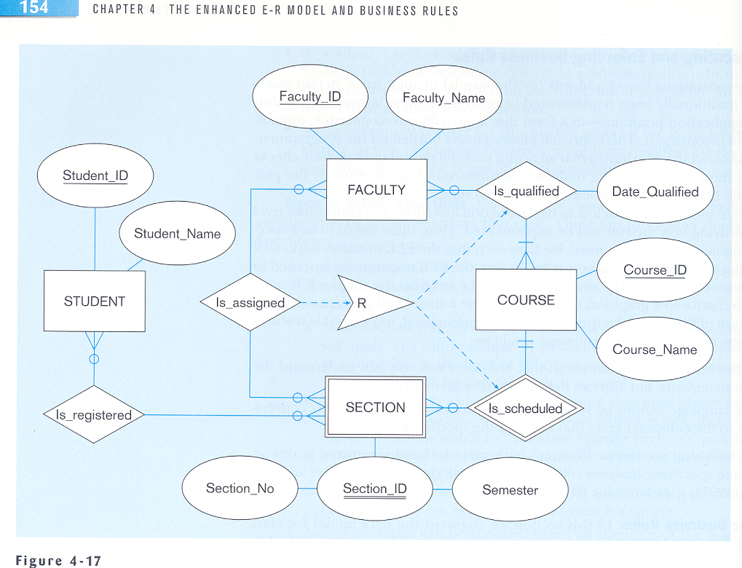
Entity Relationship Model

Slide 23
HW # 1
      Do lab Exercise 1.1 on page 25. This is just an exercise. Do not turn in any thing for this exercise.
      Do lab exercise 1.2 on page 28. For this exercise print all tables that you create, all queries that you write, the result of all queries and all reports that you may generate. Turn in the hard copy of every thing that you print during this exercise (1.2 only).

