Slide 1

Databases Illuminated
Chapter 4
The Relational Model

Slide 2
History of Relational Model
1970 Paper by E.F. Codd
“A Relational Model of Data for Large Shared Data Banks” proposed relational model
System R, prototype developed at IBM Research Lab at San Jose, California – late 1970s
System R results used in developing DB2 from IBM and also Oracle
Peterlee Test Vehicle, IBM UK Scientific Lab
INGRES, University of California at Berkeley

Slide 3
History (contnued)
Early microcomputer based DBMSs were relational - dBase, Rbase, Paradox
Microsoft’s Access, now most popular microcomputer-based DBMS, is relational
Oracle, DB2, Informix, Sybase, Microsoft’s SQL Server, MySQL - most popular enterprise DBMSs, all relational

Slide 4
Advantages of Relational Model
Based on mathematical notion of relation
Can use power of mathematical abstraction
Can develop body of results using theorem and proof method of mathematics – results then apply to many different applications
Can use expressive, exact mathematical notation
Theory provides tools for improving design
Basic structure is simple, easy to understand
Separates logical from physical level
Data operations easy to express, using a few powerful commands
Operations do not require user to know storage structures used

Slide 5
Data Structures
Relations are represented physically as tables
Tables are related to one another
Table holds information about objects
Rows (tuples) correspond to individual records
Columns correspond to attributes
A column contains values from one domain
Domains consist of atomic values

Slide 6
Properties of Tables
Each cell contains at most one value
Each column has a distinct name, the name of the attribute it represents
Values in a column all come from the same domain
Each tuple is distinct – no duplicate tuples
Order of tuples is immaterial

Slide 7
Example of Relational Model
See Figure 4.1
Student table tells facts about students
Faculty table shows facts about faculty
Class table shows facts about classes, including what each faculty member teaches
Enroll table relates students to classes

Slide 8
Mathematical Relations
For two sets D₁ and D_{2,} the Cartesian Product,
D₁ X D₂ , is the set of all ordered pairs in which the first element is from D₁ and the second is from D₂
A relation is any subset of the Cartesian Product
Could form Cartesian product of 3 sets; relation is any subset of the ordered triples so formed
Could extend to n sets, using n-tuples

Slide 9
Database Relations
A relation schema R, is a set of attributes A₁, A₂,…,A_{n} with their domains D₁, D₂,…D_{n}
A relation r on relation schema R is a set of mappings from the attributes to their domains
Relarion r is a set of n-tuples (A₁:d₁, A₂:d₂, …, A_{n}:d_{n}) such that d₁ε D₁, d₂ εD₂ , …, d_{n} εD_{n}
In a table to represent the relation, list the A_{i}s as column headings, and let the (d₁, d₂, …d_{n}) become the n-tuples, the rows of the table

Slide 10
Properties of Relations
Degree: the number of attributes
  2 attributes - binary; 3 attributes - ternary; n attributes - n-ary
  A property of the intension – does not change
Cardinality: the number of tuples
  Changes as tuples are added or deleted
  Property of the extension – changes often

Slide 11
Relation Keys
Relations never have duplicate tuples, so you can always tell tuples apart; implies there is always a key (which may be a composite of all attributes, in worst case)
Superkey: set of attributes that uniquely identifies tuples
Candidate key: superkey such that no proper subset of it is also a superkey (i.e. it has no unnecessary attributes)
Primary key: candidate key chosen for unique identification of tuples
Cannot verify a key by looking at an instance; need to consider semantic information to ensure uniqueness
A foreign key is an attribute or combination of attributes that is the primary key of some relation (called its home relation)

Slide 12
Integrity Constraints
Integrity: correctness and internal consistency of data
Integrity constraints: are rules or restrictions that apply to all instances of the database
Enforcing integrity constraints ensures that only legal states of the database are created

Slide 13
Types of constraints
  Domain: limits set of values for attribute
  Entity integrity: no attribute of a primary key can have a null value
  Referential integrity: each foreign key value must match the primary key value of some tuple in its home relation or be completely null.
  General constraints or business rules:
  statements indicating certain predicate must be true
  may be expressed as table constraints or SQL assertions (Will be discussed later)

Slide 14
Representing Relational Database Schemas
Can have any number of relation schemas
For each relation schema list name of relation followed by list of attributes in parentheses
Underline primary key in each relation schema
Indicate foreign keys (We use italics – arrows are best)
Database schema actually includes domains, views, character sets, constraints, stored procedures, authorizations, etc.
Example: University database schema
    Student (stuId, lastName, firstName, major, credits)
    Class (classNumber, facId, schedule, room)
    Faculty (facId, name, department, rank)
    Enroll(stuId,classNumber,grade)

Slide 15
Types of Relational Data Manipulation Languages
Procedural: proscriptive - user tells system how to get data - e.g. relational algebra
Non-procedural: declarative - user tells what data is needed, not how to get it - e.g. relational calculus, SQL
Other types:
  Graphical: user provides illustration of data needed e.g. Query By Example(QBE)
  Fourth-generation: 4GL uses user-friendly environment to generate custom applications (often menu driven)
  Natural language: 5GL accepts restricted version of English or other natural language

Slide 16
Relational Algebra
Theoretical language with operators that apply to one or two relations to produce another relation
Both operands and results are tables
Can assign name to resulting table (rename)
SELECT, PROJECT, JOIN allow many data retrieval operations

Slide 17
The Relational Algebra Continued
Contains operations to manipulate relations.
Used to specify retrieval requests (queries).
Query result is in the form of a relation.
Relational Operations:
SELECT σ
PROJECT π
UNION U
INTERSECTION ∩
DIFFERENCE -
CARTESIAN PRODUCT X.
JOIN | |
Other relational operations:
DIVISION
OUTER JOIN
AGGREGATE FUNCTIONS.

Slide 18
SELECT σ and PROJECT π
SELECT operation (denoted by σ ):
- Selects the tuples (rows) from a relation R that satisfy certain selection condition c.
- Form of the operation: σ_{c}(R)
- The condition c is an arbitrary Boolean Expression on the attributes of R.
- Resulting relation has the same attributes as R.
- Resulting relation includes each tuple in r(R) whose attribute values satisfy the condition c.
Examples:
σ_{DNO=4}(EMPLOYEE)
σ_{SALARY>30000}(EMPLOYEE)
σ(DNO=4 AND SALARY>25000) OR DNO=5 (EMPLOYEE)

Slide 19
SELECT Operation σ
Applied to a single table, returns rows that meet a specified predicate, copying them to new table
Returns a horizontal subset of original table
SELECT tableName WHERE condition [GIVING newTableName]
Symbolically, [newTableName = ] σ _{predicate} (table-name)
Predicate is called theta-condition, as in σ_{θ}(table-name)
The resulting table is horizontal subset of its operand
Predicate can have operators <, <=, >, >=, =, <>, ∧(AND), ∨(OR), ¬ (NOT)

Slide 20
PROJECT operation (denoted by π ):
- Keeps only certain attributes (columns) from a relation R specified in an attribute list <L>.
- Form of operation: π_{<L>} (R)
- Resulting relation has only those attributes of R specified in L from every tuple of R.

Slide 21
PROJECT Operator
Operates on single table
Returns unique values in a column or combination of columns
PROJECT tableName OVER (colName,...,colName) [GIVING newTableName]
Symbolically
[newTableName =] Π _{colName,...,colName} (tableName)
Can compose SELECT and PROJECT, using result of first as argument for second

Slide 22
Projection (continued)
Example: π_{<FNAME,LNAME,SALARY>}(EMPLOYEE)
- The PROJECT operation eliminates duplicate tuples in the resulting relation so that it remains a mathematical set (no duplicate elements)
Example: π_{<SEX,SALARY>} (EMPLOYEE)
If several male employees have salary 30000, only a single tuple <M, 30000> is kept in the resulting relation.
Duplicate tuples are eliminated by the π operation.

Slide 23
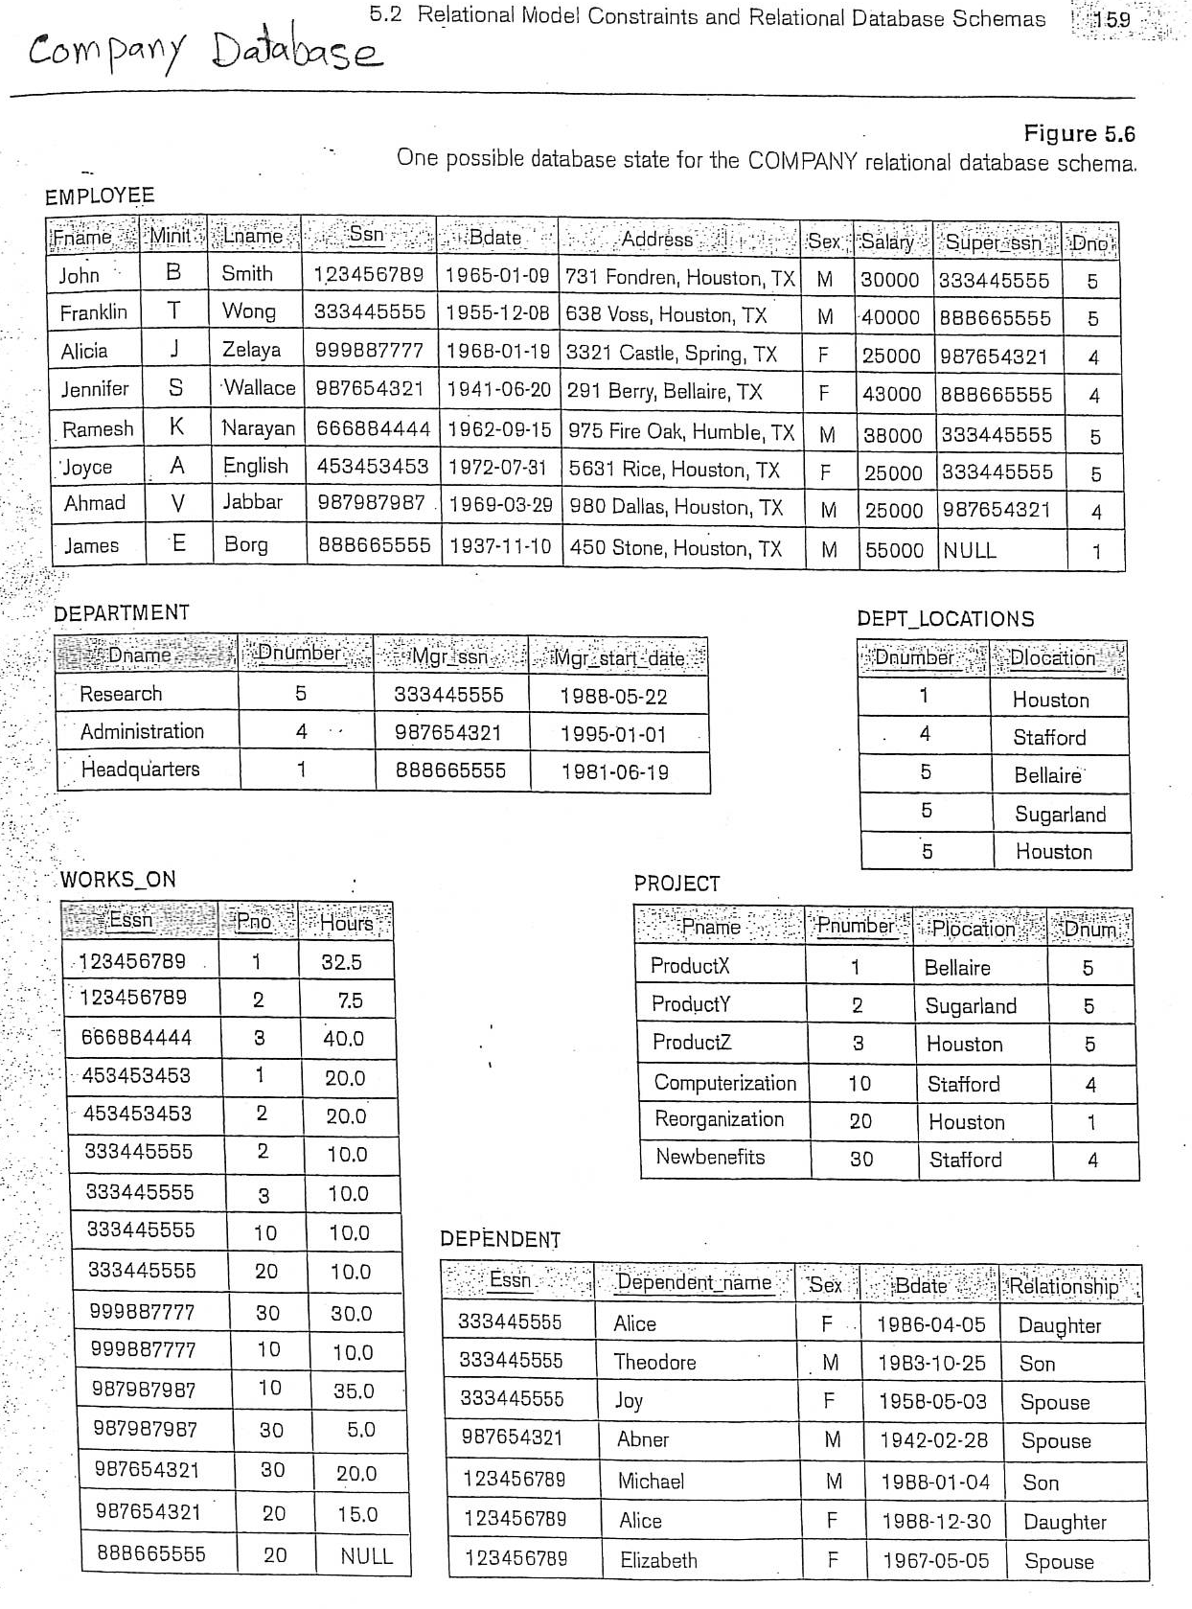

Slide 24
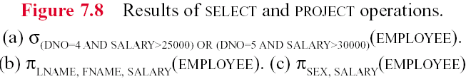
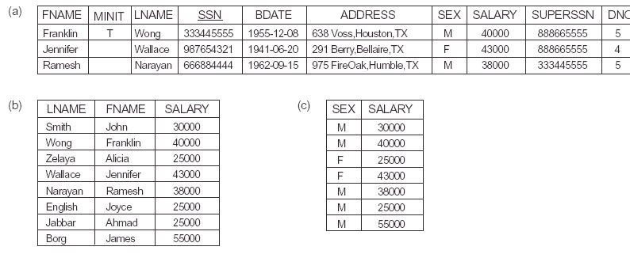
Figure 6.1

Slide 25
Sequence of operations
Several operations can be combined to form a relational algebra expression (query)
Example: Retrieve the names and salaries of employees who work in department 4:
π_{<FNAME,LNAME,SALARY>}(σ_{DNO=4}(EMPLOYEE) )
- Alternatively, we specify explicit intermediate relations for each step:
DEPT4_EMPS ← σ_{DNO=4}(EMPLOYEE)
R ← π_{<FNAME,LNAME,SALARY>}(DEPT4_EMPS)

Slide 26

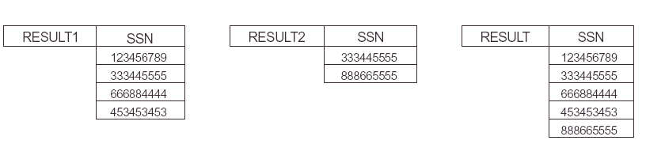
Figure 6.3

Slide 27
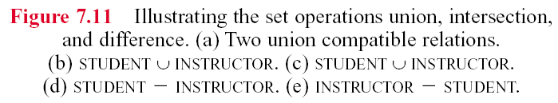
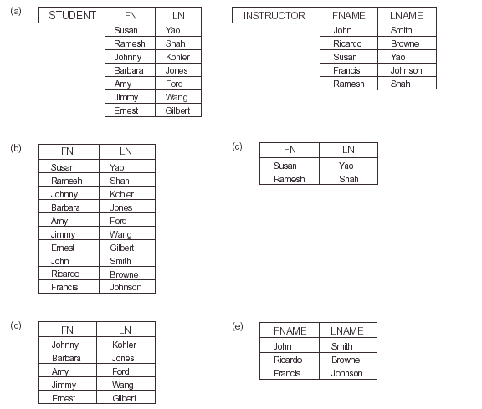
Figure 6.4
∩

Slide 28
Cartesian Product
For the relations:
R₁(A₁, A₂, ..., A_{m}) and R₂(B₁, B₂, ..., B_{n})
the Cartesian Product of R₁ and R₂ is:
R(A₁, A₂, ..., A_{m}, B₁, B₂, ..., B_{n})←
R₁(A₁, A₂, ..., A_{m} ) X R₂(B₁, B₂, ..., B_{n})
A tuple t exists in R for each combination of tuples t₁ from R₁ and tuples t₂ from R₂ such that:
t = [A₁, A₂, ..., A_{m}, B₁, B₂, ..., B_{n}]
t[A₁, A₂, ..., A_{m} ]=t₁ and t[B₁, B₂, ..., B_{n}]=t₂
If R₁ has n₁ tuples and R₂ has n₂ tuples, then R will have n₁*n₂ tuples.

Slide 29
Cartesian Product (Continued)
CARTESIAN PRODUCT is a meaningless operation on its own but, It can combine related tuples from two relations if followed by the appropriate SELECT operation .
Example:
We can combine each DEPARTMENT tuple with the EMPLOYEE tuple of the manager buy the following two operations:
DEP_EMP ← DEPARTMENT X EMPLOYEE
DEPT_MANAGER ← σ _{MGRSSN=SSN}(DEP_EMP)

Slide 30
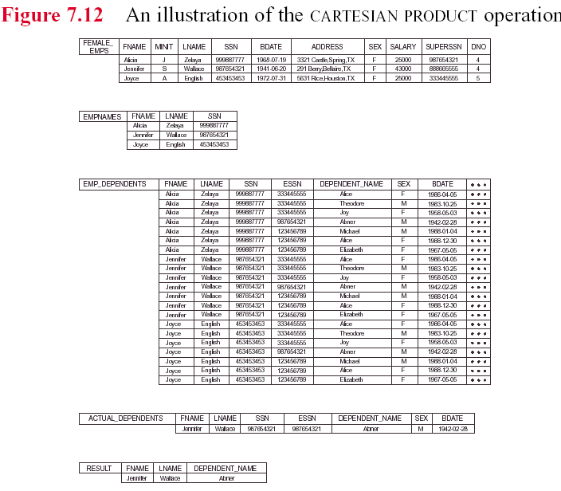
Figure 6.5
This is: cartesian product of empnames and dependents

Slide 31
Renaming attributes
Attributes can optionally be renamed in the resulting left-hand-side relation (this may be required for some operations that will be presented later):
DEPT4_EMPS ← σ_{DNO=4}(EMPLOYEE)
R(FIRSTNAME,LASTNAME,SALARY) ← π_{<FNAME,LNAME,SALARY>}(DEPT4_EMPS)

Slide 32

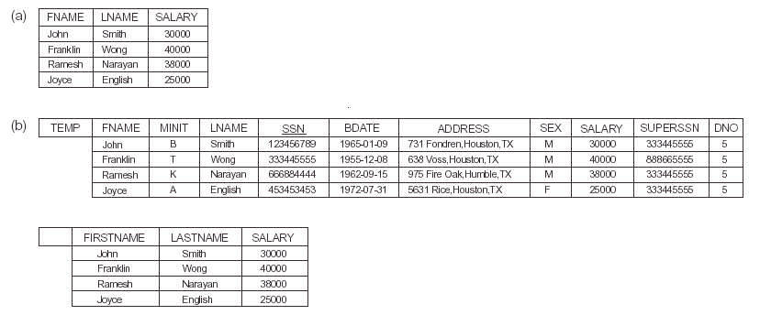
R

Slide 33
Product and Theta-join
Binary operations – apply to two tables
Product: Cartesian product – cross-product of A and B – A TIMES B, written as A x B
  all combinations of rows of A with rows of B
  Degree of result is deg of A + deg of B
  Cardinality of result is (card of A) * (card of B)
THETA join of A and B is: A X B followed by SELECT using θ
A | |_{θ} B = σ_{θ}(A x B)

Slide 34
Equi-join and Natural Join
EQUIJOIN formed when θ is equality on column common to both tables (or comparable columns)
The common column appears twice in the result
Eliminating the repeated column in the result gives the NATURAL JOIN, usually called just JOIN
A | | B

Slide 35
Semijoins
Left semijoin A| B is formed by finding
A| |B and projecting result onto attributes of A
Result is tuples of A that participate in the join
Right semijoin A | B defined similarly; tuples of B that participate in join

Slide 36
Outerjoin
Outerjoin is formed by adding to the join those tuples that have no match, adding null values for the attributes from the other table
e.g. A OUTER- EQUIJOIN B
consists of the equijoin of A and B, supplemented by the unmatched tuples of A with null values for attributes of B and the unmatched tuples of B with null values for attributes of A
Can also form left outerjoin or right outerjoin

Slide 37
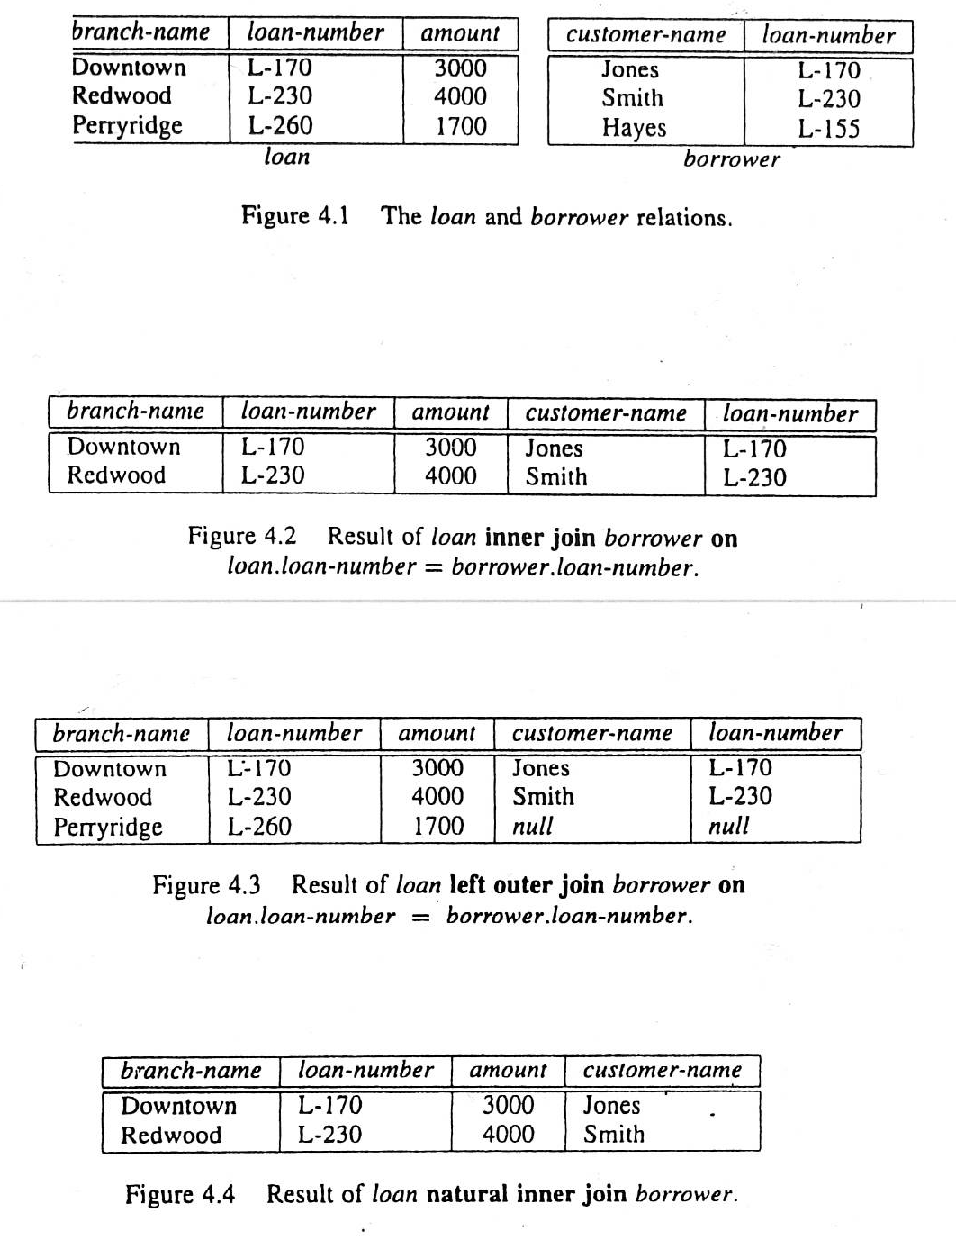

Slide 38
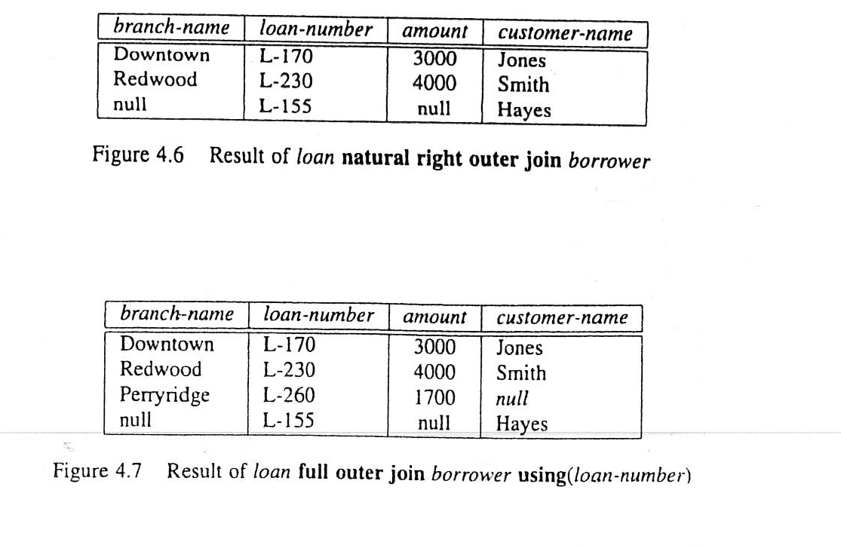

Slide 39
Division
Binary operator where entire structure of one table (divisor) is a portion of structure of the other (dividend)
Result is projection onto those attributes of the dividend that are not in the divisor of the tuples of dividend that appear with all the rows of the divisor
It tells which values of those attributes appear with all the values of the divisor

Slide 40

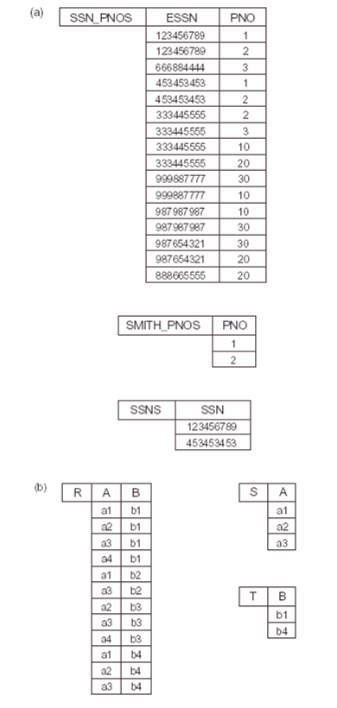
Figure 6.8
A tuple apears in T if every combination of it with tuples in S apears in R.

Slide 41
Set Operations
Tables must be union compatible – have same basic structure
A UNION B: set of tuples in either or both of A and B, written A ∪ B
A INTERSECTION B: set of tuples in both A and B simultaneously, written A ∩ B
Difference or A MINUS B: set of tuples in A but not in B, written A - B

Slide 42
Set Operations
- Binary operations from mathematical set theory:
UNION: R₁ U R₂,
INTERSECTION: R₁ ∩ R₂,
SET DIFFERENCE: R₁ - R₂,
CARTESIAN PRODUCT: R₁ X R₂.
union compatibility
For U, ∩, -, the operand relations R₁(A₁, A₂, ..., A_{n}) and R₂(B₁, B₂, ..., B_{n}) must have the same number of attributes, and the domains of corresponding attributes must be compatible; that is, dom(A_{i})=dom(B_{i}) for i=1, 2, ..., n. This condition is called union compatibility.
- The resulting relation for U, ∩, or - has the same attribute names as the first operand relation R₁ (by convention).

Slide 43
Relational Calculus
Formal non-procedural language
Two forms: tuple-oriented and domain-oriented
Based on predicate calculus

Slide 44
Tuple-oriented predicate calculus
Uses tuple variables, which take tuples of relations as values
Query has form {S ⎜ P(S)}
  S is the tuple variable, stands for tuples of relation
  P(S) is a formula that describes S
  Means “Find the set of all tuples, s, such that P(S) is true when S=s.”
Limits queries to safe expressions – test only finite number of possibilities

Slide 45
Domain-oriented predicate calculus
Uses variables that take their values from domains
Query has form
{<x₁,x₂,...,x_{n}> ⎜ P(x₁,x₂,...,x_{m} )}
  x₁,x₂,...,x_{n} are domain variables
  P(x₁,x₂,...,x_{m}) is a predicate
  n<=m
  Means set of all domain variables x₁,x₂,...,x_{n} for which predicate P(x₁,x₂,...,x_{m}) is true
Predicate must be a formula
Often test for membership condition, <x,y,z >∈ X

Slide 46
Views
External models in 3-level architecture are called external views
Relational views are slightly different
Relational view is constructed from existing (base) tables
View can be a window into a base table (subset)
View can contain data from more than one table
View can contain calculated data
Views hide portions of database from users
External model may have views and base tables

Slide 47
Mapping ER to Relational Model
Each strong entity set becomes a table
Non-composite, single-valued attributes become attributes of table
Composite attributes: either make the composite a single attribute or use individual attributes for components, ignoring the composite
Multi-valued attributes: remove them to a new table along with the primary key of the original table; also keep key in original table
Weak entity sets become tables by adding primary key of owner entity
Binary Relationships:
  1:M-place primary key of 1 side in table of M side as foreign key
  1:1- make sure they are not the same entity. If not, use either key as foreign key in the other table
  M:M-create a relationship table with primary keys of related entities, along with any relationship attributes
Ternary or higher degree relationships: construct relationship table of keys, along with any relationship attributes

Slide 48
JOIN Operations
THETA JOIN: Similar to a CARTESIAN PRODUCT followed by a SELECT. The condition c is called a join condition.
    R(A₁, A₂, ..., A_{m}, B₁, B₂, ..., B_{n}) ←
    R₁(A₁, A₂, ..., A_{m}) X _{c} R₂ (B₁, B₂, ..., B_{n})

Slide 49
JOIN Operations (continued)
EQUI JOIN: In an Equi join the join condition c includes one or more equality comparisons involving attributes from R₁ and R₂. That is, c is of the form:
    (A_{i} = B_{j}) AND ... AND (A_{h} = B_{k}); 1<i, h<m, 1<j, k<n
    In the above EQUI JOIN operation:
    A_{i}, ..., A_{h} are called the join attributes of R₁
    B_{j}, ..., B_{k} are called the join attributes of R₂
Example of using EQUI JOIN:
  Retrieve each DEPARTMENT's name and its manager's name:
    DEPT_MGR ← DEPARTMENT X _{MGRSSN=SSN} EMPLOYEE
    RESULT ← π _{<DNAME,FNAME,LNAME>} (DEPT_MGR)

Slide 50
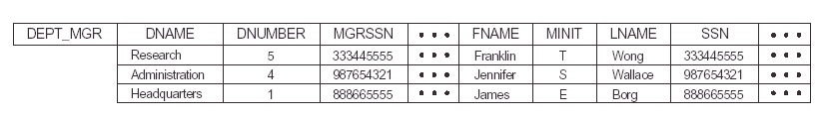
This illustrate the first operation (just the join operation)

Slide 51
Natural Join (*):
In an EQUI JOIN R ← R₁ X _{c} R₂, the join attribute of R₂ appear redundantly in the result relation R. In a NATURAL JOIN, the redundant join attributes of R₂ are eliminated from R. The equality condition is implied and need not be specified.
R ← R1 * (join attribute of R1),(join attribute of R2) R2
Example: Retrieve each EMPLOYEE's name and the name of the DEPARTMENT he/she works for:
  T ← EMPLOYEE * _{(DNO),(DNUMBER)} DEPARTMENT
  RESULT ← π _{<FNAME,LNAME,DNAME>} (T)

Slide 52
Write a query to retrieve the name of employee and the name of his / her supervisor

Slide 53
Natural Join (*): (continued)
If the join attributes have the same names in both relations, they need not be specified and we can write R ← R1 * R2.
Example: Retrieve each EMPLOYEE's name and the name of his/her SUPERVISOR:
  SUPERVISOR(Super_ssn,SFN,SLN) ←
  π _{<SSN,FNAME,LNAME>} (EMPLOYEE)
  T ← EMPLOYEE * SUPERVISOR
  RESULT ← π _{<FNAME,LNAME,SFN,SLN>} (T)
Work it out to see what the result is

Slide 54
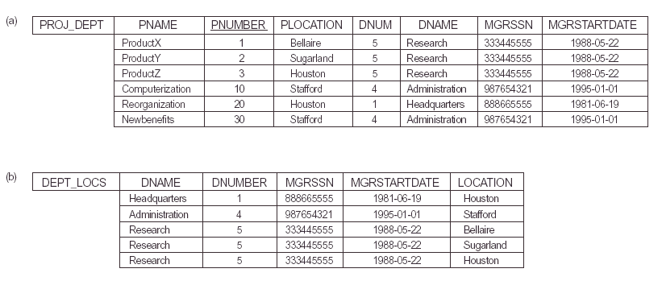
Where DEPT is: DEPT ← σ (DNAME, DNUM, MGRSSN, MGRSTARTDATE) (DEPARTMENT)

Slide 55
Note: In the original definition of NATURAL JOIN, the join attributes were required to have the same names in both relations.
There can be more than one set of join attributes with a different meaning between the same two relations. For example:
JOIN ATTRIBUTES RELATIONSHIP (Meaning)
EMPLOYEE.Ssn= EMPLOYEE manages
DEPARTMENT.Mgr_ssn the DEPARTMENT
EMPLOYEE.Dno= EMPLOYEE works for
DEPARTMENT.Dnumber the DEPARTMENT
Example: Retrieve each EMPLOYEE's name and the name of the DEPARTMENT he/she works for:
  T ← EMPLOYEE X _{Dno=Dnumber} DEPARTMENT
  RESULT ← π _{<Fname,Lname,Dname>} (T)

Slide 56
A relation can have a set of join attributes to join it with itself:
JOIN ATTRIBUTES RELATIONSHIP
EMPLOYEE(1).Super_ssn= EMPLOYEE(2) supervises
EMPLOYEE(2).Ssn EMPLOYEE(1)
One can think of this as joining two distinct copies of the same relation, although only one relation actually exists.
In this case, renaming can be useful

Slide 57
Example:
Retrieve each EMPLOYEE's name and the name of his/her SUPERVISOR:
  SUPERVISOR(Sssn,Sfn,Sln) ←
  π _{<Ssn,Fname,Lname>} (EMPLOYEE)
  T ← EMPLOYEE X _{Super_ssn=Sssn} SUPERVISOR
  RESULT ← π _{<Fname,Lname,Sfn,Sln>} (T)

Slide 58
Complete Set of Relational Algebra Operations:
All the operations discussed so far can be described as a sequence of only the operations SELECT, PROJECT, UNION, SET DIFFERENCE, and CARTESIAN PRODUCT.
Hence, the set {σ, π, U, -, X } is called a complete set of relational algebra operations.
Any query language equivalent to these operations is called relationally complete.

Slide 59
Additional Relational Operations
For database applications, additional operations are needed that were not part of the original relational algebra.
These include:
1. Aggregate functions and grouping.
2. OUTER JOIN and OUTER UNION.
AGGREGATE FUNCTIONS
  Functions such as SUM, COUNT, AVERAGE, MIN, MAX are often applied to sets of values or sets of tuples in database applications
  <grouping attributes> F _{<function list>} (R)
The grouping attributes are optional

Slide 60
Continued
Example 1: Retrieve the average salary of all employees (no grouping needed):
R(AVGSAL) ← F _{AVERAGE Salary} (EMPLOYEE)
Example 2: For each department, retrieve the department number, the number of employees, and the average salary (in the department):
  R(Dno,Numemps,Avgsal) ←
  Dno F _{COUNT Ssn, AVERAGE Salary} (EMPLOYEE)
  DNO is called the grouping attribute in the above example

Slide 61
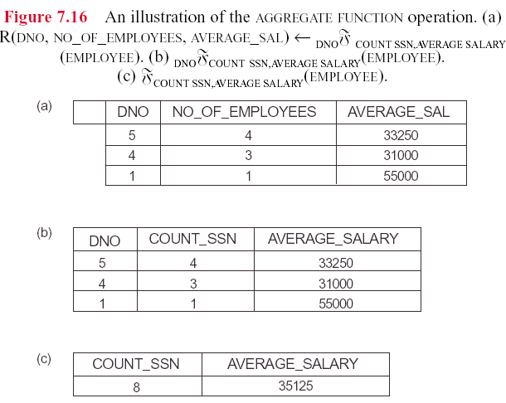
Renaming is done
Function name and attribute name are concatenated (not an standard)

Slide 62
Outer Join
In a regular EQUI JOIN or NATURAL JOIN operation, tuples in R1 or R2 that do not have matching tuples in the other relation do not appear in the result
Some queries require all tuples in R1 (or R2 or both) to appear in the result
When no matching tuples are found, nulls are placed for the missing attributes
LEFT OUTER JOIN: R1 X R2 lets every tuple in R1 appear in the result
RIGHT OUTER JOIN: R1 X R2 lets every tuple in R2 appear in the result
- FULL OUTER JOIN: R1 X R2 lets every tuple in R1 or R2 appear in the result

Slide 63
Left Outer Join Examle
Suppose we want to list all employee’s name and the name of the department they manage (if any)
We can apply a left outer join for this:
T ← (EMPLOYEE lotj _{SSN=MGRSSN} DEPARTMENT
RESULT ← π _{FNAME, MINIT, LNAME, DNAME} (T)

Slide 64
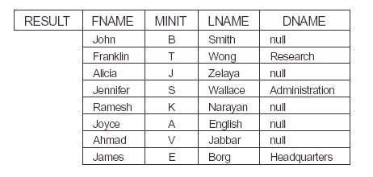

Slide 65
Relational Calculus
It is another formal Query Language.
Relational Calculus:
  Tuple relational Calculus
  Domain Relational Calculus

Slide 66
The Tuple Relational Calculus
Each formal query is a declarative expression.
In relation algebra we write a sequence of operations to specify a retrieval request.
In relational calculus, we specify what we need. We don’t specify how to get it.
So: Relational Algebra is considered to be a procedural language while Relational Calculus considered to be nonprocedural language

Slide 67
Lets have the expression:
{t | COND(t))}
It means all tuples satisfying COND(t)
Example:
{t | EMPLOYEE(t) and t.salary > 30000}
Means all attributes of all employees with salary > 30000.
{t.fname, t.lname | EMPLOYEE(t) and t.salary > 30000
Means only fname and last name of all employees with salary > 30000.
{t.BDATE, T.ADDRESS, | EMPLOYEE(t) AND t.FNAME = ‘john’ AND t.MINIT= ‘B’ AND T.LNAME = ‘SMITH’
Means information about Smith specifically.

Slide 68
Domain Relational Calculus
It is also called Domain Calculus.
IBM developed RC and QBE.
QBE is domain based.
Then Domain Calculus was developed.
The difference is that it uses different variables in the expressions.

