Slide 1

Databases Illuminated
Chapter 7
The Object-Oriented Model

Slide 2
Why OO?
Traditional relational model does not represent complex data and relationships well
Need additional support for advanced applications
OO paradigm widely used for programming
OO database provides persistent objects to correspond to temporary objects in programs
Examples: Objectivity, GemStone, ObjectStore, Versant, DB4o http://freshmeat.net/projects/db4o/

Slide 3
OO Data Concepts
An object has a state and a unique identifier
  Similar to an entity, but has methods in addition to attributes (data elements)
  Objects are encapsulated – data and methods form a unit with restricted access
  Only object’s methods have access to its data
  Object’s interface is visible to outside world
A literal has a state but no identifier – can be atomic (values of built-in types) or structured

Slide 4
Object Classes
A object class is a set of objects having the same structure- same variables with the same datatypes, same methods, and same relationships
  Roughly equivalent to an entity type
  Includes data elements, operations and relationships
  Datatypes can be predefined atomic types (integer, real, char, boolean), more complex types, or user-defined types
Set of objects in a class is called the extent (like extension)
  Class extent is roughly equivalent to an entity set
  Objects in the class (instances, object instances, objects) are similar to entity instances

Slide 5
Defining a Class
Class is defined by listing components
  Data members (attributes, instance variables)
  Member methods (functions or procedures that belong to the class)
  Relationships that the class participates in
Simplified Example:
class Person {
attribute string name;
attribute string address;
attribute string phone;
void setName(string newName); // method
string getName( ); //method
relationship Job hasjob; //relates to Job class
}

Slide 6
Writing and Using Methods
Method written in OO language-Java, C++, etc.
Ex:
    void setName(string newName)
    {
    self.name = newName;
    }
User’s program may have a Person object
Person firstPerson = new Person( );
Invoke method using Person object
firstPerson.setName(‘Jack Spratt’);
firstPerson becomes “calling object”, referred to as self in method

Slide 7
Class Hierarchies
Classes organized into class hierarchies
  Superclasses (base classes) and subclasses
  Each subclass has an isa relationship with its superclass
similar to specialization and generalization in the EER model
Subclasses inherit the data members, methods, and relationships of their superclasses, and may have additional data members and methods of their own
Hierarchy diagram-See Figure 8.2
  Represent classes as rectangles
  Connect subclasses to isa triangle, and connect triangle to superclass

Slide 8
UML Class Diagrams-1
Unified Modeling Language (UML) class diagrams - See Figure 8.5
  Rectangles for classes- 3 sections: class name, attributes, methods
  Relationships – 2 types
    Association
      for uni- or bi-directional relationships between distinct classes (Ex Student – Faculty relationship)
      represented by directed line connecting rectangles, with optional name
      Any descriptive attributes of association in box connected to association line by dotted line (Ex grade in Student - ClassSection)
      Rolenames can appear on line, but placement is opposite that in E-R (Ex. Student hasAdvisor role appears next to Faculty)
    Aggregation
      Connects parts to a whole, described by “is part of” (Ex ClassSection to Course)
      Represented by line with diamond on side of aggregate
      Can be given a name, or interpreted as “has”
  Reflexive association or reflexive aggregation shown by line back to same class, with rolenames (Ex Course)

Slide 9
UML Diagrams- ( Continued)
Multiplicity indicators show cardinality & participation
  min..max, but place opposite to placement in E-R; no ( )
  Use * for M; use 1 for 1..1
Generalization hierarchies
  Lines connect subclasses to superclass, with triangle at end, pointing to superclass
  Filled triangle for overlapping subclasses
  Open triangle (outline only) for disjoint subclasses
  Can write constraints in curly braces on line near triangle (Ex. {overlapping, optional} near Person class rectangle)
Weak entity represented by rectangle with line to strong entity, with discriminator written in box below strong entity (Ex. date is discriminator for Evaluation)

Slide 10
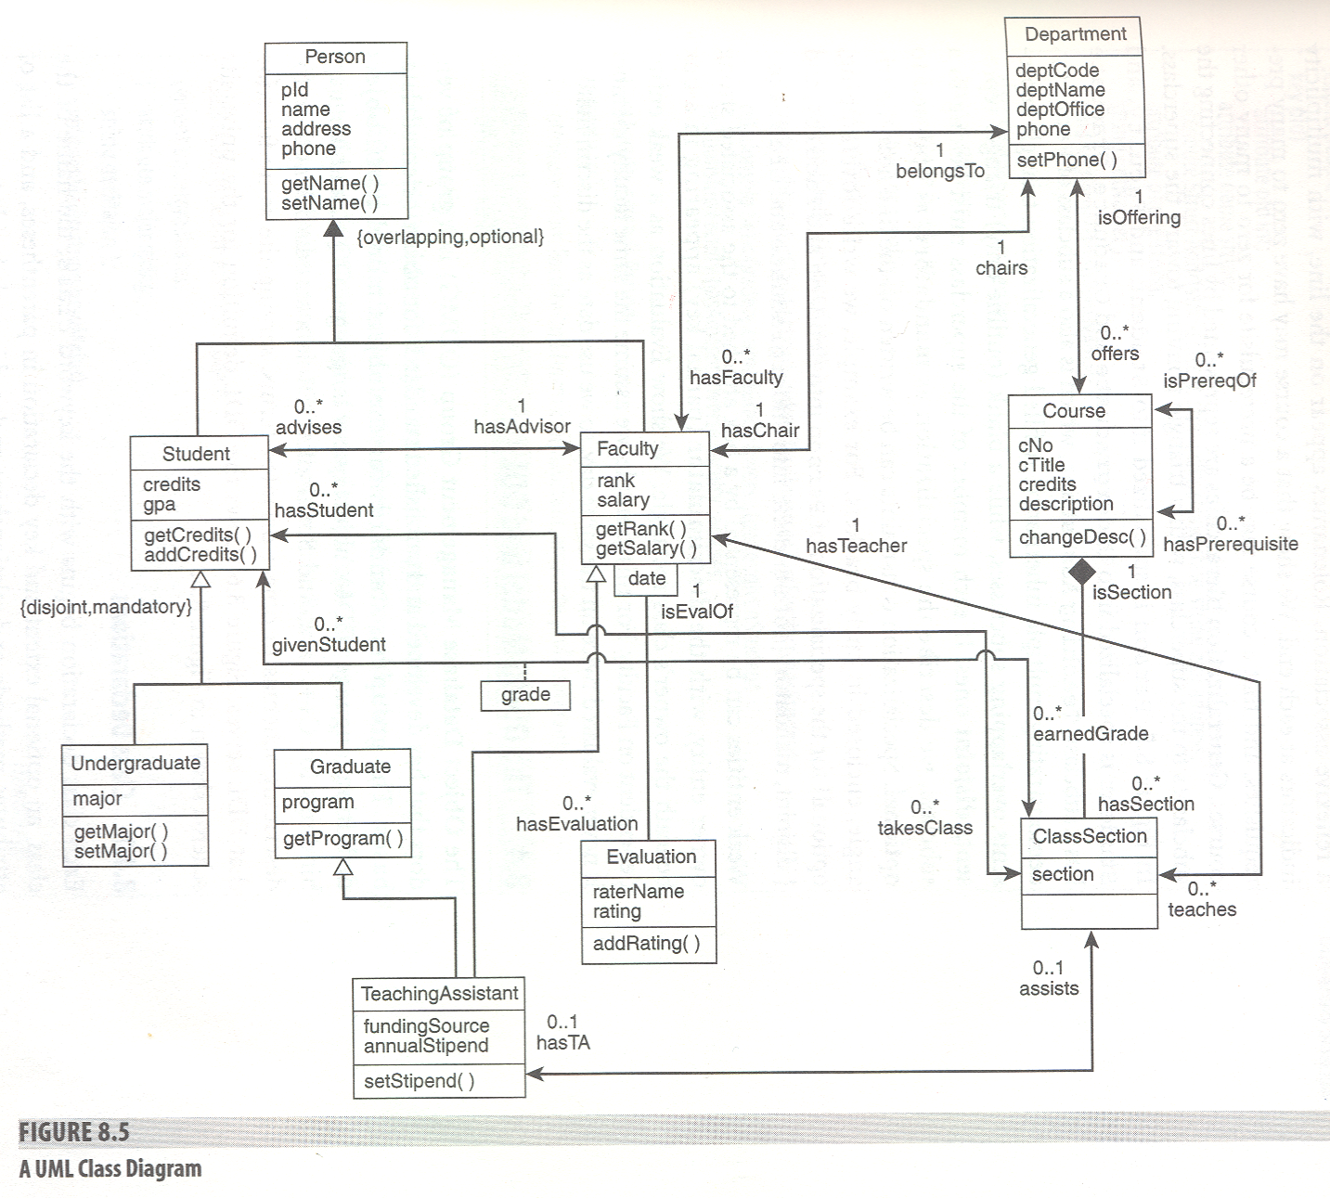

Slide 11
ODMG Model
Object Database Management Group
Group of vendors
Developed standards for OO databases
Standards for
  Object model
  Object definition language (ODL) like DDL
  Object query language (OQL) like DML
  Language bindings for C++, Java, Smalltalk

Slide 12
ODL-Class Declarations
Class declarations
  Begin with word class, then classname
  Optional extent and key declarations in parentheses
  List of attributes, methods, and relationships, all enclosed in curly braces

Slide 13
A Class Definition Example
class Person
(extent people
key pId)
{ attribute pId int;
attribute name string;
attribute Struct Addr(string street, string city, string state, string zip) address;
attribute phone string;
string getName( );
void setName(string newName);
};

Slide 14
A Complete Example
This is an example of University Database
See Figure 8.6 page 443

Slide 15
extent
extent
  Can be thought of as the set of object instances for that class that are stored in the database at a given time.
  The class itself is the intention and the extent is the extension
  Class correspond to schema and extent corresponds to table
  Class is like entity type and extent is like entity instances
  Can be thought of as the name of the file where the objects in the class are stored

Slide 16
ODL-Attribute Types
Attribute types
atomic, structured, collection type
Atomic types
  integer, float, character, string, boolean, and enumerated types
  Enumerated types
    keyword enum, name of the type, curly braces with a list of literals for the type, and the name of the attribute with that type
  Ex: attribute enum FacultyRank{instructor, assistant, associate, professor} rank;

Slide 17
ODL-Structured Types
Keyword Struct, the name of the type, curly braces with each attribute and its datatype, then the attribute name of that type
Ex: attribute Struct Addr{string street, string city, string state, string zip} address;
If type used again for other classes, must identify the class it was defined in, using the scoped name (class name), double colon, and the type name
Ex: If we defined Addr type in Person class, and we need a NewAddress field in another class in the same schema, write:
attribute newAddress Person::Addr

Slide 18
Collection Types
Besides Struct, there are type constructors for five collection types. They are:
Set- finite number of unordered values of one datatype, specified in angled brackets, Set<typename>, Set<Courses>
List- finite list of elements of a single type, written List<datatype>, EX: List<integer>, List<Person::Addr>
Array- set of elements all of the same type, with an index indicating position of each element; constructor requires datatype and number of elements, as in Array<float, 5>
Bag or multiset- Similar to a set, but permits duplicate values, written Bag<datatype>
Dictionary- Constructor has the form Dictionary <K,V> where K and V are some datatypes- used to construct pairs of values, <k,v> where k is a key type and v is some range type.
Purpose: to find value of range type for a given value of key type efficiently.

Slide 19
Relationships
O-O model represents Relationships by references
In ODL, System stores and maintains the references
Ex 1: in Faculty class, we have:
relationship Department belongsTo Inverse Department::hasFaculty;
  Defines relationship belongsTo connecting Faculty to Department
  A “one” relationship - only one Department reference per Faculty object
  There is also an inverse relationship hasFaculty (a set of faculty) in Department (bidirectional relationship)
  Not all relationships have inverses – unidirectional is OK
class Faculty extends Person
(extent facs)
{ attribute enum FacultyRank{instructor, assistant, associate, professor} rank;
attribute salary real(8,2);
string getRank( );
relationship Department belongsTo Inverse Department::hasFaculty;
relationship Set<ClassSection> teaches Inverse ClassSection::hasTeacher
relationship Set<Student> advises Inverse Student::hasAdvisor;
relationship Department chairs Inverse Department::hasChair;
};

Slide 20
class Department
(extent departments
key deptCode, deptName)
{
attribute deptCode string;
attribute deptName string;
attribute deptOffice string;
attribute phone string;
relationship Set<Faculty> hasFaculty Inverse Faculty::belongsTo;
relationship Faculty hasChair Inverse Faculty::chairs;
relationship Set<Courses> offers Inverse Courses::isOffering
};

Slide 21
Ex 2: in Student class
relationship Set<ClassSection> takesClass Inverse ClassSection::hasStudent; (a set of students)
  Defines relationship takesClass connecting Student to ClassSection
  Each Student object has a set of references to ClassSection objects-a “many” relationship
Cardinality of relationship shown by whether or not the word “Set” appears in the relationship specification

Slide 22
Student Class
class Student extends Person
(extent students)
{ attribute credits int;
attribute gpa real(3,2);
int getCredits( );
void addCredits(int numCredits);
relationship Set<ClassSection> takesClass Inverse ClassSection::hasStudent;
relationship Set<Grade> earnedGrade Inverse Grade::givenStudent
relationship Faculty hasAdvisor Inverse Faculty::advises;
};

Slide 23
ClassSection Class
class ClassSection extends Course
(extent sections)
{
attribute section string
relationship Set<Student> hasStudent Inverse Student::takesClass;
relationship Faculty hasTeacher Inverse Faculty::Teaches
relationship TeachingAssistant hasTA Inverse TeachingAssistant::assists;
relationship Set<Grade> students Inverse Grade::section
};

Slide 24
Methods
A method is a function or procedure that can be performed on members of the class
Declarations specify the signature - the name of the method, the return type (if any), and the number and type of parameters, identified as IN, OUT, or IN/OUT
Two methods for the same class may have the same name but if their signatures are different, they are different methods
Actual code for the method is not part of the ODL, but written in a host language
May be overloaded - same method name used for different classes, with different code for them
Class member methods are applied to an instance of the class
EX: string getName(); defined in Person class

Slide 25
Subclasses Definition
Format:
Keyword class, subclass name, keyword extends superclass name
Ex: class Student extends Person
Subclass inherits all attributes, relationships, methods
Can have additional properties of its own
For multiple inheritance, add a colon and the name of the second superclass
Second superclass must be an interface, a class definition without an associated extent
Ex: If Student also inherited from a Customer interface
class Student extends Person:Customer

Slide 26
Relationship Classes
For binary M:M relationships without descriptive attributes, use relationship clause in classes, with Set specification in both directions (no third class)
Binary M:M relationships with descriptive attributes
  Cannot be represented by sets in both directions, since that leaves no place for descriptive attributes
  Set up a class for the relationship (descriptive attribute), place the descriptive attributes as attributes of the new class, and define two one-to-many relationships between the new class and the two original classes
  See Grade class in Figure 8.6

Slide 27
For ternary or higher-order relationships
create a class for the relationship itself
  New relationship class definition includes three or more relationships that connect the new class to the originally-related classes
  Also list any descriptive attributes

Slide 28
N-ary Relationship
The same as ternary relationship:
Class BookOrder
{
relationship Faculty teacher Inverse …
relationship Book bookFor Inverse …
relationship ClassSection uses Inverse …
}

Slide 29
Keys
Keys are optional in ODL
System uses unique object identifier (OID), automatically given to each object instance, to tell instances apart
Designer can identify any candidate keys as well
Done at the beginning of the class declaration within the same parentheses as the extent declaration
Key may be a single attribute or a composite, identified by parentheses around the component attribute names

Slide 30
Key Definition
Examples:
class Faculty
  (extent Facs
  Key facId, SocSecNo, (name, department))
  For weak entity set Evaluation, we can write:
  class Evaluation
  (extent Evaluations
  Key (date, IsEvalof))

Slide 31
OQL-Object Query Language-1
Syntax is similar to SQL, but operates on objects, not tables
Form for queries is
    SELECT expression list
    FROM list of variables
    WHERE condition;
expression list
can contain the names of attributes using dot notation, essentially invoking automatic get method, as in
    SELECT s.stuId, s.credits
    FROM students s;

Slide 32
OQL-Expression list (Continued)
Can use methods in the expression list
Will get the result of applying the method
    SELECT p.getName( )
    FROM people p;
Can use relationship in the expression list.
Will retrieve the object or set of objects related to the calling object through the relationship
    SELECT s.stuId, s.takesClass
    FROM students s
    WHERE s.stuId = ‘S999’;

Slide 33
OQL-FROM line
List of variables -similar to defining an alias in SQL
List the name of an extent, such as students or people, and an identifier for the name of the variable, such as s or p
Variable is actually an iterator variable that ranges over the extent
Alternate forms for declaring an iterator variable
    FROM students s
    FROM s in students
    FROM students as s

Slide 34
OQL-WHERE line
Must be boolean expression having constants and variables which are defined in the FROM clause
Can use <, <=, >, >=, !=, AND, OR and NOT
Does not eliminate duplicates; returns a bag
To eliminate duplicates, add DISTINCT
Can optionally add ORDER BY

Slide 35
Examples
Using dot notation:
SELECT s.stuId, s.credits
FROM students s;
Can use method in the expression list:
SELECT p.getname()
FROM people p;

Slide 36
More example
Can use relationship in the expression list
SELECT s.stuId, s.talesClass
FROM students s
WHERE s.stuId = ‘S999’;

Slide 37
Alternative forms of From line:
FROM students s
FROM s in students
FROM students as s

Slide 38
More examples
Can use boolean expression and order by:
SELECT s.stuId, s.name, s.major
FROM students s
WHERE s.credits >=60 and s.credits <=90 ORDER BY s.name;

Slide 39
Can use relationship to find records through references:
SELECT f.name
FROM departments as d, d.hasFaculty as f
WHERE d.deptName = ‘Biology’;
Retrieves the name of all faculty in the biology dept.

Slide 40
Nested query
The first part of previous query can be used as nested query:
SELECT f.name
FROM (SELECT d
FROM d in departments
WHERE d.deptName = ‘BIOLOGY’) as b,
b.hasFaculty as f;

Slide 41
Can define structures from returned results:
SELECT struct(name: f.name, rank: f.rank, salary: f.salary)
FROM Faculty as f
WHERE f.belongTo = ‘English’
ORDER BY salary DESC;

Slide 42
Can use function COUNT, SUM, AVG, MAX and MIN
AVG(SELECT f.salary
FROM faculty as f
WHERE f.belongsTo = ‘History’;
COUNT(SELECT u
FROM undergraduates as u
WHERE u.major = ‘Computer Science’)

Slide 43
Find all sections with more than 30 students
SELECT s
FROM sections as s
WHERE COUNT(s.hasStudents >30);

Slide 44
HW # 5
Step1: Create a UML diagram for the company database represented by the E-R diagram on the next slide.
Step2: Convert this UML diagram into an Object-Oriented database model and write the ODL for the schema similar to sample project on page 458 of your textbook.

Slide 45
Unidirectional Relationship
In a relationship, only one entity has a relationship field or property that refers to the other. For example, LineItem would have a relationship field that identifies Product, but Product would not have a relationship field or property for LineItem. In other words, LineItem knows about Product, but Product doesn’t know which LineItem instances refer to it.

Slide 46
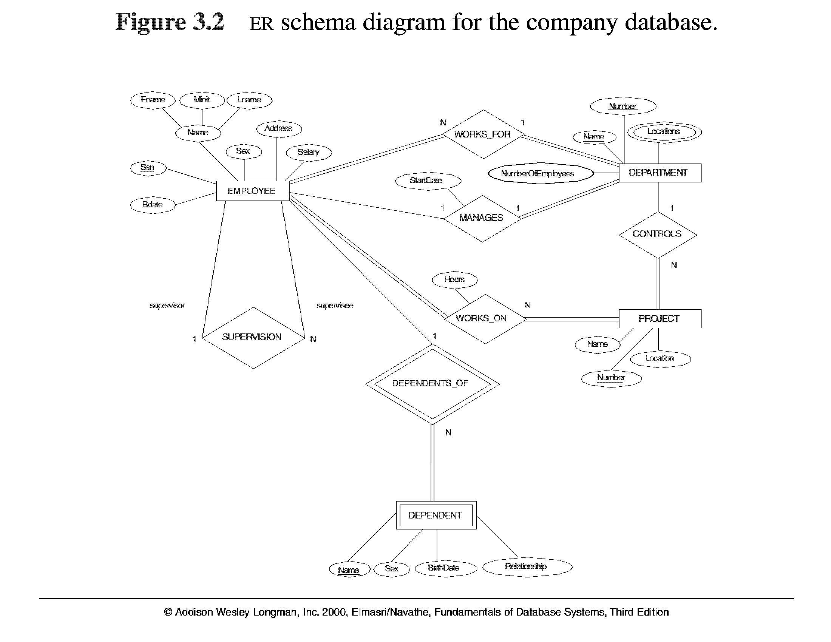
M
$$$$$$$$$$$$$$$$$$$$$$$$$$$$$$$$$$$$$$$$$$-

Slide 49
Developing an OO Database
See Figure 8.7
Natural extension of application development in an object-oriented programming environment
Language bindings specified in ODMG standard for C++, Java, and Smalltalk
Difference between program objects and database objects is persistence
OODBMS provides facilities to make program objects persist, and provides access to database objects for manipulation within programs

Slide 50
Defining the Schema
Designer defines the schema using a data definition language such as ODL or an OO programming language such as C++
Class definitions can be standard C++ (or other language) that has been extended to provide persistence and to support relationships between objects, as well as inheritance
Persistence is provided by making all objects that are to be persistent inherit from a class provided by the OODBMS just for that purpose
Objectivity provides the class ooOdb for C++.

