Slide 1
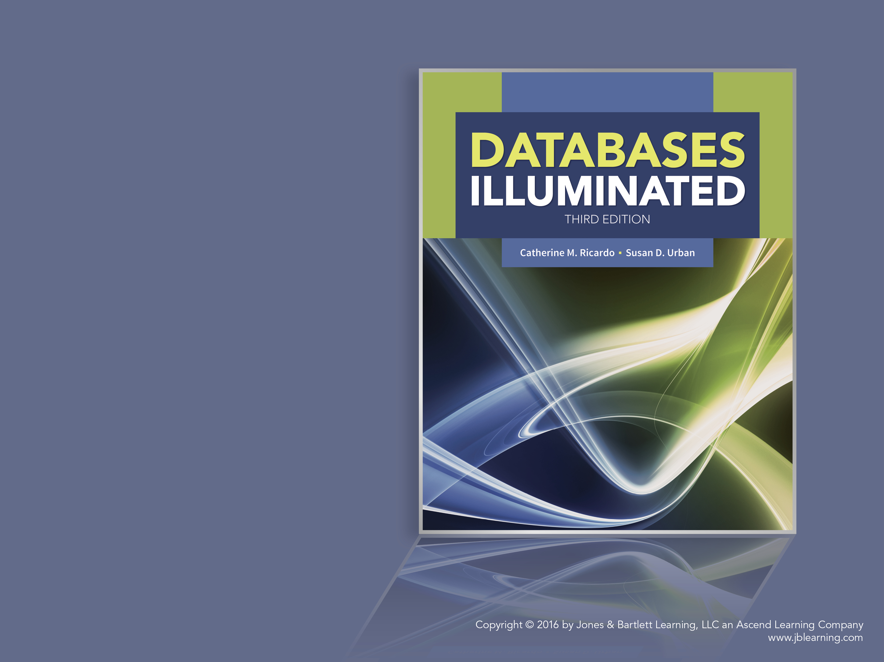
Databases Illuminated
Chapter 8
Database Security

Slide 2
Privacy and Security
Database security
  Protecting the database from unauthorized access, modification, or destruction
Data security is an important subcomponent of an organization’s overall information systems security plan
Privacy
  The right of individuals to have some control over information about themselves
  Protected by law in many countries
Right to privacy can be protected by database security

Slide 3
The CIA Model of Security
Confidentiality – Only authorized users should have access to information to preserve privacy, intellectual property, and national security efforts
Integrity – Only authorized users should be allowed to modify data to ensure data consistency and trustworthiness
Availability – Information should be accessible by authorized users when needed

Slide 4
Some Security Laws and Standards
Federal Information Security Management Act (FISMA)
European General Data Protection Regulation (GDPR)
U.S. Healthcare Insurance Portability and Accountability Act (HIPPA)
Sarbannes-Oxley (SOX)
Gramm-Leach-Bliley (GLBA)
Payment Card Industry Data Security Standard (PCI DSS)

Slide 5
Accidental Security Threats
User errors
  User unintentionally requests object or operation for which he/she should not be authorized
Communications system errors
  User sent a message that should be sent to another user
  System connects a user to a session that belongs to another user with different access privileges
OS errors
  Accidentally overwrites files and destroys part of database
  Fetches the wrong files and sends them to the user
  Fails to erase files that should be erased

Slide 6
Deliberate Security Threats-Sources
User intentionally gains unauthorized access and/or performs unauthorized operations on the database
Disgruntled employee who is familiar with the organization's computer system seeks revenge
Industrial spies seek information for competitors

Slide 7
Deliberate Security Threats-Methods
Wiretapping of communication lines
Electronic eavesdropping-picking up electronic signals
Reading display screens or printouts left unsupervised
Impersonating authorized users or users with greater access
Writing programs to bypass the DBMS and access database data directly
Writing applications programs that perform unauthorized operations
Deriving information about hidden data by clever querying

Slide 8
Deliberate Security Threats-Methods
Modifying database queries through SQL injection to gain unauthorized access to data or to maliciously modify or delete data
Removing physical storage devices from the computer facility
Making copies of stored files without going through the DBMS
Bribing, blackmailing or influencing authorized users to obtain information or damage the database
Privileged users inappropriately grant themselves access to sensitive data

Slide 9
Physical Security
Should begin with physical security measures for the building-physical barriers, control access, require badges, sign-in etc.
Should have more physical security for the computer facilities-e.g. locked door
Additional security control for database

Slide 10
Information System Access Control
Information system access control must address:
  Authorization
  Identification
  Authentication
  Accountability

Slide 11
Authorization
DBMSs designed for multiple users have a security subsystem
Provide for authorization - Users are assigned rights to use database objects
Authorization language - Allows the DBA to write authorization rules specifying which users have what type of access to database objects

Slide 12
Identification
For identification, users typically have a computer system user ID
Databases require an additional database ID for defining access rules in the database authorization language
Other forms of identification include:
  Smart cards to access parking lots, buildings, and rooms
  Biometrics such as fingerprints, handprints, face recognition, voice recognition, and retina scans

Slide 13
Authentication
User authentication - Verifying the identity of users
Operating system uses user profiles, user ids, passwords, authentication procedures, badges, keys, or physical characteristics of the user
System has a user profile for each id, giving information about the user
Stored profiles should be kept secure, possibly in encrypted form
Profile normally includes a password, allegedly known only to the user
Passwords should be kept secret and changed frequently
System should never display passwords at sign-in time

Slide 14
Other Authentication Procedures
Password limitation - Users write them down, choose words that are easy to guess, or share them
Use length and special character requirements for passwords
Account lock out for several invalid login attempts
Use multi-factor identification, such as user id and password together with a smartcard or some form of biometrics
Authentication procedure can be series of questions - takes longer and is more difficult to reproduce than a password
User should be required to produce an additional password to access the database

Slide 15
Accountability
Accountability is the need to capture and maintain log files for traceability when security incidents occur
Examples include log files of
  Login information
  Directories, files, and databases accessed by a user
  Database inserts, updates, and deletes
Log files are especially useful for forensic activity after a security breach

Slide 16
Database Access Control
Access control covers the mechanisms for implementing authorizations
Access control matrix
  Planning tool to identify operations different users are permitted to perform on various database objects
  List users in left column; objects on top row; write operations permitted at intersection
DBA can delegate authorization powers to others-requires careful planning to avoid abuse
See Figure 8.1

Slide 17
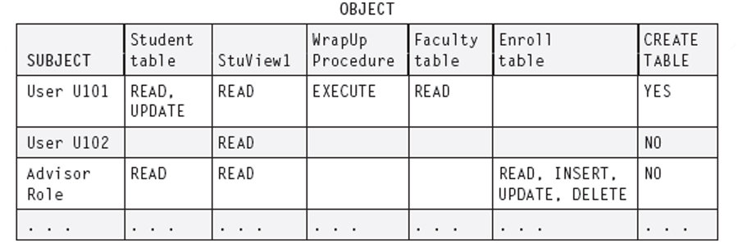
Figure 8.1 Access Control Matrix

Slide 18
Security Mechanisms
Views - Simple method for access control
  May be value-dependent or value-independent
Security log - Journal for storing records of attempted security violations
Audit trail - Records all access to the database -requestor, operation performed, workstation used, time, data items and values involved
Triggers can be used to set up an audit trail
Encryption of data in the database

Slide 19
Encryption
Uses a cipher system that consists of
  Encryption algorithm that converts plaintext into ciphertext
  encrypting key
  Decryption algorithm that reproduces plaintext from ciphertext
  decrypting key
Widely-used schemes for encryption
  Triple Data Encryption Standard (3DES)-replaced DES
  Advanced Encryption Standard (AES)-Rijndael scheme
  Public key encryption

Slide 20
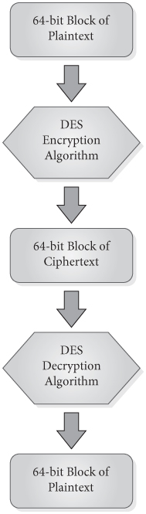
DES, 3DES, and Symmetric Key Encryption
Data Encryption Standard-DES See Figure 8.4
  National Bureau of Standards, 1977
  Algorithm is public-can have hardware implementation; Key is private
  Symmetric Key Encryption - Decryption key is the same as the encryption key and decryption algorithm is the inverse of encryption algorithm
  56-bit key on 64-bit blocks of plaintext, producing 64-bit blocks of ciphertext
  Characters are substituted and rearranged according to the value of the key
  Challenges with the DES system: key security and ease of cracking the code
Triple DES
  US National Institute of Standards and Technology, 1999
  Does DES three times, with three keys
Figure 8.4 Overview of DES Encryption

Slide 21
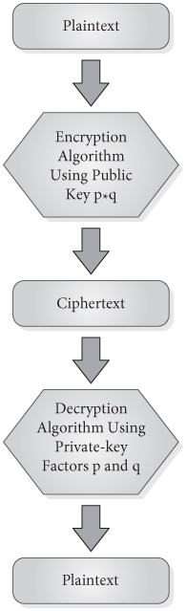
AES and Public Key Encryption
Advanced Encryption Standard-AES
  Developed in 2000, adopted as US govt agency standard in 2002
  Developed by Daemen and Rijmen, called Rijndael scheme
  Symmetric scheme; but more sophisticated than the DES scheme
  Three key sizes-128,192, or 256 bits, depending on the level of security needed
  Data broken into 128-bit blocks; 4 round of transformations determined by key values
Public Key Encryption
  Uses a product of primes as a public key, and the prime factors of the product as a private key
  See Figure 8.5
Figure 8.5 Overview of Public-Key Encryption

Slide 22
SQL Authorization Language
GRANT statement used for authorization
REVOKE statement used to retract authorization
Privileges can be given to users directly
Privileges can also be given to a role, and role given to users or to another role
System keeps track of authorizations using a grant diagram, also called an authorization graph
In Oracle, privileges include object privileges and system privileges
  Granted using the authorization sublanguage or through the Oracle Security Manager

Slide 23
GRANT Statement
GRANT {ALL PRIVILEGES | privilege-list}
ON {object-name}
TO {PUBLIC | user-list|role-list} [WITH GRANT OPTION];
privileges for base tables are SELECT, DELETE, INSERT, UPDATE or REFERENCES(col-name)
For updatable views, SELECT, DELETE, INSERT and UPDATE
Used to grant privileges to a user
GRANT SELECT ON Student TO U101 WITH GRANT OPTION;
To create and use a role
CREATE ROLE AdvisorRole;
To grant privileges to the role
    GRANT SELECT ON Student TO AdvisorRole;
To assign a role to a user
    GRANT AdvisorRole to U999;
To assign a role to another role
    GRANT FacultyRole TO AdvisorRole;
Allows inheritance of role privileges

Slide 24
REVOKE
REVOKE {ALL PRIVILEGES | privilege-list}
ON object-list
FROM {PUBLIC | user-list | role-list}
[CASCADE | RESTRICT];
Example:
  REVOKE INSERT ON Student FROM U101;
Can revoke just the grant option, without revoking the underlying privilege,
  REVOKE GRANT OPTION FOR INSERT ON Student FROM U101;
By default, revocations cascade or trigger other revocations, if the user has passed on the privileges that are revoked
If RESTRICT is specified, any revocation that would cascade to others will not be performed

Slide 25
Security in Oracle
  Oracle has four predefined accounts-SYS, SYSTEM, SYSMAN, DBSNMP
  Prompts for passwords for both the SYS and SYSTEM accounts on setup
  Both SYS and SYSTEM automatically have the DBA role
    Permits a user to create roles and users, grant privileges, etc.
  User accounts, roles, and privileges can be defined using
    Oracle Enterprise Manager Database Control – a facility for granting and revoking privileges
    SQL*Plus – writing SQL authorization commands
  Views can be defined to limit user access
Data stored in the database or transmitted over networks can be encrypted using AES, 3DES, and others
Authentication protocols include Kerberos, SSL with digital certificates, RADIUS (Remote Authentication Dial-In User Service), Public key Infrastructure (PKI)

Slide 26
Privileges in Oracle
Object privilege
  The right to perform an action using DML commands on a table, view, procedure, function, sequence, or package
  Creator of a schema automatically has all object privileges on all objects in the schema, and can grant the same object privileges to other users
System privileges
  The right to perform actions using DDL commands on database data, schemas, tablespaces, or other resources
  Right to create user accounts
  About 166 different system privileges
  List of them: SELECT name FROM SYSTEM_PRIVILEGE_MAP;
  Can be given by a privileged user such as SYS or SYSTEM through SQL*Plus using a GRANT command of the form
GRANT <systemprivilege> TO <username> [WITH ADMIN OPTION];

Slide 27
Statistical Databases
Support statistical analysis on populations
Data itself may contain facts about individuals, but is not meant to be retrieved on an individual basis
Users are permitted to access statistical information-totals, counts, or averages, but not information about individuals

Slide 28
Statistical DB Security
Need special precautions to ensure users are not able to deduce data about individuals
Even if all queries are required to involve count, sum or average, user can use conditions in WHERE line to narrow the population down to one individual
System can refuse any query for which only one record satisfies the predicate-not sufficient protection
Can restrict queries
  Require that the number of records satisfying the predicate be above some threshold
  Require that the number of records satisfying a pair of queries simultaneously cannot exceed some limit
  Can disallow sets of queries that repeatedly involve the same records

Slide 29
SQL Injection
SQL injection is a form of attack that takes advantage of vulnerabilities associated with the dynamic construction of SQL queries.
SQL injection can be used
  To retrieve information that the attacker is not authorized to retrieve
  To insert data that would give an attacker unauthorized access to a database
  To maliciously modify or delete data
Discovered in 1998 and is now one of the top security concerns

Slide 30
Dynamic Query Construction
Consider a web form that allows a user to enter an id and password
In code, a query can be dynamically constructed as follows:
studentInfoQuery = “SELECT * FROM student WHERE userID =
‘” + userID + “’ AND password = ‘” + password + “’;”
If the user enters an userID of John and a password of x1y2z3, then studentInfoQuery is
SELECT * FROM student
WHERE userID = ‘John’ AND password = ‘x1y2z3’;

Slide 31
Query Construction Vulnerabilty
Consider what happens if the user enters a single quote in the password (x1y’z3)
SELECT * FROM student
WHERE userID = ‘John’ AND password = ‘x1y’z3’;
SQL will generate an error message because of the extra single quote between y and z in the password
Attackers use this technique to discover that SQL injection is possible
The error message indicates that the code was not written to validate user input

Slide 32
SQL Injection Example
If the attacker enters Y’or‘a’=’a as the password, the query will be:
SELECT * FROM student
WHERE userID = ‘X’ AND password = ‘Y’ OR ‘a’=’a’;
The userID and password are invalid, but the OR condition causes the query to evaluate as follows, which retrieves all of the student information:
SELECT * FROM student
WHERE ’a’=’a’;
This technique can be used to append statements at the end of the select statement that maliciously update or delete data in the database

Slide 33
Another SQL Injection Example
If the user enters Y’ OR ‘a’=’a’; DELETE * FROM student; -- as the password, the dynamically constructed query will be:
SELECT * FROM student
WHERE userID = ‘X’ AND password = ‘Y’ OR ‘a’=’a’;
DELETE * FROM student;
--‘;
The query retrieves all student information and then deletes all rows from the student table
The “- -“ comment characters are used to comment out any extraneous characters to avoid a syntax error

Slide 34
Mitigation of SQL Injection
SQL injection is an attack that violates privacy, confidentiality, and integrity of a database.
To prevent SQL injection:
  Do not use dynamic query construction
  Use parameterized queries, as in the JDBC API. This forces type checking on parameter values
  Always validate user input to make sure it conforms to valid types and patterns
  Some database products do not allow query strings that contain multiple SQL statements separated by semicolons

Slide 35
Need for DB Security on the Internet
Messages transmitted in plaintext can be read by intruders using packet sniffing software
Users need privacy for their messages
Customers need assurance their financial information is secure when sent over the Internet
Companies that allow web access to their databases need to protect them from attack
Receivers and senders of messages need to be sure messages are genuine and trustworthy
Senders of messages should not be able to repudiate them
Users who download executable content such as Java applets, ActiveX, or VBScript need to know code will not harm their databases or systems

Slide 36
Techniques for Internet Security
  Proxy servers
  Firewalls
  Digital signatures
  Certifications authorities such as Verisign that issue digital certificates using SSL or S-HTTP
  SET and 3-D Secure for financial information

Slide 37
Proxy Server
    Acts as an intermediary between a client and server, handling messages in both directions
Can hide the actual IP address of the server
Can improve performance by caching previous server responses
Can prevent access to sites that an organization wishes to block from its members
Can protect the server from malware
Can protect data by scanning outbound messages for data leaks

Slide 38
Firewalls
A hardware/software barrier that protects an organization’s intranet from unauthorized access
Ensures that messages entering or leaving intranet meet the organization’s standards
Packet filter examines each packet of information before it enters or leaves the intranet
Gateway techniques can apply security mechanisms to applications or connections

Slide 39
Digital Signatures
Use double form of public key encryption to create secure two-way communications that cannot be repudiated
  Sender encodes a message first with his or her own private key, and then with the public key of the receiver
  Receiver decrypts the message first using his or her private key, and then using the sender’s public key
  Ensures both parties are authentic and message is intact

Slide 40
Certification Authorities-SSL Protocol
Verisign-method of verifying that a site is genuine
  Uses public key encryption
  Site begins by generating a public key and a private key, and sending a request to Verisign, along with the site’s public key
  Verisign issues an encrypted certificate to the site; Certificate also contains the site’s public key
  Customer browser asks the site for its Verisign certificate; receives it in encrypted form
  Browser decrypts the certificate using Verisign’s public key, verifies that this is a Verisign certificate, and that the site’s URL is the correct one
  Browser creates a session key, encrypts it using the site’s public key from the certificate, and sends the session key to the site
  Only the actual site can decrypt it using its private key
  Browser and the site are the sole holders of the session key; they can exchange messages encrypted with it

Slide 41
SET and 3-D Secure
Secure Electronic Transaction (SET) protocol
  Provides additional security for credit card info
  When customer is ready to transmit order info, browser sends the site most of the order information encoded with its public key
  Credit card information is encoded with the public key of the credit card company, so site cannot decode it directly
  Site sends credit card information directly to the card company site for approval and payment
  Has been replaced by newer methods
3-D Secure
  Uses XML messages
  Uses SSL protocol
  Requires authentication of client
  Used in Verisign by Visa, American Express SafeKey, MasterCard SecureCode

