Slide 1

Databases Illuminated
Chapter 8
The Enhanced Entity-Relationship Model and the Object-Relational Model

Slide 2
Why Extend the E-R Model?
E-R suitable for traditional business applications
E-R not semantically rich enough for advanced applications
Applications where E-R is inadequate
  Geographical information systems (GIS)
  Search engines
  Data mining
  Multimedia
  CAD/CAM
  Software development
  Engineering design...and others
  The database used for these applications must be capable to represent more semantic information than ER.

Slide 3
Specialization Abstraction
Process of breaking up a class into subclasses
Specialization-needed when:
  an entity set has subsets that have special attributes
    OR
  that participate in special relationships
Ex: Faculty contains AdjunctFac and FullTimeFac
  All Faculty have attributes facid, lastName, firstName, rank.
  AdjunctFac also have coursePayRate
  FullTimeFac have annualSalary

Slide 4
Representing Specialization
EER diagram - shows specialization circle (is a relationship), and inheritance symbol (subset symbol)
  See Figure 7.1(a)
Specialization can also involve just one subclass – no need for circle, but show inheritance
Ex. Class has LabClass specialization symbol
–see Figure 7.1(b)
Subclasses can participate in their own relationships
Ex. FullTimeFac subscribes to Pension
  See Figure 7.1(c)

Slide 5
Generalization Abstraction
Inverse of specialization
Recognizing that classes have common properties and identifying a superclass for them
Ex. Student and Faculty are both people
It is a bottom-up process, as opposed to top-down process of specialization
EER diagram is the same as for specialization – See Figure 7.1(d)

Slide 6
Generalization/Specialization Constraints
Subclasses can be overlapping or disjoint
Place o or d in specialization circle to indicate constraint

Slide 7
Total vs Partial
Specialization can be total (every member of superclass must be in some subclass) or partial
  Total -double line connecting superclass to specialization circle
  Partial-single line

Slide 8
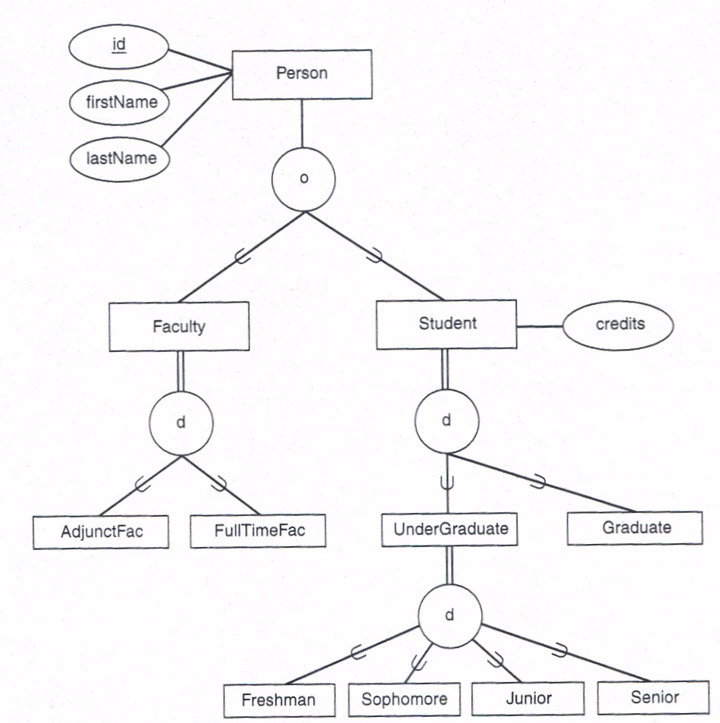

Slide 9
Specialization Definition Methods
Specialization definition can be
  predicate-defined - each subclass has a defining predicate
  Attribute defined – the value of the same attribute is used in defining predicate for all subclasses
  User-defined – user is responsible for identifying proper subclass

Slide 10
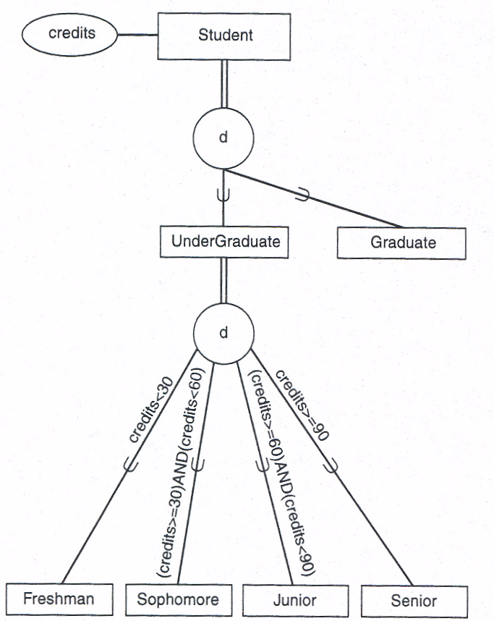
Predicate defined Specialization

Slide 11
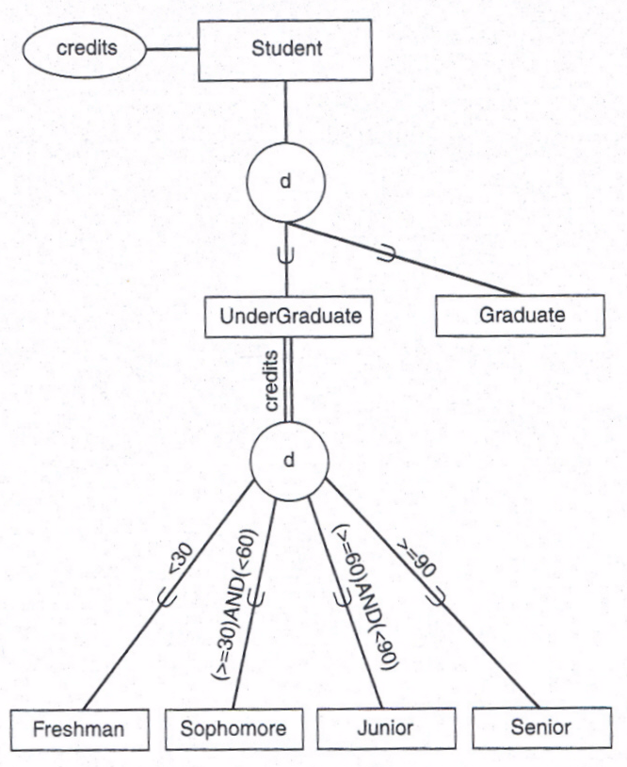
Attribute defined Specialization

Slide 12
Multiple Specializations
Can have different specializations for the same class
Ex. Figure 7.3(a) shows undergraduates specialized:
by year
and
by residence.
These are independent of each other

Slide 13
Multiple Inheritance
Can have shared subclasses – have multiple inheritance from two or more superclasses
Ex. Figure 7.3(b) shows Teaching Assistant as subclass of both Faculty and Student

Slide 14
Union or Category
Subclass is related to a collection of superclasses
Each instance of subclass belongs to one, not all, of the superclasses
Superclasses form a union or category
Ex. A Sponsor may be a team, a department, or a club – Figure 7.4(a), top portion
Each Sponsor entity instance is a member of one of these superclasses, so Sponsor is a subclass of the union of Team, Dept, Club
EER diagram - connect each superclass to union circle, connect circle to subclass, with subset symbol on line between circle and subclass

Slide 15
Total and Partial Unions
Total category – every member of the sets that make up the union must participate
  Shown on EER by double line from union circle to subset
  In Figure 7.4(b) every Concert or Fair must be a Campus-Wide Event
Partial category – not every member of the sets must participate
  Shown by single line
  In Figure 7.4(b) not every Club, Team, or Dept must be a Sponsor

Slide 16
Total Union vs. Specialization
Total union can often be replaced by specialization (hierarchy)
Choose hierarchy representation if superclasses have many common attributes
See Figure 7.4(b) Total and Partial Union
See Figure 7.5 Total Union replaced by Specialization/Generalization

Slide 17
(min..max) Notation for Relationships
Shows both cardinality and participation constraints
Can be used for both ER and EER diagrams
Use pair of integers (min..max) on line connecting entity to relationship diamond
  min is the least number of relationship instances an entity must participate in
  max is the greatest number it can participate in (can write M or N for many); some authors use * for many
  See Figure 7.6 and Figure 7.7

Slide 18
Question: Do you see any problem with this?
E-ID
Name
Pay Rate
EMPLOYEE
Is this any better?
E-ID
Name
Hourly-Rate
Salary
EMPLOYEE

Slide 19
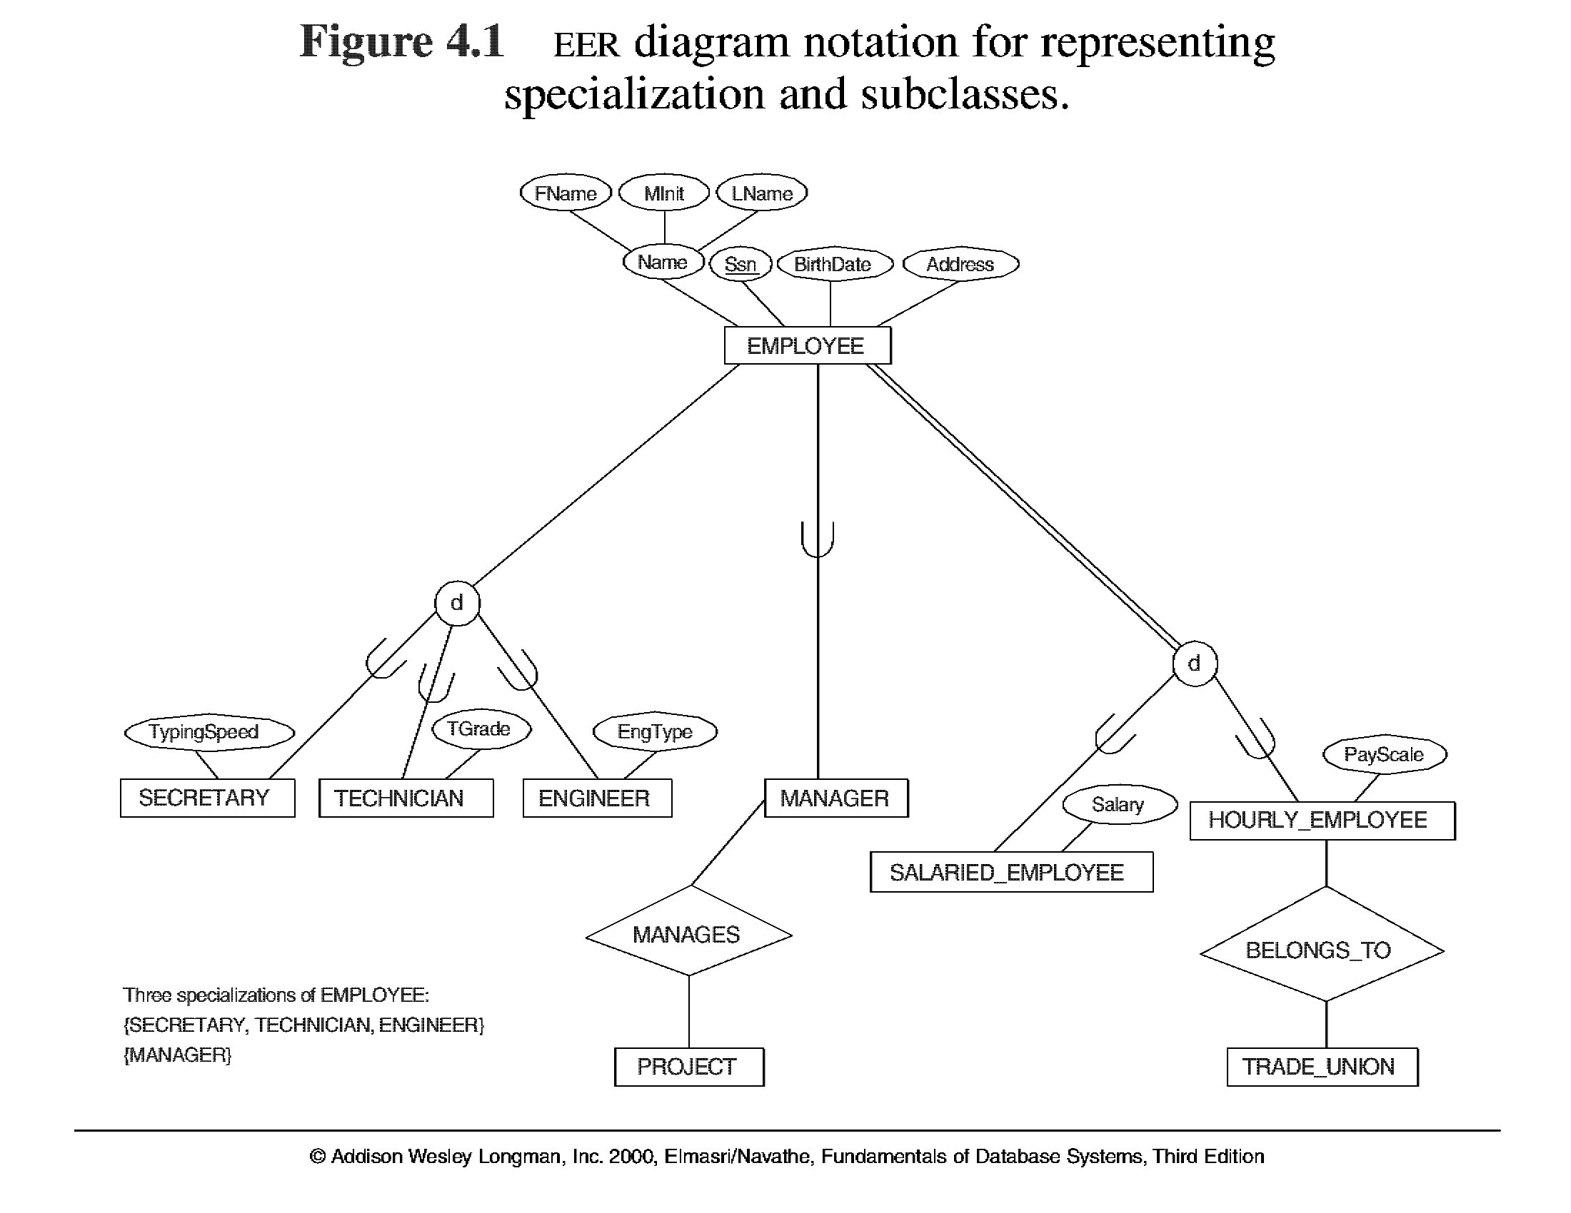
Reason for specialization:
Some attributes and relationship belong to a subset of an entity type but not to all entity types
Three Specializations of EMPLOYEE (SECRETARY, TECHNICIAN, ENGINEER)

Slide 20
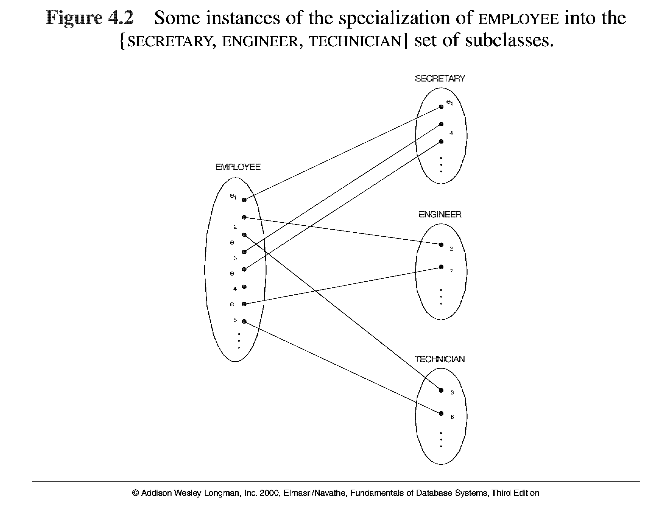
The subclasses are subsets of the superclass
Note the disjointness of these subclasses
This employee is not in any of these subclasses

Slide 21
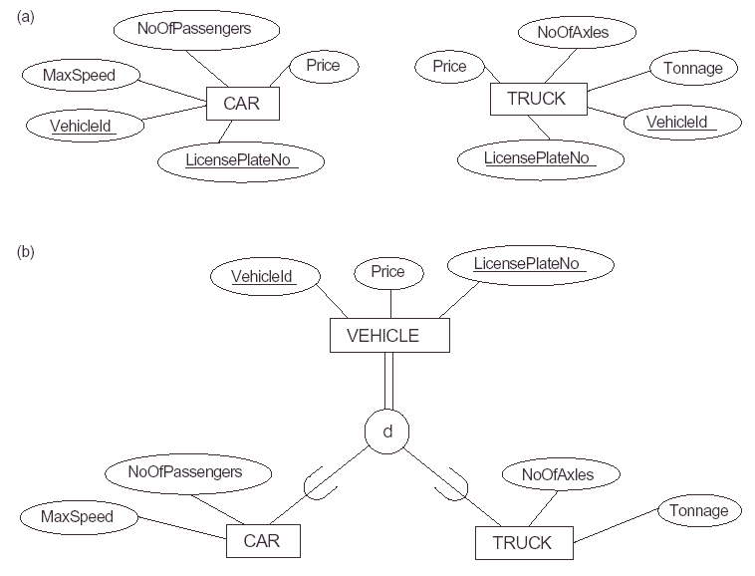

Slide 22

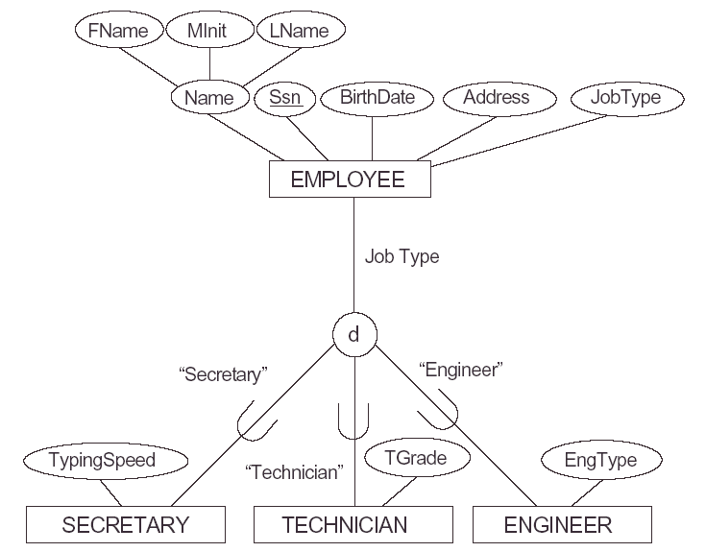

Slide 23

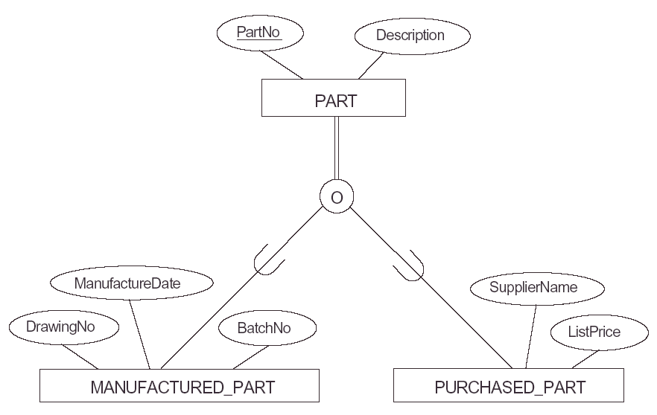
This is a total participation

Slide 24

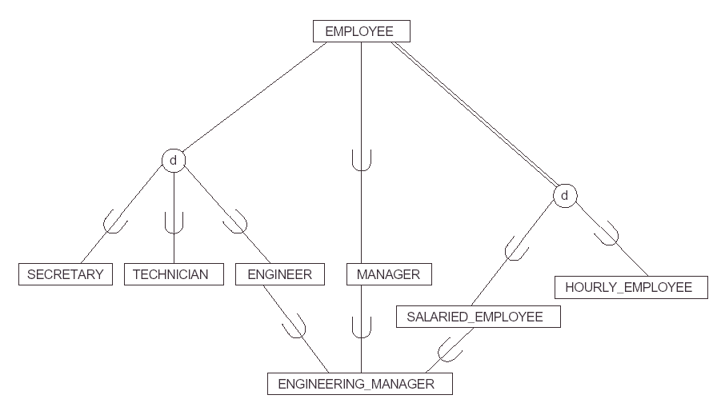
This indicates that an engineering manager must be engineer and salaried employee

Slide 25
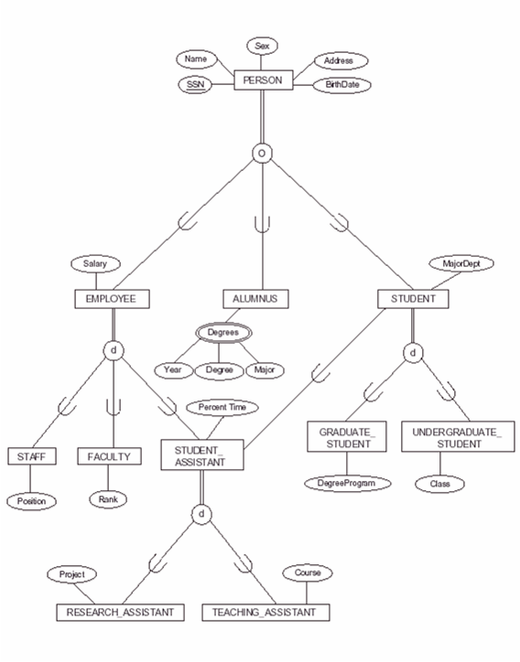

Slide 26

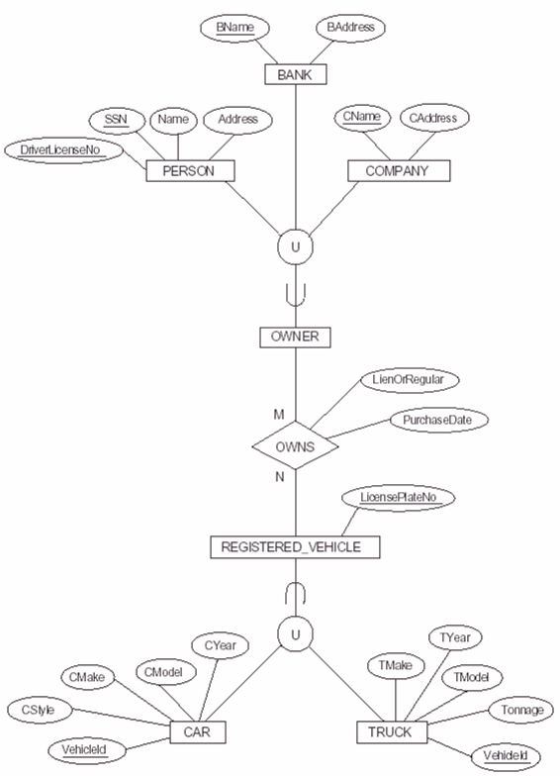

Slide 27
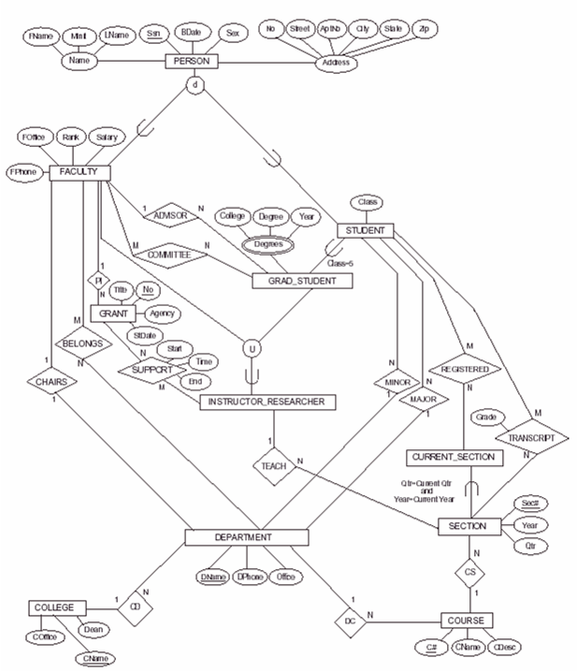

Slide 28
EER to Relational Model -1
For entity sets that are not part of generalization or union, do the mapping as usual
  Map strong entity sets to tables, with column for each attribute, but
    For composite attributes, create column for each component, or single column for composite
    For multi-valued attribute, create separate table with primary key of entity, plus multi-valued attribute as composite key
  Weak entity sets – include primary key of owner
  Binary Relationships
    1-M: use key of “one” side as foreign key in “many” side
    1-1: use either key as foreign key in the other’s table
    M-M: create relationship table with both primary keys
  Higher-Order Relationships-create relationship table

Slide 29
EER to Relational Model - 2
Mapping Class Hierarchies to Tables See Figure 7.1(a)
  Method 1: Create a table for superclass and one for each of the subclasses, placing primary key of superclass in each subclass
    Ex : Faculty(facId, lastName, firstName, rank)
    AdjunctFac(facId, coursePayRate)
    FullTimeFac(facId, annualSalary)
  Method 2: Create table for each subclass, including all attributes of superclass in each, with no table for superclass
    Ex: AdjunctFac(facId, lastName, firstName, rank, coursePayRate)
    FullTimeFac(facId, lastName, firstName, rank, annualSalary)
  Method 3: Create a single table with all attributes of superclass and of all subclasses
Ex: AllFac(facId, lastName, firstName, rank, annualSalary, coursePayRate)
  Variation of method 3 is to add a “type field” to each record, indicating subclass it belongs to

Slide 30
EER to Relational Model - 3
Mapping Unions Figure 7.4(b) and Figure 7.5
If supperclasses have the same keys,
  create table for the union itself, and individual tables for each of the superclasses, using foreign keys to connect them. Include a type code field in union table
Ex:
  CampusWideEvent(eventName, date, time, eventType)
  Concert(eventName, performer)
  Fair(eventName, theme, charity)
If superclasses have different primary keys, create a surrogate key which will be the primary key of the union, Include it in each supperclass.
Ex:
  Sponsor(sponsorId, sponsorType) Figure 7.4(b) Top part
  Club(clubName, president, numberOfMembers, sponsorId)
  Team(teamName, coach, sport, sponsorId)
  Department(deptName, deptCode, office, sponsorId)

Slide 31
Extending the Relational Data Model
Relational Data Model
  Allows single-valued attributes.
Object Relational Data Model
  Allows some of the features of Object-Oriented data model.
  SQL:1999 standard also extended the SQL language to support these new features.
Object-Oriented Data Model
  Is discussed in chapter 7.

Slide 32
SQL:1999 Object-Relational Features
Richer fundamental datatypes, including types for multimedia – text, images, video, audio, etc.
Collection types that can hold multiple attributes
User-defined datatypes, including user-written operations to manipulate them
Representation of class hierarchies, with inheritance of both data structures and methods
Reference or pointer types for objects
  enable us to refer to large objects such as multimedia files that are stored elsewhere
  Can also store relationships, replacing foreign keys
NOTE: This discussion is about standard SQL:1999. Oracle and other DBMSs have different syntax

Slide 33
New Datatypes
SQL:1999 added two new fundamental datatypes BOOLEAN and LOB as well as two new type constructors ARRAY and ROW.
  BOOLEAN
  Ex. To add a matriculated field to the Student table
  matriculated BOOLEAN DEFAULT false
  Large Object, LOB
    Store text, audio, video, multimedia objects, signatures, etc.
Two new type constructors (structured collection types) ARRAY and ROW were added.

Slide 34
LARGE OBJECT (LOB)
    Have very restricted functions, such as substring operations
    Comparisons only for equality or inequality,
    Cannot be used for ordering or in GROUP BY or ORDER BY clauses
    large files, normally simply stored and rarely retrieved again
    Manipulated using a LOB locator, a system-generated binary surrogate for the actual value.
    Ex:. If we stored students’ signatures, add in CREATE TABLE command
      signature CLOB REF IS sigid SYSTEM GENERATED,
      sigid is a pointer to the file containing an image of the signature
    Variants: BLOB (BINARY LARGE OBJECT) and CLOB (CHARACTER LARGE OBJECT)

Slide 35
Array Type
ARRAY[n]
  Ordered collection of values of the same base datatype stored as a single attribute
  must specify the base type
    attribute-name basetype ARRAY [n]
  Ex: If we allow students to have double majors, specify in CREATE TABLE
    majors VARCHAR(10) ARRAY[2], //Oracle does not use this syntax
  Use constructor to create array of values
    INSERT INTO Stu VALUES(‘S555’, ‘Quirk’,’Sean’, true, ARRAY[‘French’,’Psychology’], 30);
  Use standard square bracket notation to refer to individual elements
  SELECT Stu.majors[1]
  FROM Stu
  WHERE stuId = ‘S999’;

Slide 36
Declaring Row Type
declaration of ROW type
  sequence of pairs of field names and datatypes
  can use the ROW type declaration to create a datatype and then use the type to create a table
  Ex:
  CREATE ROW TYPE team_row_type(
  teamName CHAR(20),
  coach CHAR(30),
  sport CHAR(15));
  CREATE TABLE Team OF TYPE team_row_type;
can refer to an individual field using the dot notation, as in
  SELECT Team.coach
  FROM Team
  WHERE Team.sport= ‘soccer’;

Slide 37
Nested Tables Using Row Type
An attribute can have a row-type, allowing nested tables.
Ex: An attribute of a table can represent a team that the student belongs to:
  CREATE TABLE NewStu (
  stuId CHAR(6),
  ...
  team team_row_type,
  ...);

Slide 38
Arrays of Row Types
The ROW constructor can use any datatype for its fields, including ROW and ARRAY.
Ex: student’s record may have an array of teams:
CREATE TABLE NewStu2 (
stuId CHAR(6),
lastName CHAR(20) NOT NULL,
firstName CHAR(20) NOT NULL,
matriculated BOOLEAN DEFAULT false;
teams team_row_type ARRAY[3],
majors CHAR(10) ARRAY[2],
credits SMALLINT DEFAULT 0,
CONSTRAINT…);

Slide 39
Using Array and Row Constructors
Insert NewStu2 records using ARRAY and ROW constructors
INSERT INTO NewStu2 VALUES(‘S999’, ‘Smith’, ‘Michael’, true, ARRAY[ROW(‘Angels’,’Jones’,’soccer’), ROW(‘Devils’,’Chin’,’swimming’),ROW(‘Tigers’,’Walters’,’basketball’)], ARRAY[‘Math’, ‘Biology’], 60);

Slide 40
Accessing Attributes within Arrays and Rows
Can refer to the individual attributes using nested dot notation
Ex: To retrieve all coaches for teams that a student is on
SELECT NewStu2.teams.coach
FROM NewStu2
WHERE stuId = “S999’;
To get only the coach of the first team, use
SELECT NewStu2.teams[1].coach
FROM NewStu2
WHERE stuId = “S999’;

Slide 41
User Defined Data Types
User-defined DISTINCT Data Types
  Can construct user-defined DISTINCT data type, from a base type
  Ex:
CREATE DISTINCT TYPE
studentAgeType AS INTEGER;
CREATE DISTINCT TYPE numberOfCreditsType AS INTEGER;
cannot compare a studentAgeType
attribute with a numberofCreditsType attribute.

Slide 42
User-defined Structured Types
User-defined structured datatypes (UDTs) can have several attributes
Attributes can be any SQL type, including built-in types, LOB types, ARRAY or ROW types, or other structured types
Can nest structured types
a structured UDT can be either the type used for an attribute, or the type used for a table
Attributes can be stored items or they can be virtual
Type can be instantiable, which allows instances of the type to be created, or not instantiable
SQL provides a default constructor function for instantiable types
  Has the same name and datatype as the UDT
  Invoke it by using the name of the type
  Takes no parameters; assigns default values to the instance attributes
Users can also create their own constructors

Slide 43
Operations on UDTs
UDTs have only a few basic operations predefined on them
  Default constructor to initialize the attributes to default values.
  Automatic observer methods that return the values of attributes
  Automatic mutator methods that allow values to be assigned to attributes
  User can override these methods by redefining them, but they cannot be overloaded
Built-in functions (SUM, COUNT, MAX, MIN, AVG) are not defined for these types
Users define operations on their UDTs by building on the basic operations defined for the source types
The definition of a new type includes a list of its attributes and its methods
Methods are defined only for a single user-defined type, and do not apply to other types the user creates
Structured types can be manipulated using operations defined by the user as methods, functions, and procedures

Slide 44
Example of UDT
We define a new StudentType as follows:
CREATE TYPE StudentType AS
(stuId VARCHAR(6),
lastName VARCHAR(15),
firstName VARCHAR(12),
advisorId VARCHAR2(6),
credits SMALLINT,
dateOfBirth DATE)
METHOD addCredits(smallint);
Can optionally add
INSTANTIABLE
NOT FINAL

Slide 45
Type Definition Components
Type definition contains
  The name of the type
  List of attributes with their datatypes within parentheses
    Attributes can be previously-defined UDTs
  List of methods (if any) for the type
    Indicate the argument types and return type (if any) for each method
  Note that we do not indicate a primary key for the type, since we are defining a type, not a table

Slide 46
Writing and Using Methods
The code for the methods is written separately
Within the method, the implicit parameter is referred to as self
Ex: The code for the addCredits method might be
CREATE METHOD addCredits (numberOfCredits smallint) FOR StudentType
BEGIN
SET self.credits = self.credits + numberOfCredits;
END;
When invoked, a method takes an instance of the type as an implicit parameter.
Methods are invoked using dot notation.
Ex: if firstStudent is an instance of the StudentType, write
firstStudent.addCredits(3);

Slide 47
Constructing Object Tables
Ex: Using this new StudentType, can create a new version of the Student table:
CREATE TABLE Student of StudentType
(CONSTRAINT Student_stuId_pk PRIMARY KEY(stuId),
CONSTRAINT Student_advisorId_fk FOREIGN KEY (advisorId) REFERENCES Faculty (facId));
These are called object tables
They are tables that consist of a single UDT

Slide 48
Inserting Records into an Object Table
Use the constructor for the UDT
Ex: Use the StudentType type constructor, as in:
INSERT INTO Student
VALUES(StudentType('S999', 'Fernandes', 'Luis', ‘F101’, 0, ’25-Jan-1985’));
Can also insert records in the usual way, without invoking constructor

Slide 49
Using Methods for UDT
Invoke user-written methods using dot notation:
Ex. StudentType has the addCredits( ) method that we wrote earlier. Invoke by
myStudent.addCredits(3);
2. Invoking built-in accessor (observer) method:
attribute-name( ) returns the value of the named attribute of a tuple
Ex: to get the first Name of firstStudent:
firstStudent.firstName();
3. Invoking built-in mutator method:
attribute-name(value) assigns the value to the named attribute
Ex: to assign value of 30 to credits of secondStudent:
secondStudent.credits(30);

Slide 50
Type Hierarchies
Structured types can participate in type hierarchies
Subtypes inherit attributes and operations, may have additional attributes and operations of their own
if UDT is FINAL, no subtypes can be defined for it; if NOT FINAL, subtypes allowed
If type is NOT INSTANTIABLE, cannot create instances of that type, but if it has subtypes, instances of the subtypes can be created, if subtypes are instantiable

Slide 51
Example of Type Hierarchies
EX: Using StudentType, which was NOT FINAL, can define a subtype, UndergraduateType, by writing
CREATE TYPE UndergraduateType UNDER StudentType AS (major varchar(10) ARRAY[2])
INSTANTIABLE,
NOT FINAL;

Slide 52
Creating sub-table
Can create a sub-table of UndergraduateType
CREATE TABLE Undergraduate OF UndergraduateType UNDER Student;
The tuples of undergraduate table inherit all the attributes of Student tuples and have additional attribute which is array of majors.

Slide 53
UDT Functions, Methods, Procedures
UDTs and subtypes can have their own methods, functions, and procedures
Methods have implicit self parameter
Functions do not have implicit parameter, and must have a return type
Procedures have no return type
  can have input parameters, identified by the keyword IN
  output parameters, identified by OUT
  two-way parameters, identified by IN/OUT
  IN, OUT, IN/OUT is specified before the name of the formal parameter in the procedure heading

Slide 54
UDT Functions
Ex: can define a new function, hasDoubleMajor, for the Undergraduate subtype:
CREATE FUNCTION hasDoubleMajor (u UndergraduateType) RETURNS BOOLEAN
BEGIN
IF (u.major[2] IS NOT NULL)
THEN
RETURN TRUE;
ELSE
RETURN FALSE;
END IF;
END;
To use a function in a program, we must provide an actual
parameter of UndergraduateType –as in
IF (hasDoubleMajor(thirdStudent)) THEN...

Slide 55
UDT Procedures
Ex:
CREATE PROCEDURE countMajors(IN u UndergraduteStudent, OUT numberOfMajors SMALLINT)
BEGIN
numberOfMajors =0;
IF (u.majors[1] is NOT NULL) THEN numberOfMajors = numberOfMajors +1;
IF (u.majors[2] IS NOT NULL) THEN numberOfMajors = numberOfMajors +1;
END;
The procedure would be invoked in statements such as
countMajors(fourthStudent, count);
The output parameter can be used as in
IF (count = 2) THEN…

Slide 56
Subtypes of Subtypes
Can create a type called FreshmanType under UndergraduateType
CREATE TYPE FreshmanType UNDER UndergraduateType AS (peerMentor varchar(25))
INSTANTIABLE,
FINAL;
CREATE TABLE Freshmen OF FreshmanType UNDER Undergraduate;

Slide 57
Creating References
In strictly relational, foreign keys are used to establish relationships between tables
In object-relational tables can have attributes that are actually references or pointers to another type, in place of foreign keys
Ex: Suppose we had already defined FacultyType and a Faculty table of that type. Now we can define StudentType with a reference to the faculty advisor, called aId:
CREATE OR REPLACE TYPE StudentType AS (
(stuId VARCHAR(6),
lastName VARCHAR(15),
firstName VARCHAR(12),
aId REF(FacultyType) SCOPE Faculty,
credits SMALLINT,
dateOfBirth DATE)
METHOD addCredits(smallint);
Then to create the Student table, we write
CREATE TABLE Student OF StudentType;

Slide 58
System Generated Object Id
SQL:1999 requires that a table that will have a
reference to it contains an attribute for the identification of each tuple similar to a surrogate key.
Therefore when we create the table Faculty, we must add the reference attribute, whose value can be generated by the system.
CREATE TABLE Faculty of FacultyType
REF IS aid SYSTEM GENERATED

Slide 59
Using Reference Types
System generates values for references when tuples of the referenced types are inserted
User must explicitly find and set the reference value when a referencing tuple is inserted
Ex. To insert Student tuple, first insert with null reference for advisor’s aId
INSERT INTO Student VALUES(‘S555’, ‘Hughes’,’John’, null, 0,’04-Jan-1988’);
Then update the tuple using a sub-query to find reference to the advisor
UPDATE Student UPDATE Student
SET aId = (SELECT f.aid SET aId = ‘F101’ FROM Faculty AS f WHERE stuId = ‘S555’;
WHERE facId = ‘F101’)
WHERE stuId =’S555’; will this work?

Slide 60
Dereferencing a reference
In queries, can use DEREF operator to find the entire referenced tuple.
SELECT s.lastName, s.firstName, DEREF(s.aId), s.dateOfBirth
FROM Student s
WHERE s.lastName =’Smith’;
Can use the -> operator to retrieve the value of an attribute of the tuple referenced
aId-> lastName
Retrieves the last name of the Faculty advisor
// Note: Oracle uses different method and syntax for references

Slide 61
Converting an EER Diagram to an Object-Relational Database
Entity sets and relationships that are not part of generalizations or unions
  Proceed as in the relational model
  Entities map to tables, either using SQL2 syntax or creating a type and using that type for the table
  For composite attributes, can use ROW type, or define a structured type for the composite, with the components as attributes of the type.
  For multi-valued attributes use ARRAY
  For relationships, reference types can be used in place of the foreign key
For specialization hierarchies, types and subtypes can be defined, and tables and sub-tables UNDER them to correspond to the types
No subtype can have multiple inheritance
  choose among potential supertypes for a shared subtype
  subtype’s relationship to other supertype(s) expressed using references or foreign keys
No direct representation of unions (categories)
  can use the same method as for relational model
    create a table for the union itself, and individual tables for each of the superclasses, using foreign keys or references to connect them.

Slide 62
HomeWork #5
New Book:
Do the Exercises 8.1, 8.2 and 8.3
Old Book:
Do the Exercises 7.1, 7.2 and 7.3

