Slide 1
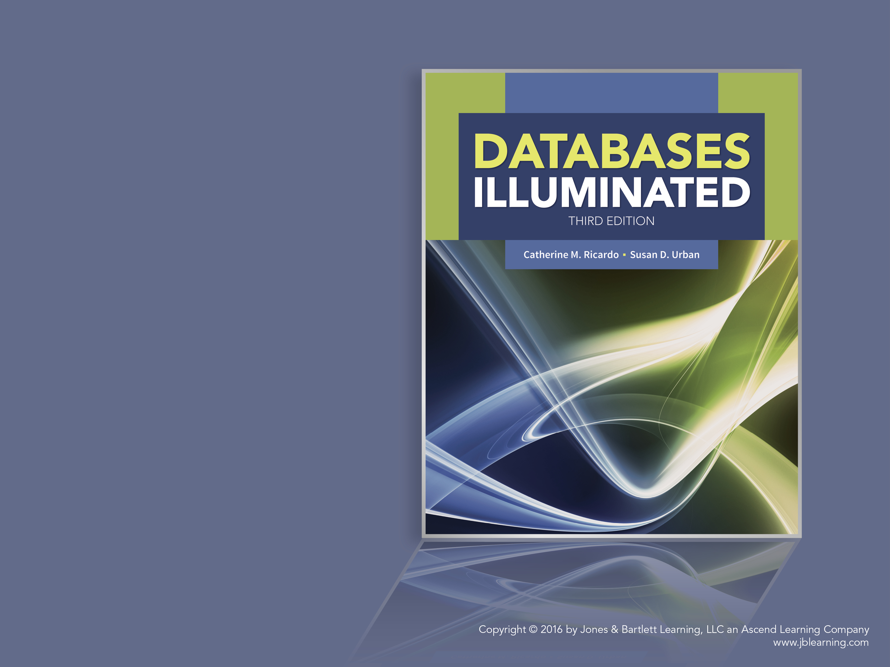
Databases Illuminated
Chapter 9
Transaction Management

Slide 2
Protecting the Database During Transactions
Concurrency control-allows simultaneous use of the database without having users interfere with one another
Recovery-restoring the database to a correct state after a failure
Both protect the database

Slide 3
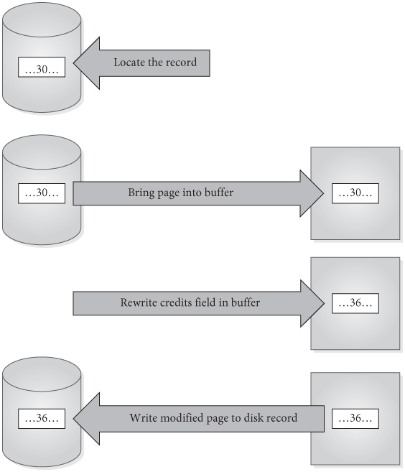
Steps in a Transaction
Simple update of one record:
  Locate the record to be updated
  Bring the page into the buffer
  Write the update to buffer
  Write the modified page out to disk
Figure 9.1

Slide 4
Steps in a Transaction
More complicated transactions may involve several updates
Modified buffer page might not be written to disk immediately after transaction terminates-must assume there is a delay before actual disk write is done

Slide 5
Basic Ideas About Transactions
Transaction- a logical unit of work that takes the database from one consistent state to another
Transactions can terminate successfully and commit or unsuccessfully and be aborted
Aborted transactions must be undone (rolled back) if they changed the database
Committed transactions cannot be rolled back
  See Figure 9.2

Slide 6
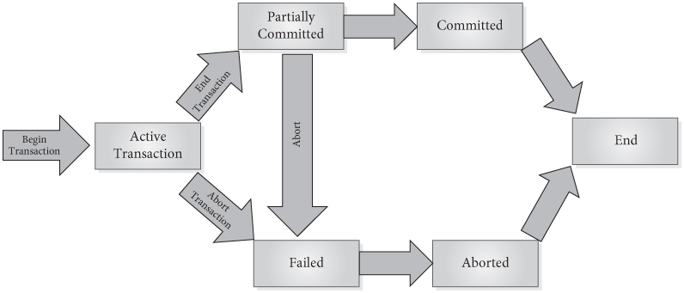
Figure 9.2 Transaction State Diagram

Slide 7
ACID Properties of Transactions
Atomicity
  Single “all or none” unit; entire set of DB update operations carried out or none are
  DBMS must roll back-UNDO- transactions that will not be able to complete successfully if they have changed the database
  Log of transactions’ writes used in the rollback process
Consistency
  Users responsible for ensuring that each transaction, executed individually, leaves the database in a consistent state
  Concurrency control subsystem must ensure this for multiple transactions
Isolation
  When transactions execute simultaneously, DBMS ensures that the final effect is as if the transactions were executed one after another (serially)
Durability
  Effect of any committed transaction is recorded in the database, even if the system crashes before all its writes are made to the database
  Recovery subsystem must guarantee durability

Slide 8
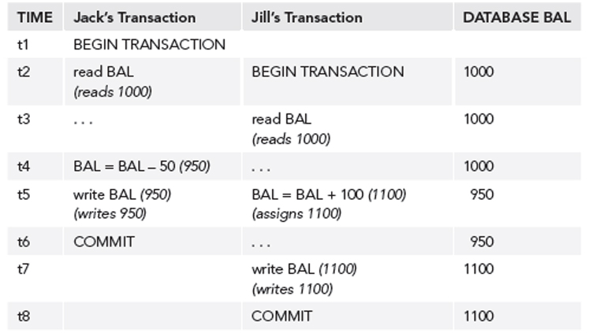
Concurrency Problems
Concurrency control needed when transactions are permitted to process simultaneously, if at least one is an update
Potential problems due to lack of concurrency control:
  Lost update problem-
Figure 9.3

Slide 9
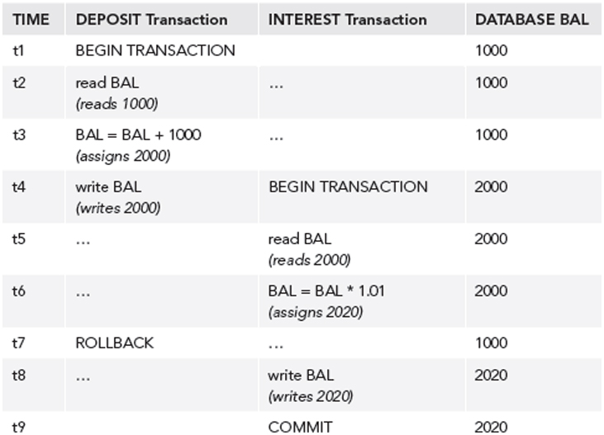
Concurrency Problems
  Uncommitted update problem-
Figure 9.4

Slide 10
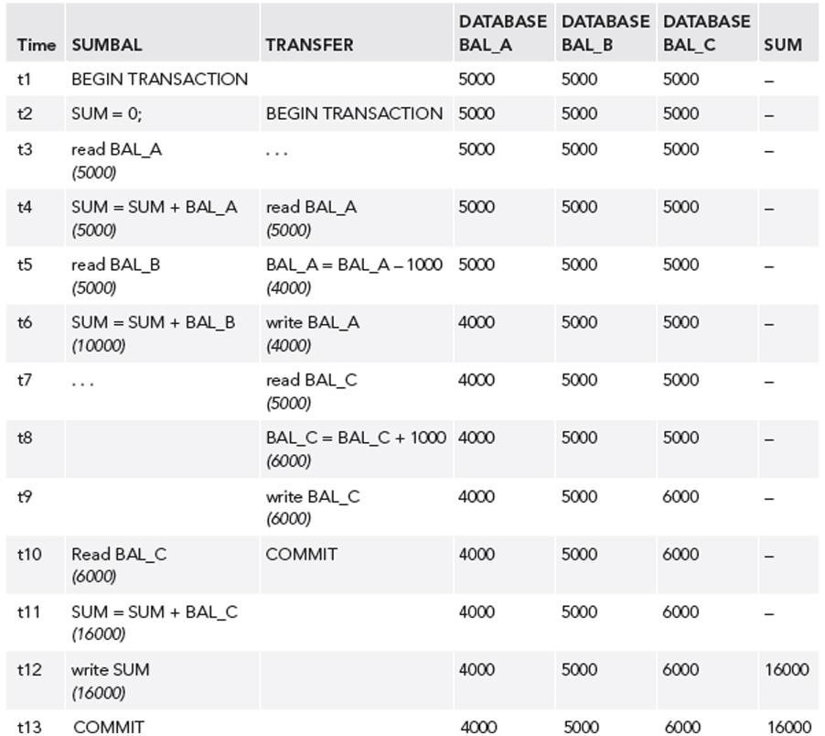
Concurrency Problems
  Inconsistent analysis problem-
Figure 9.5

Slide 11
Concurrency Problems
  Non-repeatable read problem-first transaction reads an item; second transaction writes a new value for the item; first transaction rereads the item and gets a different value
  Phantom data problem- first transaction reads a set of rows; second transaction inserts a row; first transaction reads the rows again and sees the new row

Slide 12
Conflict in Transactions
If two transactions are only reading data items, they do not conflict and order is not important
If two transactions operate on completely separate data items, they do not conflict and order is not important
If one transaction writes to a data item and another either reads or writes to the same data item, then the order of execution is important
Therefore, two operations conflict only if all of these are true
  they belong to different transactions
  they access the same data item
  at least one of them writes the item

Slide 13
Serial vs. Interleaved Execution
Interleaved execution – control goes back and forth between operations of two or more transactions
Serial execution- execute one transaction at a time, with no interleaving of operations. Ex. A, then B
  Can have more than one possible serial execution for two or more transactions –Ex:A,B or B,A
  For n transactions, there are n! possible serial executions
  They may not all produce the same results
  However, DB considers all serial executions to be correct
  See Figure 9.6

Slide 14
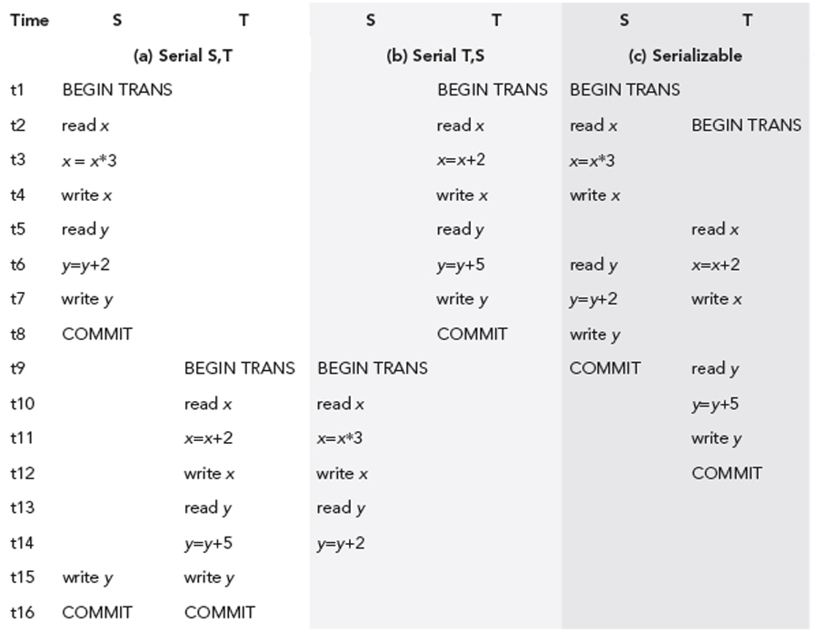
Figure 9.6 Two Serial Schedules and a Serializable Schedule for Transactions S and T

Slide 15
Serializable Schedules
A schedule is used to show the timing of the operations of one or more transactions
Shows the order of operations
Schedule is serializable if it produces the same results as if the transactions were performed serially in some order
Objective is to find serializable schedules to maximize concurrency while maintaining correctness

Slide 16
Conflict Serializability
If schedule orders any conflicting operations in the same way as some serial execution, the results of the concurrent execution are the same as the results of that serial schedule
This type of serializability is called conflict serializability

Slide 17
Precedence Graph
Used to determine whether a schedule, S, is conflict serializable
Draw a node for each transaction, T1, T2, …Tn. For the schedule, draw directed edges as follows
  If Ti writes x, and then Tj reads x, draw edge from Ti to Tj
  If Ti reads x, and then Tj writes x, draw edge from Ti to Tj
  If Ti writes x, and then Tj writes x, draw edge from Ti to Tj
S is conflict serializable if graph has no cycles
If S is serializable, we can use the graph to find an equivalent serial schedule by examining the edges
  If an edge appears from Ti to Tj, put Ti before Tj
  If several nodes appear on the graph, we usually get a partial ordering of graph
  May be several possible serial schedules

Slide 18
Methods to Ensure Serializability
Locking
Timestamping
Concurrency control subsystem is "part of the package" and not directly controllable by either the users or the DBA
A scheduler is used to allow operations to be executed immediately, delayed, or rejected
If an operation is delayed, it can be done later by the same transaction
If an operation is rejected, the transaction is aborted but it may be restarted later

Slide 19
Locks
Transaction can ask DBMS to place locks on data items
Lock prevents another transaction from modifying the object
Transactions may be made to wait until locks are released before their lock requests can be granted
Objects of various sizes (DB, table, page, record, data item) can be locked.
Size determines the fineness, or granularity, of the lock
Lock implemented by inserting a flag in the object or by keeping a list of locked parts of the database
Locks can be exclusive or shared by transactions
  Shared locks are sufficient for read-only access
  Exclusive locks are necessary for write access
Figure 9.8

Slide 20
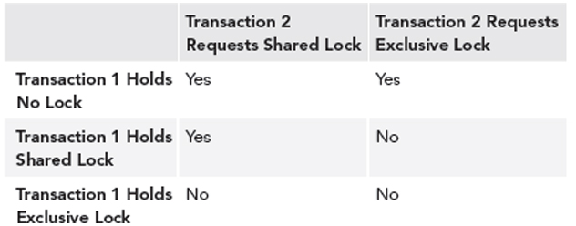
Figure 9.8 Lock Compatibility Matrix

Slide 21
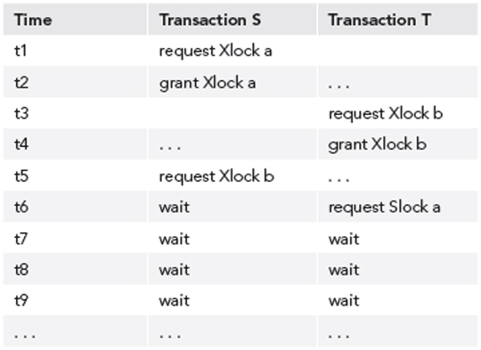
Deadlock
Often, transaction cannot specify in advance exactly what records it will need to access in either its read set or its write set
Deadlock- two or more transactions wait for locks being held by each another
Deadlock detection uses a wait-for graph to identify deadlock
  Draw a node for each transaction
  If transaction S is waiting for a lock held by T, draw an edge from S to T
Cycle in the graph shows deadlock
Figure 9.9 Deadlock with Two Transactions

Slide 22
Deadlock
Deadlock is resolved by choosing a victim-newest transaction or one with least resources
Should avoid always choosing the same transaction as the victim, because that transaction will never complete - called starvation

Slide 23
Two-phase locking protocol
Guarantees serializability
Every transaction acquires all its locks before releasing any, but not necessarily all at once
Transaction has two phases:
  In growing phase, transaction obtains locks
  In shrinking phase, it releases locks
Once it enters its shrinking phase, a transaction can never obtain a new lock
For standard two-phase locking, the rules are
  Transaction must acquire a lock on an item before operating on the item.
  For read-only access, a shared lock is sufficient. For write access, an exclusive lock is required.
  Once the transaction releases a single lock, it can never acquire any new locks
Deadlock can still occur

Slide 24
Cascading Rollbacks
Cascading rollback.
  Locks can be released before COMMIT in standard two-phase locking protocol
  An uncommitted transaction may be rolled back after releasing its locks
  If a second transaction has read a value written by the rolled back transaction, it must also roll back, since it read dirty data
Avoiding cascading rollback
  Strict two phase locking: transactions hold their exclusive locks until COMMIT, preventing cascading rollbacks
  Rigorous two-phase locking: transactions hold all locks, both shared and exclusive, until COMMIT

Slide 25
Lock Upgrading and Downgrading
Transaction may at first request shared locks-allows other transactions concurrent read access to the items
When transaction is ready to do an update, it requests that the shared lock be upgraded, converted into an exclusive lock
Upgrading can take place only during the growing phase, and may require that the transaction wait until another transaction releases a shared lock on the item
Once an item has been updated, its lock can be downgraded, converted from exclusive to shared mode
Downgrading can take place only during the shrinking phase.

Slide 26
Intention Locking
Can represent database objects as a hierarchy by size
Root node is DB, level 1 tables, level 2 pages, level 3 records, level 4 data items
If a node is locked, all its descendants are also locked
If a second transaction requests an incompatible lock on the same node, system knows that the lock cannot be granted
If second transaction requests a lock on any descendant, system checks to see if any of its ancestors are locked before deciding whether to grant the lock
If a transaction requests a lock on a node when a descendant is already locked, we don’t want to search too much to determine this
  Need an intention lock, shared or exclusive-shows some descendant is probably locked
Two-phase protocol is used
  No lock can be granted once any node has been unlocked
  No node may be locked until its parent is locked by an intention lock
  No node may be unlocked until all its descendants are unlocked
Apply locking from the root down, using intention locks until the node is reached, and release locks from leaves up
Deadlock is still possible

Slide 27
Timestamping
Each transaction has a timestamp; gives the relative order of the transaction
Timestamp could be clock reading or logical counter
Each data item, P, has
  a Read-Timestamp(P)-timestamp of last transaction that read the item
  a Write-Timestamp(P)-timestamp of last transaction that wrote the item
Problems
  Transaction tries to read an item already updated by a younger transaction (late read)
  Transaction tries to write an item already updated by a later transaction (late write)
Protocol takes care of these problems by rolling back transactions that cannot execute correctly

Slide 28
Basic Timestamping Protocol
Compare TS(T) with Write-Timestamp(P) and/or Read-Timestamp(P), which identify the transaction(s) that last wrote or read the data item, P
1. If T asks to read P, compare TS(T) with Write-Timestamp(P)
  (a) If Write-Timestamp(P) <= TS(T) then proceed using the current data value and replace Read-Timestamp(P) with TS(T). However, if Read-Timestamp(P) is already larger than TS(T), just do the read and do not change Read-Timestamp(P)
  (b) If Write-Timestamp(P) > TS(T), then T is late doing its read, and the value of P that it needs is already overwritten, so roll back T
2. If T asks to write P, compare TS(T) with both Write-Timestamp(P) and the Read-Timestamp(P)
  (a) If Write-Timestamp(P) <= TS(T) and Read-Timestamp(P) <= TS(T), do the write and replace Write-Timestamp(P) with TS(T)
  (b) else roll back T, assign a new timestamp, and restart T

Slide 29
Thomas’ Write Rule
Variation of the basic timestamping protocol that allows greater concurrency
Applies when T is trying to write P, but new value has already been written for P by a younger transaction
If a younger transaction has already read P, then it needed the value that T is trying to write, so roll back T and restart it
Otherwise ignore T’s write of P, and let T proceed

Slide 30
Multi-versioning
Concurrency can be increased if we allow multiple versions of data items to be stored
Transactions can access the version that is consistent for them
Data item P has a sequence of versions <P1, P2, …, Pn>, each of which has
  The content field, a value for Pi,
  Write-Timestamp(Pi), timestamp of transaction that wrote the value
  Read-Timestamp(Pi), timestamp of youngest transaction that has read version Pi
When write(P) is done, a new version of P is created, with appropriate write-timestamp
When read(P) is done, the system selects the appropriate version of P

Slide 31
Multi-version Timestamp Protocol
When T does a read(P)
  Value used is the value of the content field associated with the latest Write-Timestamp that is less than or equal to TS(T)
  Read-Timestamp is set to later of TS(T) or current value
When T does a write(P)
  Version used is the one whose write timestamp is the largest one that is less than or equal to TS(T)
  For that version
    If Read-Timestamp(P) > TS(T), P has already been read by a younger transaction, so roll back T, since it would be a late write
    Else create a new version of P, with read and write timestamps TS(T)

Slide 32
Optimistic Techniques
Also called validation techniques
Assume that conflict will be rare
Transactions proceed as if there were no concurrency problems
Before a transaction commits, perform check to determine whether a conflict has occurred
If there is a conflict, the transaction must be rolled back
Assume rollback will be rare
Rollback is the price to be paid for eliminating locks
No cascading rollbacks, because writes are to local copy only
Allow more concurrency, since no locking is done

Slide 33
Phases in Validation Techniques
Transaction goes through two phases for read-only, three for updating:
  Read phase, from transaction’s start until just before it commits
    reads all the variables it needs, stores them in local variables
    Does any writes to local copy of the data, not to the database
  Validation phase, follows the read phase
    Tests to determine whether there is any interference
    For read-only transaction, checks to see that there was no error due to another transaction active when the data values were read. If no error, the transaction is committed. If interference occurred, the transaction is aborted and restarted
    For a transaction that does updates, checks whether the current transaction will leave the database in a consistent state, with serializability. If not, the transaction is aborted.
  Write phase, follows successful validation phase for update transaction
    The updates made to the local copy are applied to the database

Slide 34
Validation Phase
Examines reads and writes of other transactions,T, that may cause interference
Each other transaction, T, has three timestamps
  Start(T), the relative starting time of the transaction
  Validation(T), given at the end of its read phase as it enters its validation phase
  Finish(T), the time it finished (including its write phase, if any)
To pass the validation test, one of the following must be true:
All transactions with earlier timestamps must have finished (including their writes) before the current transaction started
OR
2. If the current transaction starts before earlier one finishes, then both of these are true
a) the items written by the earlier transaction are not the ones read by the current transaction, and
b) the earlier transaction completes its write phase before the current transaction enters its validation phase
  Rule (a) guarantees that the writes of the earlier transaction are not read by the current transaction; rule (b) guarantees that the writes are done serially

Slide 35
Need for Recovery
Many different types of failures can affect database processing
Some causes of failure
  Natural physical disasters
  Sabotage
  Carelessness
  Disk malfunctions- result in loss of stored data
  System crashes due to hardware malfunction-result in loss of main and cache memory
  System software errors-result in abnormal termination or damage to the DBMS
  Applications software errors

Slide 36
Possible Effects of Failure
Loss of main memory, including database buffers
Loss of the disk copy of the database
Failure to write data safely to disk
DBMS recovery subsystem uses techniques that minimize these effects

Slide 37
Recovery Manager
DBMS subsystem responsible for ensuring atomicity and durability for transactions in the event of failure
Atomicity-all of a transaction is performed or none
  Recovery manager ensures that all the effects of committed transactions reach the database, and that the effects of any uncommitted transactions are undone
Durability-effects of a committed transaction are permanent
  Effects must survive loss of main memory, loss of disk storage, and failure to write safely to disk

Slide 38
Loss of Disk Data
Handled by doing frequent backups-making copies of the database
In case of disk failure, the backup can be brought up to date using a log of transactions
Good practice to have mirrored disks, other RAID storage, or remote live backup site

Slide 39
Handling Failure to Write
Modified pages are written first to the local disk and then to the mirror or remote disk
After both writes are complete, the output is considered to be done
If a data transfer error is detected, examine both copies
  If they are identical, the data is correct
  If one has an error condition, use the other copy to replace the faulty data
  If neither has an error condition but they have different values, replace the first copy with the second, which undoes the write- can redo later

Slide 40
System Failure
If system failure occurs
  Database buffers are lost
  Disk copy of the database survives, but it may be incorrect, due to partial transactions
A transaction can commit once its writes are made to the database buffers
Updates made to buffer are not automatically written to disk, even for committed transactions
May be a delay between commit and actual disk writing
If system fails during this delay, we must ensure that these updates reach the disk copy of the database

Slide 41
Recovery Log
Contains records of each transaction showing
  The start of transaction
  Write operations of transaction
  End of transaction
If system fails, the log is examined to see what transactions to redo and/or what transactions to undo
Redo means redoing writes, not re-executing the transaction; undo means rolling back writes
Several different protocols are used

Slide 42
Deferred Update Protocol
DBMS does all database writes in the log, and does not write to the database until the transaction is ready to commit
Uses the log to protect against system failures:
  When transaction T starts, write a record <T starts> to the log
  When transaction T writes a new value, n, for x, write log record of form <T,x,n>; do not write to database or buffers
  Before commit, write log record <T commits>, write all the log records for the transaction to disk, then commit
  Use log records to perform the updates to the database buffers. Later, these updated pages will be written to disk
  If the transaction aborts, ignore the log records
  a redo/no undo method

Slide 43
Checkpoints
After a failure, we may not know how far back in the log to search for redo of transactions
Can limit log searching using checkpoints
Scheduled at predetermined intervals
Checkpoint operations
  Write modified blocks in the database buffers to disk
  Write a checkpoint record to the log-contains the names of all transactions that are active at the time of the checkpoint
  Write all log records now in main memory out to disk

Slide 44
Using Checkpoint Records
When a failure occurs, check the log
If transactions are performed serially
  Find the last transaction that started before the last checkpoint
  Any earlier transaction would have committed previously and would have been written to the database at the checkpoint
  Need only redo the one that was active at the checkpoint (provided it committed) and any subsequent transactions for which both start and commit records appear in the log
If transactions are performed concurrently
  Checkpoint record contains the names of all transactions that were active at checkpoint time
  Redo all those transactions (if they committed) and all subsequent ones that committed

Slide 45
Immediate Update Protocol
Updates are applied to the database buffers as they occur and written to the database itself when convenient
A log record is written first, since this is a write-ahead log protocol
Protocol
  When a transaction T starts, write record <T starts> to the log
  When T performs a write operation to x, write a log record <T,x,o,n> with old(o) and new(n) values for x
  After writing log record, write the update to the database buffers
  When convenient, write the log records to disk and then write updates to the database itself
  When the transaction commits, write a record of the form <T commits> to the log

Slide 46
Using the Immediate Update Log
If a transaction aborts, use log to undo it, since it contains all the old values for the updated fields
  Writes are undone in reverse order
  Writing the old values means the database will be restored to its state prior to the start of the transaction
If the system fails
  In recovery, use the log to undo or redo transactions, making this a redo/undo protocol
  For a transaction T, if both <T starts> and <T commits> appear in the log, redo T, using the log records to write the new values of updated fields-any write that did not actually reach the database will now be performed
  For a transaction S, if the log contains an <S starts> record, but not an <S commits> record, need to undo S – use log records to write the old values of the affected fields, in reverse order

Slide 47
Shadow Paging-Page Tables
Alternative to logging
DBMS keeps page table with pointers to all current database pages
Keeps both a current page table and a shadow page table, which are initially identical
All modifications are made to the current page table-shadow table is left unchanged
To modify a database page, system finds an unused page on disk, copies the old database page to the new one, and makes changes to the new page
Updates the current page table to point to the new page

Slide 48
Shadow Paging-Transaction End
If the transaction completes successfully, current page table becomes the shadow page table
  Write all modified pages from database buffers to disk
  Copy the current page table to disk
  In the location on disk where the address of the shadow page table is recorded, write the address of the current page table, making it the new shadow page table
If the transaction fails, new pages are ignored; shadow page table becomes the current page table

Slide 49
ARIES Recovery Technique
Flexible, efficient method for recovery
Each log record given a unique log sequence number (LSN), assigned in increasing order
Each log record records the LSN of the previous log record for the same transaction, forming a linked list
Each database page has a pageLSN, the LSN of the last log record that updated it
Transaction table -entry for each active transaction, with the transaction identifier, the status, and the lastLSN, the LSN of the latest log record for the transaction
Dirty page table has an entry for each page in the buffer that has been updated but not yet written to disk, and the recLSN, the LSN of the oldest log record for any update to the buffer page
Uses write-ahead logging-log record is written to disk before any database disk update
Does checkpointing to limit log searching

Slide 50
ARIES Recovery Protocol
Tries to repeat history during recovery-repeats all database actions done before the crash, even of incomplete transactions
Does redo and undo as needed
Three phases
  Analysis: begins with most recent checkpoint record, reads forward in the log-identifies which transactions were active at failure; uses transaction table and dirty page table to determine which buffer pages contain updates not yet written to disk; determines how far back in the log it needs to go to recover, using the linked lists of LSNs
  Redo: from starting point in the log identified during analysis, goes forward in the log, applies all the unapplied updates from the log records
  Undo: going backwards from the end of the log, undoes updates done by uncommitted transactions, ending at the oldest log record of any transaction that was active at the time of the crash

Slide 51
Oracle Transactions
Oracle transaction consists of one or more DML statements that form a unit of work, or a single DDL statement
Every transaction has a beginning and an end point – implicit or explicit
Transaction begins with either
  the first executable SQL statement
  or the SET TRANSACTION statement
Transaction ends when
  a COMMIT or ROLLBACK is reached
  or the user exits
  or the program terminates
  or a DDL command is reached

Slide 52
Oracle Transaction Management
Multi-version concurrency control mechanism, with no read locks, but several types of write locks
For read-only transaction, uses a consistent view of the database at the point in time when it began, including only those updates that were committed at that time
Creates rollback segments (undo data segments) with the older versions of data items-used for both read consistency and undo operations that may be needed
Transaction table within the undo segment has the IDs of transactions using the segment
Each transaction gets an ID and a slot on the transaction table; its log entries show that ID; uses immediate update protocol
Uses type of timestamp called a system change number (SCN) for each database update
Programmer can specify SAVEPOINTs for possible rollbacks

Slide 53
Oracle Isolation Level
Several types of locks available, including both DML and DDL locks
  DDL locks are applied at the table level
  DML locks are at the row-level
Uses a deadlock detection scheme, and rolls back if needed
Provides three isolation levels, degrees of protection from other transactions
  Read committed: statement level consistency-default level-guarantees that each statement in a transaction reads only data committed before it started-there may be non-repeatable reads and phantom data
  Serializable: transaction-level consistency-ensures that a transaction sees only data committed before the transaction started
  Read-Only: transaction-level consistency for read-only transactions-read transaction sees consistent snapshot of DB
Can specify level at start of transaction
  SET TRANSACTION ISOLATION LEVEL READ COMMITTED;
  SET TRANSACTION ISOLATION LEVEL SERIALIZABLE;
  SET TRANSACTION READ ONLY;

Slide 54
Oracle Table Lock Modes
To obtain a lock, user writes
EXEC SQL LOCK TABLE tablename IN mode MODE [NOWAIT /WAIT];
Modes are
  ROW SHARE or SHARE UPDATE (RS): allows concurrent reading of the table, but no exclusive lock on the table by other users
  ROW EXCLUSIVE (RX): prevents other users from obtaining either a shared or exclusive lock on the table
  SHARE (S): allows concurrent queries but not updates of the locked table.
  SHARE ROW EXCLUSIVE (SRX): allows other users to read rows of the table concurrently, but not to lock the table in SHARE mode or to update rows of the table
  EXCLUSIVE(X) allows others to read the table, but no other activity on it
NOWAIT-transaction will not wait for lock-will return control to the transaction if the lock is not available immediately
WAIT-transaction will wait a specified number of seconds for a lock before returning control

Slide 55
Oracle Recovery
Recovery manager (RMAN) is a GUI tool that the DBA can use to control backup and recovery operations
RMAN can make backups of the database or parts of it, backups of recovery logs, can restore data from backups, can perform recovery operations of redo, undo
Maintains control files, rollback segments, redo logs, and archived redo logs
When a redo log is filled, it can be archived automatically
Can also provide a managed standby database
  Copy of the operational database kept at another location
  Takes over if the regular database fails
  Kept nearly up to date by shipping the archived redo logs and applying the updates to the standby database

