Slide 1
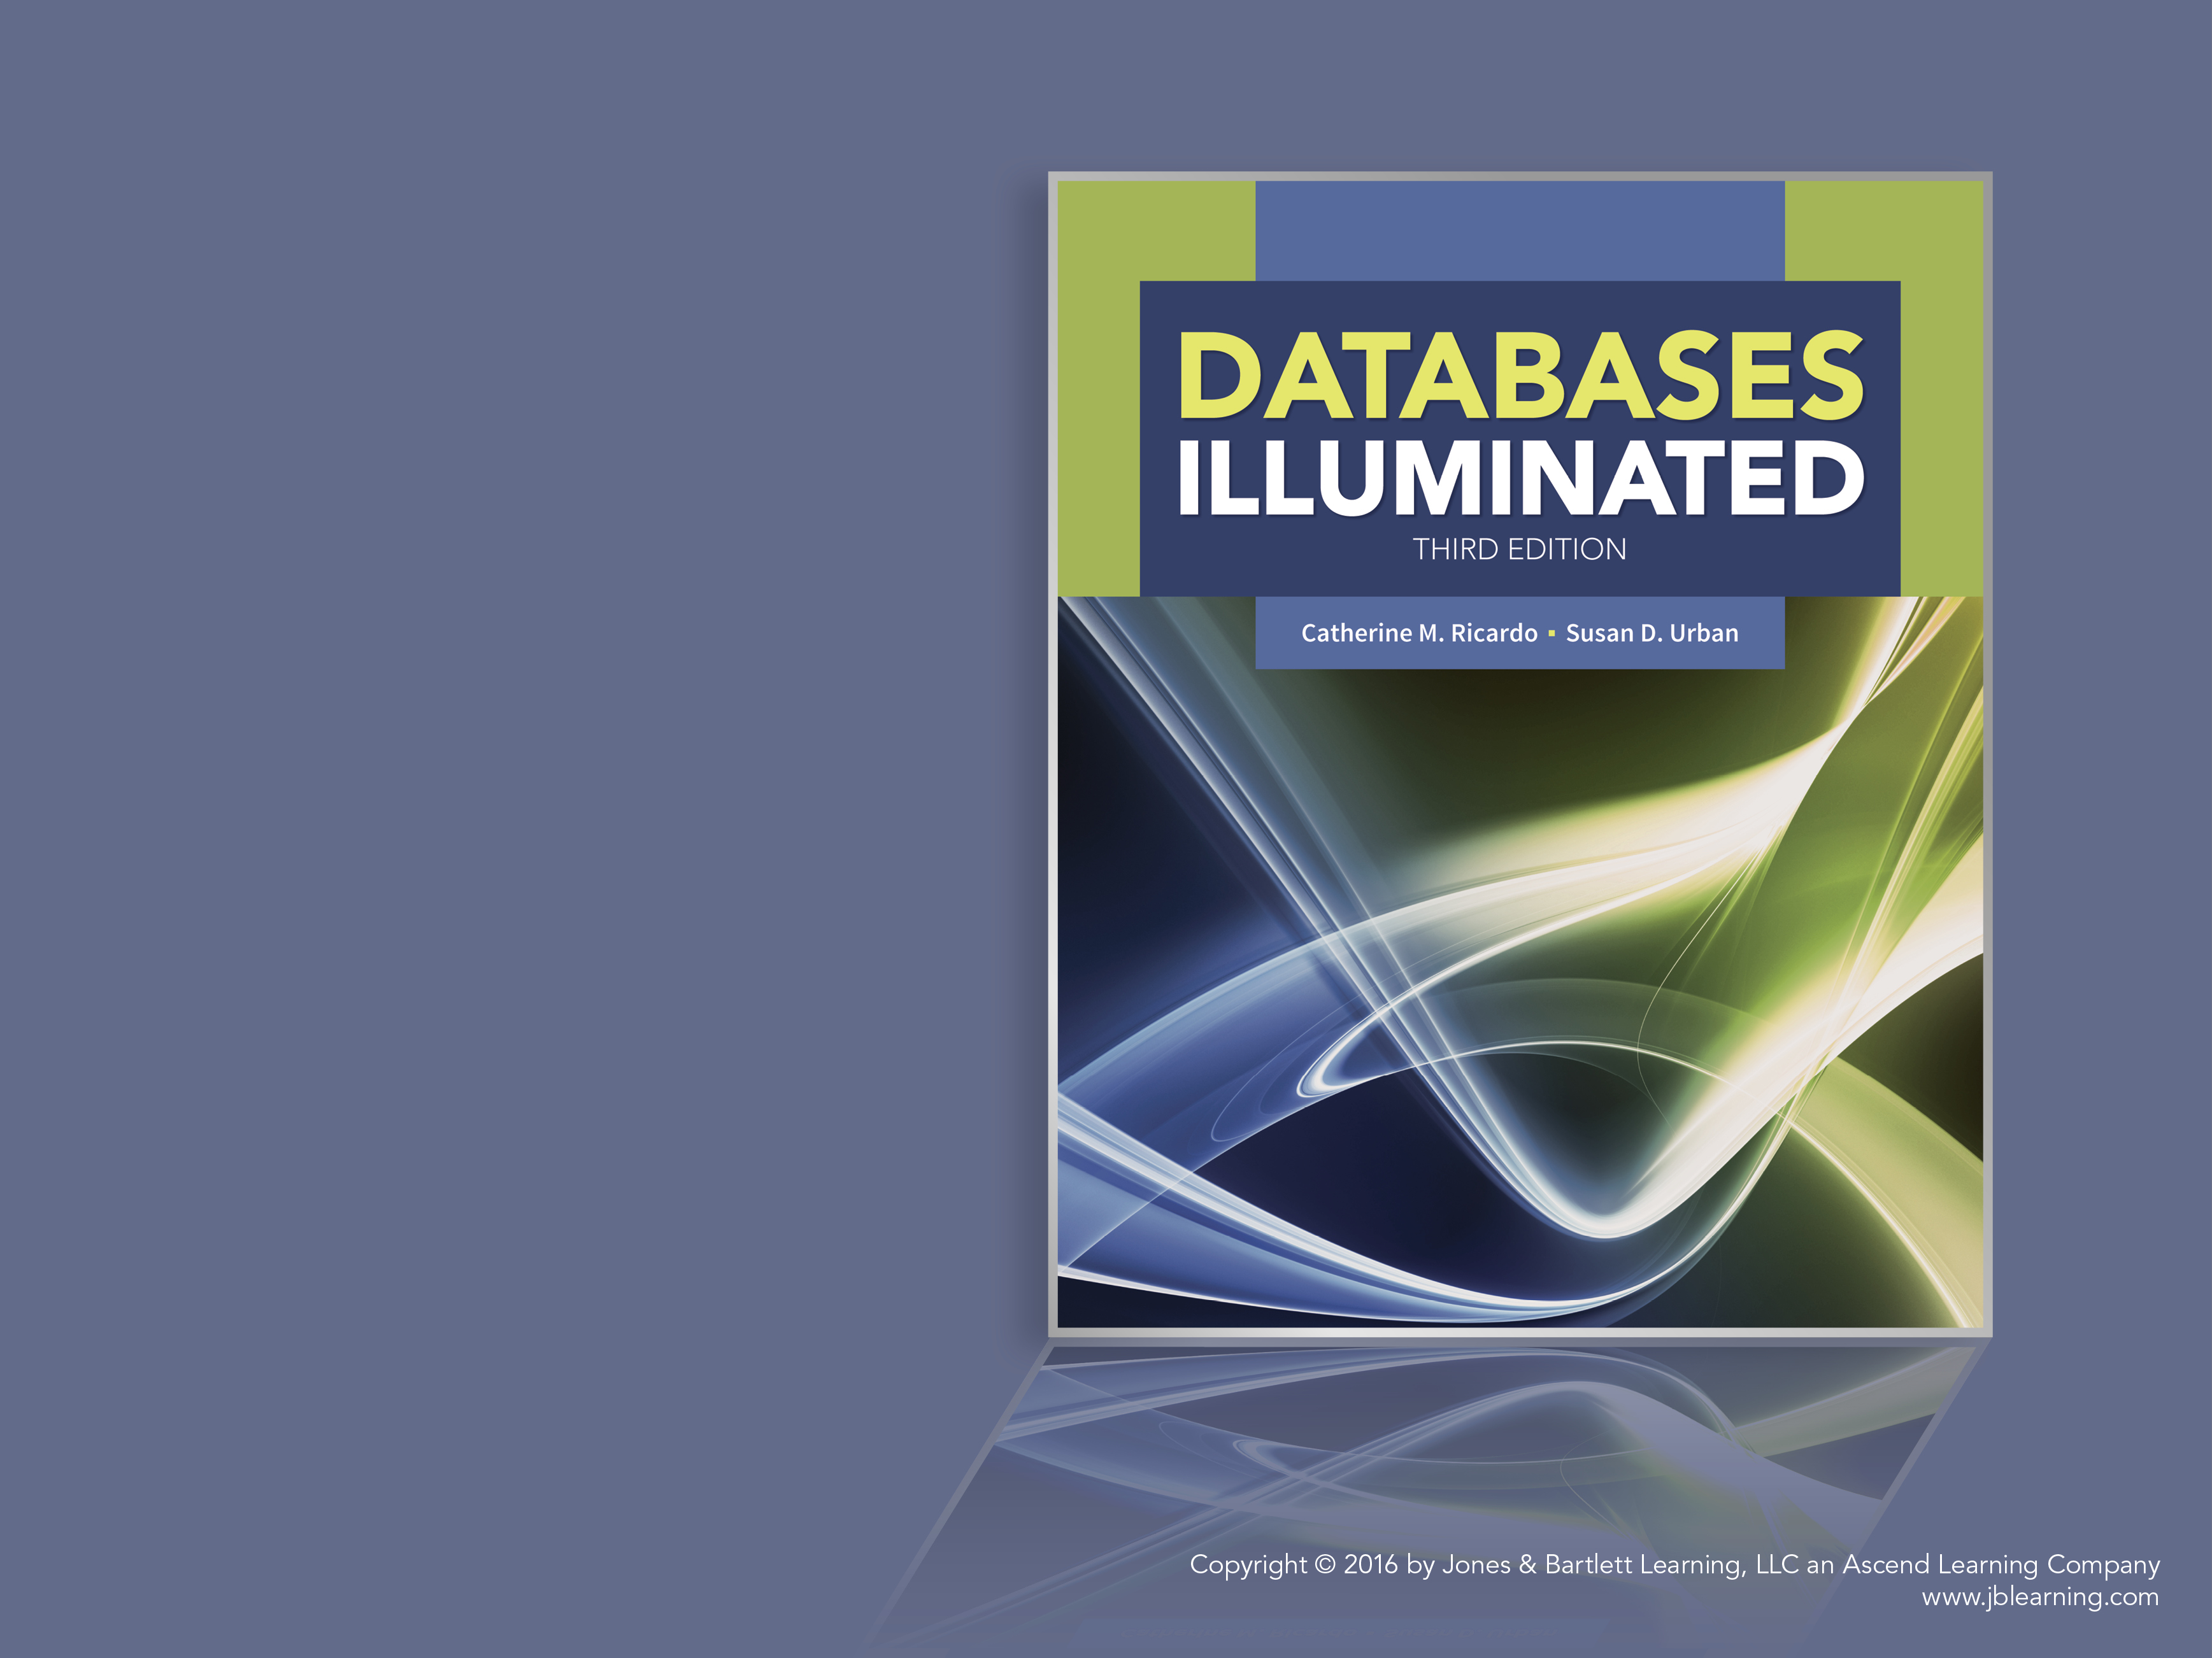
Databases Illuminated
Chapter 10
Distributed Databases

Slide 2
Distributed Database System
Multiple sites connected by a communications system
Data at any site available to users at other sites
Sites may be far apart; linked by telecommunications lines
May be close together; linked by a local area network
Can be traditional SQL-based relational system, object database, XML-based database, unstructured data system, NoSQL database, NewSQL database

Slide 3
Advantages of Distribution
Compared to a single, centralized system that provides remote access, distributed system advantages are
  Local autonomy
  Improved reliability
  Better data availability
  Increased performance
  Reduced response time
  Lower communications costs

Slide 4
Architecture Design Considerations
Factors the designer considers in choosing an architecture for a distributed system
  Type of communications system
  Data models supported
  Types of applications
  Data placement alternatives

Slide 5
Architecture Alternatives
Centralized database with distributed processing
Figure 10.1
Client-server system Figure 10.2
Parallel databases
  Shared memory Figure 10.3(A)
  Shared disk Figure 10.3(B)
  Shared nothing-provides linear scale up and speed up-often used for web applications Figure 10.3(C)
  Hierarchical/Cluster Figure 10.3(D)
  data partitioned using range partitioning, hashing, or in round-robin fashion
true distributed database-data and processing shared among autonomous sites

Slide 6
Types of Distributed Systems
Homogeneous
  All nodes use the same hardware and software
Heterogeneous
  Nodes have different hardware or software
  Require translations of codes and word lengths due to hardware differences
  Translation of data models and data structures due to software differences
  Must provide location transparency despite differences

Slide 7
Software Components of DDBMS
Distributed database system normally has software components as in Figure 10.4
Data communications component (DC)
Local database management system (DBMS)
Global data dictionary (GDD)
Distributed database management system component (DDBMS)
Not all sites have all these components

Slide 8
DDBMS Functions
Provides the user interface
  Needed for location transparency
Locates the data
  Directs queries to proper site(s)
Processes queries
  Local, remote, compound (global)
Provides network-wide concurrency control and recovery procedures-preserves ACID properties
Provides translation in heterogeneous systems

Slide 9
Factors in Data Placement Decision
Locality of reference
Reliability of data
Availability of data
Storage capacities and costs
Distribution of processing load
Communications costs

Slide 10
Data Placement Alternatives
Centralized
  All data at one site only
Replicated
  All data duplicated at all sites
Partitioned Figure 10.6
  Data divided among sites
  Fragmentation scheme: horizontal, vertical, mixed fragments
  Each item appears only once
Hybrid
  Combination of the others
Data placement for University database Figure 10.7

Slide 11
Types of Transparency
Data distribution transparency
  Fragmentation transparency
  Location transparency
  Replication transparency
DBMS heterogeneity transparency
Transaction transparency
  Concurrency transparency
  Recovery transparency
Performance transparency

Slide 12
Transaction Management for DDBMS
Each site that initiates transactions has a transaction coordinator to manage transactions that originate there
  For local or remote transactions, transaction manager at data site takes over
  For global transactions, originating site coordinator
    Starts execution
    Uses GDD to form sub-transactions
    Directs sub-transactions to appropriate sites
    Receives sub-transaction results
    Controls transaction end-either commit or abort at all sites
Additional concurrency control problem
  Multiple-copy inconsistency problem
Solutions use locking and timestamping

Slide 13
Locking Protocols
Extension of two-phase locking protocol
  Single-site lock manager
    May use Read-One-Write-All replica handling
    Site may become a bottleneck
  Distributed lock manager
    Can use Read-One-Write-All method
    Deadlock difficult to determine
  Primary copy
    Dominant node for each data item
  Majority locking

Slide 14
Global Deadlock Detection
Each site has local wait-for graph-detects only local deadlock Figure 10.8(B)
Need global wait-for graph Figure 10.8(C)
  Single site can be global deadlock detection coordinator
  Constructs global graph and checks for cycles
  Responsibility could be shared among sites

Slide 15
Timestamping Protocols
One site could issue all timestamps
Instead, multiple sites could issue them
  Each timestamp has two parts-the time and the node identifier
  Guarantees uniqueness of timestamps
  Difficult to synchronize clocks-to control divergence, can advance clock reading if later timestamp received
  Can apply basic timestamping, Thomas’ Write Rule, multi-version timestamp protocols using unique timestamps

Slide 16
Recovery-Failures
Must guarantee atomicity and durability of transactions
Failures include usual types, plus loss of messages, site failure, link failure
Network partitioning
  Failure where network splits into groups of nodes that are isolated from other groups, but can communicate with one another

Slide 17
Handling Node Failure
System flags node as failed
System aborts and rolls back affected transactions
System checks periodically to see if node has recovered, or node self-reports
After restart, failed node does local recovery
Failed node catches up to current state of DB, using system log of changes made while it was unavailable

Slide 18
Commit Protocols
Two-phase commit protocol –most common
  Phase 1-voting phase for transaction T
    Coordinator writes <begin commit T> to its log, writes log to disk, sends <prepare T> msg to all participants. Each site either does a <ready T> or <abort T> and sends its vote to coordinator
  Phase 2-resolution phase
    Coordinator resolves fate of transaction
      If any abort msg received, makes all sites abort
      Failure of any site to vote generates global abort
      If all sites voted ready, coordinator tells all to commit
      Handles various types of failure
  Has protocols to handle failure of participating site or coordinator, but may cause blocking
Three-phase commit protocol – non-blocking, assumes no more than k sites fail, for some k

Slide 19
Distributed Query Processing
Queries can be
  Local: done at originating site only
  Remote: done at different site
  Compound: requires multiple sites
Must consider cost of transferring data between sites
Semijoin operation is sometimes used when a join of data stored at different sites is required

Slide 20
Steps in Distributed Query-1
Accept user’s request
Check request’s validity
Check user’s authorization
Map external to logical level
Determine request processing strategy
For heterogeneous system, translate query to DML of data node(s)
Encrypt request
Determine routing (job of DC component)

Slide 21
Steps in Distributed Query-2
Transmit messages (job of DC component)
Each node decrypts its request
Do update synchronization
Each data node’s local DBMS does its processing
Nodes translate data, if heterogeneous system
Nodes send results to requesting node or other destination node
Consolidate results, edit, format results
Return results to user

