Slide 1
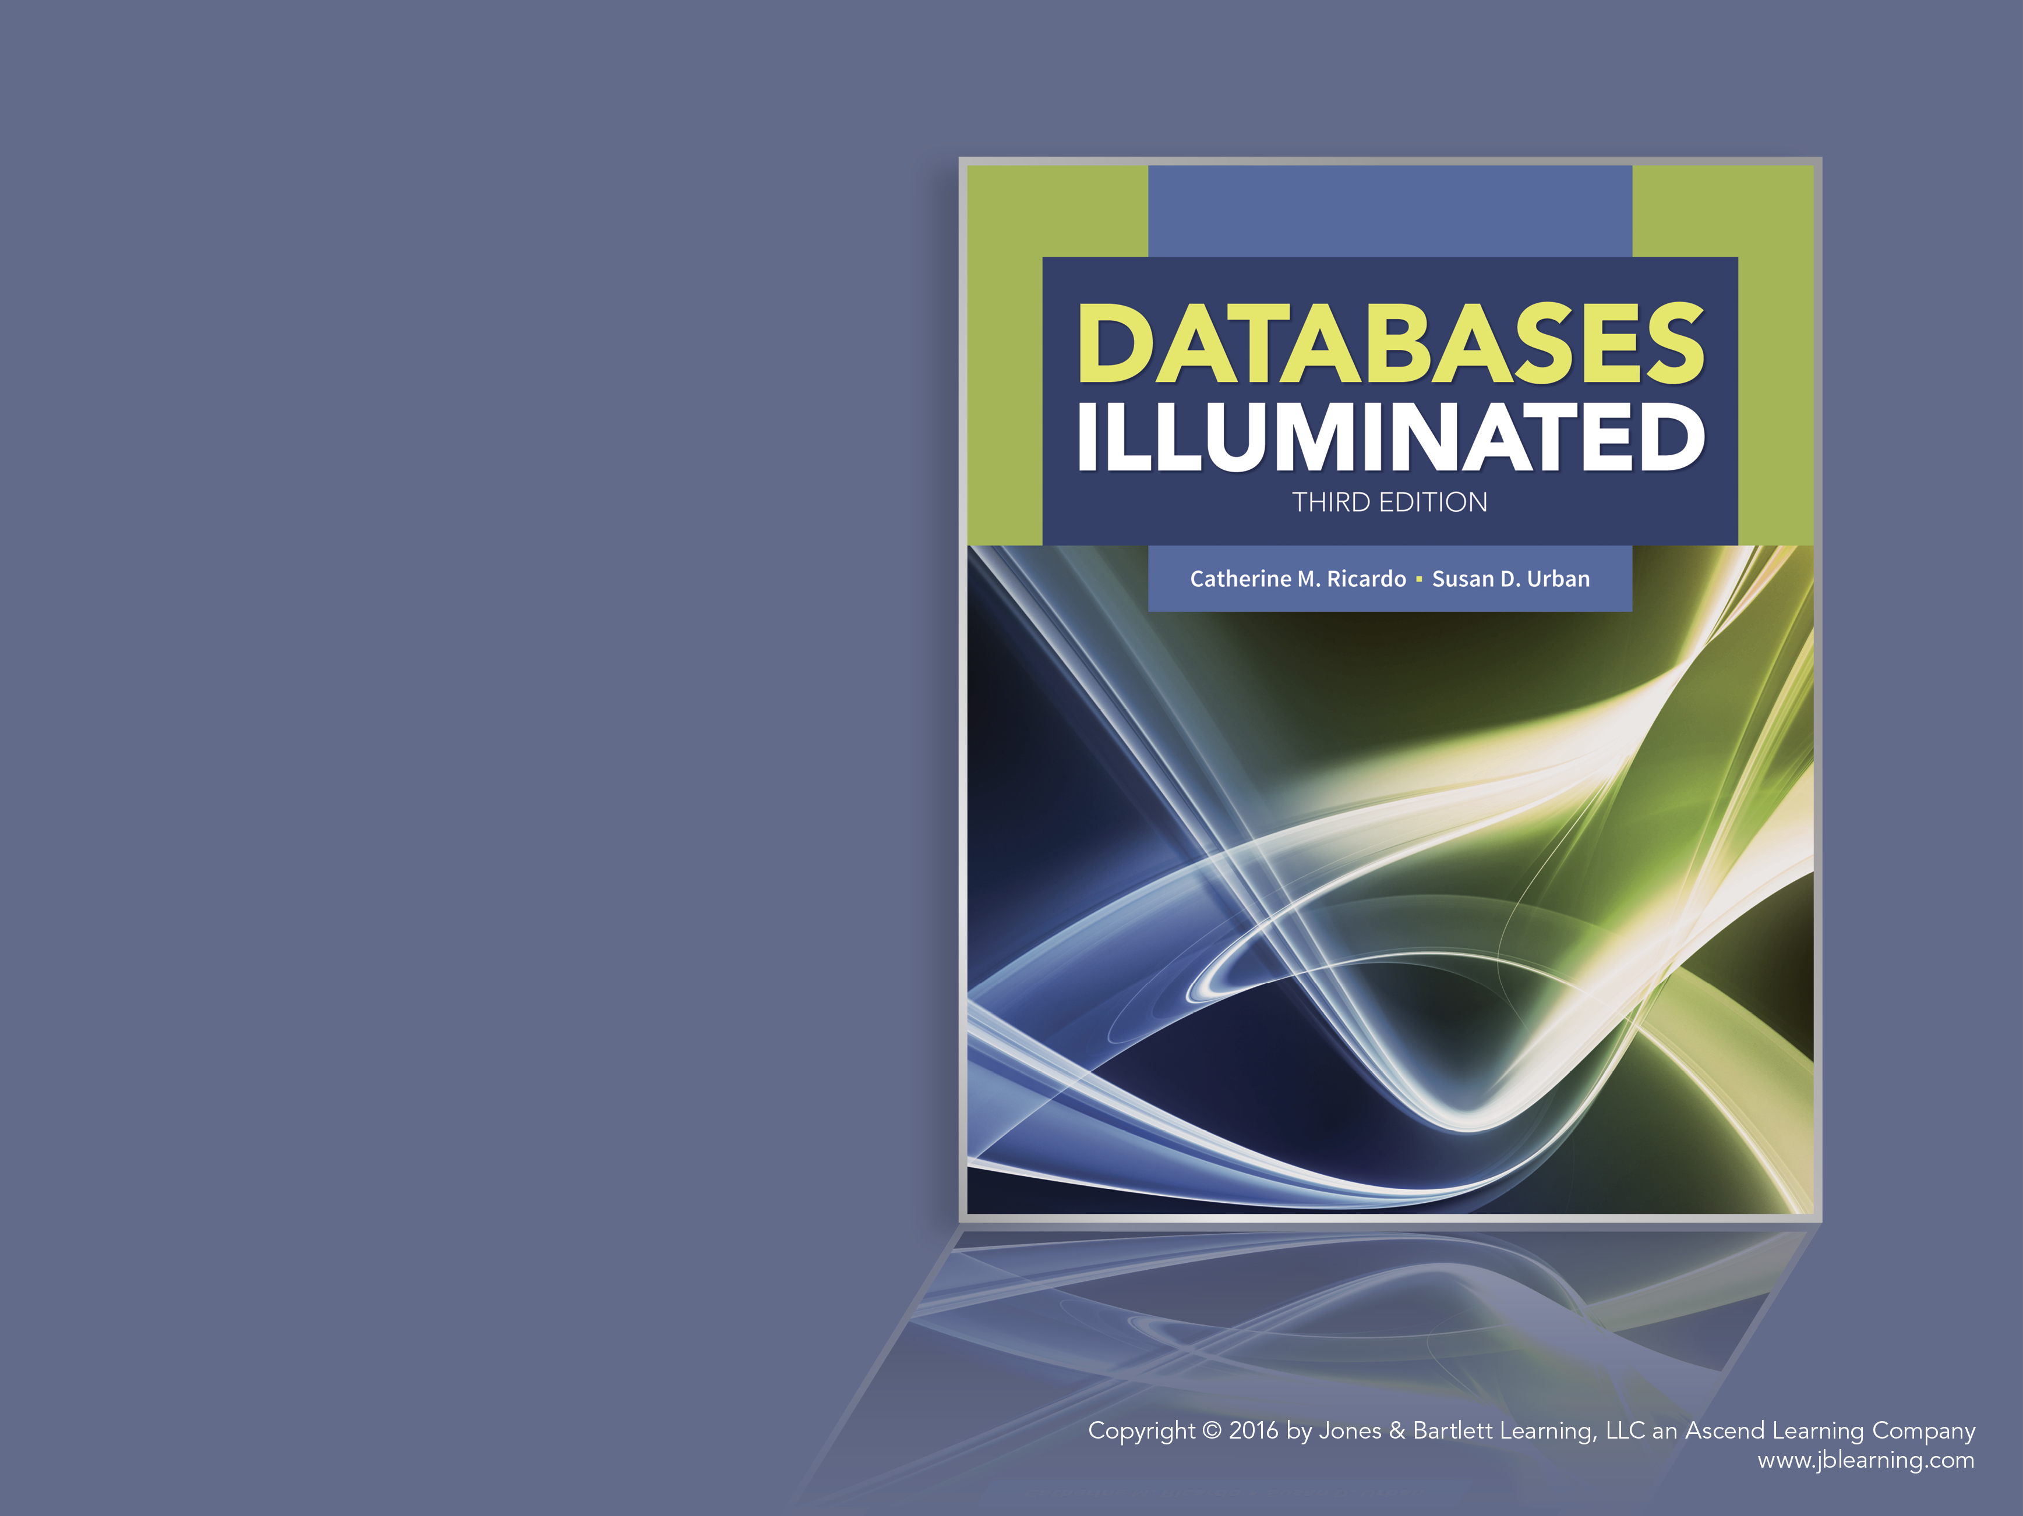
Databases Illuminated
Chapter Twelve
Big Data and NoSQL

Slide 2
Motivation for Big Data
The amount of data that is collected by many organizations has grown at an unprecedented rate
The size of data collected exceeds the capacity of most RDBMS products
Data collected is not typical of the type found in relational tables:
Unstructured
Generated in real-time
May not have a well-defined schema
Varying types: pictures, video, social media posts, sensor data, purchase transactions, cell phone data

Slide 3
Big Data Statistics
2.5 quintillion (10¹⁸) bytes of data generated every day
90% of the world’s data generated since 2012
570 new web sites every day
The amount of data is doubling every year and expected to reach 40,000 exabytes by the year 2020 (40 trillion gigabytes of data)
The ability to handle data of this magnitude requires new approaches to data management and query processing

Slide 4
Big Data Applications
Facebook: Collects over 500 terabytes of data every day
Netflix: Collects over 30 million movie plays per day (rewinds, fast forwards, pauses) and 3-4 million ratings and searches to use for recommendations
Energy Companies: Collect and analyze large amounts of data to analyze the reliability and status of the power grid
Seattle Children’s Hospital: Analyze and visualize terabytes of data to reduce medical errors and save on medical costs
IBM Watson Computer System: Accessed 200 million pages of data over four terabytes of disk storage to win the Jeopardy quiz show in 2011

Slide 5
Defining Big Data
Figure 12.1 illustrates the five V’s that characterize big data.
Volume – Massive volumes of data
Variety – Data in a wide variety of forms: structured, unstructured, or semi-structured
Velocity – Real-time streaming data generated from sensors and mobile devices
Veracity – Uncertainty about the correctness and validity of data
Value – The advantage that the successful analysis of big data can bring to organizations

Slide 6
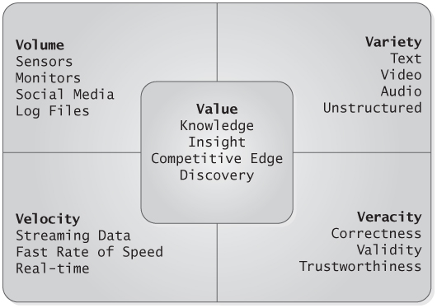
Figure 12.1 The Five Vs of Big Data

Slide 7
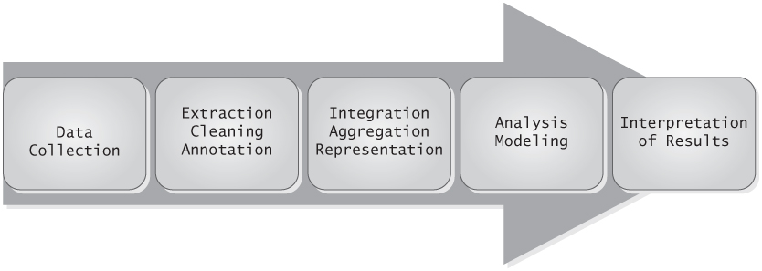
Using Big Data
The big data research community characterizes the process of using big data as a pipeline.
Data Collection
Extraction, Cleaning, and Annotation
Integration, Aggregation, and Representation
Analysis and Modeling
Interpretation of Results
Figure 12.2 The Big Data Pipeline

Slide 8
Hadoop: Background
Framework that initiated the era of big data
Invented by Doug Cutting and Mike Carafella in 2002 at University of Washington (originally known as Nutch)
Was revised to become Hadoop after the publication of key papers by Google:
2003 paper on the Google File System
2004 paper on MapReduce
Hadoop became an open-source Apache Software Foundation project in 2006
Provides storage and analytics for companies such as Facebook, LinkedIn, Twitter, Netflix, Etsy, and Disney

Slide 9
Hadoop Backbone
Hadoop Distributed File System (HDFS)
A system for distributing large data sets across a network of commodity computers
Can be complex to manage distributed file components and metadata
Provides a high level of fault tolerance
Supports parallel processing for faster computation
MapReduce parallel programming model
Designed to operate in parallel over distributed files and merge the results
Map: Filters and/or transforms data into a more appropriate form
Reduce: Performs calculations and/or aggregations over data from the map step to merge results from distributed sources

Slide 10
HDFS Blocks
A file is divided into subcomponents known as blocks (basic unit of storage)
Default size is 64 megabytes; sometimes 128 megabytes or larger
Advantage of large block size:
Supports streaming, sequential data access
Minimizes disk seek time for file retrieval
Leads to faster sequential data access
Hadoop is not good for random access

Slide 11
HDFS Terminology and Architecture
The blocks of a data set are used to form an HDFS cluster
A cluster is composed of:
Nodes: each is a single computer
Racks: a collection of 30-40 nodes on the same network switch
A cluster is a collection of racks
Blocks are stored in data nodes
A name node is used to store metadata about data nodes
See Figure 12.3

Slide 12
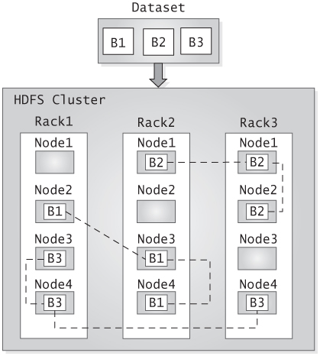
Figure 12.3 Organization of Dataset Blocks Within an HDFS Cluster

Slide 13
Fault Tolerance in HDFS
HDFS replicates blocks
By default, three replicas across two racks (one replica in one rack and two replicas in a different rack)
A pipeline is used to link the replicas together
The number of replicas can be increased

Slide 14
MapReduce
HDFS distributes a large data set across multiple nodes
MapReduce is then used to parallelize a programming job that requires reading the nodes to perform some form of computation
Using the MapReduce paradigm:
Computation is done in parallel over individual blocks (the map step)
The results are merged (the reduce step)

Slide 15
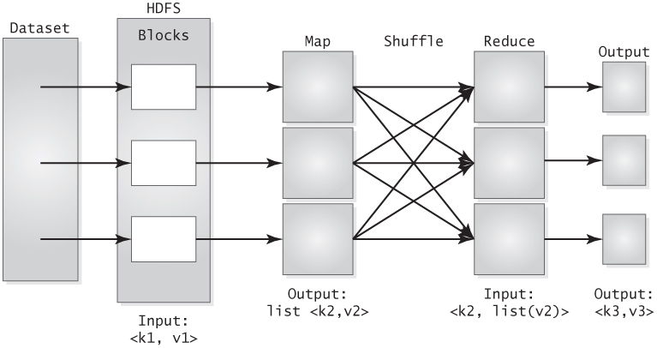
Dataflow in MapReduce
Data flow in a MapReduce program
Figure 12.4 Dataflow in MapReduce

Slide 16
Dataflow in MapReduce
A data set that is sent to HDFS to be divided into blocks is stored in each block as key-value pairs: <k1, v1>
k1 is a unique identifier assigned by HDFS
v1 is the original value of a line within the data set

Slide 17
MapReduce Example
Consider an online competition to find the most popular dog names
Assume the original file contains the data in a form that indicates a user’s id and pet name:
Bob:Fido
Bob:Max
Sue:Indy
Joe:Mushu
Karen:Blue
Karen:Max
Jill:Ruby
Jill:Max
Andy:Fido

Slide 18
MapReduce Example
HDFS transforms the file into a key-value pair format and distributes the data among blocks:
Input to Block 1:
<0, Bob:Fido>
<1, Bob:Max>
<2, Sue:Indy>
Input to Block 2:
<3, Joe:Mushu>
<4, Karen:Blue>
<5, Karen:Max>
Input to Block 3:
<6, Jill:Ruby>
<7, Jill:Max>
<8, Andy:Fido>
HDFS assigns the key values of
0 to 8

Slide 19
MapReduce Example
The map process transforms the key-value pairs into a new form in preparation for the reduce step
Output from Block 1 map step:
<Fido,1>
<Max,1>
<Indy,1>
Output from Block 2 map step:
<Mushu,1>
<Blue,1>
<Max,1>
Output from Block 3 map step:
<Ruby,1>
<Max,1>
<Fido,1>
The map procedure discards the
person id, uses the dog name as
a key, and uses 1 as the value of
the key-value pair. The value of 1 in each key-value pair indicates one occurrence of the dog name.

Slide 20
MapReduce Example
The output from map is then shuffled to produce the input for the reduce step
The shuffle process transforms the map output into the form <k2, list(v2)>, combining the map output values that have the same key into a list of values (list(v2)) associated with the key (k2)

Slide 21
MapReduce Example
The shuffle process produces the following input to the reduce step:
Block 1 input to reduce step:
<Blue, list(1)>
<Fido, list(1,1)>
Block 2 input to reduce step:
<Indy, list(1)>
<Max, list(1,1,1)>
Block 3 input to reduce step:
<Mushu, list(1)>
<Ruby, list(1)>
The numbers in each list indicate
the number of times each name
has occurred.
Example: The name Blue has
occurred one time. The name
Max has occurred three times.

Slide 22
MapReduce Example
The reduce step is then written to aggregate the list value and transform the data into the form <k3, v3>, where k3=k2 and v3 is the sum of the list values:
<Blue, 1>
<Fido, 2>
<Indy, 1>
<Max, 3>
<Mushu, 1>
<Ruby, 1>
See Figure 12.5 for an illustration of the example
The value of each key-value pair indicates the
total number of dogs with the indicated name.

Slide 23
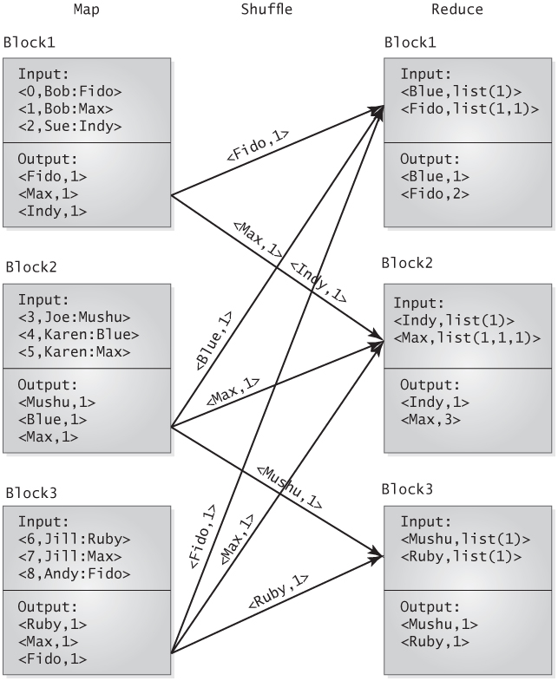
Figure 12.5 MapReduce Example: Finding the Most Common Dog Names

Slide 24
The Hive Data Warehouse System
The previous example provides a simple illustration of MapReduce program functionality
In general, writing MapReduce code can be quite complex
A Solutions: The Hive data warehouse system was created to provide a more abstract way of extracting and manipulating data in HDFS
Hive was initially developed by Facebook to simplify MapReduce programming
Hive is now part of the open-source Apache Software Foundation

Slide 25
Overview of Hive
Hive is built on top of Hadoop, providing traditional query capabilities over Hadoop data using HiveQL
Hive is not a full-scale database, providing no support for updates, transactions, and indexes
Hive was designed for batch jobs over large data sets
HiveQL queries are automatically translated to MapReduce jobs
Queries demonstrate a higher degree of latency than queries in relational systems
Operates in schema-on-read mode rather than schema-on-write mode as in relational systems

Slide 26
Schema-On-Read vs Schema-On-Write
Schema-On-Write (traditional database systems)
User defines schema
Creates DB according to the schema
Loads data
Data must conform to the schema definition
Schema-On-Read (Hive)
Data is loaded into a file in its native format
The data is not checked against a schema until it is read through a query
Users can apply different schemas to the same data set
Fast data loads but slower query execution time

Slide 27
Data Organization in Hive
Hive data is organized into:
Databases: Highest level of abstraction; serves as a namespace for tables, partitions, and buckets
Tables: Same concept as tables in RDBMS
Partitions: Organizes a table according to the values of a specific column; Fast way to retrieve a portion of the data
Buckets: Organizes a table based on the hash value of a specific column; Convenient way to sample data from large data sets

Slide 28
Hive Directory Structure
Hive stores each database as multiple files in the directory structure of HDFS:
Directory for DB1
Directory for file of DB1:Table1
Directory for file of DB1:Table1:Partition1
Directory for file of DB1:Table1:Partition2
Directory for file of DB1:Table2
Directory for DB2
Directory for file of DB2:Table1
Directory for file of DB2:Table2
Directory for file of DB2:Table2:Bucket1
Directory for file of DB2:Table2:Bucket2
Directory for file of DB2:Table3

Slide 29
Managed vs. External Tables
Tables are either internal or External
Internal table called: A managed table is physically loaded in the Hive data warehouse and stored in the HDFS file system
When dropped, the metadata and data of the table are removed from Hive
An external table is located in the directory structure outside of the Hive data warehouse
Provides a way to share tables with other applications
When dropped, only the metadata is removed from Hive since the data resides external to Hive

Slide 30
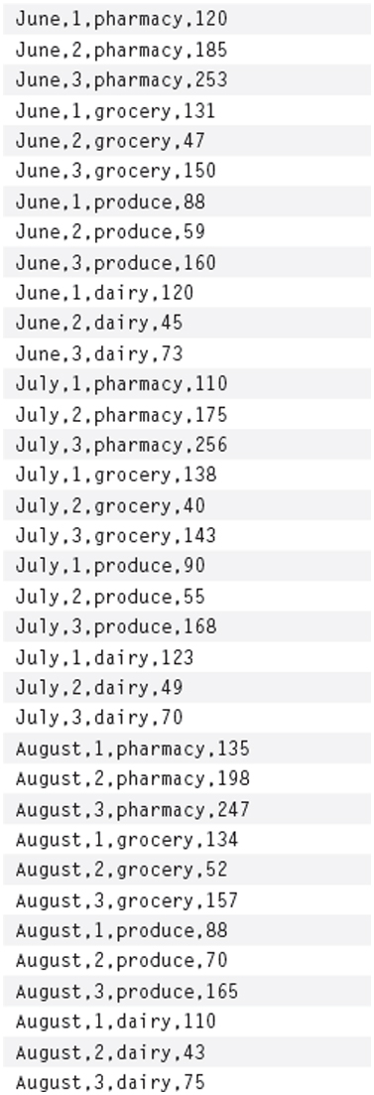
Creating Tables in Hive
The CREATE TABLE statement below specifies that data will be loaded from a comma-delimited file, as shown in Figure 12.6
hive> CREATE TABLE sales
> (
> month STRING,
> store INT,
> dept STRING,
> amount INT
> )
> ROW FORMAT DELIMITED
> FIELDS TERMINATED BY ‘,’
> STORED AS TEXTFILE;
hive>
Figure 12.6

Slide 31
Loading Data Into Tables
The following statement loads data from a local file (not in HDFS) into the sales table
hive> LOAD DATA LOCAL INPATH ‘/home/user/mydata/sales.csv’
> OVERWRITE INTO TABLE sales;
To load a file from HDFS, omit the keyword LOCAL
The keyword OVERWRITE indicates that the contents of the file will be overwritten
To append data to the end of the file, omit the keyword OVERWRITE

Slide 32
Creating a Partitioned Table
The following statement creates a table that can be used to partition the data in the sales table according to month.
hive> CREATE TABLE sales_partition
> (
> store INT,
> dept STRING,
> amount INT
> )
> PARTITIONED BY (month STRING)
> ROW FORMAT DELIMITED
> FIELDS TERMINATED BY ‘,’
> STORED AS TEXTFILE;
hive>

Slide 33
Loading Data Into a Partitioned Table
The INSERT statement below will read data from the sales table and use it to partition the data in the sales_partition table.
hive> INSERT OVERWRITE TABLE sales_partition
> PARTITION (month = ‘July’)
> SELECT store, dept, amount
> FROM sales s
> WHERE s.month = ‘July’;
Hive>
The execution of the statement will create a file named July in the sales_partition directory that contains the store, dept, and amount from July sales, making it easier to retrieve the July subset of the sales data.

Slide 34
Creating a Bucketed Table
The following statement creates a bucketed sales table by hashing the month attribute. The data is randomly organized into 4 buckets.
hive> CREATE TABLE sales_buckets
> (
> store INT,
> dept STRING,
> amount INT,
> month STRING
> )
> CLUSTERED BY (month) INTO 4 BUCKETS
> ROW FORMAT DELIMITED
> FIELDS TERMINATED BY ‘,’
> STORED AS TEXTFILE;
hive>

Slide 35
Loading and Querying Table Buckets
Data can be loaded into the sales_bucket table as follows:
hive> INSERT OVERWRITE TABLE sales_buckets
> SELECT * FROM sales;
The advantage of buckets is that a query can be expressed over a random subset of the buckets using the TABLESAMPLE clause instead of using the entire dataset:
hive> SELECT * FROM sales_buckets
> TABLESAMPLE (BUCKET 1 OUT OF 4 ON month);

Slide 36
Storage Formats in Hive
Files can be stored in row format or file format
All examples have been in row format (text files)
Hive uses a Serializer-Deserialize (SerDe) interface to read and write the data
Deserialization transforms a row of data into an internal object representation
Serialization transforms the internal representation into a form used to write to an output file
Users can write their own SerDe interfaces
File formats are used for storing data in binary form

Slide 37
HiveQL
HiveQL is an SQL interface that supports ad-hoc queries over Hive tables
HiveQL is a dialect of SQL-92 and does not support all features of the standard
Syntax is similar to the SQL syntax of MySQL
HiveQL queries are automatically translated to MapReduce jobs
Designed for batch processing and not real-time processing

Slide 38
SQL Syntax Support by HiveQL
SELECT-FROM-WHERE
Predicates of the WHERE clause (= , <>, !=, <, <=, >, >=, IS NULL, IS NOT NULL, LIKE, RLIKE)
GROUP BY and HAVING clauses
Column aliases
UNION ALL
DISTINCT
ORDER BY and SORT BY
CREATE VIEW
ANSI Join Syntax only (INNER JOIN, LEFT OUTER JOIN, RIGHT OUTER JOIN, LEFT SEMI-JOIN)
Nested queries in the FROM clause only
CAST function

Slide 39
SQL Features Not Supported by HiveQL
No row level inserts, updates, or deletes
No updateable views
No stored procedures
Caveat: SORT BY will only sort the output of a single reducer; Use ORDER BY to get a total ordering of the output from all reducers

Slide 40
Unique Features of HiveQL
Writing the results of a query to a file
hive> INSERT OVERWRITE LOCAL DIRECTORY ‘/home/user/mydata’
> SELECT store, SUM(amount) AS totalStoreSales
> FROM sales
> GROUP BY store;
hive>

Slide 41
Unique Features of HiveQL
Querying a partitioned table according to the partitioned attribute
hive> SELECT * FROM sales_partition
> WHERE month = ‘June’ OR month = ‘July’;
Explaining the MapReduce job of a query
hive> EXPLAIN SELECT * FROM sales_partition
> WHERE month = ‘June’ OR month = ‘July’;

Slide 42
Unique Features of HiveQL
Defining a table with a STRUCT and an ARRAY
hive> CREATE TABLE faculty
> (
> facId STRING,
> facName STRUCT<first:STRING,
> last:STRING>,
> degrees ARRAY<STRING>
> )
> ROW FORMAT DELIMITED
> FIELDS TERMINATED BY ‘,’
> COLLECTION ITEMS TERMINATED BY ‘|’
> STORED AS TEXTFILE;
hive>

Slide 43
Unique Features of HiveQL
Dot notation is used to access elements of a STRUCT and an index is used to access elements of an ARRAY (index always starts from 1)
hive> SELECT facName.first, facName.last, degrees[1]
> FROM faculty;

Slide 44
NoSQL Systems
HDFS was designed for batch-oriented, sequential access of large data sets
Many applications that access big data still have a need for real-time processing of queries, as well as row-level inserts, updates, and deletes
NoSQL systems were designed to meet these additional needs for big data applications
Many NoSQL systems are built on top of Hadoop as a storage system for big data

Slide 45
Origins of NoSQL
The term NoSQL was first used by Carlo Strozzi in 1998 when he built a relational database that did not provide an SQL interface
In 2004, Google introduced BigTable, which was designed for:
High speed, large data volumes, and real-time access
Flexible schema design for semi-structured data
Relaxed transactional characteristics
BigTable has become the basis for several column-oriented NoSQL products
Today, NoSQL is often interpreted as meaning “Not Only SQL” since many products provide SQL access in addition to programmatic access

Slide 46
The RDBMS Motivation for NoSQL
RDBMS technology has several shortcoming with respect to large-scale, data intensive applications
RDBMS was design primarily for centralized computing
Handling more users requires getting a bigger server
Expensive, with limits to server size
Not easy to change
Sharding is used to partition data across servers
Complex to maintain
Difficult for query processing and updates
Rigid with respect to schema design
ACID properties of data transactions are restrictive, with more focus on consistency than performance

Slide 47
The Role of NoSQL Systems
NoSQL systems were designed to address the needs of large-scale, data intensive, real-time applications
NoSQL is not a replacement for RDBMS technnology
NoSQL can be used in a complementary fashion with RDBMS technology, to handle the needs of modern, Internet-scale applications that have grown beyond the capacity of traditional, transaction-oriented data technology.

Slide 48
Features of NoSQL Technology
Store and process petabytes of data in real time
Horizontal scaling with replication and distribution over commodity servers
Flexible data schemas
Weaker concurrency model
Simple call level interface
Parallel processing

Slide 49
The CAP Theorem
In 2000, Eric Brewer proposed that a distributed system cannot simultaneously satisfy the following three properties:
Consistency: All users see the same updated data
Availability: Read and write operations always succeed
Partition Tolerance: A system can continue to operate even in the presence of network partitions
Gilbert and Lynch proved this property in 2002, which has become known as the CAP theorem
NoSQL systems choose to satisfy availability and partition tolerance over consistency, sacrificing traditional ACID properties of transactions

Slide 50
BASE Properties
Instead of ACID properties, NoSQL systems settle for eventual consistency
Eventual consistency is referred to as the BASE properties:
Basically Available all the time
Soft-State (does not have to be consistent all the time)
Eventually Consistent (will eventually be in a known, consistent state)

Slide 51
Types of NoSQL Systems
Key-Value Pair Systems: Build on the key-value pair approach of HDFS
Column-Oriented Table Systems: Based on the column-oriented approach of BigTable, with a flexible approach to managing data with variable structure
Document-Oriented Systems: Data is encapsulated in a form known as a document, as in XML or JSON (Java Object Script Notation). All documents do not have to have the same structure
Graph-Oriented Systems: Supports data that has natural hierarchical or network structure and uses graph traversal techniques for data retrieval

Slide 52
HBase
HBase is a column-oriented NoSQL system based in Google’s Big Table and built on top of HDFS
Ideal for:
Large, sparsely populated tables
Real-time processing
Read/write random access
Characterized as a sparse, distributed, multi-dimensional, sorted map

Slide 53
HBase Data Model
Tables contain rows and columns
Differences from relational tables:
Cell values are uninterpreted byte arrays (no notion of different data types)
Individual cells of a table can be versioned, storing the history of values for a cell
Each row has a row key, with the table sorted by the row key
Atomicity is only guaranteed at the row level (no atomicity for multi-row updates)
Major difference: Columns in Hbase are not the same as columns in relational tables!

Slide 54
Columns in HBase
Columns are known as column qualifiers
Column qualifiers are organized into column families
Column families conceptually organize column qualifiers into groups that have the same access patterns
Column families must be defined when a table is created
The number of column qualifiers in a column family is dynamic and can be defined as needed, giving HBase flexibility for dealing with unstructured data
The number of column families should be limited to no more than two or three families for storage efficiency

Slide 55
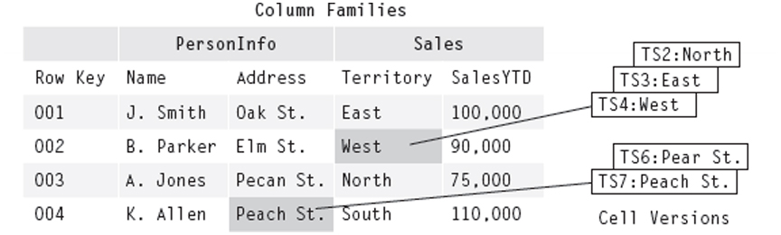
HBase Table Example
Figure 12.7 The Salesperson Table in HBase
Consider the SalesPerson table in HBase
Each row has a unique key
Two column families: PersonInfo and Sales
PersonInfo column family has two column qualifiers: Name and Address
Sales column family has two column qualifiers: Territory and SalesYTD
All values have a timestamp
Territory for row key 002 has multiple values that have changed over time (same for Address of row key 004)

Slide 56
Data as a Multidimensional Map
{“001” : {“PersonInfo” :
{“Name” :
{TS1: “J. Smith”}
“Address” :
{TS1: “Oak St”}}
“Sales” :
{“Territory” :
{TS1: “East”}
“SalesYTD” :
{TS1: “100,000”}}}
“002” : {“PersonInfo” :
{“Name” :
{TS2: “B. Parker”}
“Address” :
{TS2: “Elm St.”}}
“Sales” :
{“Territory” :
{TS4: “West”
TS3: “East”
TS2: “North”}
“SalesYTD” :
{TS2: “90,000”}}}
…}
A row key maps to a list of
column families.
A column family maps to a list
of column qualifiers
Each column qualifier maps to a
list of timestamps
Each timestamp maps to a
value

Slide 57
Table Storage
Column families are physically stored together in HDFS for efficient access
Each value in HBase is stored together with its row key, column family name, column qualifier name, and timestamp
Guideline: Keep row keys, column family names, and column qualifiers names as small as possible to reduce storage size and data transfer on retrieval
001:personinfo:name:ts1:J. Smith
001:personinfo:address:ts1:Oak St.
001:sales:territory:ts1:East
001:sales:salesytd:ts1:100,000

Slide 58
HBase Table Design Issues
More complex than relational table design
HBase table design is driven by data access patterns
Tables should be structured to return data in an efficient manner
Important considerations:
What values should compose the key?
What column families are needed (specified at table creation)?
What column qualifiers are associated with each column family?

Slide 59
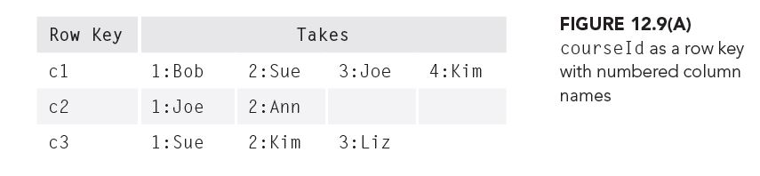
Distance Learning University Example: Design 1
Course id is the row key
One column family: Takes
A column qualifier for each student enrolled, with a number for the column name

Slide 60
Assessment of Design 1
Consider the following queries:
Query 1: Who is enrolled in course c1?
Query 2: Is Joe enrolled in course c1?
Query 3: Find the courses that Joe is enrolled in
Good for Queries 1 and 2, but Query 2 could be expensive if thousands of students enrolled
Not good for Query 3. Requires a scan of the entire table
Update issue: How do you determine the next column number?

Slide 61
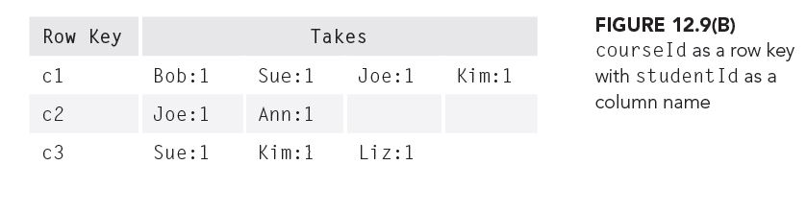
Distance Learning University Example: Design 2
Student id is the column name
The number 1 is used as a column value
Assessment
Simplifies enrolling and dropping students from a course
Cannot efficiently find courses in which a student is enrolled

Slide 62
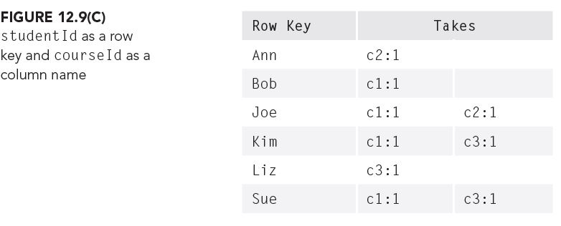
Distance Learning University Example: Design 3
Invert the table values to use student id as the row key and course as the column name
Efficient for finding the course in which each student is enrolled
Need to maintain Design 2 and Design 3 to fully answer all queries (overhead of multiple tables)

Slide 63
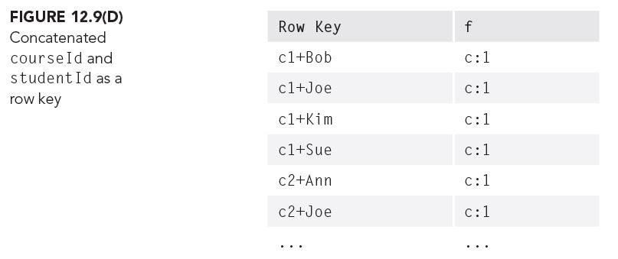
Distance Learning University Example: Design 4
Course name and student id are concatenated to form the row key; can search by either value
Column family and qualifier names become small placeholder values to minimize data transfer

Slide 64
HBase Shell Environment
Allows a user to interactively
Create tables
Insert data
Retrieve data
Main commands
create
put
get
scan
In realistic applications, data access is programmatic through the HBase API
The shell is useful for learning HBase concepts

Slide 65
Creating Tables and Column Families
The number of versions to maintain defaults to one
Short cut version to create the salesPerson table with two column families: personinfo and sales
hbase> create ‘salesPerson’, ‘personinfo’, ‘sales’
Alternate syntax with version specification
hbase> create ‘salesperson’, {NAME => ‘personinfo’, VERSIONS => 3}, {NAME => ‘sales’, VERSIONS => 3}

Slide 66
Putting Data in Tables
The put command is used to write a single cell
hbase> put ‘salesPerson’,‘001’,‘personinfo:name’,‘J. Smith’
hbase> put ‘salesperson’,‘001’,‘personinfo:address’,‘Oak St.’
hbase> put ‘salesperson’,‘001’,‘sales:territory’,‘East’
hbase> put ‘salesperson’,‘001’,‘sales:salesytd’,‘100,000’
To change a cell value, use the put command to write to the same cell. Hbase will automatically assign timestamps to each cell version
hbase> put ‘salesPerson’,‘002’,‘sales:territory’,‘North’
hbase> put ‘salesPerson’,‘002’,‘sales:territory’,‘East’

Slide 67
Getting Data from Tables
Retrieve all contents of a row
hbase> get ‘salesperson’,‘001’
Restrict data of a row to a timerange
hbase> get ‘salesperson’, 001’,{TIMERANGE =>[ts1, ts5]}
Retrieve a specific column value of a row
hbase> get ‘salesperson’,‘001,{COLUMN => ‘personinfo:name’}

Slide 68
Getting Data from Tables
Retrieve several column values of a row
hbase> get ‘salesperson’,‘001’,{COLUMN => [‘personinfo:name’,‘personinfo:address’]}
Indicate number of versions to retrieve
hbase> get ‘salesperson’,‘001’,{COLUMN => [‘personinfo:name’,‘personinfo:address’],VERSIONS => 3}

Slide 69
Filtering Data
Filters can be specified on columns
hbase> get ‘salesperson’,‘001’,{FILTER => “ValueFilter(=,‘binary:Oak St.’)”}
A ValueFilter is used to filter cell values using a comparison operator and a comparator (in single quotes)
The comparator indicates a comparison type together with a value separated by a colon
Comparison types:
binary (byte-to-byte comparison of values)
binaryprefix (a cell should begin with the value)
regexstring (specifies a pattern for the value)

Slide 70
Filtering Data
Other filter types:
RowFilter: compares a value to the row key
FamilyFilter: compares a value to each column family name
QualifierFilter: compares a value to each column qualifier name
Family and qualifier filters allow the user to query based on family and qualifier names rather than column qualifier values

Slide 71
Scanning Tables
The following statement will read the entire table and print the data in key-value pair format:
hbase> scan ‘salesperson’
Specify start and stop row keys for the scan
hbase> scan ‘salesperson’,{STARTROW =>‘001’,STOPROW => ‘003’}
Specify a timestamp for the data to retrieve
hbase> scan ‘salesperson’, {TIMESTAMP => TS1}

Slide 72
Scanning Tables
Scan and return key-value pairs of the indicated columns
hbase> scan ‘salesperson’,{COLUMN => [‘personinfo:name’,‘personinfo:address’]}
Scan and return key-value pairs of all columns in a column family
hbase> scan ‘salesperson’,{COLUMN => ‘personinfo’}

Slide 73
NewSQL Systems
Many financial and business applications that handle large amounts of data cannot afford to sacrifice ACID properties of transactions
NewSQL systems are a developing alternative to NoSQL and RDBMS technology
NewSQL systems exploit distributed database technology together with cloud computing to handle big data together with transactional capabilities that support ACID properties

