Slide 1

Databases Illuminated
Chapter 13
Relational Query Optimization

Slide 2
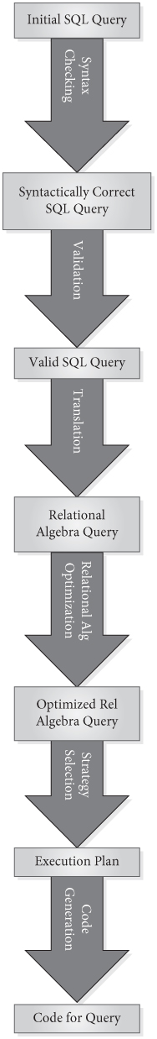
Query processing overview
Steps in executing SQL query-DBMS:
  Checks query syntax
  Validates query-checks data dictionary; verifies objects referred to are database objects and requested operations are valid
  Translates query into relational algebra (or relational calculus)
  Rearranges relational algebra operations into most efficient form
  Uses its knowledge of table size, indexes, order of tuples, distribution of values, etc. to determine how the query will be processed-estimates the "cost" of alternatives and chooses the plan with the least estimated cost-considers the number of disk accesses, amount of memory, processing time, and communication costs, if any
  Execution plan is then coded and executed
Figure 13.1

Slide 3
Relational Algebra Translation
SQL Select..From..Where usually translates into combination of RA SELECT, PROJECT, JOIN
RA SELECT-unary operator: σ_{p}(table-name)
  p is a predicate, called the θ (theta) condition
  Returns entire rows that satisfy θ
RA PROJECT-unary operator: Π_{proj-list}(table-name)
  Proj-list is a list of columns
  Returns unique combinations of values for those columns
RA JOIN-binary operator: table1 |X| table2
  Compares table1 and table2, which have a common column (or columns with same domain)
  Chooses rows from each that match on common column(s)
  Combines those rows, but shows common column only once

Slide 4
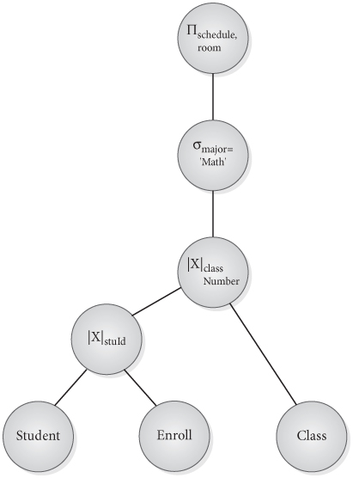
Constructing a Query Tree
Graphical representation of the operations and operands in a relational algebra expression
Figure 13.2A Initial Query Tree

Slide 5
Constructing a Query Tree
  A leaf node is created for each relation (table) in the expression
  For each unary or binary operation on a relation, an upward branch is drawn from the node
  Reading upward from the leaves, as each operation is included, an internal, non-leaf node is created to represent the result of the operation
  Root node represents the entire expression

Slide 6
Evaluating a Query Tree
  An internal node can be executed when its operands are available
  Node is replaced by the result of the operation it represents
  Process continues until root node is reached
  Root node is executed last, and is replaced by the result of the entire query

Slide 7
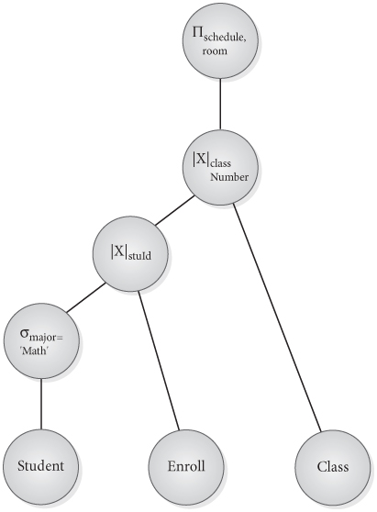
Doing SELECT early
Same SQL statement can be translated to different relational algebra statements
Performing SELECT early reduces size of intermediate nodes-
Figure 13.2B Revised Query Tree

Slide 8
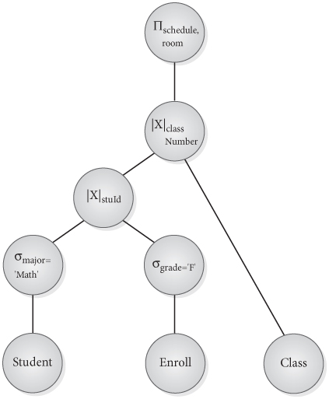
Push SELECT as far down the tree as possible
For conjunctive SELECT on different tables, do each part on its own tree instead of waiting for join-
Figure 13.3B

Slide 9
RA Equivalences-1
All joins and products are commutative
  R × S ≡ S × R and
  R |×| _{θ} S ≡ S |×|_{θ} R and
  R |×| S ≡ S |×| R
Joins and products are associative
(R × S) × T ≡ R × (S × T)
(R |×|_{θ} S) |×|_{θ} T ≡ R |×|_{θ} (S |×|_{θ} T)
(R |×| S) |×| T ≡ R |×| (S |×| T)

Slide 10
RA Equivalences-2
3. Select is commutative
σ _{p} ( σ _{q} (R)) ≡ σ_{q} (σ _{p} (R))
4. Conjunctive selects can cascade into individual selects
  σ_{p&q&…&z} (R) ≡ (σ_{p} (σ_{q}...( σ _{z} (R))...))
Successive projects can reduced to the final project
If list1, list2, … listn are lists of attribute names and each of the listi contains listi-1, then
  Π_{list1} (Π_{list2} (...Π_{listn} (R)...) ≡ Π_{list1}(R)
  So only the last project has to be executed

Slide 11
RA Equivalences-3
6. Select and project sometimes commute
  If p involves only the attributes in projlist, then select and project commute
    Π_{projlist} ( σ_{p} (R)) ≡ σ_{p} ( Π _{projlist} (R))
7. Select and join (or product) sometimes commute
  If p involves only attributes of one of the tables being joined, then select and join commute
    σ _{p} (R |×| S) ≡ (σ _{p} (R)) |×| S
  only if p refers just to R

Slide 12
RA Equivalences-4
8. Select sometimes distributes over join (or product)
  For p AND q, where p involves only the attributes of R and q only the attributes of S the select distributes over the join
  σ_{p AND q} (R |×| S) ≡ ( σ_{p} (R)) |×| ( σ_{q} (S))
Project sometimes distributes over join (or product)
  If projlist can be split into separate lists, list1 and list2, so that list1 contains only attributes of R and list2 contains only attributes of S, then
  Π_{projlist} (R |×| S) ≡ ( Π_{list1} (R)) |×| ( Π_{list2} (S))

Slide 13
RA Equivalences-5
10. Union and intersection are commutative
  R ∪ S ≡ S ∪ R
  R ∩ S ≡ S ∩ R
  Set difference is not commutative
11. Union and intersection are individually
associative
  (R ∪ S) ∪ T ≡ R ∪ (S ∪ T)
  (R ∩ S) ∩ T ≡ R ∩ (S ∩ T)
  Set difference is not associative

Slide 14
RA Equivalences-6
12. Select distributes over union, intersection, and
difference
  σ_{p} (R ∪ S) ≡ σ_{p} (R) ∪ σ_{p} (S)
  σ_{p} (R ∩ S) ≡ σ_{p} (R) ∩ σ_{p} (S)
  σ_{p} (R - S) ≡ σ_{p} (R) - σ_{p} (S)
13. Project distributes over union, intersection, and
difference
  Π_{projlist} (R ∪ S) ≡ (Π_{projlist} (R)) ∪ (Π_{projlist} (S))
  Π_{projlist} (R ∩ S) ≡ (Π_{projlist} (R)) ∩ (Π_{projlist} (S))
  Π_{projlist} (R - S) ≡ (Π_{projlist} (R)) - (Π_{projlist} (S))
14. Project is idempotent-repeating it produces the same result
  Π_{projlist} (R)( Π_{projlist}(R)) ≡ Π_{projlist}(R)
15. Select is idempotent
  σ_{p}(σ_{p}(R)) ≡ σ_{p} (R)

Slide 15
Heuristics for Optimization
Do selection early
  Use cascading, commutativity, and distributivity to move selection down
  Rearrange relations so the selection operation that will produce the smallest table will be executed first
If possible, change products to joins
  If a product appears as an argument for a selection, where the selection involves attributes of the tables in the product, change the product to a join
  If the selection involves attributes of only one of the tables in the product, apply the selection to that table first
Do projection early
  Use cascading, distributivity and commutativity to move the projection as far down the query tree as possible.
Eliminate unnecessary projections
If a sequence of selections and/or projections have the same argument, combine them into one selection, one projection, or a selection followed by a projection
If a sub-expression appears more than once in the query tree, and the result it produces is not too large, compute it once and save it

Slide 16
Cost Factors
Cost factors of executing a query
  Cost of reading files
  Processing costs once data is in main memory
  Cost of writing and storing intermediate results
  Communication costs
  Cost of writing final results to storage
Most significant factor is the number of disk accesses, the read and write costs
System uses statistics stored in the system catalog and knowledge about the size, distribution of values, structure and access methods of each file

Slide 17
Estimating Access Cost
Access cost-number of blocks brought into main memory for reading or written to secondary storage as result
Tables may be stored in
  packed form-blocks contain only tuples from one table (usual assumption)
  unpacked form, tuples are interspersed with tuples from other tables
If unpacked, have to assume every tuple of relation is in a different block
If packed, estimate the number of blocks from tuple size, number of tuples, and capacity of the block
Some useful symbols:
  t(R), number of tuples in relation R
  b(R), number of blocks needed to store R
  bf(R), number of tuples of R per block, called blocking factor of R
  If R is packed, then b(R) = t(R)/bf(R)
Example: If the Student relation has blocks of 4K bytes, and there are 10,000 Student records each 200 bytes long, then 20 records fit per block (4096/200). We need 10000/20 or 500 blocks to hold this file in packed form

Slide 18
Access Paths for a Table
May be in sequential order by key (primary or secondary)
May be hashed on the value of a primary key
May have an index on the primary key, and/or secondary indexes on non-primary key attributes

Slide 19
Indexes
May be a clustered index, tuples with the same value of the index appear in the same block-at most one per table. Other indexes will then be non-clustered
May be dense, having an entry for each tuple of the relation, or non-dense
Normally B+ tree or a similar structure is used
Must first access the index itself, so cost of accessing the index must be considered, in addition to data access
Index access cost is usually small compared to the cost of accessing the data records

Slide 20
Symbols for Cost of Using Indexes
l(index-name), the number of levels in a multi-level index, or the average number of index accesses needed to find an entry
n(A,R), the number of distinct values of attribute A in relation R
If the values of A are uniformly distributed (i.e. each value of A has the same likelihood of occurrence as every other value of A in R), then the number of tuples expected to have a particular value, c, for A, the selection size or s(A=c,R), is
s(A=c,R) = t(R)/n(A,R)
if A is a candidate key, each tuple has a unique value for A, so n(A,R) = t(R) and the selection size is 1

Slide 21
Example
Estimate the number of students in the university with a major of Mathematics, assuming uniform distribution of values
  If there are 10,000 students, t(Student) =10000
  If there are 25 major subjects, n(major, Student) = 25
  Then number of Mathematics majors is
s(major='Math',Student) = t(Student)/n(major,Student) = 10000/25 = 400
We assume majors are uniformly distributed, that the number of students choosing each major is about equal
Some DBMSs (including Oracle) use histograms, graphs that show the frequencies of different values of attributes. The histogram gives a more accurate estimate of the selection size for a particular value
Some DBMSs store the minimum and maximum values for each attribute

Slide 22
Estimating Cost for SELECT,σ_{A=c}(R)
Depends on what access paths exist
  If file hashed on the selection attribute(s)
  If file has an index on the attribute(s) and whether the index is clustered
  If file is in order by the selection attribute(s)
  If none of the above applies

Slide 23
Full Table Scan
“Worst case” method-always compare other methods to this one
Used when there is no access path for the attribute
Cost is the number of blocks in the table-have to examine every tuple in the table to see if it qualifies
Once a block is in the buffer, can read all tuples in that block without another access
Cost is b(R)
Example, find all students who have first name of Tom. We need to access each block of Student.
If the number of blocks of Student is 10000/20 or 500,
Reading Cost (σ_{firstName=’Tom’} (Student)) = b(Student) = 500

Slide 24
Using Hash Key
Suppose A is a hash key having unique values
Apply the hashing algorithm to calculate the target address for the record
For no overflow, the expected number of accesses is 1
If overflow, need an estimate of the average number of accesses required to reach a record, depends on the amount of overflow and the overflow handling method
This statistic, h, may be available to the optimizer
cost is h
Example, suppose Faculty file is hashed on facId and h=2
Reading Cost (σ_{facId=’F101’} (Faculty)) = 2

Slide 25
Index on Unique Key
For index on a unique key field, retrieve index blocks and then go directly to the record from the index
System stores the number of levels in indexes
Cost is l(index-name) + 1
Example: σ_{stuId = 'S1001’} (Student)
Since stuId is the primary key, suppose index on stuId is called Student_stuId_ndx, and has 3 levels
Reading Cost (σ_{stuId=’S1001’} (Student)) = l(Student_stuId_ndx) + 1 = 3+1 = 4

Slide 26
Non-clustered Index on a Secondary Key Attribute
Assume secondary key A has a non-clustered index
Number of tuples that satisfy the condition is the selection size of the indexed attribute, s(A=c,R)
Must assume the tuples are on different blocks
Assume all the tuples having value A=c are pointed to by the index, perhaps using a linked list or an array of pointers
Cost is the number of index accesses plus the number of blocks for the tuples that satisfy the condition, or
  l(index-name) + s(A=c,R)
Example, assume a non-clustering index on major in Student. For
σ_{major=’CSC’} (Student), find records having a major value of CSC by reading the index node for CSC and going from there to each tuple it points to. If the index has 2 levels, cost is
Reading Cost(σ_{major=’CSC’} (Student)) = l(Student_major_ndx) + s(major=’CSC’, Student)= 2 + (10000/25) = 2+400 = 402
Note that this is only slightly less than the worst case cost, which is 500.

Slide 27
Selection Using a Clustered Index
Assume clustering index on A. Use the selection size for A divided by the blocking factor to estimate the number of data blocks
Assume the tuples of R having value A = c reside on contiguous blocks. This calculation estimates the number of blocks needed to store these tuples
We add that to the number of index blocks needed
Cost is then l(index-name) + (s(A=c,R))/bf(R))
Example, if the index on major in the Student file were a clustering index, we would assume that the 400 records expected to have this value for major would be stored on contiguous blocks and the index would point to the first block. Then we could simply retrieve the following blocks to find all 400 records. The cost is
Reading Cost(σ_{major=’CSC’} (Student)) = l(Student_major_ndx) + s(major=’SCS’, Student)/bf(Student) =2+400/20 = 22

Slide 28
Selection on an Ordered File
If A is a key with unique values and records are in order by A
  Use binary search to access the record with A value of c
  Cost is approximately log₂ b(R)
Example, find a class record for a given classNumber, where Class file is in order by classNumber. Calculating the number of blocks in the table, if there are 2,500 Class records, each 100 bytes long, stored in blocks of size 4K, the blocking factor is 4096/100, or 40, so the number of blocks is 2500/40 or 63
Reading Cost(σ_{classNumber=’Eng201A’} (Class)) = log₂(63) ≈ 6
If A is not a key, may be several records with A value of c. Estimate must consider the selection size, s(A=c,R) divided by the number of records per block.
Cost is log ₂ b(R) + s(A=c,R)/bf(R)

Slide 29
Conjunctive Selection with a Composite Index
If predicate is a conjunction and a composite index exists for the attributes in the predicate, this case reduces to one of the previous cases
Cost depends on whether the attributes are a composite key, and whether the index is clustered

Slide 30
Conjunctive Selection without a Composite Index
If one of the conditions involves an attribute used for ordering records in the file, or with an index or a hash key, use the appropriate method from those described to retrieve records that satisfy that part of the predicate
Once the records are retrieved,check to see if they satisfy the rest of the conditions
If no attribute can be used for efficient retrieval, use the full table scan and check all the conditions simultaneously for each tuple

Slide 31
Processing Joins
The join is generally the most expensive operation to perform in a relational system
Since it is often used in queries, it is important to be able to estimate its cost
Cost depends on the method of processing as well as the size of the results
Note: Results for selection are usually small, so we did not discuss them

Slide 32
Methods of Performing Joins
Nested loops-default method
Sort-merge join
Using index or hash key

Slide 33
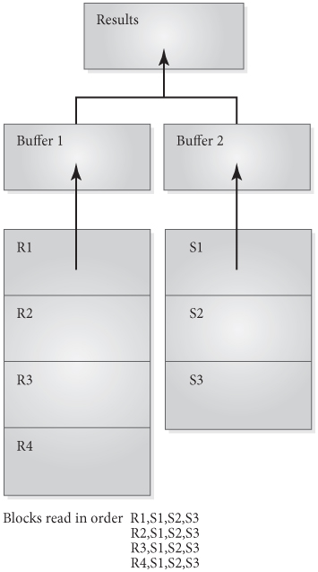
Cost of Performing Nested Loop Joins
Default method, used when no special access paths exist
If we have two buffers for reading, plus one for writing the result, bring the first block of R into the first buffer, and then bring each block of S, in turn, into the second buffer
Compare each tuple of the current R block with each tuple of the current S block before switching in the next S block
Once finished all the S blocks, bring in the next R block into the first buffer, and go through all the S blocks again
Repeat this process until all of R has been compared with all of S
Figure 13.5 Nested Loop Join with Two Buffers for Reading

Slide 34
Cost of Performing Nested Loop Joins
Read cost (R |×| S) = b(R) + (b(R)*b(S))
since each block of R has to be read, and each block of S has to be read once for each block of R.

Slide 35
More on Nested Loop Joins
Should pick the smaller file for the outside loop, since number of blocks in file in the outer loop file must be added to the product
If buffer can hold more than three blocks, read as many blocks as possible from the outer loop file, and only one block from the inner loop, plus one for writing the result
If b(B) is the number of buffer blocks, using R as the outer loop, read b(B)-2 blocks of R into the buffer at a time, and 1 block of S
Total number of R blocks still b(R), but number of S blocks is approximately b(S)*(b(R)/(b(B) - 2))
The cost of accessing the files:
b(R) + ((b(S)*(b(R))/(b(B) - 2))

Slide 36
Nested Join with Small Files
If all of R fits in main memory, with room for one block of S and one block for result, then read R only once, while switching in blocks of S one at a time
The cost of reading the two packed files is then the most efficient possible cost
b(R) + b(S)

Slide 37
Sort-Merge Join
If both files are sorted on the attribute(s) to be joined, the join algorithm is like the algorithm for merging two sorted files
b(R) + b(S)
If unsorted, may be worthwhile to sort files before a join
Add the cost of sorting, which depends on the sorting method used

Slide 38
Join Using Index or Hash Key
if A is a hash key for S, retrieve each tuple of R in the usual way, and use hashing algorithm to find all matching records of S. Cost is b(R) + t(R)*h
For index on A, cost depends on the type of index:
  If A is the primary key of S, access cost is cost of accessing blocks of R plus cost of reading the index and accessing one record of S for each of the tuples in R
  b(R) + (t(R) * (l(indexname) + 1))
  If A is not a primary key, consider the number of matches in S per tuple of R, b(R) + (t(R) * (l(indexname) + s(A=c,S)))
  If the index is a clustering index, reduce the estimate by dividing by the blocking factor
  b(R) + (t(R) * (l(indexname) + s(A=c,S)/bf(S))

Slide 39
Estimating Size of the Join Result-1
Let R and S have size t(R) and t(S)
If the tables have no common attributes, can only do a Cartesian product (not usually called a join), and the number of tuples in the result is t(R) * t(S)
If the set of common attributes is a key for one of the relations, the number of tuples in the join can be no larger than the number of tuples in the other relation, since each of these can match no more than one of the key values
If the common attributes are a key for R, then the size of the join is less than or equal to t(S)
Ex. For natural join of Student and Enroll, since stuId is the primary key of Student, the number of tuples in the result will be the same as the number of tuples in Enroll, or 50,000, since each Enroll tuple has exactly one matching Student tuple

Slide 40
Estimating Size of the Join Result-2
If common attributes are not a key of either relation
  assume that there is one common attribute, A, whose values are uniformly distributed in both relations. For a particular value, c, of A in R, the number of tuples in S having a matching value of c for A is the selection size of A in S, or s(A=c,S), which is t(S)/n(A,S). This gives us the number of matches in S for a particular tuple in R. However, since there are t(R) tuples in R, each of which may have this number of matches, the total expected number of matches in the join is
  t(R |×| S) = t(R)*t(S) / n(A,S)
If we had started by considering tuples in S and looked for matches in R, we would have derived t(R |×| S) = t(S)*t(R) / n(A,R)
Use the formula that gives the smaller result

Slide 41
Cost of Writing Join Result
Estimate the number of bytes in the joined tuples to be roughly the sum of the bytes of R and S, and divide the block size by that number to get the blocking factor of the result
The number of blocks in the result is the expected number of tuples divided by the blocking factor

Slide 42
Cost of Projection with Key
Projection requires finding the values of the attributes in the projection list for each tuple, and eliminating duplicates, if any
If the projection list contains a key of the relation, there are no duplicates to eliminate
  The read cost is number of blocks in the relation is b(R)
  The number of tuples in the result is number of tuples in the relation, t(R)
  The resulting tuples may be much smaller than the tuples of R, so the number of blocks needed to write the result may be much smaller than b(R)

Slide 43
Cost of Projection-General Case
If the projection list does not contain key, must eliminate duplicates
Method Using Sorting
  Sort the results so that duplicates appear together
  Eliminate any tuple that is a duplicate of the previous one
  Cost is the sum of the costs of
    Accessing all the blocks of the relation to create a temporary file with only attributes on the projection list
    Writing the temporary file
    Sorting the temporary file
    Accessing the sorted temporary file to eliminate duplicates
    Writing the final results file
  Most expensive step is sorting temporary file
    Use external sorting since DB files are large
    Can use two-way merge sort if there are 3 buffers available
    if file has n pages, the number of passes needed will be (log₂n)+1, and the number of disk accesses required just for the sorting phase will be
  2n((log₂n)+1))
Can use hashing method if several buffers available

Slide 44
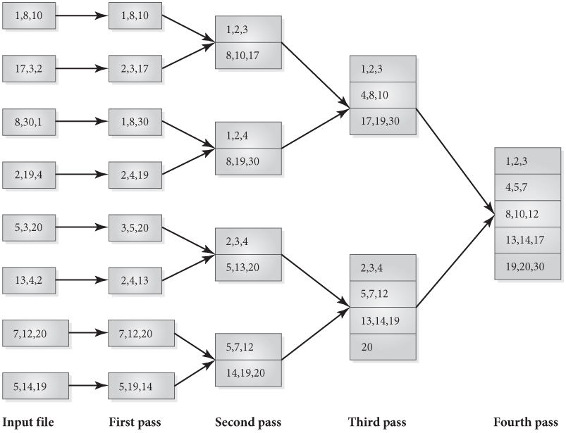
Figure 13.6B External Two-Way Merge Sort

Slide 45
Cost of Set Operations
Sort both files on the same attributes
Use basic sort-merge algorithm
  For union, put in results file any tuple that appears in either of the original files, but drop duplicates
  For intersection, place in the results file only the tuples that appear in both of the original files, but drop duplicates
  For set difference, R - S, examine each tuple of R and place it in the results file if it has no match in S
Cost is the sum of the cost of
  Accessing all the blocks of both files
  Sorting both and writing the temporary sorted files
  Accessing the temporary files to do the merge
  Writing the results file

Slide 46
Pipelining
Materialization of intermediate results can be expensive
pipelining
  Tuples “pass through” from one operation to the next in the pipeline, without creation of a temporary file
  Cannot be used in algorithms that require that the entire relation as input

Slide 47
Oracle Cost-Based Optimization
Determines cost of an execution plan from knowledge of statistics, constraints, indexes, cost savings from temporary indexes, scan methods and join algorithms
System gathers statistics for columns, tables, and schema
Frequencies of column values are recorded using histograms
Optimizer uses statistics to estimate cost of methods of executing queries and chooses cheapest
User can influence the choice by providing hints as formatted comments in the query e.g. +INDEX
Users can examine execution plans by command EXPLAIN PLAN
Adaptive Query Optimization allows the optimizer to self-correct using adaptive plans and adaptive statistics
Users can extend optimization to user-defined types by extensible optimization option

