Slide 1
Introduction
CS 3270 — Chapters 1–6

Slide 2
About Python
Evolved from a government-funded project to teach programming to children (the “ABC” language)
The project tanked, but Guido van Rossum didn’t let it go
He began implementation of Python in 1989
Now in version 3.10.0
Download at python.org
Python is dynamically typed
No declarations, no compiler
To get up to speed quickly:
https://thispointer.com/python-programming/

Slide 3
More About Python
Readable (”executable pseudocode”)
Easy to learn
Robust
Massive standard library and 3rd-party support
You can do almost anything (scripts, number-crunching, web…)
Not used for real-time applications
Python is interpreted, not compiled
Notes:
Visit tiobe.com

Slide 4
IDEs Don’t Use Visual Studio Python Plugin!
IDLE (Built-in)
PyCharm
Wing IDE 101
Thonny
Sublime Text
VS Code
Xcode
Note: Very few online IDEs support Python 3.10
Notes:
Demo the online ones

Slide 5
A Sample Program
# interest.py
principal = 1000 # Initial amount
rate = 0.05 # Interest rate 5%
numyears = 5 # Number of years
year = 1
while year <= numyears:
principal = principal * (1 + rate)
print(year, principal)
year += 1
1 1050.0
2 1102.5
3 1157.625
4 1215.5062500000001
5 1276.2815625000003
Indentation is
required!
Start a comment
Starts a block (not a new scope!)

Slide 6
An IDLE Session
Let’s run the previous program in IDLE
And then in pythontutor.com
Then from the command line
Notes:
Use code from slide 5.

Slide 7
Getting Help
Docs on python.org
The help function in the interpreter
pythontutor.com
debugger and memory visualizer

Slide 8
Conditionals
if product == "game" and type == "pirate memory" \
and not (age < 4 or age > 8):
print("I'll take it!")
if suffix == ".htm":
content = "text/html"
elif suffix == ".jpg":
content = "image/jpeg"
elif suffix == ".png":
content = "image/png"
else:
raise RuntimeError("Unknown content type")

Slide 9
The match statement “Structural Pattern” Matching (3.10+ Only)
Switch statement on steroids!
Inspired by ML, Rust
Cases use pattern matching:
Values
Types
Data Structures
Can nest
Alternation with |
Conditions with if
Capture subpatterns with as
Patterns can capture nested data
See:
https://mathspp.com/blog/pydonts/pattern-matching-tutorial-for-pythonic-code
https://www.python.org/dev/peps/pep-0636/

Slide 10
Factorial Using Patterns
>>> def factorial(n):
... match n:
... case 0 | 1:
... return 1
... case _:
... return n*factorial(n-1)
...
>>> factorial(5)
120

Slide 11
Capture
>>> def third_or_less(stuff):
... match stuff:
... case [_,_,t,*_]:
... return t
... case [_,s]:
... return s
... case [f]:
... return f
... case []:
... return None
...
>>> third_or_less([1,2,3,4])
3
>>> third_or_less([1,2,3])
3
>>> third_or_less([1,2])
2
>>> third_or_less([1])
1
>>> third_or_less([])
>>> third_or_less([]) is None
True
>>> third_or_less((1,2))
2

Slide 12
>>> def act(command):
... match command.split():
... case "Cook", "breakfast":
... return "I love breakfast."
... case "Cook", *_:
... return "Cooking..."
... case "Go", "North" | "East" | "South" | "West" as direction:
... return f"Alright, I'm going {direction}!"
... case "Go", *_:
... return "I can't go that way..."
... case _:
... return "I can't do that..."
...
>>> print(act("Go North"))
Alright, I'm going North!
>>> print(act("Go asdfasdf"))
I can't go that way...
Named capture

Slide 13
Built-in Data Types
bool (True, False)
int, float (IEEE double), complex
arbitrary precision for int
Sequences:
str (Unicode), list, tuple, bytes, bytearray
Only list and bytearray are mutable
Hashed data structures:
dict, set, frozenset (immutable)
None (like null or void)
Note capitalization
No char! A character is a string of length 1.
Notes:
Demo arbitrary precision

Slide 14
Division and Exponentiation
>>> a = 3
>>> b = 2
>>> a / b
1.5
>>> a // b
1
>>> a**b
9
Mathematical Division with /
Integer Division with //
Exponentiation with **

Slide 15
Numeric Literals and Conversions
>>> # Base literals
... 0b1011
11
>>> 0o13
11
>>> 0xb
11
>>>
>>> # Conversions
... int(3.5)
3
>>> int('3')
3
>>> float('3.5')
3.5
>>> int(True)
1
>>> bool(1)
True
>>> bool(5)
True
>>> bool('')
False
>>> str(1.5)
'1.5’
>>> hex(11), oct(11), bin(11)
('0xb', '0o13', '0b1011')

Slide 16
Everything is an Object
Variables are names bound to values
they do not have permanent storage
they are like pointers
Assignment rebinds a variable to a new value
an old value will be garbage-collected
>>> a = 3
>>> id(a)
4297538016
>>> id(3)
4297538016
>>> a = 'hello'
>>> id(a)
4329470136

Slide 17
Everything Really is an Object
>>> import math
>>> items = {} # A dictionary
>>> math
<module 'math' from '/Library/Frameworks/Python.framework/Versions/3.6/lib/python3.6/lib-dynload/math.cpython-36m-darwin.so'>
>>> items['math'] = math
>>> ValueError
<class 'ValueError'>
>>> items['error'] = ValueError
>>> abs
<built-in function abs>
>>> items['abs'] = abs
Continued...

Slide 18
>>> nums = [1,2,3,4]
>>> nums.append
<built-in method append of list object at 0x101aa39c8>
>>> items['abs'](-45)
45
>>> items['math'].sqrt(2)
1.4142135623730951
>>> try:
... x = int("oops!")
... except items['error']:
... print('conversion error')
...
conversion error
>>> items['append'] = nums.append
>>> items['append'](100)
>>> nums
[1, 2, 3, 4, 100]

Slide 19
String Literals
>>> s = 'jello'
>>> id(s)
4329470472
>>> a = "isn't"
>>> b = 'a "quote"'
>>> a + ' ' + b
'isn\'t a "quote"'
>>> print(_)
isn't a "quote"
>>> c = '''a
... multi-line
... string'''
>>> c
'a\nmulti-line\nstring'
>>> print(c)
a
multi-line
string
Use single or double quotes
allows nesting
Triple quotes for multi-line strings
_ = last value computed

Slide 20
String Formatting
Use f'…' syntax
evaluates expressions inside {}
>>> n = 2
>>> x = 10.5
>>> s = 'book'
>>> result = f'{n} {s}s costs ${n*x*1.06:.2f}'
>>> result
'2 books costs $22.26'
>>> f"{n=}" # New in 3.8
'n=2'

Slide 21
String Format Descriptors
d, i Decimal integer (int or long).
u Unsigned integer or long integer.
o Octal integer or long integer.
x Hexadecimal integer or long integer.
X Hexadecimal integer (uppercase hex-digit letters).
f Floating point as [-] m.dddddd.
e Floating point as [-] m.dddddd e± x x.
E Floating point as [-] m.dddddd E± x x.
g, G Uses e or E for exponents less than –4 or greater than the precision; otherwise, use %f.
s String or any object with a __str__( ) method.
r Produces the same string as produced by repr( ).
c Single character. Variable can be an int or a 1-character string.

Slide 22
The str.format( ) Method
Provides positional formatting capabilities (a la C#)
r = "{0} {1} {2}".format('GOOG',100,490.10)
r = "{} {} {}".format('GOOG',100,490.10) # Automatically advances
r = "{name} {shares} {price}".format(name='GOOG',shares=100,price=490.10)
r = "Hello {0}, your age is {age}".format("Elwood",age=47)
r = "Use {{ and }} to output single curly braces".format()
stock = {'name' : 'GOOG',
'shares' : 100,
'price' : 490.10 }
r = "{0[name]} {0[shares]} {0[price]}".format(stock)
x = 3 + 4j
r = "{0.real} {0.imag}".format(x)
r = "{name:8} {shares:8d} {price:8.2f}".format(name="GOOG",shares=100,price=490.10)
name = "Elwood"
r = "{0:<10}".format(name) # r = 'Elwood '
r = "{0:>10}".format(name) # r = ' Elwood'
r = "{0:^10}".format(name) # r = ' Elwood '
r = "{0:=^10}".format(name) # r = '==Elwood=='
Notes:
'GOOG 100 490.1'
'GOOG 100 490.1'
'GOOG 100 490.1'
'Hello Elwood, your age is 47'
'Use { and } to output single curly braces'
'GOOG 100 490.1'
'3.0 4.0'
'GOOG 100 490.10'

Slide 23
Ranges
The range function returns a range object
Can be iterated
But is not consumed (some iterators are)
>>> r = range(10, 101, 10)
>>> r
range(10, 101, 10)
>>> list(r)
[10, 20, 30, 40, 50, 60, 70, 80, 90, 100]
>>> list(r)
[10, 20, 30, 40, 50, 60, 70, 80, 90, 100]
>>> sum(r)
550
>>> sum(list(r))
550

Slide 24
str vs. repr
str yields a human-friendly string
repr yields a string that represents (can create) the object
>>> import datetime
>>> today = datetime.datetime.now()
>>> today
datetime.datetime(2020, 1, 4, 0, 54, 16, 516957) # an object
>>> repr(today)
'datetime.datetime(2020, 1, 4, 0, 54, 16, 516957)'
>>> eval(repr(today))
datetime.datetime(2020, 1, 4, 0, 54, 16, 516957) # the object
>>> str(today)
'2020-01-04 00:54:16.516957' # meaningful string
Danger!
Notes:
Mention the security risk of eval.

Slide 25
Strings are Immutable
>>> s
'hello'
>>> id(s)
4329470136
>>> s[0] = "j"
Traceback (most recent call last):
File "<stdin>", line 1, in <module>
TypeError: 'str' object does not support item assignment
>>> s = 'jello'
>>> id(s)
4329470472

Slide 26
Slices Works for All Sequences (str, list, tuple)
Extracts subsequences
Syntax: s[start:stop]
the stop position is not included
the length extracted is stop – start
extract through the end with s[start:]
Strides (skipping):
s[start:stop:step]
>>> s = 'abcdefg'
>>> s[1:3]
'bc'
>>> s[1:2]
'b'
>>> s[1:1]
''
>>> s[0:len(s):2]
'aceg'
>>> s[0::2]
'aceg'
>>> s[::2]
'aceg'

Slide 27
Slicing with Negative Indices and Strides
[–1] is the last character
s[-1] = s[len(s) – 1]
s[-2] = s[len(s) – 2]
s[-len(s)] = s[0]
>>> s = 'help'
>>> s[-1]
'p'
>>> s[-3]
'e'
>>> s[-1:-3]
''
>>> s[-1:-3:-1]
'pl'
>>> s[-2::-1]
'leh'
>>> s[::-1]
'pleh'
String | H | e | l | p
Index: | 0 | 1 | 2 | 3
Neg index | -4 | -3 | -2 | -1

Slide 28
Slice Practice
a = "hello":
a[5:0:-1] == ?
a[0:10:-1] == ?
a[-2:10] == ?
a[10:-2] == ?
a[:2:-1] == ?
a[::2] == ?
a[::-2] == ?

Slide 29
Basic String Operations
split
separates a string into its parts
join
joins the parts back into a string
strip
removes outside whitespace
find, rfind, index, rindex
Searches for substrings
>>> s = "Now is the time"
>>> s.split()
['Now', 'is', 'the', 'time']
>>> '-'.join(_)
'Now-is-the-time'
>>> _.split('-')
['Now', 'is', 'the', 'time']
>>> s = " no like outer space "
>>> s.strip()
'no like outer space'
Notes:
Show >>>help(str)

Slide 30
More String Operations
>>> s = "Now is the time"
>>> s.upper()
'NOW IS THE TIME'
>>> s[0].islower()
False
>>> s[1].islower()
True
>>> 'NOW'.isupper()
True
>>> 'Now'.isupper()
False
>>> s.endswith('me')
True
>>> s.startswith('me')
False
lower/upper
Converts to lower/upper-case
islower/isupper
obvious
isalpha, isdigit, isspace
endswith, startswith
Notes:
Show >>>help(str)

Slide 31
The sorted function
Can sort any sequence:
string, list, tuple, …
Returns a new list
You can customize it:
Sort in reverse order
Specify a key function
>>> sorted('hello')
['e', 'h', 'l', 'l', 'o’]
>>> sorted('hello',reverse=True)
['o', 'l', 'l', 'h', 'e’]
>>> stuff = [(1,'c'),(2,'b'), (4,'a'), (3,'a')]
>>> sorted(stuff)
[(1, 'c'), (2, 'b'), (3, 'a'), (4, 'a')]
>>> sorted(stuff,reverse=True)
[(4, 'a'), (3, 'a'), (2, 'b'), (1, 'c')]
>>> def compkey(elem): return elem[1]
...
>>> sorted(stuff,key=compkey)
[(4, 'a'), (3, 'a'), (2, 'b'), (1, 'c')]
>>> def compkey(elem): return (elem[1],elem[0])
...
>>> sorted(stuff,key=compkey)
[(3, 'a'), (4, 'a'), (2, 'b'), (1, 'c')]
sorted is a stable sort

Slide 32
Console Input
input function
returns a string (like readLine, getline, etc. in other languages)
Can convert to data with constructors or eval)
>>> s = input('Enter a number: ')
Enter a number: 7
>>> s
'7’
>>> eval(s)
7
>>> int(s)
7
>>> s = "{1:'one', 2:'two'}”
>>> eval(s)
{1: 'one', 2: 'two'}
>>> type(_)
<class 'dict'>
Evaluates just as it would in the interactive interpreter
(beware security issues!)

Slide 33
Dictionaries A First Look
>>> d = {1:"one", 2:"two"}
>>> d[3] = "three"
>>> d
{1: 'one', 2: 'two', 3: 'three'}
>>> d.keys()
dict_keys([1, 2, 3])
>>> list(_)
[1, 2, 3]
>>> tuple(d.values())
('one', 'two', 'three')
>>> 2 in d
True
>>> 4 in d
False
>>> for k,v in d.items():
... print(f"({k}, {v})")
...
(1, one)
(2, two)
(3, three)
Hash Tables holding <key,value> pairs
Aka “maps”, “associative arrays”
Uses key as an “index”
d[key] reads or writes

Slide 34
Processing Input Files
The open function
Close with the close method, or, better yet, use a with context
Methods:
readline Reads and returns the next line in the file
readlines Returns all the lines in a list of strings
read Reads the entire file into a single string

Slide 35
File Input Example
The following are equivalent:
>>> f = open('words.txt')
>>> lines = f.readlines()
>>> f.close()
>>> len(lines)
81486
>>> with open('words.txt') as f:
... s = f.read()
... print(s.count('\n'))
...
81486
>>> with open('words.txt') as f:
... lcount = 0
... for line in f:
... lcount += 1
...
>>> lcount
81486

Slide 36
Loops
while for general loops; for for iterating through sequences
Both can have an else clause
for checking if the loop completed, instead of being exited via break
for line in open("foo.txt"):
stripped = line.strip() # Visible after for loop ends!
if not stripped:
break
# process the stripped line
...
else:
raise RuntimeError("Missing section separator")

Slide 37
Using Parallel Assignment in Iteration
>>> x = [1,2,3]
>>> y = [4,5,6]
>>> pairs = zip(x,y) # iterator to [(1, 4), (2, 5), (3, 6)]
>>> for k,v in pairs:
... print(f'({k}:{v})')
...
(1:4)
(2:5)
(3:6)
Notes:
Zip actually returns an iterable.

Slide 38
Truthiness Zero, None, and empty structures are False
print(bool([]))
print({} or [])
print({} and [])
print(not 2)
print(bool(None))
print(bool(""))
print(bool([""]))
def first_non_empty(a,b,c):
return a or b or c or None
print(first_non_empty(1,2,3))
print(first_non_empty(0,2,3))
print(first_non_empty(0,[],3))
print(first_non_empty(0,[],{}))
False
[]
{}
False
False
False
True
1
2
3
None
Length is not 0

Slide 39
Testing Truthiness in Sequences all and any
>>> all([1,2,3])
True
>>> all([0,1])
False
>>> any([0,1])
True
>>> any([{},{'a'}])
True
>>> all([{},{'a'}])
False

Slide 40
+ and * are Overloaded
>>> 2 + 3 # Addition
5
>>> "a" + "b" # Concatenation
'ab'
>>> "a" * 5 # Sequence Duplication
'aaaaa'
>>> 2 * (1,2)
(1, 2, 1, 2) # NOT ((1,2),(1,2))
>>> [1,2] * 2
[1, 2, 1, 2] # NOT [[1,2],[1,2]]

Slide 41
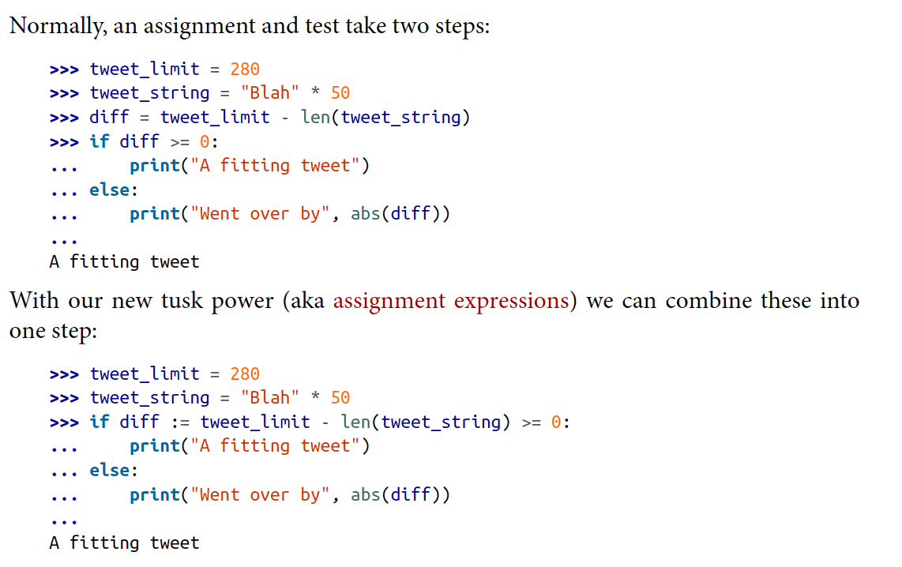
Assignment Expressions The Walrus Operator
:=
Notes:
Page 60.

Slide 42
The in Operator
>>> x = [1,2,3]
>>> y = (1, "one")
>>> 1 in x
True
>>> 5 in x
False
>>> 1 in y
True
>>> 'e' in y[1]
True
>>> 'f' in y[1]
False
>>> d = {1:"one", 2:"two"}
>>> 1 in d, 3 in d
(True, False)

Slide 43
Defining Functions A First Look
>>> def f(x, y):
... print(f"{x=}, {y=}")
... return x+y
...
>>> print(f(1,2))
x=1, y=2
3
Debug print (3.8+)

Slide 44
Style Checking with pylint Doesn’t support 3.10 yet ☹
Install:
$ pip install pylint
To run:
$ pylint myfile.py
Exceptions
# pylint: disable=invalid-name,…

