Slide 1
Functions
CS 3270 — Chapter 9

Slide 2
Agenda
Functions
Decorators
Generators
Scope
Exceptions

Slide 3
Functions

Slide 4
Function Parameters
Passed by assignment of object reference
aka “pass by sharing”
changes made through mutable arguments persist after returning
>>> def add1(stuff, x):
... stuff.append(x)
...
>>> s = [1,2,3]
>>> add1(s,4)
>>> s
[1, 2, 3, 4]
Notes:
Illustrate on board or in pythontutor.com

Slide 5
Default Arguments
Must occur after non-default parameters
Best if they are not mutable objects
Oops! Mutable.
>>> def f(a, b=0):
... print('a:',a,'b:',b)
...
>>> f(1,2)
a: 1 b: 2
>>> f(3)
a: 3 b: 0
def h(x, y = []):
y.append(x)
return y
print(h(1)) # [1]
print(h(2)) # [1, 2]
print(h(3,[7]))# [7, 3]
print(h(4)) # [1, 2, 4]
Notes:
Run in pythontutor.com

Slide 6
Using Parameters as Keyword Arguments
Useful when there are many arguments
Order doesn’t matter when using parameter names in the call
>>> def f(a,b):
... print('a =',a,'b =',b)
...
>>> f(b=10,a=20)
a = 20 b = 10
Notes:
Explain print’s arguments.

Slide 7
Variable-Length Arguments Lists
Use an asterisk before the parameter name
def f(*stuff)
The arguments are collected as a tuple
print(*objects, sep=' ', end='\n',
file=sys.stdout, flush=False)
>>> def avg(*stuff):
... print(f"{stuff=}")
... return sum(stuff) / len(stuff)
...
>>> avg(1,2)
stuff=(1, 2)
1.5
>>> avg(1,2,3)
stuff=(1, 2, 3)
2.0

Slide 8
Not Just for Function Parameters But collects into a list here
>>> a,b,*rest = range(5)
>>> a,b,rest
(0, 1, [2, 3, 4])
>>> a,b,c,*rest = range(5)
>>> a,b,c,rest
(0, 1, 2, [3, 4])
>>> a,b,c,d,*rest = range(5)
>>> a,b,c,d,rest
(0, 1, 2, 3, [4])
>>> a,b,c,d,e,*rest = range(5)
>>> a,b,c,d,e,rest
(0, 1, 2, 3, 4, [])
>>> a,*middle,e = range(5)
>>> a,middle,e
(0, [1, 2, 3], 4)
Collects into a list.
Only one variable on the left can have a *.

Slide 9
Unpacking Tuples in a Function Call
Only works in a function call
>>> def f(a, b, c):
... print('a =', a, 'b =' , b, 'c =' , c, sep=' ')
...
>>> stuff = ('one', 2, 3.33)
>>> f(*stuff) # same as f('one', 2, 3.33)
a = one b = 2 c = 3.33

Slide 10
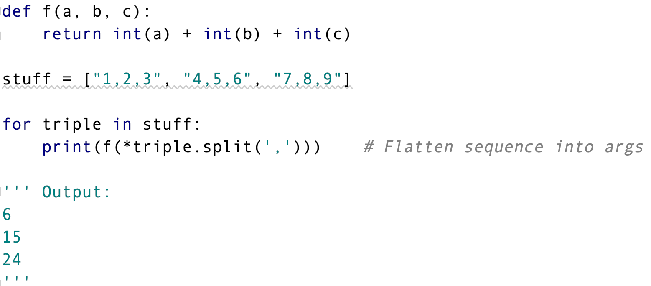
Unpacking Example 2

Slide 11
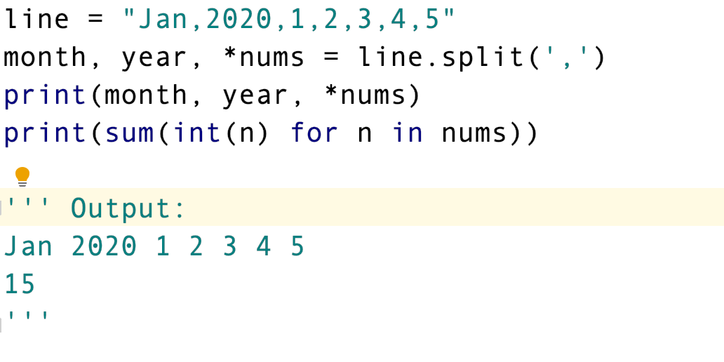
Unpacking Example 3

Slide 12
Variable-length Keyword Arguments
Collected into a dictionary
Use ** as a parameter prefix
>>> def f(**kwargs):
... print(kwargs)
...
>>> f(a=1, b='two', c=[3])
{'a': 1, 'c': [3], 'b': 'two'}

Slide 13
Unpacking Dictionaries in a Function Call
Only works in a function call
>>> def f(a, b, c):
... print('a =', a, 'b =', b, 'c =', c, end = ' ')
...
>>> args = {'a':'one', 'b':2, 'c':[3]}
>>> f(**args) # Same as f(a='one', b=2, c=[3])
a = one b = 2 c = [3]

Slide 14
Order of Arguments Matters
1) Positional
2) Default
3) Variable-length non-keyword (using *)
4) Variable-length keyword (using **)
All are optional

Slide 15
Putting It All Together
fix1 = 1
def1 = 2
def2 = 3
args = (4, 5, 6)
kwargs = {'foo': 7, 'bar': 'baz’}
fix1 = 4
def1 = 5
def2 = 6
args = ()
kwargs = {'foo': 7, 'bar': 'baz'}
fix1 = 6
def1 = 1
def2 = 2
args = ()
kwargs = {'foo': 7, 'bar': 'baz'}
def f(fix1,def1=1,def2=2,*args,**kwargs):
print('fix1 =',fix1)
print('def1 =',def1)
print('def2 =',def2)
print('args =',args)
print('kwargs =',kwargs)
f(1,2,3,4,5,6,foo=7,bar='baz')
f(4,5,6,foo=7,bar='baz')
f(6,foo=7,bar='baz')

Slide 16
Function Attributes
Functions (like everything else in Python) are objects
They can have attributes (independent of its parameters)
>>> def f():
... "A function that returns the next counting number"
... f.x += 1
... return f.x
...
>>> f.x = 0 # f must have been previously defined
>>> f.__doc__
'A function that returns the next counting number'
>>> for i in range(5):
... print(f(),end=' ')
...
1 2 3 4 5
>>> print(vars(f)) # vars returns attributes in a dict
{'x': 5}

Slide 17
Function Annotations
A way of describing a function’s signature
No error checking is done
it’s just documentation
But mypy and pyre check them
See annotations.py

Slide 18
A Very Useful Function Pattern Used for Decorators
def f(*args, **kwargs):
for arg in args:
print(arg)
for key in kwargs:
print(key, '=', kwargs[key])
f(1,2,t=3,f=4)
Takes any number of positional args followed by keyword args
1
2
t = 3
f = 4

Slide 19
Decorators
A decorator is a function that “wraps” another function with new behavior
enables pre-and-post processing around the original function
Decorators can be composed to have many layers of added functionality
So cool!

Slide 20
Decorator Example (The Old-Fashioned Way)
def trace(f):
def wrapper(*args1, **args2):
print(f.__name__,'with',args1,args2)
return f(*args1, **args2)
return wrapper
def foo(parm):
print(parm)
foo = trace(foo) # Decorate foo
def bar(parm1, parm2):
print(parm1, parm2)
bar = trace(bar) # Decorate bar
foo(1)
bar(2,3)
foo(parm=4)
bar(5,parm2=6)
foo with (1,) {}
1
bar with (2, 3) {}
2 3
foo with () {'parm': 4}
4
bar with (5,) {'parm2': 6}
5 6
Notes:
We don’t use the return value here.

Slide 21
Using @ Syntax The Modern Way
def trace(f):
def wrapper(*args1, **args2):
print(f.__name__,'with',args1,args2)
return f(*args1, **args2)
return wrapper
@trace
def foo(parm):
print(parm)
@trace
def bar(parm1, parm2):
print(parm1, parm2)
foo(1)
bar(2,3)
foo(parm=4)
bar(5,parm2=6)
foo with (1,) {}
1
bar with (2, 3) {}
2 3
foo with () {'parm': 4}
4
bar with (5,) {'parm2': 6}
5 6

Slide 22
Did You Notice?
The inner function wrapper is returned
But it references trace’s argument, f
Even though trace has returned when we use the decorated function later!
So, what is returned is actually a closure:
Not just a function
It also keeps a reference to the original f
def trace(f):
def wrapper(*args1, **args2):
print(f.__name__,'with',args1,args2)
return f(*args1, **args2)
return wrapper

Slide 23
Interesting Behavior
def trace(f):
def wrapper(*args1, **args2):
print(f.__name__,'with',args1,args2)
return f(*args1, **args2)
return wrapper
@trace
def foo(parm):
print(parm)
foo(3)
print(foo.__name__)
''' Output:
foo with (3,) {}
3
wrapper
'''
“dunder” notation
Notes:
Typically, we want the decorated to appear as the original function to the user.

Slide 24
A Manual Fix Using a Function Attribute
def trace(f):
def wrapper(*args1, **args2):
print(f.__name__,'with',args1,args2)
return f(*args1, **args2)
wrapper.__name__ = f.__name__
return wrapper
@trace
def foo(parm):
print(parm)
foo(3)
print(foo.__name__)
''' Output:
foo with (3,) {}
3
foo
'''

Slide 25
A Pythonic Fix Using the functools.wraps Decorator
import functools
def trace(f):
@functools.wraps(f)
def wrapper(*args1, **args2):
print(f.__name__,'with',args1,args2)
return f(*args1, **args2)
return wrapper
@trace
def foo(parm):
print(parm)
foo(3)
print(foo.__name__)
foo.__wrapped__(3) # Call original foo
''' Output:
foo with (3,) {}
3
foo
3
'''
Notes:
__wrapped__ is bound to the original function.

Slide 26
Preventing Repeated Decoration
You can set a flag in the wrapper function
If exists, don’t decorate
Just return the passed function
See quote.py

Slide 27
Closures
More than just a plain function
Contains a reference to the actual function body plus the non-local variable(s) it uses
>>> def addx(x): return lambda y: x+y
...
>>> f = addx(5)
>>> f.__closure__[0].cell_contents
5
>>> f(1)
6
>>> g = addx(10)
>>> g.__closure__[0].cell_contents
10
>>> g(1)
11
Notes:
Draw stack frames on board.

Slide 28
The nonlocal Statement
Finds names in enclosing scopes (not global, though)
Useful inside inner (nested) functions (when you want to change the nonlocal)
def g():
a = 10
def f():
nonlocal a
a += 1 # Changes g’s a
print(a) # 10
f()
print(a) # 11

Slide 29
A Running Average with a Closure
Store nonlocal data in outer function
Define the averaging function as a nested function and return it
See runavg0.py

Slide 30
Infinite Streams with Closures
def fibonacci():
cur = 0
nxt = 1
def func():
nonlocal cur, nxt
result = cur
cur, nxt = nxt, cur + nxt
return result
return func
f = fibonacci() # Priming call returning a closure
for i in range(10):
print(f(), end = ' ')
Output: 0 1 1 2 3 5 8 13 21 34
We’ll see a better way to do this shortly with generators

Slide 31
Closures vs. Classes
They accomplish the same thing with different syntax
In classes, the data is bound to:
Instances
Class objects for static data
With closures, data is bound to
Non-local variables
Attributes of the outer function for static data
See closure.py

Slide 32
Tracking Function Calls Using Function Attributes
def track(f):
def wrapper(*args1, **args2):
wrapper.count += 1
return f(*args1, **args2)
wrapper.count = 0
return wrapper
@track
def f():
... # Or `pass`
for i in range(5): f()
print(f.count) # Prints 5

Slide 33
Composing Decorators
def trace(f):
def wrapper(*args1, **args2):
print(f.__name__,'with',args1,args2)
return f(*args1, **args2)
return wrapper
def bracket(f):
def wrapper(*args1, **args2):
print("<<< Start of", f.__name__,">>>")
result = f(*args1, **args2)
print("<<< End of", f.__name__,">>>")
return result
return wrapper

Slide 34
Composing Decorators
@trace
@bracket
def foo(parm):
print(parm)
@bracket
@trace
def bar(parm1, parm2):
print(parm1, parm2)
foo(1)
wrapper with (1,) {} # trace
<<< Start of foo >>> # bracket
1
<<< End of foo >>> # bracket
bar(2,3)
<<< Start of wrapper >>> # bracket
bar with (2, 3) {} # trace
2 3
<<< End of wrapper >>> # bracket

Slide 35
Composing Decorators (continued)
@trace
@bracket
def foo(parm):
print(parm)
@bracket
@trace
def bar(parm1, parm2):
print(parm1, parm2)
foo(parm=4)
wrapper with () {'parm': 4}
<<< Start of foo >>>
4
<<< End of foo >>>
bar(5,parm2=6)
<<< Start of wrapper >>>
bar with (5,) {'parm2': 6}
5 6
<<< End of wrapper >>>

Slide 36
Decorators with Arguments
Requires an extra, outer function layer to receive the arguments
def storeargs(arglist):
def real(f):
def wrapper(*args,**kwargs):
arglist.add(str(args)+str(kwargs))
return f(*args,**kwargs)
return wrapper
return real
theargs = set()
@storeargs(theargs) # Calls storeargs == @real
def fib(n):
return n if n in (0,1) else fib(n-1) + fib(n-2)
print(fib(3))
print(fib)
print(theargs)
Start Exercise 3 now
2
<function storeargs.<locals>.real.<locals>.wrapper at 0x101879d90>
{'(0,){}', '(1,){}', '(3,){}', '(2,){}'}

Slide 37
Generators Resumable Functions
A function that contains a yield expression
Used for iteration
Does not behave like a normal function
calling the generator the first time returns an iterator
the function has not started executing yet!
calling next( ) on the iterator will advance the function to the next yield expression in its code
The function resumes where it left off from the previous call to next( )
Useful for potentially infinite sequences
aka streams

Slide 38
An Infinite Fibonacci Generator
def fib():
last,current = 0,1
yield last
yield current
while True:
last,current = current,last+current
yield current
g = fib() # Priming call
for n in range(10):
print(next(g))
print()
print(next(g))
0
1
1
2
3
5
8
13
21
34
55

Slide 39
Composing Generators Decorator Style
See stream.py

Slide 40
Removing Comments A Problem-solving Exercise
A good use for generators
We will remove both // and /* … */ style comments
// is line-based
Ignore until end of line (but keep the newline)
/* ... */ ignores any embedded newlines
We will model with a state machine…
Notes:
Develop state machine in no_comment.png using madebyevan.com/fsm. Then develop no_comment.py.

Slide 41
File Objects are Iterable An Example from CS 1410
Ben
5 0 0 0 0 0 0 1 0 1 -3 5 0 0 0 5 5 0 0 0 0 5 0 0 0 0 0 0 0 0 1 3 0 1 0 -5 0 0 5 5 0 5 5 5 0 5 5 0 0 0 5 5 5 5 -5
Moose
5 5 0 0 0 0 3 0 0 1 0 5 3 0 5 0 3 3 5 0 0 0 0 0 5 0 0 0 0 0 3 5 0 0 0 0 0 5 -3 0 0 0 5 0 0 0 0 0 0 5 5 0 3 0 0
…
with open('ratings.txt') as f:
ratings = {}
for name in f:
ratings[name.strip().lower()] = [int(i) for i in next(f).split()]
Same as list(map(int, next(f).split())
Notes:
Reads 2 lines at time. Creates a dictionary where each name is the key and the value is the list of ratings. Alternative: list(map(int,next(f).split())

Slide 42
Generator Expressions
A kind of comprehension that returns an iterable
You don’t commit to a sequence type (list, set, dict)
Can only traverse once (iterator is exhausted)
>>> s = (x*x for x in range(1,4))
s
<generator object <genexpr> at 0x10120fdb0>
>>> for n in s: print(n,end=' ') # Can only do this once
...
1 4 9
>>> cartesian = ((x,y) for x in set1 for y in set2 if x != 'b' if y < 3)
>>> list(cartesian)
[('a', 1), ('a', 2), ('c', 1), ('c', 2)]

Slide 43
Generator Expression != Generator Function!
A Generator Expression is an expression
A shorthand for a generator function
A Generator Function is a function
Uses def and yield

Slide 44
Generator Expressions and any/all
>>> x = [1,2,3,4,5]
>>> any(n > 5 for n in x)
False
>>> any(n < 5 for n in x)
True
>>> all(n < 5 for n in x)
False
>>> def is_prime(n):
... import math
... return n == 2 or \
... n%2 == 1 and not any(n%k == 0 for k in range(3,int(sqrt(n))+1,2))
>>> [n for n in range(2,20) if is_prime(n)]
[2, 3, 5, 7, 11, 13, 17, 19]

Slide 45
Calling next on Sequences Using iter
Using the iter built-in function
Returns an iterator for your sequence
You can call next on it
Allows advancing within a loop body
>>> # Skip characters after each ‘e’
>>> s = "tippecanoe and tyler too"
>>> it = iter(s)
>>> keep, skip = [], []
>>> for c in it:
... keep.append(c)
... if c == 'e':
... c = next(it)
... skip.append(c)
...
>>> ''.join(keep)
'tippeanoeand tyle too'
>>> ''.join(skip)
'c r'
Notes:
What does the code do? (Skips any character after ‘a’)

Slide 46
Coroutines
Like generators, but can also receive input
Mainly used for consuming input only, but sometimes used to produce an on-going accumulated result
Allows back-and-forth processing between multiple functions
aka “cooperative multitasking” between two tasks
Need to “prime” with next(gen) (to reach the first yield; initial None is ignored)
The caller of the coroutine sends input to the coroutine
gen.send(<data>) (next(f) == f.send(None))
See coroutine2.py, runavg.py, themin.py

Slide 47
Generators vs. Coroutines
We “pull” data from generators by calling next
We typically “push” data to coroutines with send
But can also get a response
Generators can act like decorators
Coroutines can be used to ”broadcast”
def broadcast(targets):
while True:
item = yield
for target in targets:
target.send(item)
Each target is a coroutine

Slide 48
yield from
Opens a channel from an iterator to the caller of the current generator containing the yield from
the context in the current function is put on hold!
Exhausts the iterator before continuing in the current function
# Uses "yield from" to chain iterables
def chain(*iters):
for it in iters:
yield from it # yields directly to caller
it1 = (x*x for x in range(1,7))
it2 = ['a','b','c']
gen = chain(it1,it2)
for item in gen:
print(item,end = ' ') # 1 4 9 16 25 36 a b c
print()
Start Exercise 4 now

Slide 49
Anonymous Functions
aka lambda expressions
Use the lambda keyword
Can only take a single expression
not a multi-line function body
A return is implied
don’t write return yourself

Slide 50
Sorting Ignoring Case
>>> words = ['hello', 'jello', 'Hello', 'Jello']
>>> sorted(words)
['Hello', 'Jello', 'hello', 'jello']
>>> sorted(words, key=str.lower)
['hello', 'Hello', 'jello', 'Jello']
>>> sorted(words, key=lambda x: (str.lower(x), x))
['Hello', 'hello', 'Jello', 'jello']
sorted is “stable”

Slide 51
Higher-Order Functions
A fancy term for functions that use other functions as parameters or return values
Possible, because in Python, functions are real objects
Functions passed as parameters can customize the host function
Like a custom compare function passed to sort( ) (or sorted)
Hence, sort is a higher-level function
(See next slide...)
Decorators are higher-order functions because they take a function parameter and return a function (the wrapper)

Slide 52
list.sort is a Higher-Order Function
>>>emps = [('Joe',100,2500), ('Jill',200,1200)]
# Sort by product of last two fields
>>>emps.sort(key=lambda r: r[1]*r[2])
>>>emps
[('Jill', 200, 1200), ('Joe', 100, 2500)]
# Descending order
>>>emps.sort(key=lambda r: r[1]*r[2], reverse=True)
>>>emps
[('Joe', 100, 2500), ('Jill', 200, 1200)]

Slide 53
Packaging A Custom Sorter
We will write a function, custom_sort, that takes a comparator function as input
It returns a function that calls sorted on its argument using that comparator
We parameterize the key function for reuse
>>>def custom_sort(cmp):
... return lambda stuff: sorted(stuff, key=cmp)
...
>>>emp_sort = custom_sort(lambda r: r[1]*r[2])
>>>emps = [('Joe',100,2500),('Jill',200,1200)]
>>>emp_sort(emps)
[('Jill', 200, 1200), ('Joe', 100, 2500)]
Creates a sort function that uses a key function
Notes:
Can call emp_sort many times. It was created by specializing custom_sort.

Slide 54
Partial Function Evaluation With functools.partial
We just used a closure that fixed one of the arguments for a function call ahead of time
functools.partial does it for you!
returns a closure waiting for more arguments
>>> from functools import partial
>>> revsort = partial(sorted, reverse=True)
>>> revsort([1,2,3])
[3, 2, 1]
>>> revsort(['a', 'b', 'c'])
['c', 'b', 'a']

Slide 55
Redoing Our Custom Sort with partial
>>>emps = [('Joe',100,2500), ('Jill',200,1200)]
>>>from functools import partial
>>>emp_sort = partial(sorted, key=lambda r: r[1]*r[2])
>>>emp_sort(emps)
[('Jill', 200, 1200), ('Joe', 100, 2500)]
See also stream2.py
(There is also a partialmethod for methods of a class)

Slide 56
Partial Function Evaluation aka “Currying”
We can give only some of a function’s arguments
We would like a function back waiting for other arguments
Thus, allowing function customization
We can do this with a decorator
See curry.py in pythontutor.com
Note how the stack frame/closure is preserved
See currysort.py
(This version doesn’t support keyword arguments)

Slide 57
map and filter Processing Sequences
map builds a new iterable applying a function to each element
filter extracts elements that satisfy a predicate (a boolean function)
They return iterators
To get lists, use comprehensions instead
>>> stuff = [1,2,3]
>>> map(lambda x: x+1, stuff)
<map object at 0x1029e7fd0>
>>> list(_)
[2, 3, 4]
>>> [x+1 for x in stuff]
[2, 3, 4]
>>> filter(lambda x: x % 2 == 1, stuff)
<filter object at 0x1029e7cf8>
>>> list(_)
[1, 3]
>>> [x for x in stuff if x % 2 == 1]
[1, 3]

Slide 58
functools.reduce
This function process lists all at once in a very flexible way
Syntax: reduce(accumulator function, sequence, initial value)
def reduce(f, seq, init):
result = init # Initializer/empty result
for x in seq:
result = f(result, x) # f is a binary fun
return result

Slide 59
reduce Example
>>> from functools import reduce
>>> nums = [1,2,3,4]
>>> reduce(lambda sofar, x: sofar*x, nums, 1) # product
24
>>> import operator
>>> reduce(operator.mul, nums, 1) # product
24
>>> reduce(lambda sofar, x: sofar + x*x, nums, 0) # sum of squares
30
>>> def compose(*funs):
... return lambda x: reduce(lambda sofar, f: f(sofar), reversed(funs), x)
...
>>> comp = compose(lambda x: x+1, lambda x: 2*x) # fn composition
>>> comp(1)
3
>>> comp(2)
5

Slide 60
functools.lru_cache
A caching decorator
Do NOT use for Exercise 3!
See fib_cache.py

Slide 61
Scope
The region of code where an identifier is visible
The following constitute a scope, and can have attributes:
module (.py file)
function
class
object

Slide 62
if, else and Loops Do Not Define Scopes!
if debug:
def square(x):
if not isinstance(x, float):
raise TypeError("Expected a float")
return x * x
else:
def square(x):
return x * x
# square can be used here
square is defined at the top (aka module) level

Slide 63
An Interesting Circumstance
>>> x = 1
>>> def f(y):
... print(y)
... print(x)
... x = 2
...
>>> f(3)
3
Traceback (most recent call last):
File "<stdin>", line 1, in <module>
File "<stdin>", line 3, in f
UnboundLocalError: local variable 'x' referenced before assignment
Cannot always use the same identifier as both a local and non-local variable
Notes:
Because print(x) precedes a local definition of x. Remove the print(x) and rerun.

Slide 64
The global Statement
Declares that an identifier is defined at module/file scope
This is important when you want to modify a global variable
because variables are bound by assignment
>>> a = 10
>>> def f():
... global a # Required!
... a += 1 # Otherwise this would fail
...
>>> print(a)
10
>>> f()
>>> print(a)
11

Slide 65
The LEGB Rule
Names are resolved by searching the following in order:
Local scope
Enclosing scopes (function, class and superclasses)
Global scope (the current module/file)
Built-ins (shared by all modules)

Slide 66
Exceptions
Must be in the Exception hierarchy
Commonly used exception types:
Exception (base class), IndexError, StopIteration, TypeError, ValueError
Create your own by subclassing Exception
Throw exceptions with raise
Catch exceptions with try...except...finally
See except.py

