Slide 1
Graphics
CS 3270 Chapter 20, 22

Slide 2
Agenda
GUIs with tkinter
Visualizing data with matplotlib
Using numpy to hold numeric data

Slide 3
About Tkinter
A GUI Framework
Comes with Python
cross-platform
Most popular industrial GUI: PyQt
Enter the following command line to make sure it is installed properly:
python3 –m tkinter
First look: gui0.py

Slide 4
Adding Widgets to a Window
Create the Widgets
Assign them to a containing widget/window
Specify a layout geometry:
pack, grid, or place
See gui1.py, gui1b.py
Color strings available at http://www.science.smith.edu/dftwiki/index.php/Color_Charts_for_TKinter

Slide 5
Event-Driven Programming
A GUI program is just one big loop
checks for input events (click, keypress...)
calls the associated handler (“callback” method)
Note: Tkinter runs in the main thread, so main blocks
Tkinter uses the command parameter to register callbacks
See gui2.py

Slide 6
Buttons
tkinter.Button
See gui6.py

Slide 7
Creating GUI Classes
Not required
just a different style of using Tkinter
See guiapp.py

Slide 8
Text Areas and Scrollbars
See gui7.py
scrolledtext widget (gui8.py)

Slide 9
Frames
Occupy screen space
Can hold other widgets
Can track button clicks and keypresses
using bind
See gui3.py

Slide 10
Message Box Dialogs
Simple response dialogs
Class messagebox
showinfo, showwarning, showerror, askquestion, askokcancel, askyesno, askretrycancel
Class simpledialog
askinteger, askfloat, askstring
See gui4.py

Slide 11
Menus
Menu class
add_cascade – add a top-level menu
add_command – adds a menu entry
add_separator – inserts a separator line
See gui5.py

Slide 12
Review Exercise 6 Spec

Slide 13
Using matplotlib.pyplot
Installation
pip install matplotlib
Figures
Holds one or more axes
Axes
An x-y canvas
Can have multiple plots in one x-y drawing
Adornments
Labels/legends, ticks, line styles, color, titles
import matplotlib.pyplot as plt
Sample Files:
plot.py
plot2.py
plot3.py
plot4.py

Slide 14
numpy.ndarray
The third-party module numpy has support for mathematical array processing and data analysis
It has a powerful array type: ndarray
You can operate on it all at once instead of only element-by-element
Makes multi-dimensional arrays easier to use
$ pip install numpy or $ python –m pip install numpy
Can create ndarrays from initial values with the numpy.array function…
Notes:
Illustrate installing numpy.

Slide 15
Using numpy.ndarray
import numpy as np
a = np.array(range(10), 'i2') # ‘i2’ = int16
print(a)
print(-a)
print(a+1)
print(a.dtype, a.itemsize, a.size, a.nbytes, a.shape)
b = np.array([[1,2,3], [4,5,6]]) # Infers type print(b, b.shape, b.dtype)
print(b[1], b[1].shape)
print(b[0]*b[1])
[0 1 2 3 4 5 6 7 8 9]
[ 0 -1 -2 -3 -4 -5 -6 -7 -8 -9]
[ 1 2 3 4 5 6 7 8 9 10]
int16 2 10 20 (10,)
[[1 2 3]
[4 5 6]] (2, 3) int64
[4 5 6] (3,)
[ 4 10 18]
Notes:
If you leave off ‘i2’, you will get int64 = ‘i8’ by default for a. The itemsize would be 8 in that case.
Consider doing this in pythontutor.com.

Slide 16
Common numpy.ndarray Types
Type Code | Meaning
‘?’ | bool
‘b’ | byte
‘i’ | int
‘f’ | float
‘c’ | complex
The last 3 types above can be suffixed with byte size:
‘i4’ = np.int32 = 4-byte (32-bit) integer
‘f8’ = np.float64 = double-precision floating-point
etc.

Slide 17
Copying a ndarray
Warning: Slices of ndarrays don’t make copies!
They are writable views into the original array
Use .copy( ) to make a copy.
>>> a = np.arange(10)
>>> a
array([0, 1, 2, 3, 4, 5, 6, 7, 8, 9])
>>> s = a[2:5]
>>> s
array([2, 3, 4])
>>> s[1] = 99
>>> s
array([ 2, 99, 4])
>>> a
array([ 0, 1, 2, 99, 4, 5, 6, 7, 8, 9])
Notes:
Because numbers are simple values and have no deeper data. And scientists like to view subsets of data efficiently.

Slide 18
arange and reshape
>>> x = np.arange(12) # Returns a ndarray
>>> x
array([ 0, 1, 2, 3, 4, 5, 6, 7, 8, 9, 10, 11])
>>> y = x.reshape(2,6)
>>> y
array([[ 0, 1, 2, 3, 4, 5],
[ 6, 7, 8, 9, 10, 11]])
>>> y.reshape(3,4)
array([[ 0, 1, 2, 3],
[ 4, 5, 6, 7],
[ 8, 9, 10, 11]])
>>> y.reshape(2,2,3) # 3-dimensions!
array([[[ 0, 1, 2],
[ 3, 4, 5]],
[[ 6, 7, 8],
[ 9, 10, 11]]])
Notes:
Data analysis typically uses tables which are 2-d arrays.

Slide 19
linspace
Useful for creating an evenly spaced range of numbers
Used for x-coordinates in plotting
The above creates 25 equal-sized spaces (with 26 numbers altogether including both ends) between 0 and 100 inclusive
So, if you want n intervals, you need to specify n+1 points
>>> np.linspace(0,100,26)
array([ 0., 4., 8., 12., 16., 20., 24., 28., 32., 36., 40.,
44., 48., 52., 56., 60., 64., 68., 72., 76., 80., 84.,
88., 92., 96., 100.])

Slide 20
Reading Numbers From a Text File
Fast and easy with numpy.loadtxt
Each row in the file must have the same number of values
The code below reads one of the files from Project E
Note that it assumes float by default, but we want int in Project E
>>> import numpy as np
>>> a = np.loadtxt('as_ch01-0537xx_Record1042.dat', dtype='i4')
>>> a
array([ 0, 36, 36, ..., 52, 8, 24], dtype=int32)
>>> len(a)
3072

Slide 21
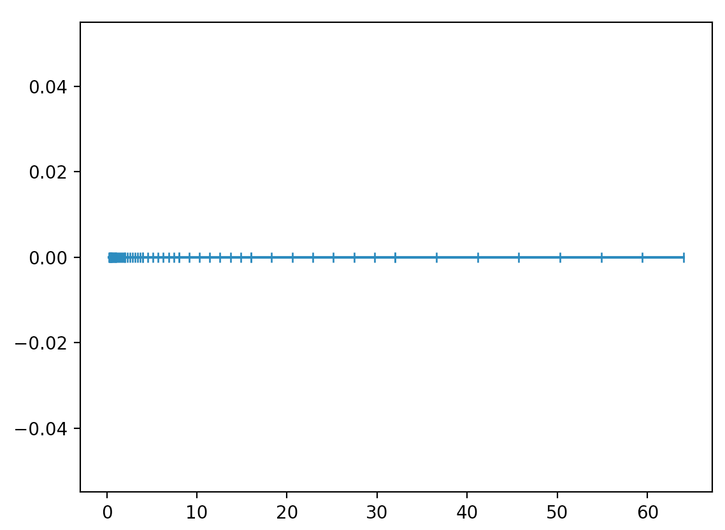
Illustrating FP Number Distribution
How would we plot the graph below?
There are 8 evenly spaced numbers (7 spaces) between successive powers of 2

Slide 22
The matplotlib code (with numpy)
x0 = np.linspace(.25, .5,8)[:-1]
x1 = np.linspace(.5, 1.0,8)[:-1]
x2 = np.linspace(1.0, 2.0,8)[:-1]
x3 = np.linspace(2.0, 4.0,8)[:-1]
x4 = np.linspace(4.0, 8.0,8)[:-1]
x5 = np.linspace(8.0, 16.0,8)[:-1]
x6 = np.linspace(16.0, 32.0,8)[:-1]
x7 = np.linspace(32.0, 64.0,8)[:-1]
x = np.concatenate((x0,x1,x2,x3,x4,x5,x6,x7))
y = np.zeros(len(x)) # Set y’s to 0
_, ax = plt.subplots()
ax.plot(x, y, marker='|')
plt.show()

Slide 23
Pandas Data Science tool
Tabular data analysis
Pandas = numpy + spreadsheet + relational database

Slide 24
Using Pandas
Install with pip
Data resides in a Series (1 column) or Dataframe (table)
Tables = collection of Columns
Can import data from:
Lists, Dictionaries
Files: .csv, .json, sqlite databases

Slide 25
Using Series
Read data from file
Extract subsets of series data
Operations:
agg, map, apply, transform, mean, where, …
Sample file: 2_Record2038.dat
See series.py
You can plot Series objects with matplotlib
-24
4
-4
-12
-52
0
-32
-28
…

Slide 26
Using DataFrame
Import tables from CSV file
Extract subsets of table data based on conditions
Operations:
read_csv, [ ], loc
Sample file: data.csv
See dataframe.py
Duration,Pulse,Maxpulse,Calories
60,110,130,409.1
60,117,145,479.0
60,103,135,340.0
45,109,175,282.4
45,117,148,406.0
…

Slide 27
Review Project E Spec

