Slide 1
Section 2.1:
Categorical Variables

Slide 2
The Big Picture
Population
Sampling
Sample
Statistical Inference
Descriptive Statistics

Slide 3
Descriptive Statistics
In order to make sense of data, we need ways to summarize and visualize it
Summarizing and visualizing variables and relationships between two variables is often known as identifying the descriptive statistics (also known as exploratory data analysis)
Type of summary statistics and visualization methods depend on the type of variable(s) being analyzed (categorical or quantitative)

Slide 4





One Categorical Variable
A random sample of US adults in 2012 were surveyed regarding the type of cell phone owned
Android? iPhone? Blackberry? Non-smartphone? No cell phone?

Slide 5
Frequency Table
A frequency table shows the number of cases that fall in each category:
Subset of Raw Data
Case 1 | Android
Case 2 | none
Case 3 | none
Case 4 | iPhone
Case 5 | Non Smartphone
Case 6 | iPhone
Case 7 | Blackberry
Case 8 | Non Smartphone
Case 9 | Android
Case 10 | Android
… | (for 2253 cases…)
Frequency Table
Android | 458
iPhone | 437
Blackberry | 141
Non Smartphone | 924
No cell phone | 293
Total | 2253

Slide 6

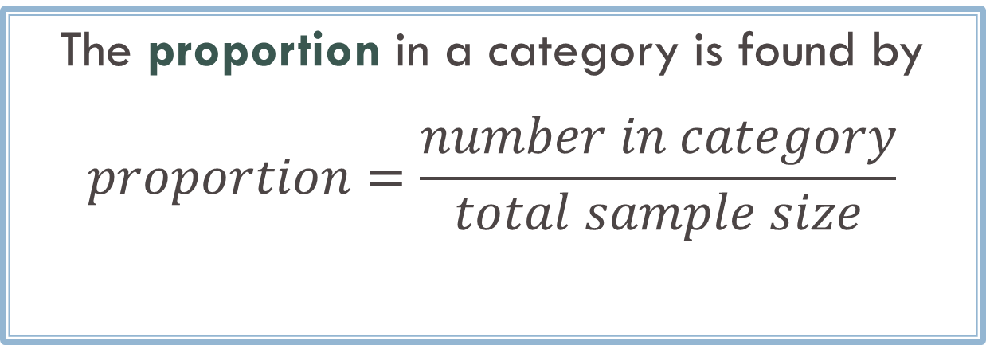
Proportion
The proportion in a category is found by
$$proportion=\frac{number in category}{total sample size}$$
Proportion for a sample: $\hat{p}$ (“p-hat”)
Proportion for a population: p

Slide 7
Proportion
What proportion of adults sampled do not own a cell phone?
Android | 458
iPhone | 437
Blackberry | 141
Non Smartphone | 924
No cell phone | 293
Total | 2253
Proportions and percentages can be used interchangeably

Slide 8
Relative Frequency Table
A relative frequency table shows the proportion of cases that fall in each category
Android | 0.203
iPhone | 0.194
Blackberry | 0.063
Non Smartphone | 0.410
No cell phone | 0.130
All the numbers in a relative frequency table sum to 1

Slide 9
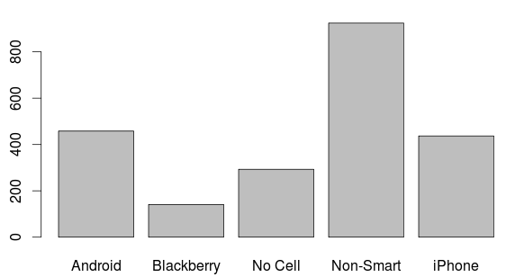
Bar Chart/Plot/Graph
In a barplot, the height of the bar corresponds to the number of cases falling in each category

Slide 10
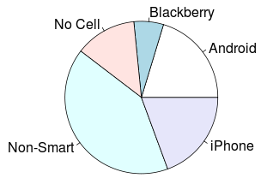
Pie Chart
In a pie chart, the relative area of each slice of the pie corresponds to the proportion in each category

Slide 11
Example 1: Airborne Antibiotics
A recent study shows that antibiotics added to animal feed to accelerate growth can become airborne. Some of these drugs can be toxic if inhaled and may increase the evolution of antibiotic-resistant bacteria. Scientists analyzed 20 samples of dust particles from animal farms. Tylosin, an antibiotic used in animal feed, showed up in 16 of the samples. (cont’d…)

Slide 12
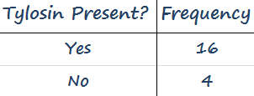
Example 1: Airborne Antibiotics
a) What is the variable in this study? What are the individual cases?
b) Display the results in a frequency table.

Slide 13
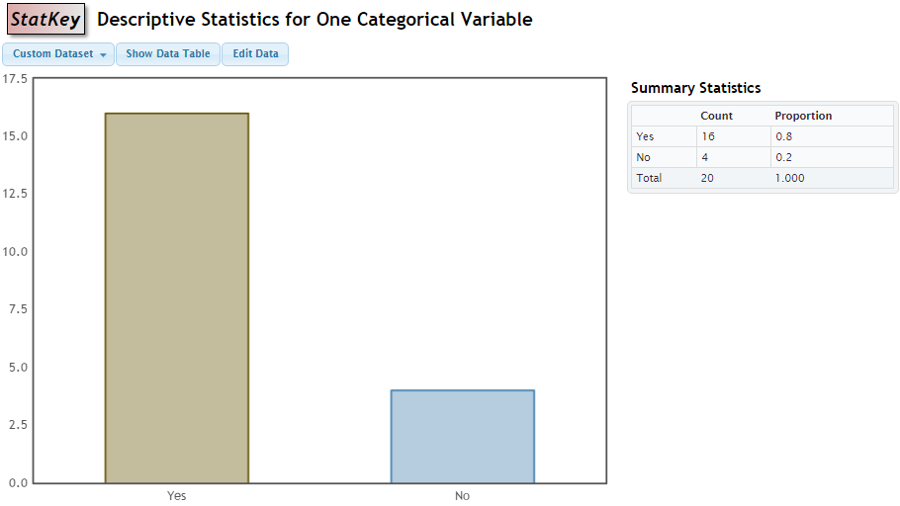
Example 1: Airborne Antibiotics
c) Make a bar chart of the data.

Slide 14
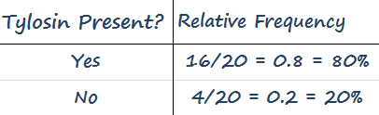
Example 1: Airborne Antibiotics
d) Give a relative frequency table of the data.

Slide 15

Give the relevant proportion using correct notation: A survey conducted of 1060 randomly selected US teens aged 13 to 17 found that 605 of them say they have made a new friend online.
p $=0.57$
p $=0.76$
p $=0.57$
p $=0.76$
^
^
Lenhart, A., “Teens, Technology, and Friendships,” Pew Research Center, pewresearch.org, August 6, 2015.

Slide 16
Give the relevant proportion using correct notation: In the 2010 US Census, we see that 37,342,870 people, or 12.4% of all residents, are foreign-born.
^
p =0.124
p =0.373
p =0.124
p =0.373
^
http://www.census.gov.

Slide 17
Summary: One Categorical Variable
Summary Statistics
Proportion
Frequency table
Relative frequency table
Visualization
Bar chart
Pie chart

Slide 18
Two Categorical Variables
Look at the relationship between two categorical variables
Relationship status
Gender

Slide 19
Summary Statistic for Two Categorical Variables: Two-Way Table
 | Female | Male | Total
In a Relationship | 32 | 10 | 42
It’s Complicated | 12 | 7 | 19
Single | 63 | 45 | 108
Total | 107 | 62 | 169
We add a second dimension to a frequency table to account for the second categorical variable.
It doesn’t matter which variable is displayed in the rows and which in the columns

Slide 20
What proportion of students in this sample are in a relationship?
42/169 ≈ 25%
32/107 ≈ 30%
10/62 ≈ 16%
32/42 ≈ 76%
 | Female | Male | Total
In a Relationship | 32 | 10 | 42
It’s Complicated | 12 | 7 | 19
Single | 63 | 45 | 108
Total | 107 | 62 | 169

Slide 21
What proportion of females in this sample are in a relationship?
42/169 ≈ 25%
32/107 ≈ 30%
10/62 ≈ 16%
32/42 ≈ 76%
 | Female | Male | Total
In a Relationship | 32 | 10 | 42
It’s Complicated | 12 | 7 | 19
Single | 63 | 45 | 108
Total | 107 | 62 | 169

Slide 22

Notice that the denominators in the last two examples were different…
Just as we can interpret the fraction 3/5 as “three out of five equal size parts of a whole unit” the denominators in the last examples are describing different whole units:
In the first example, the “whole unit” was all of the students in the sample, whereas in the second example it was just the females in the sample.

Slide 23
What proportion of males in this sample are in a relationship?
42/169 ≈ 25%
32/107 ≈ 30%
10/62 ≈ 16%
32/42 ≈ 76%
 | Female | Male | Total
In a Relationship | 32 | 10 | 42
It’s Complicated | 12 | 7 | 19
Single | 63 | 45 | 108
Total | 107 | 62 | 169

Slide 24
What proportion of people in a relationship in this sample are female?
42/169 ≈ 25%
32/107 ≈ 30%
10/62 ≈ 16%
32/42 ≈ 76%
 | Female | Male | Total
In a Relationship | 32 | 10 | 42
It’s Complicated | 12 | 7 | 19
Single | 63 | 45 | 108
Total | 107 | 62 | 169

Slide 25
Two-Way Table
CAUTION: The proportion of females in a relationship is NOT THE SAME AS the proportion of people in a relationship who are female!
30% ≠ 76%!
 | Female | Male | Total
In a Relationship | 32 | 10 | 42
It’s Complicated | 12 | 7 | 19
Single | 63 | 45 | 108
Total | 107 | 62 | 169

Slide 26
What proportion of students in this sample are female and in a relationship?
42/169 ≈ 25%
32/169 ≈ 19%
32/107 ≈ 30%
10/62 ≈ 16%
32/42 ≈ 76%
 | Female | Male | Total
In a Relationship | 32 | 10 | 42
It’s Complicated | 12 | 7 | 19
Single | 63 | 45 | 108
Total | 107 | 62 | 169

Slide 27
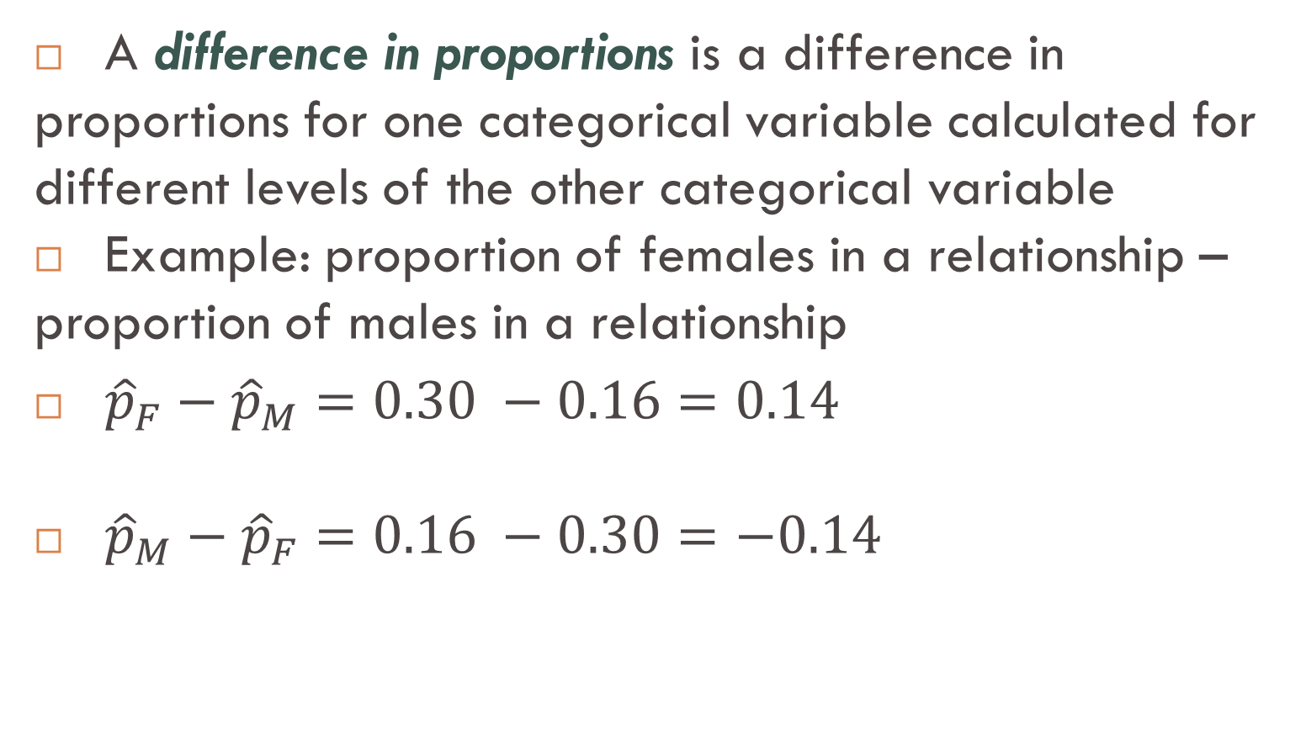
Summary Statistic for Two Categorical Variables: Difference in Proportions
A difference in proportions is a difference in proportions for one categorical variable calculated for different levels of the other categorical variable
Example: proportion of females in a relationship – proportion of males in a relationship
${\hat{p}}_{F}−{\hat{p}}_{M}=0.30 −0.16=0.14$
${\hat{p}}_{M}−{\hat{p}}_{F}=0.16 −0.30=−0.14$

Slide 28
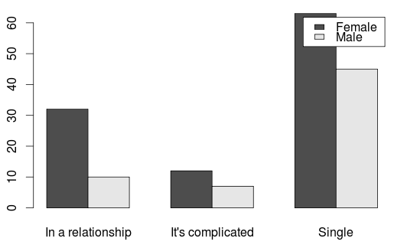
Visualization for Two Categorical Variables: Side-by-Side Bar Chart
The height of each bar is the number of the corresponding cell in the two-way table

Slide 29
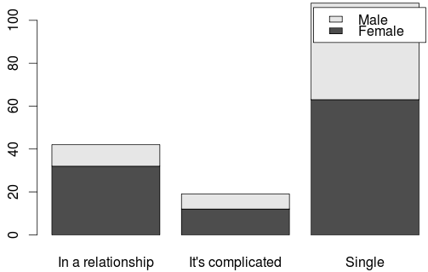
Visualization for Two Categorical Variables: Segmented Bar Chart
A segmented bar chart is like a side-by-side bar chart, but the bars are stacked instead of side-by-side

Slide 30
Summary: Two Categorical Variables
Summary Statistics
Two-way table
Difference in proportions
Visualization
Side-by-side bar chart
Segmented bar chart

