Slide 1
Section 2.3:
One Quantitative Variable – Measures of Spread

Slide 2
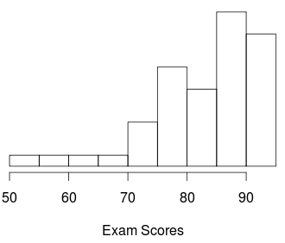
The exam scores shown in the histogram are
Symmetric
Left-skewed
Right-skewed

Slide 3
The Basics
Class 1 | Class 2
80 | 68
80 | 70
80 | 80
80 | 80
80 | 80
80 | 87
80 | 95
a) Consider the following two samples of quiz scores. What are their means? medians? modes?
b) How are the samples different from each other?

Slide 4
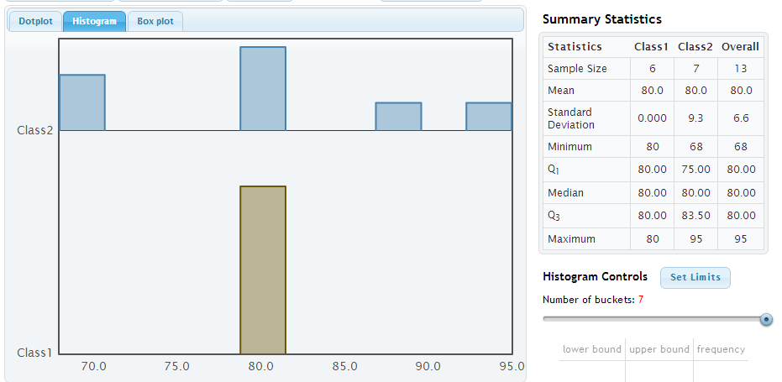
The Basics

Slide 5
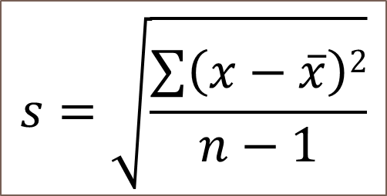
Standard Deviation
The standard deviation for a quantitative variable measures the spread of the data
$$s=\sqrt{\frac{\sum{\left(x−\overline{x}\right)2}}{n−1}}$$
Sample standard deviation: s
Population standard deviation: σ (“sigma”)

Slide 6
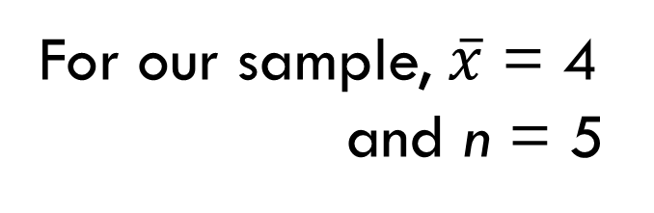
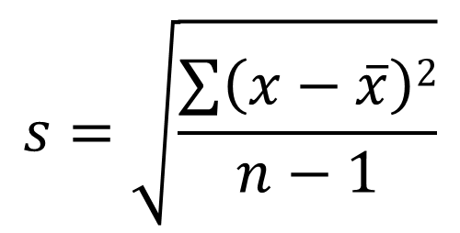
Example: Our Only Time We Will Use the Formula
Sample Data: {1, 3, 3, 6, 7}
$$s=\sqrt{\frac{\sum{\left(x−\overline{x}\right)2}}{n−1}}$$
For our sample, $\overline{x}$ = 4
and n = 5

Slide 7
Example: Our Only Time We Will Use the Formula

Slide 8
So What is a Standard Deviation?

Slide 9
So What is a Standard Deviation?
The standard deviation gives a rough estimate of the typical distance of the data values from the mean
The larger the standard deviation, the more variability there is in the data and the more spread out the data are.

Slide 10
Standard Deviation
Both of these distributions are bell-shaped

Slide 11
Example 3: Arsenic in Toenails
Arsenic is toxic to humans and people can be exposed to it through contaminated drinking water, food, dust, and soil. Scientists have devised an interesting new way to measure a person’s level of arsenic poisoning: by examining toenail clippings.
The table on the next slide gives toenail arsenic concentrations (in ppm) for 19 individuals with private wells in New Hampshire. (cont’d…)

Slide 12
Example 3: Arsenic in Toenails
0.119 0.118 0.099 0.118 0.275 0.358 0.080 0.158 0.310 0.105 0.073 0.832
0.517 0.851 0.269 0.433 0.141 0.135 0.175
a) Use technology to find the mean, median, max, and standard deviation.

Slide 13
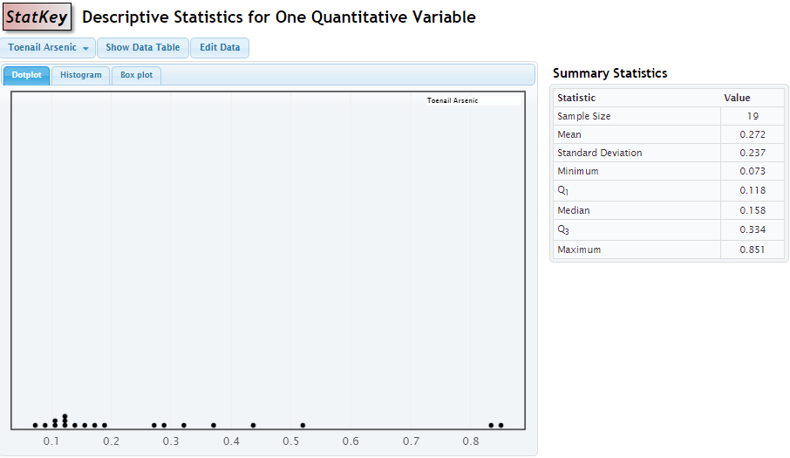
Example 3: Arsenic in Toenails
StatKey
Mean = __0.272__
Median = __0.158__
Max = ____0.851____
St. Dev = __0.237____

Slide 14
95% Rule
If a distribution of data is approximately symmetric and bell-shaped, about 95% of the data should fall within two standard deviations of the mean.
For a population, 95% of the data will be between
µ – 2σ and µ + 2σ
StatKey

Slide 15
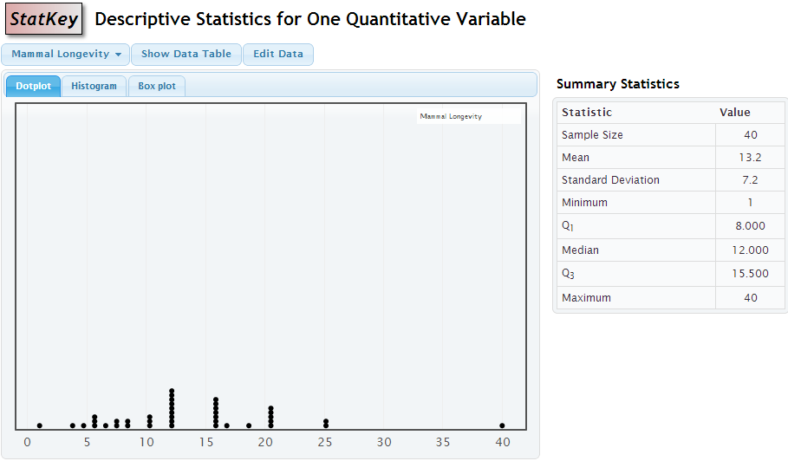
Example of 95% Rule

Slide 16
The 95% Rule

Slide 17
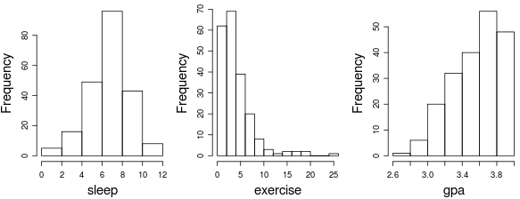
The standard deviation for hours of sleep per night is closest to
½
1
2
4
I have no idea

Slide 18
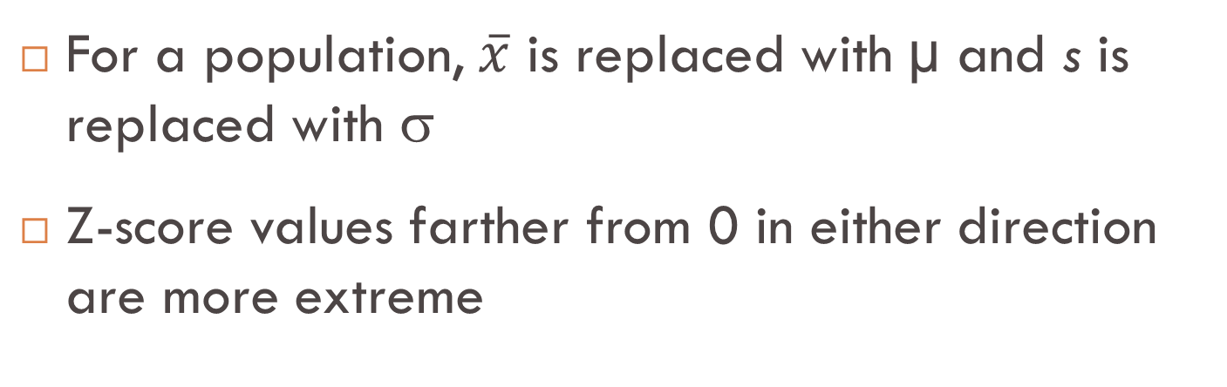
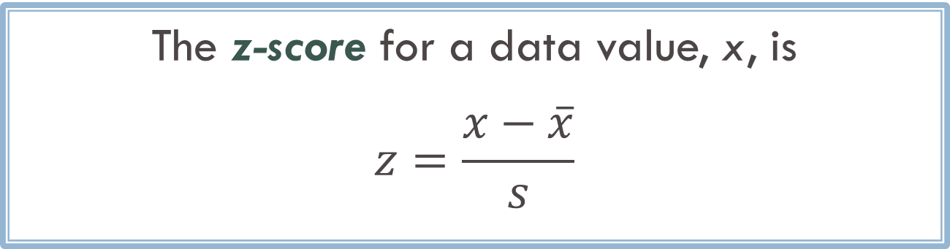
Z-score
The z-score for a data value, x, is
$$z=\frac{x−\overline{x}}{s}$$
For a population, $\overline{x}$ is replaced with µ and s is replaced with σ
Z-score values farther from 0 in either direction are more extreme

Slide 19

Z-score
A z-score puts values on a common scale
A z-score is the number of standard deviations a value falls from the mean
95% of all z-scores fall between what two values?

Slide 20
Which is better, an ACT score of 28 or a combined SAT score of 2100? ACT: μ = 21, σ = 5 SAT: μ = 1500, σ = 325 Assume ACT and SAT scores have approximately bell-shaped distributions
ACT score of 28
SAT score of 2100
I don’t know

Slide 21
Example 3: Arsenic in Toenails
0.119 0.118 0.099 0.118 0.275 0.358 0.080 0.158 0.310 0.105 0.073 0.832 0.517 0.851 0.269 0.433 0.141 0.135 0.175
b) Compute the z-score for the largest concentration and interpret it.

Slide 22
Other Measures of Location
Maximum = largest data value
Minimum = smallest data value
Quartiles:
Q₁ = median of the values below m.
Q₃ = median of the values above m.

Slide 23
Five Number Summary
Min
Q₁
m
Q₃
Max
←25%→
←25%→
←25%→
←25%→

Slide 24
The five number summary of the number of hours that a sample of students reported studying is: Min. 1st Qu. Median 3rd Qu. Max. 2.00 10.00 15.00 20.00 69.00 The distribution of number of hours spent studying each week is:
Symmetric
Right-skewed
Left-skewed
Impossible to tell

Slide 25
Percentile
The P^{th} percentile is the value which is greater than P% of the data
We already used z-scores to determine whether an SAT score of 2100 or an ACT score of 28 is better
We could also have used percentiles:
ACT score of 28: 91st percentile
SAT score of 2100: 97th percentile

Slide 26
Five Number Summary and Corresponding Percentiles
Min
Q₁
m
Q₃
Max
←25%→
←25%→
←25%→
←25%→
0th percentile
25th percentile
50th percentile
75th percentile
100th percentile

Slide 27
More Measures of Spread Range = Max – Min Interquartile Range (IQR) = Q₃ – Q₁ Is the range resistant to outliers?
Yes
No

Slide 28
Is the IQR resistant to outliers?
Yes
No

Slide 29
Comparing Statistics
Measures of Center:
Mean (not resistant)
Median (resistant)
Measures of Spread:
Standard deviation (not resistant)
IQR (resistant)
Range (not resistant)
Most often, we use the mean and the standard deviation, because they are calculated based on all the data values, so use all the available information

Slide 30
Summary: One Quantitative Variable
Summary Statistics
Center: mean, median
Spread: standard deviation, range, IQR
Measures of Location: z-scores, Percentiles, Quartiles
Visualization
Dotplot
Histogram
Other concepts
Shape: symmetric, skewed, bell-shaped
Resistance

