Slide 1
Section 2.4:
Boxplots and
Quantitative / Categorical Relationships

Slide 2
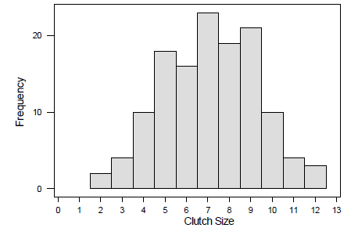
A naturalist counts the number of baby birds, or clutch size, in 130 different nests. The standard deviation of clutch sizes is closest to…
1
2
3
4

Slide 3
Outliers
Outliers can be informally identified by looking at a plot, but one rule of thumb for identifying outliers is data values more than 1.5 of the IQR beyond the quartiles
A data value is an outlier if it is
Smaller than Q1 – 1.5(IQR)
or
Larger than Q3 + 1.5(IQR)

Slide 4
Boxplot
To draw a boxplot:
Draw a numerical scale appropriate for the data
Draw a box stretching from Q₁ to Q₃
Divide the box with a line at the median
Draw a line from each quartile to the most extreme data value that is not an outlier
Identify each outlier individually by plotting with a symbol such as an asterisk or dot

Slide 5
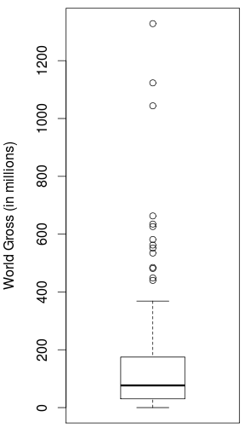
Boxplot
Outliers
Lines (“whiskers”) extend from each quartile to the most extreme value that is not an outlier
Q₃
Median
Q₁

Slide 6
Example: Infection in Dialysis Patients
The table on the next slide gives data showing the time to infection, at the point of insertion of the catheter, for kidney patients using portable dialysis equipment. There are 38 patients, and the data give the first observation for each patient. The five number summary for the data is (2, 15, 46, 149, 536).

Slide 7
Example: Infection in Dialysis Patients
2 5 6 7 7 8 12 13 15 15 17 22 22 23 24 27 30 34 39 53 54 63 96 113 119 130 132 141 149 152 152 185 190 292 402 447 511 536
Identify any outliers in the data. Justify your answer.
Draw the boxplot.
Describe the shape of the data.

Slide 8
Example: Infection in Dialysis Patients
a) Identify any outliers in the data. Justify your answer.
The five number summary for the data is (2, 15, 46, 149, 536).
Q₁–1.5(IQR) =
Q₃+1.5(IQR) =
Outliers:

Slide 9
Example: Infection in Dialysis Patients
b) Draw the boxplot.

Slide 10
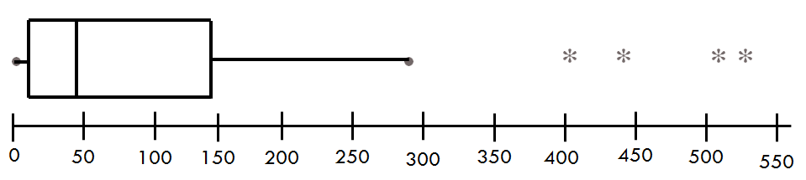
c) Describe the shape of the data from the Infection in Dialysis Patients dataset.
Skewed right
Skewed left
Approximately symmetric
None of these

Slide 11
d) Give a rough approximation for the mean of the Infection in Dialysis Patients dataset.
15
45
100
175

Slide 12
Summary: One Quantitative Variable
Summary Statistics
Center: mean, median
Spread: standard deviation, range, IQR
Measures of Location: z-scores, Percentiles, Quartiles
Visualization
Dotplot
Histogram
Boxplot
Other concepts
Shape: symmetric, skewed, bell-shaped
Resistance
Outliers

Slide 13
Quantitative and Categorical Relationships
In this case, we are interested in breaking down a quantitative variable by categorical groups

Slide 14

Tea and the Immune System
Participants were randomized to drink five or six cups of either tea or coffee every day for two weeks (both drinks have caffeine but only tea has L-theanine)
After two weeks, blood samples were exposed to an antigen, and production of interferon gamma (immune system response) was measured
Explanatory variable: tea or coffee
Response variable: measure of interferon gamma
Mednick, Cai, Kanady, and Drummond (2008). “Comparing the benefits of caffeine, naps and placebo on verbal, motor and perceptual memory,” Behavioral Brain Research, 193, 79-86.

Slide 15
If the tea drinkers have significantly higher levels of interferon gamma, can we conclude that drinking tea rather than coffee caused an increase in this aspect of the immune response?
Yes
No

Slide 16
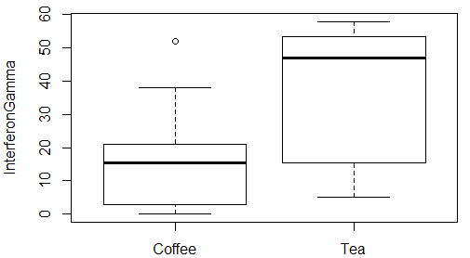
Visualization for One Categorical and One Quantitative Variable: Side-by-Side Boxplots

Slide 17
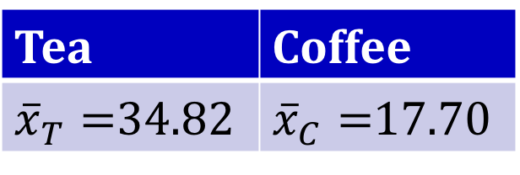
Quantitative Statistics by a Categorical Variable
Any of the statistics we use for a quantitative variable can be looked at separately for each level of a categorical variable
Mean level of interferon gamma by drink:
Tea | Coffee
${\overline{x}}_{T}=$34.82 | ${\overline{x}}_{C}=$17.70

Slide 18

Summary Statistic for One Categorical and One Quantitative Variable: Difference in Means
Often, when comparing a quantitative variable across two categories, we compute the difference in means.
${\overline{x}}_{T}−$ ${\overline{x}}_{C}=34.82−17.70=17.12$

Slide 19
Percent of College Graduates by Region of the US
The dataset USStates includes information on the percent of the population to graduate from college (of those age 25-34) for each US state. Use StatKey to obtain side-by-side boxplots for percent of college graduates by region of the country (Midwest, Northeast, South, and West.) Then answer the following questions.
Various online sources, mostly at www.census.gov

Slide 20
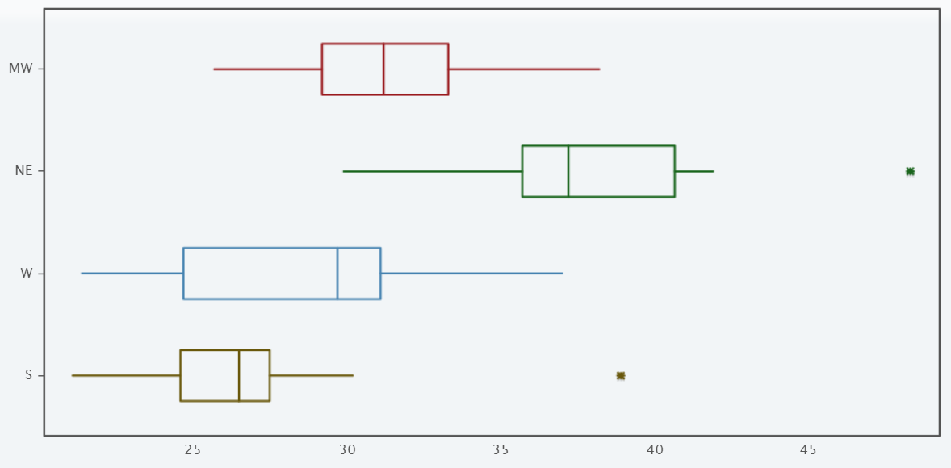
Which region has the highest percent of college graduates?
Midwest
Northeast
South
West

Slide 21
Which region has the lowest percent of college graduates?
Midwest
Northeast
South
West

Slide 22
How many outliers are there?
2
4
6
8

Slide 23
Does there appear to be an association between these two variables?
Yes
No

Slide 24
Can we conclude that the Region and College are causally related?
Yes
No

Slide 25
Summary: One Quantitative and One Categorical
Summary Statistics
Any summary statistics for quantitative variables, broken down by groups
Difference in means
Visualization
Side-by-side boxplots

