Slide 1
Section 6.5:
Paired Difference in Means

Slide 2
Outline
Paired data
Confidence interval for difference in means based on paired data
Hypothesis test for difference in means based on paired data

Slide 3
Paired Data
In Section 6.4, we consider inference for a difference in means when the data consist of two separate samples.
What about situations such as matched pairs experiments (discussed in Section 1.3) where the data being compared consist of pairs of data values?
Paired data examples:
Two measurements on each case (compare each case to themselves under different treatments)
Twin studies
Each case is matched with a similar case, and one case in each pair is given each treatment for comparison

Slide 4
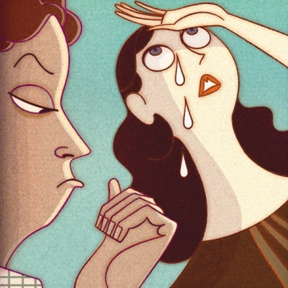
Pheromones in Tears
Do pheromones (subconscious chemical signals) in female tears affect testosterone levels in men?
Cotton pads had either real female tears or a salt solution that had been dripped down the same female’s face
50 men had a pad attached to their upper lip twice, once with tears and once without, order randomized.
Response variable: testosterone level
Paired Data!
Gelstein, et. al. (2011) “Human Tears Contain a Chemosignal," Science, 1/6/11.

Slide 5
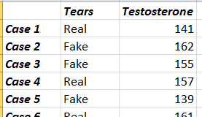
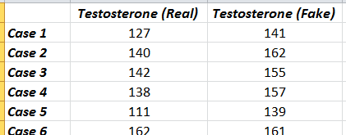
Paired Data
Separate samples:
Some men would get real tears, and a separate group of men get fake tears
Can list the entire response variable
in one column.
Paired Data:
Each man gets both real and fake tears
2 measurements for each man
Real tear response data in one
column, fake tear response data
in another column

Slide 6
Should data from the following situation be analyzed as paired data or separate samples? To study the effect of sitting with a laptop computer on one’s lap on scrotal temperature, 29 men have their scrotal temperature tested before and then after sitting with a laptop for one hour.
Paired Data
Separate Samples

Slide 7
Should data from the following situation be analyzed as paired data or separate samples? A study investigating the effect of exercise on brain activity recruits sets of identical twins in middle age, in which one twin is randomly assigned to engage in regular exercise and the other doesn’t exercise.
Paired Data
Separate Samples

Slide 8
Should data from the following situation be analyzed as paired data or separate samples? In a study to determine whether the color red increases how attractive men find women, one group of men rate the attractiveness of a woman after seeing her picture on a red background and another group of men rate the same woman after seeing her picture on a white background.
Paired Data
Separate Samples

Slide 9
Should data from the following situation be analyzed as paired data or separate samples? To measure the effectiveness of a new teaching method for math in elementary school, each student in a class getting the new instructional method is matched with a student in a separate class on IQ, family income, math ability level the previous year, reading level, and all demographic characteristics. At the end of the year, math ability levels are measured.
Paired Data
Separate Samples

Slide 10
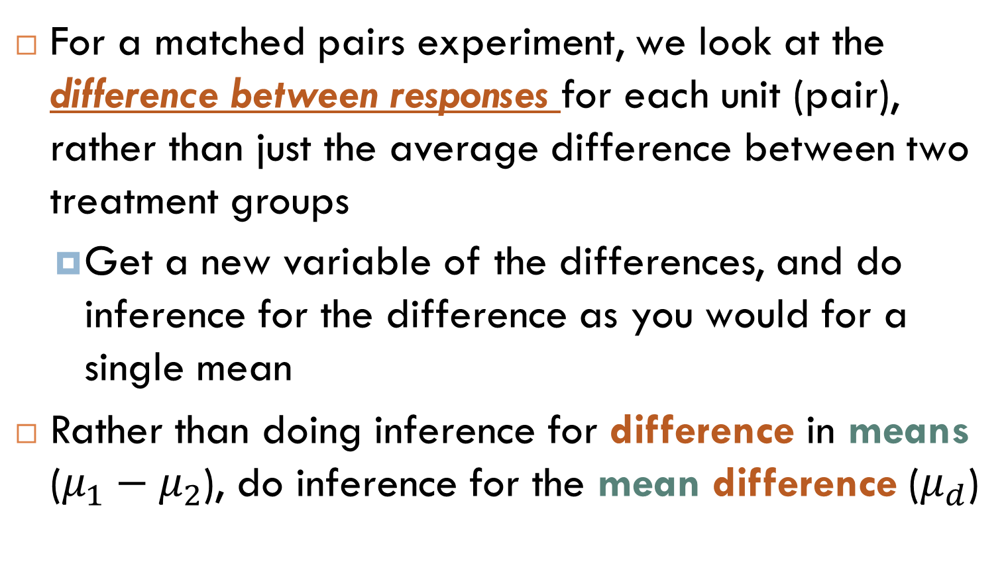
Analyzing Paired Data
For a matched pairs experiment, we look at the difference between responses for each unit (pair), rather than just the average difference between two treatment groups
Get a new variable of the differences, and do inference for the difference as you would for a single mean
Rather than doing inference for difference in means ($μ_{1}−μ_{2}$), do inference for the mean difference ($μ_{d}$)

Slide 11
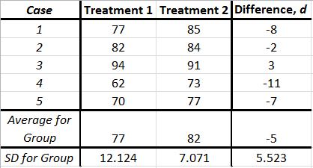
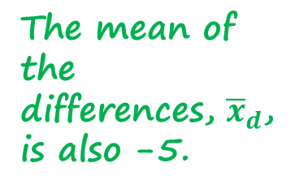

Analyzing Paired Data
The mean of the differences, ${\overline{x}}_{d}$, is also -5.
Using matched pairs decreases the standard deviation of the response, which decreases the standard error
The difference in the two means, ${\overline{x}}_{1}−{\overline{x}}_{2}$, is -5.

Slide 12
Why use paired data?
Decrease standard deviation of the response
Decrease the chance of a Type II error for tests
Decrease the margin of error for intervals
All of the above
None of the above

Slide 13
Matched Pairs
Matched pairs experiments are particularly useful when responses vary a lot from unit to unit
We can decrease standard deviation of the response (and so decrease standard error of the statistic) by comparing each unit to a matched unit

Slide 14
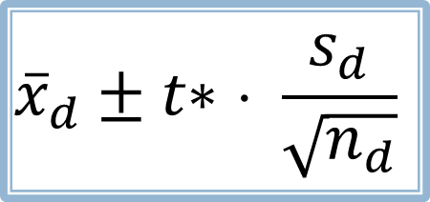
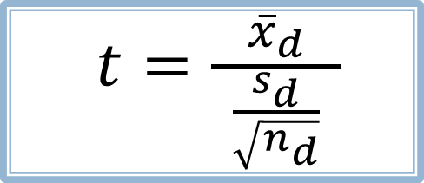
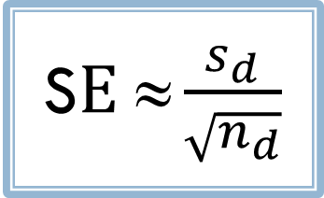
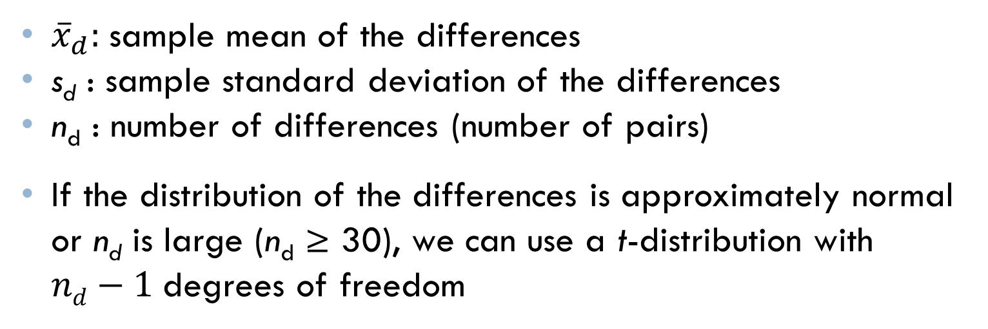
Inference for Paired Data
To analyze the differences, we use the same formulas
we already learned for a single mean:
S$E ≈\frac{s_{d}}{\sqrt{n_{d}}}$
$${\overline{x}}_{d}±t\text{∗ }\text{⋅ }\frac{s_{d}}{\sqrt{n_{d}}}$$
$t=\frac{{\overline{x}}_{d}}{ \frac{s_{d}}{\sqrt{n_{d}}} }$
${\overline{x}}_{d}:$sample mean of the differences
s_{d} : sample standard deviation of the differences
n_{d} : number of differences (number of pairs)
If the distribution of the differences is approximately normal or n_{d} is large (n_{d} ≥ 30), we can use a t-distribution with $nd−1$degrees of freedom

Slide 15
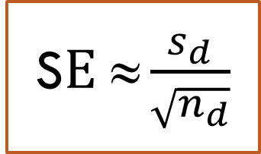
For the 50 men, the average difference in testosterone levels between tears and no tears was −21.7 pg/ml. (“pg” = picogram = 0.001 nanogram = 10⁻¹² gram). The standard deviation of these differences was 46.5. Average level before sniffing was 155 pg/ml. Do female tears lower male testosterone levels? Calculate standard error.
4.79
5.42
6.23
6.58
S$E ≈\frac{s_{d}}{\sqrt{n_{d}}}$

Slide 16
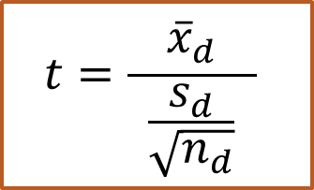
For the 50 men, the average difference in testosterone levels between tears and no tears was −21.7 pg/ml. (“pg” = picogram = 0.001 nanogram = 10⁻¹² gram). The standard deviation of these differences was 46.5. Average level before sniffing was 155 pg/ml. Do female tears lower male testosterone levels? Calculate test statistic.
0.001
-0.47
-3.3
-3.9
$$t=\frac{{\overline{x}}_{d}}{ \frac{s_{d}}{\sqrt{n_{d}}} }$$

Slide 17
For the 50 men, the average difference in testosterone levels between tears and no tears was −21.7 pg/ml. (“pg” = picogram = 0.001 nanogram = 10⁻¹² gram). The standard deviation of these differences was 46.5. Average level before sniffing was 155 pg/ml. Do female tears lower male testosterone levels? Find the p-value.
0.0009
0.009
0.09
0.9

Slide 18

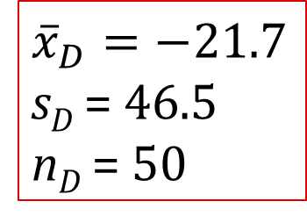
Pheromones in Tears: Hypothesis Test
${\overline{x}}_{D}=−21.7$ s_{D} = 46.5
n_{D} = 50
H₀: μ_{D} = 0
H_{a}: μ_{D} < 0
1. State hypotheses:
2. Check conditions:
n_{D} = 50 ≥ 30
3. Calculate standard error:
4. Calculate test statistic:
5. Compute p-value:
Distribution: t with 50 – 1 = 49 df
6. Interpret in context:

Slide 19
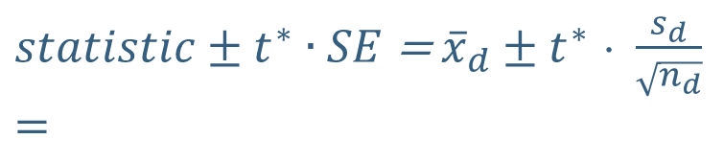
Pheromones in Tears: 95% CI
n_{D} = 50 ≥ 30
${\overline{x}}_{D}=−21.7$ s_{D} = 46.5
n_{D} = 50
1. Check conditions:
t with 50 – 1 = 49 df, 95% CI:
=> t* = 2.01
2. Find t*:
3. Calculate standard error:
4. Calculate CI:
$statistic±t^{∗}∙SE$ = ${\overline{x}}_{d}±t^{∗} \text{⋅ }\frac{s_{d}}{\sqrt{n_{d}}}$
$$=$$
5. Interpret in context:

Slide 20
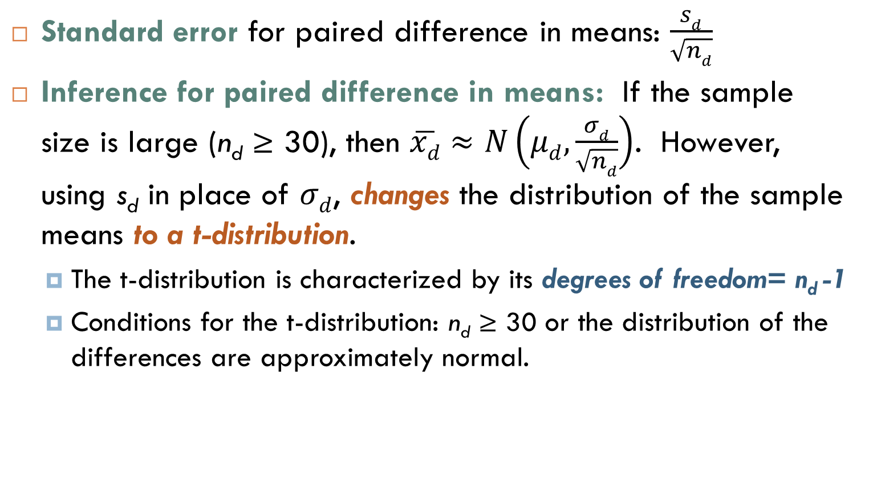
Summary
Standard error for paired difference in means: $\frac{sd}{\sqrt{nd}}$
Inference for paired difference in means: If the sample size is large (n_{d} ≥ 30), then $\overline{xd}≈N\left(μd,\frac{σd}{\sqrt{nd}}\right)$. However, using s_{d} in place of $σd$, changes the distribution of the sample means to a t-distribution.
The t-distribution is characterized by its degrees of freedom= n_{d} -1
Conditions for the t-distribution: n_{d} ≥ 30 or the distribution of the differences are approximately normal.

