Slide 1

SCHOOL OF COMPUTER SCIENCE AND ENGINEERING
IILM University, Greater Noida, U.P.
Java Full Stack Developer
VIRTUAL INTERNSHIP
AICTE – National Internship Portal | in association with EduSkills Academy
Rohan Singh
Roll No. 2410031588 • B.Tech CSE • Batch 2026-27
Internship Report — Presentation

Slide 2
OVERVIEW
What This Presentation Covers
01
Introduction
06
Technologies & Tools
02
Organization Profile
07
System Architecture
03
Problem Statement
08
Methodology
04
Project Objectives
09
Expected Outcomes
05
Scope of the Project
10
Certificate & Conclusion
Java Full Stack Developer Virtual Internship
2

Slide 3
01 · INTRODUCTION
About the Internship
This report presents the work carried out during the “Java Full Stack Developer Virtual Internship,” organized under the National Internship Portal by AICTE, Ministry of Education, Government of India, in association with EduSkills Academy.
8
Weeks Duration
The program delivered hands-on, industry-oriented exposure to full stack Java development — covering the user interface, server-side logic and the underlying database — as part of the B.Tech CSE curriculum at IILM University, Greater Noida.
Completed Aug–Oct
2026
O
Final Grade – Outstanding
Java Full Stack Developer Virtual Internship
3

Slide 4
02 · ORGANIZATION PROFILE
Who Delivered the Program
AICTE
All India Council for Technical Education — sets the standardized curriculum and evaluation framework.
MoE
Ministry of Education, Government of India — apex body behind the National Internship Portal.
NIP
National Internship Portal — connects students nationwide to structured virtual internships.
ES
EduSkills Academy — “Nation Building Through Skills”; delivers mentor-guided training content.
Java Full Stack Developer Virtual Internship
4

Slide 5
03 · PROBLEM STATEMENT
The Gap Between Theory and Practice
Traditional Curriculum
This Internship
• Front-end and back-end taught in isolation
• End-to-end project workflow, UI to database
• Limited exposure to full development lifecycle
• Industry-standard tools and practices
• Little practice integrating a database layer
• Mentor-guided, structured 8-week path
Java Full Stack Developer Virtual Internship
5

Slide 6
04 · PROJECT OBJECTIVES
What the Internship Set Out to Achieve
1
Understand and apply core Object-Oriented Programming principles using Java
2
Design responsive front-ends using HTML, CSS and JavaScript
3
Build REST APIs and server-side logic using Spring and Spring Boot
4
Integrate applications with a MySQL database via JDBC/Hibernate
5
Gain hands-on experience with professional tools such as Git, Maven and Postman
Java Full Stack Developer Virtual Internship
6

Slide 7
05 · SCOPE OF THE PROJECT
Full Spectrum of Full Stack Development
Presentation Layer
HTML, CSS & JavaScript — the user-facing interface
Application Logic
Core Java & Spring Boot — business rules and REST APIs
Data Layer
MySQL via JDBC/Hibernate — storage and retrieval
The curriculum progressed from foundational concepts to advanced topics — API design, security basics and deployment — giving a holistic view of how a modern web application is built end-to-end.
Java Full Stack Developer Virtual Internship
7

Slide 8
06 · TECHNOLOGIES & TOOLS
The Stack Used Throughout the Internship
Java
HTML/CSS/JS
Spring Boot
Core language & OOP
Front-end
Back-end framework
JDBC / Hibernate
MySQL
Maven
Data access
Database
Build & dependencies
Git & GitHub
Eclipse / IntelliJ
Postman
Version control
Development IDE
API testing
Java Full Stack Developer Virtual Internship
8

Slide 9
07 · SYSTEM ARCHITECTURE
Layered (n-Tier) Application Design
Presentation Layer
HTML · CSS · JavaScript
Handles user interaction & displays server data
Business / Service Layer
Spring · Spring Boot
Core logic, exposed via RESTful web services
Data Access Layer
JDBC · Hibernate / JPA
Communicates with the MySQL database
Java Full Stack Developer Virtual Internship
9

Slide 10
08 · METHODOLOGY
An 8-Week, Module-Based Learning Path
Wk 1–2
Wk 3–4
Wk 5–6
Wk 7–8
Java Foundations
Front-End Development
Back-End with Spring Boot
Integration & Testing
Core Java & OOP concepts
HTML, CSS & JavaScript
REST APIs & business logic
Database integration, final assessment
Java Full Stack Developer Virtual Internship
10

Slide 11
09 · EXPECTED OUTCOMES
Skills and Competencies Gained
Solid grasp of Java & Object-Oriented Programming
Ability to build responsive web front-ends independently
✓
✓
Competence in developing REST APIs with Spring Boot
Practical experience connecting Java apps to a database
✓
✓
Improved problem-solving and debugging skills
Readiness for entry-level full stack development roles
✓
✓
Java Full Stack Developer Virtual Internship
11

Slide 12
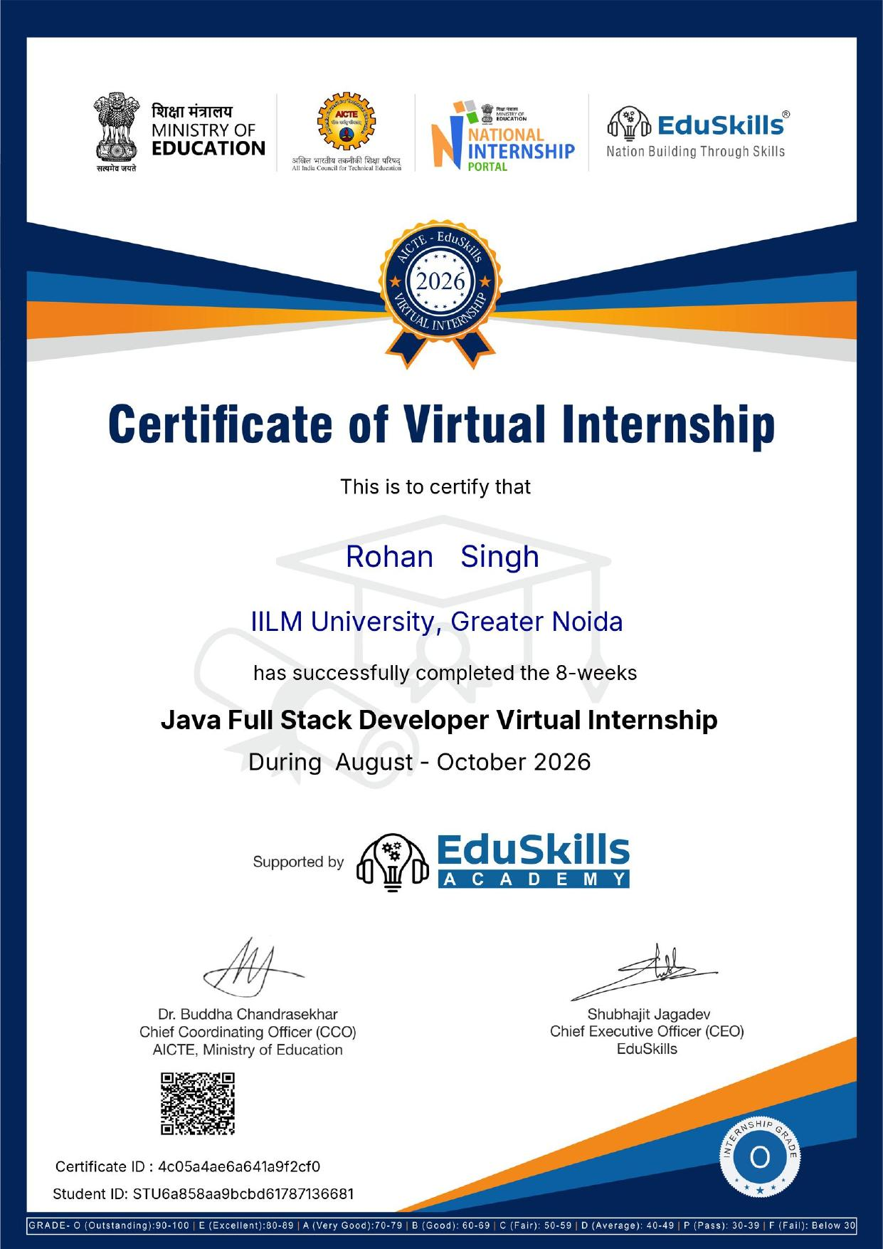
10 · CERTIFICATE OF COMPLETION
Recognized by AICTE, MoE & EduSkills Academy
PROGRAM
Java Full Stack Developer Virtual Internship
DURATION
8 Weeks (August – October 2026)
GRADE
O — Outstanding
CERTIFICATE ID
4c05a4ae6a641a9f2cf0
STUDENT ID
STU6a858aa9bcbd61787136681
Java Full Stack Developer Virtual Internship
12

Slide 13
Thank You
Java Full Stack Developer Virtual Internship — Key Takeaway
A complete, hands-on journey from Java fundamentals to a working full stack application — front-end, back-end and database — built the practical foundation for real-world software development.
Rohan Singh • 2410031588 • B.Tech CSE • IILM University, Greater Noida

