Slide 1
Weighted round robin & VPN
Johnson Zhou

Slide 2
Weighted round robin - Simplified
A Load-balancing algorithm
A weighted version of Round Robin scheduling
Round Robin - scheduling all tasks to servers equally
Scheduling based on server weight.
The stronger server get more load.

Slide 3
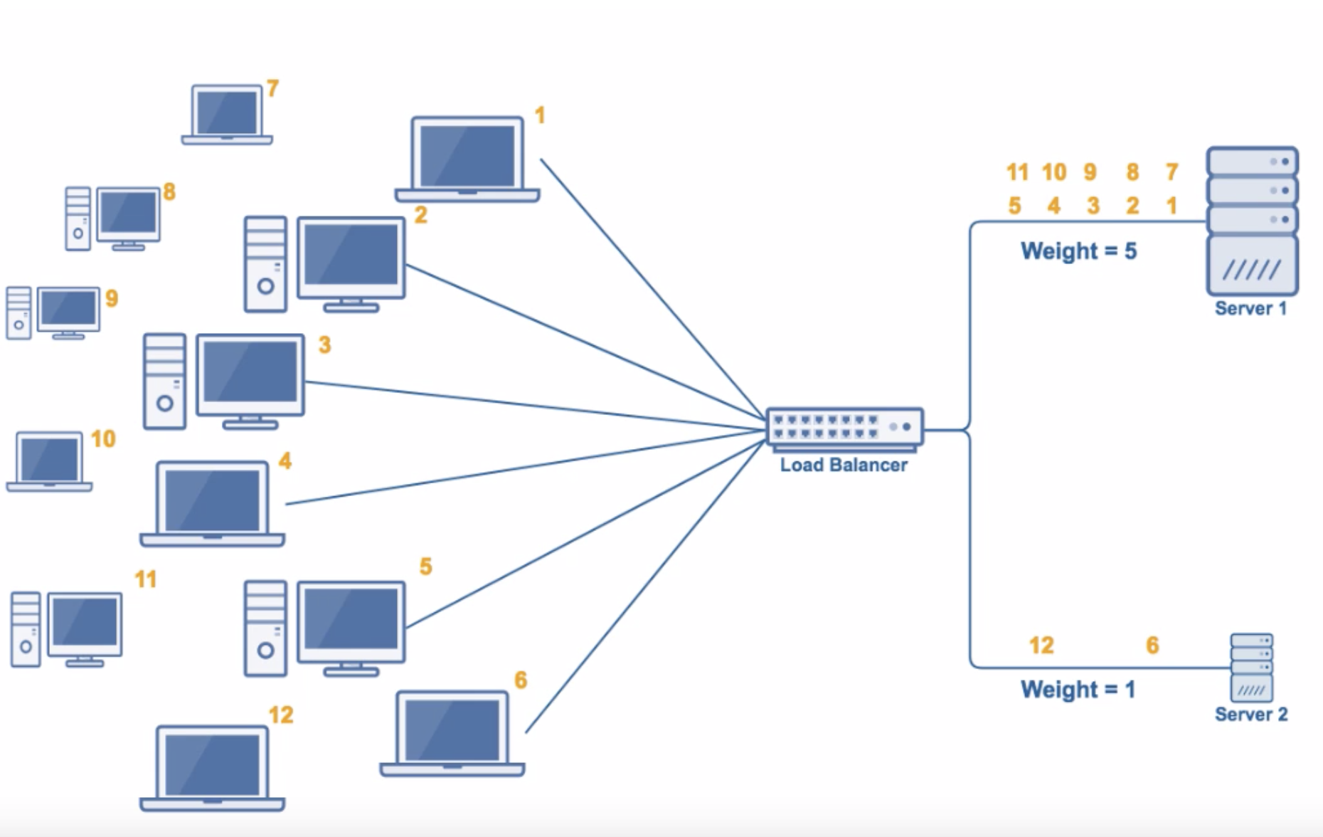

Slide 4
Weight Round Robin (WRR)
Each packet flow or connection has its own packet queue in a network interface controller.
It is the simplest approximation of generalized processor sharing (GPS).
GPS serves infinitesimal amounts of data from each nonempty queue
WRR serves a number of packets for each nonempty queue. The number of packets served is in proportion to the assigned weight and in inverse proportion to the size of the packets.

Slide 5
WRR – Pseudo-code
// calculate number of packets to be served each round by connections
for each flow f
f.normalized_weight = f.weight / f.mean_packet_size
min = findSmallestNormalizedWeight
for each flow f
f.packets_to_be_served = f.normalized_weight / min
// main loop loop for each non-empty flow queue f
min(f.packets_to_be_served, f.packets_waiting).times do
servePacket f.getPacket

Slide 6
Limitations and improvements
First used for ATM scheduling
Internet uses IP for networking
IP has variable packet size
That requires estimation of the average packet size, which makes a good GPS approximation hard to achieve in practice with WRR.
WRR only works well when packet size is constant or the average packet size is known in advance.

Slide 7
VPN (Virtual Private Network)
Virtual private network is an encrypted connection to a private network.
The encryption of data ensures the privacy and security of the information transmitted.
Different protocols are used for different VPNs.

Slide 8
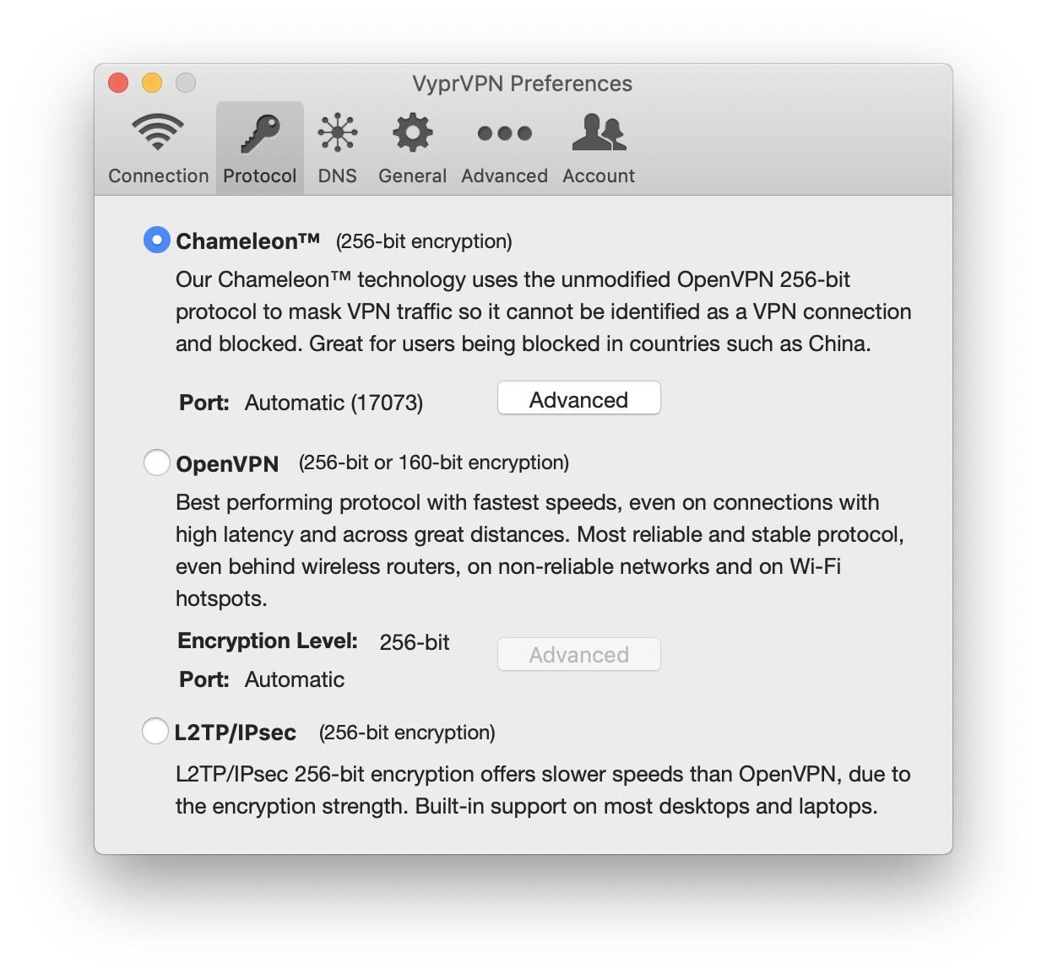
VPN Protocols
1. Site-to-site VPN
2. Remote Access VPN
IPSec
L2TP
PPTP

Slide 9
VPN: Security
VPNs are used by corporations to transfer data securely. On an open network, data packets are vulnerable to interception. It also allows remote users to securely access corporation applications and other resources that would otherwise be unavailable.

Slide 10
VPN: Network
VPN could be used to overcome national barriers
E.g. watch Netflix in China
Use QQMusic in the US
Site to site connection
Connect geographically separated offices together
Offer Internal network benefits:
University library subscriptions
Intranet resources

