Slide 1
CLUSTERSAGE
Cloud-Native DevOps Platform
Norah Elizabeth Biju

Slide 2
Problem Statement
Kubernetes troubleshooting is slow and difficult because logs, metrics, events, and resource data are spread across multiple tools.
Operations teams spend too much time manually investigating incidents and identifying root causes, especially without deep Kubernetes expertise.

Slide 3
What is ClusterSage?
ClusterSage is an AI-powered Kubernetes operations platform built for monitoring, troubleshooting, and overall platform visibility.
It collects logs, events, metrics, and resource snapshots from clusters through a lightweight in-cluster agent and centralizes them in a SaaS platform.
It uses AI to analyze cluster issues, correlate multiple telemetry signals, and generate actionable operational insights and recommendations.

Slide 4
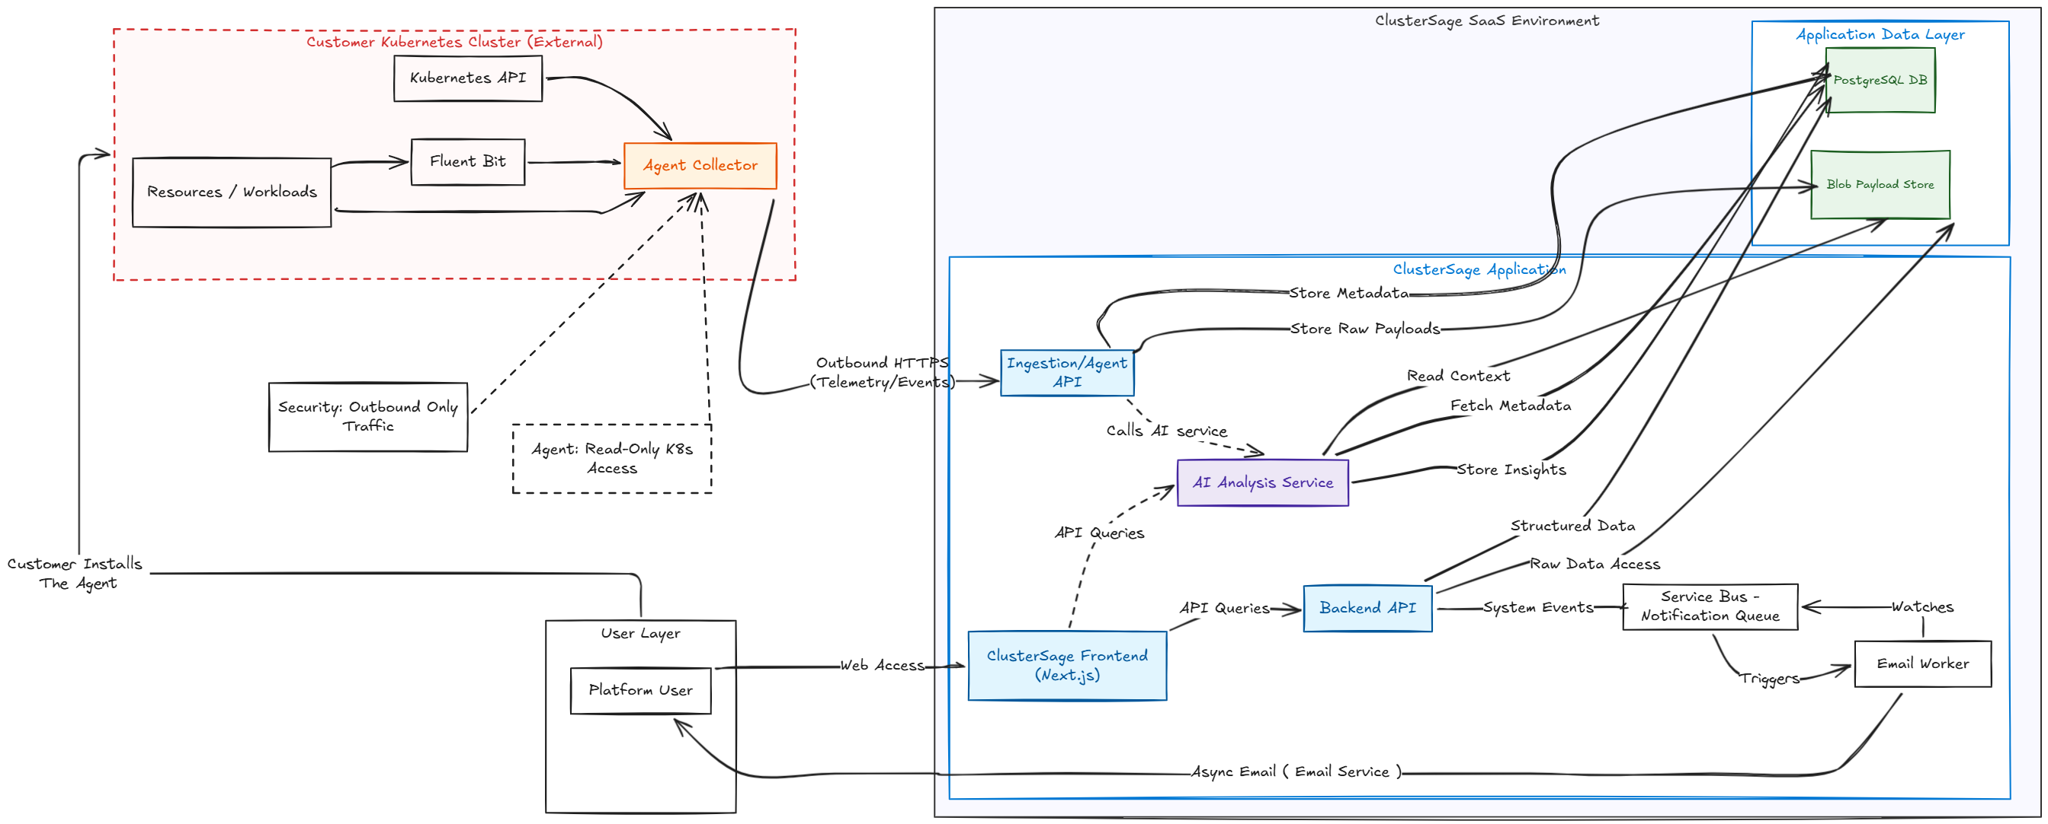
Application Architecture

Slide 5
Repository & Infrastructure Design
Split-Repo Architecture
Terraform Environment Roots
Six isolated repositories enforce clear ownership boundaries:
Each environment has a dedicated Terraform root with isolated state:
frontend — Next.js dashboard
services — FastAPI API, email worker
helm — workload packaging
gitops — environment values, ArgoCD source of truth
infra — Terraform roots per environment
docs — platform documentation
global-shared — ACR, global outputs
nonprod-shared — shared non-prod Front Door, WAF
dev / staging / prod — AKS, VNet, PostgreSQL, Key Vault, Service Bus
Terraform provisions infra only — workloads deploy via Helm + ArgoCD.

Slide 6
CI/CD Pipeline Triggers
Branching Strategy-GitHub Flow
GitHub Flow is a simple branching strategy where main always represents the latest stable code.
New work is done in short-lived feature branches created from main
Changes are merged back only through pull requests after review and validation checks pass.
Branching Rules
No direct push to main.
PR is required for merging to main.
Approval required from atleast one person from the review team for the PR.

Slide 7
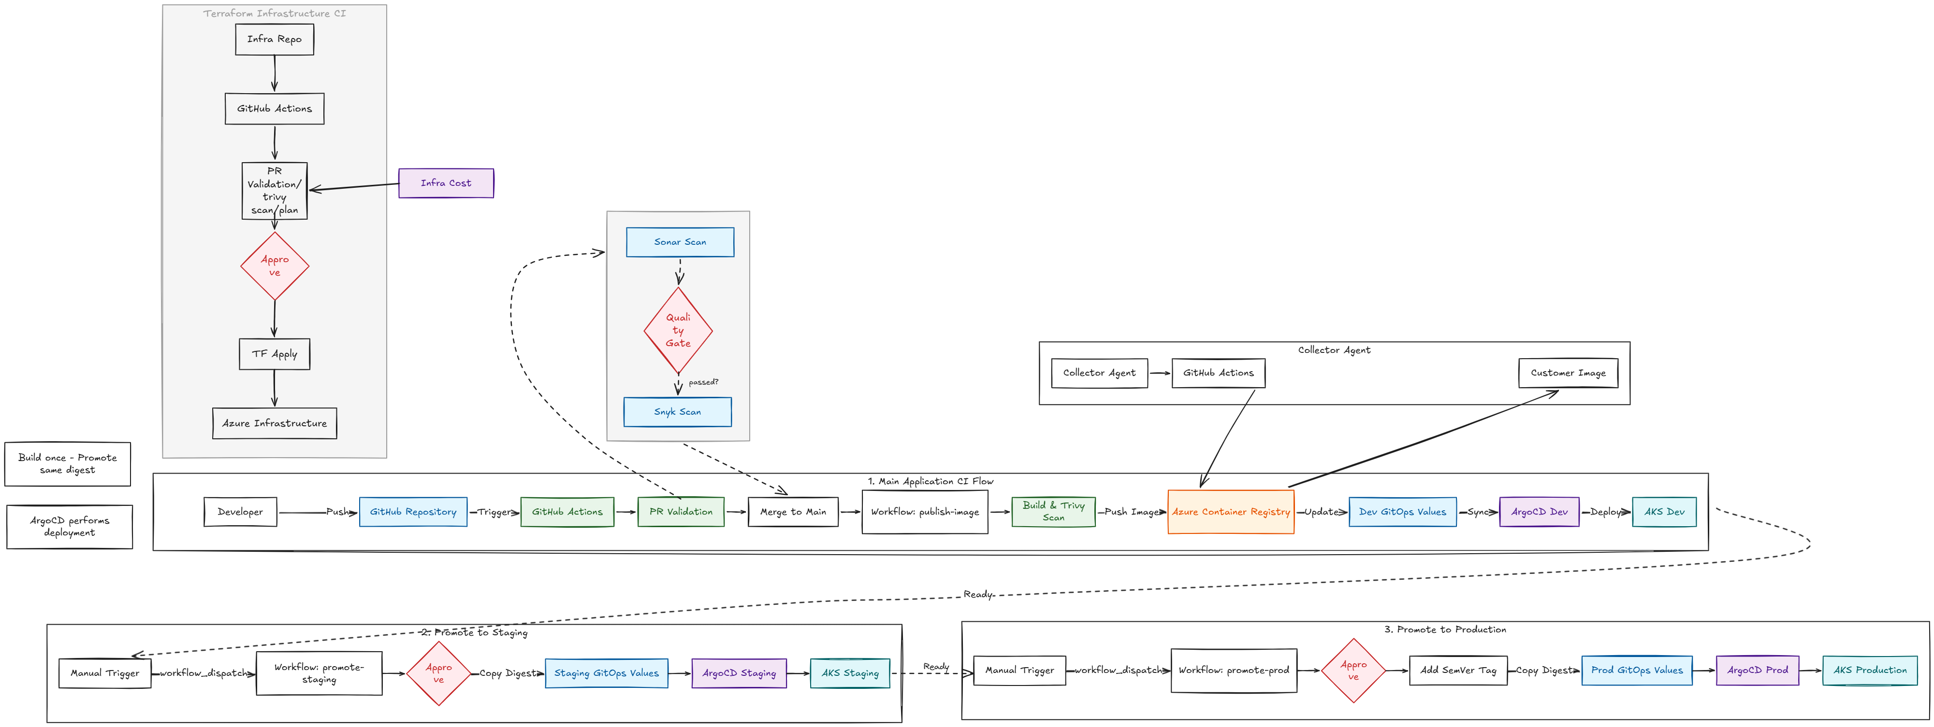
CI/CD Architecture

Slide 8
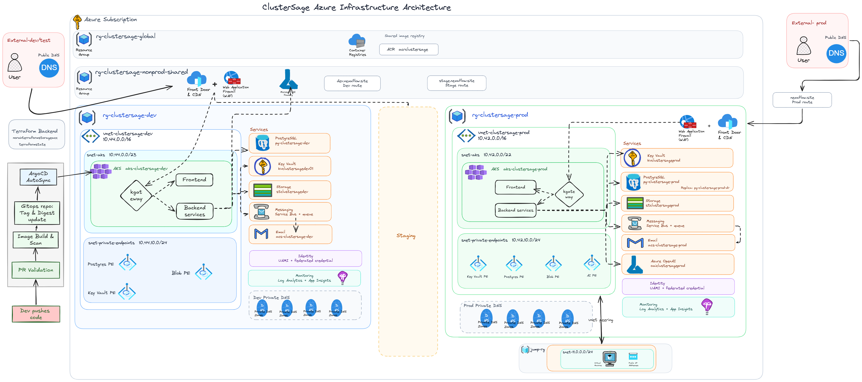
Cloud Architecture

Slide 9
Security
Identity and access are secured using Azure AD / Entra ID, AKS RBAC, managed identities, and workload identity, which avoids broad access and reduces reliance on static credentials.
Secrets are protected through Azure Key Vault, GitHub Secrets, and OIDC-based pipeline authentication, so sensitive values are not hardcoded or stored directly in code.
Network security is strengthened through private endpoints, disabled public access on sensitive services, node pools without public IPs, and outbound-only communication from the cluster agent.
Runtime access is minimized by giving the in-cluster agent read-only Kubernetes permissions, reducing risk while still allowing monitoring and analysis.

Slide 10
Governance, Scaling & Cost Strategy
Governance Model
Scaling Strategy
Cost Optimization
GitOps is the single source of truth. Infra and app delivery are separated. Prod promotions require manual confirmation with semantic version inputs. No direct kubectl or Helm upgrades to prod.
Frontend and API run with multiple replicas and HPA support. AKS autoscaling enabled with optional separate user node pool. Shared ACR eliminates registry duplication. PostgreSQL read replica support available.
Shared ACR and non-prod Front Door reduce duplication. Environment separation applied only where governance justifies it. Immutable promotion eliminates redundant rebuild cycles. Selective private endpoint rollout based on risk.

Slide 11
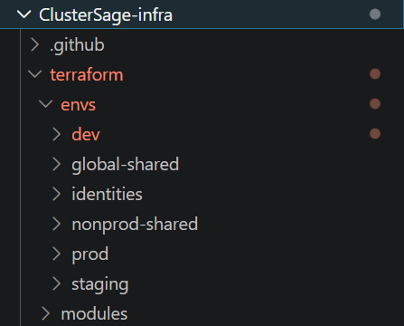
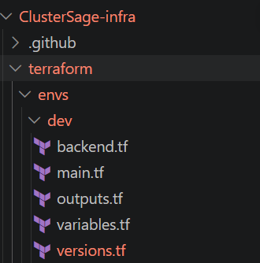
Terraform

Slide 12
Remote State and Secret Management
A dedicated blob container is used to maintain the Terraform state for each environment.
State locking is handled automatically by the Azure backend during Terraform operations, preventing multiple users or pipelines from modifying the same state at the same time.
This avoids race conditions, conflicting updates, and state corruption during plan and apply.
Secrets are injected securely into the pipeline using GitHub Secrets.
Azure authentication for Terraform is handled through OIDC-based login, reducing the need for long-lived static credentials.

Slide 13
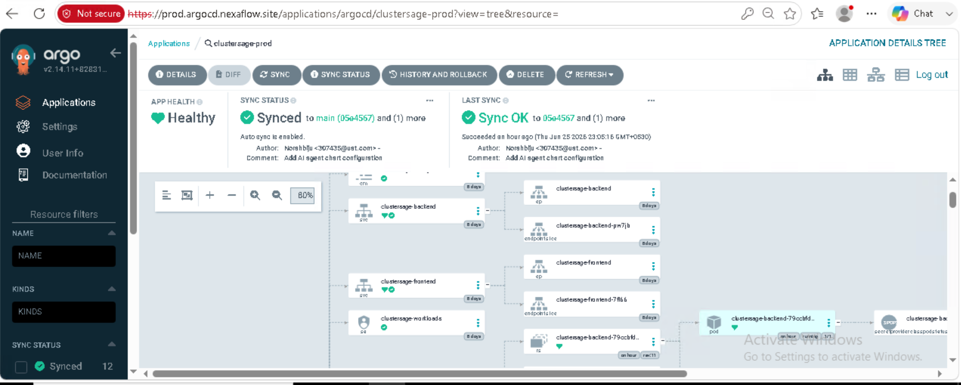

Slide 14
