Slide 1
An agile and fast FPGA kernel dev for VLM application
CSBOT technical report

Slide 2
Outline
Philosophy.
Model analysis and target operator choices.
Hardware and architecture design choices.
Llama.cpp modification and integration.
Achieved results.
How to run.

Slide 3
Philosophy
The AI model is rapidly evolving.
  Require agile hardware development.
Tiling based hardware design leads to a humongous number of hardware design choices.
  Traditional RTL based FPGA kernel development is very time consuming and error prone.
A multi-kernel vivado project is very difficult to make.
  Limited resource on FPGA, especially routing resource.
Hardware competition:
  We don’t work on the model, e.g., different quantization.
HLS allows us to develop fast hardware prototype.
  We use Vitis HLS for FPGA.
Llama.cpp allows easy integration with many optimized CPU ops.
  Don’t reinvent the wheels.
Make two bitstreams for vit+prefill and decode, and switch them during runtime.
  Save us from endless CPU time wasted on Vivado.

Slide 4
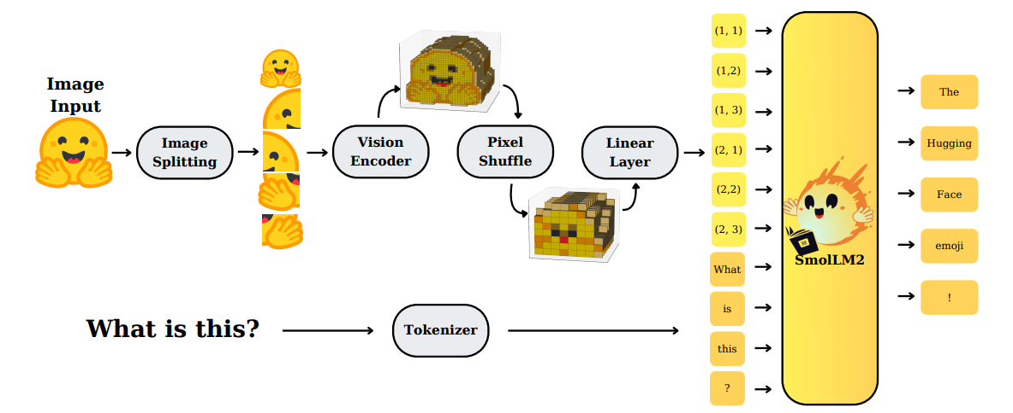
Model analysis
The model consists of two main parts: vision encoder and language model.
  Both use transformer layer.
The key bottlenecks on the CPU are:
  QKVO projection computation/FFN computation/Attention. All GEMM operations.
  The decoding stage on language model uses GEMV.

Slide 5
Operator choices
We decide to accelerate the GEMM/GEMV of the model. Reasons are:
  They constitute 80-90% of compute time.
  Other operators are mostly scalar operators, pure bandwidth bottleneck.
  Model susceptible to exp/Gelu/Swiglu precision. LUT trick degrades accuracy too much.
Attention is not accelerated:
  Requires complicated flash-attention style operator fusion to speed up. Very resource demanding.
  Attention requires online dequant on two outputs. The CPU can just compute it using floating point arithmetic.

Slide 6
Architecture design choices
Stick to the Q8_0 format.
  Good accuracy and throughput balanced.
Use systolic array for GEMM.
  Usual tensor core requires 3D routing, too heavy for FPGA limited routing resources.
  Tensor core requires O(N^2) data bandwidth while systolic array requires O(N).
Use stream processing for GEMV.
  Fully exploit DDR bandwidth.
  Fully interleave data movement and computation.
Agile and fast kernel development.
  Use Vitis HLS + AI agent.
  Keep the LUT/DSP/FF utilization moderate. This helps reducing the Vitis/Vivado run-time.
  Use many BRAM/URAM to improve data locality.

Slide 7


Runtime design choice
Load gemm.bit
The biggest issue is that the resource on FPGA is not enough to support both GEMM and GEMV.
  Or it is very difficult to make bit-stream that fits both. Long dev time.
We decide to make two separate bitstream and switch them during runtime.
  Normally done by DFX. In this case we just use PYNQ. Slower but simpler development.
Start server
ViT prefill +
Text prefill
PL+PS
PS
Decode starts.
Switch to gemv.bit
PL+PS
Decode bost.

Slide 8
Tiling
GEMM and GEMV use the same tiling strategy.
B[N, K] → (N//512)*(K//256) [min(512, N%512), 256].
  The K dimension is padded with zeros if K is not multiple of 256.
Inter tile data layout: (block wise row major)
Intra tile data layout: (column major on subtile)
tile[0,0]
tile[0,1]
tile[0,2]
tile[0,K//256]
tile[1,0]
tile[1,1]
tile[1,2]
tile[1,K//256]
low
high
[col, row]=[0-16, 0]
[0-16, 1]
[0-16, 255]
[16-32, 0]
[16-32, 1]
[16-32, 255]
low
high

Slide 9
Tiling (why?)
Bundle 16 int8 data into 128-bit word is good for AXI transaction.
128 x 256 x 8 = 4096B, the minimum amount for efficient DDR read.
Column major on sub-tile is required by the systolic array.
The scales for Q8_0 follow similar data layout:
  Bundle 8 data because scales are half data type.
min(512, N%512) is applied to data, for scale it’s strictly 512:
  Scale tile is only [512, 8]. If N<512 then the scale block is not multiple of 4096B, very DDR inefficient.
  Only exception is ViT’s QKVO and ViT’s FFN-up. We have a [256, 8] tile.

Slide 10
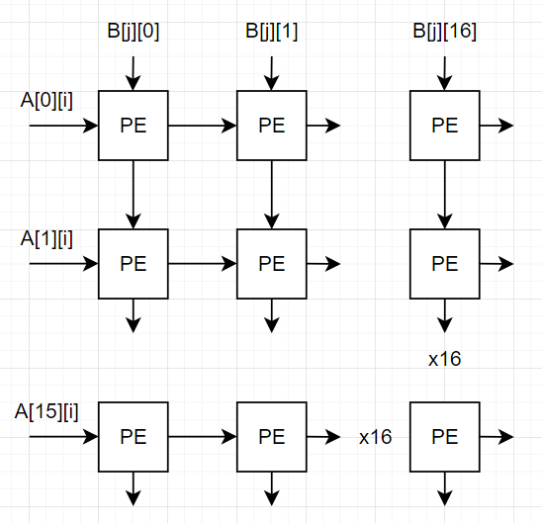
Systolic array
A 16x16 spatial array.
C = A * B.
A tensor flows horizontally. B tensor flows vertically.
The systolic array takes 16 int8 data from A/B tensor per cycle.
  16x8x2 = 256 bits/cycle.

Slide 11
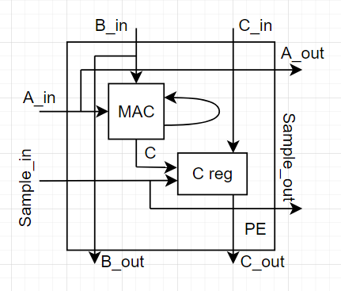
PE design
PE features an INT8 based MAC.
  ap_int<8> for both A/B.
  ap_int<24> for C.
The C is accumulated locally.
Sampling signal triggers copying of C into the local C reg buffer.
If sample signal is not valid, the C also shifts.
The sampling signal also shifts.
A full PE.

Slide 12
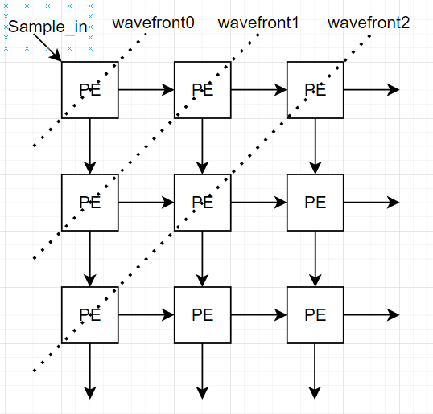
Sample network
The sampling signal shifts in Manhatten style.
Sample_in = Sample_vertical || Sample_horizontal.
This matches the wavefront of the systolic array.
  2*N-1 cycles to sample all Cs.

Slide 13
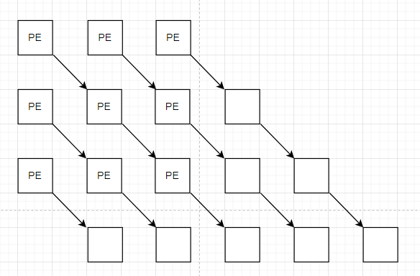
C (result) network
The C network is complicated.
It shifts diagonally.
There are also blank PE (without computation units) to convert the column into the wavefront.
We will use 3x3 as an example to demonstrate.

Slide 14
C (result) network (intermezzo)
Why don’t we just sample and shift C regularly?
The core issue is that the systolic array has a large launch overhead. We want to halt the systolic array minimally.
Problem 1: Q8_0 requires dequantization every 32 values. Cannot feed A/B as a continuous stream.
  Each PE requires 1xINT8 DSP + 2xFP32 mult + 1xFP32 add dsp.
  The FP32 arithmetic is notorious for its latency.
Problem 2: vertical/horizontal shift produces skewed outputs.
  Any sampling scheme not matching the wavefront of the systolic array has this problem.

Slide 15
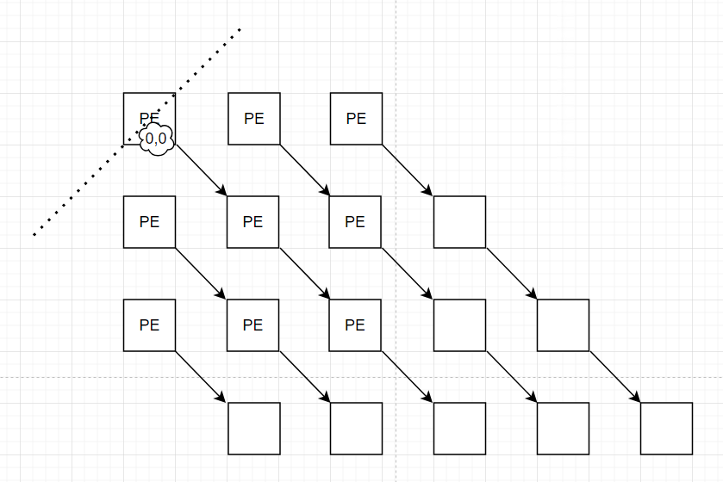
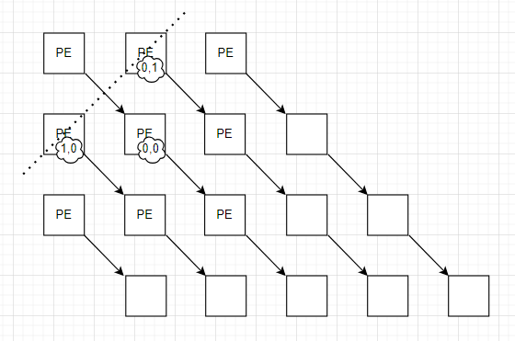
C (result) network
Dashed line is the wavefront. The coord in the cloud is the coord of the generated C tensor.
Sample cycle 0
Sample cycle 1

Slide 16
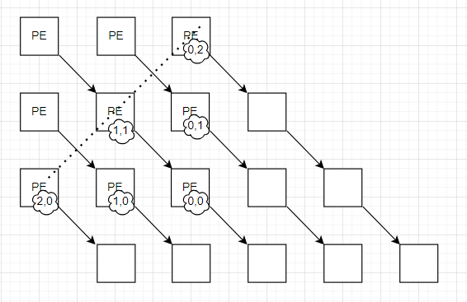
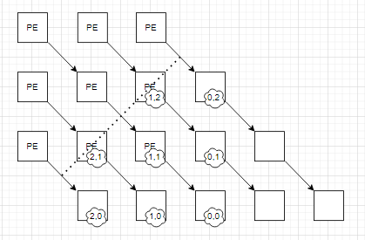
C (result) network (cont’d)
Sample cycle 2
Sample cycle 3

Slide 17
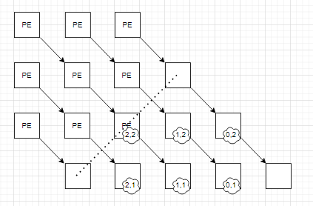
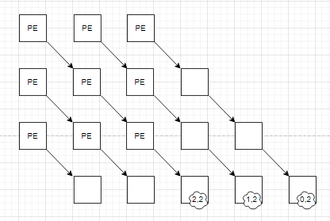
C (result) network (cont’d)
Sample cycle 4
Sample cycle 5

Slide 18
C (result) network
The additional blank PE allows the columns of C to be collected over N clock cycles at the bottom.
This helps reduce the routing effort between the systolic array and the BRAM/URAM.
Since the systolic array produces a column of C per cycle, the C BRAM/URAM can be resized, not partitioned.

Slide 19
HLS kernel design
The HLS kernel is designed on top of the 16x16 spatial systolic array.
It takes at most a M/N/K=512/512/256 tile per launch.
  The user can choose M/N as long as they are multiple of 16.
  But not K. K is fixed at 256. The reason is a non-constant K mess with the HLS loop dependency analysis.
It takes the int8 A/B and half A/B scale separately.
It computes M/N/K=16x16x256 tile continuously, to achieve this
  Computing 16x16x32 tile and accumulate locally as usual.
  Meanwhile, compute the dequantization scale by multiplying a_scale and b_scale.
  Send out and store the 16x16 output tile in a local buffer, in total (256/32) 16x16 output tiles in the local buffer.
  After that, we compute the float accumulation.
For details, refer to the HLS design.

Slide 20
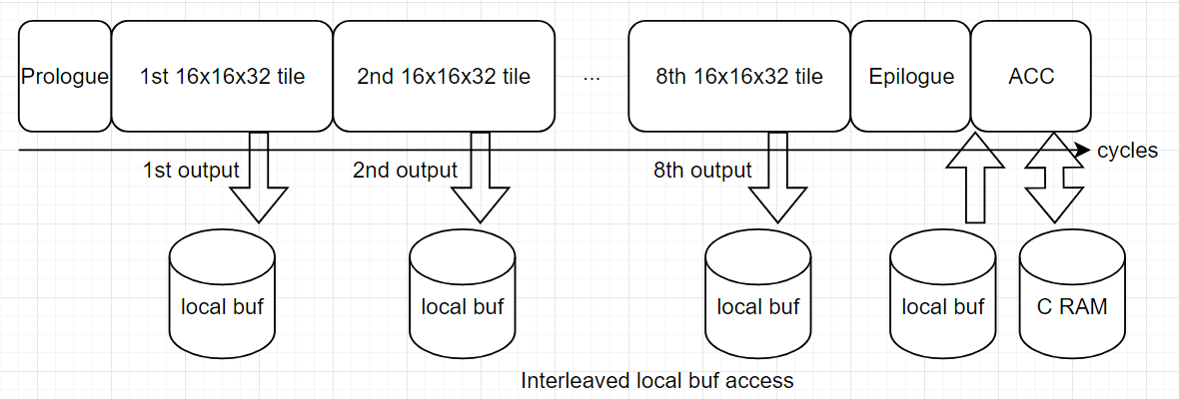
Main iteration space
Why not interleave ACC with the systolic array computation?
  FP arith has high latency.
  The HLS fails to predict the inter-loop dependencies. II drops significantly.
  In theory interleaving is possible, but probably in HDL or using dataflow.

Slide 21
GEMV design
The GEMV does not have much data re-use.
  Apply stream processing to keep the DDR busy.
How to maximize bandwidth?
  4 HP ports. → 128-bit x 200MHz x4 = 12.8GB/s → 60% of max 19.2GB/s DDR bandwidth.
  On each port, 4KB axi burst access. → DDR compatible.
  Decoding must use the same data tiling as the prefill to avoid extra weight reformatting during runtime.
Stream processing between weight data read and computation.

Slide 22
GEMV design
The dataflow pragma allows pipelining among tasks with different II.
Heavy use of fifo. Less use of BRAM/URAM.
Weight data tile reading
64 way i8 MAC
64 way dequantization
64 way inplace float accumulation
axi
fifo
fifo
fifo
buffer

Slide 23
Weight data tile reading task
DDR address space
[0-16, 0-256]
[16-32, 0-256]
[32-48, 0-256]
[48-64, 0-256]
Port 1
Port 2
Port 3
Port 4
concatenation
Task domain
fifo
[0-64,0]
[0-64,1]
[0-64,2]

Slide 24
64 way i8 MAC task
For m in range(80):
For i in range(32):
For j in range(64):
#unroll
Cint[m, j] += Cint[m, j] + A[m*32+i]*B[j, m*32+i]
Computes the MAC of each Q8_0 tile (32 numbers).
Downsample the input stream data rate by 32.
  Input FIFO: 64x8bit B tensor data per clock cycle.
  Output FIFO: 64x22bit accumulation data per 32 clock cycles.
Runs at II=1.
  Int8 MAC is very fast using DSP48.

Slide 25
64 way dequantization
For i in range(80):
For j in range(64):
#unroll
Cdeq[i, j] = (float) Cint[i, j] * A_scale[i] * B_scale[j, i]
Dequantize each 32 group int8 accumulation to float using A_scales and B_scales (preloaded onto the FPGA).
Hide A_scale/B_scale fetching time and computation in data stream.
Runs at 1<II<32.
Cint[0, :]
Cint[1, :]
cycle
0
32
33
64
Load and
compute scales
Cdeq[0, :]

Slide 26
64 way inplace float accumulation
For i in range(80):
For j in range(64):
#unroll
Csum[j] += Cdeq[i, j]
Accumulate using float addition over the whole K=2560 dimension.
Runs at 1<II<32.
Store results to a local buffer.

Slide 27
GEMV summary
Stream based design.
  More FIFOs, less cycle accurate control.
Float arithmetic latency hidden by the 32-cycle interval produced by the i8 MAC task.
Fully pipeline between the B tensor loading and the MAC computation.
  Main latency still limited by B loading. In other words, the computation is completely hidden!
Achieved DDR loading data rate roughly 10GB/s, more than 50% of the total DDR bandwidth (19.2GB/s).

Slide 28
Llama.cpp modification
Catch the ViT and transformers on language model and dispatch them to the FPGA.
The ViT gemm shapes contain:
  M/N/K = 768/1024/768 -> QKVO projection.
  M/N/K = 3072/1024/768 -> FFN-up.
  M/N/K = 768/1024/3072 -> FFN-down.
The language model shapes contain:
  M/N/K = 960/X/960 -> QO projection.
  M/N/K = 960/X/320 -> KV projection.
  M/N/K = 2560/X/960 -> FFN-up/FFN-gate.
  M/N/K = 960/X/2560 -> FFN-down.
Decoding gemv captured.

Slide 29
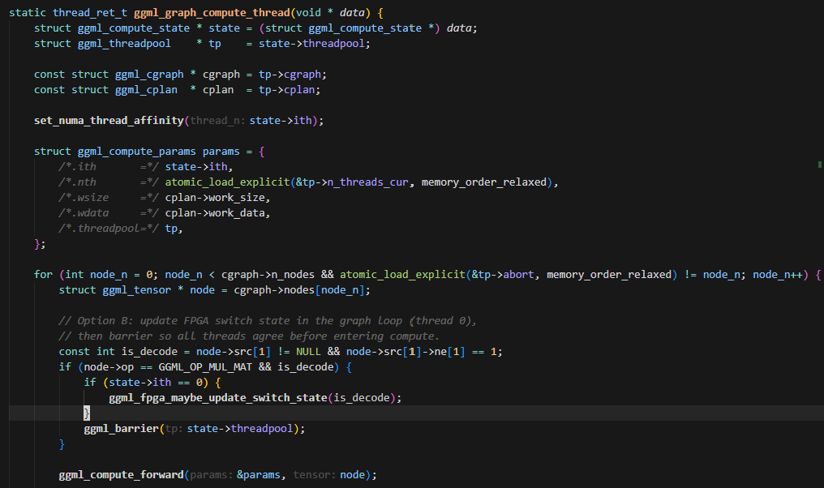
Main modifications
Bitstream switching location.

Slide 30
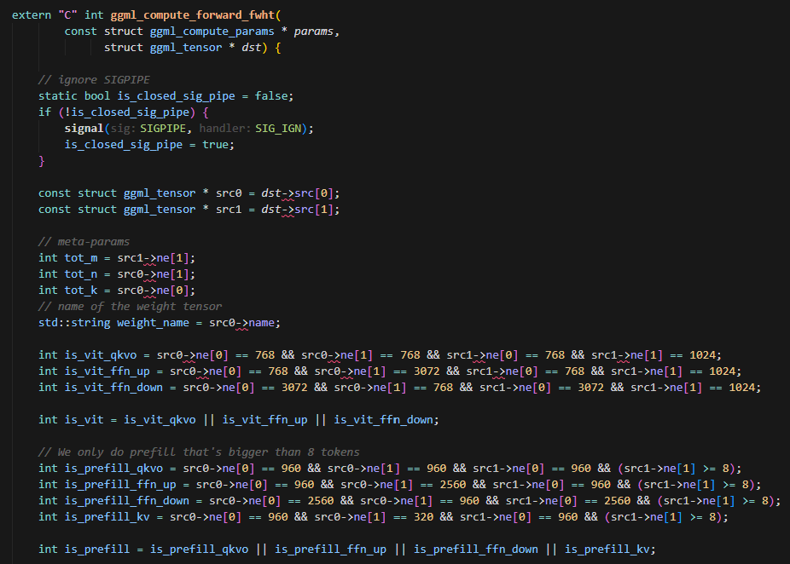
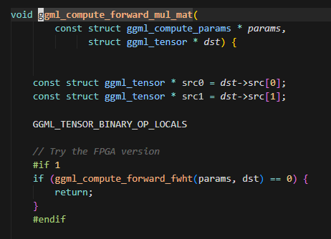
Main modifications
Try to do mul_mat in fpga domain.
  If not supported, continue with CPU’s op.

Slide 31
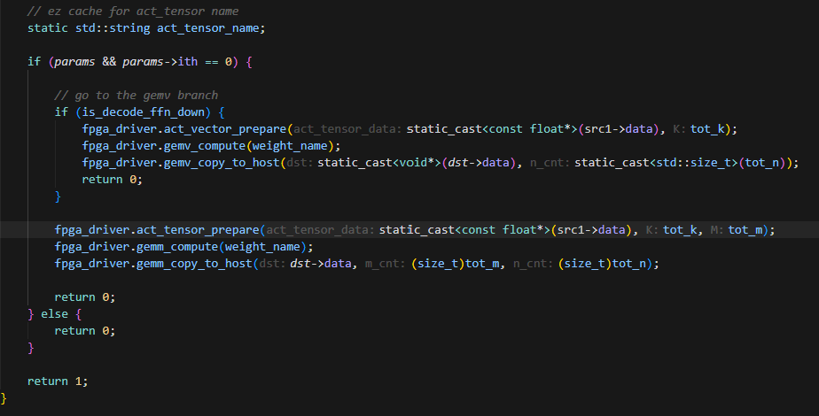
Main modifications
Only call FPGA kernel with thread 0.
  Other threads just return success.
Call FPGA driver API.
The FPGA driver API includes input quant/FPGA launch/memcpy for the output…
Legacy. FFN_DOWN includes
many layers…

Slide 32
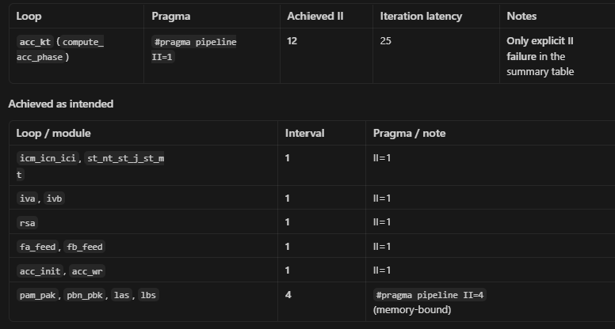
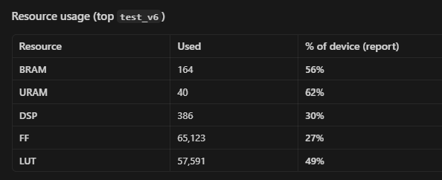
Achieved results
GEMM hls kernel.
Sorry that names are acronyms. Stupid vivado’s ip naming issues.
Main MAC loop.

Slide 33
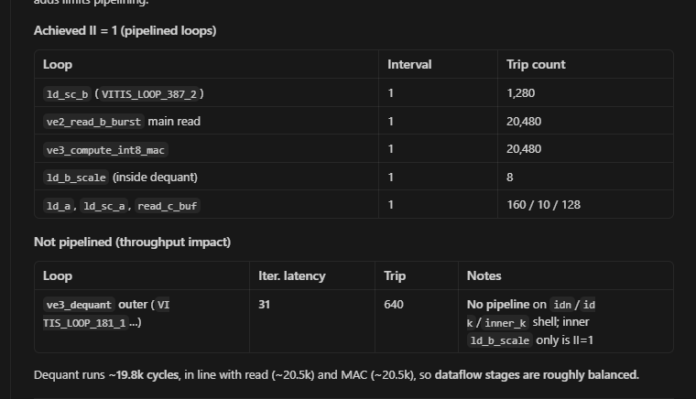
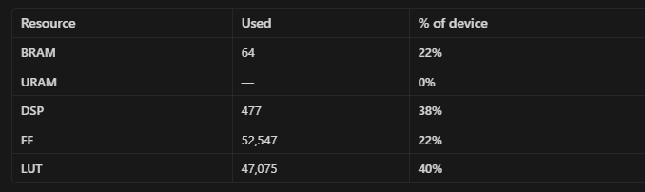
Achieved results
GEMV hls kernel.

Slide 34
How to run.
User name: root. Password: ck197&pMjt641..7
Connect the FPGA to LAN. Find out the LAN address. Connect to the jupyter notebook.
Three steps in parallel:
  Run /root/jupyter_notebooks/hw/load_overlay.ipynb in jupyter notebook
  Run llama-server:
    [bash] cd /root/jupyter_notebooks/sw
    [bash] ./build-release/bin/llama-server -m ./inputs/SmolVLM2-500M-Video-Instruct-Q8_0.gguf --mmproj ./inputs/mmproj-SmolVLM2-500M-Video-Instruct-Q8_0.gguf
  Run test scripts:
    [bash] cd /root/jupyter_notebooks/aicas/scripts
    [bash] source ../venv/bin/activate
    [bash] python throughput_eval.py -i test2.jpg -o dummy.json

