Slide 1
CAPSTONE PROJECT · FINAL ORAL DEFENSE
WEB-BASED ACCREDITATION MANAGEMENT AND
READINESS ASSESSMENT SYSTEM FOR
STI WEST NEGROS UNIVERSITY
JOSE MARIE CLYDE B. TABURADA
Candidate, Master in Information Technology (MIT)
Graduate School · State University of Northern Negros, Sagay City, Negros Occidental
Study Locale & Pilot: College of Information & Communications Technology (BSCS Program), STI WNU, Bacolod City
November 2026
Notes:
Good day to the Chair and Members of the Oral Examination Panel. I am Jose Marie Clyde B. Taburada, presenting my Master in Information Technology capstone project entitled 'Web-Based Accreditation Management and Readiness Assessment System for STI West Negros University.'

Slide 2
Research Context, Institutional Problem & Prior Arts Gap
CH. I–II · CONTEXT | 02 / 16
Operational pain points in accreditation self-surveys and synthesis of reviewed literature (Chapters I–II)
OPERATIONAL CHALLENGES IN SELF-SURVEY PREPARATION
PRIOR ARTS SYNTHESIS & RESEARCH GAP (CHAPTER II)
PRIOR ARTS
1. Fragmented Documentary Exhibits
Syllabi, faculty profiles, research outputs, and committee records are prepared by different personnel across personal drives, shared folders, and physical binders—causing episodic cramming and lost institutional memory.
• Commercial Platforms (Watermark, Creatrix Campus, AchieveIt): Support broad institutional workflows and cloud repositories, but reviewed materials show no native PACUCOA 30-weight engine or dual-constraint floor evaluator.
• Local Higher-Ed Repositories (Pardiñan et al., 2024; Dres & Rabut, 2025; Galande, 2025; Salac et al., 2025): Digitize tagging and storage for SUCs/AACCUP, without database-enforced self-verification blocking or isolated what-if simulation.
• Identified Gap Addressed: A PACUCOA-specific platform uniting criterion mapping, RLS separation of duties, 30-weight floor forecasting, and CICT's 4-column compliance matrix.
2. Manual Weighting & Floor-Rule Blind Spots
Spreadsheet tracking does not continuously evaluate PACUCOA's 30-weight formula alongside dual-constraint Area and criterion floor rules, allowing single-Area deficits to go unnoticed until pre-survey reviews.
INSTITUTIONAL LOCALE & BSCS PILOT CONTEXT (STI WNU)
PILOT SCOPE
• Study Locale: College of Information and Communications Technology (CICT) & Quality Assurance Office, STI West Negros University, Bacolod City.
• Why BSCS Pilot: BSCS earned official PACUCOA Level I status in September 2026 (valid to Sept. 2030), while BSIT holds Level II status—making BSCS the active candidate transitioning toward Level II digital readiness.
• Working Instrument: 79 active evaluative criteria across 10 PACUCOA Areas (derived from the CICT BSCS Compliance Report; dynamically configurable per program).
3. Unenforced Verification & Audit Boundaries
Generic cloud drives lack academic role delegation and separation-of-duties controls, permitting uploaders to mark their own exhibits complete without independent supervisory inspection.
Notes:
Chapters I and II identify three operational problems during accreditation preparation: scattered files across personal drives, difficulty tracking PACUCOA's 30-weight and dual-constraint floor rules manually, and lack of enforced separation of duties. Reviewed commercial and local systems do not natively model PACUCOA's mathematical floors or database-level self-verification blocking.

Slide 3
Regulatory Foundation: PACUCOA Undergraduate Framework
CH. I & III · PACUCOA | 03 / 16
Official 10 Evaluative Areas, 30-Weight Distribution (Table 1), and Dual-Constraint Level Thresholds
Area | PACUCOA Undergraduate Evaluative Area | Weight
Area I | Philosophy and Objectives | 3
Area II | Faculty | 3
Area III | Instruction (Highest Curricular Weight) | 4
Area IV | Laboratory | 3
Area V | Research | 3
Area VI | Library | 3
Area VII | Student Services | 3
Area VIII | Social Orientation & Community Involvement | 3
Area IX | Physical Plant and Facilities | 2
Area X | Organization and Administration | 3
TOTAL | Sum of Equivalent Area Weights | 30
DUAL-CONSTRAINT ACCREDITATION LEVEL THRESHOLDS
CANDIDATE STATUS [Overall >= 3.00 | No minimum Area floor constraint]
Requires overall weighted program average of at least 3.00 (Satisfactory) across the 30-weight instrument.
LEVEL I ACCREDITED [Overall >= 3.00 | AND No Area Mean < 3.00]
Every one of the ten PACUCOA Areas must achieve an Area mean of at least 3.00; any single Area < 3.00 blocks eligibility.
LEVEL II REACCREDITED [Overall >= 3.50 | AND No Area Mean < 3.50]
Requires higher overall program mean (>= 3.50) AND all ten individual Area means at or above 3.50.
LEVELS III & IV [Overall >= 4.00 | AND No Criterion < 4.00*]
System enforces the stricter minimum-rating summary rule (no individual criterion < 4.00; Manual Section 10 notes Area mean 4.00). Supplementary criteria lie outside self-survey scoring.
Scope Note: Models PACUCOA Step Two (Institutional Self-Survey) & Revisit Compliance; required document count (R) is a QA-configurable completeness proxy, not an accreditor-prescribed count.
Notes:
The system's mathematical rules come directly from the Revised September 2023 PACUCOA Manual. Ten undergraduate Areas carry weights totaling 30—Instruction carries 4, Physical Plant carries 2, and the other eight Areas carry 3 each. Levels require satisfying both an overall weighted mean and strict Area or criterion minimum floors.

Slide 4
Objectives of the Study
CH. I · OBJECTIVES | 04 / 16
General Objective and Six Specific Research & Engineering Objectives (Chapter I)
GENERAL
OBJECTIVE
To design, develop, and evaluate a Web-Based Accreditation Management and Readiness Assessment System for STI West Negros University that automates evidence mapping, enforces independent verification with a self-verification block, calculates PACUCOA-compliant readiness ratings, provides what-if readiness simulation, and tracks post-visit compliance.
Evidence Management & Mapping
OBJ 01
Scoring & 5x2 Command Dashboard
OBJ 02
What-If Readiness Simulation
OBJ 03
Store accreditation exhibits under PACUCOA criteria and validate file types, effective dates, and required document proxy counts (R) with server-side PDF text-layer extraction.
Compute real-time ratings at criterion, Area, and program levels using PACUCOA's 30-weight formula and dual-constraint floor rules in a zero-scroll 5x2 layout.
Project program ratings and accreditation level floor thresholds when up to ten unresolved criteria are completed (benchmark 4.00) without mutating live production records.
Post-Visit Compliance Tracking
OBJ 04
RBAC & Separation of Duties
OBJ 05
ISO/IEC 25010 Quality Evaluation
OBJ 06
Record opportunities for improvement, PACUCOA recommendations, sub-numbered actions taken (1.1, 1.2), and linked verification exhibits in a four-column matrix.
Enforce 8-role access control and database-level separation of duties preventing self-verification (uploader_id != verifier_id; QA Officer exempt) across academic delegations.
Assess software quality across all eight ISO/IEC 25010 characteristics with N = 20 purposive respondents (15 institutional stakeholders and 5 external IT experts).
Notes:
Our General Objective is to design, develop, and evaluate the web-based accreditation management and readiness assessment system for STI West Negros University, operationalized through six specific objectives covering our four functional modules, role-based separation of duties, and ISO/IEC 25010 evaluation.

Slide 5
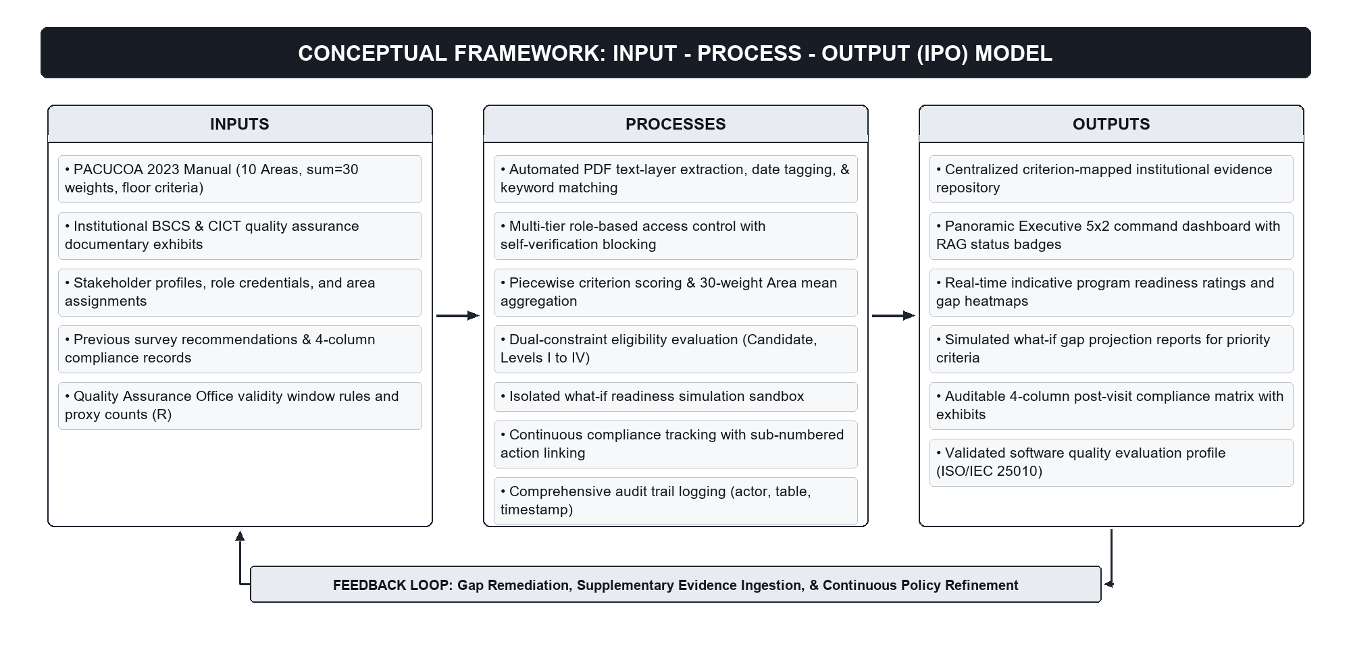
Conceptual Framework of the Study
CH. I · FRAMEWORK | 05 / 16
Input–Process–Output (IPO) Model with Continuous Quality Improvement Feedback Loop (Figure 1)
1. INPUTS
PACUCOA 2023 Manual (10 Areas, sum=30), BSCS exhibits, 8 user role profiles, QA validity/proxy rules (R), and prior revisit recommendations.
2. PROCESSES
PDF text-layer regex tagging, RLS self-verification blocking, piecewise & 30-weight scoring, dual-constraint evaluation, and isolated simulation.
3. OUTPUTS
Centralized repository, 5x2 RAG dashboard, indicative readiness & simulation forecasts, 4-column compliance matrix, and ISO 25010 profile.
4. FEEDBACK LOOP
Channels gap analytics back to QA Officers, Deans, Program Heads, and Faculty for continuous exhibit curation before PACUCOA visits.
Notes:
Figure 1 illustrates the Input-Process-Output Conceptual Framework with a continuous feedback loop. PACUCOA standards, BSCS exhibits, user roles, and prior survey recommendations enter deterministic validation, RLS verification, scoring, and simulation processes to produce real-time readiness intelligence.

Slide 6
Research Design & Agile Scrum Development Methodology
CH. III · METHODS | 06 / 16
Developmental-Evaluative Research (Richey & Klein, 2007) across Four Iterative Scrum Sprints (Table 3, Aug–Oct 2026)
Research Design:
Developmental & Descriptive-Evaluative
SDLC Framework:
Agile Scrum (Schwaber & Sutherland, 2020)
Timeline:
August – October 2026 (4 Sprints)
Sampling & Eval:
Purposive (N = 20) · ISO/IEC 25010
ITERATION 1 · Late Aug – Early Sep 2026
Schema, Auth & RBAC
ITERATION 2 · September 2026
Repository & Verification
ITERATION 3 · Late Sep – Early Oct 2026
Scoring, 5x2 UI & Sandbox
ITERATION 4 · October 2026
Compliance, Audit & Eval
• Requirements matrix from PACUCOA 2023 Manual & CICT Compliance Report
• 15 normalized PostgreSQL relational tables in Supabase
• JWT authentication & 8 institutional role definitions
• Program & Area delegation schema (Chair, Co-Chair, Member)
• Dynamic PACUCOA 10-Area & 79 BSCS pilot criteria configuration
• Private S3 object storage with 300-sec signed preview URLs
• Server-side PDF text-layer regex date/keyword parser (no OCR)
• Must-View preview gate & RLS self-verification block
• Piecewise criterion formula S(V, R) & N.A. exclusion logic
• 30-weight program rating & dual-constraint floor evaluator
• Zero-scroll Executive 5x2 RAG Command Dashboard
• Isolated What-If Simulation Sandbox (<= 10 criteria at 4.00)
• 4-Column Post-Visit Compliance Matrix (CICT report format)
• Sub-numbered actions (1.1, 1.2) linked to repository PDFs
• Append-only relational audit_log & boundary test suite
• Formal ISO/IEC 25010 quality evaluation across N = 20 respondents
Deliverable: Normalized DB Schema & RBAC Auth
Deliverable: Evidence Library & Review Queue
Deliverable: Scoring Engine, 5x2 UI & Sandbox
Deliverable: Compliance Matrix & ISO Evaluation
Notes:
Chapter III employs a Developmental Research Design with a descriptive-evaluative component following Agile Scrum across four iterations from August to October 2026—progressing from PostgreSQL schema and RBAC, to PDF text-layer ingestion, to the 30-weight scoring and simulation engine, and finally the 4-column compliance matrix and N=20 evaluation.

Slide 7
Three-Tier Cloud System Architecture & Technical Stack
CH. III · ARCHITECTURE | 07 / 16
Modular Serverless Presentation, Deterministic Application Services, and PostgreSQL RLS Data Layer (Chapter III)
TIER 1 · PRESENTATION LAYER
Next.js 14 · TypeScript · Tailwind CSS (Vercel)
TIER 2 · APPLICATION & LOGIC
Next.js Server Routes & Deterministic Engines
TIER 3 · DATA & SECURITY (BaaS)
Supabase · PostgreSQL 15 · Private S3 Storage
Executive 5x2 Command UI
Zero-scroll panoramic 10-Area grid with RAG status badges & drill-down.
Deterministic PDF Text Parser
Extracts PDF text layer + regex ISO/alphanumeric dates & keywords (no black-box ML; human-in-the-loop).
15 Normalized Relational Tables
Dynamic frameworks, areas, criteria, levels, users, assignments, evidence, scores, cycles, matrix.
Role-Scoped Workspaces
Dedicated portals for Admin, QA, Dean, Program Head, Chairs, Faculty, Reps.
PACUCOA Scoring Service
Executes piecewise S(V, R), N.A. filtering, 30-weight sum, and dual-constraint floor checks.
Row-Level Security (RLS)
Database-enforced separation of duties: blocks UPDATE where uploader_id = auth.uid() (QA exempt).
Interactive Preview & Sandbox
In-browser PDF signed-URL viewer, What-If selector, & 4-Column Matrix.
Signed URL & Auth Broker
Validates pgjwt session scopes and mints 300-second expiry download tokens.
Private Object Storage Bucket
Non-public exhibit bucket encrypted with AES-256 at rest; blocks direct URL guessing.
Transport Security
Evergreen browsers over full HTTPS / TLS 1.3 transport encryption.
Sandbox Isolation Controller
Computes <= 10-criteria projections into isolated records without mutating live scores.
Append-Only Audit Trail
Relational audit_log records actor, action, target entity, and timestamp for completed transactions.
Deployment Specs: Dev: Core i5/Ryzen 5, 8–16 GB RAM, Node.js v20+ | Cloud: Vercel Edge + Supabase PostgreSQL 15 | Client: OS-agnostic, 4 GB RAM, 1366x768+ (1920x1080 optimal).
Notes:
The platform uses a modular three-tier cloud architecture: Next.js, React, TypeScript, and Tailwind CSS on Vercel for presentation; deterministic server-side routes for PDF text-layer extraction, scoring, and signed URL brokerage; and Supabase PostgreSQL 15 with Row-Level Security and private AES-256 object storage.

Slide 8
Mathematical Readiness Engine & Separation-of-Duties Security
CH. III · ENGINE & RLS | 08 / 16
Piecewise Criterion Formula, 30-Weight Aggregation, 8-Role RBAC, and PostgreSQL RLS Self-Verification Block
DETERMINISTIC PACUCOA SCORING MECHANICS
EQUATIONS
System Role (8 Roles) | Scope | Enforced Permissions & Boundaries
System Admin | Institution | Depts, programs, users, audit log; CANNOT upload/verify.
QA Officer | Institution | Frameworks, weights (=30), oversight; EXEMPT from self-block.
College Dean | College | Read-only 5x2 analytics, simulations & compliance oversight.
Program Head | Program | Assigns chairs, runs simulations, verifies (except own uploads).
Area Chair / Co-Chair | Assigned Area | Verifies assigned Area exhibits (except own uploads).
Faculty Member | Assigned Area | Uploads exhibits & metadata; CANNOT verify any exhibit.
Alumni / Student Rep | Program | Sanitized readiness summary only; zero file/user access.
1. Piecewise Criterion Score s in [0.00, 5.00]
Let V = verified valid exhibits, R = configurable required document proxy count:
• Missing (V = 0): s = 0.00
• Partial (0 < V < R): s = max( 1.00, 2.00 x (V / R) ) [yields 1.00 – 1.99]
• Met / Exceeded (V >= R): s = min( 5.00, 3.00 + 2.00 x ((V / R) - 1) )
Why the jump to 3.00 at V = R? 3.00 represents PACUCOA's 'Satisfactory' compliance baseline once required documentary completeness (R) is met; supplemental verified exhibits scale linearly up to 5.00 (at V = 2R).
2. Area Mean & 30-Weight Program Rating
• Area Mean_a = Sum(s_i) / n_a (criteria marked Not Applicable [N.A.] excluded)
• Program Rating = Sum( Area Mean_a x Weight_a ) / 30
3. Dashboard RAG Status Thresholds
Red < 3.00 (Deficit) | Amber 3.00–3.49 | Yellow 3.50–3.99 | Green >= 4.00
DUAL-LAYER SEPARATION OF DUTIES (RLS + MUST-VIEW GATE)
• Mandatory Preview Gate: Reviewers must open the signed-URL document preview ('Must View' -> 'Inspected') before Approve/Reject unlocks.
• PostgreSQL RLS Self-Block: UI disables action ('Cannot evaluate own upload') AND RLS policy rejects UPDATE when uploader_id = auth.uid() (QA Officer exempt).
Notes:
Slide 8 details the two core engineering controls: on the left, our deterministic piecewise criterion formula, N.A. exclusion, and 30-weight aggregation; on the right, our 8-role RBAC hierarchy and dual-layer self-verification block enforced in both the React UI and Supabase PostgreSQL RLS.

Slide 9
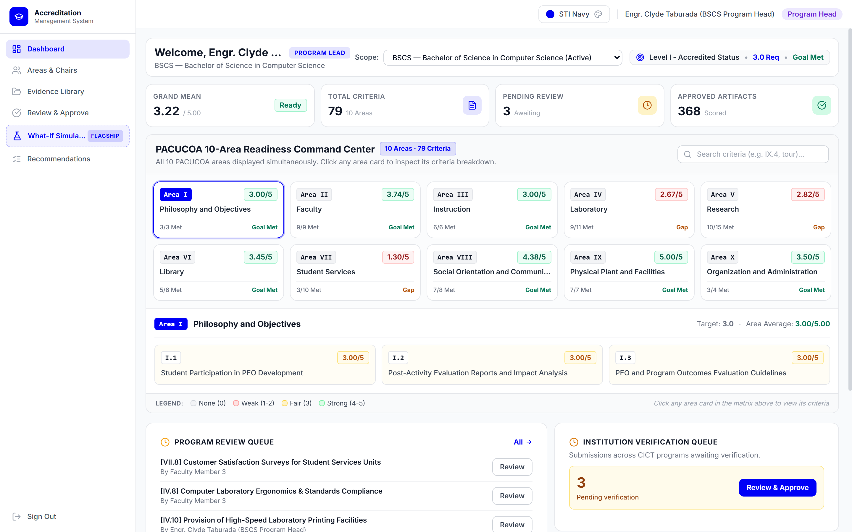
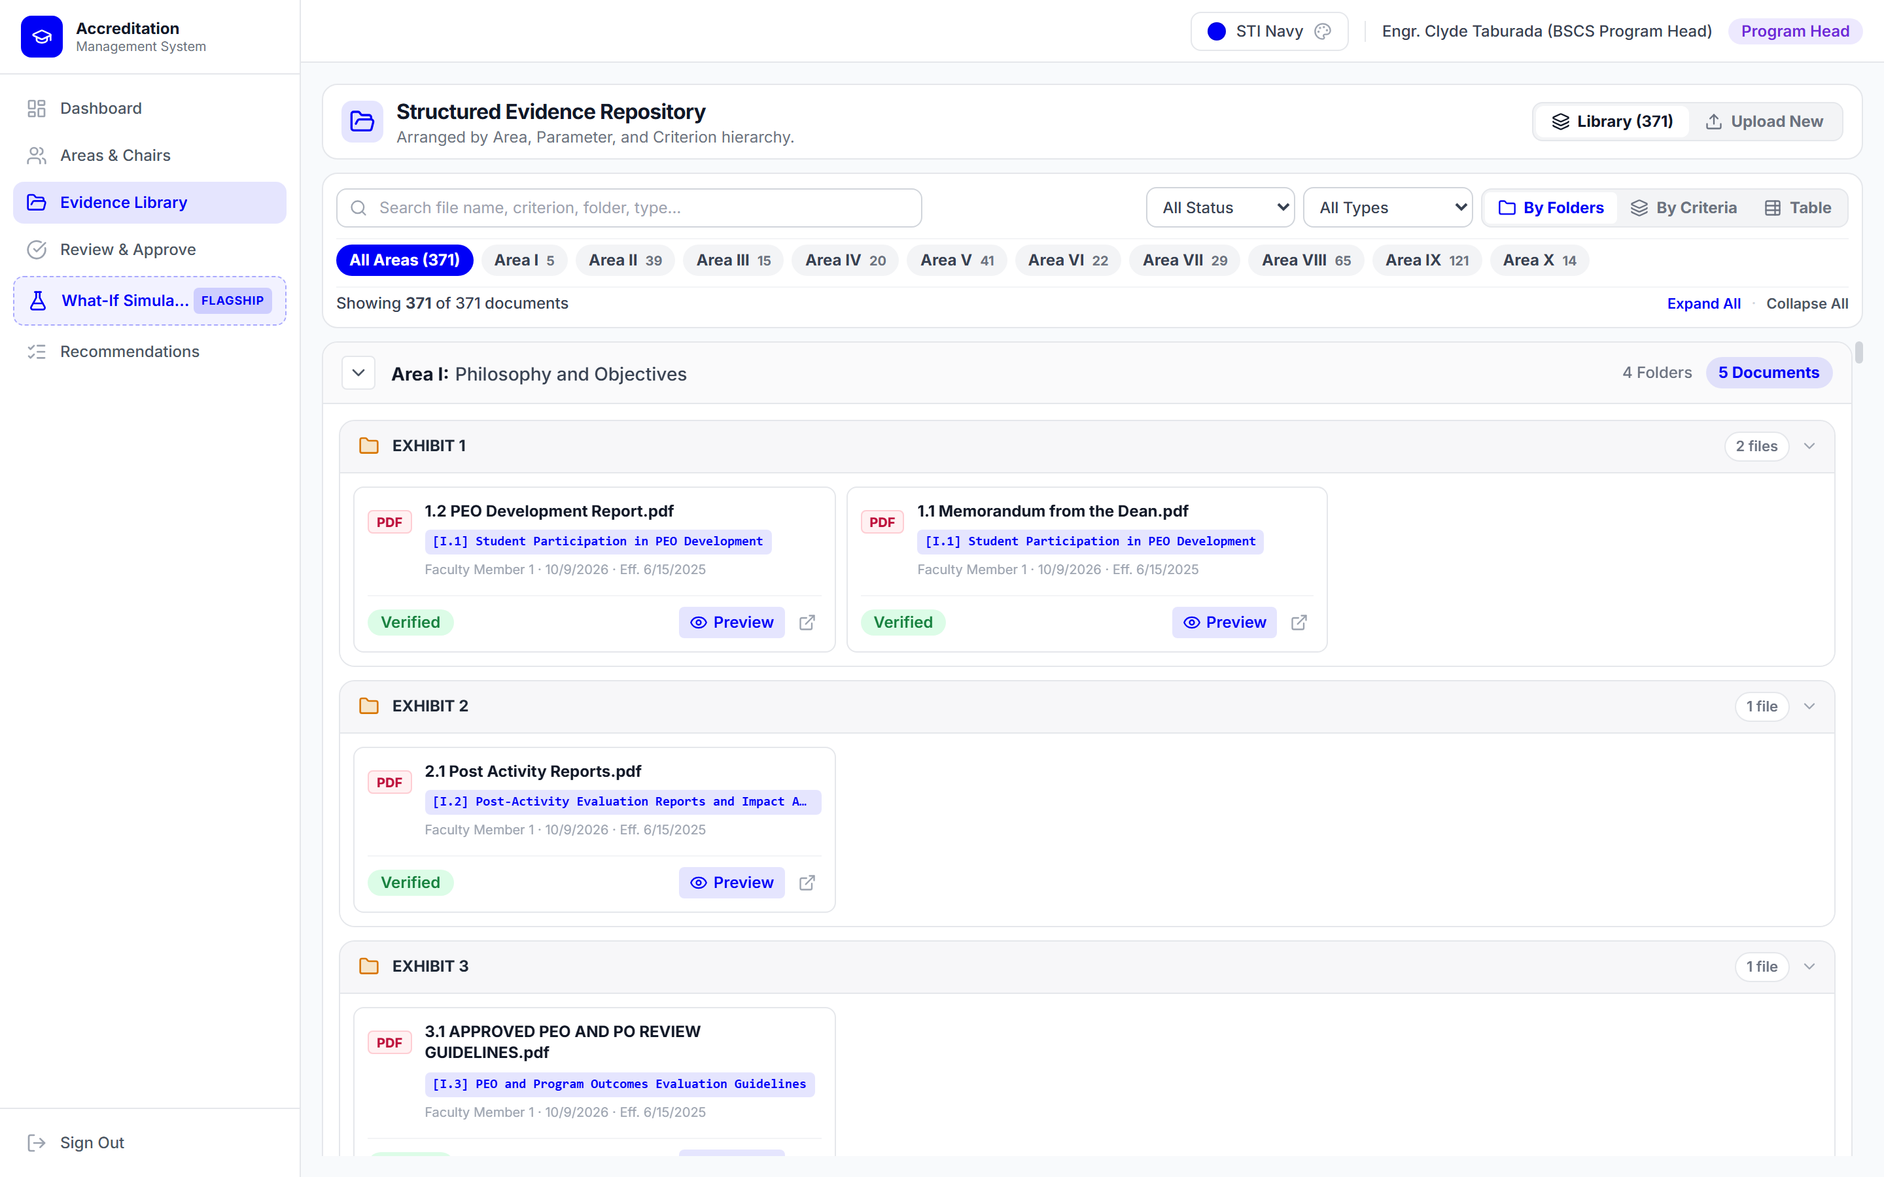
System Implementation (1/2): Command Dashboard & Repository
CH. IV · LIVE SYSTEM | 09 / 16
Operational BSCS Pilot Screenshots — Executive 5x2 Command Dashboard (Fig. 16) & Evidence Library (Fig. 17)
Fig. 16 · Executive 5x2 Dashboard: Displays 3.22/5.00 baseline, 79 criteria, 368 approved files, & flags Areas IV, V, VII (< 3.00).
Fig. 17 · Evidence Repository: Organizes 371 exhibits across Areas I–X with PDF text-layer metadata tagging & signed URLs.
Notes:
Figures 16 and 17 demonstrate the live deployed platform for the BSCS pilot. On the left, the Executive 5x2 Command Dashboard renders all 10 PACUCOA Areas simultaneously with the 3.22 indicative rating and flags Areas IV, V, and VII. On the right, the Evidence Repository organizes 371 digital artifacts by Area and Exhibit.

Slide 10
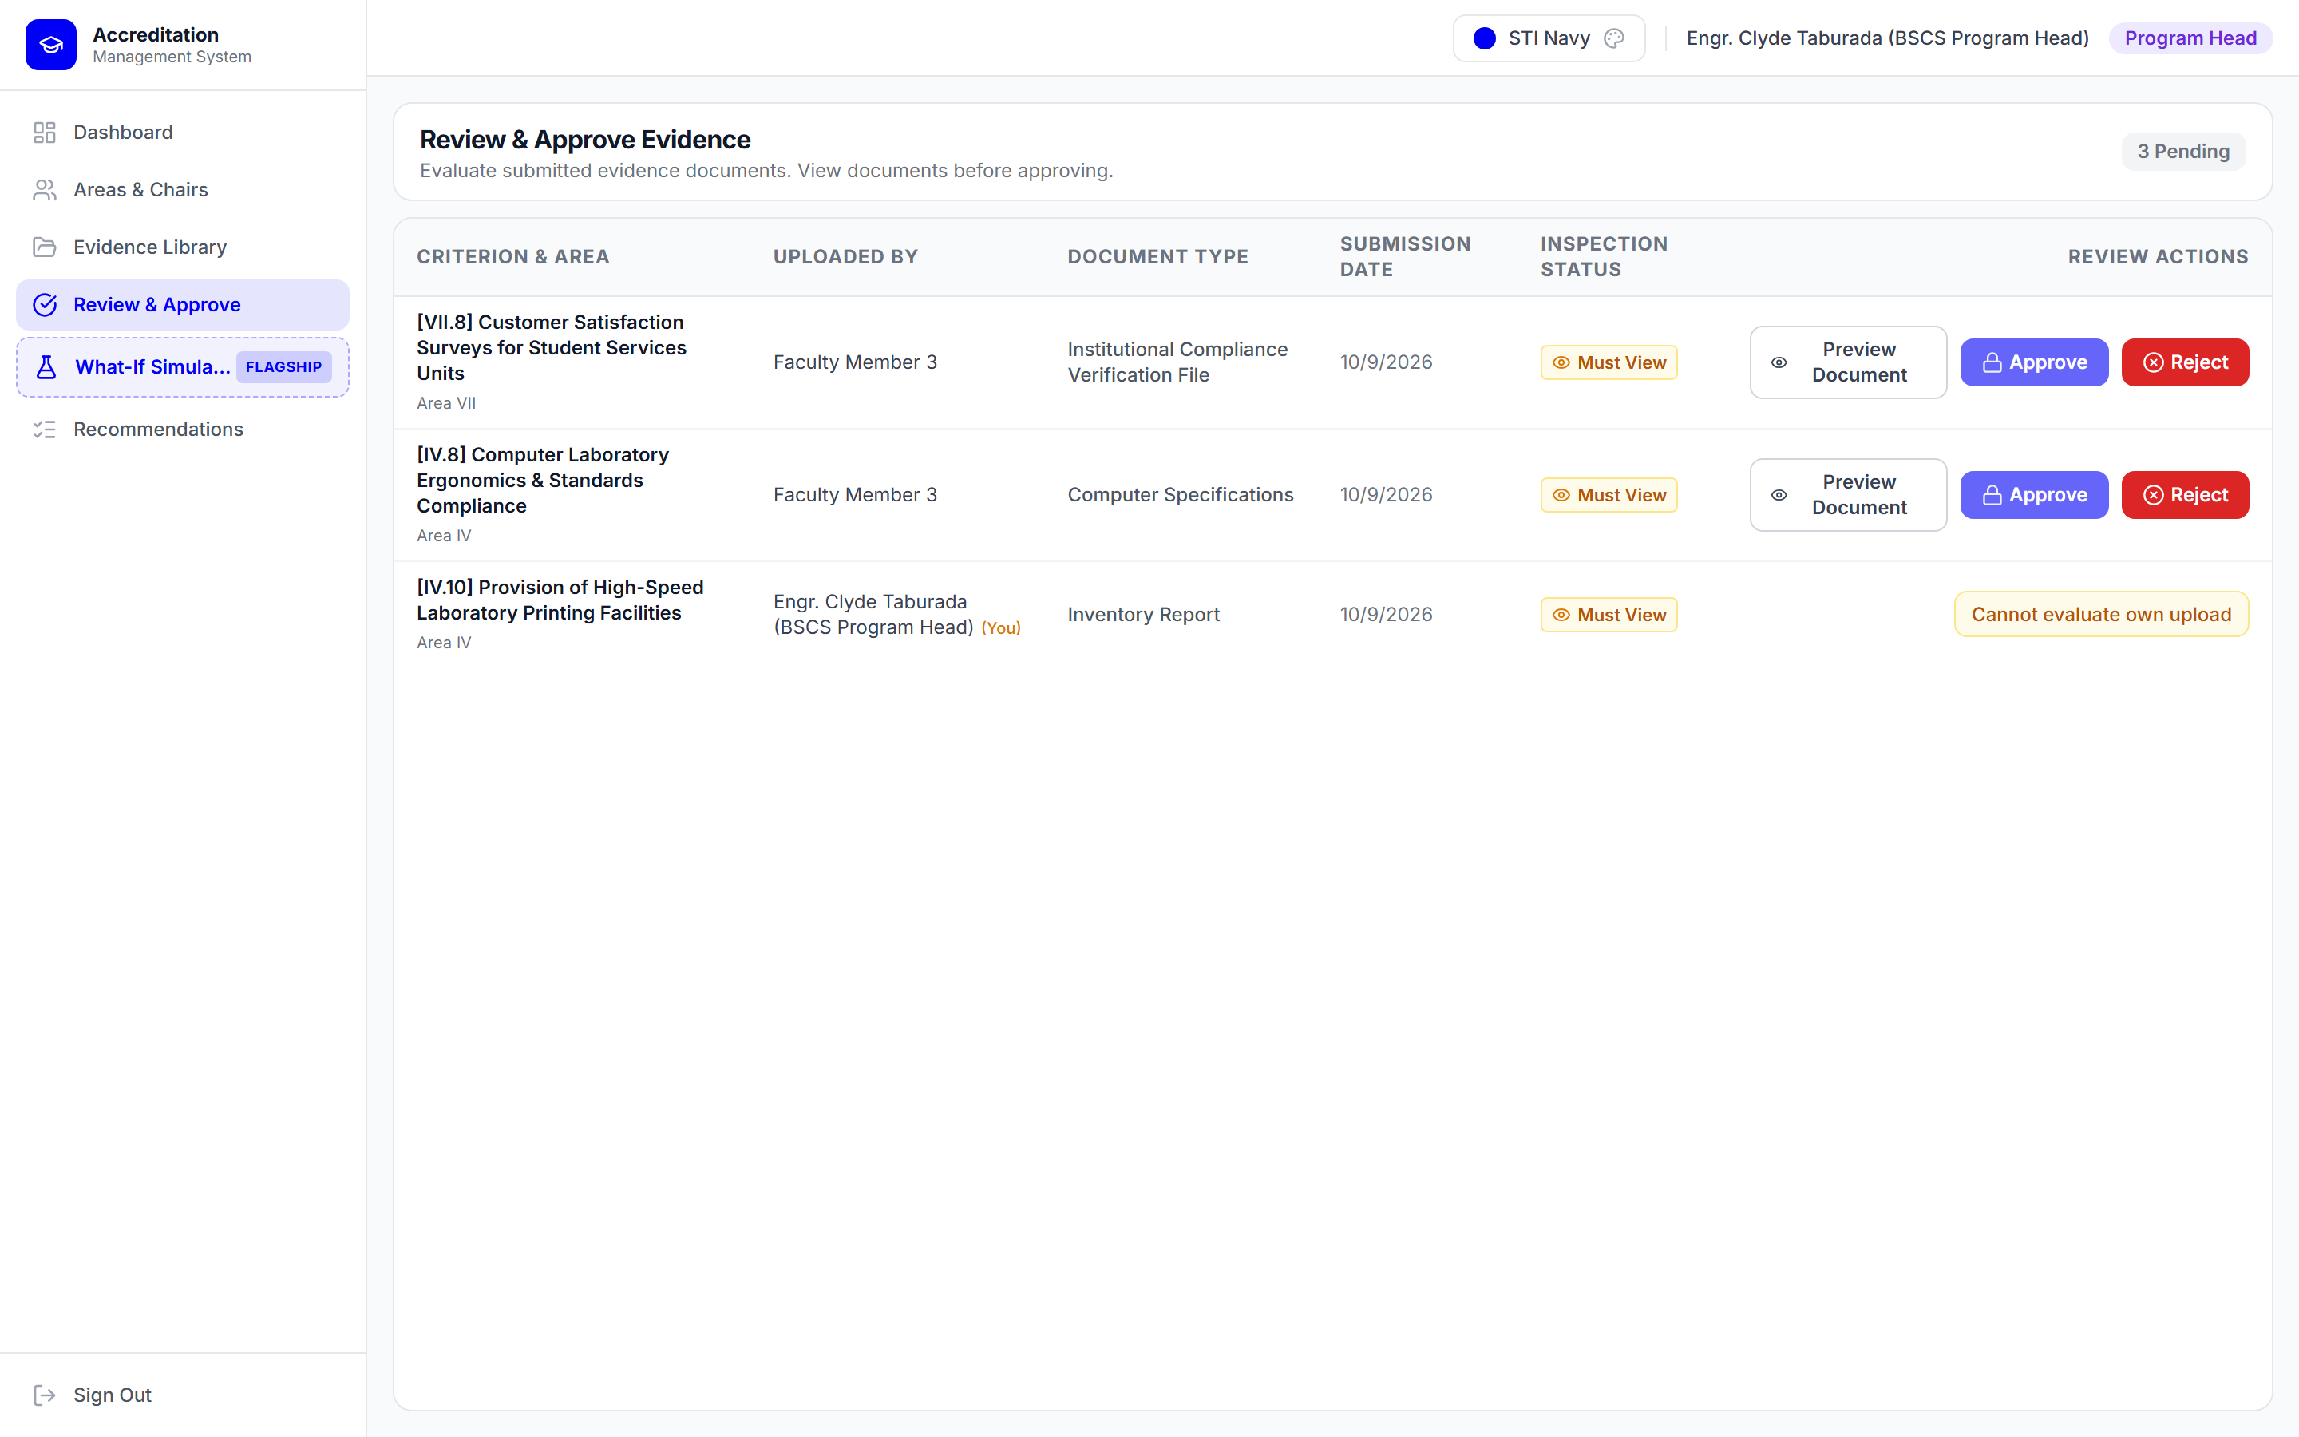
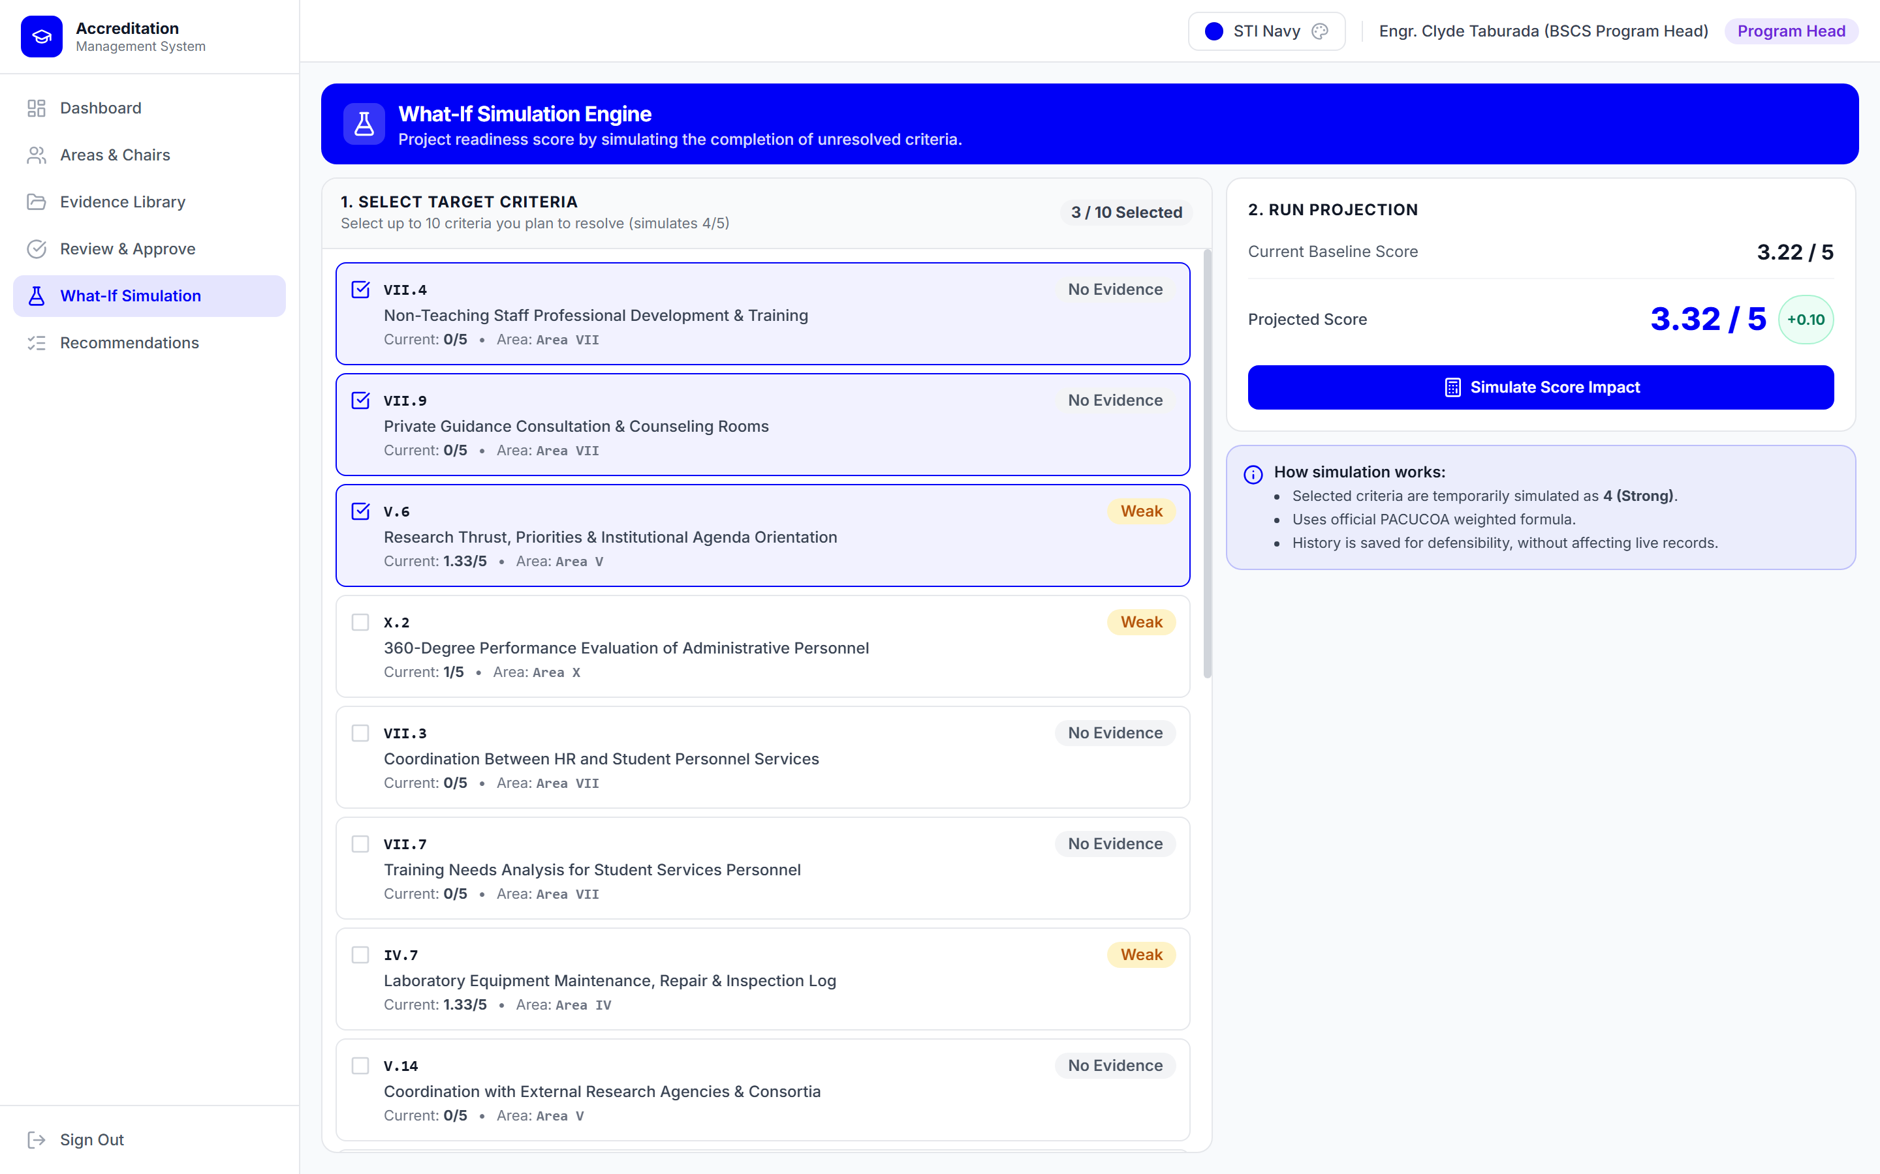
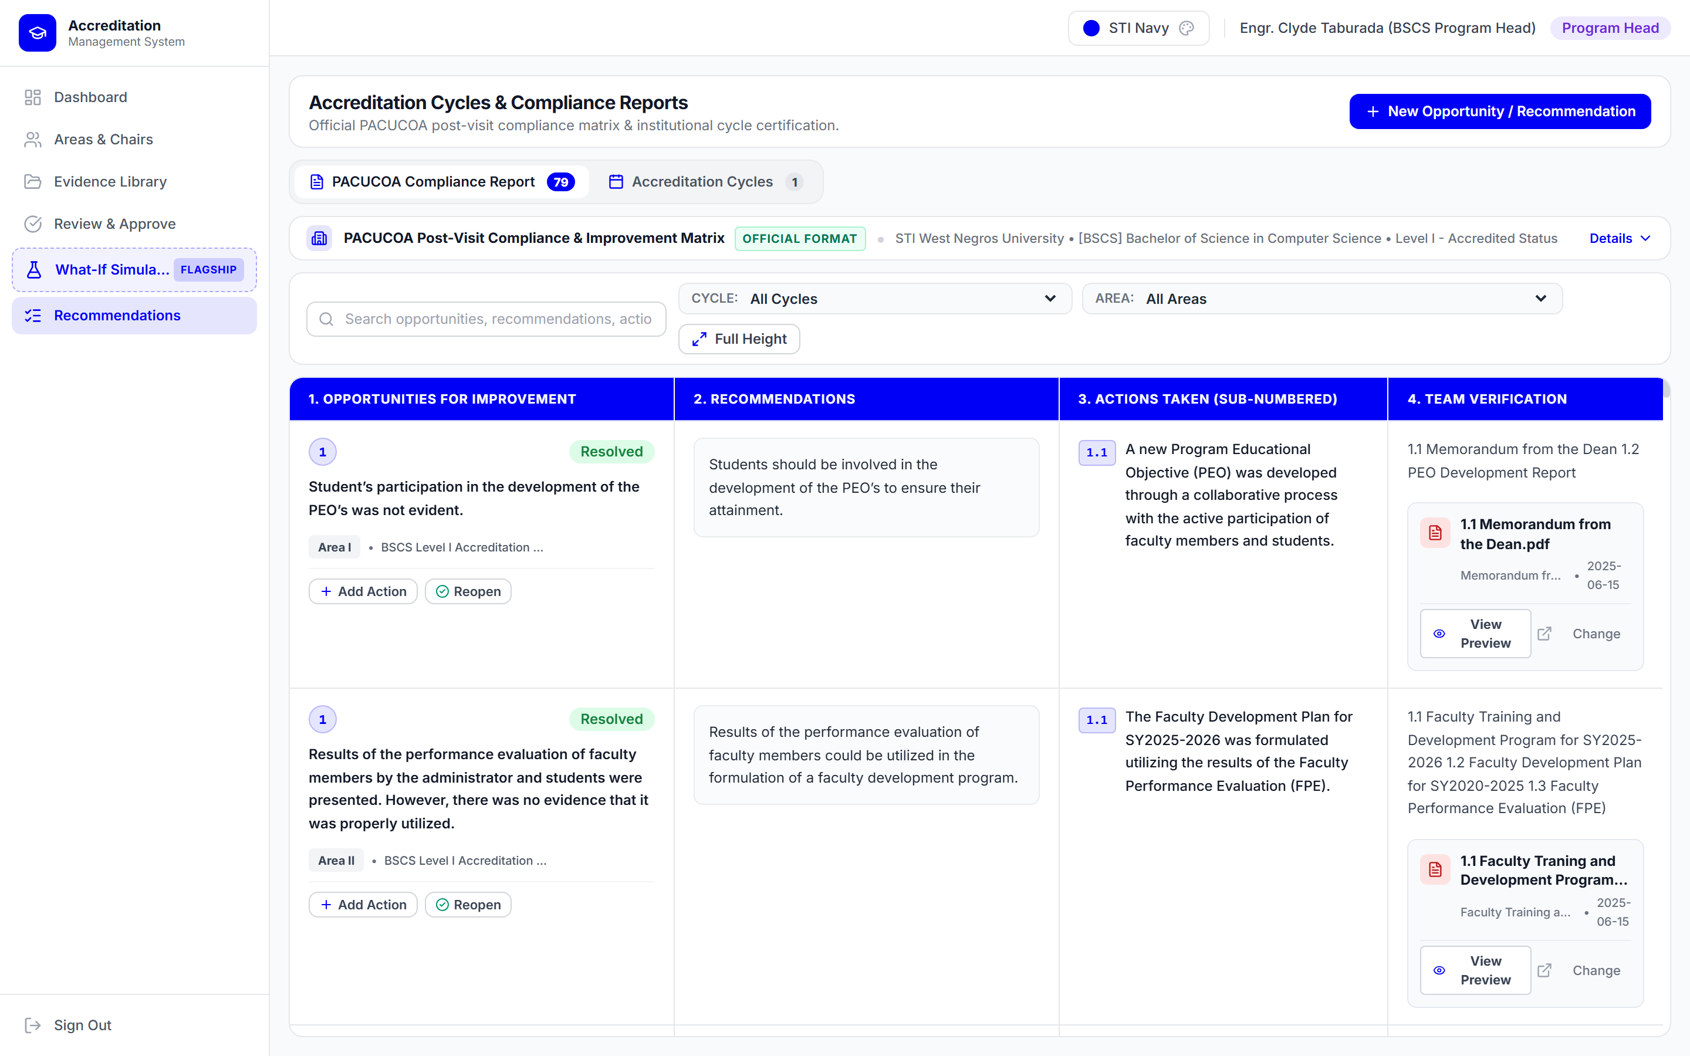
System Implementation (2/2): Verification, Simulation & Compliance
CH. IV · LIVE SYSTEM | 10 / 16
Operational Interfaces for Self-Verification Blocking (Fig. 18), What-If Sandbox (Fig. 19) & 4-Column Matrix (Fig. 20)
Fig. 18 · Verification Queue & Self-Block
Fig. 19 · What-If Simulation Sandbox
Fig. 20 · 4-Column Compliance Matrix
• Enforces 'Must View' inspection gate prior to approval.
• Blocks uploader self-approval ('Cannot evaluate own upload' on Criterion IV.10) at UI + PostgreSQL RLS.
• Selects up to 10 unresolved criteria ('Weak' / 'No Evidence').
• Projects 4.00 completion gains in real time without mutating production self-survey scores.
• Follows CICT BSCS Compliance Report layout (79 items).
• Tracks OFIs, PACUCOA Recommendations, sub-numbered Actions (1.1), & direct repository PDF previews.
Notes:
Figures 18, 19, and 20 demonstrate our three governance and decision-support modules: the Independent Verification Queue showing the Must-View gate and 'Cannot evaluate own upload' block; the isolated What-If Simulation Engine; and the 4-Column Post-Visit Compliance Matrix with sub-numbered actions and linked PDFs.

Slide 11
Empirical Results (1/2): BSCS Baseline & What-If Simulation
CH. IV · RESULTS | 11 / 16
Indicative Repository Baseline (Table 9) and 10-Criteria Strategic What-If Simulation Forecast
PACUCOA Evaluative Area | Wt | Baseline (Wt.Val) | Simulated (+10) | Post-Sim Floor Status
I. Philosophy & Objectives | 3 | 3.00 (9.00) | 3.00 (9.00) | L1 Met · L2 (<3.50)
II. Faculty | 3 | 3.74 (11.22) | 3.74 (11.22) | L1 & L2 Floors Met
III. Instruction | 4 | 3.00 (12.00) | 3.00 (12.00) | L1 Met · L2 (<3.50)
IV. Laboratory [+2 Sim] | 3 | 2.67 (8.01) | 3.40 (+0.73) | L1 Cleared · L2 (<3.50)
V. Research [+3 Sim] | 3 | 2.82 (8.46) | 3.62 (+0.80) | L1 & L2 Floors Cleared
VI. Library | 3 | 3.45 (10.35) | 3.45 (10.35) | L1 Met · L2 (<3.50)
VII. Student Services [+5 Sim] | 3 | 1.30 (3.90) | 3.30 (+2.00) | L1 Cleared · L2 (<3.50)
VIII. Social Orientation | 3 | 4.38 (13.14) | 4.38 (13.14) | L1 & L2 Floors Met
IX. Physical Plant & Facilities | 2 | 5.00 (10.00) | 5.00 (10.00) | L1 & L2 Floors Met
X. Organization & Admin. | 3 | 3.50 (10.50) | 3.50 (10.50) | L1 & L2 Floors Met
OVERALL PROGRAM RATING | 30 | 3.22 (96.58/30) | 3.57 (107.16/30) | All L1 Cleared · 5 Areas <3.50
1. BASELINE: 3.22 (INDICATIVE)
Meets Candidate (>=3.00) but flags Areas IV (2.67), V (2.82), & VII (1.30) below 3.00 due to unuploaded files. Distinct from official Sept. 2026 PACUCOA Level I award.
2. WHAT-IF SIMULATION: 3.57 (+0.35)
Completing 10 priority criteria at 4.00 (+2 in IV, +3 in V, +5 in VII) adds +10.58 weighted pts (96.58 -> 107.16 / 30 = 3.57), isolated from live records.
3. DUAL-CONSTRAINT VERDICT
All 10 Areas clear the 3.00 Level I floor & 3.57 passes the 3.50 overall mark; however, 5 Areas (I, III, IV, VI, VII) remain < 3.50, pinpointing exact 2030 Level II targets.
Notes:
Table 9 presents the empirical verification of the scoring engine on the loaded BSCS dataset. The baseline rating is 3.22 (96.58 / 30), flagging Areas IV (2.67), V (2.82), and VII (1.30) below the 3.00 Level I floor. Note that BSCS earned official PACUCOA Level I status in September 2026; 3.22 reflects digitized repository files. Simulating 10 priority criteria raises the rating to 3.57, clearing all Level I floors while 5 Areas remain below the 3.50 Level II Area floor.

Slide 12
Empirical Results (2/2): ISO/IEC 25010 Quality Evaluation
CH. IV · ISO 25010 | 12 / 16
Comparative Software Quality Ratings Across Institutional Users (n = 15) & External IT Experts (n = 5) (Table 10)
ISO/IEC 25010 Characteristic | Users (n=15) | Experts (n=5) | Combined (N=20) | Combined Interpretation
1. Functional Suitability | 4.84 | 4.10* | 4.66 | Very Highly Acceptable
2. Performance Efficiency | 4.78 | 4.50 | 4.71 | Very Highly Acceptable
3. Compatibility | 4.80 | 4.10* | 4.63 | Very Highly Acceptable
4. Usability | 4.87 | 4.30 | 4.73 | Very Highly Acceptable
5. Reliability | 4.82 | 4.20* | 4.67 | Very Highly Acceptable
6. Security (Highest Rated) | 4.89 | 4.90 | 4.89 | Very Highly Acceptable
7. Maintainability | 4.77 | 4.60 | 4.73 | Very Highly Acceptable
8. Portability | 4.85 | 4.50 | 4.76 | Very Highly Acceptable
COMPOSITE GRAND MEAN | 4.83 (SD 0.37) | 4.40 (SD 0.53) | 4.72 (SD 0.46) | Strongly Agree / VHA
PURPOSIVE RESPONDENTS (N = 20)
• Institutional Users (n = 15): 1 QA Officer, 1 PhD Dean, 2 Program Heads (BSCS/BSIT), 11 CICT Faculty.
• External IT Experts (n = 5): 1 DIT, 1 Master's holder, 3 IT industry software/systems practitioners.
CONVERGENCE ON SECURITY (4.89 / 4.90)
Both users (4.89) and external IT experts (4.90) ranked Security #1, endorsing PostgreSQL RLS policies, private storage signed URLs (300s), and self-verification blocking, alongside Maintainability (4.60 experts).
*COHORT DIVERGENCE & SCALE NOTE
• Scale: 4.21–5.00 Strongly Agree (VHA); 3.41–4.20 Agree (HA).
• *Expert 'Agree' Ratings: Experts rated Functional Suitability (4.10), Compatibility (4.10), & Reliability (4.20) conservatively—highlighting automated SIS/LMS/HRIS API sync for wider deployment.
Notes:
Table 10 summarizes the ISO/IEC 25010 evaluation by 20 purposive respondents: 15 institutional users (grand mean 4.83, SD 0.37) and 5 external IT experts (grand mean 4.40, SD 0.53), yielding a combined grand mean of 4.72 (SD 0.46, Very Highly Acceptable). Security ranked highest in both groups (4.89 / 4.90), while IT experts rated Functional Suitability (4.10), Compatibility (4.10), and Reliability (4.20) as Agree.

Slide 13
Scope Boundaries & Methodological Transparency
CH. I & III · RIGOR | 13 / 16
Explicit Architectural Trade-Offs and Study Delimitations Documented for Audit & Defense Rigor (Chapters I & III)
1. PACUCOA Process Boundary
STEP TWO
2. Dynamic Criteria & Proxy Count (R)
CONFIGURABLE
• Automates Step Two (Institutional Self-Survey) and Revisit / Level II 4-column compliance tracking.
• Out of Software Scope: Step One (formal application), Step Three (accrediting team organization), on-site peer visit judgment, board-licensure eligibility track, and Level III/IV supplementary institutional criteria.
• Source of 79 Pilot Criteria: Script-seeded from the CICT BSCS Compliance Report as the working BSCS pilot configuration—not a rigid universal constant across programs.
• Indicative Proxy Score: Required count (R) is a QA-configurable completeness proxy; scores measure documentary readiness rather than replacing PACUCOA peer evaluators' qualitative ratings.
3. Deterministic Parsing & File Handling
DETERMINISTIC
4. Evaluation & Pilot Delimitations
TRANSPARENCY
• Zero Black-Box ML in Scoring: Uses deterministic piecewise equations and rule-based regex on PDF text layers with human-in-the-loop metadata confirmation.
• Document Limitations: Reads text-layer PDFs only (no OCR for scanned image-only PDFs yet) and replaces/adds files without multi-revision document version history.
• Cohort Reporting (15:5): Reports Users (M = 4.83, SD = 0.37) and External IT Experts (M = 4.40, SD = 0.53) separately alongside the 15:5 sample-weighted combined mean (4.72).
• Familiarity & Rollout Scope: Acknowledges potential familiarity bias among stakeholders consulted during requirements gathering; BSCS is populated while BSIT awaits phased rollout.
Notes:
To maintain complete scientific and regulatory rigor, Slide 13 explicitly summarizes the system's scope boundaries and design trade-offs documented in Chapter I and Chapter III—clarifying Step Two self-survey focus, dynamic criteria and R proxy counts, deterministic text-layer parsing, and evaluation considerations.

Slide 14
Conclusions
CH. V · CONCLUSIONS | 14 / 16
Five Empirical Conclusions Grounded in BSCS Pilot Verification and ISO/IEC 25010 Evaluation (Chapter V)
01
Centralized Criterion-Mapped Repository
Addressed scattered accreditation files across personal drives and folders by establishing a unified, cloud-hosted digital exhibit repository mapped across PACUCOA's ten Areas at STI West Negros University.
02
Transparent Dual-Constraint Readiness Assessment
Automating the 30-weight formula and Area floor rules prevented manual spreadsheet miscalculations and surfaced indicative digital gaps (3.22 baseline; Areas IV, V, VII < 3.00, distinct from official Sept. 2026 Level I status).
03
Database-Enforced Separation of Duties
Enforcing uploader_id != verifier_id via PostgreSQL RLS policies (QA Officer exempt) alongside a mandatory Preview Gate safeguarded self-survey evaluation integrity against unilateral self-verification.
04
Data-Driven What-If Resource Prioritization
Isolated simulation demonstrated that completing 10 high-leverage criteria raises BSCS from 3.22 to 3.57—clearing all 3.00 Level I Area floors while identifying the 5 Areas still below the 3.50 Level II floor for 2030 planning.
05
Validated ISO/IEC 25010 Software Quality (M = 4.72)
Evaluated as Very Highly Acceptable overall (Users 4.83, IT Experts 4.40), led by Security (4.89 / 4.90), while expert ratings (4.10) on Compatibility & Functional Suitability guide enterprise integration before wider rollout.
Notes:
Chapter V draws five empirical conclusions directly aligned with our objectives: centralizing scattered exhibits, automating the 30-weight and dual-constraint floor checks, enforcing database-level separation of duties, enabling high-leverage 2030 resurvey planning via what-if simulation, and confirming high acceptability under ISO/IEC 25010 while noting integration priorities.

Slide 15
Recommendations
CH. V · FUTURE WORK | 15 / 16
Six Actionable Institutional Policy & Software Engineering Recommendations (Chapter V)
Phased Institutional Deployment
REC 01
Continuous Semester-End Policy
REC 02
Enterprise SIS / LMS / HRIS APIs
REC 03
Adopt the platform in phases starting with the BSCS pilot and progressively populate BSIT and other CICT programs after addressing expert-noted technical limitations.
Institutionalize term-end digital exhibit submission (syllabi, exams, committee minutes) in CICT to sustain year-round readiness ahead of the 2030 Level II resurvey.
Develop secure API connectors with STI WNU's Student Information, Learning Management, and HR systems to automate exhibit and faculty credential ingestion.
OCR & NLP Document Intelligence
REC 04
Multi-Accreditor Framework Support
REC 05
Document Versioning & Licensure
REC 06
Integrate Optical Character Recognition (OCR) for scanned image-only PDFs and NLP classifiers to assist semantic criteria-to-exhibit alignment.
Extend the configurable relational framework engine to support PAASCU, ALCUCOA, AACCUP, and ASEAN University Network-Quality Assurance (AUN-QA).
Incorporate multi-revision exhibit version control and model PACUCOA's separate board-examination-based licensure eligibility track.
Notes:
In light of our conclusions and the IT experts' constructive feedback, Chapter V presents six concrete recommendations covering phased deployment to BSIT, continuous semester-end uploads, SIS/LMS/HRIS API integration, OCR and NLP classification, multi-accreditor framework support, and document versioning with licensure tracking.

Slide 16
Key References
REFERENCES & Q&A | 16 / 16
Selected Regulatory, Methodological, Security, and Software Quality References (APA 7th Edition)
Aftab, M. U., et al. (2019). Permission-based separation of duty in dynamic role-based access control model. Symmetry, 11(5), Article 669.
Commission on Higher Education. (2019). Policies and guidelines on the grant of autonomous and deregulated status to private HEIs (CMO No. 12, s. 2019).
Etikan, I., Musa, S. A., & Alkassim, R. S. (2016). Comparison of convenience sampling and purposive sampling. American Journal of Theoretical and Applied Statistics, 5(1), 1–4.
Groll, S., Fuchs, L., & Pernul, G. (2025). Separation of duty in information security. ACM Computing Surveys, 57(3), 1–38.
ISO & IEC. (2011 / 2023). Systems and software engineering — SQuaRE — System and software quality models (ISO/IEC 25010).
PACUCOA. (2023). Manual of accreditation (Rev. ed., September 2023). Philippine Association of Colleges and Universities Commission on Accreditation.
Pardiñan, E. G., Bondad, R. M., & Mangubat, J. C. (2024). Key informants' perception on records digitization and a web-based technology platform for accreditation of Philippine SUCs. Education and Information Technologies, 30, 11127–11150.
Richey, R. C., & Klein, J. D. (2007). Design and development research: Methods, strategies, and issues. Lawrence Erlbaum Associates.
Sandhu, R. S., Coyne, E. J., Feinstein, H. L., & Youman, C. E. (1996). Role-based access control models. IEEE Computer, 29(2), 38–47.
Schwaber, K., & Sutherland, J. (2020). The Scrum guide: The definitive guide to Scrum.
THANK YOU · READY FOR PANEL QUESTIONS & LIVE SYSTEM DEMONSTRATION | Jose Marie Clyde B. Taburada (MIT Candidate, SUNN)
Notes:
Slide 16 lists the key regulatory, methodological, security, and software quality references cited in the manuscript. Thank you very much—I am now ready for the panel's questions and live system demonstration.

