Slide 1
FYP Interim Demo
Corey Lynch - 40363992

Slide 2
Current Progress 1
42 Months of data spanning entirety of covid timeline (Dec. 2019 – May 2023) – Learning on screen BoB
  - BBC news programmes (2-5 hours each) was most consistent on BoB
Pipeline to clean → segment → filter transcripts into analysable data
Pass data to a pre-trained sentiment analysis model – categorises each sentence into positive, neutral and negative

Slide 3
Current Progress 2
Summarises monthly sentiment of dataset into these metrics:
  Mean sentiment
  Sentiment category distribution
  Covid related sentence count (+ per 100 sentences)
  Sentiment volatility (standard deviation in each month)
Dashboard to display these results

Slide 4
Current Progress 3
2 methods of transcript filtering
  Loose: any sentence containing a covid-lexicon word passes filter – gives more noise*
  Tight: sentences containing 1+ direct covid words pass filter immediately (e.g. ‘covid’, ‘coronavirus’, etc.), sentences must otherwise have 2+ indirect covid words to pass filter (e.g. ‘pandemic’, ‘ventilator’, etc.)

Slide 5
Current Progress 4
2 sentiment analysis models
  cardiffnlp/twitter-roberta-base-sentiment
    Trained on tweets, useful for trending topics
    Base model – faster but less parameters = less expressive
  siebert/sentiment-roberta-large-english
    More diverse training method, social media + reviews
    Large model - slower but more parameters = more expressive

Slide 6
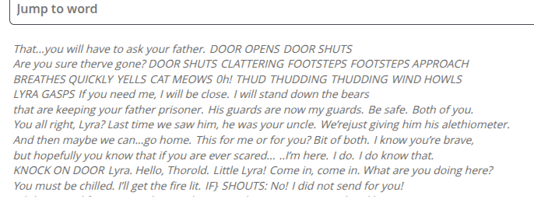
Improvements 1
Use web scraping to get more accurate transcripts – no scrolling/duplication
- transcripts will be more reliable
BBC archives also has transcripts where not available on BoB

Slide 7
Improvements 2
Much more data needed
  Need a radio source
  Entertainment as well as news
  No transcripts available on BoB – mp3 to text conversion
  Need control TV and radio sources
    Another 42 month period to compare ‘normal’ media sentiment against covid media sentiment
  May be useful to use data that didn’t pass filters

Slide 8
Improvements 3
Currently only measuring polar sentiment (just positive or negative)
Need to measure specific emotions (fear, anger, etc.)
Must utilise confidence scores as a weighting
  Currently only using pos/neg count in metrics

Slide 9
Improvements 4
Relevant headline of each month to assist user in analysing trends – vaccine rollout = increase in sentiment?

