Slide 1
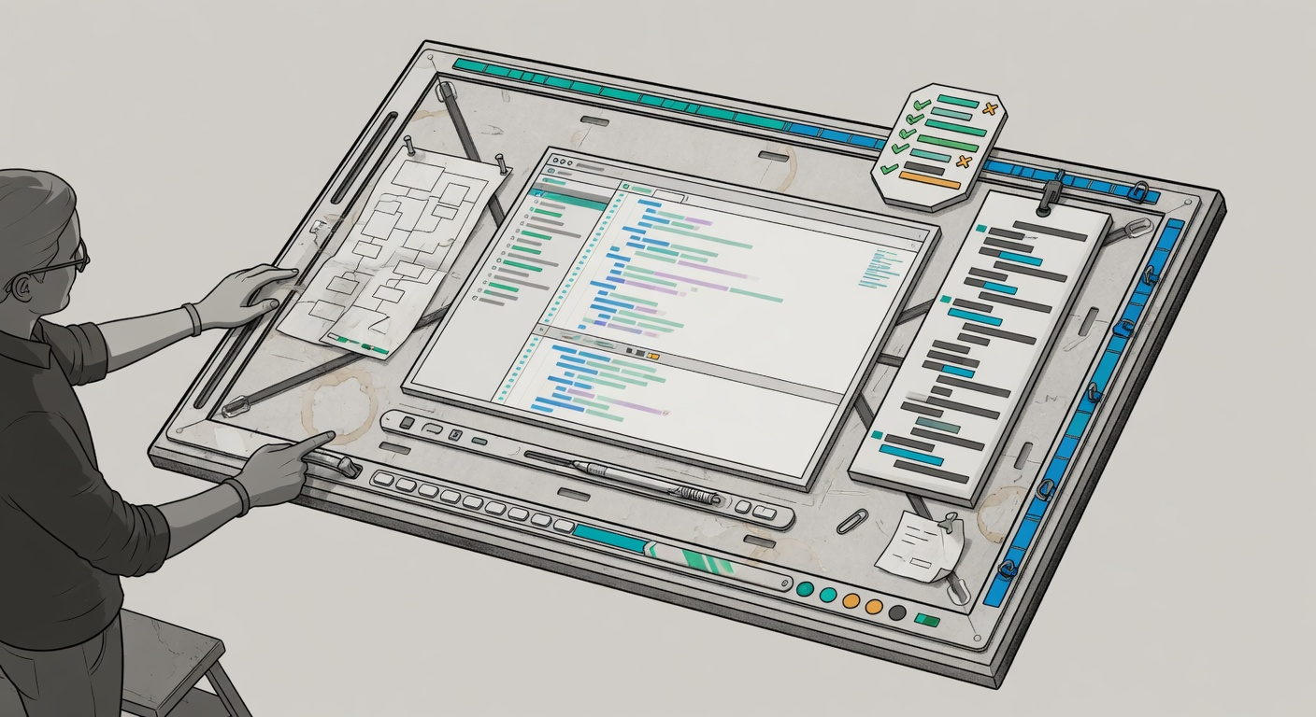
AI BASICS 102
Agent Harnesses
How teams keep Copilot useful, bounded, and reviewable.
Rules
Moves
Tools
Checks
20 minutes | VS Code + GitHub Copilot framing
01

Slide 2
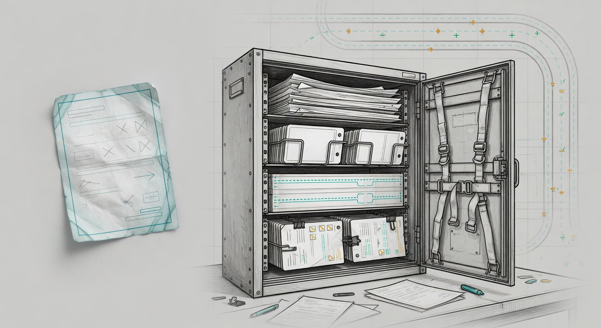
PROMPTING IS NOT ENOUGH
A good prompt helps once. A harness helps every session.
REPO HARNESS
ONE-OFF PROMPT
Instructions
Prompt, context, and steering.
Skills
Scripts
Useful once, then forgotten unless the human repeats it.
Checks
The repo should carry the rules, checks, and habits the agent should not rediscover.
The goal is not more trust. The goal is more inspectable work.
102 Agent Harnesses
02

Slide 3
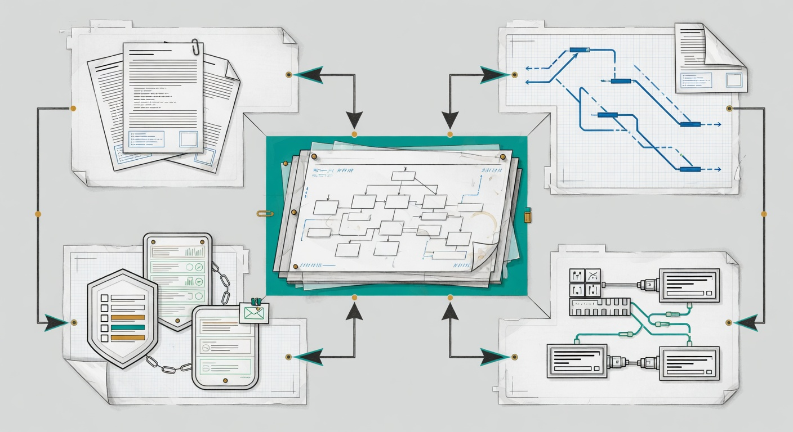
THE HARNESS MODEL
Use four pieces: rules, moves, tools, checks.
Rules
Moves
Standing instructions and boundaries.
Skills, playbooks, and team procedures.
HARNESS
Tools
Checks
A harness is the system around Copilot, not one magic prompt.
Scripts, commands, and controlled capabilities.
Tests, lint reports, diagnostics, and review.
102 Agent Harnesses
03

Slide 4
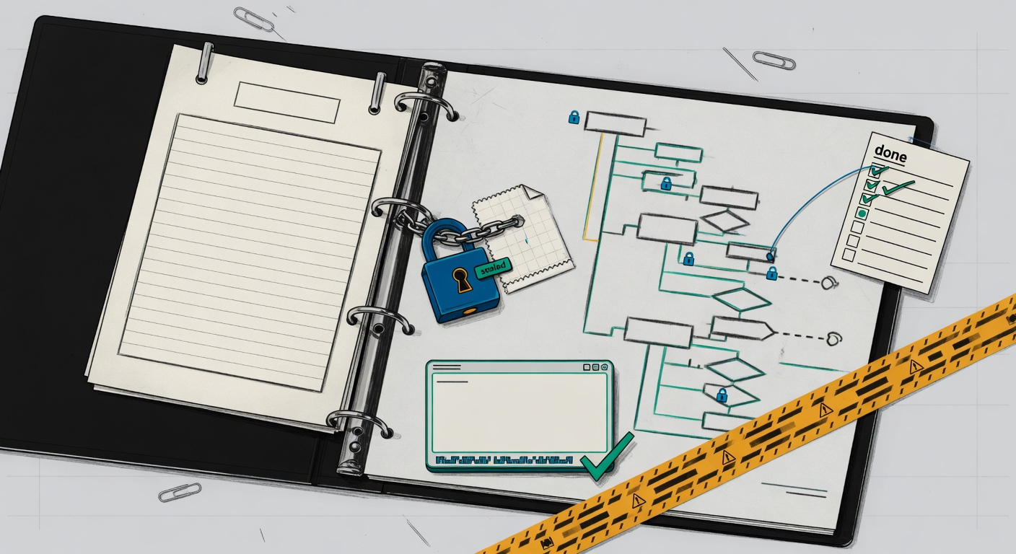
RULES: COPILOT INSTRUCTIONS
Repo instructions are standing orders.
.github/copilot-instructions.md
Write the rules the agent should not guess every time.
01
Commands
02
Conventions
Install, build, lint, test, and local checks.
Patterns, helpers, naming, errors, and logging.
03
Boundaries
04
Done
Risky paths, APIs, secrets, migrations, and deploys.
Required checks before Copilot says complete.
VS Code Docs: Copilot custom instructions | GitHub Docs: customizing Copilot responses
04

Slide 5
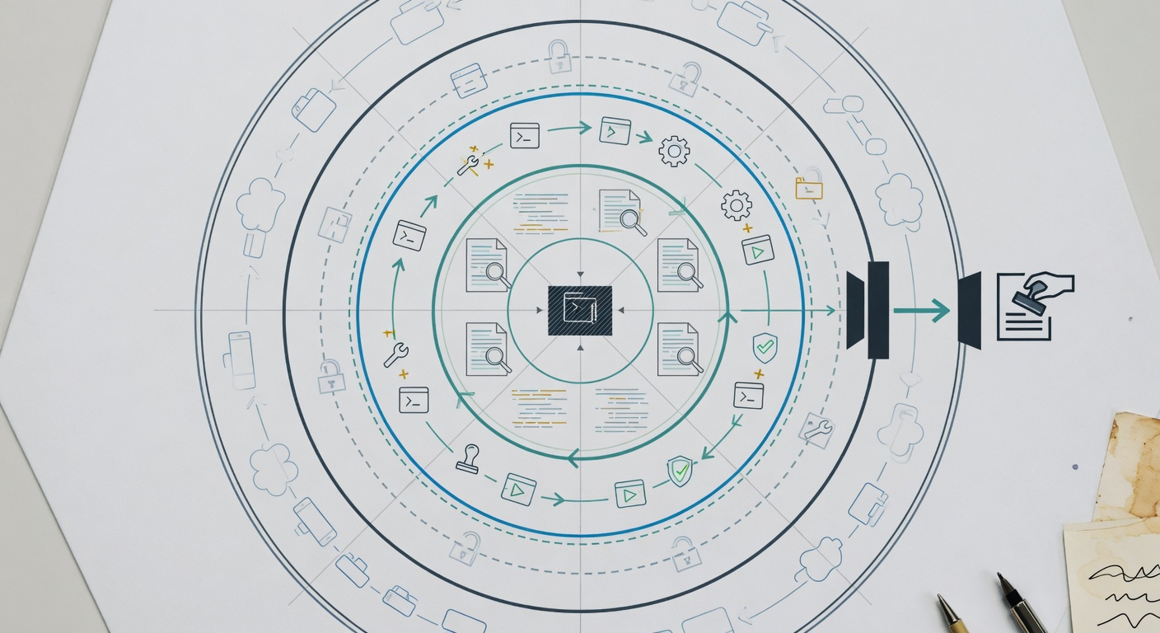
RULES: BOUNDARIES AND BLAST RADIUS
Different actions deserve different permission.
Read
Edit
Run
Ship
Files, docs, logs, issues.
Local code, tests, docs.
Allowlisted commands.
Deploys, data, merges.
Allowed
Ask first
Never alone
Read code, inspect tests, update focused local files.
Install packages, delete files, migrations, or public API changes.
Secrets, production data, releases, or protected branches.
Boundaries make Copilot safer and make the search space smaller.
102 Agent Harnesses
05

Slide 6
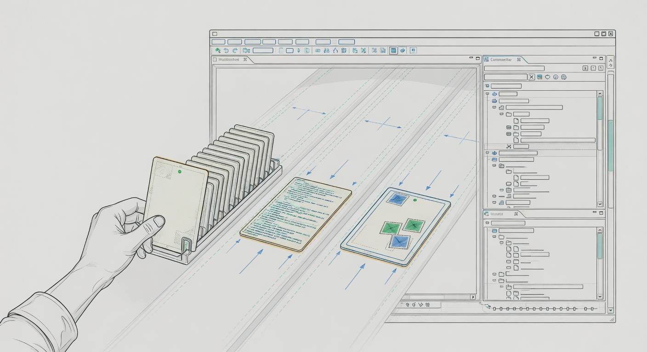
MOVES: SKILLS AND PLAYBOOKS
Skills teach repeatable moves.
Instructions define the rules. Skills define the moves.
Before coding
Stress-test the plan, scope, and missing evidence.
After coding
Diagnose the generated feature and hunt for bugs.
grill-me
diagnose
review-auth
ui-smoke
During review
Skills should be named, repeatable, and narrow enough to review.
Check auth, UI, migrations, or release notes with the team recipe.
GitHub Docs: Copilot customization cheat sheet | Matt Pocock skills repo: diagnose skill
06

Slide 7
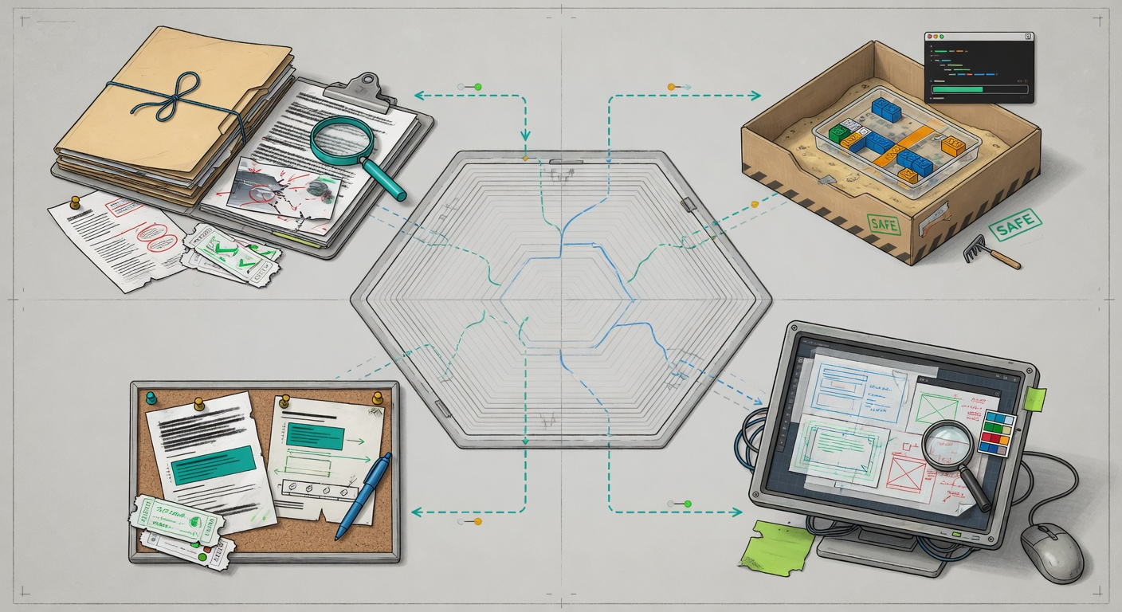
MOVES: TEAM HABITS
A harness captures how your team works.
Bug triage
Migration safety
Start with evidence, owner, repro, and one likely surface.
Dry-run first. Human approval before data-changing commands.
UI testing
PR review
Run the app, inspect the screen, capture the visual result.
Summarize evidence, behavior changes, checks, and risk.
If the team repeats a move, make it part of the harness.
102 Agent Harnesses
07

Slide 8
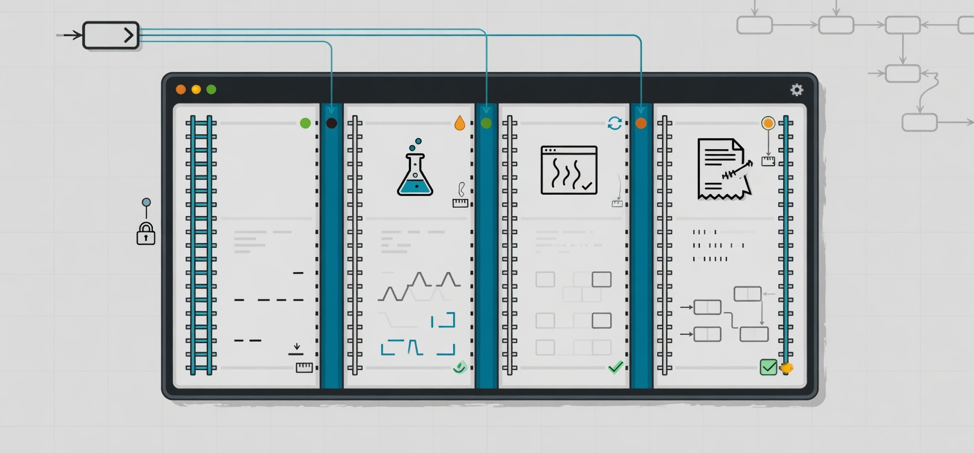
TOOLS: SCRIPTS AGENTS CAN RUN
Give Copilot safe paths through verification.
A named script is better than asking the agent to invent the right command.
npm run test:changed
Run only tests related to changed files.
npm run agent:verify
Bundle typecheck, lint report, tests, and smoke checks.
npm run smoke:local
Open the app path and confirm the main behavior still works.
npm run check:pr
Collect review evidence before merging.
102 Agent Harnesses
08

Slide 9
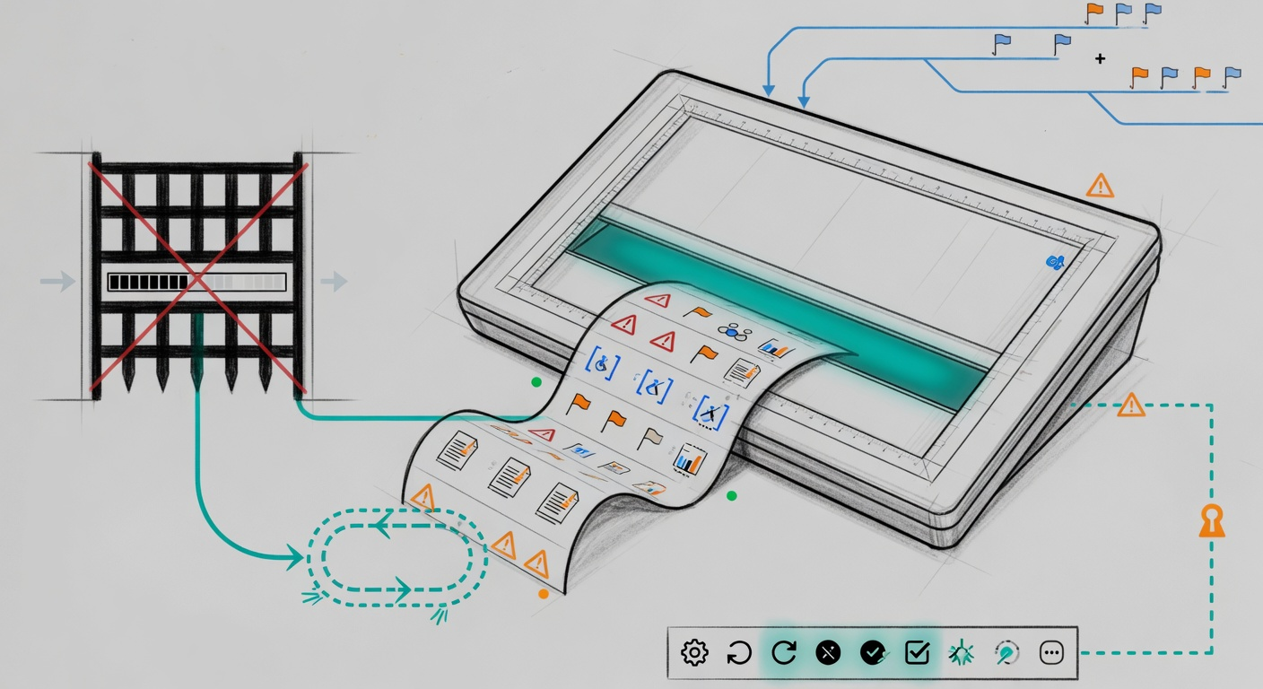
SOFT CHECKS
Warnings can be a useful middle ground.
Not every repo has hard lint gates. Agents still need feedback.
Hard gate
Soft report
Blocks merge when the repo already enforces the rule.
Returns warnings so Copilot can fix obvious issues without stopping.
Typical soft reports
unused code
unsafe any
a11y hints
slow tests
wide diff
A soft check is not permission to ignore quality. It is a way to surface quality earlier.
102 Agent Harnesses
09

Slide 10
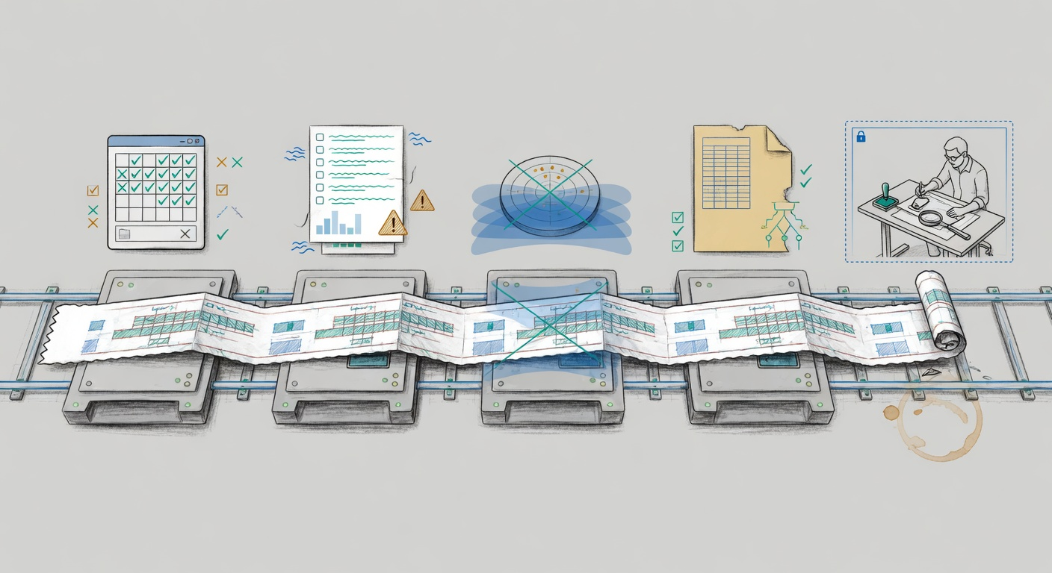
CHECKS: AFTER GENERATION
Inspect before review.
Human review starts from evidence, not from a confident summary.
01
Generate
02
Run checks
03
Diagnose
04
Report
Copilot edits code inside the task boundary.
Changed tests, soft lint, typecheck, and smoke commands.
Use a review or debug skill to look for likely bugs.
Evidence, changes, checks, gaps, and risk.
102 Agent Harnesses
10

Slide 11
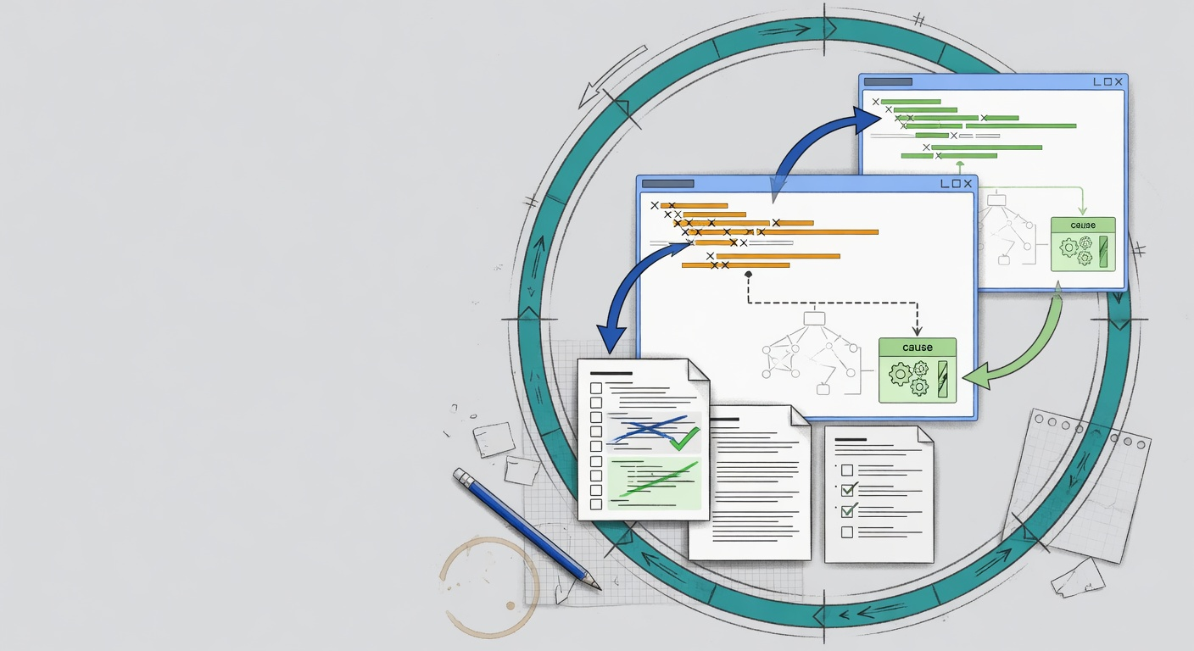
THE HARNESS LEARNING LOOP
When Copilot fails, improve the harness.
Failure
Cause
Harness fix
Next session
Missing context
Wrong command
Add an instruction or path rule.
Add or document a script.
Weak proof
Bad review
Add a focused test or smoke check.
Add checklist or diagnostic skill.
Do not only fix the prompt. Fix the system that shaped the prompt.
102 Agent Harnesses
11

Slide 12
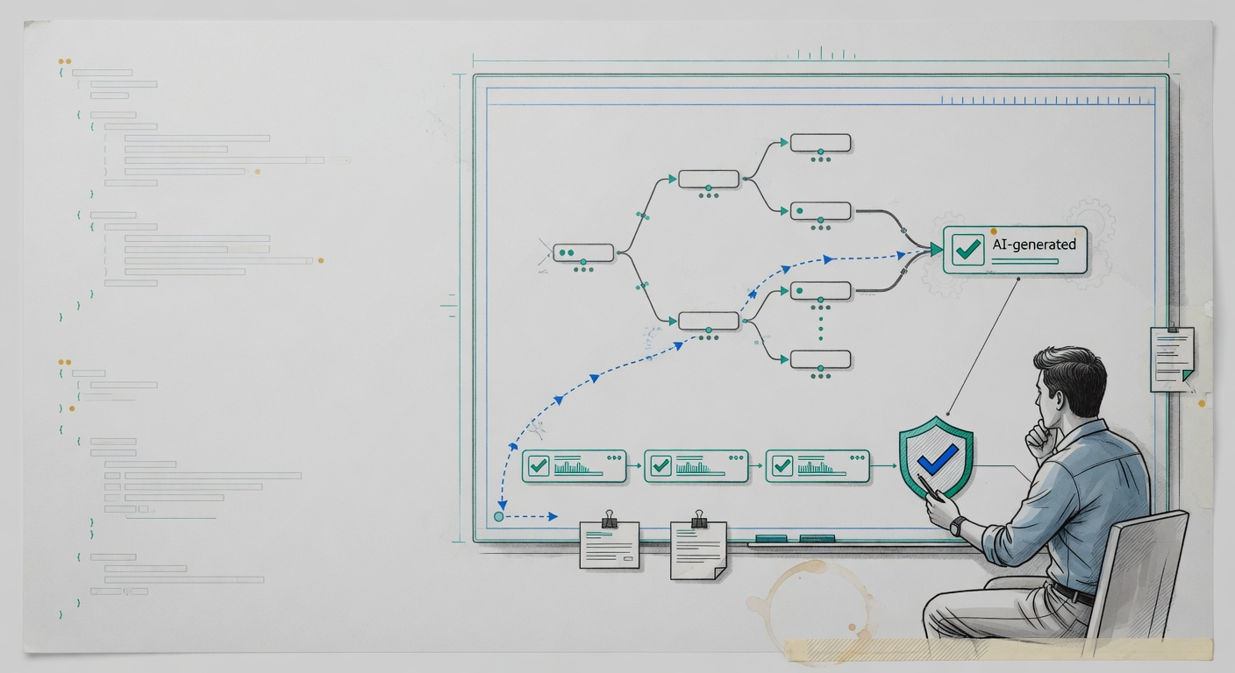
CONCLUSION
Make AI work inspectable.
Bounded
Instructions and permissions define the work area.
Visible
Skills and scripts expose the path the agent followed.
Checkable
Tests, soft reports, diagnostics, and review prove the work.
The goal is not to trust Copilot more. The goal is to make the work easier to inspect.
102 Agent Harnesses
12

Slide 13
PRESENTER APPENDIX
Fidelity Tasks VS Code demo cue
Open the Fidelity Tasks repo and show the harness parts in this order.
Rules
Moves
Copilot instructions and path-specific boundaries.
Skills/playbooks such as planning, grilling, diagnosis, and review.
Tools
Checks
Changed-test script, heavy soft-lint/report script, and smoke command.
Post-generation diagnostic pass and human review checklist.
Presenter-only slide. Not included in Ara narration.
102 Agent Harnesses
13

