Slide 1
R Markdown
Introduction and sales pitch

Slide 2
A Cautionary Tale

Slide 3
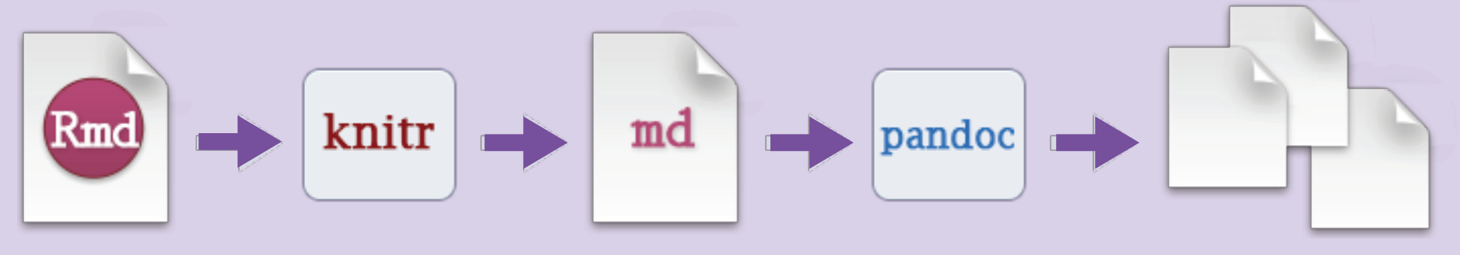
What is R Markdown?
A syntax, primarily
Readable, plain text instructions
Used in many other places, such as Stack Exchange
Informally, a set of tools baked together in R Studio to make your life easier, more organized, and more reproducible

Slide 4
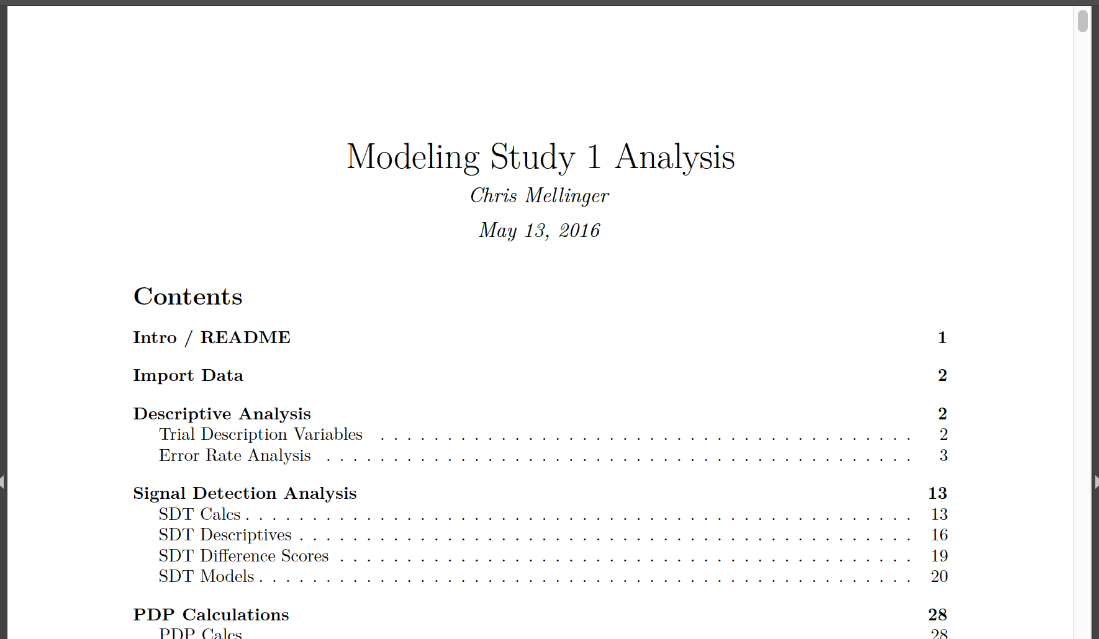
What Can You Do with R Markdown?

Slide 5
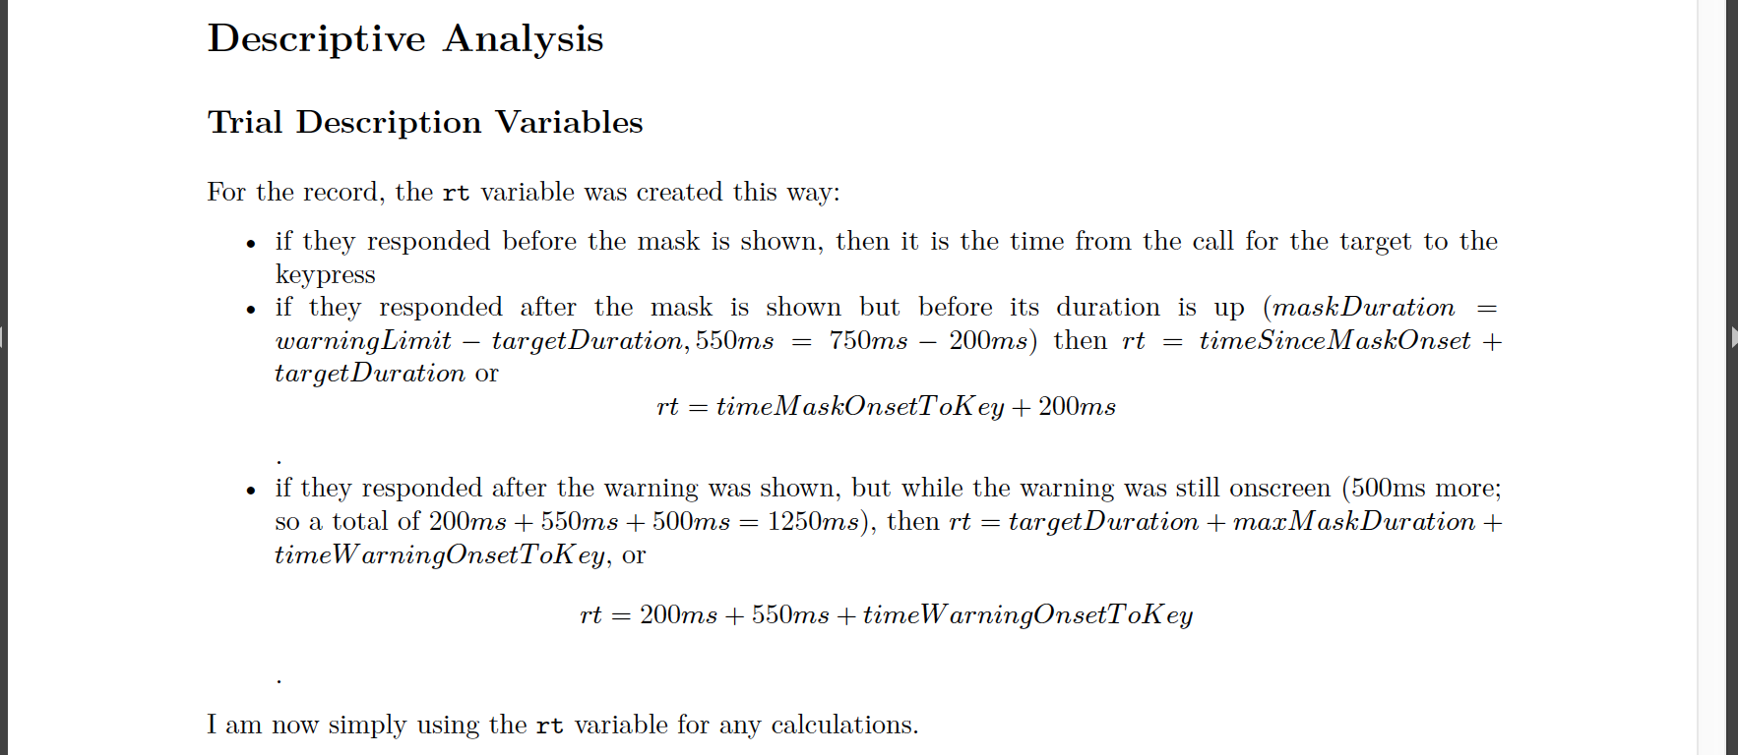
What is R Markdown?

Slide 6
What is R Markdown?

Slide 7
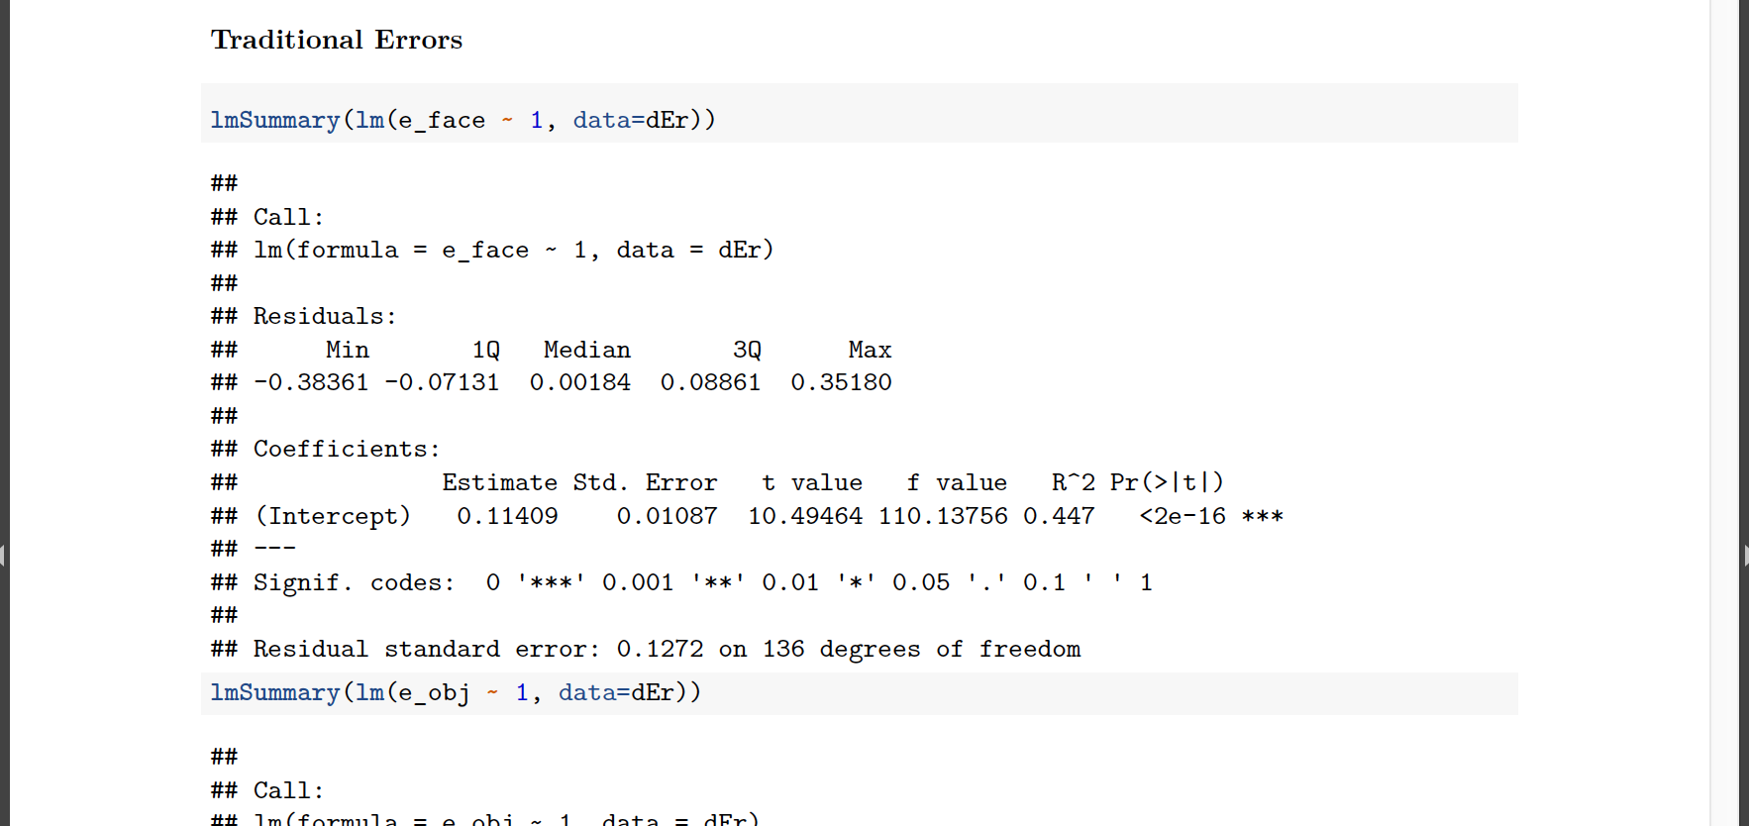
What is R Markdown?

Slide 8
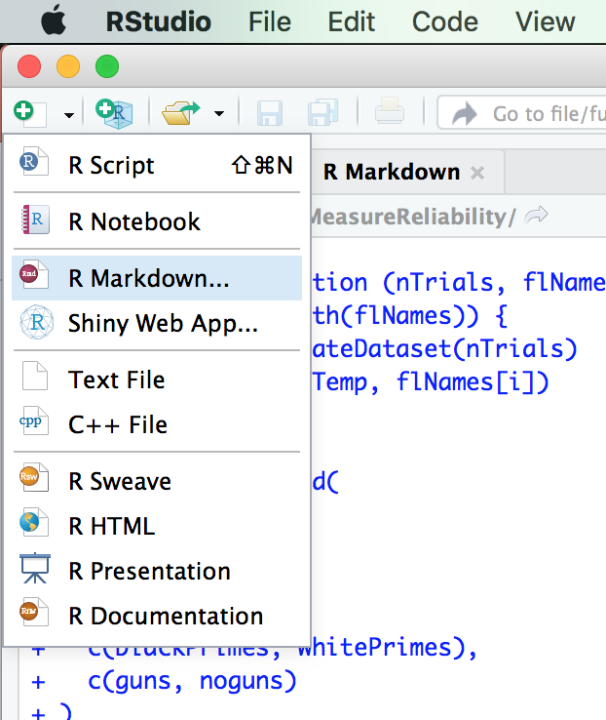
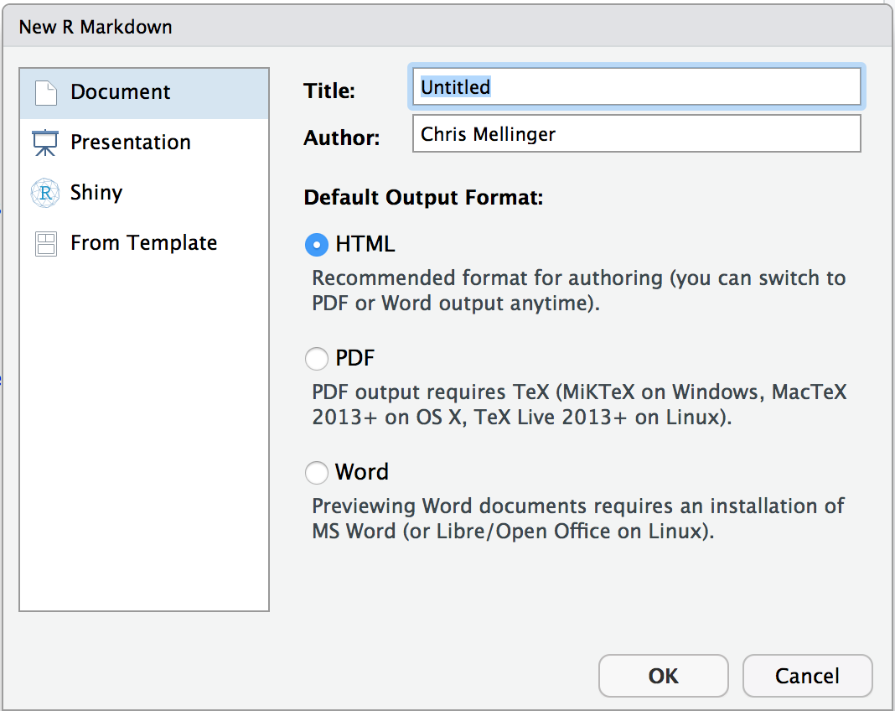
Building an R Markdown Document

Slide 9
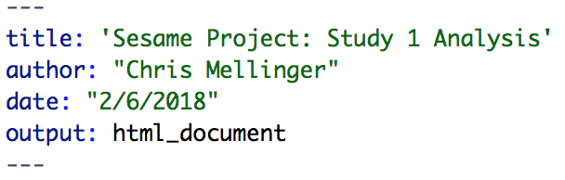
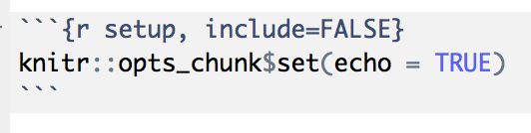
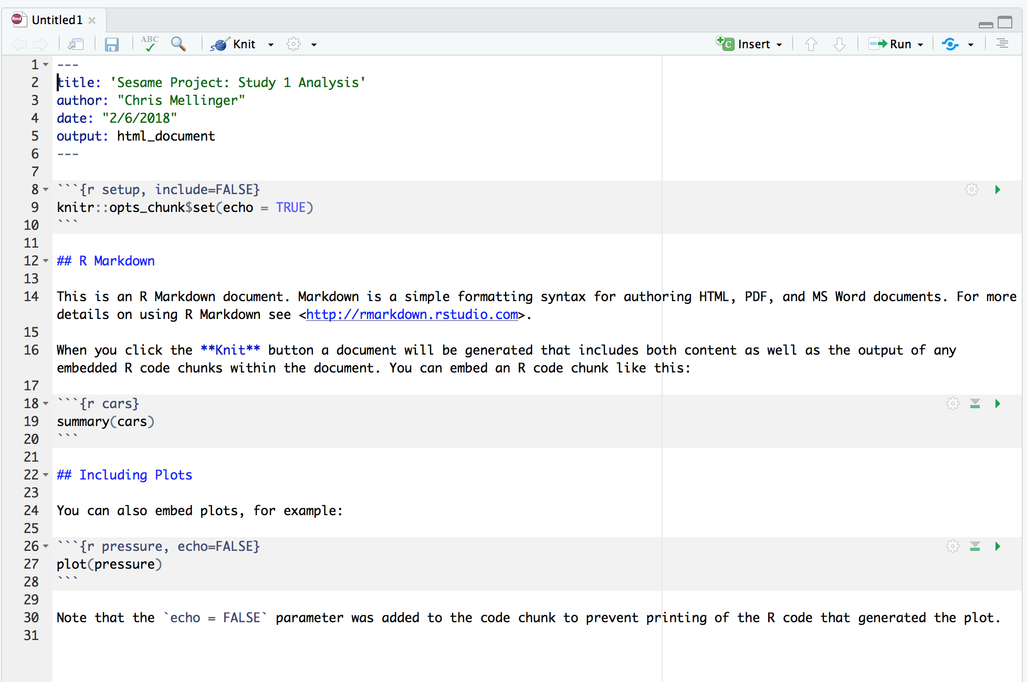


Building an R Markdown Document

Slide 10
See It For Real

Slide 11

R Markdown Processing
HTML file (text)
PDF
Word Document
Text file
Text file
R Package
External Software
(LaTeX!! If PDF)

Slide 12
R Markdown Processing
Equations and crazy math expressions?
LaTeX

Slide 13
R Markdown Processing
Controlling the way that code and its output are typeset?
Code chunk options

Slide 14
R Markdown Processing
Know and love you some good ol’ HTML?

Slide 15
How To Learn R Markdown
Go try it! Commit to doing 1 full analysis in it.
Spend about 20 minutes reading one of the excellent intro pages linked at the end of the “Practical R Markdown” document.
When things go wrong:
Consult the cheat sheet.
Consult an intro page.
Google the error.

Slide 16
Requirements For Your Computer
Have a recent version of R
Install RStudio (not technically required, but so much better)
Install Tex (large, takes a while to download, but gets you beautiful PDFs; ”mactex” is the thing to search if you use Mac)
Install the knitr package in R
Optional:
The papaja package, for APA style results and formatting
The stargazer package for making quick tables
The xtables package for making (not-so-quick) flexible tables
Download the RStudio cheatsheets for packages you use and for R Markdown

