Slide 1
R Markdown
A practical introduction

Slide 2
A Cautionary Tale
A conscientious researcher collects a large dataset. In his first pass, he simply opens the data file in Excel. He calculates a few statistics in Excel, some of which are relevant to one of his graduate student’s projects. He copies and pastes the relevant columns (variables) into a separate Excel document and sends it via email to his graduate student. The student cleans the data, and does her best to record the participants she removed in a separate word document. Meanwhile, the researcher also performs some data cleaning, but keeps less detailed notes than his student. He publishes his analyses in a well-known journal.
A year later, a post doc is investigating a question relevant to the study. He requests the data from the researcher, who happily hands it over. However, the post doc cannot replicate a key finding which was published from the original study. The researcher digs into his project folder and finds three different data files, two different sets of participant exclusions, and little other documentation.

Slide 3
A Happier Ending
A researcher collects a large dataset, and stores it in a single raw file on the OSF website. He writes a pre-processing script to do his initial pass, but realizes later that he needs to clean the data. Instead of changing the data file, he adds a data cleaning section to his analysis script, and is able to replicate his analysis with the cleaned data in a single button press. He uploads the analysis script to the OSF website. He publishes his findings in a well-known journal.
He gives access to his student and his post doc via the OSF website. In addition, the analysis script with the cleaning procedures is available to both via the same project site. The student is able to use his code to precisely replicate the cleaned data, and do her own analyses. The post doc, though he uses different analysis software, is also able to translate the cleaning code into his own analysis script, replicating previous findings and producing a transparent analysis record in the process.

Slide 4
This talk is…
Part sales pitch, part tutorial
Not comprehensive
Posted here: https://github.com/Cmell/BBMarkdownTalkSpring2018

Slide 5
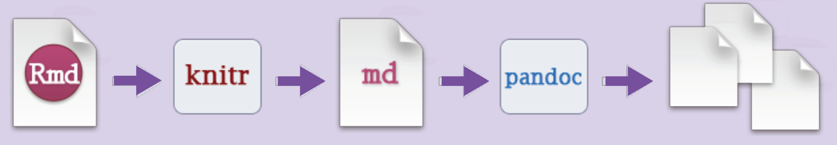
What is R Markdown?
A syntax, primarily
Readable, plain text instructions
Used in many other places, such as Stack Exchange
Informally, a set of tools baked together in R Studio to make your life easier, more organized, and more reproducible

Slide 6
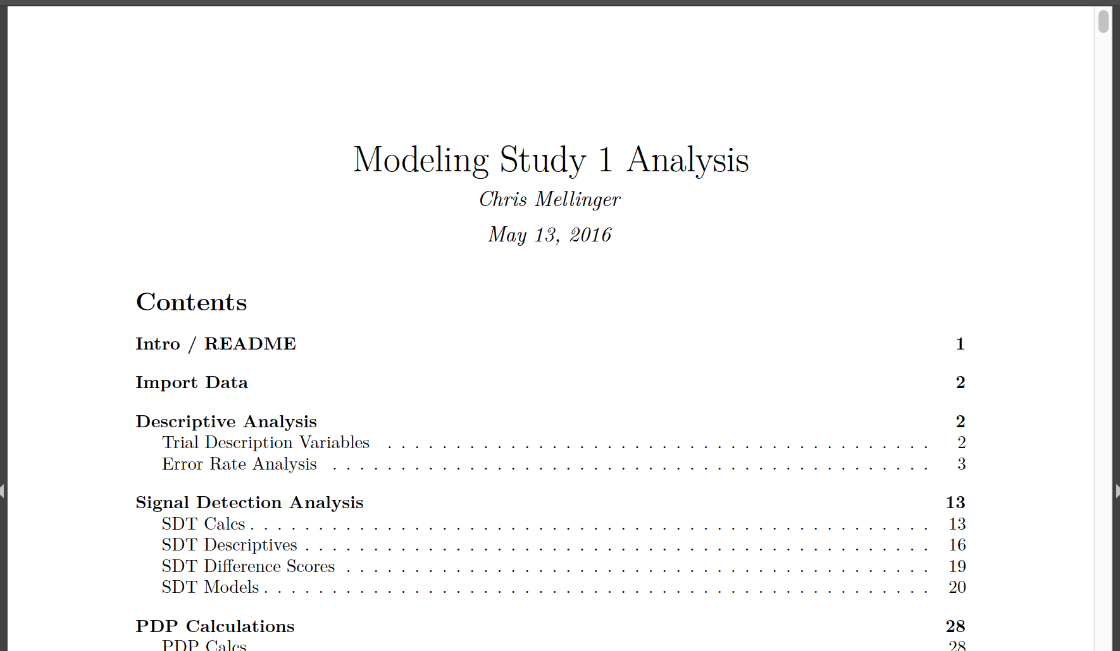
What Can You Do with R Markdown?

Slide 7
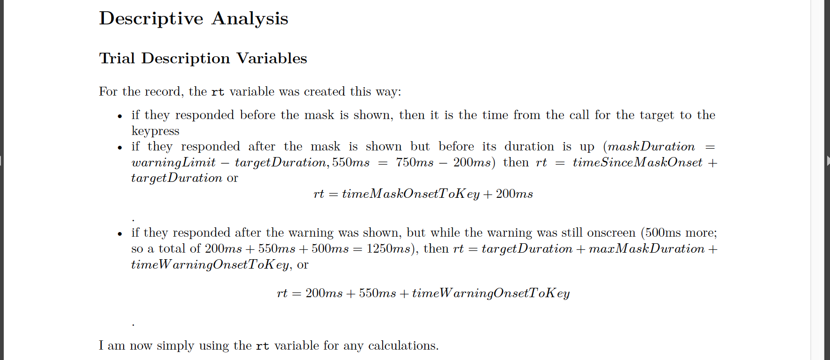
What Can You Do with R Markdown?

Slide 8
What Can You Do with R Markdown?

Slide 9
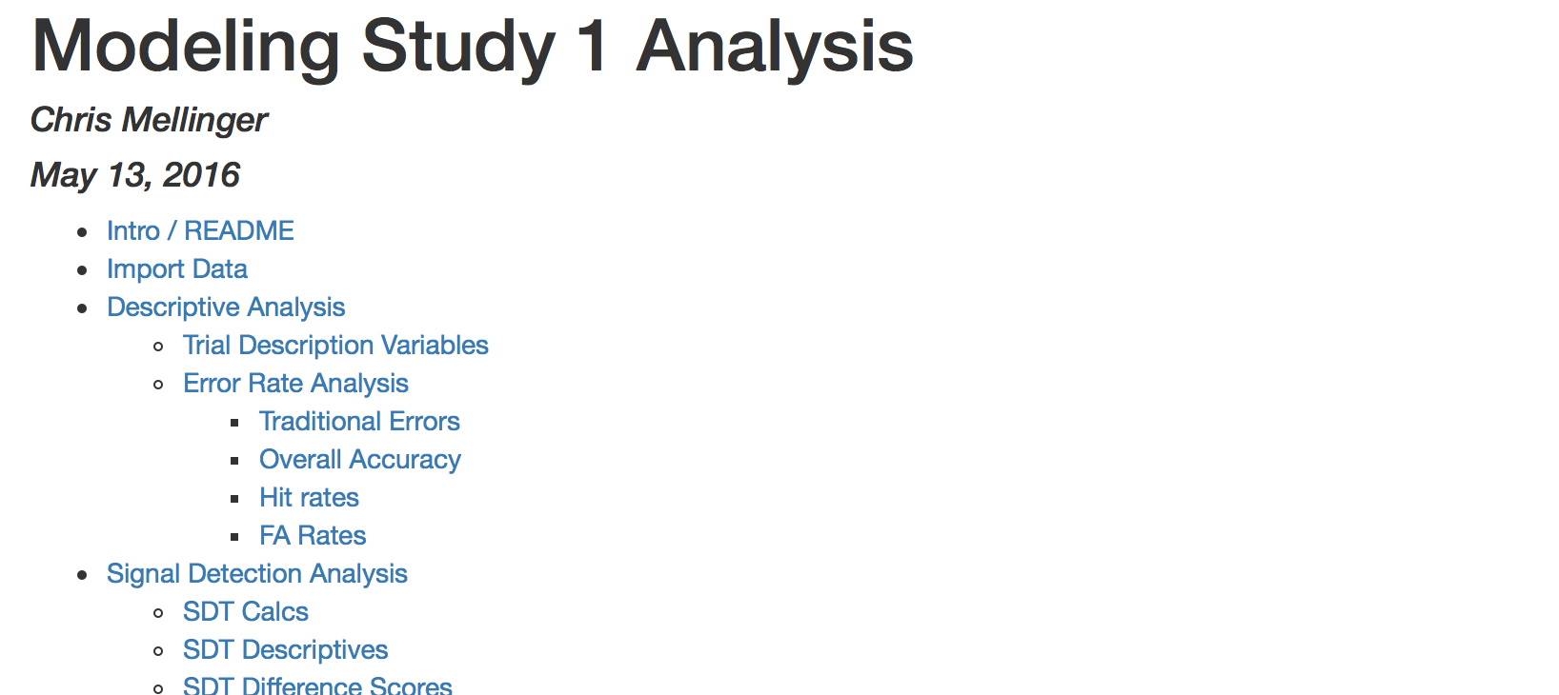
What Can You Do with R Markdown?

Slide 10
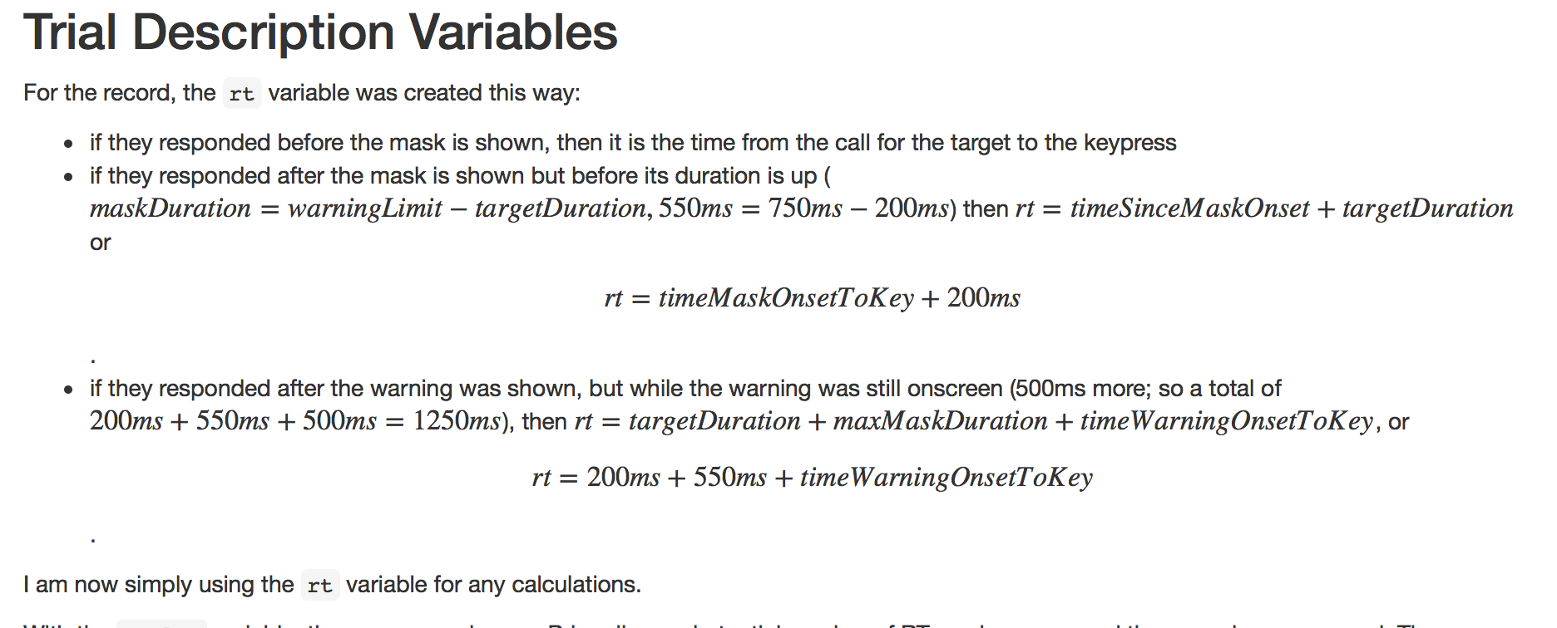
What Can You Do with R Markdown?

Slide 11
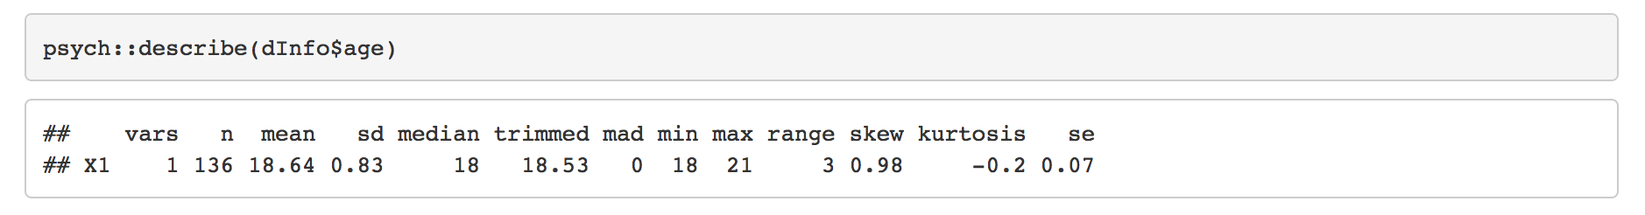
What Can You Do with R Markdown?

Slide 12
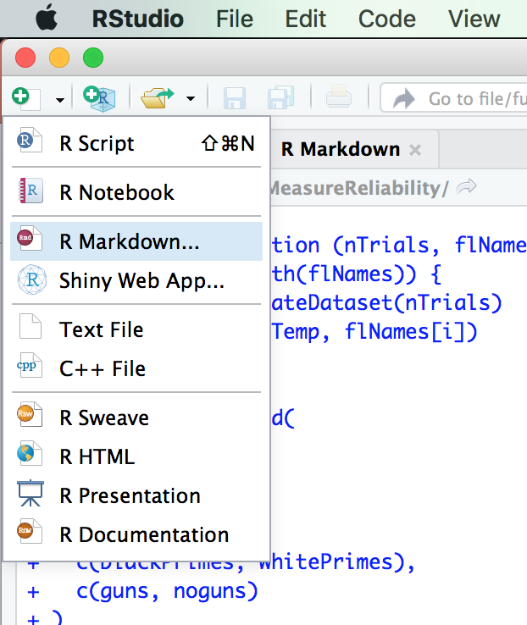
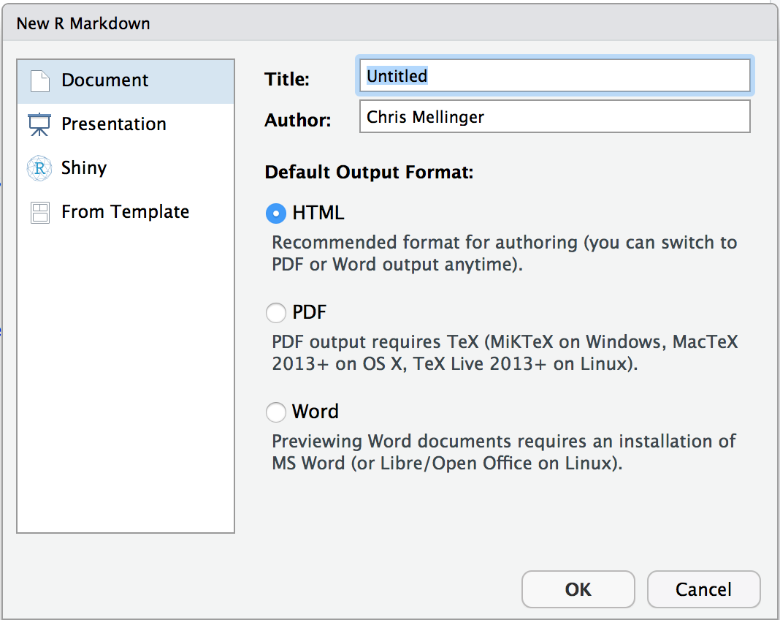
Building an R Markdown Document

Slide 13
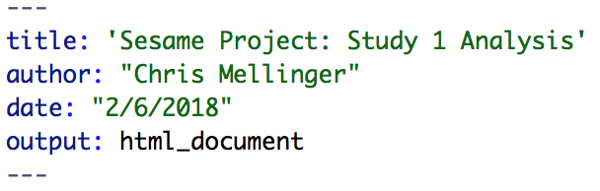
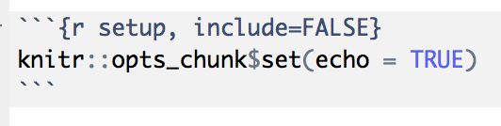
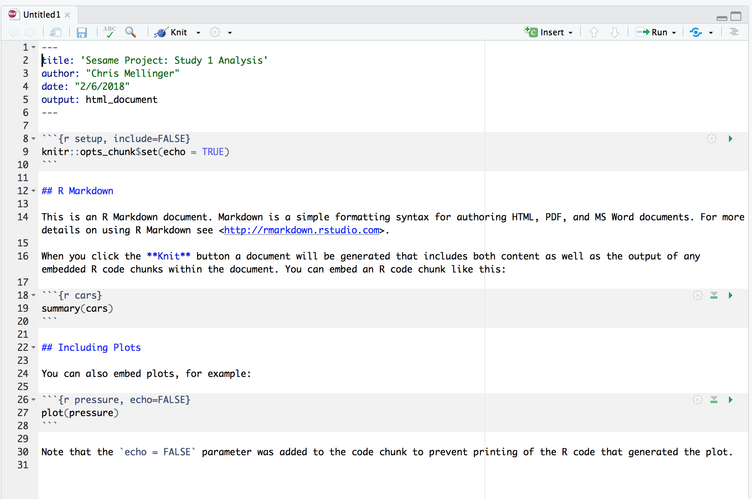


Building an R Markdown Document

Slide 14
See It For Real

Slide 15

R Markdown Processing
HTML file (text)
PDF
Word Document
Text file
Text file
R Package
External Software
(LaTeX!! If PDF)

Slide 16
R Markdown Processing
Equations and crazy math expressions?
LaTeX

Slide 17
R Markdown Processing
Controlling the way that code and its output are typeset?
Code chunk options

Slide 18
R Markdown Processing
Know and love you some good ol’ HTML?

Slide 19
Other Cool Things About R Markdown
Knitting run a fresh R session, increasing reproducibility
R Notebooks are even more responsive than R Markdown pure
R Presentations can make presentations that are dynamic and flexible, just like R Markdown documents (but learning curve!)
It is possible to run other programming languages in code chunks, like Python
It is possible to create APA formatted documents (for submission even) with templates

Slide 20
Other Cool Things About R Markdown
Automatic citation and bibliography generation are possible
Works extremely well with version control software (VCS) such as git and github!
There are alternatives for other languages, for example, Jupyter (see http://jupyter.org/)

Slide 21
How To Learn R Markdown
Go try it! Commit to doing 1 full analysis in R Markdown.
Spend about 20 minutes reading one of the excellent intro pages linked at the end of the “Practical R Markdown” document.
When things go wrong:
Consult the cheat sheet.
Consult an intro page.
Google the error.
Drop by my office.

Slide 22
Requirements For Your Computer
Have a recent version of R
Install RStudio (not technically required, but so much better)
Install Tex (large, takes a while to download, but gets you beautiful PDFs; ”mactex” is the thing to search if you use Mac)
Install the knitr package in R
Optional:
The papaja package, for APA style results and formatting
The stargazer package for making quick tables
The xtables package for making (not-so-quick) flexible tables
Download the RStudio cheatsheets for packages you use and for R Markdown

