Slide 1
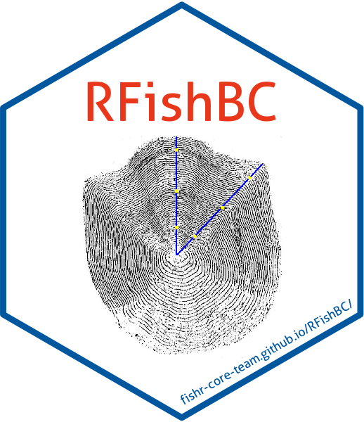
Intro and Demo
Taylor Cubbage, M.Sc.
Package created by Derek Ogle, Ph.D.

Slide 2
What is RFishBC?
Package to replace FishBC software
Import hard structure photos
Annotate and measure annuli on photos
Compare annuli measurements between readers
Transfer annuli measurements to .csv files
Use standard models to back-calculate fish lengths at age
And more!

Slide 3
General workflow
Make directory containing
.csv file of data about fish to be examined
fish ID, length at capture, location, date, etc.
Photos of hard structures for each individual
Saved as JPG/JPEG, PNG, BMP, TIFF/TIF
Named informatively, e.g. structure_fishID.jpeg = otolith_F42.jpeg
Image preferably has scale bar of known length for reference

Slide 4
General workflow
Make R script to age structures and specify
Who is aging the structure?
Is the margin of the structure an annulus or was the fish caught during growth?
What length is the scale bar and what units of measurement?
How many individuals to age at a time?
Mark annuli measurements on hard structures!
Save annuli measurements as a .csv file, compare among readers

Slide 5
General workflow
Combine age and annuli measurement data with fish data
Use built in models, or your own model, to back-calculate fish lengths at age
Go forth and use your back-calculated length data for the good of Alaska’s fisheries!

Slide 6
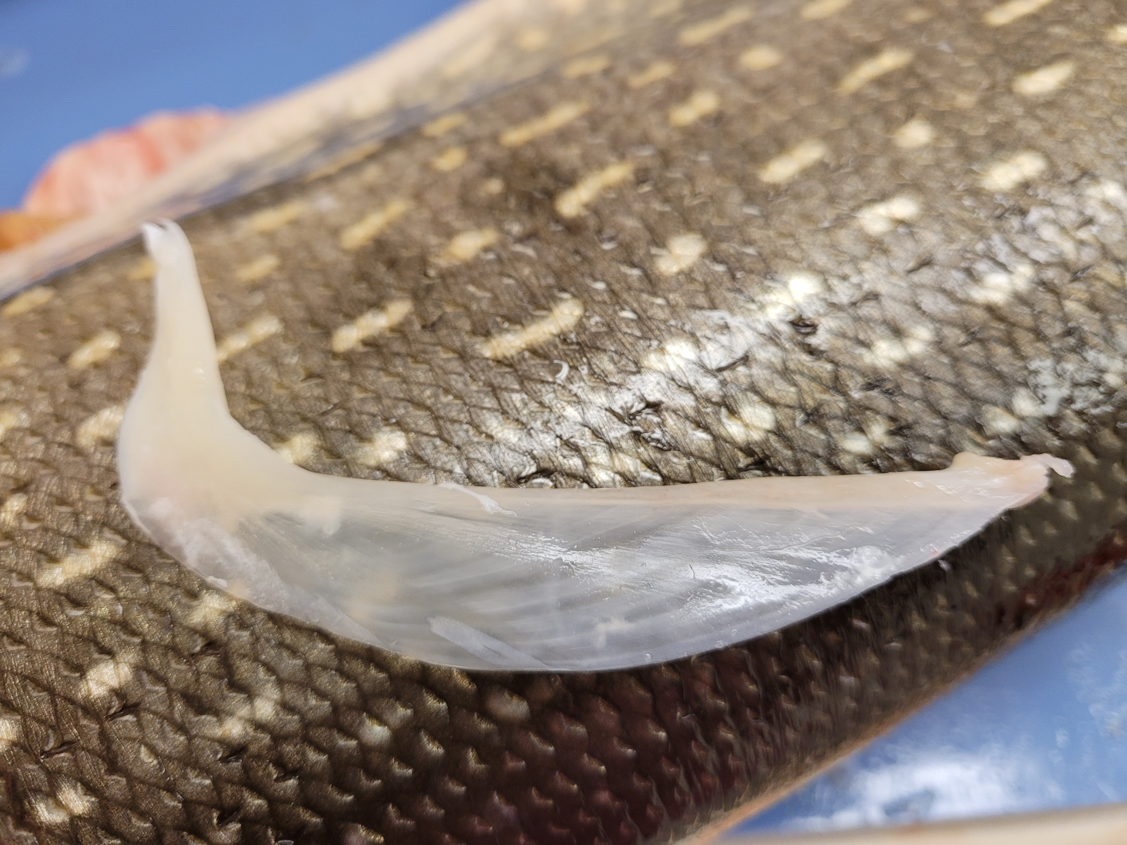

My use
Graduate project – compare physiology of invasive/native pike in Alaska
Collect cleithra from pike (preferred aging structure for esocids)
Age each pike and measure cleithral radii
Back-calculate lengths at age for each individual
Estimate growth rates at age for each individual
Compare growth rates among populations

Slide 7
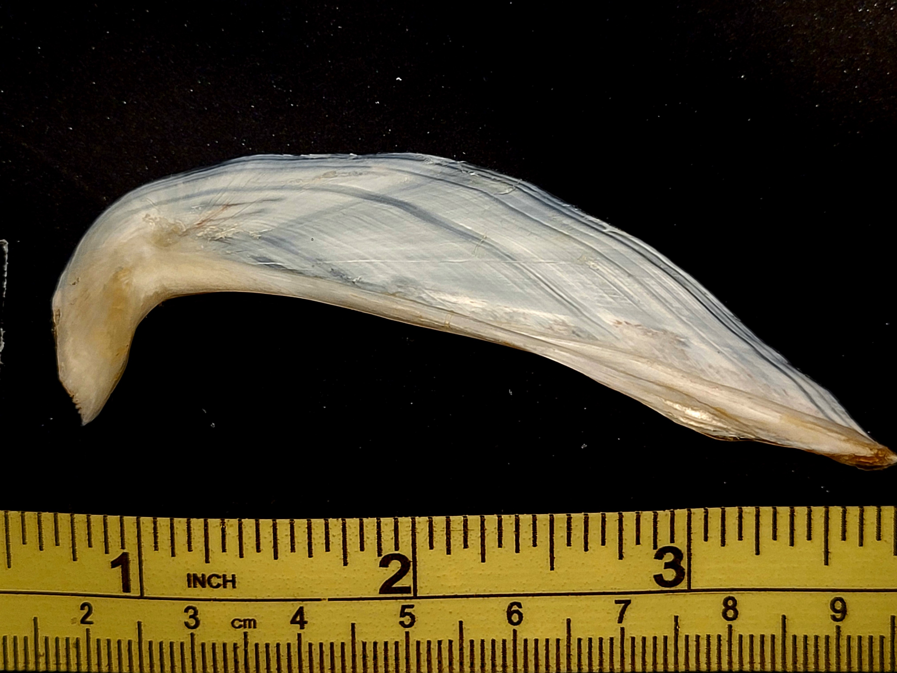
My use
Collect pike, measure length at time of capture, dissect and clean cleithra
Take photos of cleithra
Rename photos as:
Cleithra_fishID.jpeg
Make R script to age and measure cleithral radii

