Slide 1
CIRCLE LOGISTICS
Carrier Database
Your intelligent carrier management platform — carrier profiles, lane history, live loads, and smart matching, all in one place.
96
406
100%
5
Carriers
Active Loads
Real-Time Sync
Preferred
carrierdatabasev2.netlify.app

Slide 2
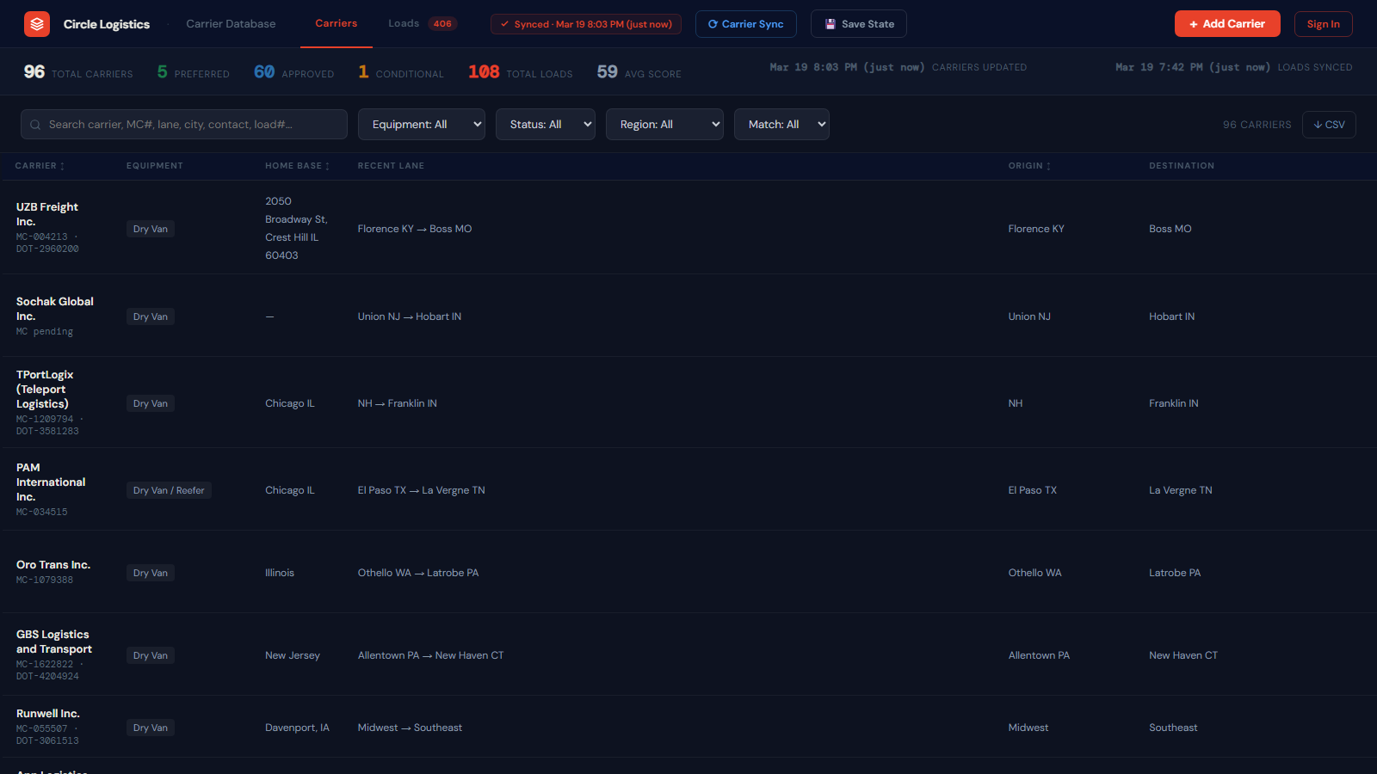
OVERVIEW
What Is the Carrier Database?
📋 Central Carrier Hub
All 96 carriers in one searchable, filterable list — MC#, DOT, equipment, lanes, and performance.
🔄 Live & Always Synced
Carriers and loads update in real time. Any team member sees the same data instantly.
🔍 Powerful Search & Filters
Search by name, MC#, city, lane, or dispatcher. Filter by equipment, status, and region.
📊 Performance Scoring
Every carrier has a 0–100 reliability score based on on-time pickup, delivery, and claims history.
Access: carrierdatabasev2.netlify.app · Sign in with your @circledelivers.com Google account

Slide 3
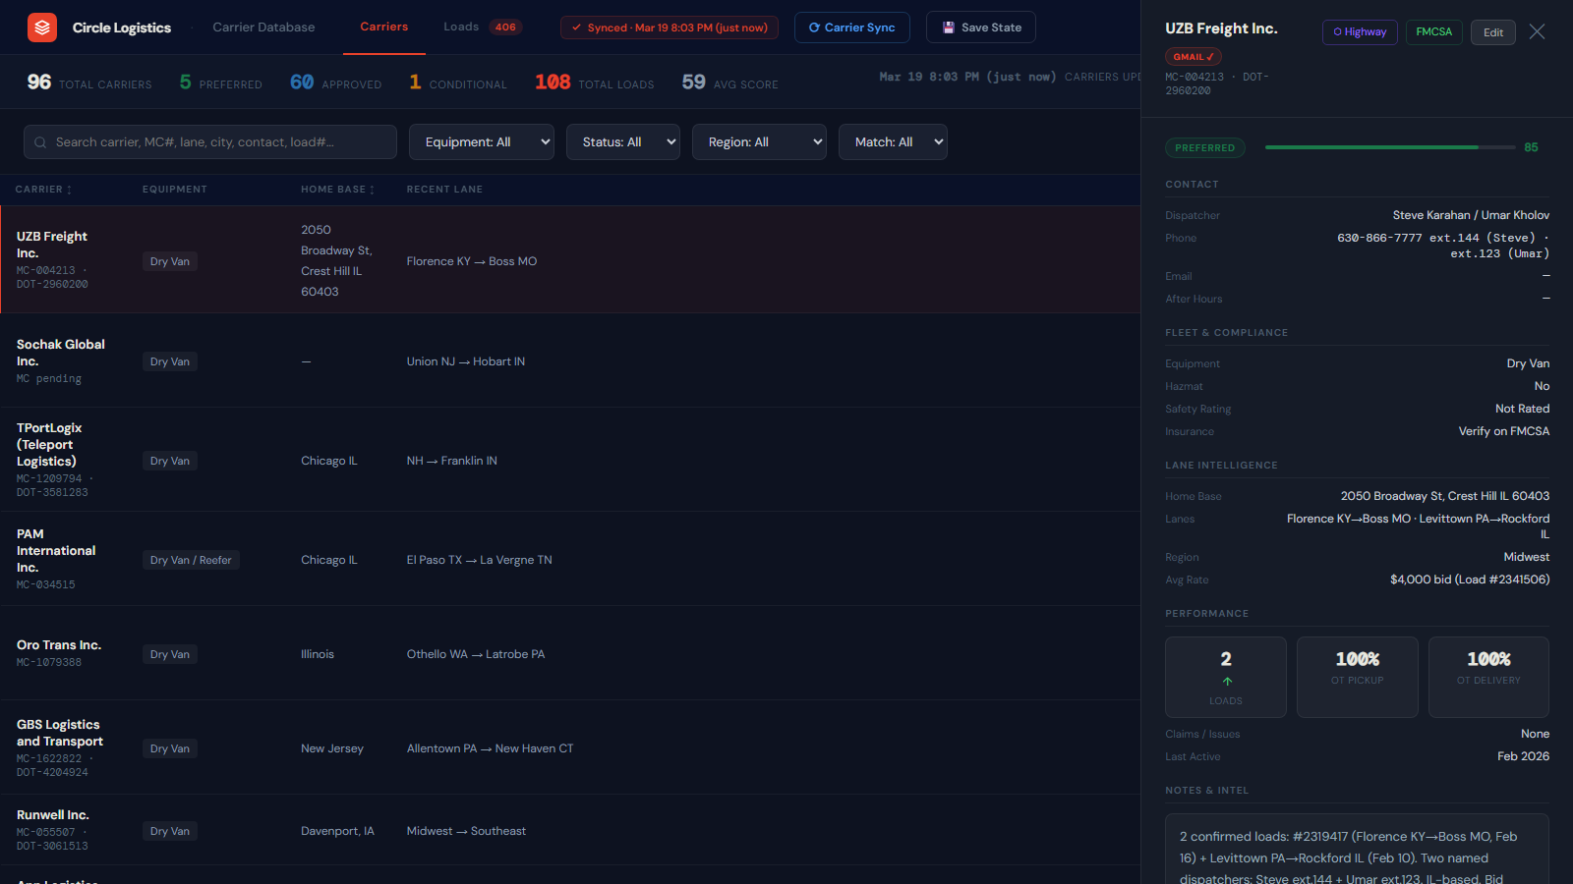
CARRIER PROFILES
Click Any Carrier — See Everything
Status Badge
Fleet & Compliance
Preferred, Active, Conditional, or Do Not Use — color-coded at a glance.
Equipment type, hazmat cert, FMCSA safety rating, and insurance.
Reliability Score
Lane Intelligence
0–100 score with visual bar. Green = trusted, amber = watch list.
Home base, preferred lanes, region, and historical rate anchor.
Dispatcher Contacts
Performance Stats
Names, direct extensions, email, and after-hours numbers.
Loads run, on-time pickup %, on-time delivery %, and claims.
Highway · FMCSA · Edit buttons are available in every carrier profile header

Slide 4
CARRIER PROFILES · INTELLIGENCE LAYER
Notes, Call Prep & Load History
📝 Editable Notes
Click any note field and type — saves automatically on blur. No button to press.
📞 Call Prep Talking Points
Auto-generated from real data: last active date, rate anchor, score tier, and relationship cues.
📦 Load History
Every load this carrier has run with Circle — route, date, and outcome status.
📡 Data Source Audit
Shows exactly where data came from: Gmail rate confirmations, Book Now emails, or manual entry.
All profile changes sync instantly across every logged-in team member.

Slide 5
SMART MATCHING
Smart Load Matching — Inside Every Carrier Profile
How Matching Works
Lane Alignment
1
Compares carrier's origin/destination states against every open load.
Equipment Match
2
Only shows loads the carrier can actually run (Van, Reefer, Flatbed, etc.).
Score Ranking
3
Results sorted by reliability score — most trusted carriers surface first.
Strong vs. Possible
4
Strong Match = same state pair hauled before. Possible = adjacent lanes.
Matched loads link into carrier load history when their status is updated

Slide 6
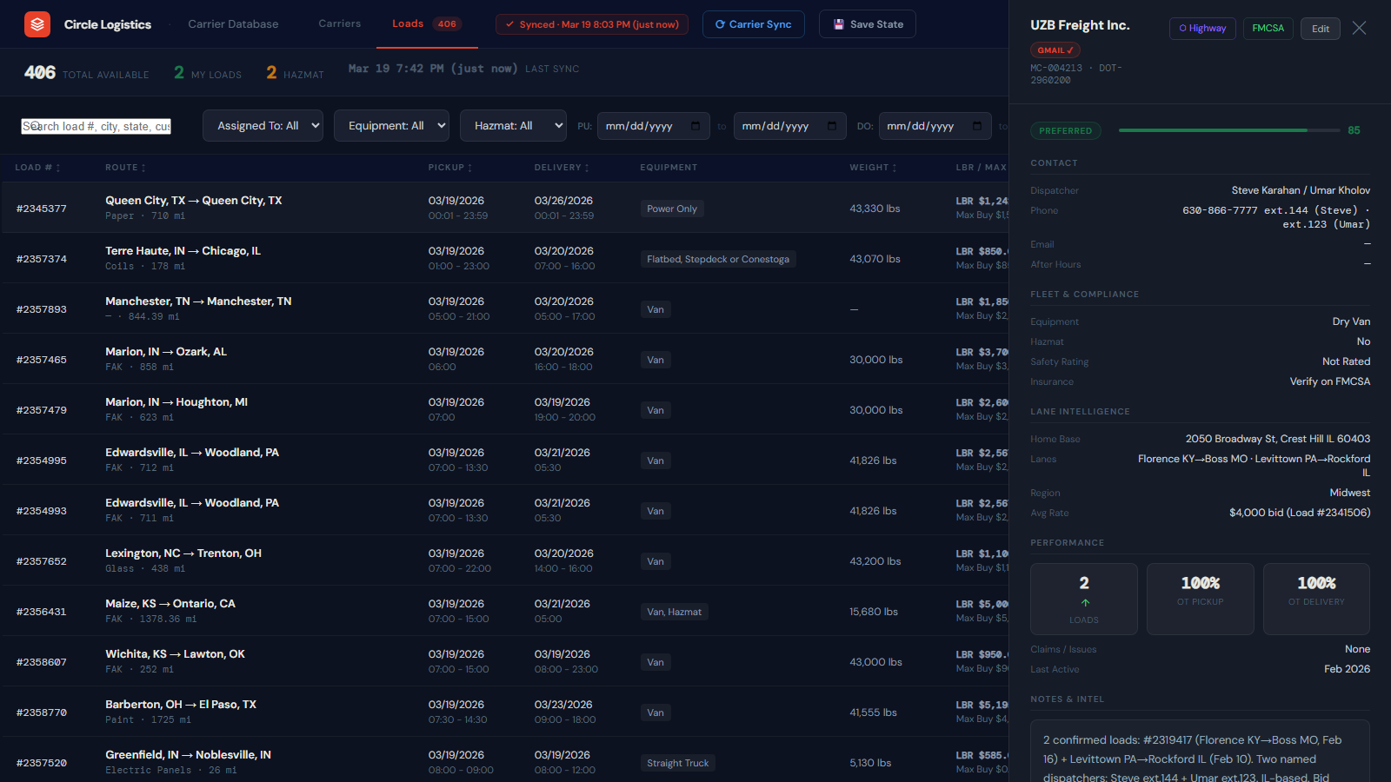
LOADS TAB
Live Freight Board — 406 Active Loads
Route + miles
Pickup & delivery windows
Equipment type
Weight (lbs)
LBR rate + Max Buy
Hazmat flag
Filter by date / equipment
Upload .htm or .pdf

Slide 7
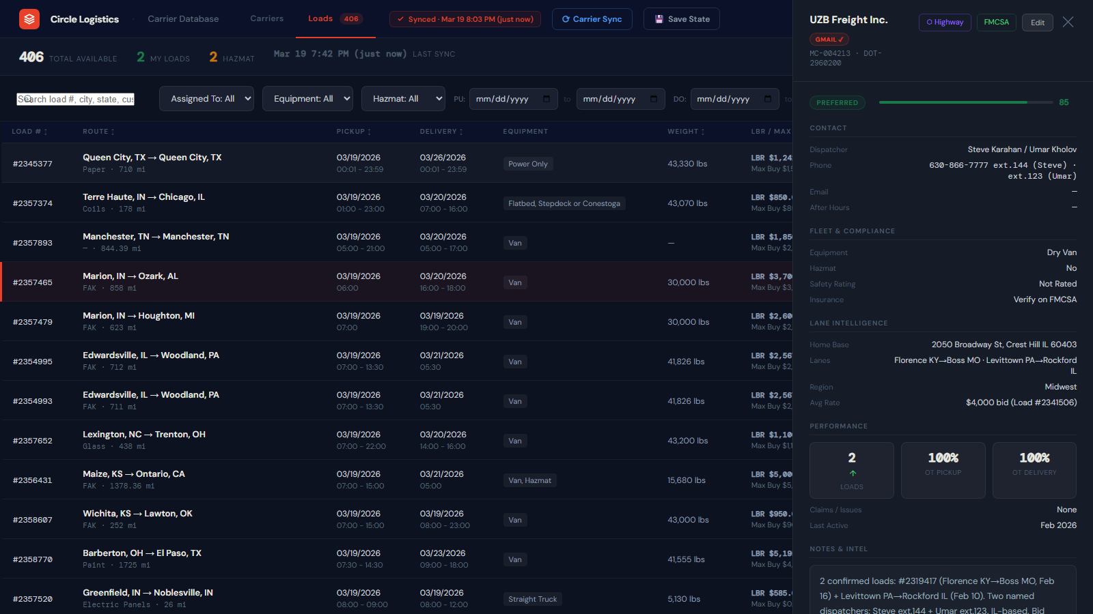
LOAD DETAIL PANEL
Click Any Load — Carrier Matches Appear Instantly
Load Details Panel
Best Carrier Matches
Route · pickup/delivery windows · customer · commodity · weight · miles · LBR rate · max buy · spread · $/mi
Top 5 carriers pre-ranked by lane fit and reliability score. Click Highway to open their safety profile instantly.
LBR vs Max Buy — see spread instantly
$/mile — rate efficiency at a glance
Top 5 Carriers — pre-ranked for this lane
Highway Button — 1-click compliance check

Slide 8
GMAIL SYNC · TEAM LOGIN
Automatic Carrier Data from Your Inbox
How Carrier Sync Works
Team Login — Google SSO
"Book Now Dispatch" Emails
🔐
Sign In with Google
1
Scans TMS emails for every new carrier booking — route, dispatcher, phone, lane, pickup/delivery.
Click "Sign In" in the top bar. Use your @circledelivers.com or @circlelogistics.com account.
Rate Confirmation Threads
📧
Connect Your Gmail
2
Cross-references MC numbers and carrier contact details from rate confirmation emails.
Once signed in, your Gmail is connected. The next Carrier Sync scans your inbox too.
Auto-Creates Carrier Profiles
👥
See Who's Connected
3
New carriers appear automatically. Existing carriers are updated with fresh lane data.
Click your avatar → "Gmail Users" to see all connected team members and their last sync time.
Press "Carrier Sync" Anytime
🔔
Admin Notifications
4
Hit the blue "Carrier Sync" button to manually trigger a fresh scan of all connected inboxes.
Conrad gets an email when anyone signs in or a sync runs — with a full results summary.

Slide 9
QUICK START
How to Use the Carrier Database
Find a Carrier
Work a Load
1
Go to the Carriers tab
1
Click the Loads tab (406 available)
2
Search by name, MC#, city, or lane
2
Filter by equipment, date, or hazmat
3
Filter by equipment, status, or region
3
Click a load row to open details
4
Click any row to open the full profile
4
Scroll — carrier matches appear below
Add a New Carrier
Verify Carrier Safety
1
Click "+ Add Carrier" in the top bar
1
Open any carrier profile
2
Fill in MC#, contact, equipment, lanes
2
Click "Highway" — vetting dashboard opens
3
Save — visible to all team members
3
Click "FMCSA" — check DOT safety record
4
Run Carrier Sync to fill data from Gmail
4
Update status: Active, Preferred, or DNU

Slide 10
CIRCLE LOGISTICS
One platform.
Every carrier.
Always current.
Sign in now →
carrierdatabasev2.netlify.app
Use your @circledelivers.com or @circlelogistics.com Google account
96 Carriers
406 Live Loads
Gmail Auto-Sync

