Slide 1
INTEGRATED CROP PROTECTION SYSTEM
PIP2001 Capstone Project
Review-0
Batch Number:70
Under the Supervision of,
Dr./Mr./Ms./Prof. Serin V Simpson
Professor / Associate Professor / Assistant Professor
School of Computer Science and Engineering
Presidency University
Roll Number | Student Name
20211CSE0801 | VAISHNAVI M
20211CSE0822 | KUSUMA B
20221LCS0020 | YAMUNA A K
Name of the Program: CSE
Name of the HoD: Dr. Asif Mohammed H.B
Name of the Program Project Coordinator: Mr. Amarnath J.L & Dr. Jayanthi K.
Name of the School Project Coordinators: Dr. Sampath A K / Dr. Abdul Khadar A / Mr. Md Ziaur Rahman

Slide 2
Content
Problem Statement
GitHub Link
Analysis of Problem Statement
Timeline of the Project
References

Slide 3
Problem Statement Number:
Organization: Agriculture and Rural Development
Category (Hardware / Software / Both) : Software
Problem Description: AgroDoc is an app which uses state of the art deep learning techniques to help farmers optimize farming techniques. AgroDoc has multiple features like Disease Detection, Crop Recommendations, Fertilizer suggestions..
Difficulty Level: Simple

Slide 4
GitHub Link
The GitHub link provided should have public access permission
https://github.com/Cmsproject03/7th-capstone-project

Slide 5
Analysis of Problem Statement
Technology Stack Components:
Disease Detection (using images of crops)
Deep Learning Frameworks:
TensorFlow : For building Convolutional Neural Networks (CNNs) to classify and detect plant diseases.
Pre-trained Models:
EfficientNet : These models can be fine-tuned for plant disease detection using transfer learning.
Image Dataset:
Use datasets like PlantVillage for training and validation.
Cloud Services:
Google Cloud AI Platform : For scalable training and deployment

Slide 6
Analysis of Problem Statement (contd...)
2.Crop Recommendations (based on soil, weather, etc.)
Machine Learning Algorithms:
Gradient Boosting Machines: For crop prediction based on historical data.
• Deep Learning:
LSTMs for time series forecasting (e.g., predicting weather patterns or seasonal variations)
Data Sources:
Weather APIs like OpenWeatherMap, Soil APIs, and government agricultural data.
• Feature Engineering:
Use geospatial data for location-specific crop recommendations

Slide 7
Analysis of Problem Statement (contd...)
3. Fertilizer Suggestions
Recommender Systems:
Build a collaborative filtering model using TensorFlow Recommenders to suggest fertilizers based on soil health, crop type, and weather.
• Soil Health Prediction:
Use Support Vector Machines (SVMs) to predict soil quality based on input data.
• IoT Integration:
Use sensors (Raspberry Pi) for real-time soil health monitoring.

Slide 8
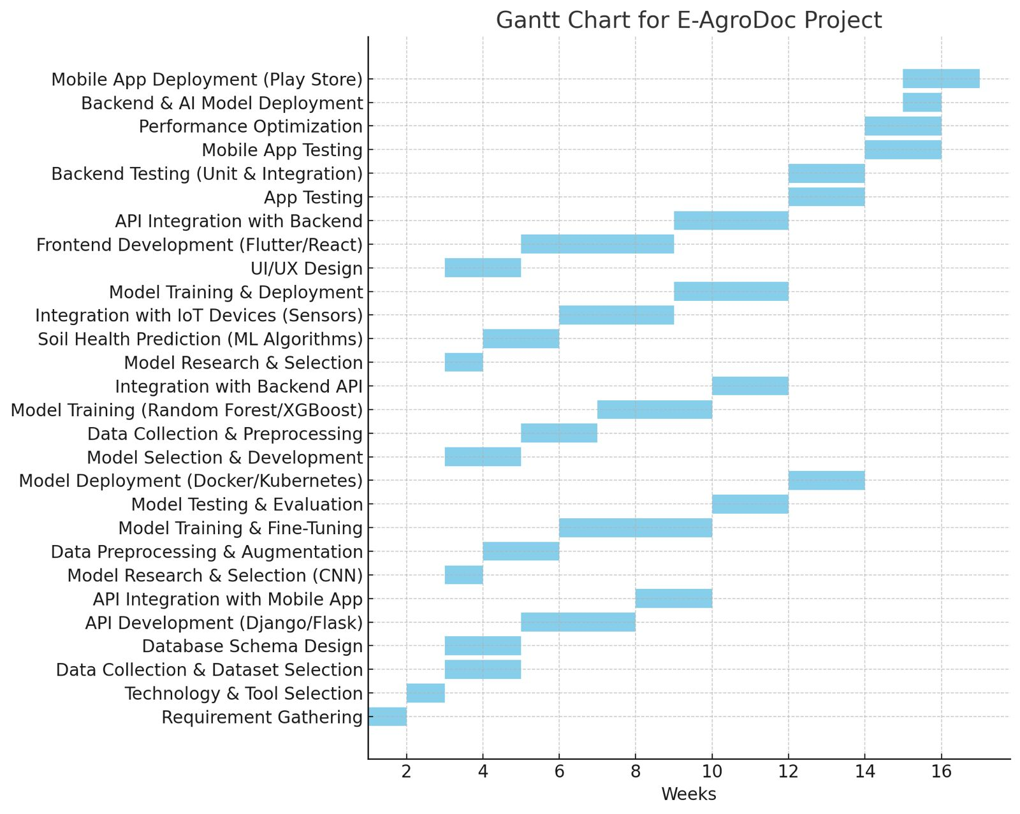
Timeline of the Project (Gantt Chart)

Slide 9
REFERENCES
http://www.fao.org/in-action/integrated-crop-management

Slide 10


