Slide 1
PIP2001 Capstone Project VIVA-VOCE
INTEGRATED CROP PROTECTION SYSTEM
Batch Number:69
Under the Supervision of,
Dr. / Mr. Serin V Simpson
Assistant Professor
School of Computer Science Engineering
Presidency University
Names | Roll Number
VAISHNAVI M | 20211CSE0801
KUSUMA B | 20211CSE0822
YAMUNA A K | 20221LCS0020
Roll Number | Student Name

Slide 2
Introduction
Purpose: AgroDoc is a mobile app that uses advanced deep learning to help farmers improve their farming techniques.
Features:
- Disease Detection: Identifies crop diseases using image analysis.
- Crop Recommendations: Suggest suitable crops based on local conditions.
- Fertilizer Suggestions: Recommends the best fertilizers for optimal crop growth.
Goal: To empower farmers with useful tools and insights for healthier crops and more sustainable farming.

Slide 3
Literature Review
Paper Name | Problem Addressed | Solution Proposed | Drawbacks | Limitations
"Sustainable Pest Management" (Smith et al., 2015) | Increasing pesticide resistance and environmental degradation | Adoption of integrated pest management (IPM) strategies including biological controls, crop rotation, and reduced pesticide use | Biological control may not be effective in all climates | Needs high farmer knowledge and continuous monitoring
"Crop Protection through Agroecology" (Brown et al., 2016) | Conventional farming causing biodiversity loss | Incorporation of agroecological practices into crop protection such as habitat diversification | Incorporation of agroecological into crop protection such as habitat diversification | Requires local adaptation and ecological knowledge
"Biological Control in IPM" (Johnson et al., 2017) | Over-reliance on chemical pesticides leading to resistance | Use of natural predators and parasitoids in pest control | Unpredictable efficiency in different environmental conditions | Sensitive to ecological imbalance and requires time to establish
"Digital Tools in Precision Agriculture" (Martinez & Lee, 2018) | Lack of precision in pest and disease detection | Utilization of drones and sensor technologies for real- time monitoring | High initial cost and technical know-how | Not accessible for small-scale farmers

Slide 4
Research Gaps Identified
Disease Detection
No data: All the models built for disease detection are based on large data that is not available for most crops or even in a region. It prevents them from generalizing if the plants and diseases are less represented.
Environmental factors: Most of the techniques developed to date are not environmentally friendly and take into consideration factors like temperature, humidity, and quality of soil that play a very crucial role in disease formation and detection.
Crop Recommendation Systems
Lack of personalization: Crop recommendation models in general are based on data that is not fully particularized for the unique needs of an individual farmer, yet more relevant, specific conditions under which a given field stands, such as prior yields or soil health.
Most of the existing models have not considered changing climate patterns that affect crop suitability over time.
Dynamic Data Integration: Most systems treat static data and are not updated in real-time by novel weather events, soil properties, or market conditions.
Fertilizer Recommendation Systems
Nutrient Profile Limitations: Current models mainly recommend the three major nutrients N, P, and K and almost completely ignore the other nutrients, calcium and magnesium, and the micronutrients
Soil Degradation: Many of the above models fail to account for the period-dependent degradations that the soil undertakes.

Slide 5
Proposed Methodology
AgroDoc Solution Overview:
Integration of Deep Learning: AgroDoc employs state-of-the-art deep learning techniques, particularly Convolutional Neural Networks (CNNs), for tasks like disease detection and crop classification, enhancing accuracy and efficiency in identifying agricultural issues.
Modules:
Disease Detection Module: This module utilizes a CNN model trained on a diverse dataset of plant images to identify diseases early. This allows for timely interventions, minimizing crop loss.
Crop Recommendation Module: Incorporates machine learning algorithms to analyze soil conditions, climate data, and local agricultural practices, providing personalized crop suggestions tailored to specific regions.
Fertilizer Suggestion Module: Analyzes soil health data to recommend optimized fertilizer usage, improving crop yield while minimizing environmental impact. This module aims for sustainable agriculture by ensuring efficient nutrient application.
User-Friendly Interface: Designed with farmers in mind, AgroDoc features a mobile-friendly interface that makes it accessible for users with varying levels of technological expertise

Slide 6
Objectives
Enhance Disease Detection Accuracy: Implement deep learning algorithms, particularly CNNs, to achieve high accuracy in identifying plant diseases from images. This aims to minimize crop losses by enabling early intervention.
Provide Personalized Crop Recommendations: Utilize machine learning to analyze various parameters such as soil health, climate conditions, and local agricultural practices, allowing farmers to receive tailored crop suggestions that maximize yield potential.
Optimize Fertilizer Usage: Develop a recommendation system that analyzes soil data and crop requirements, ensuring efficient fertilizer application to enhance productivity while promoting sustainability and reducing environmental impact.
Increase Accessibility of Technology: Design an intuitive mobile application that simplifies the use of advanced agricultural technology for farmers, addressing the digital divide and making it easier for small-scale farmers to access crucial information.
Integrate Real-Time Data for Informed Decision-Making: Incorporate real-time weather updates and market trends into the app, empowering farmers to make timely and informed decisions regarding crop management and sales.

Slide 7
System Design & Implementation
System Overview:
A mobile or web application this interacts with farmers, gathering data from the them and processing it using the Machine Learning models to yield actionable insights as regards disease diagnosis, crop suggestions, and fertilizer recommendation. It can be cloud hosted for scalability and to secure data.
2. Component of the System:
- User Interface (UI)
• Mobile app or Web app (Cross-platform framework like Flutter for mobile, React for web)
• Capture image of plants, input soil conditions, and fetching recommendations
• Push notifications and alerts for disease outbreaks and seasonal crop recommendations Backend
• User Details Database, Raw Input, Crop Historical Data, etc.
- Data Storage
• Image storage: Cloud Storage, such as AWS.
• Crop and Soil Information Storage: Relational such as PostgreSQL
• Historical data storage: This will be to track User recommendations and disease outbreaks
- Machine Learning Models
• Disease Detection Model: Deep learning-based CNN with TensorFlow for image classification
• Crop Recommendation Model: Utilizing soil conditions, climate, location, and season

Slide 8
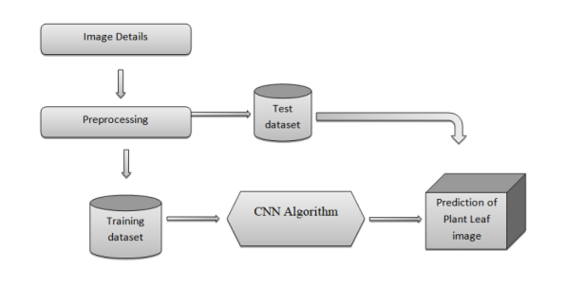
- System Design Architecture
i. Frontend (Web App) Web application development using React:
• Capture images to identify diseases
• Forms to provide soil information and crop requirement
• Crop and fertilizer recommendations
• Optional Chatbot feature to guide the farmer
ii. API & Processing API Layer:
• API Gateway (Node.js) to process requests
• Authentication (JWT-based for secure login)
• Routing for different services (disease detection, crop/fertilizer recommendation)

Slide 9
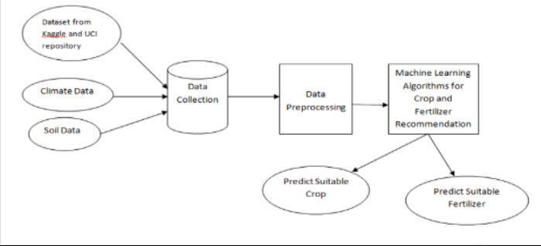
System Architecture for crop and fertilizer recommendation

Slide 10
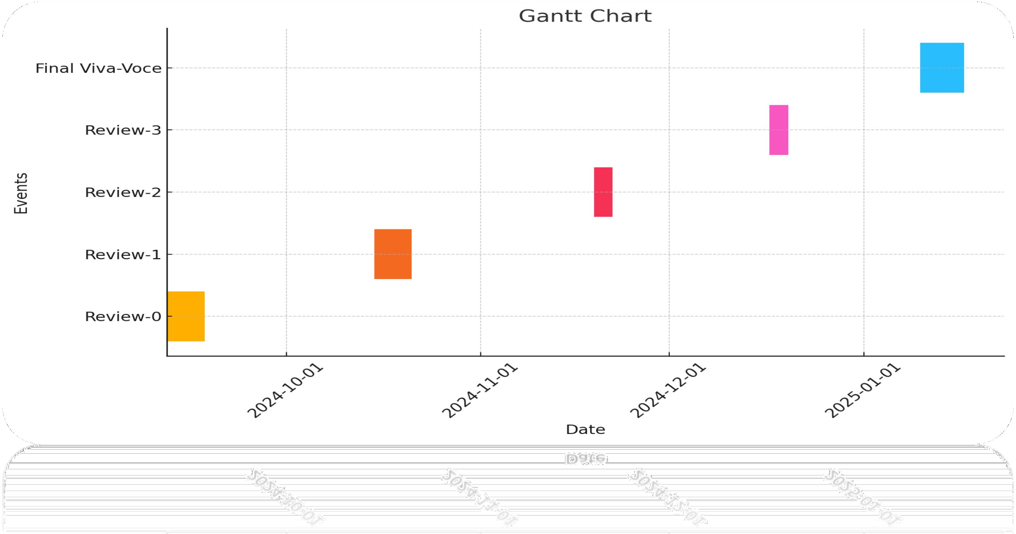
Timeline of Project

Slide 11
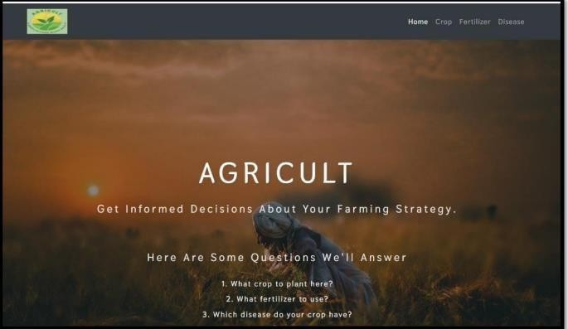
Outcomes / Results Obtained
Home Page
Home page: This is the home page of a program that will help farmers implement well-thought decisions regarding the farming strategy. Solutions will be provided on some key questions of what to grow, which fertilizer to apply, and what type of diseases the crop may get infected with. The layout has a navigation bar with sections such as "Home," "Crop," "Fertilizer," and "Disease," showing the holistic approach the platform will take to managing agriculture

Slide 12
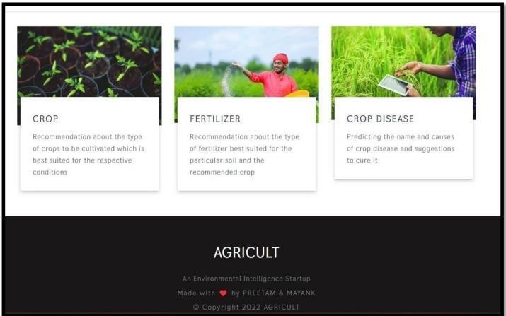
Platform Features
Platform Features: This can be proven by three major characteristics of the "AGRICULT" platform: this is environmental intelligence, the nature of which can improve a farming practice. The first is "Crop," which indicates advice on what crops should be planted under certain conditions in the environment and soil, and therefore makes easier optimization of the cultivation. The second is "Fertilizer," which advises what fertilizer is best used for the type of soil in question and recommended crop, keeping nutrient management in balance.

Slide 13
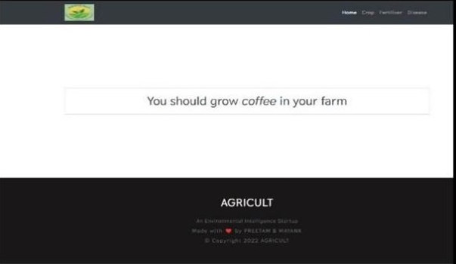
Crop prediction system
Crop Prediction System: Above is an image representing a user interface of a crop recommendation system. The system must, therefore likely guide farmers to pick crops for their environment. From the application of this case, the system had learned of the user's farm environment and went ahead to let him know it would be appropriate for him to grow coffee since his environment was rich in climate and other environmental features that are relevant for coffee crops.

Slide 14
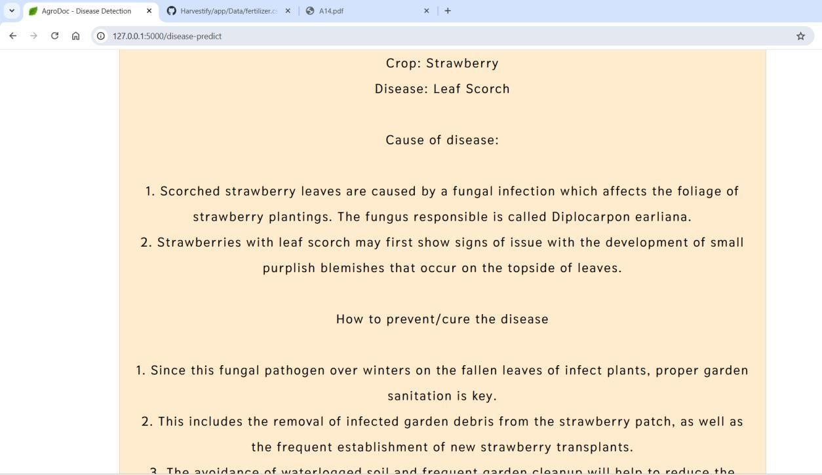
Disease Detection System
Disease Detection System: It is actually a plant disease-detecting system, whereby the output image you have shown was from a result page. It scans the uploaded photo of the infested plant to determine that its problem is in fact Leaf Scorch in the Strawberry plant. Some of the information about the disease would appear on the result page, referring to the cause for which it is believed to be due to infection by a fungus called Diplocarpon earliana.

Slide 15
Conclusion
Innovative Agricultural Solution:
AgroDoc uses advanced deep learning to tackle agricultural challenges like disease detection, crop recommendations, and fertilizer suggestions.
Empowering Farmers:
AgroDoc provides real-time insights and tailored recommendations, enabling farmers to make informed decisions that boost crop yield and reduce disease losses.
Accessibility and Impact:
With a user-friendly mobile interface, AgroDoc is accessible to small-scale farmers, bridging traditional farming and modern data-driven practices.
Future Outlook:
Development will focus on localization and new features like market trend analysis and monsoon prediction, enhancing value for farmers in various regions.
Data-Driven Sustainable Farming:
AgroDoc promotes sustainable agriculture by optimizing resources like fertilizers and water, contributing to long- term environmental benefits and supporting global sustainability goals .

Slide 16
References
Deep Learning Based Detection of Plant Disease
Citation: Brahimi, M., Boukhalfa, K., & Moussaoui, A. (2017). "Deep learning for tomato diseases: Classification and symptoms visualization." 2017 International Conference on Multimedia Computing and Systems (ICMCS), 1-6.DOI: 10.1109/ICMCS.2017.7905491
Crop Recommendation Using Machine Learning and IoT
Citation: Deore, S., Prabhune, M., Shinde, S., & Mulla, M. (2018). "Crop recommendation and fertilizer purchase system using IoT and machine learning.“2018 IEEE Global Conference on Wireless Computing and Networking (GCWCN), 113-118.DOI:10.1109/GCWCN.2018.8668601
Image-Based Plant Disease Detection Using Deep Learning
Citation: Amara, J., Bouaziz, B., & Algergawy, A. (2017). "A deep learning-based approach for banana leaf diseases classification." 2017 IEEE Applied Imagery Pattern Recognition Workshop (AIPR), 1-7.DOI: 10.1109/AIPR.2017.8457948
Crop Yield Prediction Using Deep Learning
Citation: Ghadge, A. R., Kakade, P. P., & Wagh, P. (2019). "Crop yield prediction using machine learning." 2019 IEEE Punecon, 1-5.DOI: 10.1109/PUNECON.2019.9106207
AI and Deep Learning for Plant Health Monitoring
Citation: Dhingra, S., Kumar, A., & Tomar, R. (2020). "Artificial intelligence techniques for soil and plant health monitoring: A review."2020 6th International Conference on Signal Processing and Communication (ICSC), 62-67.DOI: 10.1109/ICSC48311.2020.9182811

Slide 17
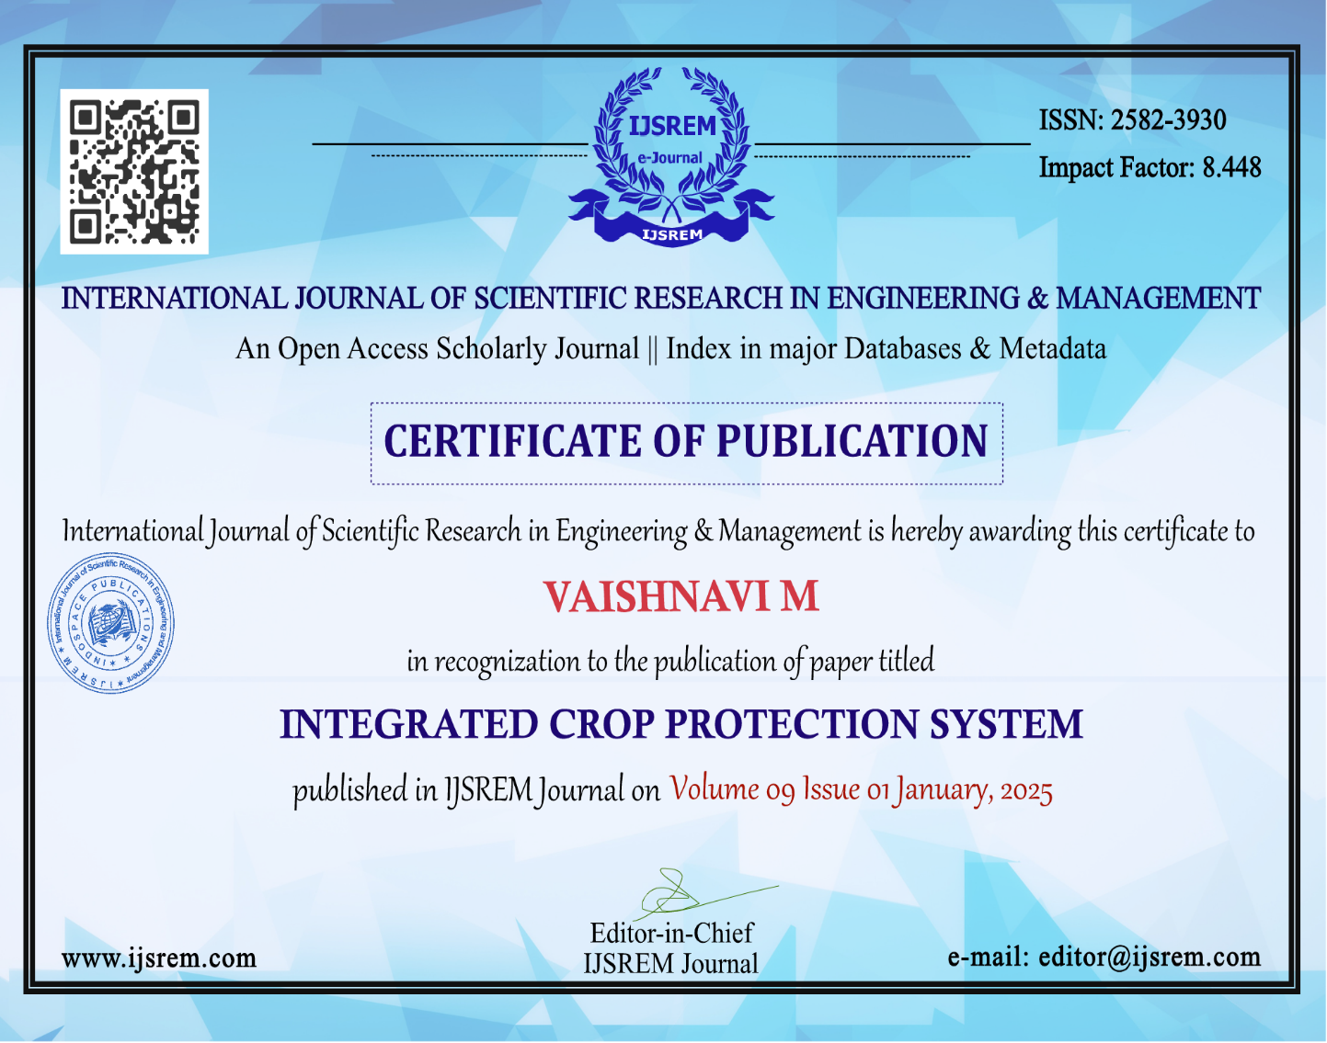
Publication Details
LINK : https://ijsrem.com/download/integrated-crop-protection-system/

Slide 18


Slide 19


Slide 20
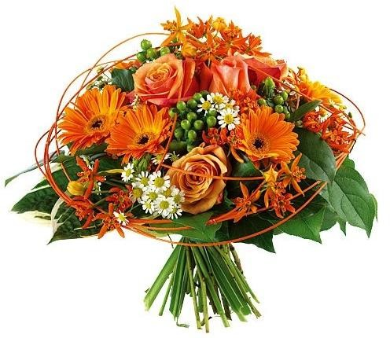
Thank You

