Slide 1
INDIAN SIGN LANGUAGE RECOGNITION
PIP4004 University Project
Review-0
Batch Number:69
Under the Supervision of,
Prof. Serin V Simpson
Assistant Professor
School of Computer Science and Engineering
Presidency University
Roll Number | Student Name
20211CSE0801 | VAISHNAVI M
20211CSE0822 | KUSUMA B
20221LCS0020 | YAMUNA A K
Name of the Program: CSE
Name of the HoD: Dr. Asif Mohammed H.B
Name of the Program Project Coordinator: Mr. Amarnath J.L & Dr. Jayanthi K.
Name of the School Project Coordinators: Dr. Sampath A K / Dr. Abdul Khadar A / Mr. Md Ziaur Rahman

Slide 2
Content
Problem Statement
GitHub Link
Analysis of Problem Statement
Timeline of the Project
References

Slide 3
Problem Statement Number:
Organization: Ministry of Social Justice and Empowerment
Category (Hardware / Software / Both) : Software
Problem Description: The lack of effective communication between the deaf community, which uses Indian Sign Language (ISL), and non-signers leads to significant barriers in everyday interactions. This project seeks to develop a system that converts spoken language into ISL in real time, using speech recognition, natural language processing, and gesture rendering. The solution aims to improve accessibility and inclusivity for deaf individuals across various settings. Thus, we propose an application which takes in live speech or audio recording as input, converts it into text and displays the relevant Indian Sign Language images or GIFs.
Difficulty Level: Simple

Slide 4
GitHub Link
The GitHub link provided should have public access permission
https://github.com/Cmsproject03/University_project-G69

Slide 5
Analysis of Problem Statement
Technology Stack Components:
1. Frontend/Client-Side (User Interface)
Platform:
Web Application: React.js for web-based access.
Rendering/Display:
Video Rendering: HTML5/CSS for video-based sign language playback.
UI Frameworks:
Web: Tailwind CSS for responsive, accessible designs.

Slide 6
Analysis of Problem Statement (contd...)
2. Backend/Server-Side
Web Framework:
Django (Python) is used to manage requests and responses.
Speech Recognition API:
Microsoft Azure Speech to convert audio input into text.
Natural Language Processing (NLP):
Hugging Face Transformers for parsing and interpreting the transcribed text.
Database:
MySQL is used to store gesture mappings, user preferences, and regional variations of ISL.

Slide 7
Analysis of Problem Statement (contd...)
3. APIs and Cloud Services
Cloud Hosting and Storage:
Microsoft Azure for hosting the application and storing gesture videos or 3D models.
Real-Time Data Transmission:
WebSocket for real-time audio-to-sign translation and gesture rendering on client devices.
4. Additional Tools
Authentication and Security:
OAuth2.0 for user authentication.
Version Control:
GitHub for version control and collaboration.

Slide 8
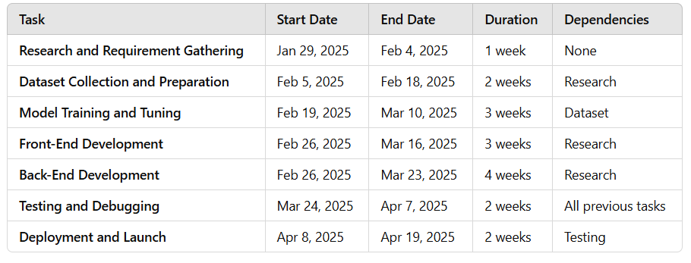
Timeline of the Project(Gantt Chart)

Slide 9
REFERENCES
A. Sharma, S. Sharma, and K. Bharti, "Sign Language Recognition Using Deep Learning," 2019 IEEE 9th International Conference on Advanced Computing (IACC), New Delhi, India, 2019, pp. 140-144.
S. Kaur and S. Arora, "Sign Language Recognition System for Deaf and Dumb People Using Image Processing," International Journal of Advanced Research in Computer Science and Software Engineering, vol. 6, no. 5, pp. 90-95, May 2016.

Slide 10


