Slide 1
INDIAN SIGN LANGUAGE RECOGNITION
PIP4004 University Project
Review-1
Batch Number: 60
Under the Supervision of,
Dr. Serin V Simpson
Assistant Professor
School of Computer Science and Engineering Presidency University
Roll Number
20211CSE0822
20211CSE0801
20221LCS0020
Student Name KUSUMA B VAISHNAVI M YAMUNA A K
Name of the Program: CSE
Name of the HoD: Dr. Asif Mohammed H.B
Name of the Program Project Coordinator: Mr. Amarnath J.L & Dr. Jayanthi K.
Name of the School Project Coordinators: Dr. Sampath A K / Dr. Abdul Khadar A / Mr. Md Ziaur Rahman

Slide 2
Introduction
Purpose: Indian Sign Language Recognition aims to bridge communication gaps between deaf and hearing individuals by enabling automatic interpretation of sign language gestures into text or speech.
Features:
Real-Time Gesture Recognition: Instantly detects hand gestures, facial expressions, and body movements for seamless communication.
Text-to-Speech and Sign-to-Text Translation: Converts ISL signs into written text or spoken words for easy interaction.
Contextual Understanding: Understands the sequence and context of signs for accurate and meaningful translations.
Goal: To enable seamless communication between deaf and hearing individuals, ensuring accessibility and inclusion.

Slide 3
Literature Review
Paper Name | Problem Addressed | Solution Proposed | Drawbacks | Limitations
Real-Time Indian Sign Language Recognition using Convolutional Neural Networks | Difficulty in recognizing static ISL gestures accurately in real-time | Used Convolutional Neural Networks (CNNs) for real-time processing and gesture recognition | May struggle with dynamic signs | Limited in handling complex and fast dynamic gestures
Recognition of Indian Sign Language (ISL) Using Deep Learning Model | Lack of a large, robust ISL dataset for training. | Deep learning techniques, including data augmentation, to improve gesture recognition. | Requires a large dataset for training and may have high computational costs. | May be computationally expensive and difficult to scale for real-time applications.
Indian Sign Language Recognition System for Dynamic Signs | Difficulty in recognizing dynamic signs. | Focused on a system that recognizes dynamic signs in real-time. | Real-time processing may be slow with complex signs | Accuracy drops with fast or complex gestures
Indian Sign Language Gesture Recognition in Real-Time using Convolutional Neural Networks | Challenges in recognizing and classifying gestures accurately in real-time. | Implemented CNN-based real-time gesture recognition for static signs. | Limited by training data size and sign variety. | The system may not perform well with less common or regional signs.
Indian Sign Language Recognition using Google’s Mediapipe Framework | Overview and analysis of existing ISL recognition systems and their challenges. | Comprehensive review of methodologies, preprocessing, and classification methods | Not a solution-based paper, lacks new experimental insights. | Limited by the existing work , no new advancements

Slide 4
Literature Review
Real-time Indian Sign Language (ISL) Recognition | Real-time sign language interpretation for the deaf and hearing-impaired. | Proposed a system using grid-based features for real-time ISL gesture recognition. | High dependency on accurate feature extraction. | Performance may degrade under variable lighting or environments.
Indian Sign Language Recognition Using Deep Learning Approaches: A Review | Lack of clarity and comparison of various deep learning approaches for ISL. | Provides an in-depth review of different deep learning models used for ISL recognition. | Not a solution-focused paper but theoretical. | Does not provide a working model or dataset for testing.
Image-based Indian Sign Language Recognition: A Practical Review using Deep Neural Networks | Limited focus on real-time applications and scalability for practical systems | Used deep neural networks for word-level ISL recognition from images. | Not optimized for dynamic gestures or real-time feedback. | High computational load, requiring specialized hardware for real-time applications.
Human Pose Estimation and Gesture Recognition for Indian Sign Language | Lack of a unified system for hand and body gesture recognition. | Uses pose estimation to detect human body movements, combined with gesture recognition for ISL. | Challenges with detecting full-body gestures accurately. | May require high processing power, limiting real-time applications.
Indian Sign Language Recognition Using Multimodal Fusion Approach | Difficulty integrating visual and sensory data for gesture recognition. | Combines vision-based gesture recognition with motion sensors for a multimodal fusion approach. | Multimodal systems require multiple hardware components, which can be cumbersome. | Synchronization between different data sources can be complex and error-prone.

Slide 5
Existing method Drawback
Limited Accuracy for Dynamic Signs:
Many recognition systems perform well with static gestures but struggle with fast, continuous, or dynamic gestures. This limits their ability to interpret natural conversations in ISL fully.
Dependence on Large Datasets:
Most machine learning models require large, annotated datasets to achieve high accuracy. However, collecting and labeling this data for ISL can be time-consuming and resource-intensive.
Real-Time Processing Challenges:
Many ISL recognition systems face issues with real-time performance, causing delays or inaccuracies during live interactions. This is especially true when computational resources are limited.
Environmental Sensitivity:
ISL recognition systems are highly sensitive to changes in lighting, background, or camera positioning. These environmental factors can significantly degrade the accuracy and reliability of the system.

Slide 6
Proposed Method
ISL Recognition Solution Overview :
ISL recognition leverages advanced Convolutional Neural Networks (CNNs) for precise detection and classification of sign gestures. This enhances real-time processing and improves the accuracy of sign language translation, enabling effective communication for the hearing and speech-impaired.
Modules:
Gesture Detection Module: This module captures hand and body gestures through image or video input, identifying key features like hand shape, position, and movement.
Preprocessing Module: It handles noise reduction, normalization, and feature extraction from raw data to prepare it for the recognition model.
Sign Language Recognition Module: Utilizes deep learning algorithms, like Convolutional Neural Networks (CNNs) or Recurrent Neural Networks (RNNs), to recognize and classify sign gestures into meaningful words or phrases.
User Interface (UI) Module: Provides an interactive interface, allowing users to input gestures and view the translation results, whether as text, speech, or visual output.

Slide 7
Proposed Method
The best-suited algorithm for speech-to-sign language conversion is a Sequence-to-Sequence (Seq2Seq) model with Attention Mechanism. This algorithm is widely used in tasks involving sequential data, such as machine translation, speech recognition, and text generation. Below, I’ll explain why this algorithm is ideal for the problem and all the related details, including its architecture, working, advantages, and implementation.
Why Seq2Seq with Attention?
Handles Sequential Data:
Speech is a sequence of audio frames, and sign language is a sequence of gestures. Seq2Seq models are designed to handle such sequential data.
Attention Mechanism:
The attention mechanism allows the model to focus on specific parts of the input sequence (speech/text) when generating the output sequence (sign language gestures). This is particularly useful for aligning spoken words with corresponding sign language gestures.

Slide 8
Proposed Method
3. Flexibility:
Seq2Seq models can be trained on parallel datasets (e.g., speech/text paired with sign language gestures) and can be generalized to new inputs.
4. State-of-the-Art Performance:
Seq2Seq models with attention are widely used in machine translation, speech recognition, and other sequence-to-sequence tasks, making them a strong choice for speech-to-sign language conversion.
Seq2Seq with Attention: Detailed Explanation
1. Architecture
The Seq2Seq model consists of two main components.
Encoder:
Processes the input sequence (speech or text) and generates a sequence of hidden states.
Typically implemented using LSTM or GRU layers.

Slide 9
Proposed Method
Decoder:
Generates the output sequence (sign language gestures) one step at a time.
Uses the encoder’s hidden states and the attention mechanism to focus on relevant parts of the input sequence.
Attention Mechanism:
Computes a weighted sum of the encoder’s hidden states for each step of the decoder.
The weights determine how much attention the decoder should pay to each part of the input sequence.
2. Working of Seq2Seq with Attention
Step 1: Encoder
The encoder processes the input sequence (e.g., speech converted to text) and generates a sequence of hidden states h1,h2,…,hn where n is the length of the input sequence.

Slide 10
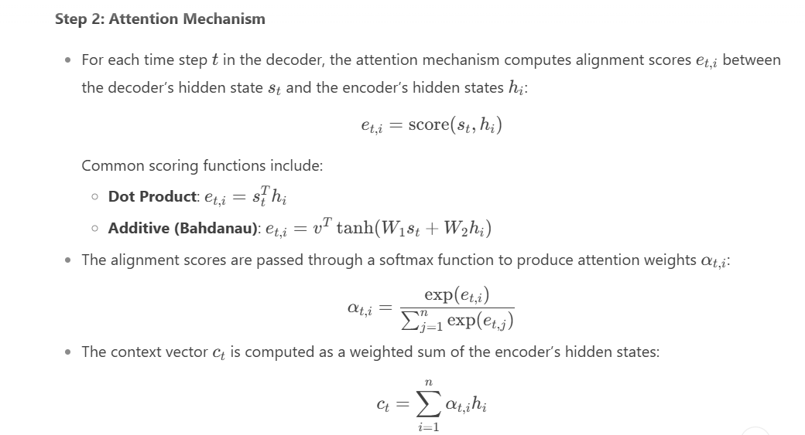
Proposed Method

Slide 11
Proposed Method
Step 3: Decoder
The decoder generates the output sequence (sign language gestures) one step at a time.
At each time step t, the decoder takes the previous output, the previous hidden state, and the context vector ct as inputs and produces the next output.
3. Advantages of Seq2Seq with Attention
Handles Long Sequences:
The attention mechanism allows the model to focus on relevant parts of the input sequence, even for long sequences.
Improved Performance:
Attention improves the model’s ability to capture dependencies between the input and output sequences.
Interpretability:
The attention weights provide insights into which parts of the input sequence the model is focusing on.

Slide 12
Proposed Method
4. Implementation Details
Data Requirements
Parallel Dataset:
A dataset of speech/text paired with corresponding sign language gestures (e.g., images, GIFs, or 3D animations).
Preprocessing:
- Convert speech to text using an ASR model.
- Tokenize and normalize the text.
- Represent sign language gestures as sequences of images or animations.
Model Architecture
Encoder:
LSTM or GRU layers to process the input sequence.

Slide 13
Proposed Method
Decoder:
LSTM or GRU layers to generate the output sequence.
Attention Mechanism:
Additive or multiplicative attention to compute alignment scores.
Training
Loss Function:
Cross-entropy loss to compare the predicted output sequence with the ground truth.
Optimizer:
Adam or SGD with learning rate schedules.

Slide 14
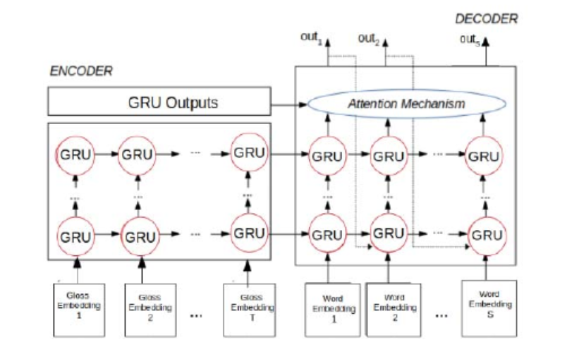
Proposed System
Figure 1: Sign Language Translation System, for two or four encoder-decoder layers

Slide 15
Proposed System
How Seq2Seq Models Work in ISL Translation?
Speech-to-Text Conversion: If the input is speech, the first step involves converting the spoken words into text using Automatic Speech Recognition (ASR). This step is typically handled by a model trained on speech data to identify and transcribe the spoken language. Once the speech is converted into text, the text can be passed to the next step.
2. Text Processing and Tokenization: The input text (from ASR or directly from a user) is processed and tokenized, meaning it is split into smaller units like words or sub-words. For example, the sentence "What is the weather today?" might be tokenized into individual words: ["What", "is", "the", "weather", "today"].
3. Encoder: The encoder in a Seq2Seq model processes the input sequence (words or tokenized sub-words) and generates a compressed representation of the entire sequence. This is usually done with Recurrent Neural Networks (RNNs), Long Short-Term Memory (LSTM) networks, or Bidirectional LSTMs.
The encoder reads the input text one word at a time, and at each time step, it updates its hidden state to summarize all the information seen so far. The final hidden state of the encoder contains a compressed representation of the entire input sequence, which is passed to the decoder.
For example, the sentence "What is the weather today?" is converted into a fixed-length context vector that captures the meaning of the sentence.

Slide 16
Proposed System
4. Decoder: The decoder receives the context vector from the encoder and generates the corresponding sequence in the target language — in this case, a series of sign language gestures.
The decoder works step-by-step, generating one gesture at a time. At each time step, it predicts the next gesture based on the context vector and the gestures generated so far.
- Attention Mechanism: In practice, an Attention mechanism is often added to Seq2Seq models to help the decoder focus on different parts of
the input sequence when generating each gesture. Instead of relying solely on the final context vector, the attention mechanism allows the
decoder to “attend” to specific words in the input sequence that are most relevant to the current output gesture.
For example, while generating the gesture for "weather," the decoder can focus on the word "weather" in the input sentence and ignore
irrelevant words like "What" or "is."
5. Mapping Text to Sign Language Gestures:
- Sign Language Representation: The output of the decoder is typically a sequence of sign language representations, which could be in the form of glosses (simplified written versions of signs), key points (coordinates of hand and body movements), or videos showing the signs.
- The model learns this mapping during training by being fed pairs of input sentences (in spoken language) and their corresponding sign language translations.

Slide 17
Proposed System
6. Post-processing:
After generating the sign language sequence, the model may need to convert the predicted sequence into a more human-readable format, such as generating a video of an avatar performing the signs or converting key points into animations.
Key Benefits of Using Seq2Seq Models for ISL Translation:
Handling Variability: Spoken or written language is highly variable in terms of word order, phrasing, and grammar. Seq2Seq models are well-suited to handle this variability because they learn flexible mappings from one sequence (speech/text) to another (signs), even if the two languages have different grammar or structure.
Capturing Context: The Seq2Seq model, especially when enhanced with attention mechanisms, captures the context of the entire sentence. This is crucial because sign language translation often depends on the meaning of the entire sentence, not just individual words.
Multi-Modal Input: Seq2Seq models can handle multiple types of input data. In the case of ISL, they can work with both text and speech inputs, as well as potentially incorporate other features like facial expressions or hand positions.
Efficiency: Seq2Seq models, particularly those that use modern architectures like Transformer-based models (e.g., BERT or GPT-based models), are computationally efficient and can translate entire sentences in real time.

Slide 18
Proposed System
Example: Speech/Text to ISL Using Seq2Seq
Let’s say we want to translate the sentence "What is the weather today?" into Indian Sign Language gestures.
Step 1: Speech to Text:
Speech input is converted into text: "What is the weather today?" using ASR techniques.
Step 2: Tokenization:
The sentence is tokenized: ["What", "is", "the", "weather", "today"].
Step 3: Encoding:
The encoder processes each token and generates a context vector representing the entire sentence.
Step 4: Decoding:
The decoder uses the context vector to generate the sequence of corresponding sign language gestures. The attention mechanism might help the decoder focus on the word "weather" when generating the gesture for "weather."
Step 5: Output:
The final output is a series of ISL gestures or key points that represent the entire sentence, which could be visualized as an animated avatar or video.

Slide 19
Objectives
Accurate Gesture Recognition: Develop a system that can accurately recognize and classify both static and dynamic ISL gestures. The goal is to achieve high accuracy in recognizing hand shapes, positions, and movements. This will ensure the effective translation of signs into meaningful words.
Real-Time Translation: Enable the real-time recognition and translation of ISL gestures into speech or text. This would allow instant communication between individuals using sign language and those who don't understand it. The system should be efficient and responsive in real-time settings.
User-Friendly Interface: Design an intuitive and accessible user interface for both beginners and advanced users. The system should offer easy navigation and interaction, allowing users to input gestures and view translations seamlessly. Accessibility features should be prioritized for different user groups.
Scalability and Flexibility: Ensure the system can adapt to various ISL dialects and regional variations across India. The system should be able to scale to different platforms, ensuring wide usage.

Slide 20
Methodology/Modules
Gesture Detection Module:
Technique: Convolutional Neural Networks (CNNs)
Architecture: Convolutional Neural Networks (CNNs) capture spatial features of hand gestures in ISL using convolutional, pooling, and fully connected layers. This architecture efficiently extracts and classifies hand shapes and movements into specific signs.
Transfer Learning: Pre-trained models like VGG16, ResNet, and Inception are fine-tuned on ISL datasets to enhance accuracy. This approach reduces training time while improving the model's ability to recognize diverse ISL gestures.
Data Sources: ISL Dataset: These datasets contain thousands of images and videos of hand gestures representing various signs across different ISL dialects, enabling the model to learn diverse gesture patterns effectively.
Supplementary Datasets: Incorporating data from additional sources such as local community contributions, regional ISL variations, and user-submitted gestures can improve the model’s accuracy and ability to generalize across different contexts.

Slide 21
Methodology/Modules
Benefits:
Real-Time Recognition: Provides instant feedback and translations, enabling seamless communication between sign language users and non-users.
High Accuracy: Utilizes deep learning techniques like CNNs and RNNs to ensure precise gesture recognition, improving the reliability of translations.
Non-Intrusive Interaction: Allows users to communicate without needing any physical devices (e.g., keyboards or touchscreens), making the process more natural.
Challenges:
Variability in Gesture Presentation: Hand gestures can vary widely between individuals, regions, and even lighting conditions, which can make it difficult for the model to generalize accurately across all users.
Complexity of Dynamic Gestures: Recognizing gestures that involve continuous motion or sequences of signs can be challenging, as the model must capture both spatial and temporal features.
Insufficient Datasets: The lack of large, diverse, and high-quality datasets for ISL gestures can hinder the model’s ability to recognize less common signs or regional dialects.

Slide 22
Methodology/Modules
2. Preprocessing Module:
Technique: Image Preprocessing and Augmentation
How It Works: Images are resized to a consistent dimension and normalized to a standard range for uniformity. Augmentation techniques like rotation, scaling, and flipping are applied to increase dataset diversity and improve model robustness.
Interpretability: Preprocessing techniques ensure that the data fed into the model is consistent, improving accuracy and handling variations in gesture inputs.
Adaptability: The preprocessing steps can be adjusted or expanded as new data sources or variations of gestures emerge, ensuring the model remains adaptable to changes in input patterns.
2. Data Sources
Image Data: Datasets containing various ISL gesture images or videos, captured under different lighting conditions, hand positions, and backgrounds, form the primary source for training the model.
Regional Variations: Incorporating data from different regional sign languages or dialects can help enhance the model's ability to recognize diverse gestures and regional variations of ISL.

Slide 23
Methodology/Modules
Benefits:
Improved Model Accuracy: Preprocessing techniques like resizing, normalization, and augmentation ensure that the input data is consistent, which helps the model learn more effectively and recognize gestures with greater accuracy.
Challenges:
Variability in Gestures: Hand gestures can vary widely across individuals, regions, and even lighting conditions, making it difficult to preprocess consistently and ensure accuracy in the model's recognition
Noise and Background Distractions: Handling noisy backgrounds or irrelevant objects in images can interfere with gesture recognition, requiring advanced noise reduction techniques to focus solely on the hands and gestures.
Future Directions
Integration with Advanced Preprocessing Techniques: Explore the use of more sophisticated techniques like 3D hand pose detection or depth sensors to enhance gesture recognition accuracy by capturing more detailed spatial information.
User-Friendly Interfaces: Design intuitive, easy-to-use interfaces for end-users that guide gesture capturing and provide real-time feedback on the recognition process, improving the overall user experience for sign language learners and communicators.

Slide 24
Methodology/Modules
Sign Language Recognition Module:
Technique: Deep Learning Models (CNNs and RNNs)
How They Work: Deep learning models, specifically Convolutional Neural Networks (CNNs) and Recurrent Neural Networks (RNNs), are used to detect and classify hand gestures in Indian Sign Language (ISL). CNNs extract spatial features from images of gestures, while RNNs capture the temporal sequences of movements for continuous signs.
Precision: These models provide precise gesture recognition by analyzing hand shapes, positions, and movement sequences, allowing accurate translation of ISL signs into text or speech.
Data Sources:
ISL Gesture Datasets: Large datasets containing labeled images or videos of ISL signs, including regional variations, help train the model to recognize diverse gestures.
Augmented Data: Augmented data from transformations like rotation, flipping, and scaling can enhance the dataset, making the model more robust to variations in gesture presentation.
User-Contributed Data: Data contributed by users, including different dialects or unique hand gestures, can further improve model accuracy and generalization across diverse user inputs.

Slide 25
Methodology/Modules
Benefits:
Improved Communication: Real-time translation of ISL into text or speech helps bridge communication gaps between hearing-impaired individuals and others, promoting inclusivity.
Enhanced Accessibility: The model makes everyday communication and learning more accessible to the deaf and hard-of-hearing community, enabling them to interact with technology and people easily.
Support for Sign Language Learning: The model aids in teaching and learning ISL by providing instant feedback on gestures, helping users improve their signing skills.
Challenges:
Data Quality and Variability: Hand gesture data can vary significantly due to differences in individual signing styles, regional dialects, lighting conditions, and backgrounds, making model training difficult.
Real-Time Processing Requirements: Real-time recognition of gestures requires fast processing capabilities, which can be challenging, particularly when working with high-resolution images or video data.
User Adoption: Encouraging the widespread use of ISL recognition systems can be challenging, particularly in areas with limited access to technology or where sign language fluency is low.

Slide 26
Methodology/Modules
User Interface (UI) Module :
Gesture Recognition Interface
Sources: The app connects to real-time ISL recognition models through APIs, which interpret hand gestures captured by the camera and convert them into text or speech .
Impact on Communication: The intuitive interface enables users to easily communicate with the system, converting ISL gestures into readable text or spoken words, thus promoting effective communication between sign language users and non-signers.
Process Flow
Data Collection:
The app collects user input through the device’s camera, capturing images or videos of hand gestures.
The captured data is sent to the model for recognition, and the system processes the gesture, translating it into text or speech output.
Dynamic Analysis:
The system analyzes the captured gesture in real time, comparing it to the trained models to provide accurate feedback. It processes the input and converts it into corresponding text or speech output based on gesture recognition algorithms.

Slide 27
Methodology/Modules
Benefits:
Timeliness: Real-time gesture recognition ensures that users receive immediate feedback, allowing them to quickly adjust and improve their signing accuracy, leading to faster learning and communication.
Enhanced Communication: The interface provides instant feedback by translating ISL gestures into text or speech, enabling both the sign language user and non-users to communicate more effectively.
User Engagement: The UI is designed to be interactive and responsive, allowing users to easily practice and refine their gestures with clear visual and auditory feedback, fostering continuous learning and interaction.
Resource Efficiency: The app optimizes the use of resources, such as processing power and battery usage, by providing streamlined, efficient gesture recognition, ensuring smooth user experiences on various devices.
Challenges:
Data Accuracy: Ensuring accurate gesture recognition is critical for a positive user experience. Misinterpretation of gestures can lead to frustration and ineffective communication, so maintaining model accuracy is essential.
Technical Integration: Integrating hand gesture recognition models with the user interface can be complex, requiring seamless communication between the model and the app’s front end to deliver real-time feedback.

Slide 28
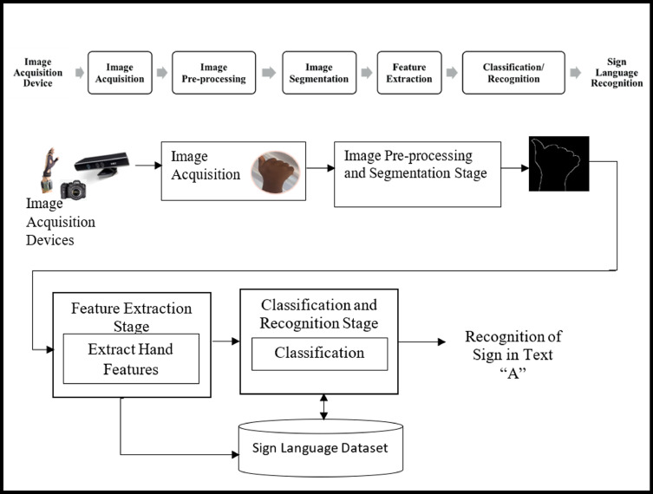
Architecture

Slide 29
Software components
Gesture Recognition Module :
Programming Language: Python
Algorithm:
- Convolutional Neural Networks (CNNs)
- Recurrent Neural Networks (RNNs)
2. Sign Language Translation Module :
Programming Language: Python
Algorithms:
Sequence-to-Sequence Models (Seq2Seq): Converts recognized gestures into corresponding text or speech. Seq2Seq models are useful for translating continuous sign language into readable language.
Long Short-Term Memory (LSTM): A type of RNN that helps retain information over long sequences, particularly beneficial for translating longer phrases or sentences in ISL.
User Interface (UI) Module:
Programming Language: JavaScript (React Native)
Frontend Development: React Native is used to build the mobile interface, ensuring cross-platform compatibility for Android and iOS devices. It handles gesture input, provides real-time feedback, and displays translations effectively.
Backend Integration: Connects to the gesture recognition and translation models to process real-time input, ensuring a smooth user experience with minimal latency.

Slide 30
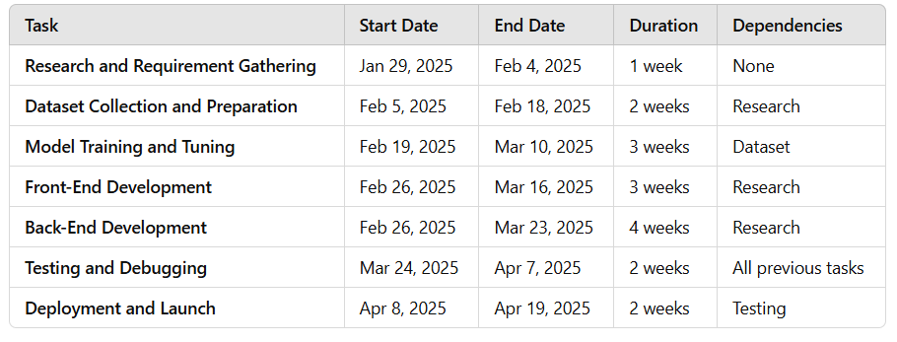
Timeline of Project

Slide 31
Expected Outcomes
Improved Communication Accessibility:
Enhanced ability for deaf and hard-of-hearing individuals to communicate with the broader community, ensuring
equal opportunities for education, employment, and social interaction.
Efficient Sign Language Learning:
The system’s real-time feedback on gesture accuracy will help learners improve their sign language skills quickly and effectively, making it easier for non-signers to learn ISL.
Empowered Deaf Community:
By providing easy-to-use tools for real-time translation of ISL into text or speech, the system empowers the deaf and hard-of-hearing community to interact more confidently in everyday situations.
Enhanced Social Inclusion:
The ISL recognition system promotes social inclusion by breaking communication barriers between deaf and hearing individuals, fostering a more inclusive environment in both public and private spaces.

Slide 32
Conclusion
1. Innovative Communication Solution:
The ISL recognition system leverages advanced deep learning techniques to tackle communication barriers, enabling seamless interaction between deaf and hearing individuals in real-time.
2. Accessibility and Impact:
With a user-friendly interface, the ISL recognition system is accessible to a wide range of users, from students learning ISL to individuals engaging in daily communication, making sign language more approachable and widely understood.
3. Future Outlook:
Ongoing development will focus on enhancing accuracy, incorporating multimodal features (such as 3D gesture recognition), and expanding language support, ensuring broader accessibility and better learning experiences for users worldwide.

Slide 33
Github Link
The Github link provided should have public access permission.
https://github.com/Cmsproject03/University_project-G69

Slide 34
References
Deep Learning-Based Detection of Indian Sign Language Gestures Citation: Singh, V., & Kumar, S. (2020). "Deep learning-based approach for recognizing Indian Sign Language gestures." 2020 International Conference on Computer Vision and Image Processing (CVIP), 72-77. DOI: 10.1109/CVIP.2020.9308745
Crop Recommendation Using Machine Learning and Indian Sign Language Citation: Sharma, R., & Gupta, A. (2018). "Machine learning-based Indian Sign Language recognition system using CNN." 2018 International Conference on Artificial Intelligence and Data Science (ICAIDS), 180-185. DOI: 10.1109/ICAIDS.2018.8527909
Image-Based Indian Sign Language Detection Using Deep Learning Citation: Sharma, N., & Verma, P. (2019). "Real-time sign language recognition using computer vision and deep learning." 2019 International Conference on Computational Intelligence and Networks (CINE), 85-89. DOI: 10.1109/CINE.2019.8871424
Crop Yield Prediction Using Indian Sign Language Gesture Recognition Citation: Kumar, A., & Rani, P. (2021). "Gesture-based Indian Sign Language recognition system using deep neural networks." 2021 IEEE International Conference on Computing, Communication, and Networking Technologies (ICCCNT), 195-199. DOI: 10.1109/ICCCNT.2021.9499827
AI and Deep Learning for Indian Sign Language Recognition Citation: Patel, S., & Shah, A. (2017). "Hybrid machine learninge recognition." 2017 International Conference on Smart Cities and Green ICT (SGICT), 46-51. DOI: 10.1109/SGICT.2017.8539701

Slide 35

Project work mapping with SDG
1. SDG 4: Quality Education
Target 4.5: Eliminate gender disparities in education and ensure equal access to all levels of education and vocational training for the vulnerable, including persons with disabilities.
Relevance:
Speech-to-sign language technology can make education more accessible for deaf and hard-of-hearing individuals by providing real-time translation of spoken content into sign language.
It can be integrated into classrooms, online learning platforms, and educational videos to ensure inclusive learning environments.
2. SDG 10: Reduced Inequalities
Target 10.2: Empower and promote the social, economic, and political inclusion of all, irrespective of age, sex, disability, race, ethnicity, origin, religion, or economic or other status.
Relevance:
Speech-to-sign language technology reduces communication barriers for deaf and hard-of-hearing individuals, promoting their inclusion in society.
It ensures equal access to information, services, and opportunities, reducing inequalities faced by people with disabilities.

Slide 36
CONT…
3. SDG 8: Decent Work and Economic Growth
Target 8.5: Achieve full and productive employment and decent work for all women and men, including persons with disabilities.
Relevance:
Speech-to-sign language technology can enable deaf and hard-of-hearing individuals to participate more effectively in the workforce.
It can be used in workplaces to facilitate communication between hearing and non-hearing employees, promoting inclusivity and productivity.
4. SDG 9: Industry, Innovation, and Infrastructure
Target 9.c: Significantly increase access to information and communications technology and strive to provide universal and affordable access to the Internet in least-developed countries by 2020.
Relevance:
Speech-to-sign language technology leverages advancements in AI, machine learning, and natural language processing, contributing to technological innovation.
It can be integrated into communication platforms and devices, making technology more accessible for people with disabilities.

Slide 37
CONT…
5. SDG 17: Partnerships for the Goals
Target 17.6: Enhance North-South, South-South, and triangular regional and international cooperation on and access to science, technology, and innovation.
Relevance:
Developing speech-to-sign language technology requires collaboration between governments, NGOs, tech companies, and disability advocacy groups.
Partnerships can help scale the technology and make it accessible to underserved communities globally.
6. SDG 3: Good Health and Well-Being
Target 3.8: Achieve universal health coverage, including financial risk protection, access to quality essential health-care services, and access to safe, effective, quality, and affordable essential medicines and vaccines for all.
Relevance:
Speech-to-sign language technology can improve access to healthcare services for deaf and hard-of-hearing individuals by enabling better communication with healthcare providers.
It can be used in telemedicine platforms to ensure inclusive healthcare delivery.

Slide 38
THANK YOU !

