Slide 1



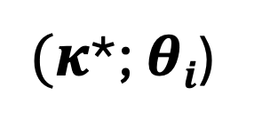
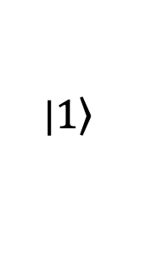


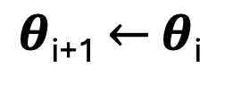
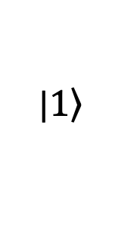
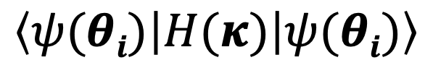


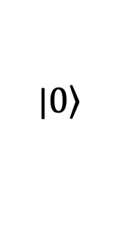

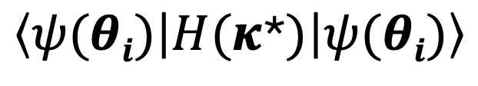
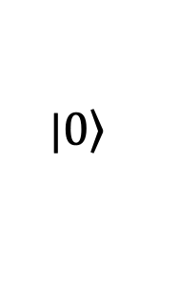

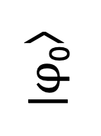
|$\left.1\right\rangle$
$$θ1$$
$$θ5$$
$$θn$$
|$\left.1\right\rangle$
$$θ2$$
$$θ6$$
|$φ$₀⟩
…
$$\left\langle ψ(θi) | H(κ) | ψ(θi)\right\rangle$$
|$\left.0\right\rangle$
$$θ3$$
$$θ7$$
|$\left.0\right\rangle$
$$θ4$$
$θ$_{i+1} $←$ $θ$_{i}
$(κ$*; $θi$)
Classical optimizer
Classical NR steps
$$\left\langle ψ(θi) | H(κ\text{*}) | ψ(θi)\right\rangle$$

Slide 2
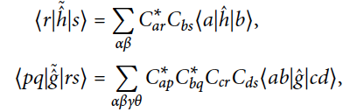




Construct Fermionic
and Qubit H
Run circuit
Orbitals rotation $κ$
Circuit parameters$θ$, $κ$
Classical NR steps

