Slide 1

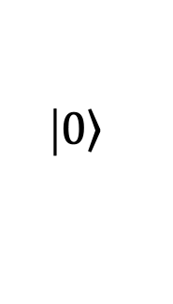

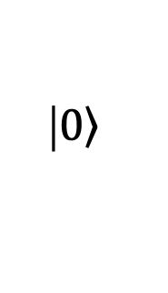

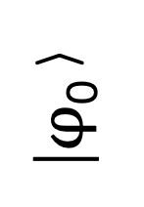

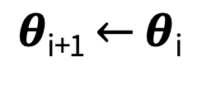
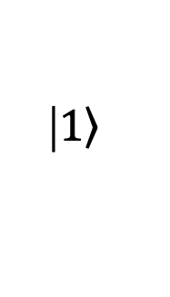

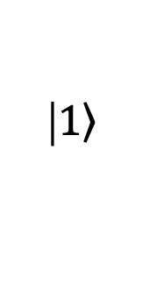


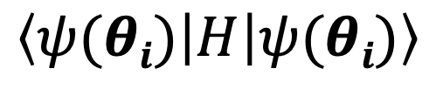


|$\left.1\right\rangle$
$$θ1$$
$$θ5$$
$$θn$$
|$\left.1\right\rangle$
$$θ2$$
$$θ6$$
|$φ$₀⟩
…
$$\left\langle ψ(θi) | H | ψ(θi)\right\rangle$$
|$\left.0\right\rangle$
$$θ3$$
$$θ7$$
|$\left.0\right\rangle$
$$θ4$$
$θ$_{i+1} $←$ $θ$_{i}
Classical optimizer

