Slide 1
BB02 Molecules of Life
Organic = C-H / C-C bonds

Slide 2
BB02 Molecules of Life
Organic = C-H / C-C bonds
C
Carbon

Slide 3
BB02 Molecules of Life
Organic = C-H / C-C bonds
C
H
Carbon
Hydrogen

Slide 4
BB02 Molecules of Life
Organic = C-H / C-C bonds
C
H
O
Carbon
Hydrogen
Oxygen

Slide 5
BB02 Molecules of Life
C
H
O
Organic biomolecules

Slide 6
BB02 Molecules of Life
C
H
O
N
Organic biomolecules

Slide 7
BB02 Molecules of Life
C
H
O
N
P
Organic biomolecules

Slide 8
BB02 Molecules of Life
C
H
O
N
P
S
Organic biomolecules

Slide 9
BB02 Molecules of Life
C
H
O
N
P
S
Organic biomolecules
Nitrogen

Slide 10
BB02 Molecules of Life
C
H
O
N
P
S
Organic biomolecules
Nitrogen
Phosphorus

Slide 11
BB02 Molecules of Life
C
H
O
N
P
S
Organic biomolecules
Nitrogen
Sulfur
Phosphorus

Slide 12
BB02 Molecules of Life
C
H
O
N
P
S
Organic biomolecules
Phosphorus
Sulfur

Slide 13
BB02 Molecules of Life
C
H
O
N
P
S
Organic biomolecules
Sulfur

Slide 14
BB02 Molecules of Life
C
H
O
N
P
S
Organic biomolecules

Slide 15
BB02 Molecules of Life
C
H
O
N
P
S
Organic biomolecules
1. Carbohydrates 碳水化合物

Slide 16
BB02 Molecules of Life
C
H
O
N
P
S
Organic biomolecules
1. Carbohydrates 碳水化合物
2. Lipids 脂質

Slide 17
BB02 Molecules of Life
C
H
O
N
P
S
Organic biomolecules
1. Carbohydrates 碳水化合物
2. Lipids 脂質
3. Proteins 蛋白質

Slide 18
BB02 Molecules of Life
C
H
O
N
P
S
Organic biomolecules
1. Carbohydrates 碳水化合物
2. Lipids 脂質
3. Proteins 蛋白質
4. Nucleic acids 核酸

Slide 19
BB02 Molecules of Life
C
H
O
N
P
S
Organic biomolecules
1. Carbohydrates 碳水化合物
2. Lipids 脂質
3. Proteins 蛋白質
4. Nucleic acids 核酸

Slide 20
BB02 Molecules of Life
C
H
O
N
P
S
Organic biomolecules
1. Carbohydrates 碳水化合物
2. Lipids 脂質
3. Proteins 蛋白質
4. Nucleic acids 核酸

Slide 21
BB02 Molecules of Life
C
H
O
N
P
S
Organic biomolecules
1. Carbohydrates 碳水化合物
2. Lipids 脂質
3. Proteins 蛋白質
4. Nucleic acids 核酸

Slide 22
BB02 Molecules of Life
C
H
O
N
P
S
Organic biomolecules
1. Carbohydrates 碳水化合物
2. Lipids 脂質
3. Proteins 蛋白質
4. Nucleic acids 核酸

Slide 23
BB02 Molecules of Life
C
H
O
N
P
S
Organic biomolecules
1. Carbohydrates 碳水化合物
C
2. Lipids 脂質
3. Proteins 蛋白質
4. Nucleic acids 核酸

Slide 24
BB02 Molecules of Life
C
H
O
N
P
S
Organic biomolecules
1. Carbohydrates 碳水化合物
C
H
2. Lipids 脂質
3. Proteins 蛋白質
4. Nucleic acids 核酸

Slide 25
BB02 Molecules of Life
C
H
O
N
P
S
Organic biomolecules
1. Carbohydrates 碳水化合物
C
H
O
2. Lipids 脂質
3. Proteins 蛋白質
4. Nucleic acids 核酸

Slide 26
BB02 Molecules of Life
C
H
O
N
P
S
Organic biomolecules
1. Carbohydrates 碳水化合物
C
H
O
C
2. Lipids 脂質
3. Proteins 蛋白質
4. Nucleic acids 核酸

Slide 27
BB02 Molecules of Life
C
H
O
N
P
S
Organic biomolecules
1. Carbohydrates 碳水化合物
C
H
O
C
H
2. Lipids 脂質
3. Proteins 蛋白質
4. Nucleic acids 核酸

Slide 28
BB02 Molecules of Life
C
H
O
N
P
S
Organic biomolecules
1. Carbohydrates 碳水化合物
C
H
O
C
H
O
2. Lipids 脂質
3. Proteins 蛋白質
4. Nucleic acids 核酸

Slide 29
BB02 Molecules of Life
C
H
O
N
P
S
Organic biomolecules
1. Carbohydrates 碳水化合物
C
H
O
C
H
O
2. Lipids 脂質
C
3. Proteins 蛋白質
4. Nucleic acids 核酸

Slide 30
BB02 Molecules of Life
C
H
O
N
P
S
Organic biomolecules
1. Carbohydrates 碳水化合物
C
H
O
C
H
O
2. Lipids 脂質
C
H
3. Proteins 蛋白質
4. Nucleic acids 核酸

Slide 31
BB02 Molecules of Life
C
H
O
N
P
S
Organic biomolecules
1. Carbohydrates 碳水化合物
C
H
O
C
H
O
2. Lipids 脂質
C
H
O
3. Proteins 蛋白質
4. Nucleic acids 核酸

Slide 32
BB02 Molecules of Life
C
H
O
N
P
S
Organic biomolecules
1. Carbohydrates 碳水化合物
C
H
O
C
H
O
2. Lipids 脂質
C
H
O
3. Proteins 蛋白質
C
4. Nucleic acids 核酸

Slide 33
BB02 Molecules of Life
C
H
O
N
P
S
Organic biomolecules
1. Carbohydrates 碳水化合物
C
H
O
C
H
O
2. Lipids 脂質
C
H
O
3. Proteins 蛋白質
C
H
4. Nucleic acids 核酸

Slide 34
BB02 Molecules of Life
C
H
O
N
P
S
Organic biomolecules
1. Carbohydrates 碳水化合物
C
H
O
C
H
O
2. Lipids 脂質
C
H
O
3. Proteins 蛋白質
C
H
O
4. Nucleic acids 核酸

Slide 35
BB02 Molecules of Life
C
H
O
N
P
S
Organic biomolecules
1. Carbohydrates 碳水化合物
C
H
O
C
H
O
2. Lipids 脂質
C
H
O
N
3. Proteins 蛋白質
C
H
O
4. Nucleic acids 核酸

Slide 36
BB02 Molecules of Life
C
H
O
N
P
S
Organic biomolecules
1. Carbohydrates 碳水化合物
C
H
O
C
H
O
2. Lipids 脂質
C
H
O
N
3. Proteins 蛋白質
C
H
O
P
4. Nucleic acids 核酸

Slide 37
BB02 Molecules of Life
C
H
O
N
P
S
Organic biomolecules
1. Carbohydrates 碳水化合物
C
H
O
C
H
O
2. Lipids 脂質
C
H
O
N
( )
3. Proteins 蛋白質
S
C
H
O
P
4. Nucleic acids 核酸

Slide 38
BB02 Molecules of Life
C
H
O
N
P
S
Organic biomolecules
1. Carbohydrates 碳水化合物
C
H
O
C
H
O
( )
2. Lipids 脂質
P
C
H
O
N
( )
3. Proteins 蛋白質
S
C
H
O
P
4. Nucleic acids 核酸

Slide 39
BB02 Molecules of Life
C
H
O
N
P
S
Organic biomolecules
1. Carbohydrates 碳水化合物
C
H
O
C
H
O
( )
2. Lipids 脂質
P
C
H
O
N
( )
3. Proteins 蛋白質
S
C
H
O
N
P
4. Nucleic acids 核酸

Slide 40
BB02 Molecules of Life
Condensation 縮合 and Hydrolysis 水解

Slide 41
BB02 Molecules of Life
Condensation 縮合 and Hydrolysis 水解

Slide 42
BB02 Molecules of Life
Condensation 縮合 and Hydrolysis 水解
Mono單-mer

Slide 43
BB02 Molecules of Life
Condensation 縮合 and Hydrolysis 水解
Mono單-mer

Slide 44
BB02 Molecules of Life
Condensation 縮合 and Hydrolysis 水解
Mono單-mer
Mono單-mer

Slide 45
BB02 Molecules of Life
Condensation 縮合
Mono(單)-mer
Mono(單)-mer

Slide 46
BB02 Molecules of Life
Condensation 縮合
Mono(單)-mer
Mono(單)-mer

Slide 47
BB02 Molecules of Life
Condensation 縮合
Mono(單)-mer
Mono(單)-mer

Slide 48
BB02 Molecules of Life
Condensation 縮合
H₂O
Mono(單)-mer
Mono(單)-mer

Slide 49
BB02 Molecules of Life
Condensation 縮合
H₂O
Mono(單)-mer
Mono(單)-mer

Slide 50
BB02 Molecules of Life
Condensation 縮合
H₂O
Mono(單)-mer
Mono(單)-mer

Slide 51
BB02 Molecules of Life
Condensation 縮合
Bond
H₂O
Mono(單)-mer
Mono(單)-mer

Slide 52
BB02 Molecules of Life
Condensation 縮合
Bond
H₂O
Di (二)-mero
Mono(單)-mer
Mono(單)-mer

Slide 53
BB02 Molecules of Life
Condensation 縮合
Bond
Di (二)-mero

Slide 54
BB02 Molecules of Life
Condensation 縮合
Bond
Di (二)-mero
Mono(單)-mer

Slide 55
BB02 Molecules of Life
Condensation 縮合
Bond
Di (二)-mero
Mono(單)-mer

Slide 56
BB02 Molecules of Life
Condensation 縮合
Bond
H₂O
Di (二)-mero
Mono(單)-mer

Slide 57
BB02 Molecules of Life
Condensation 縮合
Bond
Di (二)-mero
Mono(單)-mer
H₂O

Slide 58
BB02 Molecules of Life
Condensation 縮合
Bond
Bond
Di (二)-mero
Mono(單)-mer
H₂O

Slide 59
BB02 Molecules of Life
Condensation 縮合
Bond
Bond
Poly (多)-mero`
Di (二)-mero
Mono(單)-mer
H₂O

Slide 60
BB02 Molecules of Life
Condensation 縮合
Poly (多)-mero`

Slide 61
BB02 Molecules of Life
Condensation 縮合
Poly (多)-mero`

Slide 62
BB02 Molecules of Life
Condensation 縮合
Poly (多)-mero`

Slide 63
BB02 Molecules of Life
Condensation 縮合
H₂O
Poly (多)-mero`

Slide 64
BB02 Molecules of Life
Condensation 縮合
H₂O
Poly (多)-mero`

Slide 65
BB02 Molecules of Life
Condensation 縮合
H₂O
Poly (多)-mero`

Slide 66
BB02 Molecules of Life
Condensation 縮合
H₂O
Poly (多)-mero`

Slide 67
BB02 Molecules of Life
Condensation 縮合
H₂O
Poly (多)-mero`

Slide 68
BB02 Molecules of Life
Condensation 縮合
H₂O
H₂O
Poly (多)-mero`

Slide 69
BB02 Molecules of Life
Condensation 縮合
H₂O
H₂O
Poly (多)-mero`

Slide 70
BB02 Molecules of Life
Condensation 縮合
H₂O
H₂O
Poly (多)-mero`

Slide 71
BB02 Molecules of Life
Condensation 縮合
H₂O
H₂O
Poly (多)-mero`

Slide 72
BB02 Molecules of Life
Condensation 縮合
H₂O
H₂O
Poly (多)-mero`

Slide 73
BB02 Molecules of Life
Condensation 縮合
H₂O
H₂O
H₂O
Poly (多)-mero`

Slide 74
BB02 Molecules of Life
Condensation 縮合
H₂O
H₂O
H₂O
Poly (多)-mero`

Slide 75
BB02 Molecules of Life
Condensation 縮合
H₂O
H₂O
H₂O
Poly (多)-mero`

Slide 76
BB02 Molecules of Life
Condensation 縮合
H₂O
H₂O
H₂O
Poly (多)-mero`

Slide 77
BB02 Molecules of Life
Condensation 縮合
H₂O
H₂O
H₂O
Poly (多)-mero`

Slide 78
BB02 Molecules of Life
Condensation 縮合
H₂O
H₂O
H₂O
H₂O
Poly (多)-mero`

Slide 79
BB02 Molecules of Life
Condensation 縮合
H₂O
H₂O
H₂O
H₂O
Poly (多)-mero`

Slide 80
BB02 Molecules of Life
Condensation 縮合
H₂O
H₂O
H₂O
H₂O
Poly (多)-mero`

Slide 81
BB02 Molecules of Life
Condensation 縮合
H₂O
H₂O
H₂O
H₂O
Poly (多)-mero`

Slide 82
BB02 Molecules of Life
Hydrolysis 水解
Bond
H₂O
Di (二)-mero
Mono(單)-mer
Mono(單)-mer

Slide 83
BB02 Molecules of Life
Hydrolysis 水解
H₂O
Bond
Di (二)-mero
Mono(單)-mer
Mono(單)-mer

Slide 84
BB02 Molecules of Life
Hydrolysis 水解
Bond
H₂O
Di (二)-mero
Mono(單)-mer
Mono(單)-mer

Slide 85
BB02 Molecules of Life
Hydrolysis 水解
H₂O
Di (二)-mero
Mono(單)-mer
Mono(單)-mer

Slide 86
BB02 Molecules of Life
Hydrolysis 水解
H₂O
Mono(單)-mer
Di (二)-mero
Mono(單)-mer

Slide 87
BB02 Molecules of Life
Hydrolysis 水解
H₂O
Mono(單)-mer
Di (二)-mero
Mono(單)-mer

Slide 88
BB02 Molecules of Life
Hydrolysis 水解
H₂O
Mono(單)-mer
Mono(單)-mer

Slide 89

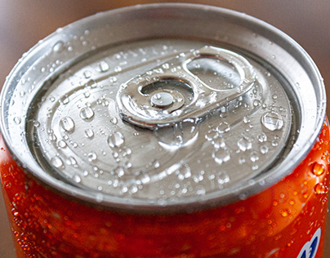
BB02 Molecules of Life
Condensation 縮合 and Hydrolysis 水解
Bond
H₂O
H₂O
hydrolysis
“Condensation 係會出水”
“水解，用水去解 (bond)”

Slide 90



宜家加大炸雞餐有特價，但阿媽話唔健康唔比買；點樣用生物科概念說服佢炸雞餐有營養需要？
快樂水
快樂條
快樂雞
總糖份: ~56g
總脂肪: ~20g
總蛋白質: ~32g
碳水化合物(Carbohydrates)係人不可或缺嘅快速能量來源(Fast respiration fuel
)，葡萄糖更係大腦必要嘅養份。
脂質(Lipids)係高效嘅能量處存 (Efficient storage
)，亦係組成細胞膜同部份荷爾蒙嘅重要成份。
蛋白質(Proteins) 3D結構多變，構成大部份身體組織 (Structural build blocks
)以及酶﹑抗體﹑血紅素等重要分子。

Slide 91
BB02 Molecules of Life
C
H
O
N
P
S
Organic biomolecules
Nitrogen
Sulfur
Phosphorus
1. Carbohydrates 碳水化合物
C
H
O
C
H
O
( )
2. Lipids 脂質
P
C
H
O
( )
3. Proteins 蛋白質
N
S
C
H
O
N
P
4. Nucleic acids 核酸

Slide 92
BB02 Molecules of Life
C
H
O
N
P
S
Organic biomolecules
Nitrogen
Sulfur
Phosphorus
1. Carbohydrates 碳水化合物
C
H
O
C
H
O
( )
2. Lipids 脂質
P
C
H
O
( )
3. Proteins 蛋白質
N
S
C
H
O
N
P
4. Nucleic acids 核酸

Slide 93

BB02 Molecules of Life
H
C
H
C
H
O
N
P
S
Carbohydrates
碳水化合物
Nitrogen
Sulfur
Phosphorus
H:O = 2:1
Mono單-mer

Slide 94
BB02 Molecules of Life
H
H
C
H
O
N
P
S
Carbohydrates
碳水化合物
Nitrogen
Sulfur
Phosphorus
H:O = 2:1
C
Mono單-mer

Slide 95
BB02 Molecules of Life
H
C
H
O
N
P
S
Carbohydrates
碳水化合物
Nitrogen
Sulfur
Phosphorus
H:O = 2:1
C
H
Mono單-mer

Slide 96
BB02 Molecules of Life
C
H
O
N
P
S
Carbohydrates
碳水化合物
Nitrogen
Sulfur
Phosphorus
H:O = 2:1
H
C
H
Mono單-mer

Slide 97
BB02 Molecules of Life
C
H
N
P
S
Carbohydrates
碳水化合物
Nitrogen
Sulfur
Phosphorus
H:O = 2:1
H
C
H
O
Mono單-mer

Slide 98
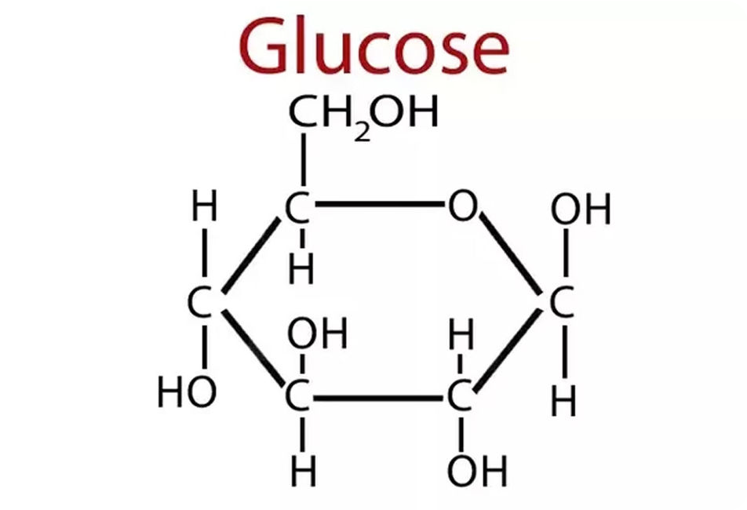
BB02 Molecules of Life
C
H
N
P
S
Carbohydrates
碳水化合物
Nitrogen
Sulfur
Phosphorus
H:O = 2:1
H
C
H
O
Mono單-mer

Slide 99
BB02 Molecules of Life
C
H
N
P
S
Carbohydrates
碳水化合物
Nitrogen
Sulfur
Phosphorus
H:O = 2:1
H
C
H
O
Mono-saccharides (單醣)
Mono單-mer

Slide 100
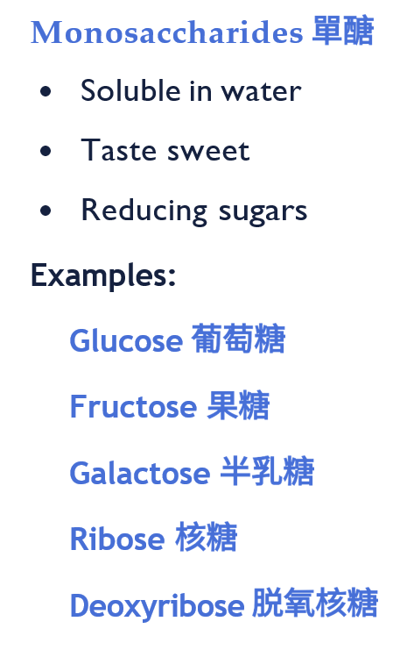
BB02 Molecules of Life
C
H
N
P
S
Carbohydrates
碳水化合物
Nitrogen
Sulfur
Phosphorus
H:O = 2:1
H
C
H
O
Mono-saccharides (單醣)
Mono單-mer

Slide 101
BB02 Molecules of Life
C
H
N
P
S
Carbohydrates
碳水化合物
Nitrogen
Sulfur
Phosphorus
H:O = 2:1
C
H
O
H
C
H
O
Mono-saccharides (單醣)
Mono單-mer

Slide 102
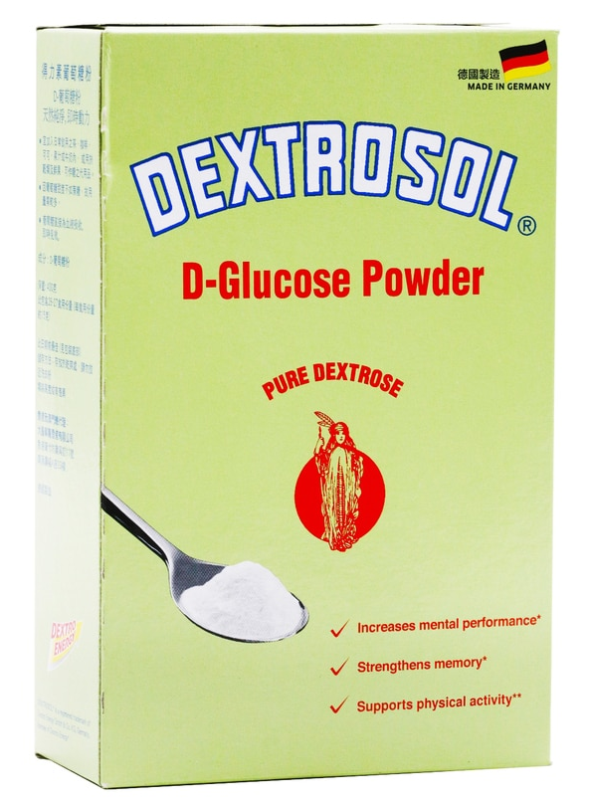
BB02 Molecules of Life
H
C
H
C
H
O
N
P
S
Carbohydrates
碳水化合物
Nitrogen
Sulfur
Phosphorus
H:O = 2:1
Mono-saccharides (單醣)
Mono單-mer

Slide 103
BB02 Molecules of Life
Carbohydrates
碳水化合物
Condensation 縮合
C
H
O
C
H
O
Monosaccharides
Monosaccharides

Slide 104
BB02 Molecules of Life
Carbohydrates
碳水化合物
Condensation 縮合
C
H
O
C
H
O
Monosaccharides
Monosaccharides

Slide 105
BB02 Molecules of Life
Carbohydrates
碳水化合物
Condensation 縮合
C
H
O
C
H
O
Monosaccharides
Monosaccharides

Slide 106
BB02 Molecules of Life
Carbohydrates
碳水化合物
Condensation 縮合
C
H
O
C
H
O
H₂O
Monosaccharides
Monosaccharides

Slide 107
BB02 Molecules of Life
Carbohydrates
碳水化合物
Condensation 縮合
C
H
O
C
H
O
H₂O
Monosaccharides
Monosaccharides

Slide 108
BB02 Molecules of Life
Carbohydrates
碳水化合物
Condensation 縮合
C
H
O
C
H
O
H₂O
Monosaccharides
Monosaccharides

Slide 109
BB02 Molecules of Life
Carbohydrates
碳水化合物
Condensation 縮合
C
H
O
C
H
O
Bond
H₂O
Monosaccharides
Monosaccharides

Slide 110
BB02 Molecules of Life
Carbohydrates
碳水化合物
Condensation 縮合
C
H
O
C
H
O
Bond
H₂O
Di (二)-mero
Monosaccharides
Monosaccharides

Slide 111
BB02 Molecules of Life
Carbohydrates
碳水化合物
Condensation 縮合
C
H
O
C
H
O
Bond
H₂O
Disaccharides (雙醣)
Di (二)-mero
Monosaccharides
Monosaccharides

Slide 112
BB02 Molecules of Life
Carbohydrates
碳水化合物
Condensation 縮合
C
H
O
C
H
O
Glycosidic bond
糖鍵
Bond
H₂O
Disaccharides (雙醣)
Di (二)-mero
Monosaccharides
Monosaccharides

Slide 113
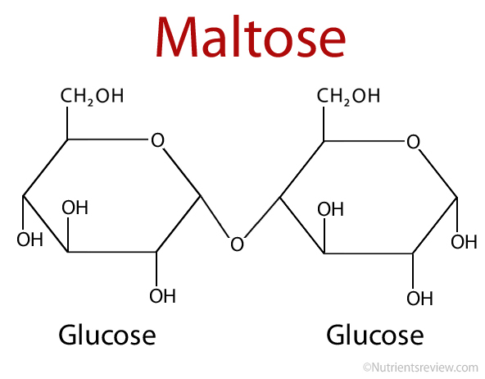
BB02 Molecules of Life
Carbohydrates
碳水化合物
Condensation 縮合
C
H
O
C
H
O
Glycosidic bond
糖鍵
Bond
H₂O
Disaccharides (雙醣)
Di (二)-mero
Monosaccharides
Monosaccharides

Slide 114

BB02 Molecules of Life
H
C
H
C
H
O
N
P
S
Carbohydrates
碳水化合物
Nitrogen
Sulfur
Phosphorus
H:O = 2:1
Monosaccharides (單醣)

Slide 115
BB02 Molecules of Life
H
C
H
C
H
O
N
P
S
Carbohydrates
碳水化合物
Nitrogen
Sulfur
Phosphorus
H:O = 2:1
Monosaccharides (單醣)

Slide 116
BB02 Molecules of Life
H
C
H
C
H
O
N
P
S
Carbohydrates
碳水化合物
Nitrogen
Sulfur
Phosphorus
H:O = 2:1
Monosaccharides (單醣)
Disaccharides (雙醣)

Slide 117
BB02 Molecules of Life
H
C
H
C
H
O
N
P
S
Carbohydrates
碳水化合物
Nitrogen
Sulfur
Phosphorus
H:O = 2:1
Hydrolysis
Condensation
Monosaccharides (單醣)
Disaccharides (雙醣)

Slide 118
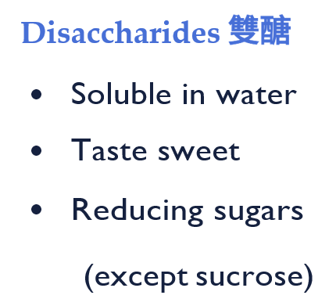
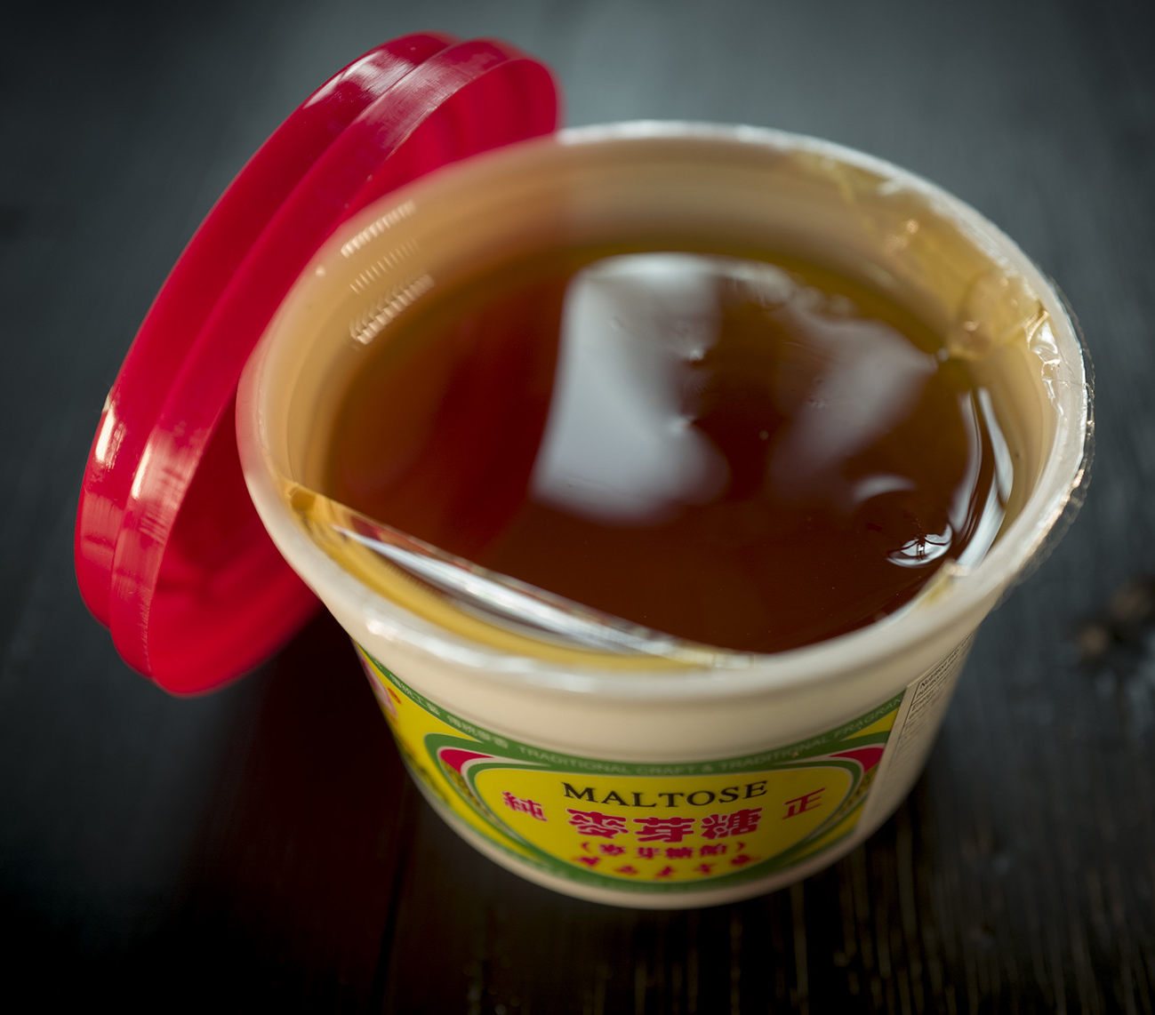
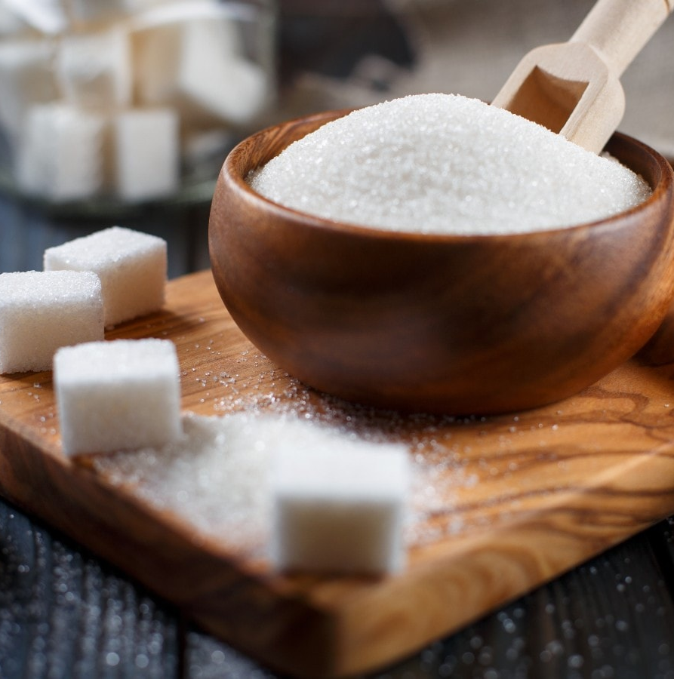
BB02 Molecules of Life
H
C
H
C
H
O
N
P
S
Carbohydrates
碳水化合物
Nitrogen
Sulfur
Phosphorus
H:O = 2:1
Maltose 麥芽糖
glucose + glucose - water
Sucrose 蔗糖
glucose + fructose - water
Lactose 乳糖
glucose + galactose - water
Disaccharides (雙醣)

Slide 119
BB02 Molecules of Life
Carbohydrates
碳水化合物
Condensation 縮合
Poly (多)-mero`

Slide 120
BB02 Molecules of Life
Carbohydrates
碳水化合物
Condensation 縮合
Poly (多)-mero`

Slide 121
BB02 Molecules of Life
Carbohydrates
碳水化合物
Condensation 縮合
Poly (多)-mero`

Slide 122
BB02 Molecules of Life
Carbohydrates
碳水化合物
Condensation 縮合
H₂O
Poly (多)-mero`

Slide 123
BB02 Molecules of Life
Carbohydrates
碳水化合物
Condensation 縮合
H₂O
Poly (多)-mero`

Slide 124
BB02 Molecules of Life
Carbohydrates
碳水化合物
Condensation 縮合
H₂O
Poly (多)-mero`

Slide 125
BB02 Molecules of Life
Carbohydrates
碳水化合物
Condensation 縮合
H₂O
Poly (多)-mero`

Slide 126
BB02 Molecules of Life
Carbohydrates
碳水化合物
Condensation 縮合
H₂O
Poly (多)-mero`

Slide 127
BB02 Molecules of Life
Carbohydrates
碳水化合物
Condensation 縮合
H₂O
H₂O
Poly (多)-mero`

Slide 128
BB02 Molecules of Life
Carbohydrates
碳水化合物
Condensation 縮合
H₂O
H₂O
Poly (多)-mero`

Slide 129
BB02 Molecules of Life
Carbohydrates
碳水化合物
Condensation 縮合
H₂O
H₂O
Poly (多)-mero`

Slide 130
BB02 Molecules of Life
Carbohydrates
碳水化合物
Condensation 縮合
H₂O
H₂O
Poly (多)-mero`

Slide 131
BB02 Molecules of Life
Carbohydrates
碳水化合物
Condensation 縮合
H₂O
H₂O
Poly (多)-mero`

Slide 132
BB02 Molecules of Life
Carbohydrates
碳水化合物
Condensation 縮合
H₂O
H₂O
H₂O
Poly (多)-mero`

Slide 133
BB02 Molecules of Life
Carbohydrates
碳水化合物
Condensation 縮合
H₂O
H₂O
H₂O
Poly (多)-mero`

Slide 134
BB02 Molecules of Life
Carbohydrates
碳水化合物
Condensation 縮合
H₂O
H₂O
H₂O
Poly (多)-mero`

Slide 135
BB02 Molecules of Life
Carbohydrates
碳水化合物
Condensation 縮合
H₂O
H₂O
H₂O
Poly (多)-mero`

Slide 136
BB02 Molecules of Life
Carbohydrates
碳水化合物
Condensation 縮合
H₂O
H₂O
H₂O
Poly (多)-mero`

Slide 137
BB02 Molecules of Life
Carbohydrates
碳水化合物
Condensation 縮合
H₂O
H₂O
H₂O
H₂O
Poly (多)-mero`

Slide 138
BB02 Molecules of Life
Carbohydrates
碳水化合物
Condensation 縮合
H₂O
H₂O
H₂O
H₂O
Poly (多)-mero`

Slide 139
BB02 Molecules of Life
Carbohydrates
碳水化合物
Condensation 縮合
H₂O
H₂O
H₂O
H₂O
Poly (多)-mero`

Slide 140
BB02 Molecules of Life
Carbohydrates
碳水化合物
Condensation 縮合
H₂O
H₂O
H₂O
H₂O
Poly (多)-mero`

Slide 141
BB02 Molecules of Life
Carbohydrates
碳水化合物
Condensation 縮合
H₂O
H₂O
H₂O
H₂O
Poly (多)-mero`
Polysaccharides (多醣)
`

Slide 142
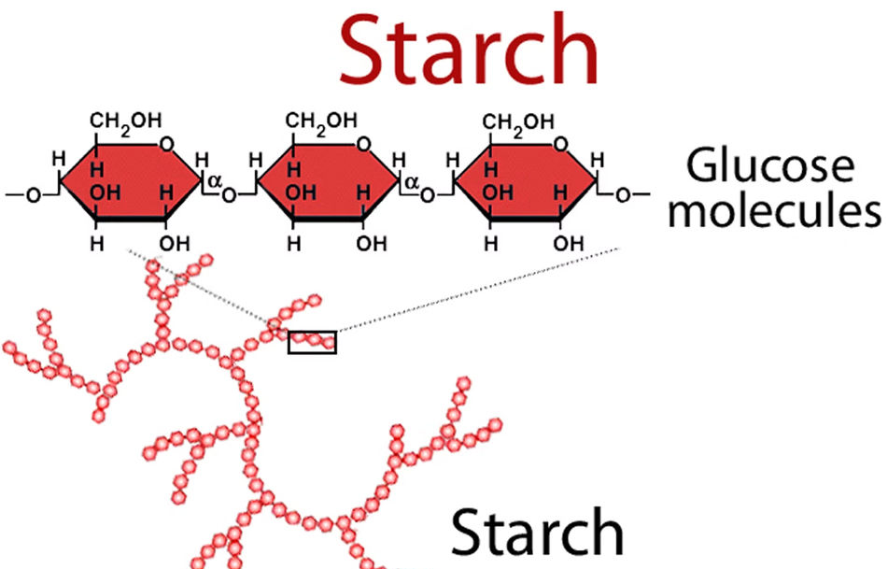
BB02 Molecules of Life
Carbohydrates
碳水化合物
Condensation 縮合
H₂O
H₂O
H₂O
H₂O
Poly (多)-mero`
Polysaccharides (多醣)
`

Slide 143
BB02 Molecules of Life
H
C
H
C
H
O
N
P
S
Carbohydrates
碳水化合物
Nitrogen
Sulfur
Phosphorus
H:O = 2:1
Hydrolysis
Condensation
Monosaccharides (單醣)
Disaccharides
(雙醣)

Slide 144
BB02 Molecules of Life
H
C
H
C
H
O
N
P
S
Carbohydrates
碳水化合物
Nitrogen
Sulfur
Phosphorus
H:O = 2:1
Hydrolysis
Hydrolysis
Condensation
Condensation
Monosaccharides (單醣)
Disaccharides
(雙醣)

Slide 145
BB02 Molecules of Life
H
C
H
C
H
O
N
P
S
Carbohydrates
碳水化合物
Nitrogen
Sulfur
Phosphorus
H:O = 2:1
Hydrolysis
Hydrolysis
Condensation
Condensation
Monosaccharides (單醣)
Disaccharides
(雙醣)
Polysaccharides (多醣)

Slide 146
BB02 Molecules of Life
H
C
H
C
H
O
N
P
S
Carbohydrates
碳水化合物
Nitrogen
Sulfur
Phosphorus
H:O = 2:1
Polysaccharides (多醣)

Slide 147
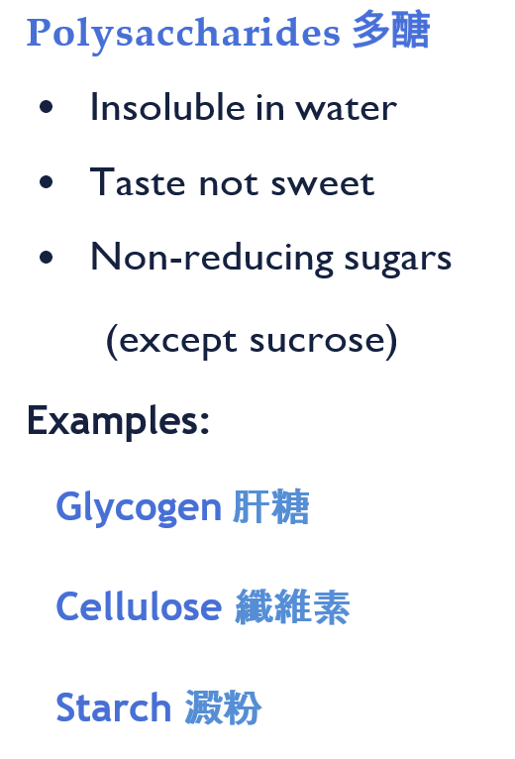
BB02 Molecules of Life
H
C
H
C
H
O
N
P
S
Carbohydrates
碳水化合物
Nitrogen
Sulfur
Phosphorus
H:O = 2:1
Polysaccharides (多醣)

Slide 148
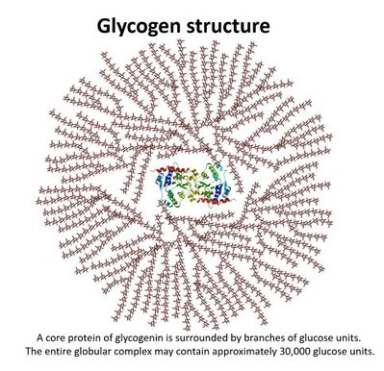
BB02 Molecules of Life
H
C
H
C
H
O
N
P
S
Carbohydrates
碳水化合物
Nitrogen
Sulfur
Phosphorus
H:O = 2:1
Polysaccharides (多醣)

Slide 149

BB02 Molecules of Life
H
C
H
C
H
O
N
P
S
Carbohydrates
碳水化合物
Nitrogen
Sulfur
Phosphorus
H:O = 2:1
Polysaccharides (多醣)

Slide 150
BB02 Molecules of Life
C
H
O
N
P
S
Organic biomolecules
Nitrogen
Sulfur
Phosphorus
1. Carbohydrates 碳水化合物
C
H
O
C
H
O
( )
2. Lipids 脂質
P
C
H
O
( )
3. Proteins 蛋白質
N
S
C
H
O
N
P
4. Nucleic acids 核酸

Slide 151
BB02 Molecules of Life
C
H
O
N
P
S
Organic biomolecules
Nitrogen
Sulfur
Phosphorus
1. Carbohydrates 碳水化合物
C
H
O
C
H
O
( )
2. Lipids 脂質
P
C
H
O
( )
3. Proteins 蛋白質
N
S
C
H
O
N
P
4. Nucleic acids 核酸

Slide 152
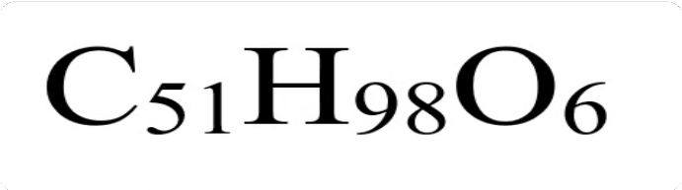
BB02 Molecules of Life
H
C
H
H
O
C
O
N
P
S
2. Lipids 脂質
Nitrogen
Sulfur
H:O > 2:1
Phosphorus
Mono單-mer

Slide 153
BB02 Molecules of Life
H
H
H
O
C
O
N
P
S
2. Lipids 脂質
Nitrogen
Sulfur
H:O > 2:1
Phosphorus
C
Mono單-mer

Slide 154
BB02 Molecules of Life
H
H
O
C
O
N
P
S
2. Lipids 脂質
Nitrogen
Sulfur
H:O > 2:1
Phosphorus
C
H
Mono單-mer

Slide 155
BB02 Molecules of Life
H
O
C
O
N
P
S
2. Lipids 脂質
Nitrogen
Sulfur
H:O > 2:1
Phosphorus
H
C
H
Mono單-mer

Slide 156
BB02 Molecules of Life
C
H
O
N
P
S
2. Lipids 脂質
Nitrogen
Sulfur
H:O > 2:1
Phosphorus
H
C
H
O
Mono單-mer

Slide 157
BB02 Molecules of Life
H
C
H
C
H
O
N
P
S
2. Lipids 脂質
Nitrogen
Sulfur
H:O > 2:1
Phosphorus

Slide 158
BB02 Molecules of Life
H
C
H
C
H
O
N
P
S
2. Lipids 脂質
Nitrogen
Sulfur
H:O > 2:1
Phosphorus
Glycerol (甘油)

Slide 159
BB02 Molecules of Life
H
C
H
C
H
O
N
P
S
2. Lipids 脂質
Nitrogen
Sulfur
H:O > 2:1
Phosphorus
Fatty acid (脂肪酸)
Fatty acid (脂肪酸)
Fatty acid (脂肪酸)
Glycerol (甘油)

Slide 160
BB02 Molecules of Life
H
C
H
C
H
O
N
P
S
2. Lipids 脂質
Nitrogen
Sulfur
H:O > 2:1
Phosphorus
1 Glycerol (甘油)
3 Fatty acids (脂肪酸)

Slide 161
BB02 Molecules of Life
H
C
H
C
H
O
N
P
S
2. Lipids 脂質
Nitrogen
Sulfur
H:O > 2:1
Phosphorus
1 Glycerol (甘油)
3 Fatty acids (脂肪酸)

Slide 162
BB02 Molecules of Life
H
C
H
C
H
O
N
P
S
2. Lipids 脂質
Nitrogen
Sulfur
H:O > 2:1
Phosphorus
1 Glycerol (甘油)
3 Fatty acids (脂肪酸)

Slide 163
BB02 Molecules of Life
H
C
H
C
H
O
N
P
S
2. Lipids 脂質
Nitrogen
Sulfur
H:O > 2:1
Phosphorus
1 Glycerol (甘油)
3 Fatty acids (脂肪酸)

Slide 164
BB02 Molecules of Life
H
C
H
C
H
O
N
P
S
2. Lipids 脂質
Nitrogen
Sulfur
H:O > 2:1
Phosphorus
H₂O
1 Glycerol (甘油)
3 Fatty acids (脂肪酸)

Slide 165
BB02 Molecules of Life
H
C
H
C
H
O
N
P
S
2. Lipids 脂質
Nitrogen
Sulfur
H:O > 2:1
Phosphorus
H₂O
1 Glycerol (甘油)
3 Fatty acids (脂肪酸)

Slide 166
BB02 Molecules of Life
H
C
H
C
H
O
N
P
S
2. Lipids 脂質
Nitrogen
Sulfur
H:O > 2:1
Phosphorus
H₂O
1 Glycerol (甘油)
3 Fatty acids (脂肪酸)

Slide 167
BB02 Molecules of Life
H
C
H
C
H
O
N
P
S
2. Lipids 脂質
Nitrogen
Sulfur
H:O > 2:1
Phosphorus
H₂O
H₂O
1 Glycerol (甘油)
3 Fatty acids (脂肪酸)

Slide 168
BB02 Molecules of Life
H
C
H
C
H
O
N
P
S
2. Lipids 脂質
Nitrogen
Sulfur
H:O > 2:1
Phosphorus
H₂O
H₂O
1 Glycerol (甘油)
3 Fatty acids (脂肪酸)

Slide 169
BB02 Molecules of Life
H
C
H
C
H
O
N
P
S
2. Lipids 脂質
Nitrogen
Sulfur
H:O > 2:1
Phosphorus
H₂O
H₂O
1 Glycerol (甘油)
3 Fatty acids (脂肪酸)

Slide 170
BB02 Molecules of Life
H
C
H
C
H
O
N
P
S
2. Lipids 脂質
Nitrogen
Sulfur
H:O > 2:1
Phosphorus
H₂O
H₂O
H₂O
1 Glycerol (甘油)
3 Fatty acids (脂肪酸)

Slide 171
BB02 Molecules of Life
H
C
H
C
H
O
N
P
S
2. Lipids 脂質
Nitrogen
Sulfur
H:O > 2:1
Phosphorus
H₂O
H₂O
H₂O
1 Glycerol (甘油)
3 Fatty acids (脂肪酸)

Slide 172
BB02 Molecules of Life
H
C
H
C
H
O
N
P
S
2. Lipids 脂質
Nitrogen
Sulfur
H:O > 2:1
Phosphorus
H₂O
H₂O
H₂O
1 Glycerol (甘油)
3 Fatty acids (脂肪酸)

Slide 173
BB02 Molecules of Life
H
C
H
C
H
O
N
P
S
2. Lipids 脂質
Nitrogen
Sulfur
H:O > 2:1
Phosphorus
Bond
H₂O
H₂O
H₂O
1 Glycerol (甘油)
3 Fatty acids (脂肪酸)

Slide 174
BB02 Molecules of Life
H
C
H
C
H
O
N
P
S
2. Lipids 脂質
Nitrogen
Sulfur
H:O > 2:1
Phosphorus
Bond
H₂O
Bond
H₂O
H₂O
1 Glycerol (甘油)
3 Fatty acids (脂肪酸)

Slide 175
BB02 Molecules of Life
H
C
H
C
H
O
N
P
S
2. Lipids 脂質
Nitrogen
Sulfur
H:O > 2:1
Phosphorus
Bond
H₂O
Bond
H₂O
Bond
H₂O
1 Glycerol (甘油)
3 Fatty acids (脂肪酸)

Slide 176
BB02 Molecules of Life
H
C
H
C
H
O
N
P
S
2. Lipids 脂質
Nitrogen
Sulfur
H:O > 2:1
Phosphorus
Bond
H₂O
Bond
H₂O
Bond
H₂O
1 Glycerol (甘油)
3 Fatty acids (脂肪酸)
3 Condensations 縮合 !

Slide 177
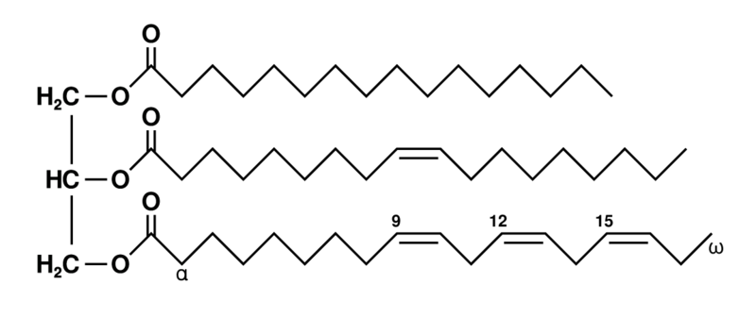
BB02 Molecules of Life
H
C
H
C
H
O
N
P
S
2. Lipids 脂質
Nitrogen
Sulfur
H:O > 2:1
Phosphorus
Tri-glycer-ides (甘油三酯)
1 Glycerol (甘油)
3 Fatty acids (脂肪酸)

Slide 178
BB02 Molecules of Life
H
C
H
C
H
O
N
P
S
2. Lipids 脂質
Nitrogen
Sulfur
H:O > 2:1
Phosphorus
Triglycerides (甘油三酯)
1 Glycerol (甘油)
3 Fatty acids (脂肪酸)

Slide 179
BB02 Molecules of Life
H
C
H
C
H
O
N
P
S
2. Lipids 脂質
Nitrogen
Sulfur
H:O > 2:1
Phosphorus
Bond
Bond
Bond
Triglycerides (甘油三酯)
1 Glycerol (甘油)
3 Fatty acids (脂肪酸)

Slide 180
BB02 Molecules of Life
H
C
H
C
H
O
N
P
S
2. Lipids 脂質
Nitrogen
Sulfur
H:O > 2:1
Phosphorus
Ester Bond
Ester Bond
Ester Bond
Triglycerides (甘油三酯)
1 Glycerol (甘油)
3 Fatty acids (脂肪酸)

Slide 181
BB02 Molecules of Life
H
C
H
C
H
O
N
P
S
P
2. Lipids 脂質
Nitrogen
Sulfur
H:O > 2:1
Phosphorus
P
P
P
P
Triglycerides
(甘油三酯)
Phospho-lipids
(磷脂)
P
P
P
P
1 Phosphate group
1 Glycerol (甘油)
+ 1 Glycerol (甘油)
+ 3 Fatty acids (脂肪酸)
+ 2 Fatty acids (脂肪酸)

Slide 182
BB02 Molecules of Life
C
H
O
N
P
S
Organic biomolecules
Nitrogen
Sulfur
Phosphorus
1. Carbohydrates 碳水化合物
C
H
O
C
H
O
( )
2. Lipids 脂質
P
C
H
O
( )
3. Proteins 蛋白質
N
S
C
H
O
N
P
4. Nucleic acids 核酸

Slide 183
BB02 Molecules of Life
C
H
O
N
P
S
Organic biomolecules
Nitrogen
Sulfur
Phosphorus
1. Carbohydrates 碳水化合物
C
H
O
C
H
O
( )
2. Lipids 脂質
P
C
H
O
( )
3. Proteins 蛋白質
N
S
C
H
O
N
P
4. Nucleic acids 核酸

Slide 184
BB02 Molecules of Life
H
C
H
H
O
C
O
N
S
N
P
3. Proteins 蛋白質
Nitrogen
Sulfur
Phosphorus
Mono單-mer

Slide 185
BB02 Molecules of Life
H
C
H
H
O
C
O
N
S
N
P
3. Proteins 蛋白質
Nitrogen
Sulfur
Phosphorus
Mono單-mer

Slide 186
BB02 Molecules of Life
H
C
H
H
O
C
O
N
S
N
P
3. Proteins 蛋白質
Nitrogen
Sulfur
Phosphorus
Mono單-mer

Slide 187
BB02 Molecules of Life
H
H
H
O
C
O
N
S
N
P
3. Proteins 蛋白質
Nitrogen
Sulfur
Phosphorus
C
Mono單-mer

Slide 188
BB02 Molecules of Life
H
H
O
C
O
N
S
N
P
3. Proteins 蛋白質
Nitrogen
Sulfur
Phosphorus
C
H
Mono單-mer

Slide 189
BB02 Molecules of Life
H
O
C
O
N
S
N
P
3. Proteins 蛋白質
Nitrogen
Sulfur
Phosphorus
H
C
H
Mono單-mer

Slide 190
BB02 Molecules of Life
C
H
O
N
S
N
P
3. Proteins 蛋白質
Nitrogen
Sulfur
Phosphorus
H
C
H
O
Mono單-mer

Slide 191
BB02 Molecules of Life
C
H
O
N
P
S
3. Proteins 蛋白質
Nitrogen
Sulfur
Phosphorus
H
C
H
O
N
Mono單-mer

Slide 192
BB02 Molecules of Life
C
H
O
N
P
S
3. Proteins 蛋白質
Nitrogen
Sulfur
Phosphorus
C
H
O
H
C
H
O
N
Mono單-mer

Slide 193
BB02 Molecules of Life
C
H
O
N
P
S
3. Proteins 蛋白質
Nitrogen
Sulfur
Phosphorus
C
H
O
H
C
H
O
N
Amino acids (胺基酸)
Mono單-mer

Slide 194
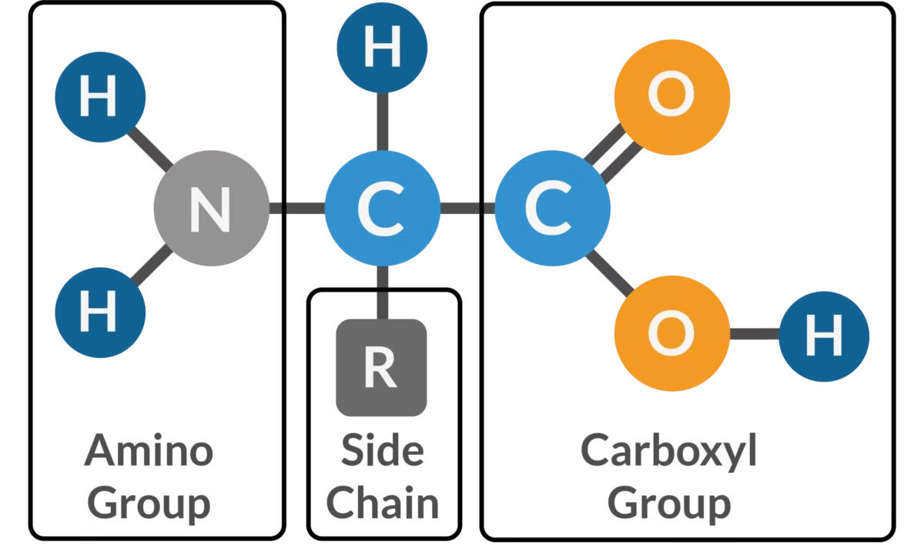
BB02 Molecules of Life
C
H
O
N
P
S
3. Proteins 蛋白質
Nitrogen
Sulfur
Phosphorus
Amino acids (胺基酸)
Mono單-mer

Slide 195

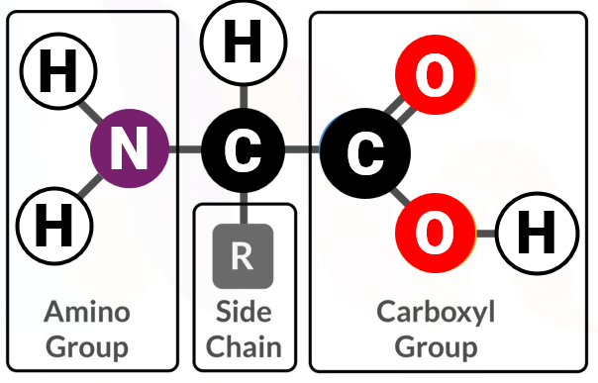
BB02 Molecules of Life
C
H
O
S
N
P
S
3. Proteins 蛋白質
Nitrogen
Sulfur
Phosphorus
Amino acids (胺基酸)
Mono單-mer

Slide 196
BB02 Molecules of Life
C
H
O
S
N
P
S
3. Proteins 蛋白質
Nitrogen
Sulfur
Phosphorus
Amino acid
Amino acid

Slide 197
BB02 Molecules of Life
C
H
O
S
N
P
S
3. Proteins 蛋白質
Nitrogen
Sulfur
Phosphorus
Amino acid
Amino acid

Slide 198
BB02 Molecules of Life
C
H
O
S
N
P
S
3. Proteins 蛋白質
Nitrogen
Sulfur
Phosphorus
Amino acid
Amino acid

Slide 199
BB02 Molecules of Life
C
H
O
S
N
P
S
3. Proteins 蛋白質
Nitrogen
Sulfur
Phosphorus
H₂O
Amino acid
Amino acid

Slide 200
BB02 Molecules of Life
C
H
O
S
N
P
S
3. Proteins 蛋白質
Nitrogen
Sulfur
Phosphorus
H₂O
Amino acid
Amino acid

Slide 201
BB02 Molecules of Life
C
H
O
S
N
P
S
3. Proteins 蛋白質
Nitrogen
Sulfur
Phosphorus
H₂O
Amino acid
Amino acid

Slide 202
BB02 Molecules of Life
C
H
O
S
N
P
S
3. Proteins 蛋白質
Nitrogen
Sulfur
Phosphorus
Bond
H₂O
Amino acid
Amino acid

Slide 203
BB02 Molecules of Life
C
H
O
S
N
P
S
3. Proteins 蛋白質
Nitrogen
Sulfur
Phosphorus
Bond
H₂O
Dipeptide (二肽)
Amino acid
Amino acid

Slide 204
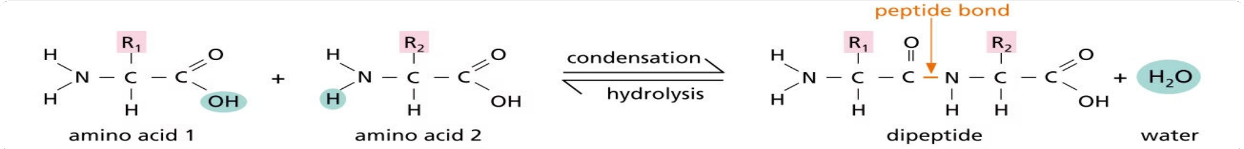
BB02 Molecules of Life
C
H
O
S
N
P
S
3. Proteins 蛋白質
Nitrogen
Sulfur
Phosphorus

Slide 205
BB02 Molecules of Life
C
H
O
S
N
P
S
3. Proteins 蛋白質
Nitrogen
Sulfur
Phosphorus

Slide 206
BB02 Molecules of Life
C
H
O
S
N
P
S
3. Proteins 蛋白質
Nitrogen
Sulfur
Phosphorus

Slide 207
BB02 Molecules of Life
C
H
O
S
N
P
S
3. Proteins 蛋白質
Nitrogen
Sulfur
Phosphorus

Slide 208
BB02 Molecules of Life
C
H
O
S
N
P
S
3. Proteins 蛋白質
Nitrogen
Sulfur
Phosphorus

Slide 209
BB02 Molecules of Life
C
H
O
S
N
P
S
3. Proteins 蛋白質
Nitrogen
Sulfur
Phosphorus
Amino
Group
Carboxyl
Group
Amino
Group
Carboxyl
Group

Slide 210
BB02 Molecules of Life
C
H
O
S
N
P
S
3. Proteins 蛋白質
Nitrogen
Sulfur
Phosphorus
Amino
Group
Carboxyl
Group
Amino
Group
Carboxyl
Group

Slide 211
BB02 Molecules of Life
C
H
O
S
N
P
S
3. Proteins 蛋白質
Nitrogen
Sulfur
Phosphorus
Amino
Group
Carboxyl
Group
Amino
Group
Carboxyl
Group

Slide 212
BB02 Molecules of Life
C
H
O
S
N
P
S
3. Proteins 蛋白質
Nitrogen
Sulfur
Phosphorus
H₂O
Amino
Group
Carboxyl
Group
Amino
Group
Carboxyl
Group

Slide 213
BB02 Molecules of Life
C
H
O
S
N
P
S
3. Proteins 蛋白質
Nitrogen
Sulfur
Phosphorus
Amino
Group
Carboxyl
Group
Amino
Group
Carboxyl
Group
H₂O

Slide 214
BB02 Molecules of Life
C
H
O
S
N
P
S
3. Proteins 蛋白質
Nitrogen
Sulfur
Phosphorus
Amino
Group
Carboxyl
Group
Amino
Group
Carboxyl
Group
H₂O

Slide 215
BB02 Molecules of Life
C
H
O
S
N
P
S
3. Proteins 蛋白質
Nitrogen
Sulfur
Phosphorus
Amino
Group
Carboxyl
Group
Amino
Group
Carboxyl
Group
H₂O

Slide 216
BB02 Molecules of Life
C
H
O
S
N
P
S
3. Proteins 蛋白質
Nitrogen
Sulfur
Phosphorus
Amino
Group
Carboxyl
Group
Amino
Group
Carboxyl
Group
H₂O

Slide 217
BB02 Molecules of Life
3. Proteins 蛋白質
Condensation 縮合
Amino
Group
Carboxyl
Group
Poly (多)-mero`

Slide 218
BB02 Molecules of Life
3. Proteins 蛋白質
Condensation 縮合
Amino
Group
Carboxyl
Group
Poly (多)-mero`

Slide 219
BB02 Molecules of Life
3. Proteins 蛋白質
Condensation 縮合
Amino
Group
Carboxyl
Group
Poly (多)-mero`

Slide 220
BB02 Molecules of Life
3. Proteins 蛋白質
Condensation 縮合
Amino
Group
Carboxyl
Group
H₂O
Poly (多)-mero`

Slide 221
BB02 Molecules of Life
3. Proteins 蛋白質
Condensation 縮合
Amino
Group
Carboxyl
Group
H₂O
Poly (多)-mero`

Slide 222
BB02 Molecules of Life
3. Proteins 蛋白質
Condensation 縮合
Amino
Group
Carboxyl
Group
H₂O
Poly (多)-mero`

Slide 223
BB02 Molecules of Life
3. Proteins 蛋白質
Condensation 縮合
Amino
Group
Carboxyl
Group
H₂O
Poly (多)-mero`

Slide 224
BB02 Molecules of Life
3. Proteins 蛋白質
Condensation 縮合
Amino
Group
Carboxyl
Group
H₂O
Poly (多)-mero`

Slide 225
BB02 Molecules of Life
3. Proteins 蛋白質
Condensation 縮合
Amino
Group
Carboxyl
Group
H₂O
H₂O
Poly (多)-mero`

Slide 226
BB02 Molecules of Life
3. Proteins 蛋白質
Condensation 縮合
Amino
Group
Carboxyl
Group
H₂O
H₂O
Poly (多)-mero`

Slide 227
BB02 Molecules of Life
3. Proteins 蛋白質
Condensation 縮合
Amino
Group
Carboxyl
Group
H₂O
H₂O
Poly (多)-mero`

Slide 228
BB02 Molecules of Life
3. Proteins 蛋白質
Condensation 縮合
Amino
Group
Carboxyl
Group
H₂O
H₂O
Poly (多)-mero`

Slide 229
BB02 Molecules of Life
3. Proteins 蛋白質
Condensation 縮合
Amino
Group
Carboxyl
Group
H₂O
H₂O
Poly (多)-mero`

Slide 230
BB02 Molecules of Life
3. Proteins 蛋白質
Condensation 縮合
Amino
Group
Carboxyl
Group
H₂O
H₂O
H₂O
Poly (多)-mero`

Slide 231
BB02 Molecules of Life
3. Proteins 蛋白質
Condensation 縮合
Amino
Group
Carboxyl
Group
H₂O
H₂O
H₂O
Poly (多)-mero`

Slide 232
BB02 Molecules of Life
3. Proteins 蛋白質
Condensation 縮合
Amino
Group
Carboxyl
Group
H₂O
H₂O
H₂O
Poly (多)-mero`

Slide 233
BB02 Molecules of Life
3. Proteins 蛋白質
Condensation 縮合
Amino
Group
Carboxyl
Group
H₂O
H₂O
H₂O
Poly (多)-mero`

Slide 234
BB02 Molecules of Life
3. Proteins 蛋白質
Condensation 縮合
Amino
Group
Carboxyl
Group
H₂O
H₂O
H₂O
Poly (多)-mero`

Slide 235
BB02 Molecules of Life
3. Proteins 蛋白質
Condensation 縮合
Amino
Group
Carboxyl
Group
H₂O
H₂O
H₂O
H₂O
Poly (多)-mero`

Slide 236
BB02 Molecules of Life
3. Proteins 蛋白質
Condensation 縮合
Amino
Group
Carboxyl
Group
H₂O
H₂O
H₂O
H₂O
Poly (多)-mero`

Slide 237
BB02 Molecules of Life
3. Proteins 蛋白質
Condensation 縮合
Amino
Group
Carboxyl
Group
H₂O
H₂O
H₂O
H₂O
Poly (多)-mero`

Slide 238
BB02 Molecules of Life
3. Proteins 蛋白質
Condensation 縮合
Amino
Group
Carboxyl
Group
H₂O
H₂O
H₂O
H₂O
Poly (多)-mero`

Slide 239
BB02 Molecules of Life
3. Proteins 蛋白質
Condensation 縮合
Amino
Group
Carboxyl
Group
H₂O
H₂O
H₂O
H₂O
Poly (多)-mero`

Slide 240
BB02 Molecules of Life
3. Proteins 蛋白質
Condensation 縮合
Amino
Group
Carboxyl
Group
H₂O
H₂O
H₂O
H₂O
Polypeptide (多肽) Chain`
Poly (多)-mero`

Slide 241
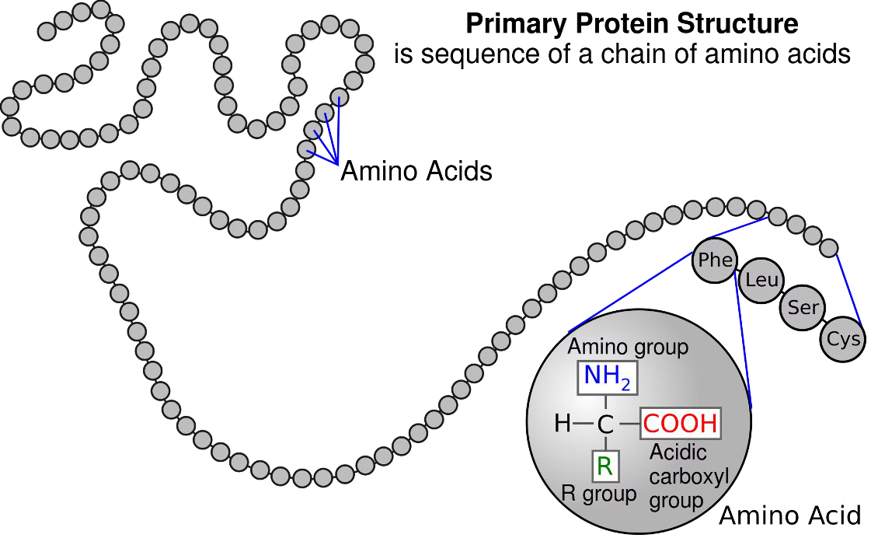
BB02 Molecules of Life
3. Proteins 蛋白質
Polypeptide (多肽) Chain`
Poly (多)-mero`

Slide 242
BB02 Molecules of Life
3. Proteins 蛋白質
Polypeptide chain 1
Polypeptide chain 2
Polypeptide (多肽) Chains`
Poly (多)-mero`

Slide 243
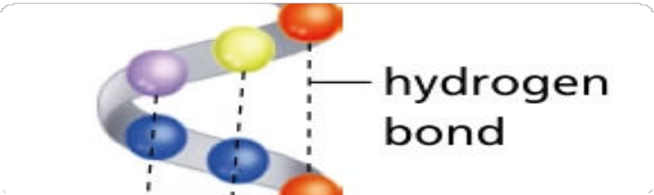
BB02 Molecules of Life
3. Proteins 蛋白質
Polypeptide chain 1
Hydrogen bonds
Polypeptide chain 2
Polypeptide (多肽) Chains`
Poly (多)-mero`

Slide 244
BB02 Molecules of Life
3. Proteins 蛋白質
Polypeptide chain 1
Polypeptide chain 2
Polypeptide (多肽) Chains`
Poly (多)-mero`

Slide 245
BB02 Molecules of Life
3. Proteins 蛋白質
Polypeptide (多肽) Chains`
Poly (多)-mero`

Slide 246
BB02 Molecules of Life
3. Proteins 蛋白質
Proteins 蛋白質
Polypeptide (多肽) Chains`
Poly (多)-mero`

Slide 247
BB02 Molecules of Life
3. Proteins 蛋白質
Proteins 蛋白質
Polypeptide (多肽) Chains`
Poly (多)-mero`

Slide 248
BB02 Molecules of Life
3. Proteins 蛋白質
Foldings give rise to 3D conformation
Proteins 蛋白質
Polypeptide (多肽) Chains`
Poly (多)-mero`

Slide 249
BB02 Molecules of Life
3. Proteins 蛋白質
Foldings give rise to 3D conformation
Proteins 蛋白質
Polypeptide (多肽) Chains`
Poly (多)-mero`

Slide 250
BB02 Molecules of Life
3. Proteins 蛋白質
Foldings give rise to 3D conformation
3D conformation determine protein functions
Proteins 蛋白質
Polypeptide (多肽) Chains`
Poly (多)-mero`

Slide 251
BB02 Molecules of Life
3. Proteins 蛋白質
Suboptimal pH and temperature denature proteins

