Slide 1
BB02 Molecules of Life
Organic = C-H / C-C bonds
C
H
O
Carbon
Hydrogen
Oxygen

Slide 2
BB02 Molecules of Life
C
H
O
N
P
S
Organic biomolecules
Nitrogen
Sulfur
Phosphorus
1. Carbohydrates 碳水化合物
C
H
O
C
H
O
( )
2. Lipids 脂質
P
C
H
O
N
( )
3. Proteins 蛋白質
S
C
H
O
N
P
4. Nucleic acids 核酸

Slide 3
BB02 Molecules of Life
Condensation 縮合 and Hydrolysis 水解
Mono單-mer
Mono單-mer

Slide 4
BB02 Molecules of Life
Condensation 縮合
H₂O
Bond
Di (二)-mero
Mono(單)-mer
Mono(單)-mer

Slide 5
BB02 Molecules of Life
Condensation 縮合
Bond
H₂O
Bond
Poly (多)-mero`
Di (二)-mero
Mono(單)-mer

Slide 6
BB02 Molecules of Life
Condensation 縮合
H₂O
H₂O
H₂O
H₂O
Poly (多)-mero`

Slide 7
BB02 Molecules of Life
Hydrolysis 水解
Bond
H₂O
Di (二)-mero
Mono(單)-mer
Mono(單)-mer

Slide 8

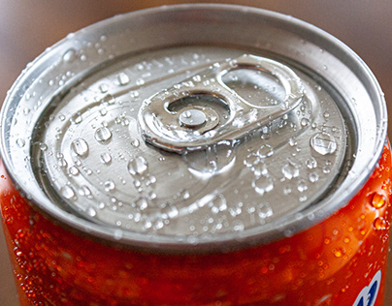
BB02 Molecules of Life
Condensation 縮合 and Hydrolysis 水解
Bond
H₂O
H₂O
hydrolysis
“Condensation 係會出水”
“水解，用水去解 (bond)”

Slide 9



宜家加大炸雞餐有特價，但阿媽話唔健康唔比買；點樣用生物科概念說服佢炸雞餐有營養需要？
快樂水
快樂條
快樂雞
總糖份: ~56g
總脂肪: ~20g
總蛋白質: ~32g
碳水化合物(Carbohydrates)係人不可或缺嘅快速能量來源(Fast respiration fuel
)，葡萄糖更係大腦必要嘅養份。
脂質(Lipids)係高效嘅能量處存 (Efficient storage
)，亦係組成細胞膜同部份荷爾蒙嘅重要成份。
蛋白質(Proteins) 3D結構多變，構成大部份身體組織 (Structural build blocks
)以及酶﹑抗體﹑血紅素等重要分子。

Slide 10
BB02 Molecules of Life
C
H
O
N
P
S
Organic biomolecules
Nitrogen
Sulfur
Phosphorus
1. Carbohydrates 碳水化合物
C
H
O
C
H
O
( )
2. Lipids 脂質
P
C
H
O
( )
3. Proteins 蛋白質
N
S
C
H
O
N
P
4. Nucleic acids 核酸

Slide 11

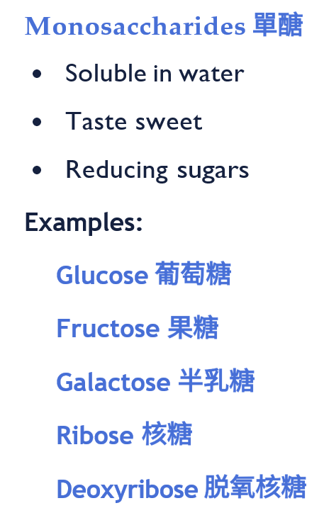
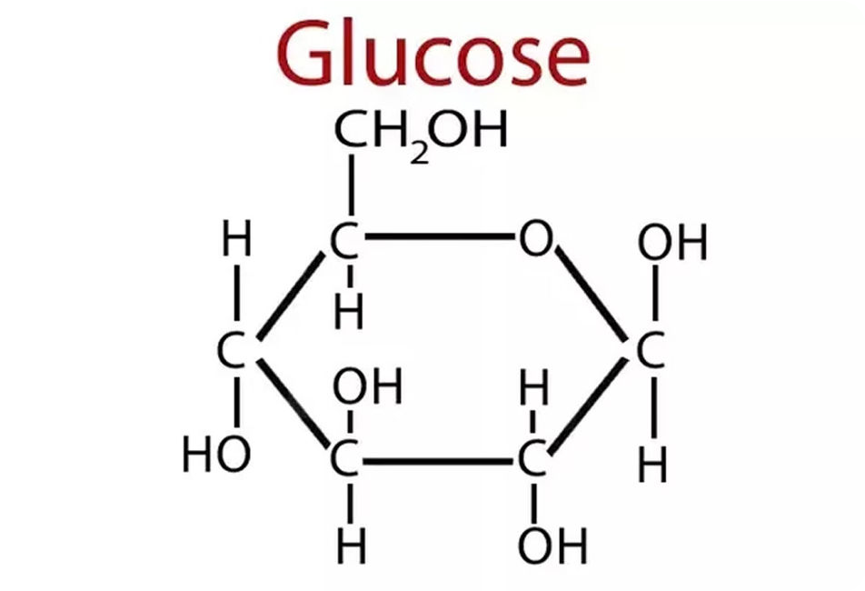
BB02 Molecules of Life
H
C
H
C
H
O
N
P
S
Carbohydrates
碳水化合物
Nitrogen
Sulfur
Phosphorus
H:O = 2:1
C
H
O
Mono-saccharides (單醣)
Mono單-mer

Slide 12
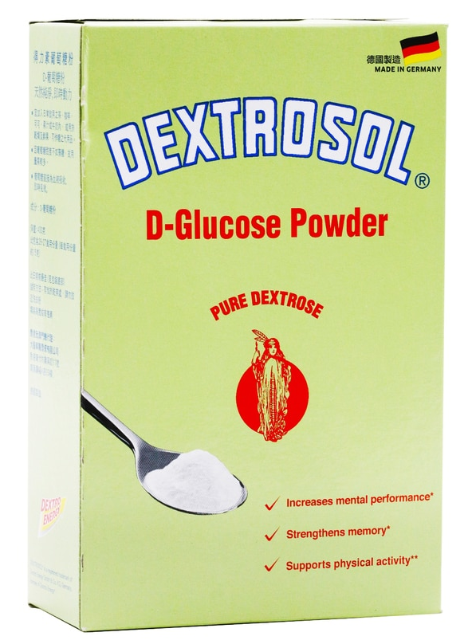
BB02 Molecules of Life
H
C
H
C
H
O
N
P
S
Carbohydrates
碳水化合物
Nitrogen
Sulfur
Phosphorus
H:O = 2:1
Mono-saccharides (單醣)
Mono單-mer

Slide 13
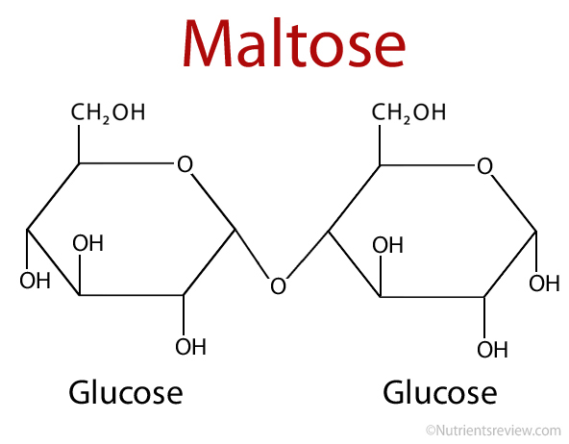
BB02 Molecules of Life
Carbohydrates
碳水化合物
Condensation 縮合
C
H
O
C
H
O
H₂O
Glycosidic bond
糖鍵
Bond
Disaccharides (雙醣)
Di (二)-mero
Monosaccharides
Monosaccharides

Slide 14

BB02 Molecules of Life
H
C
H
C
H
O
N
P
S
Carbohydrates
碳水化合物
Nitrogen
Sulfur
Phosphorus
H:O = 2:1
Hydrolysis
Condensation
Monosaccharides (單醣)
Disaccharides (雙醣)

Slide 15
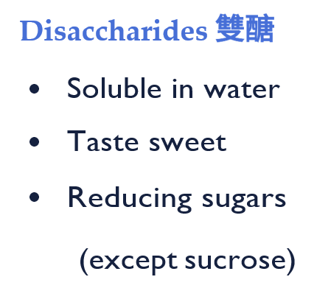
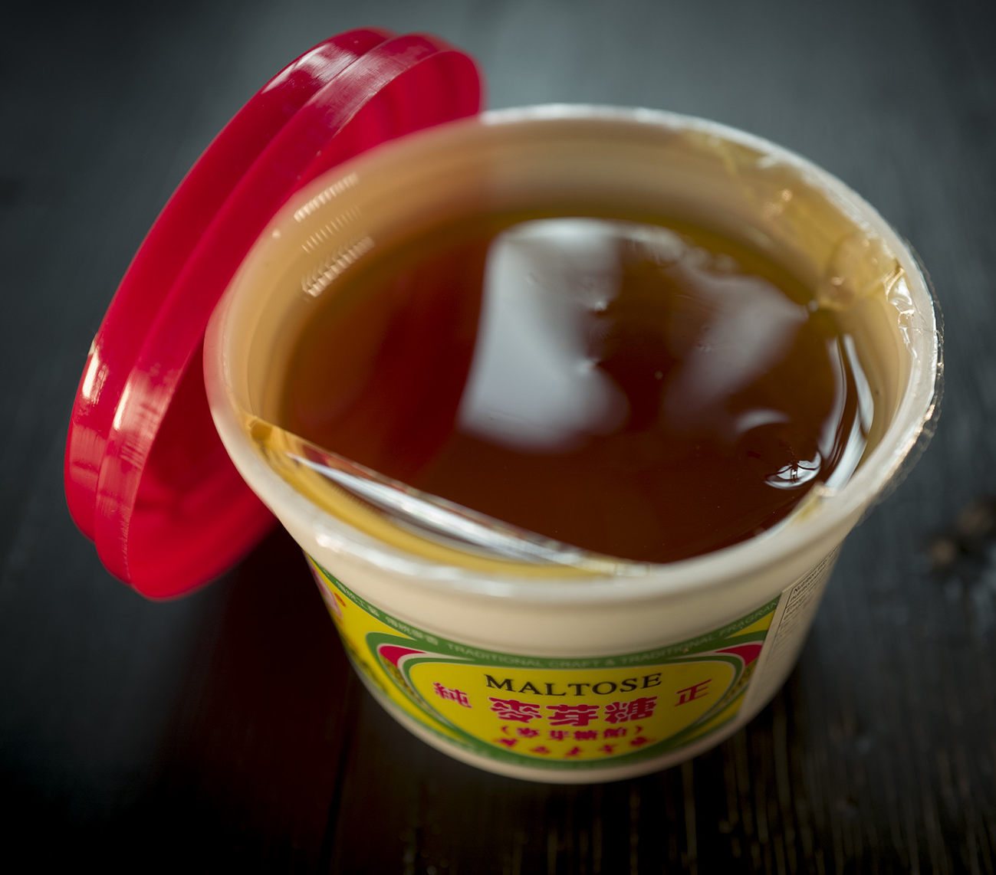
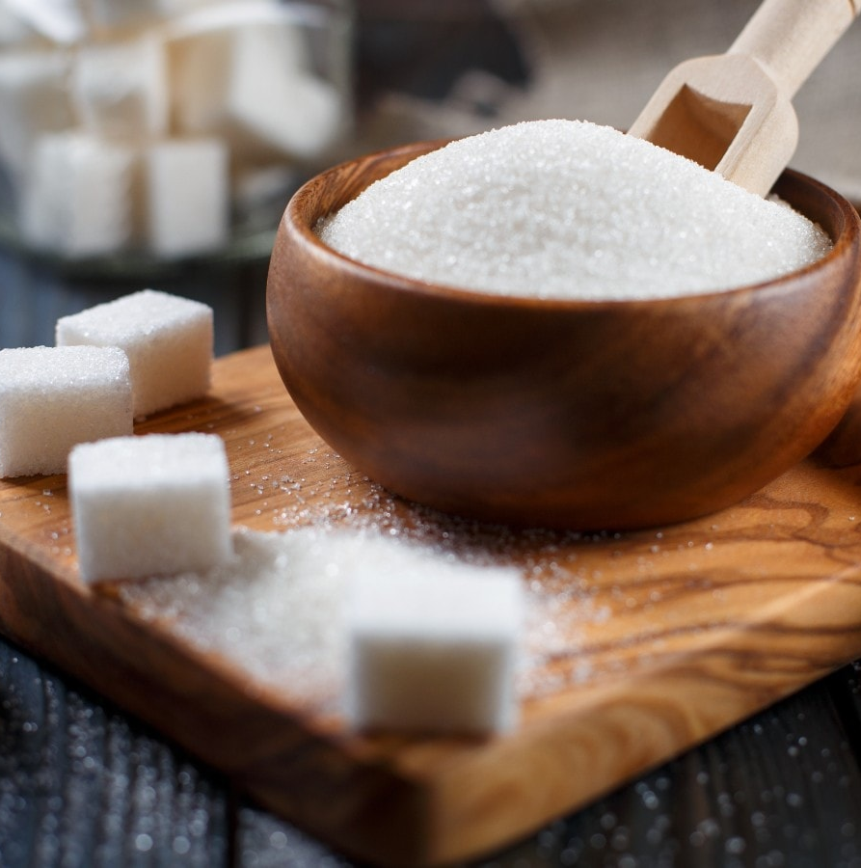
BB02 Molecules of Life
H
C
H
C
H
O
N
P
S
Carbohydrates
碳水化合物
Nitrogen
Sulfur
Phosphorus
H:O = 2:1
Maltose 麥芽糖
glucose + glucose - water
Sucrose 蔗糖
glucose + fructose - water
Lactose 乳糖
glucose + galactose - water
Disaccharides (雙醣)

Slide 16
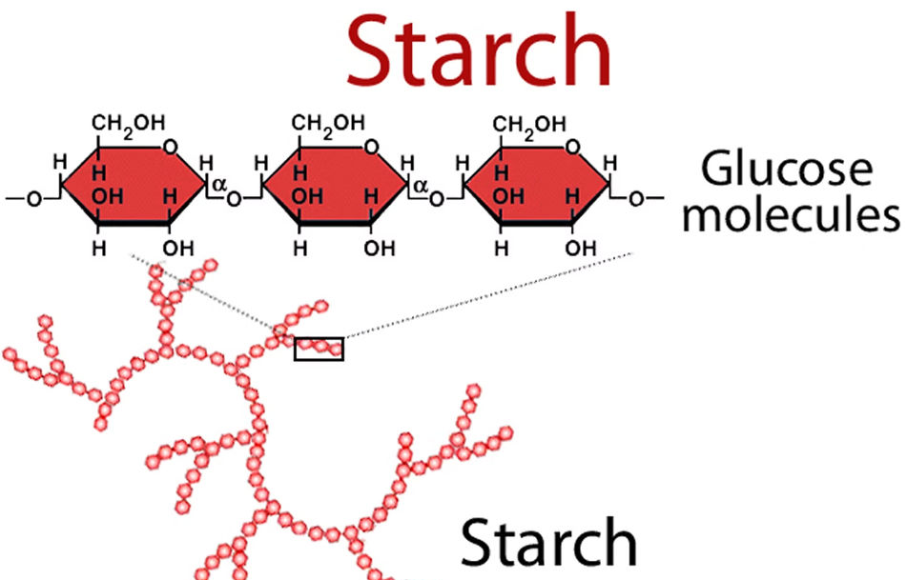
BB02 Molecules of Life
Carbohydrates
碳水化合物
Condensation 縮合
H₂O
H₂O
H₂O
H₂O
Poly (多)-mero`
Polysaccharides (多醣)
`

Slide 17
BB02 Molecules of Life
H
C
H
C
H
O
N
P
S
Carbohydrates
碳水化合物
Nitrogen
Sulfur
Phosphorus
H:O = 2:1
Hydrolysis
Hydrolysis
Condensation
Condensation
Monosaccharides (單醣)
Disaccharides
(雙醣)
Polysaccharides (多醣)

Slide 18
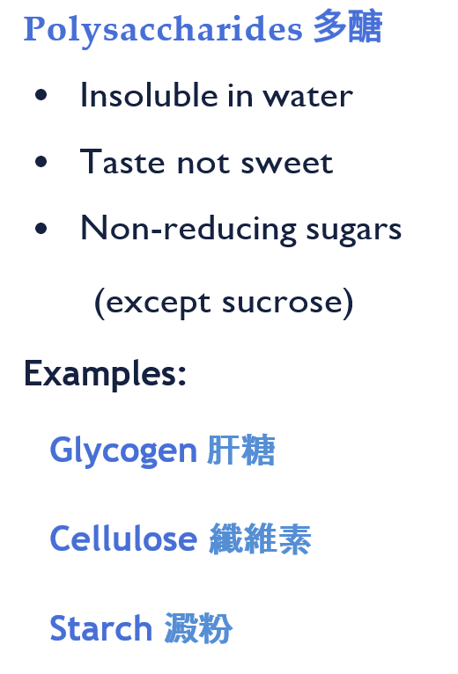

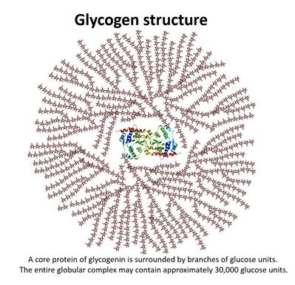
BB02 Molecules of Life
H
C
H
C
H
O
N
P
S
Carbohydrates
碳水化合物
Nitrogen
Sulfur
Phosphorus
H:O = 2:1
Polysaccharides (多醣)

Slide 19
BB02 Molecules of Life
C
H
O
N
P
S
Organic biomolecules
Nitrogen
Sulfur
Phosphorus
1. Carbohydrates 碳水化合物
C
H
O
C
H
O
( )
2. Lipids 脂質
P
C
H
O
( )
3. Proteins 蛋白質
N
S
C
H
O
N
P
4. Nucleic acids 核酸

Slide 20

BB02 Molecules of Life
H
C
H
H
O
C
O
N
P
S
2. Lipids 脂質
Nitrogen
Sulfur
H:O > 2:1
Phosphorus
Mono單-mer

Slide 21
BB02 Molecules of Life
H
C
H
C
H
O
N
P
S
2. Lipids 脂質
Nitrogen
Sulfur
H:O > 2:1
Phosphorus
Fatty acid (脂肪酸)
Fatty acid (脂肪酸)
Fatty acid (脂肪酸)
Glycerol (甘油)

Slide 22
BB02 Molecules of Life
H
C
H
C
H
O
N
P
S
2. Lipids 脂質
Nitrogen
Sulfur
H:O > 2:1
Phosphorus
H₂O
Bond
H₂O
Bond
H₂O
Bond
1 Glycerol (甘油)
3 Fatty acids (脂肪酸)
3 Condensations 縮合 !

Slide 23
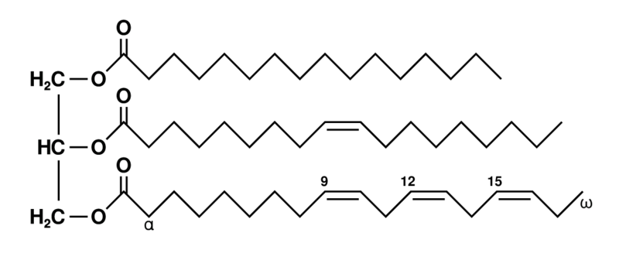
BB02 Molecules of Life
H
C
H
C
H
O
N
P
S
2. Lipids 脂質
Nitrogen
Sulfur
H:O > 2:1
Phosphorus
Tri-glycer-ides (甘油三酯)
1 Glycerol (甘油)
3 Fatty acids (脂肪酸)

Slide 24
BB02 Molecules of Life
H
C
H
C
H
O
N
P
S
2. Lipids 脂質
Nitrogen
Sulfur
H:O > 2:1
Phosphorus
Bond
Bond
Bond
Triglycerides (甘油三酯)
1 Glycerol (甘油)
3 Fatty acids (脂肪酸)

Slide 25
BB02 Molecules of Life
H
C
H
C
H
O
N
P
S
2. Lipids 脂質
Nitrogen
Sulfur
H:O > 2:1
Phosphorus
Ester Bond
Ester Bond
Ester Bond
Triglycerides (甘油三酯)
1 Glycerol (甘油)
3 Fatty acids (脂肪酸)

Slide 26
BB02 Molecules of Life
H
C
H
C
H
O
N
P
S
P
2. Lipids 脂質
Nitrogen
Sulfur
H:O > 2:1
Phosphorus
P
P
P
P
Triglycerides
(甘油三酯)
Phospho-lipids
(磷脂)
P
P
P
P
1 Phosphate group
1 Glycerol (甘油)
+ 1 Glycerol (甘油)
+ 3 Fatty acids (脂肪酸)
+ 2 Fatty acids (脂肪酸)

Slide 27
BB02 Molecules of Life
C
H
O
N
P
S
Organic biomolecules
Nitrogen
Sulfur
Phosphorus
1. Carbohydrates 碳水化合物
C
H
O
C
H
O
( )
2. Lipids 脂質
P
C
H
O
( )
3. Proteins 蛋白質
N
S
C
H
O
N
P
4. Nucleic acids 核酸

Slide 28
BB02 Molecules of Life
H
C
H
H
O
C
O
N
S
N
P
3. Proteins 蛋白質
Nitrogen
Sulfur
Phosphorus
C
H
O
Amino acids (胺基酸)
Mono單-mer

Slide 29
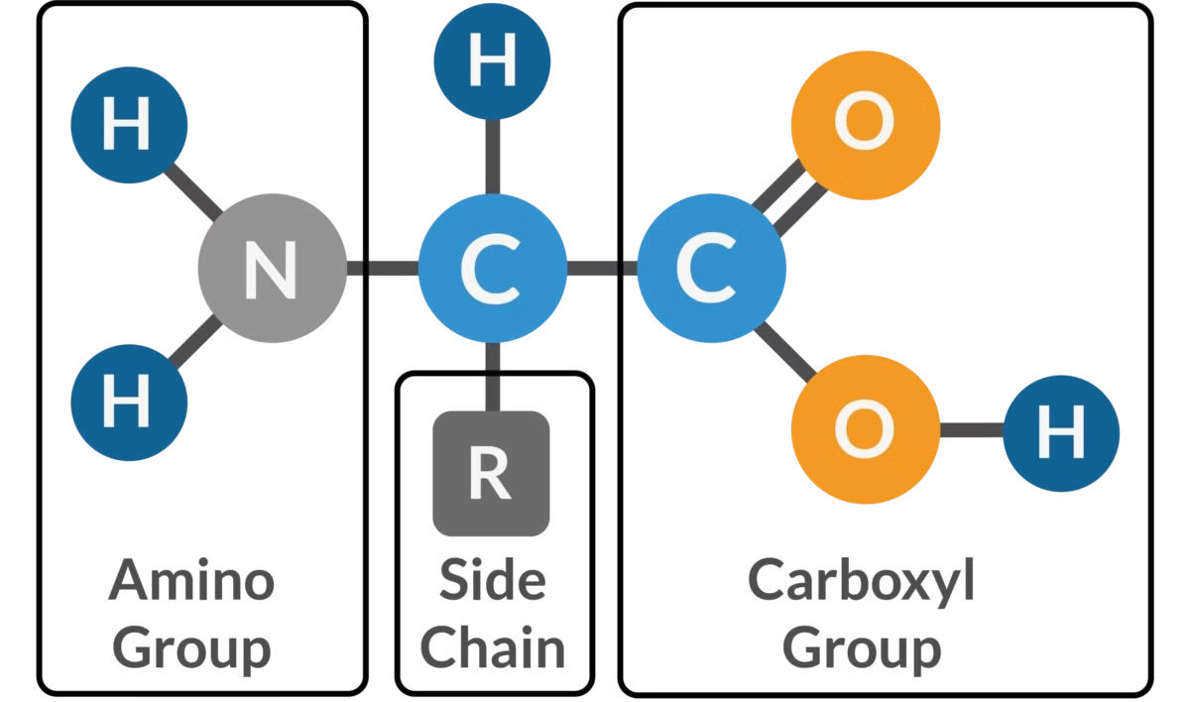
BB02 Molecules of Life
C
H
O
N
P
S
3. Proteins 蛋白質
Nitrogen
Sulfur
Phosphorus
Amino acids (胺基酸)
Mono單-mer

Slide 30

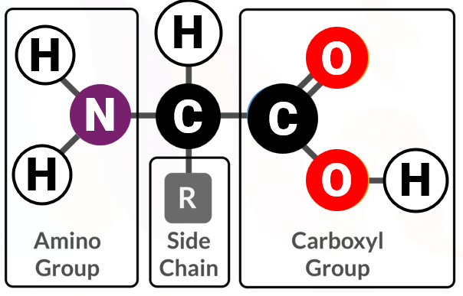
BB02 Molecules of Life
C
H
O
S
N
P
S
3. Proteins 蛋白質
Nitrogen
Sulfur
Phosphorus
Amino acids (胺基酸)
Mono單-mer

Slide 31
BB02 Molecules of Life
C
H
O
S
N
P
S
3. Proteins 蛋白質
Nitrogen
Sulfur
Phosphorus
H₂O
Bond
Dipeptide (二肽)
Amino acid
Amino acid

Slide 32
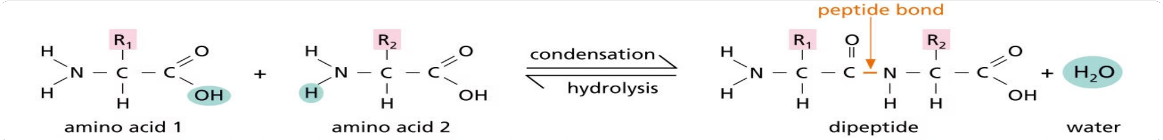
BB02 Molecules of Life
C
H
O
S
N
P
S
3. Proteins 蛋白質
Nitrogen
Sulfur
Phosphorus

Slide 33
BB02 Molecules of Life
C
H
O
S
N
P
S
3. Proteins 蛋白質
Nitrogen
Sulfur
Phosphorus
H₂O
Amino
Group
Carboxyl
Group
Amino
Group
Carboxyl
Group

Slide 34
BB02 Molecules of Life
3. Proteins 蛋白質
Condensation 縮合
Amino
Group
Carboxyl
Group
H₂O
H₂O
H₂O
H₂O
Polypeptide (多肽) Chain`
Poly (多)-mero`

Slide 35
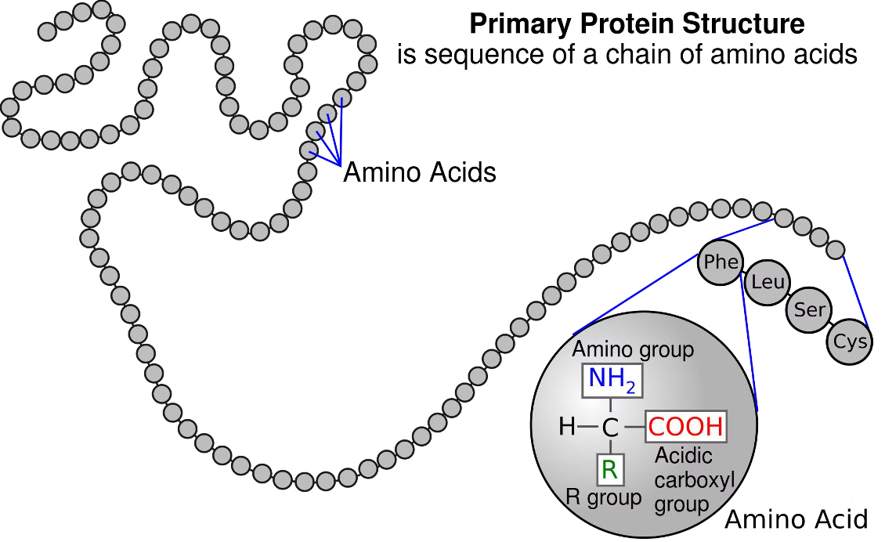
BB02 Molecules of Life
3. Proteins 蛋白質
Polypeptide (多肽) Chain`
Poly (多)-mero`

Slide 36
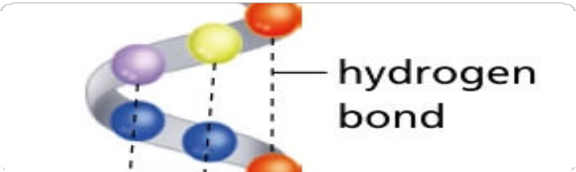
BB02 Molecules of Life
3. Proteins 蛋白質
Polypeptide chain 1
Hydrogen bonds
Polypeptide chain 2
Polypeptide (多肽) Chains`
Poly (多)-mero`

Slide 37
BB02 Molecules of Life
3. Proteins 蛋白質
3D conformation determine protein functions
Foldings give rise to 3D conformation
Proteins 蛋白質
Polypeptide (多肽) Chains`
Poly (多)-mero`

Slide 38
BB02 Molecules of Life
3. Proteins 蛋白質
Suboptimal pH and temperature denature proteins

