Slide 1

PlayDeck
Team 17: Greg Yogan, Alex Hamm, Kyle Fischer, Christian Nitz, Mark Pundmann

Slide 2
Our Vision
Bring back timeless classics of card games into a busy new world

Slide 3
Statement from User
“I don’t have time or energy to carry around a deck of cards or a table. If only there was an app for that…“ – Confucius

Slide 4
Our Answer: Introducing Play Deck
Easy to use
Full Deck of Cards
Allows a wide range of games to be played
Includes single player games such as War
Beautiful graphics

Slide 5
Customizable
Custom User Names
Custom Card Decks from your library
Custom rules
Open ended gameplay

Slide 6
Custom Rules
Choose which cards are in play
Name the Game
Choose the max number of cards in a hand
Choose certain rules such as, Do played cards stack and does the dealer rotate
Then share this between players

Slide 7
Are you ready to see it!

Slide 8
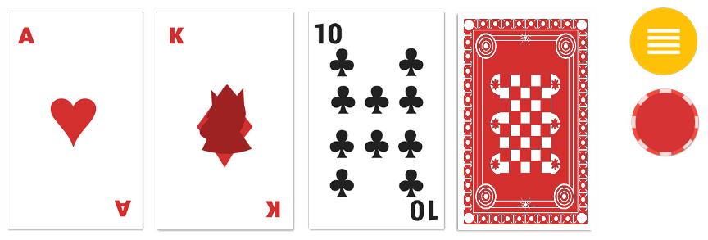

Layout and Design
“As a user, I want the graphics to be attractive, bright, and colorful”
Pre-rendered sprites for buttons, cards, etc.
Based on Google’s Material Design language

Slide 9
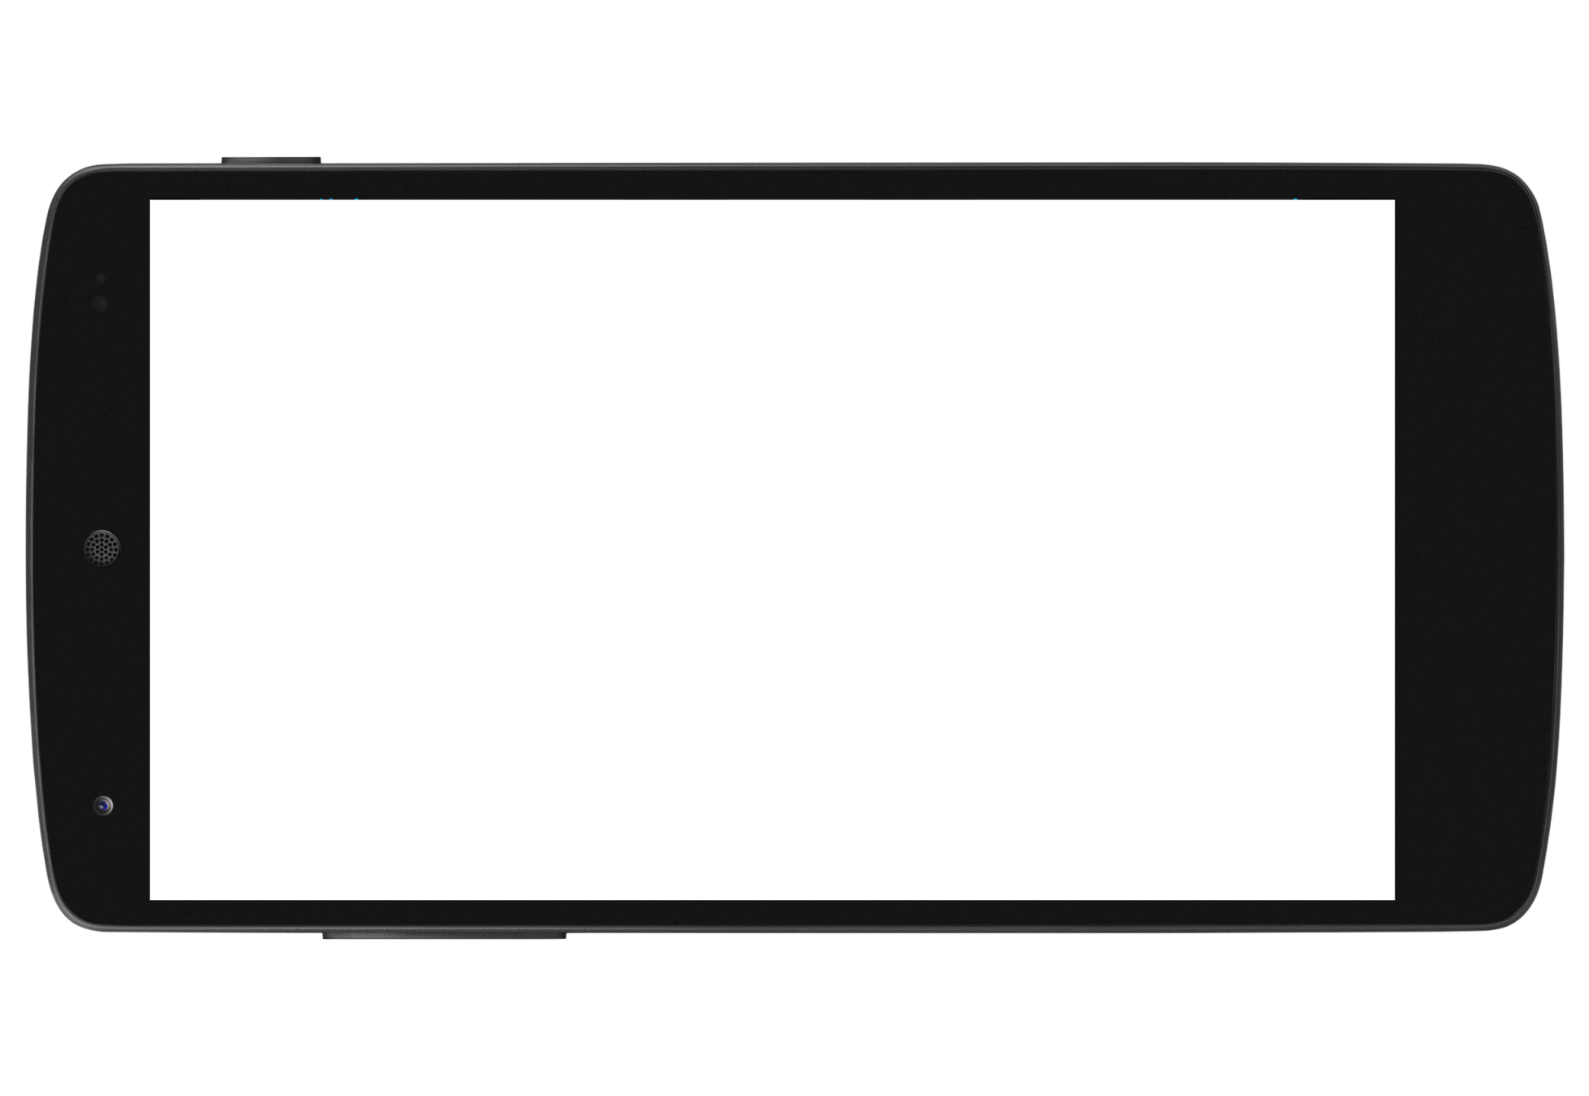
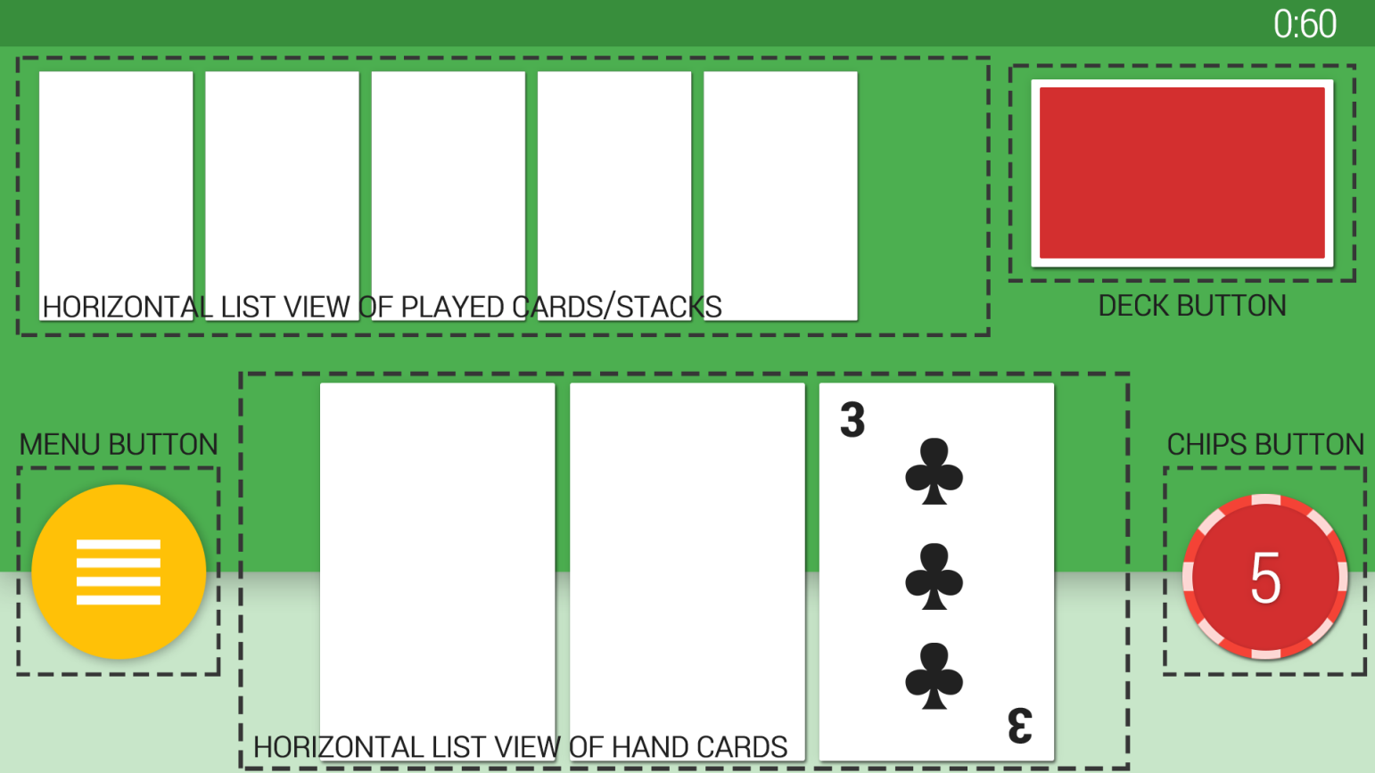
Layout and Design (CONT.)
“As a user, I want the layout of the app to be uncluttered and easy to use”
Offer as many game functions as possible using the fewest buttons as possible

Slide 10
Issues we had
GitHub
Kyle could never submit past sprint 1
Alex couldn’t pull during sprint 2
Networking
Greg has issues creating network between devices until Sprint 3
Android Studio
Christian couldn’t Launch the app emulator

