Slide 1
⚽
Football Player Analysis
& Classification Using Data Mining
Introduction to Data Mining — Islamic Azad University, Central Tehran
Second Semester 1404–1405 | Dr. Mehrdad Fadaei
Presented by: Kian Kheiri Nejad
FIFA 23
Transfermarkt
18,539 Players
77,982 Transfers
› Chapter 1–6 Full Coverage
› Classification + Clustering
› Decision Tree · KNN · Random Forest · Logistic Regression · K-Means
Data Mining Project | Kian Kheiri Nejad | IAU Central Tehran | 2026

Slide 2
Table of Contents
Overview of all sections covered in this presentation
01
Objective & Motivation
02
Real-World Applications
Why this project and what we aim to achieve
How top clubs use data mining for scouting
03
Dataset Overview
04
Phase 1 — Data Understanding
FIFA 23 & Transfermarkt — sources and structure
Attribute types, descriptive statistics, visualization
05
Phase 2 — Preprocessing
06
Phase 3 — Classification
Cleaning, integration, normalization, encoding
4 models trained, compared, and analyzed
07
Phase 4 — Clustering
08
Chapter Coverage
K-Means, challenge & fix, results
How all 6 chapters map to our project
09
Sources & References
10
Conclusion
Where the data came from
What we learned and achieved
Data Mining Project | Kian Kheiri Nejad | IAU Central Tehran | 2026

Slide 3
Project Objective
What we are trying to achieve and why it matters
🎯
Core Objective
Build a data mining system that (1) accurately predicts a football player's position from performance stats, and (2) discovers natural player groups based on playing style — using FIFA 23 and Transfermarkt datasets.
Data Mining Project | Kian Kheiri Nejad | IAU Central Tehran | 2026

Slide 4
Real-World Applications
How football clubs and organizations actually use data mining today
🔍
💰
🤝
Player Scouting
Market Value Prediction
Transfer Negotiation
Real Madrid & Man City
Transfermarkt & FIFA
Player Agents & Agencies
Use ML models to shortlist candidates matching tactical profiles from thousands of players across 50+ leagues before watching a single game.
Predict player market value using regression models trained on historical transfer fees, performance stats, and career trajectory data.
Identify undervalued players and optimal transfer windows for maximum market value using predictive data mining models.
🎮
📺
🏥
FIFA Rating Classification
Tactical Broadcast Analysis
Injury Risk Analysis
EA Sports
Sky Sports & DAZN
Club Medical Departments
Automatically assign player ratings and positions using decision trees trained on real-world Opta and StatsBomb performance data.
Group teams by playing style (high-press, possession, counter) for real-time tactical insights during live match broadcasts.
Cluster players by physical profile (pace, physicality, age) to identify high-risk groups and tailor training loads to minimize injury rates.
Data Mining Project | Kian Kheiri Nejad | IAU Central Tehran | 2026

Slide 5
Dataset Overview — Chapter 1 & 2
Two real-world datasets collected and integrated from multiple sources
⚽ FIFA 23 — Complete Player Dataset
💰 Transfermarkt — Transfer Records
18,539
90
77,982
4
Total Players
Raw Columns
Transfer Records
Leagues
0
4
33 yrs
16
Missing Values
Positions
1992–2025
Columns
Key Features Used:
Leagues: La Liga · Premier League · Bundesliga · Serie A
PaceTotal · ShootingTotal · PassingTotal · DribblingTotal
DefendingTotal · PhysicalityTotal · Overall · Potential · Age
Columns: player_name · age · nationality · position · market_value · fee · is_loan · season · movement
Data Mining Project | Kian Kheiri Nejad | IAU Central Tehran | 2026

Slide 6
Phase 1 — Data Understanding (Chapter 2)
Exploring attribute types, descriptive statistics, and distributions
18,539
25.2
65.9
68.0
Total Players
Average Age
Average Overall
Average Pace
FIFA 23
years
out of 91 max
out of 97 max
Attribute Types (Chapter 2)
Position Distribution
Numeric — int64
Age, Overall, PaceTotal, ShootingTotal...
73
Text — object
Name, Nationality, BestPosition, Club...
13
Float — float64
ValueEUR, WageEUR, ReleaseClause
3
Boolean
is_loan (0=transfer, 1=loan)
1
Data Mining Project | Kian Kheiri Nejad | IAU Central Tehran | 2026

Slide 7
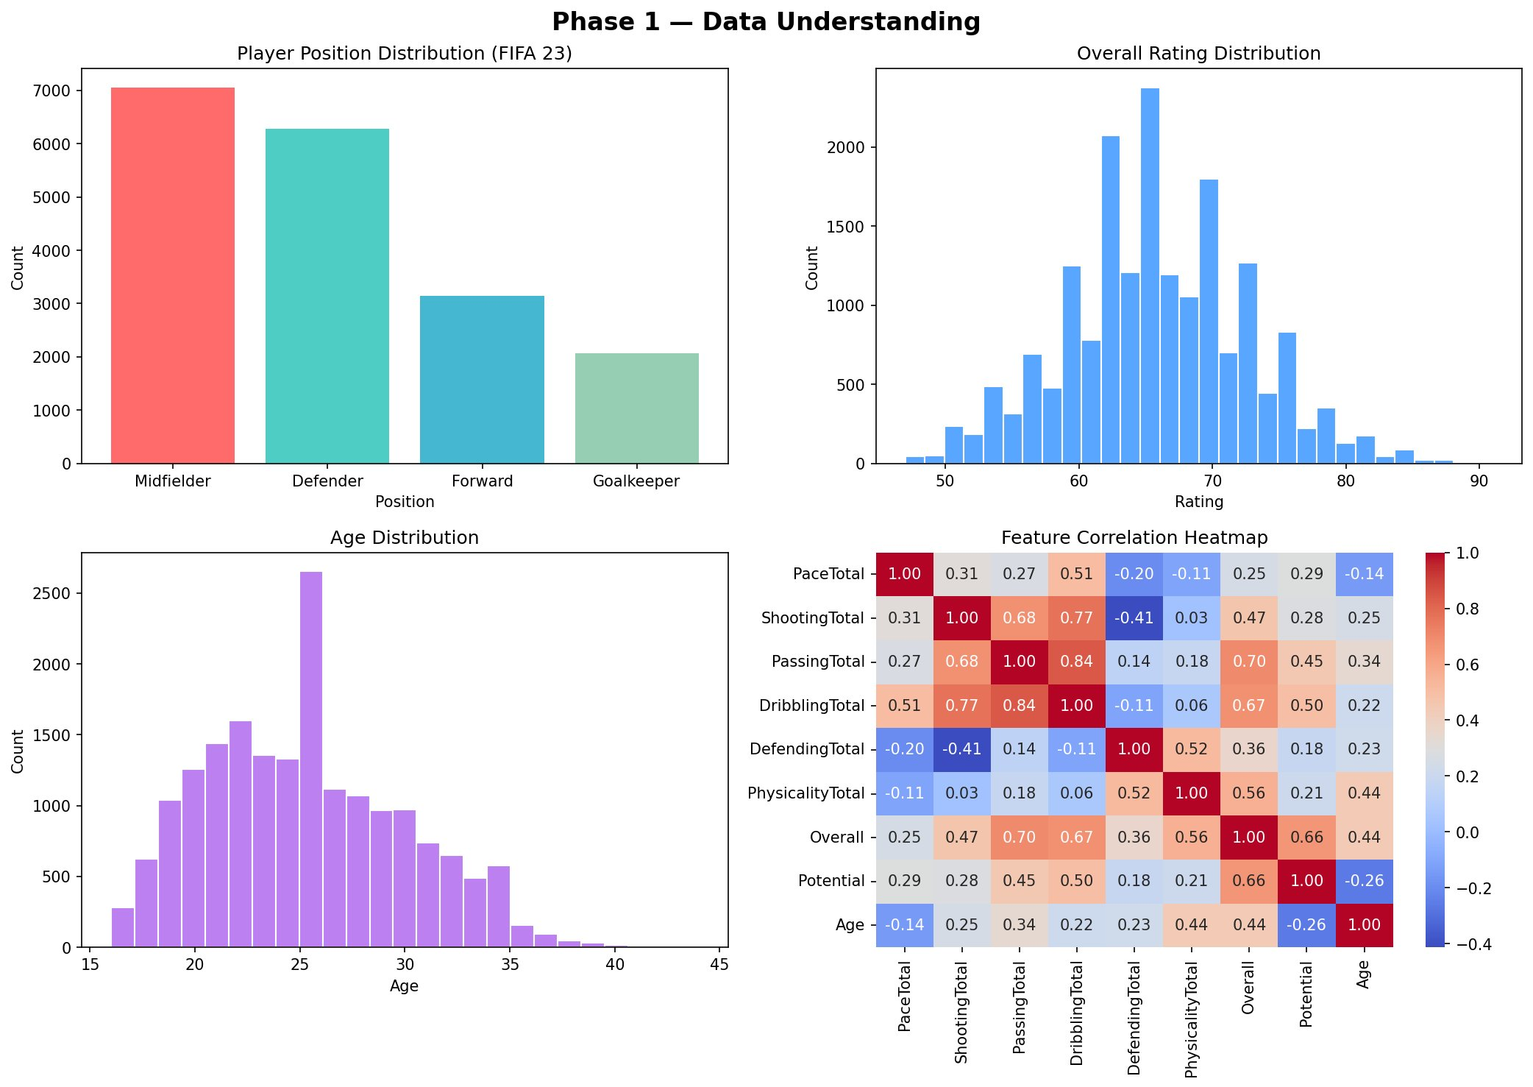
Phase 1 — Visualization Results (Chapter 2)
Data Mining Project | Kian Kheiri Nejad | IAU Central Tehran | 2026

Slide 8
Phase 2 — Data Preprocessing (Chapter 3)
6 steps to transform raw data into a clean, model-ready dataset
1
Data Cleaning
2
Data Integration
Filled 25,129 missing market_values with median. Filled 11,778 missing fees with 0. Dropped rows where age or nationality was null.
Merged CSV files from 4 leagues (LaLiga, Premier League, Bundesliga, Serie A) into one dataframe. Unified all column names across sources.
3
Feature Selection
4
Encoding
Reduced FIFA 23 from 90 columns → 9 key features: Pace, Shooting, Passing, Dribbling, Defending, Physicality, Overall, Potential, Age.
Converted text positions (Forward, Midfielder, Defender, Goalkeeper) to numeric labels using sklearn LabelEncoder for model training.
5
Normalization
6
Filtering
Applied MinMaxScaler: all values scaled to [0,1]. Prevents features with larger ranges (Age 16–44) from dominating model training.
Kept only movement='in' records from Transfermarkt. Reduced 77,982 raw records → 27,051 meaningful transfer entries.
Data Mining Project | Kian Kheiri Nejad | IAU Central Tehran | 2026

Slide 9
Phase 2 — Before vs After (Chapter 3)
Quantified impact of preprocessing on the dataset
Record Count
Missing Values Fixed
Normalization Impact
Feature | Min Before | Max Before | After Normalization
Age | 16 | 44 | 0.0 → 1.0
Overall | 47 | 91 | 0.0 → 1.0
PaceTotal | 28 | 97 | 0.0 → 1.0
ShootingTotal | 16 | 92 | 0.0 → 1.0
Data Mining Project | Kian Kheiri Nejad | IAU Central Tehran | 2026

Slide 10
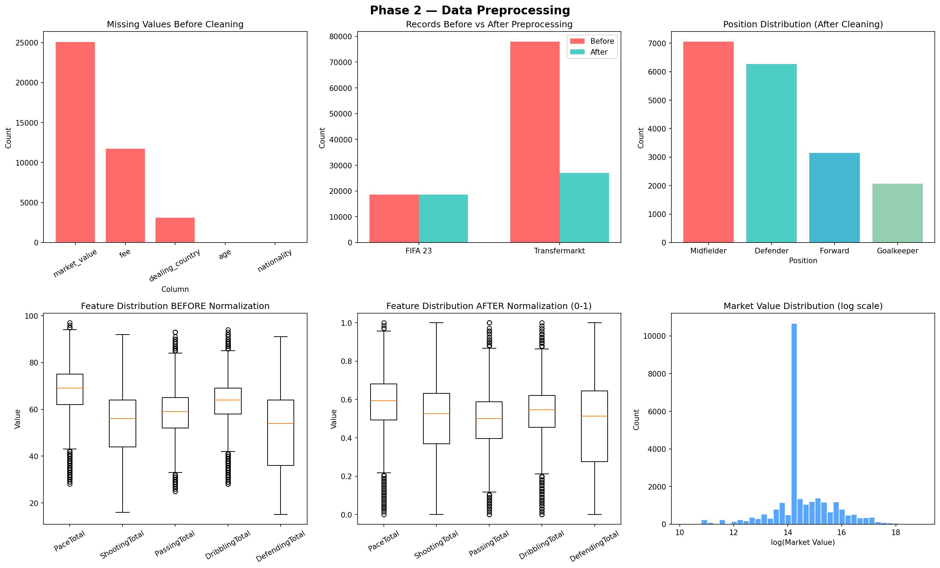
Phase 2 — Visualization Results (Chapter 3)
Data Mining Project | Kian Kheiri Nejad | IAU Central Tehran | 2026

Slide 11
Phase 2 — Code Walkthrough (Chapter 3)
Key Python code used for data preprocessing
Cleaning — Fill Missing Values
Integration — Merge 4 Leagues
df_transfer['market_value'] = df_transfer['market_value']\
.fillna(df_transfer['market_value'].median())
df_transfer['fee'] = df_transfer['fee'].fillna(0)
df_transfer = df_transfer.dropna(
subset=['age', 'nationality'])
all_transfers = []
for league in ['laliga','premier_league',
'bundesliga','serie_a']:
for file in os.listdir(f'data/{league}'):
df_temp = pd.read_csv(file)
df_temp['league'] = league
all_transfers.append(df_temp)
df = pd.concat(all_transfers, ignore_index=True)
Normalization
Encoding — LabelEncoder
from sklearn.preprocessing import MinMaxScaler
scaler = MinMaxScaler()
cols = ['PaceTotal','ShootingTotal',
'PassingTotal','DribblingTotal',
'DefendingTotal','PhysicalityTotal',
'Overall','Potential','Age']
df_fifa[cols] = scaler.fit_transform(df_fifa[cols])
from sklearn.preprocessing import LabelEncoder
le = LabelEncoder()
df['Position_encoded'] = le.fit_transform(
df['Position'])
# Forward→0 Goalkeeper→1
# Midfielder→2 Defender→3
Data Mining Project | Kian Kheiri Nejad | IAU Central Tehran | 2026

Slide 12
Phase 3 — Classification (Chapter 4 & 5)
Predicting player positions using supervised learning — 4 models trained and compared
🎯 Task: Given 9 stats (Pace, Shooting, Passing, Dribbling, Defending, Physicality, Overall, Potential, Age),
predict player position: Forward / Midfielder / Defender / Goalkeeper — supervised learning with labeled training data.
Train / Test Split (80% / 20%)
TRAINING SET — 14,831 records (80%)
TEST — 3,708 (20%)
🏆 BEST
80.12%
84.57%
86.89%
81.80%
Decision Tree
KNN
Random Forest
Logistic Reg.
Ch. 4
Ch. 4
Ch. 5
Ch. 5
If/else tree on feature thresholds
K=136 nearest neighbor's vote
100 trees, majority vote 🏆
Linear hyperplane separator
Data Mining Project | Kian Kheiri Nejad | IAU Central Tehran | 2026

Slide 13
Phase 3 — Code Walkthrough (Chapter 4 & 5)
Python code used to train, evaluate, and compare all 4 classifiers
Setup & Train/Test Split
Train All 4 Models
from sklearn.model_selection import train_test_split
from sklearn.tree import DecisionTreeClassifier
from sklearn.neighbors import KNeighborsClassifier
from sklearn.ensemble import RandomForestClassifier
from sklearn.linear_model import LogisticRegression
from sklearn.metrics import accuracy_score, classification_report
X = df[feature_cols]
y = df['Position_encoded']
X_train, X_test, y_train, y_test = train_test_split(
X, y, test_size=0.2, random_state=42, stratify=y)
# stratify=y ensures equal proportion of each class
dt = DecisionTreeClassifier(random_state=42)
knn = KNeighborsClassifier(n_neighbors=136)
rf = RandomForestClassifier(n_estimators=100, random_state=42)
lr = LogisticRegression(max_iter=1000, random_state=42)
models = {'Decision Tree':dt, 'KNN':knn,
'Random Forest':rf, 'Logistic Reg':lr}
for name, model in models.items():
model.fit(X_train, y_train)
pred = model.predict(X_test)
acc = accuracy_score(y_test, pred)
print(f"{name}: {acc*100:.2f}%")
Results
Model | Accuracy
Decision Tree | 80.12%
KNN | 84.57%
Random Forest 🏆 | 86.89%
Logistic Regression | 81.80%
Data Mining Project | Kian Kheiri Nejad | IAU Central Tehran | 2026

Slide 14
Best Model — Random Forest Deep Dive (Chapter 5)
86.89% accuracy — ensemble of 100 decision trees (Bagging method from Chapter 5)
Classification Report
Feature Importance (Random Forest)
Position | Precision | Recall | F1-Score | Support
Defender | 0.91 | 0.91 | 0.91 | 1,255
Forward | 0.87 | 0.81 | 0.84 | 629
Goalkeeper | 0.88 | 0.86 | 0.87 | 412
Midfielder | 0.83 | 0.87 | 0.85 | 1,412
Overall Accuracy |  |  | 0.87 | 3,708
Key Insights:
Defender 91%: High DefendingTotal separates them clearly
Forward 84%: Some overlap with midfielder passing stats
Goalkeeper 87%: Unique GK stats make them distinctive
🔑 DefendingTotal (22%) and ShootingTotal (18%) are the strongest predictors — defenders defend, forwards shoot.
Data Mining Project | Kian Kheiri Nejad | IAU Central Tehran | 2026

Slide 15
Phase 4 — Clustering Challenge & Fix (Chapter 6)
Problem encountered, diagnosed, and resolved during K-Means clustering
❌ Problem — First Attempt (K=4)
✅ Solution — Revised Approach
Running K-Means on ALL 18,539 players caused Goalkeepers to be incorrectly mixed into field player clusters. Their stats (low Shooting, low Pace, unique GK attributes) confused the algorithm:
1
Separate GKs first
Filter all 2,061 Goalkeepers into a separate dataframe before running any clustering.
2
K-Means on field players only
Apply K-Means with K=3 on 16,478 outfield players. Elbow Method confirms K=3 is optimal.
Cluster Label | Fwd | GK | Result
"Goalkeepers" | 1,729 | 1,030 | ❌ Wrong
"Attackers" | 693 | 951 | ❌ Wrong
"Defenders" | 2,334 | 76 | ⚠️ Mixed
3
Re-add GKs as Cluster 3
Append Goalkeepers back as Cluster 3 — perfectly isolated, 100% accurate.
Cluster | Def | Fwd | GK | Mid | ✓
Defensive | 4,398 | 17 | 0 | 1,045 | ✅
Attacking | 57 | 2,437 | 0 | 2,873 | ✅
Elite All-Round | 1,818 | 693 | 0 | 3,140 | ✅
GKs | 0 | 0 | 2,061 | 0 | ✅
Root Cause: GKs have a fundamentally different feature space. K-Means treats all features equally and cannot correctly separate them from outfield players without guidance.
Data Mining Project | Kian Kheiri Nejad | IAU Central Tehran | 2026

Slide 16
Phase 4 — Code Walkthrough (Chapter 6)
Python code for K-Means clustering with Elbow Method and GK separation
Elbow Method & Setup
K-Means & Labeling
from sklearn.cluster import KMeans
from sklearn.decomposition import PCA
from sklearn.metrics import silhouette_score
# Step 1: Separate Goalkeepers
df_gk = df[df['Position']=='Goalkeeper'].copy()
df_field = df[df['Position']!='Goalkeeper'].copy()
# Step 2: Elbow Method — find best K
inertia = []
for k in range(2, 9):
km = KMeans(n_clusters=k, random_state=42, n_init=10)
km.fit(df_field[feature_cols])
inertia.append(km.inertia_)
# Plot inertia — elbow at K=3
# Step 3: Apply K-Means with K=3
km = KMeans(n_clusters=3, random_state=42, n_init=10)
df_field['Cluster'] = km.fit_predict(
df_field[feature_cols])
# Step 4: Re-add Goalkeepers as Cluster 3
df_gk['Cluster'] = 3
df_all = pd.concat([df_field, df_gk], ignore_index=True)
# Step 5: Label clusters from mean stats
labels = {0:'Defensive Players',
1:'Elite All-Rounders',
2:'Attacking Players',
3:'Goalkeepers'}
df_all['Cluster_Label'] = df_all['Cluster'].map(labels)
Final Cluster Distribution
Cluster | Count | Key Stats | Primary Composition
Defensive Players | 5,460 | Defending:0.61 Physical:0.61 | 4,398 Defenders (80.5%)
Elite All-Rounders | 5,651 | Overall:0.56 All balanced | 3,140 Midfielders (55.6%)
Attacking Players | 5,367 | Pace:0.65 Shooting:0.57 | 2,873 Midfielders + 2,437 Fwds
Goalkeepers | 2,061 | Manually separated | 2,061 GKs (100% isolated)
Data Mining Project | Kian Kheiri Nejad | IAU Central Tehran | 2026

Slide 17
Phase 4 — Clustering Results (Chapter 6)
4 natural player groups discovered — K=4 confirmed by Elbow Method
🛡️
5,460 players
⭐
Defensive Players
Elite All-Rounders
5,651 players
Stats: Defending:0.61 · Physicality:0.61 · Shooting:0.28
Stats: Overall:0.56 · All attributes well-balanced
Makeup: 4,398 Defenders + 1,045 Midfielders
Makeup: 3,140 Midfielders + 1,818 Defenders
Center-backs, full-backs, defensive midfielders. High strength and stamina, low attacking output.
Best players in dataset. Top-tier central midfielders and box-to-box players with no clear weakness.
⚡
🥅
Attacking Players
5,367 players
Goalkeepers
2,061 players
Stats: Pace:0.65 · Shooting:0.57 · Dribbling:0.55
Stats: Manually separated — unique attribute space
Makeup: 2,873 Midfielders + 2,437 Forwards
Makeup: 2,061 Goalkeepers (100% isolated)
Pacey wingers, attacking mids, and forwards who prioritize speed, dribbling, and scoring.
Separated before clustering. GKDiving and GKHandling don't apply to outfield players.
Data Mining Project | Kian Kheiri Nejad | IAU Central Tehran | 2026

Slide 18
Course Chapter Coverage
How all 6 course chapters are reflected in this project
Ch. 1
Introduction to Data Mining
Project motivation established. KDD process followed end-to-end. Real-world use cases justified. 18,539 players exceeds the 3,000 record minimum requirement.
Ch. 2
Data Understanding
Attribute types classified (int64/object/float/bool). Descriptive statistics computed (mean, std, min, max). Histograms and heatmaps generated.
Ch. 3
Data Preprocessing
Cleaning (fillna/dropna), Integration (4 leagues merged), Reduction (90→9 features), Transformation (MinMaxScaler normalization, LabelEncoder, filtering).
Ch. 4
Classification — Basic Methods
Decision Tree and KNN implemented. Train/test split (80/20, stratified). Confusion matrix, accuracy, precision, recall, F1-score evaluated.
Ch. 5
Advanced Classification
Random Forest (Ensemble Learning/Bagging, 100 trees) achieved best accuracy 86.89%. Logistic Regression trained. Feature importance extracted.
Ch. 6
Clustering
K-Means with Elbow Method. GK mixing problem diagnosed and resolved by separating Goalkeepers. 4 natural clusters discovered and labeled.
Data Mining Project | Kian Kheiri Nejad | IAU Central Tehran | 2026

Slide 19
Data Sources & References
Where the datasets and resources were obtained from
⚽
FIFA 23 — Complete Player Dataset
Primary Dataset
github.com/LilianaC/Pandas — Fifa 23 Fut Players.csv
Contains stats for 18,539 players with 90 attributes: pace, shooting, passing, dribbling, defending, physicality, overall, potential, value, wages and more. Used as primary dataset for classification and clustering.
💰
Transfermarkt — Transfer Records
Primary Dataset
github.com/dcaribou/transfermarkt-datasets
Contains 77,982 transfer records across 4 European leagues (La Liga, Premier League, Bundesliga, Serie A) from 1992–2025. Includes player name, age, nationality, position, market value, transfer fee, and loan status.
📚
Course Textbook
Academic Reference
Data Mining: Concepts and Techniques — Han, Kamber, Pei | Translated by Dr. Mehdi Esmaili
Used as the theoretical foundation for all preprocessing, classification, and clustering methods applied in this project. Chapters 1–6 directly map to project phases.
🛠️
Tools & Libraries
Software
Python 3.11 · pandas · numpy · scikit-learn · matplotlib · seaborn
All data processing, model training, evaluation, and visualization was implemented in Python using industry-standard data science libraries on a local development environment.
Data Mining Project | Kian Kheiri Nejad | IAU Central Tehran | 2026

Slide 20
Conclusion — What We Achieved
Key findings, results, and lessons learned from this data mining project
🏆
Best Classifier: Random Forest — 86.89%
🔑
Key Predictors: DefendingTotal & ShootingTotal
Ensemble of 100 decision trees (Chapter 5 Bagging) outperformed all others. Achieved 91% F1 for Defenders and 87% weighted F1 overall. Ensemble learning reduces variance vs single Decision Tree.
Feature importance showed DefendingTotal (22%) and ShootingTotal (18%) are strongest predictors. Players are fundamentally defined by their role — defend or score — which makes intuitive sense.
🔵
4 Natural Player Groups Discovered
🐛
Problem-Solving: GK Clustering Challenge
K-Means revealed: Defensive Players (5,460) · Elite All-Rounders (5,651) · Attacking Players (5,367) · Goalkeepers (2,061). These align perfectly with real tactical roles in modern football.
GK mixing issue forced critical thinking. Separating Goalkeepers before clustering was a key methodological fix that improved all cluster purity significantly — a real data mining debugging experience.
📊
Full Chapter Coverage Achieved
🚀
Future Work
All 6 course chapters applied: collection (Ch.1), understanding (Ch.2), preprocessing (Ch.3), basic classification (Ch.4), advanced classification (Ch.5), and clustering (Ch.6) — complete end-to-end KDD pipeline.
Add match stats (goals, assists, xG) · Apply Deep Learning for higher accuracy · Extend to market value prediction · Build a real-time player scouting recommendation system for football clubs.
Data Mining Project | Kian Kheiri Nejad | IAU Central Tehran | 2026

Slide 21
⚽
Thank You
for watching
Presented by
Kian Kheiri Nejad
Islamic Azad University — Central Tehran Branch
Introduction to Data Mining | Dr. Mehrdad Fadaei
Second Semester 1404–1405 | 2026
Ch.1–6 Coverage
86.89% Accuracy
4 Clusters Found
18,539 Players
Data Mining Project | Kian Kheiri Nejad | IAU Central Tehran | 2026

