Slide 1

HRTech: Intelligent HR Analytics & Automation Platform
Leveraging data-driven HR insights for smarter decisions
Notes:
---

Slide 2
Introduction
Notes:
HRTech: Intelligent HR Analytics & Automation Platform

Slide 3

HRTech: Intelligent HR Analytics & Automation Platform
Advanced Analytics Integration
  HRTech uses machine learning and natural language processing to enhance decision-making in HR processes.
Automation and Efficiency
  The platform automates routine HR tasks, minimizing errors and reducing manual effort for teams.
Predictive and Sentiment Analytics
  Predictive analytics and sentiment analysis provide actionable insights for proactive talent management.
Scalable Modular Architecture
  Modular design ensures HRTech's scalability and flexibility for organizations of any size.
Notes:
HRTech is an advanced platform designed to revolutionize human resource management through intelligent analytics and automation. It leverages cutting-edge machine learning and natural language processing techniques to streamline HR processes, improve decision-making, and enhance workforce efficiency. The platform integrates predictive analytics, sentiment analysis, and automation tools to provide actionable insights for HR professionals. By combining data-driven strategies with user-friendly interfaces, HRTech aims to reduce manual effort, minimize errors, and enable proactive talent management. Its modular architecture ensures scalability and flexibility, making it suitable for organizations of all sizes. The ultimate goal is to empower HR teams with tools that not only analyze historical data but also forecast future trends, thereby supporting strategic planning and operational excellence.

Slide 4
Project Overview
Notes:
Brief Description and Purpose

Slide 5
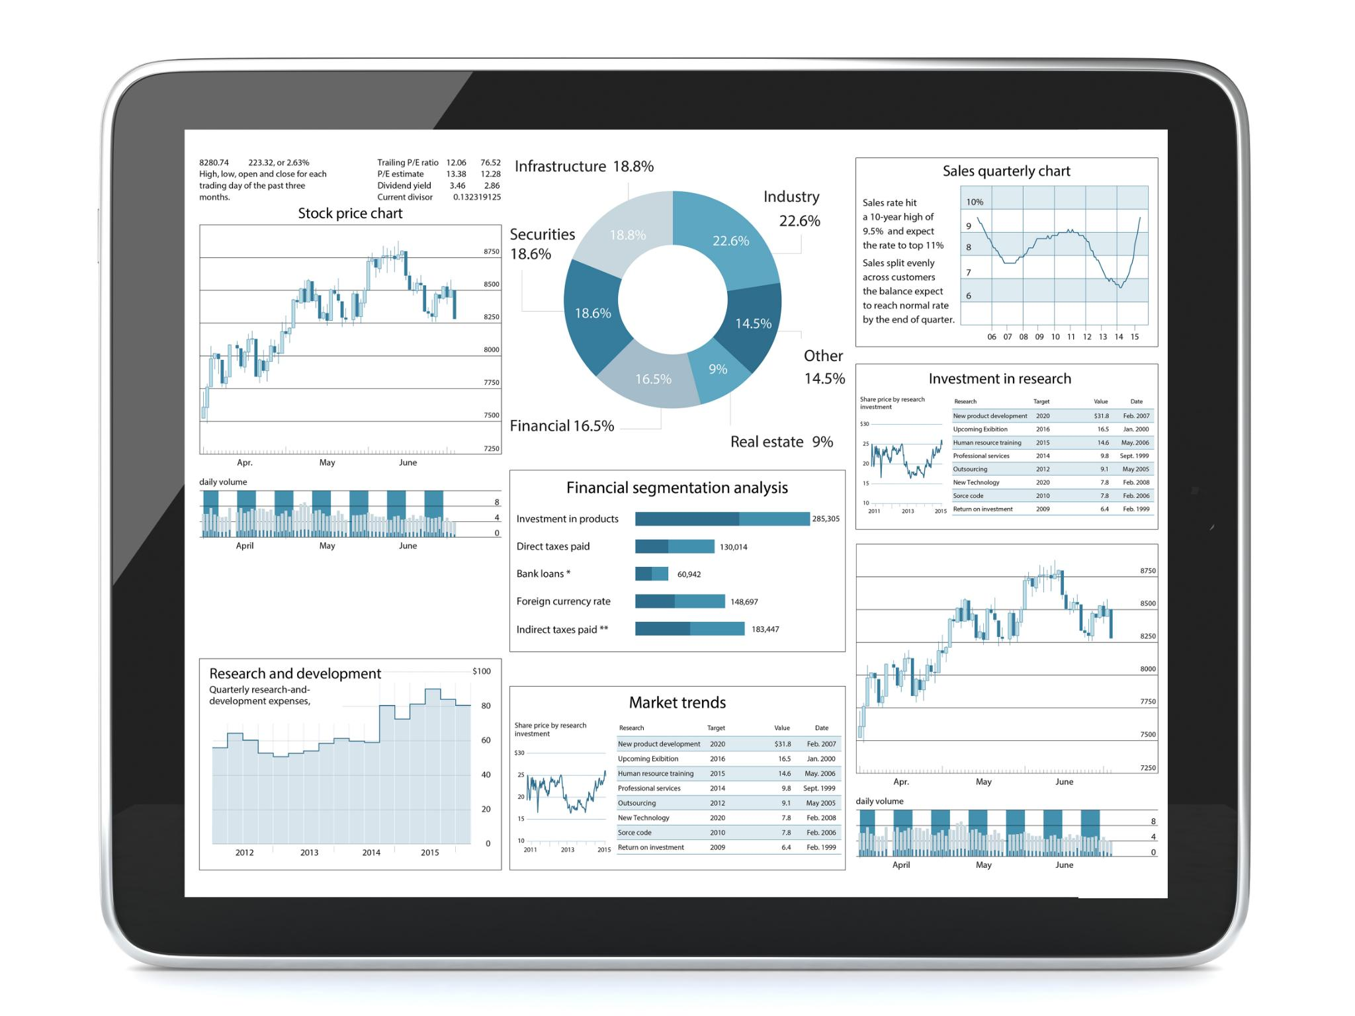
Brief Description and Purpose
AI-Driven HR Optimization
  HRTech uses AI to streamline HR operations by automating tasks and providing predictive analytics.
Machine Learning Models
  Incorporates models for attrition prediction, performance analysis, and anomaly detection to improve HR decisions.
NLP Modules for Insights
  Utilizes natural language processing for sentiment analysis and interview summarization to gauge employee engagement.
Centralized Dashboard
  An intuitive dashboard centralizes functionalities, enhancing decision-making and reducing operational costs.
Notes:
The HRTech project is an AI-powered solution designed to optimize HR analytics and automate repetitive tasks. Its primary purpose is to streamline HR operations by providing predictive insights and intelligent automation capabilities. Traditional HR processes often involve manual data handling, which can lead to inefficiencies and delays. HRTech addresses these challenges by integrating machine learning models for attrition prediction, performance analysis, and anomaly detection. Additionally, it incorporates NLP-based modules for sentiment analysis and interview summarization, enabling HR teams to understand employee engagement and recruitment effectiveness. The platform also supports resume-to-job description matching, ensuring better candidate selection. By centralizing these functionalities within an intuitive dashboard, HRTech enhances decision-making, reduces operational costs, and fosters a data-driven HR culture.

Slide 6
Key Features
Notes:
Core Functionalities

Slide 7

Core Functionalities
Predictive Analytics
  Employee attrition prediction uses machine learning to forecast turnover risks effectively.
Performance and Sentiment Analysis
  Regression analysis identifies productivity factors, while sentiment analysis gauges employee morale.
Smart Recruitment Tools
  Resume–JD matching and interview summarization automate candidate evaluation and save recruiter time.
Advanced HR Insights
  Fraud detection, EDA, time series forecasting, and LLM chatbot enhance HR decision-making and support.
Notes:
HRTech offers a comprehensive suite of features tailored to modern HR needs. These include employee attrition prediction, which uses historical data and machine learning algorithms to forecast turnover risks. Performance regression analysis helps identify factors influencing employee productivity and suggests improvement strategies. Sentiment analysis leverages NLP techniques to gauge employee morale from feedback and communication data. Resume–JD matching ensures accurate candidate-job alignment using semantic similarity models. Interview summarization automates the extraction of key points from transcripts, saving recruiters valuable time. Fraud detection employs convolutional neural networks (CNN) to identify anomalies in HR transactions. Additionally, the platform provides exploratory data analysis (EDA) and visualization tools for deeper insights, time series forecasting for trend prediction, and an LLM-powered chatbot for interactive HR support. Together, these features create a robust ecosystem for intelligent HR management.

Slide 8
Architecture & Tech Stack
Notes:
System Design and Technologies

Slide 9
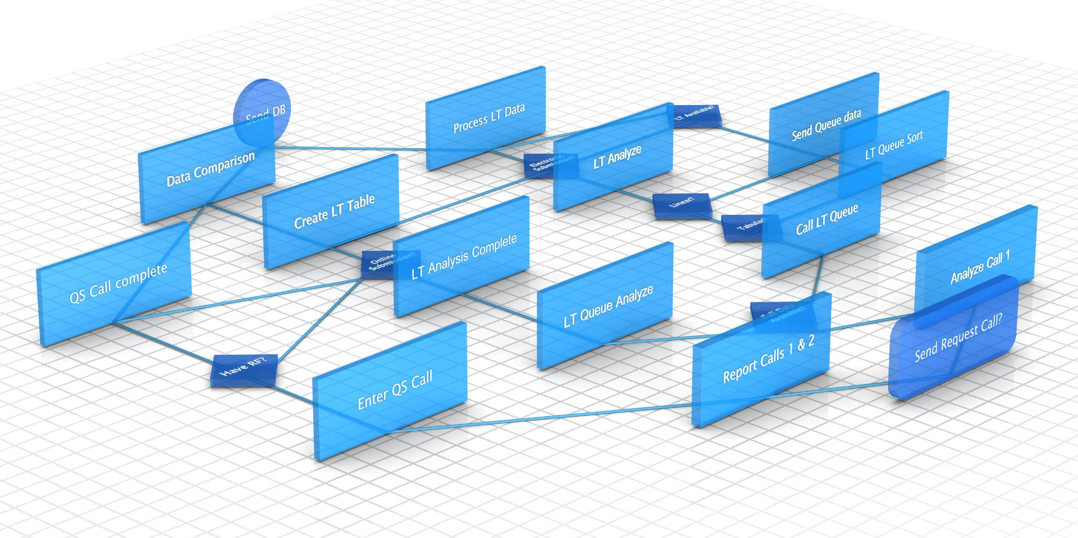
System Design and Technologies
Modular and Scalable Architecture
  HRTech's design emphasizes modularity and scalability to support evolving business needs and efficient collaboration.
Core Technologies Used
  Python powers data processing and model development, while Streamlit enables interactive user dashboards.
Machine Learning and NLP Integration
  Scikit-learn supports machine learning algorithms; Transformer models enable advanced NLP like sentiment analysis.
Organized Codebase and Integration
  Structured code organization ensures maintainability; integration with databases and APIs enhances adaptability.
Notes:
The architecture of HRTech is designed for modularity and scalability. At its core, the platform is built using Python, which serves as the primary programming language for data processing and model development. Streamlit is employed to create an interactive and user-friendly dashboard for visualization and user interaction. Data manipulation and analysis are handled by Pandas, while Scikit-learn provides a robust framework for implementing machine learning algorithms. Advanced NLP capabilities are powered by Transformer-based models, enabling tasks such as sentiment analysis and resume matching. Deep learning frameworks support CNN-based fraud detection and other complex models. The codebase follows a structured approach with a dedicated 'src/' directory for source code, along with separate folders for data, models, and logs. This organization ensures maintainability and facilitates collaborative development. The architecture also supports integration with external databases and APIs, making it adaptable to diverse HR environments.

Slide 10
Data Flow & Modules
Notes:
Workflow and Components

Slide 11
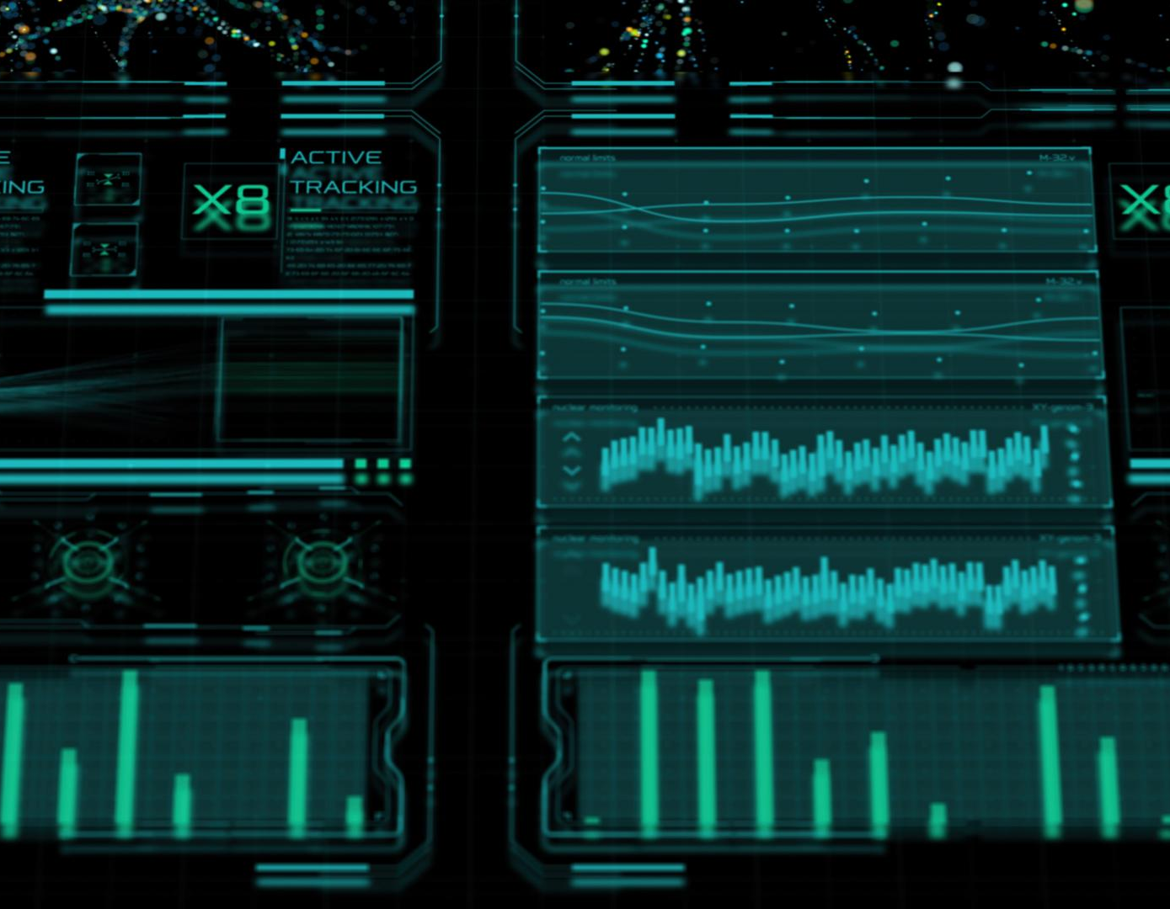
Workflow and Components
Data Ingestion and Preprocessing
  Raw data is collected from CSV files or databases and cleaned to ensure quality and consistency.
Machine Learning and NLP Modules
  Specialized modules perform tasks such as attrition prediction, sentiment analysis, and resume matching independently.
Interactive Streamlit Dashboard
  Dashboard integrates processed outputs, enabling real-time data upload, analysis, and model interaction.
Modular and Flexible Design
  Modular components allow new features to be added without disrupting existing workflows, ensuring future readiness.
Notes:
The data flow within HRTech begins with ingestion, where data is sourced from CSV files or connected databases. This raw data undergoes preprocessing and cleaning to ensure quality and consistency, including handling missing values, normalization, and feature engineering. Once prepared, the data is fed into various machine learning and NLP modules tailored for specific tasks such as attrition prediction, sentiment analysis, and resume matching. Each module operates independently but contributes to the overall analytics pipeline. The processed outputs are then integrated into the Streamlit dashboard, which serves as the primary user interface. This dashboard allows HR professionals to upload data, view analysis results, and interact with predictive models in real time. The modular design ensures that new functionalities can be added without disrupting existing workflows, making HRTech a flexible and future-ready platform.

Slide 12
User Interface
Notes:
Dashboard Features and Layout

Slide 13
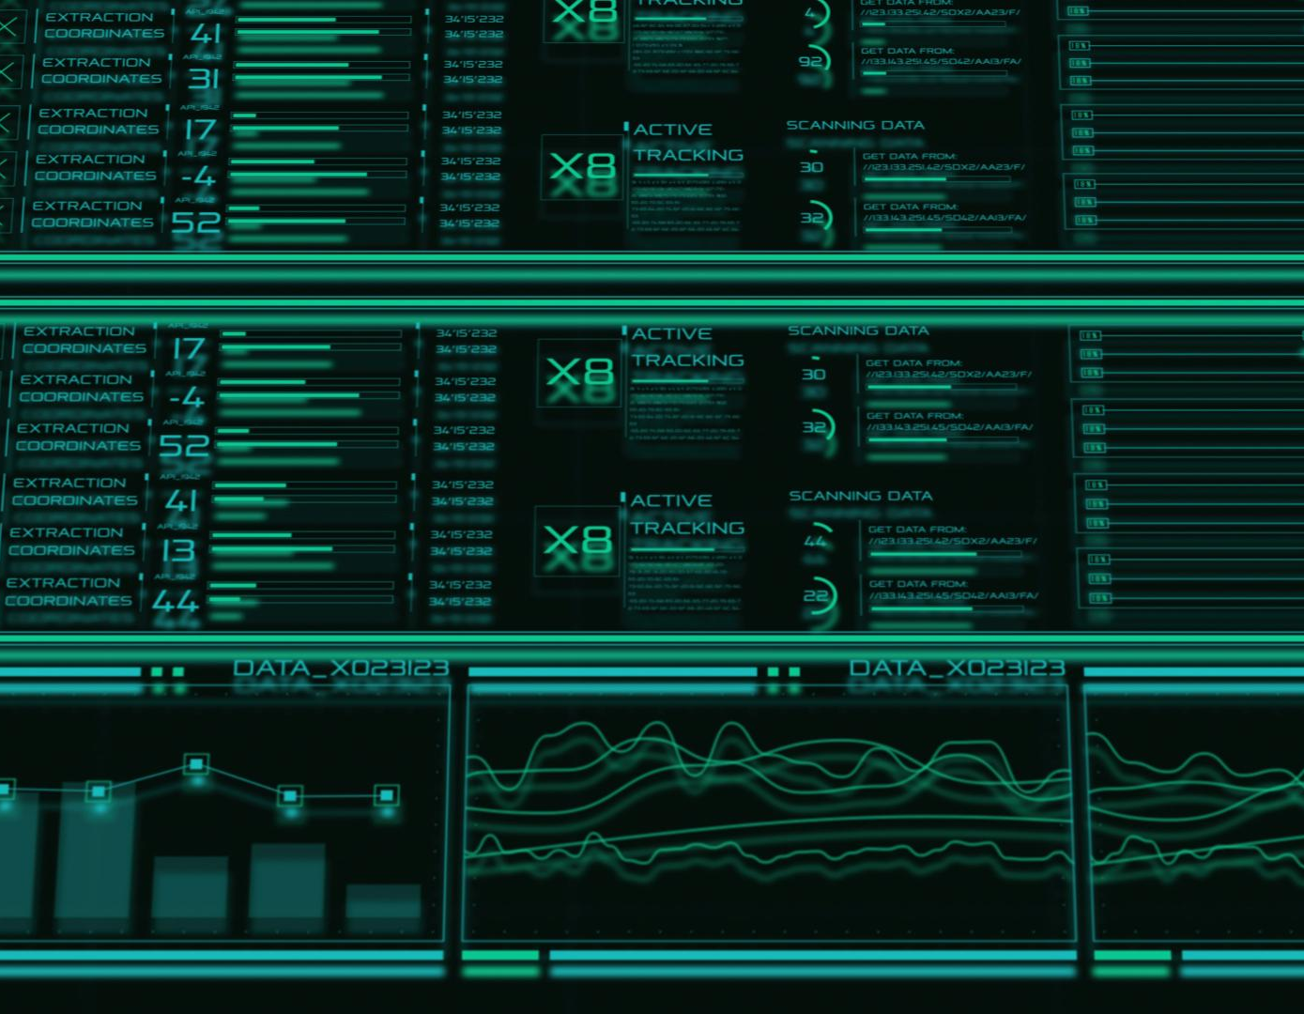
Dashboard Features and Layout
Intuitive Navigation Sidebar
  The dashboard includes a sidebar for easy switching between key modules like attrition prediction and resume matching.
Seamless Data Upload
  Users can upload CSV files or connect to databases easily, facilitating smooth data integration.
Interactive Results Display
  Processed data is presented through interactive charts, tables, and visualizations for clear insights.
User-Friendly Design
  The design ensures usability for non-technical users with dynamic filters and downloadable reports.
Notes:
The HRTech user interface is built using Streamlit, offering a clean and intuitive experience for HR professionals. The dashboard features a sidebar for navigation, enabling users to switch between modules such as attrition prediction, sentiment analysis, and resume matching. Data upload functionality allows users to import CSV files or connect to databases seamlessly. Once data is processed, results are displayed in an organized manner with interactive charts, tables, and visualizations. Key UI elements include dynamic filters, real-time model outputs, and downloadable reports. The design prioritizes usability, ensuring that even non-technical users can leverage advanced analytics without difficulty. Screenshots of the dashboard typically showcase the sidebar navigation, data upload section, and result panels, highlighting the platform's emphasis on simplicity and efficiency.

Slide 14
Q&A
Notes:
Closing and Discussion

